Slide 1
Exploration Geophysics Indoors
Rob Sternberg
Dept. of Earth and Environment
Franklin & Marshall College
Teaching Structural Geology, Geophysics, and Tectonics in the 21st Century
University of Tennessee, Knoxville
15-19 July 2012

Slide 2
Magnet in a box
Audience
Geophysics class – lecture demo; lab (with contouring)
(Elementary school – careers program)
Limitation – equipment
Goals
This exercise in the lab can help us think about how we do the following for real magnetic surveys
Set up a grid
Record data
Learn the principles of magnetometer operation
Display and interpret data
Use contouring software

Slide 3
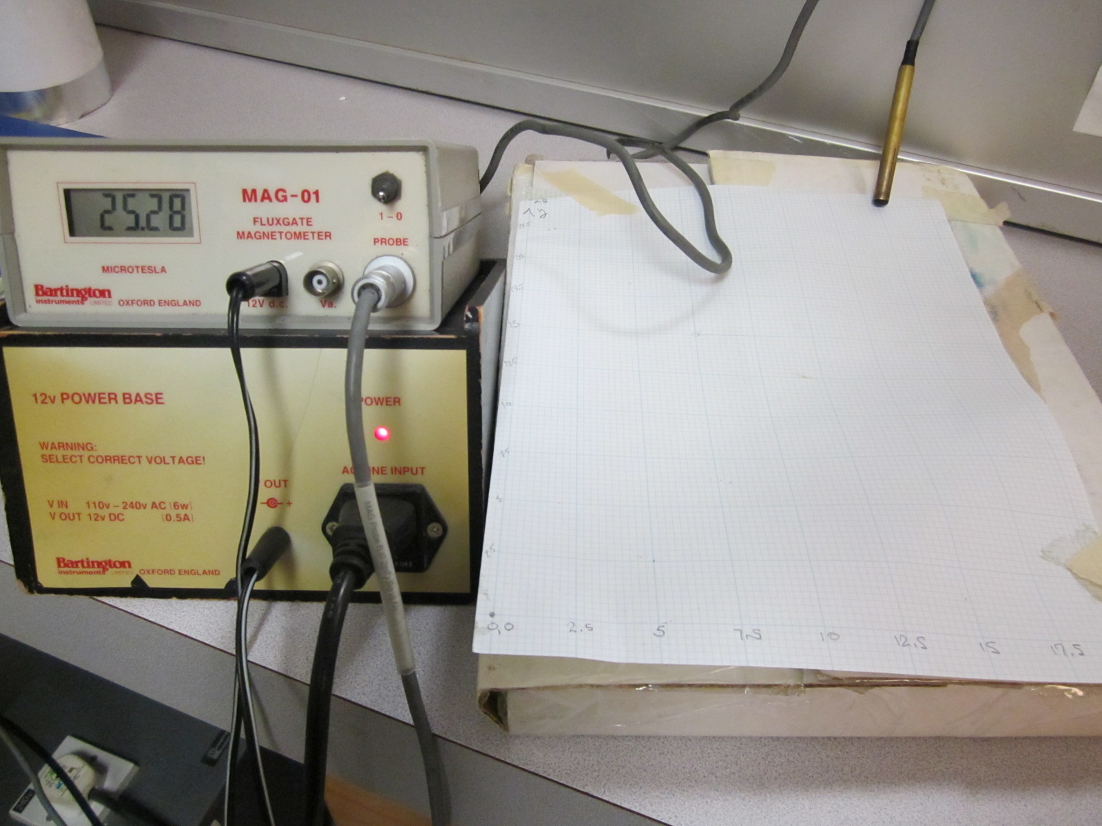
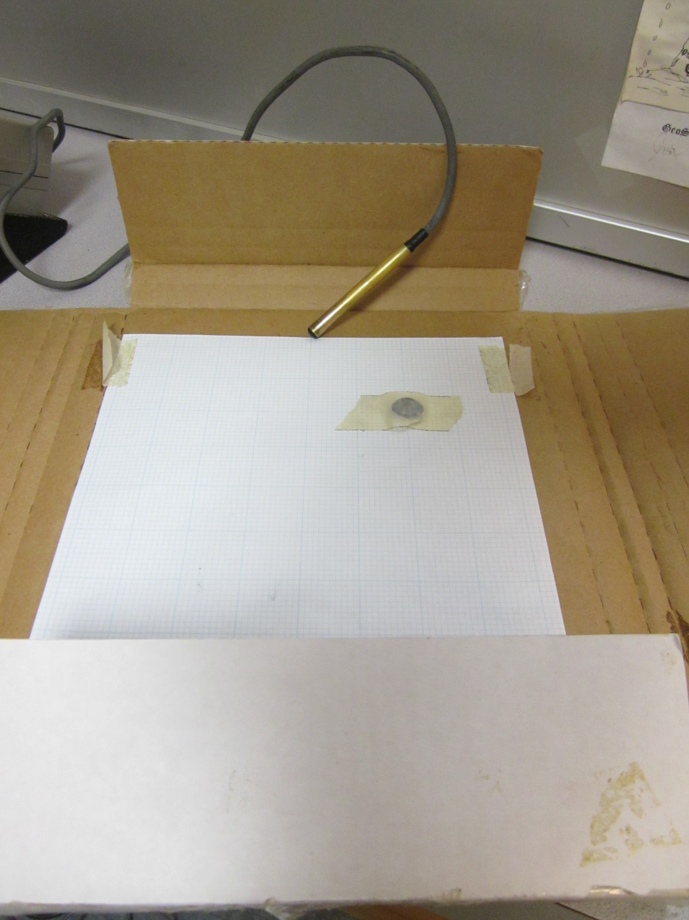
Magnet in a box
Bartington fluxgate magnetometer (≈≈$3k)
Notes:
Used as well with elementary school students

Slide 4
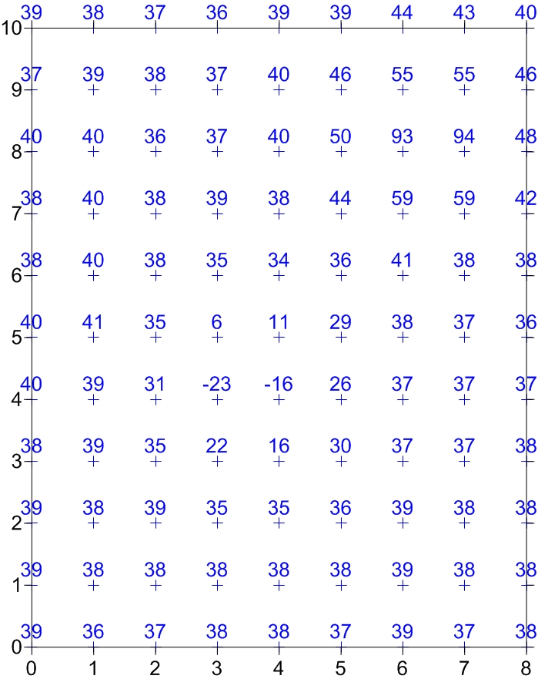
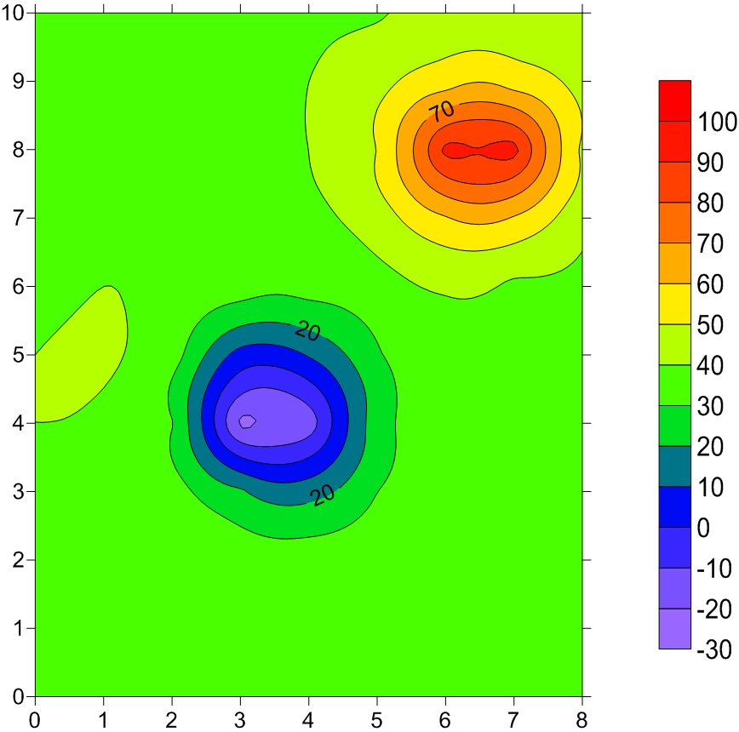
Magnet in a box
Hand contouring?
Surfer
Notes:
First time students have used Surfer

Slide 5
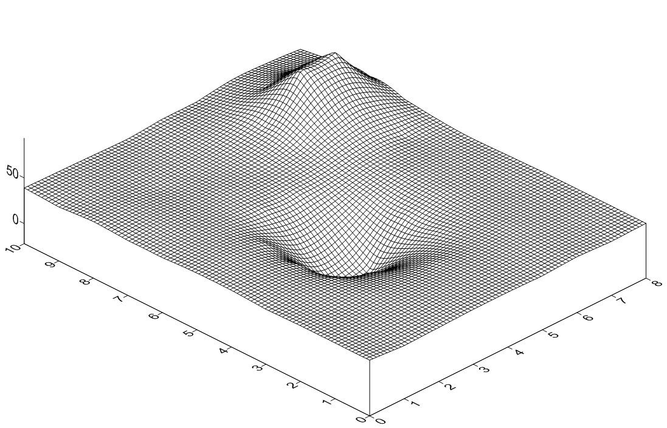
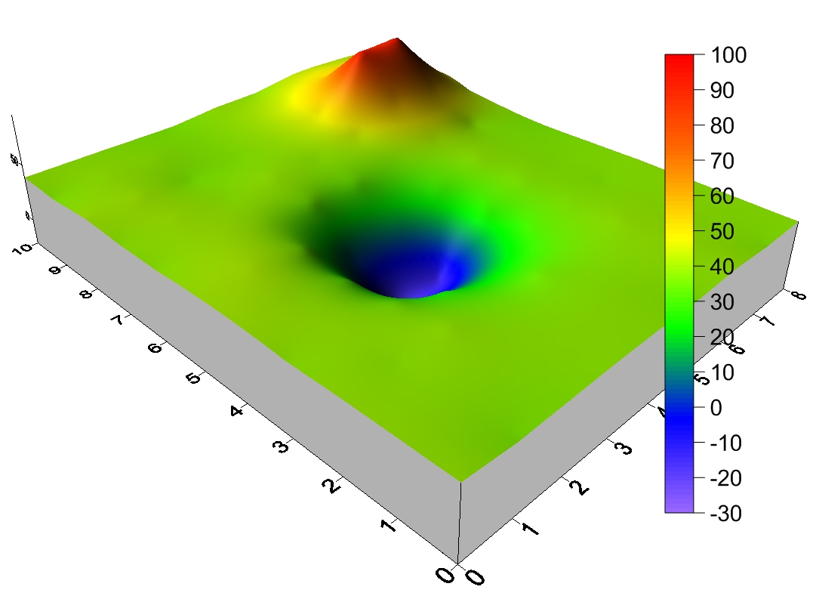
Magnet in a box

Slide 6

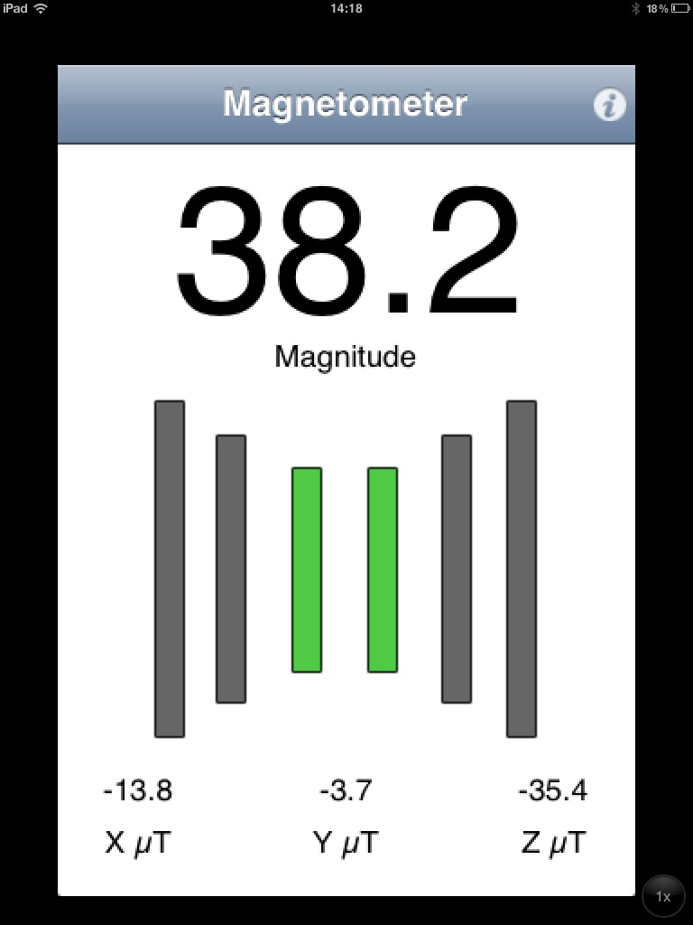
Magnet in a box
New approaches!

Slide 7
Vertical gradient of gravity
Audience
Geophysics class – 2-3 weeks of lab, with lab report
Limitation – equipment (groups of 3, outside class time)
Goals
This exercise in the lab can help us think about:
Show that gravity decreases with distance from the center of the Earth!
Learn the principles of gravimeter operation
Understand need to re-occupy base station
How to do data reduction using Excel
Basic statistical testing
Thinking about discrepancies from theoretical value

Slide 8
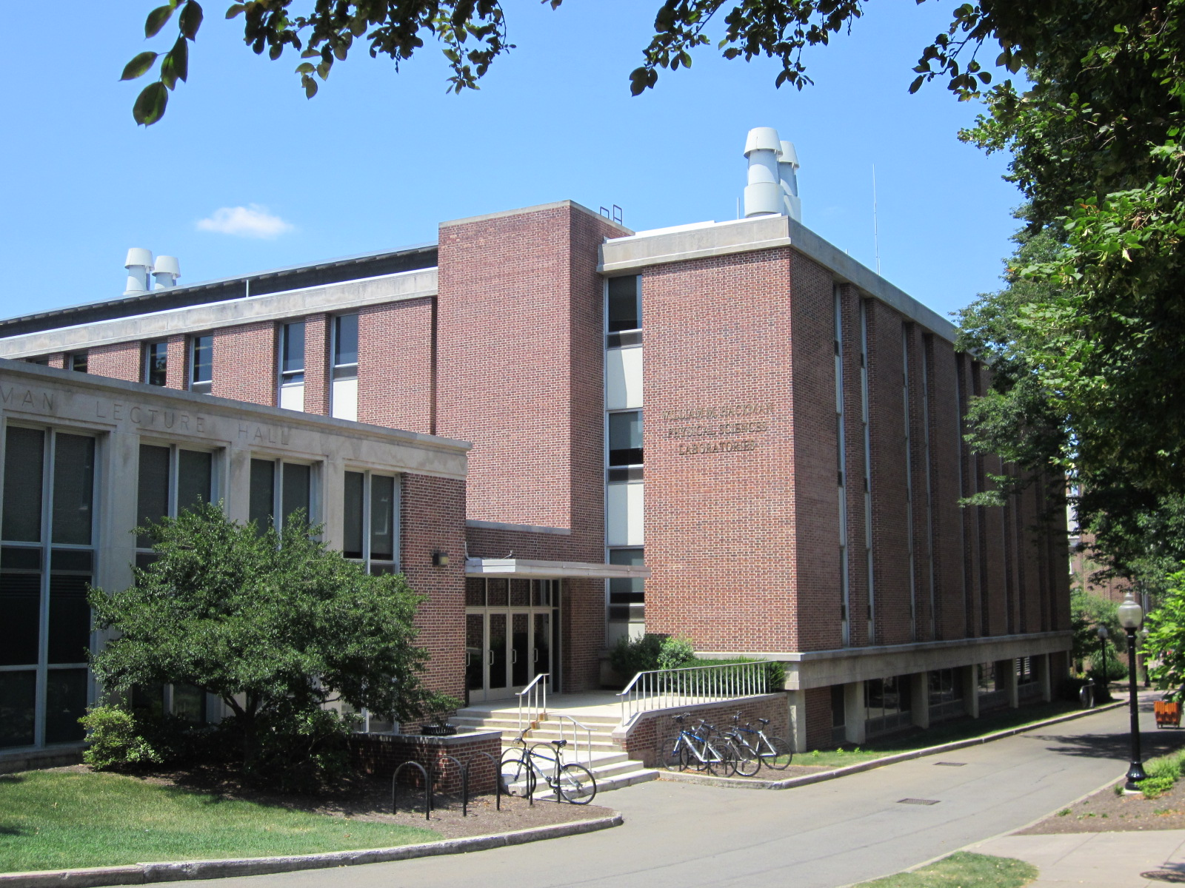
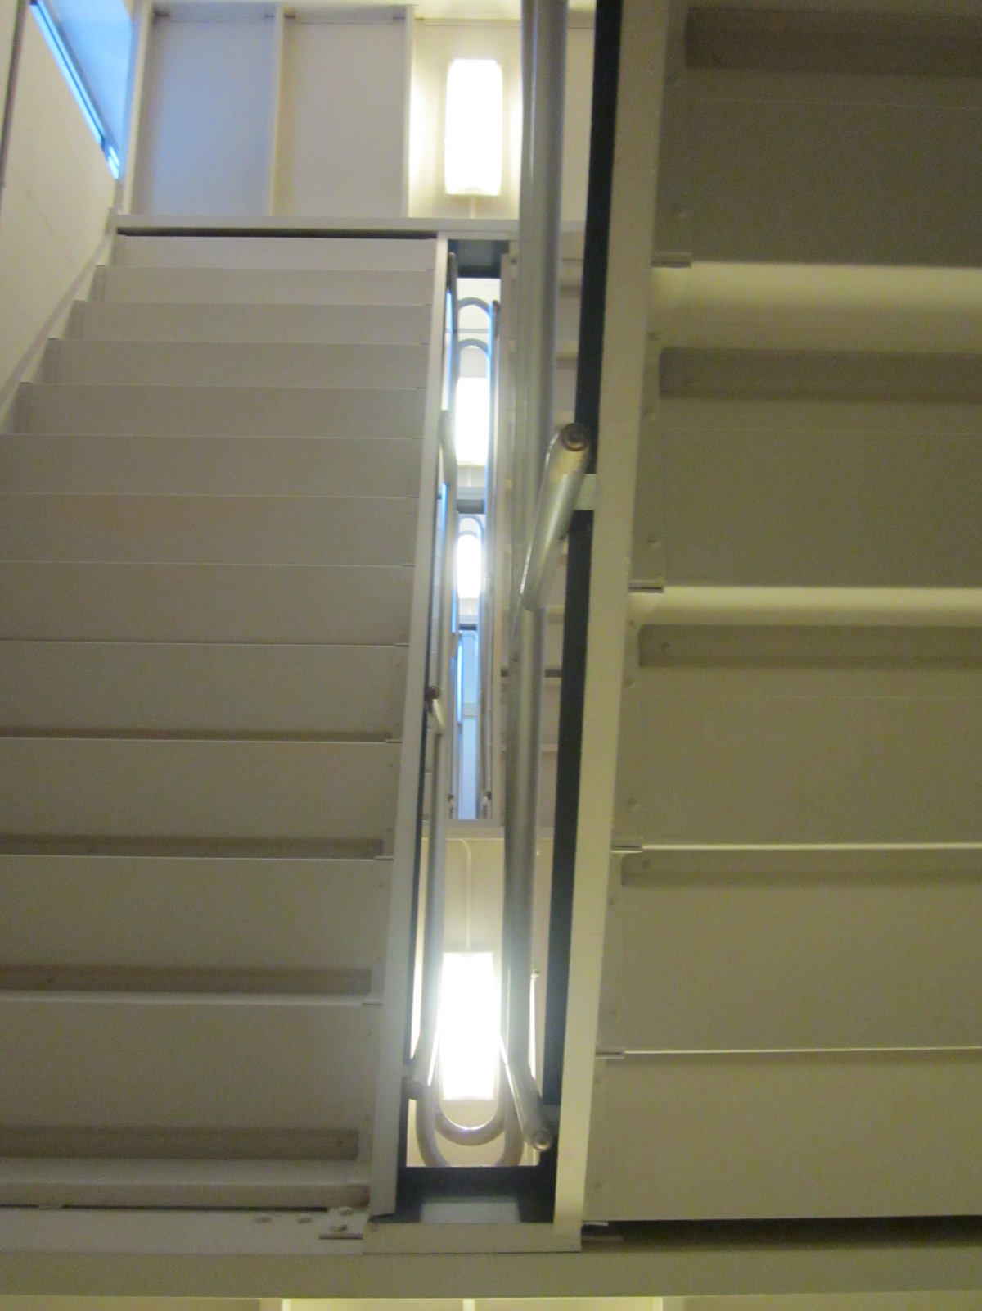
Vertical gradient of gravity

Slide 9
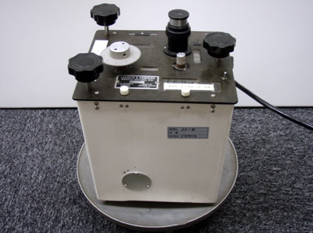
Vertical gradient of gravity
LaCoste and Romberg (or Worden) gravimeter (≈$25k)

Slide 10
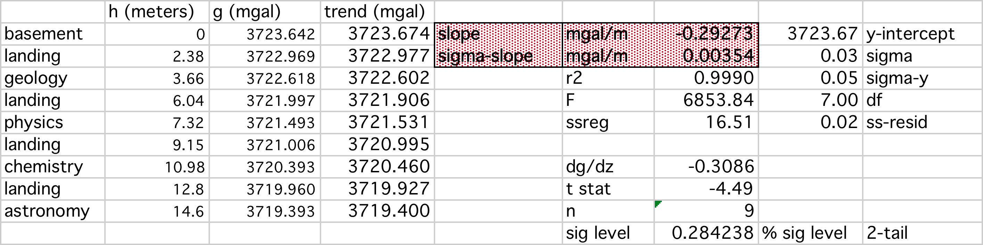
Vertical gradient of gravity
Data reduction
Excel template (may be first sophisticated use)
Regression (likely first use)
Regression statistics (probable first use)

Slide 11
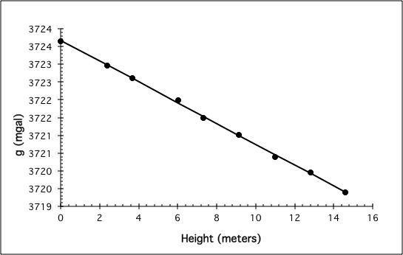
Vertical gradient of gravity
Results

Slide 12
Vertical gradient of gravity
Interpretation
Average results of groups, with std. deviation
Theoretical value = -.3086 mgal/meter
Typical exp. value = -.29 mgal/meter
t-test comparison (may be first statistics for students)
Possibilities
Instrument calibration
Characteristics of building (Kuo et al.; Variations of vertical gravity gradient in New York City and Alpine, New Jersey; Geophysics, 1969)
  Mass
  Basement cavity (Hammer; The anomalous vertical gradient of gravity; Geophysics, 1970) – can model
Regional Bouguer gravity anomaly

