Slide 1
Exercise on the Mesozoic/Cenozoic History of the North American Cordillera
Notes:
Because transects published in late 1980’s, students can use data to confirm or refute interpretations

Slide 2
Use DNAG Centennial Continent-Ocean Transect #7, B-2 Juan de Fuca Plate to Alberta Plains
&
Centennial Continent-Ocean Transect #9, B-3 Juan de Fuca Spreading Ridge to Montana Thrust Belt
Notes:
I

Slide 3
One of 4 required courses beyond ‘physical geology’ (i.e. laboratory) intro
‘Physical geology’ prerequisite; many students co-enrolled in mineralogy
Course developed to teach map skills, basic geometry of structures, basic igneous & metamorphic petrology, very basic geophysics, Earth structure
Enrollment is 15-25, mainly sophomores & juniors
Notes:
Curricular context of the course

Slide 4
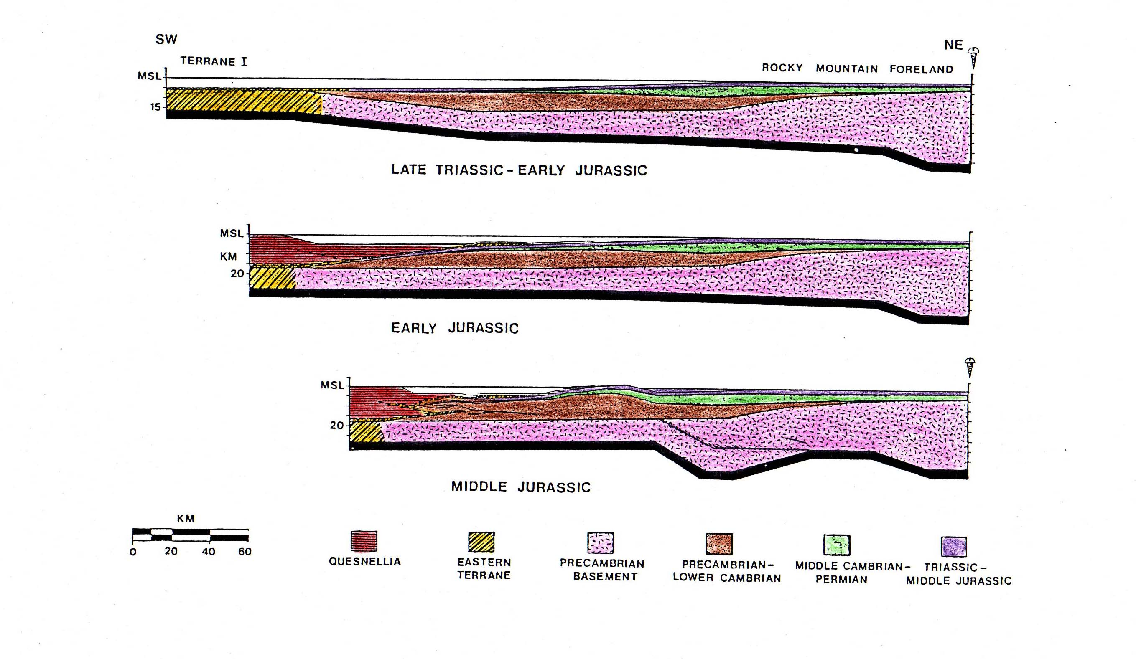
In previous lectures & laboratory exercises have examined the stratigraphy of the Canadian Rocky Mountains, with an emphasis on development of pre-orogenic migeocline ….
Restored sections show inferred depositional setting of deformed strata now found in thrust belt
Continent
Shelf
Abyssal plain
Rise
Slope

Slide 5
Calculated subsidence versus time
Palinspastically restored stratigraphic sections across Canadian Cordillera
From Bond & Kominz (1994)
Notes:
Thermal subsidence prevailed from Cambrian to Ordovician
Triassic rocks mainly shales, but include some evaporites; find widespread hiatuses correlated with global low stands

Slide 6
… & an emphasis on development of synorogenic clastic wedges (correlated to terrane accretion)
Paleocene
Upper
Cretaceous
Lower
Cretaceous
Synorogenic clastic wedge strata deposited in a foreland basin & the timing of accretion of tectonostratigraphic terranes indicate that deformation began in Jurassic & persisted into Paleocene time
Jurassic
From Stockmal et al. (1992)
Notes:
Used models of migrating foredeep basins to understand these synorogenic clastics

Slide 7
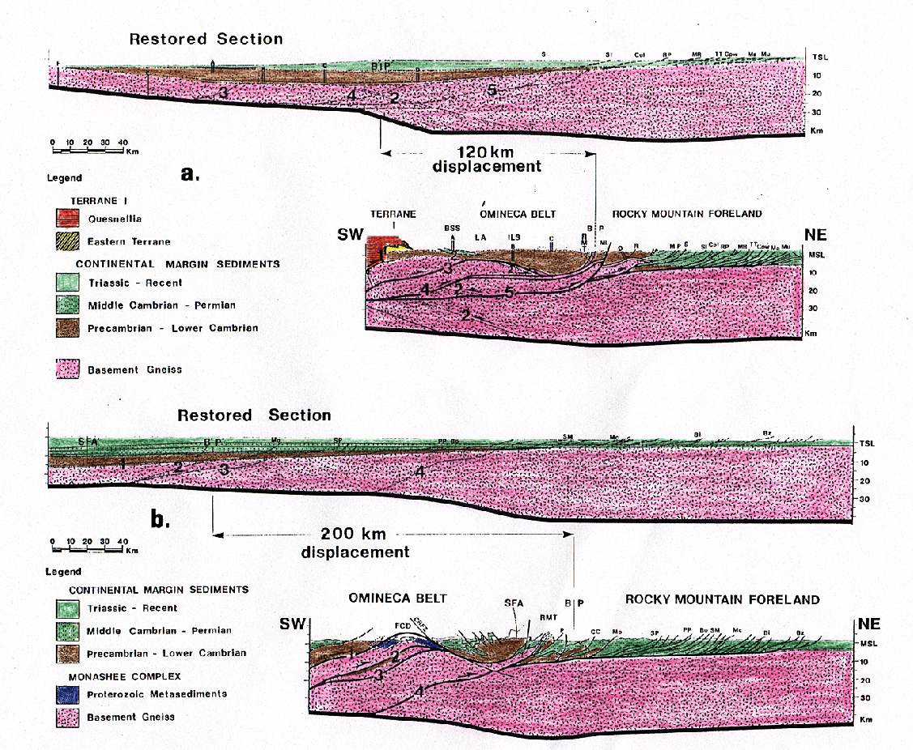
Likewise, have addressed the structure of the Canadian Rocky Mountains ….

Slide 8
…. with an emphasis on using structural & stratigraphic patterns to constrain the kinematics of regional deformation
(from Osborn et al. (2006; Geomorphology)

Slide 9
While students working on exercise, I am covering the structure & evolution of collisional belts such as the Pyrenees, Alps & Himalayas ….
Tectonic map of the Pyrenees
(from Sibuet et al. 2004)

Slide 10
…. Including how geophysical data like mantle tomography ….
(from Sibuet et al. 2004)

Slide 11
…. constrain models for the evolution of the belts
Inferred tectonic history of the Pyrenees
Overlay of different images, centered on North Pyrenean Fault
(from Sibuet et al. 2004)

Slide 12
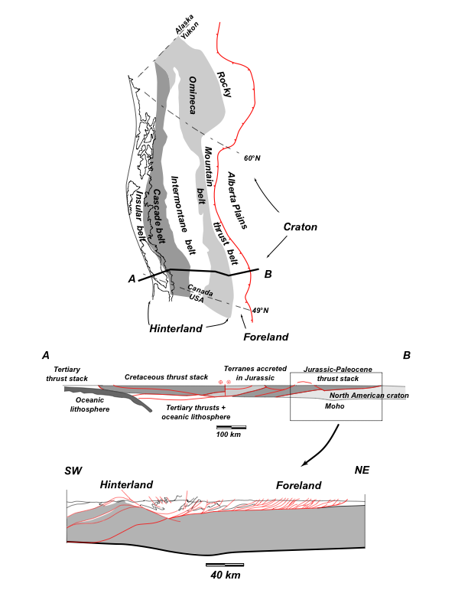
About the exercise:
It is the final exercise of the semester
Students have >2 weeks to complete the exercise
I introduce transects (strip maps, geologic sections, tectonic sections, tectonic discriminant diagrams, etc.
In written instructions & verbally, I encourage students to share & discuss their observations

Slide 13
Aims of the exercise:
Induce students to compile & correlate variety of geological/geophysical data
Work collaboratively (share observations), but think independently (draw their own inferences)
Evaluate models for the origin of orogenic belts

Slide 14
From the instructions for the exercise distributed to students:

Slide 16
Two of five questions students must answer:

Slide 17
Results:
Students are initially fearful of but then become excited about the exercise
Students do work collaboratively - share observations, debate alternatives, etc.
Better students do incorporate variety of data (model good practice for others)
Quality of work varies, but better papers show students really have integrated data from different sources & their observations

