Slide 1
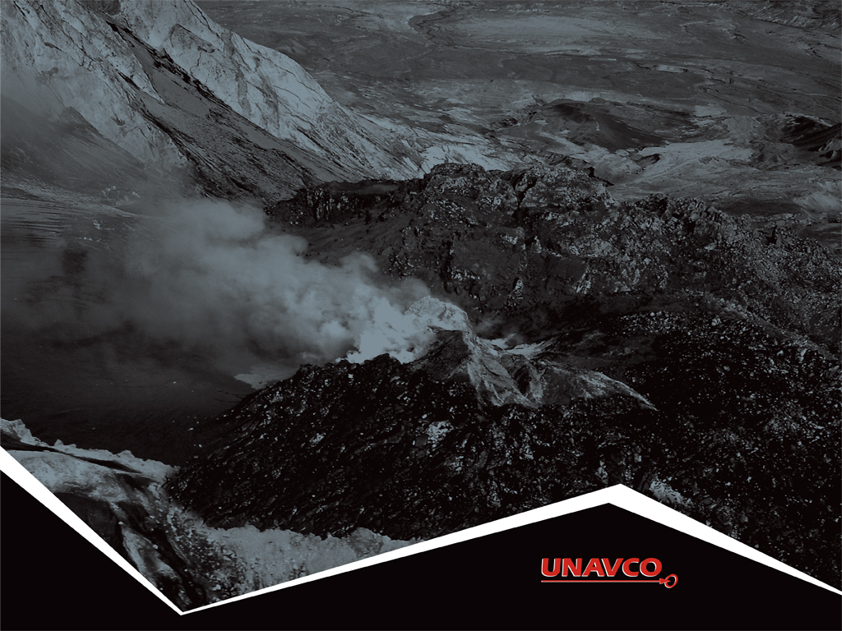
The Science of Prediction
Monitoring Volcanic Activity
www.unavco.org/cws/modules/cws/modules/yellowstone/
Notes:
This presentation is the first part of the activity “Taking the Pulse of Yellowstone’s ‘Breathing’ Caldera—Problem-Based Learning in America’s First National Park.” The activity was developed by UNAVCO to give students the chance to review and assess for themselves recent data related to Yellowstone magmatic activity.
UNAVCO is a non-profit membership-governed consortium which facilitates geoscience research and education using geodesy (http://www.unavco.org/).
UNAVCO is partnered with TOTLE and EarthScope.
If you prefer to see this in standard PowerPoint slide format, go to “View” and “Normal”.

Slide 2
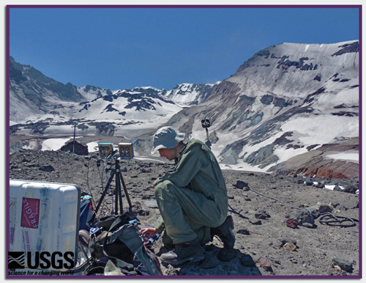
Signs of Volcanic Activity
  Eruption history
  Volcanic gas emission
  Heat and hydrothermal activity
  Earthquakes
  Ground deformation
Notes:
This slide organizes the presentation, which uses Mount St. Helens as a well-monitored example of many forms of volcanic activity. You will see photos of Mount St. Helens and, in some cases, for comparison, photos from Yellowstone National Park.
The picture is of a scientist monitoring gases given off by Mount St. Helens 6 July 2011. He is taking photographs using ultraviolet light (instead of visible light) to detect sulfur dioxide (SO₂), which absorbs ultraviolet light. The presence of SO₂ is frequently a clue that magma is actively rising.
Photo by Werner, C. 2011. USGS Volcano Hazards Program: “Postcards from the Field.” http://volcanoes.usgs.gov/about/postcards/index.php#MSHgas Retrieved15 December 2011.

Slide 3
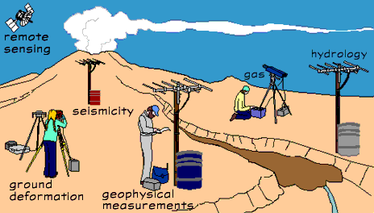
Monitoring
Scientists use tools, many of which can be set up and left, to monitor volcanoes.
Notes:
Image from USGS. 2002. Volcano Hazards Program: “How We Monitor Volcanoes”. http://volcanoes.usgs.gov/activity/methods/index.php Retrieved 1 January 2012.

Slide 4
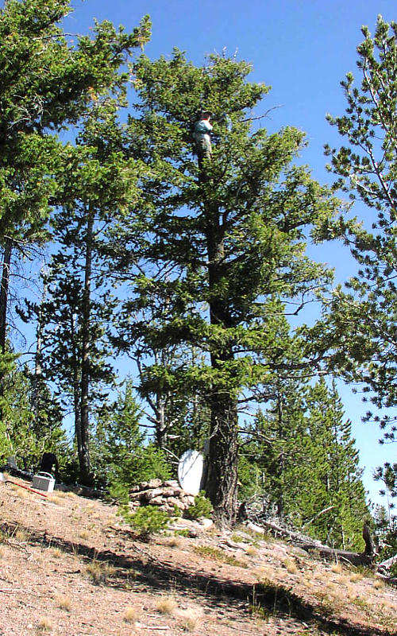
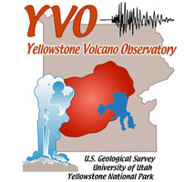
Monitoring
Instruments radio their data to a field station or volcano observatory.
Notes:
All of the five volcano observatories are partnerships between the United States Geological Survey (USGS) and other organizations.
Alaska (AVO)
Hawaii (HVO)
Cascades, WA (CVO)
Long Valley, CA (LVO)
Yellowstone, MT (YVO)
YVO is a partnership among the USGS, Yellowstone National Park, and the University of Utah.
The photo is of an engineer installing a radio antenna in a tree.
Photo by Dave Drobeck, University of Utah. 2001. http://volcanoes.usgs.gov/yvo/images/gallery2/gallery_monitoring.php. Retrieved 12 December 2011.

Slide 5
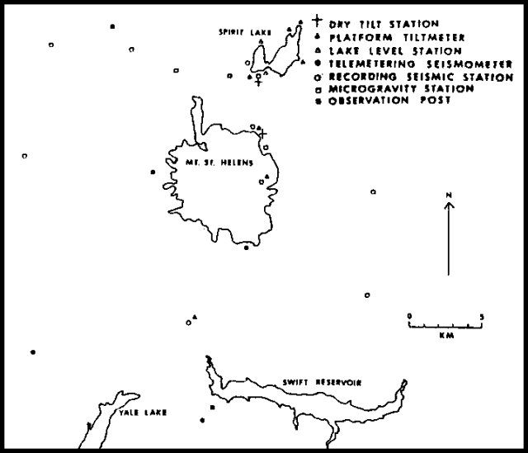
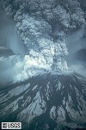
Monitoring Mount St. Helens
Notes:
When Mount St. Helens erupted catastrophically 18 May 1980, scientists were already monitoring it extensively. The map shows the kinds of instruments in place in mid-April of 1980.
The photo is of Mount St. Helens erupting 18 May 1980. USGS.
Map from Smithsonian National Museum of Natural History: Global Volcanism Program: St. Helens Index of Monthly Reports. http://www.volcano.si.edu/world/volcano.cfm?vnum=1201-05-&volpage=var#sean_0509 Retrieved 12 December 2011.
Photo by Post, A. 1980. http://vulcan.wr.usgs.gov/Volcanoes/MSH/SlideSet/ljt_slideset.html Retrieved 12 December 2011.

Slide 6
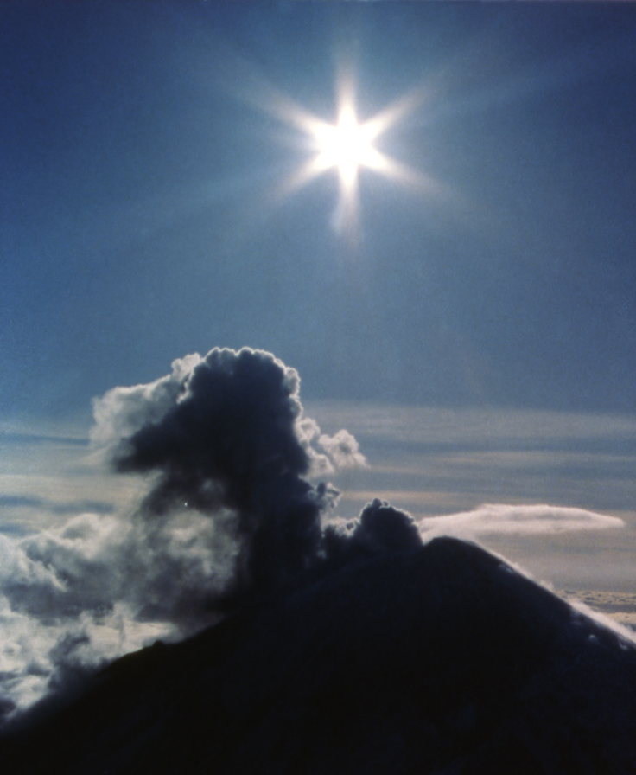
Eruption History
“The Past is the Key to the Present”
Ash, gas and steam eruptions
Notes:
A common saying in modern geology is that “the present is the key to the past”. It says that we study modern Earth processes to understand existing rocks and mountains that were the result of ancient Earth processes. The saying is called the “Law of Uniformitarianism”.
In the reversed version on the slide, “the past is the key to the present”, we imply that understanding old volcanic eruptions can help us understand what might happen in the future. By examining the eruption of Mount St. Helens and other volcanoes, we can better predict potential eruptions. This and the next 18 slides show different aspects of volcanic eruptions.
Ash, gas, and steam eruptions occur when hot, pressurized, trapped gases or steam escape. They are usually detected by surface earthquakes, elevated volcanic gas levels and visual plumes. Before erupting explosively 18 May1980, Mt. St. Helens had many gas and steam eruptions like this one of steam, 4 April 1980. The first eruption in this cycle was 27 March 1980. Since 1980, Mt. St. Helens has continued to erupt steam occasionally.
Image from Haselhorst, C. 1980. National Park Service: Yellowstone Digital Slide File: Volcanics, Igneous: 10486. http://www.nps.gov/features/yell/slidefile/geology/volcanicsigneous/Page-4.htm Retrieved12 December 2011.

Slide 7
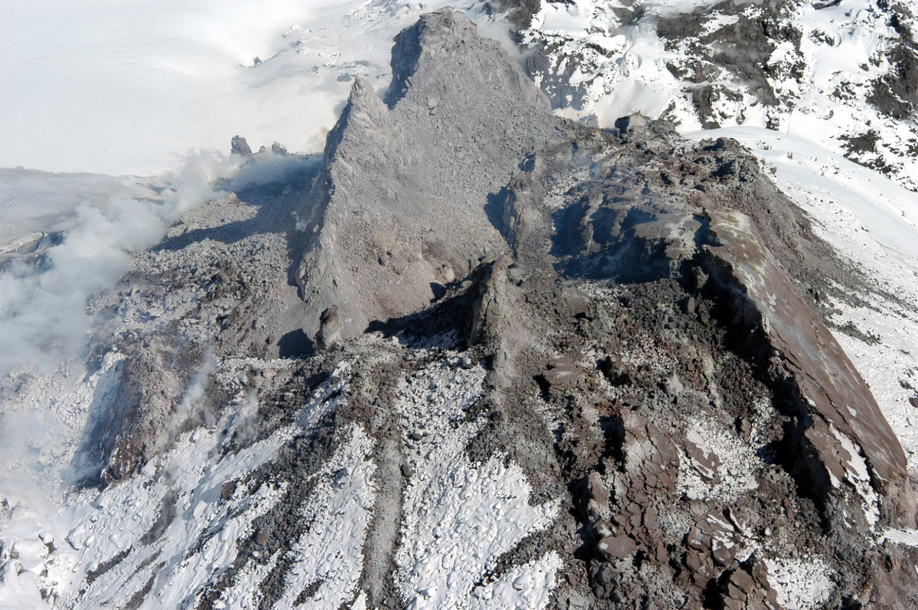
Eruption History
Lava flows
Notes:
Lava oozes or flows when magma rises to the surface and extrudes from fissures or vents. It is usually accompanied by shallow earthquakes and is followed by elevated gas levels and heat measurements.
In September of 2004, Mount St. Helens began erupting lava into its crater and slowly built a dome. This image is of the lava dome during an eruption of the volcano 24 Ma y2005.
Image from USGS, Cascade Volcano Observatory. National Park Service: Yellowstone Digital Slide File: Volcanics, Igneous: 18265d. http://www.nps.gov/archive/yell/slidefile/geology/volcanicsigneous/Page-8.htm Retrieved 13 December 2011.

Slide 8
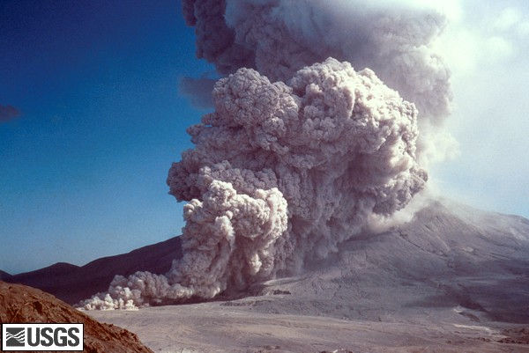
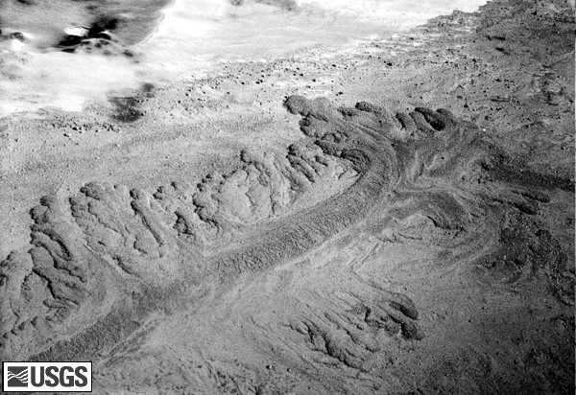
Eruption History
Pyroclastic flows
Notes:
Pyroclastic flows occur when superheated gases and solids flow down the flanks of a volcano--at rates of tens to hundreds of kilometers per hour.
Earthquakes and elevated gas levels can precede them. However, Mount St. Helens’s explosive eruption of 18 May 1980 was started by a landslide — triggered by an earthquake. The eruption produced 17 or more pyroclastic flows. The flows descended the north flank through the breach caused by the explosion, and they destroyed everything in their paths.
For more background on pyroclastic flows click on the picture.
The photo on the left is of a pyroclastic flow 7 August 1980 falling down the flank of Mount St. Helens. The photo on the right is a pyroclastic flow deposit from an eruption 12 June 1980. The tongue of debris is ½ mile long.
Lefthand photo from USGS. Lipman, P. 1980. Cascade Volcano Observatory: Digital Slide File: Mount St. Helens, Washington: Pyroclastic Flow Images: 1980-Current. http://vulcan.wr.usgs.gov/Volcanoes/MSH/Images/pyroclastic_flows.html Retrieved 13 December 2011.
Righthand photo from USGS, Rowley, P. 1980. Cascade Volcano Observatory: Digital Slide File: Mount St. Helens, Washington: Pyroclastic Flow Images: 1980-Current http://vulcan.wr.usgs.gov/Volcanoes/MSH/Images/pyroclastic_flows.html Retrieved 13 December 2011.

Slide 9
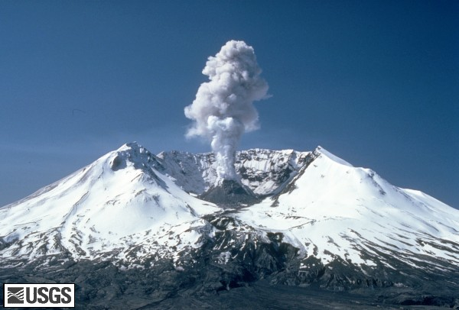
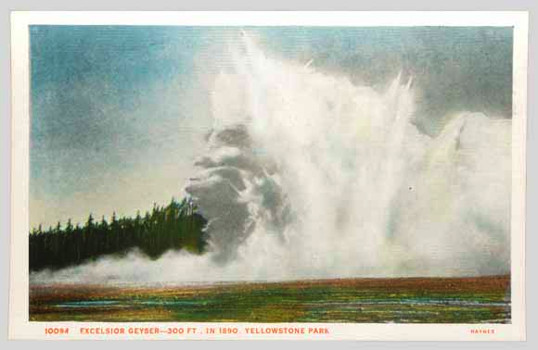
Eruption History
Hydrothermal explosions
Notes:
Hydrothermal explosions occur when superheated, pressurized and trapped steam escapes, blowing a crater in the ground. This may happen even when magma is not rising (as it was with Mount St. Helens).
The lefthand photo shows steam rising from Mount St. Helens 19 May 1982 from within the larger crater. This steam plume might or might not have blown a crater like those seen in Yellowstone. The righthand image is a postcard made from an 1888 photograph of Excelsior Geyser in Yellowstone erupting in a hydrothermal explosion.
Righthand photo from USGS. Topinka, L. 1980. Mount St. Helens, Washington: Crater and Dome Images: 1980 – 2004. http://vulcan.wr.usgs.gov/Volcanoes/MSH/Images/MSH80/crater_and_dome.html Retrieved13 December 2011.
Postcard from Haynes, KF.J. 1888. Accessed from U.S. Geological Survey Fact Sheet 2005-3024. 2005. “Steam Explosions, Earthquakes, and Volcanic Eruptions—What’s in Yellowstone’s Future?” http://pubs.usgs.gov/fs/2005/3024/ Retrieved 31 December 2011.

Slide 10
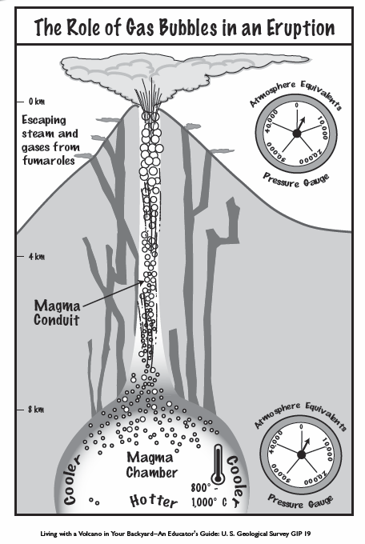
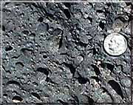
Volcanic Gases
Gas emissions
Vesicular basalt
Notes:
Gases that are dissolved in magma provide some of the energy for volcanic eruptions. Gases can be released as magma rises (easing the pressure, like opening a can of soda), as it erupts to the surface, and even as magma cools below the surface. Compare the size of the gas bubbles near the magma chamber to those near the volcano’s vent. They get bigger as the pressure on the magma lets up.
The primary gas in an eruption is water vapor!
The lefthand image is a diagram of gases exsolving (the opposite of dissolving) from magma as the magma rises. The photo, on the right, proves that magma is gassy. When magma reaches the surface—becoming “lava”--and cools quickly, holes remain from the gas bubbles it once contained.
Diagram from Driedger, C.; Doherty, A.; and Dixon, C. 2005. Living with a Volcano in your Backyard -- An Educator's Guide with Emphasis on Mount Rainier: U.S. Geological Survey and National Park Service: General Interest Publication 19. “Soda Bottle Volcano” Activity. http://vulcan.wr.usgs.gov/Outreach/Publications/GIP19/framework.html Retrieved 13 December 2011.
Photo from USGS, accessed from the National Park Service: Bryce Canyon Activity 3: Igneous Rocks. http://www.nps.gov/brca/forteachers/randmact3.htm Retrieved 13 December 2011.

Slide 11
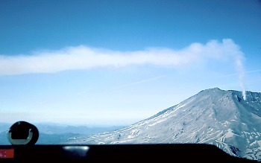
Volcanic Gases
Steam plume
Notes:
The gases scientists monitor include carbon dioxide (CO₂), sulfur dioxide (SO₂), and hydrogen sulfide (H₂S).
The view is from the cockpit of an airplane flying below a steam plume erupting from Mount St. Helens June 16, 1982. The plane was flying close to the plume to measure SO₂ concentration in order to understand the rate at which the volcano emitted gases.
Image from USGS, Brantley, S.R. 1982. Volcano Hazards Program: “Measuring volcanic gases: emission rates of sulfur dioxide and carbon dioxide in volcanic plumes.” http://volcanoes.usgs.gov/About/What/Monitor/Gas/plumes.html Retrieved 13 December 2011.

Slide 12
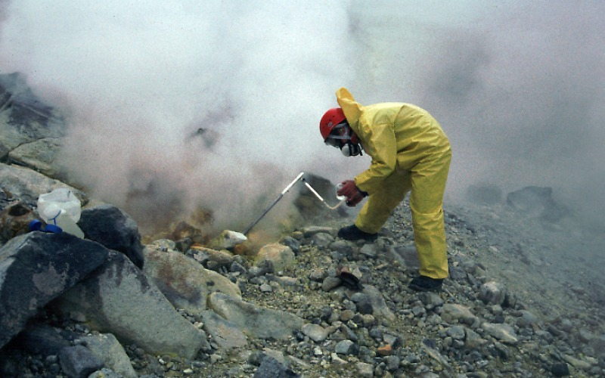
Volcanic Gases
Collecting gas samples
Notes:
A scientist collects gas samples for analysis on an Alaskan volcano. Notice his protective equipment.
Volcanic gases are hard to sample and measure because they are found in hazardous places and are toxic to living things – like this geologist. We detect the gases by using instruments on the ground or mounted on an airplane as in the previous slide. Samples can also be collected by hand, like in this photo, for analyzing in a laboratory.
Image from USGS Volcano Hazards Program: “Direct gas sampling and laboratory analysis.” http://volcanoes.usgs.gov/activity/methods/gas/sample.php Retrieved 13 December 2011.

Slide 13
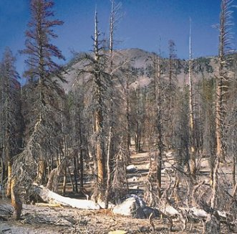
Volcanic Gases
Death by gases
Notes:
To detect and trace emissions of gases, scientists also look for changes to living things such as trees and animals
These trees at Mammoth Mountain, CA died when carbon dioxide (CO₂) suffocated their roots. Because CO₂ is denser than air, it pools at ground level. (In contrast, trees need CO₂ at branch height to photosynthesize.)
Volcanic CO₂ emissions have proven deadly to humans in Africa. In 1986, 1700 people and 3500 livestock suffocated near a lake in Cameroon. CO₂ was dissolved in the lake, like it is in a soda. A landslide disturbed the equilibrium, and, essentially, made the lake burp up the gas.
Image from USGS Fact Sheet 172-96. 2000. “Invisible CO2 Gas Killing Trees at Mammoth Mountain, California”. http://pubs.usgs.gov/fs/fs172-96/ Retrieved13 December 2011.

Slide 14
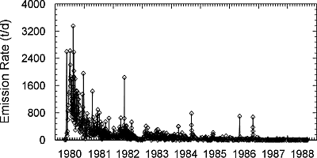
Volcanic Gases
Rate of SO₂ emission, Mount St. Helens
Notes:
Following Mount St. Helen’s eruption in 1980, sulfur dioxide levels fell dramatically. Notice that the vertical scale is in tons per day! After the 18 May eruption, Mount St. Helens still released nearly 500,000 metric tons of sulfur dioxide gas into the atmosphere.
Data is from USGS. 2002. Volcano Hazards Program: “ Emission of sulfur dioxide gas from Mount St. Helens, 1980-1988”.
http://volcanoes.usgs.gov/activity/methods/gas/msh1980-88.php Retrieved13 December 2011.

Slide 15
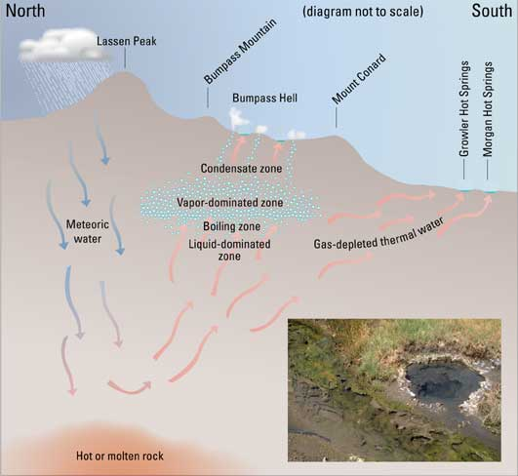
Heat and Hydrothermal Activity
Plumbing of
hydrothermal
systems
1
1
4
5
3
2
Notes:
This diagram shows heat from magma deep in the earth interacting with surface water. The combination creates hydrothermal activity such as the famous geysers and mud pots of Yellowstone National Park. Although the place names are from Lassen Volcanic National Park, as is the photograph in the lower right hand corner, the diagram shows fundamental aspects of hydrothermal system.
Water from rain and snow seeps into the ground through fractures and cracks in the bedrock.
This water is then heated by the magma chamber or hot rock. Its density decreases, causing it to rise back to the surface.
As the heated water rises, the pressure from rocks and water above decrease, and the liquid expands. It can either boil and erupt as steam in a fumarole or it can become superheated, meaning that it stays a liquid at temperatures higher 100 degrees Celsius, its boiling point at Earth’s surface.
If the superheated water is trapped, as if it were corked, pressure builds. The pressure eventually exceeds that from overlying rock and water. When the pressure is finally released, it flashes to fizzing bubbly water and steam that erupts as geysers, steam eruptions or hydrothermal explosions.
If the gas escapes quietly, the heated water bubbles calmly to the surface as a hot spring or bubbling mudpot.
Image is adapted from Clynne, M.; Janik, C.; and Muffler, L. 2003. USGS Fact Sheet 101-02. “’Hot Water” in Lassen Volcanic National Park— Fumaroles, Steaming Ground, and Boiling Mudpots. http://pubs.usgs.gov/fs/2002/fs101-02/ Retrieved 13 December 2011.

Slide 16
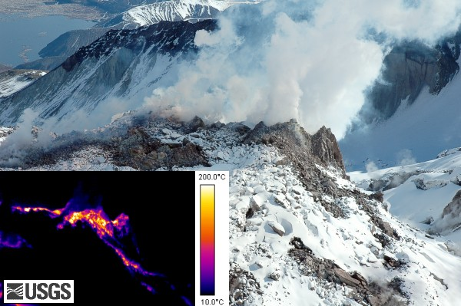
Heat and Hydrothermal Activity
FLIR image of Mt. St. Helens’ new dome June 26th 2007
Notes:
Hot magma is the ultimate source of heat in hydrothermal systems. The existence of a hydrothermal system, however, indicates only that magma lies below, not that it is pushing to the surface.
Thermal features can be monitored by aerial observations at night, photographs of geological features in infrared wavelengths of light (Forward Looking Infrared or “FLIR”), and direct temperature measurements. This pair of images shows a volcanic dome growing on Mount St. Helens in April 2007. The images are of the same features, the bigger one with visible light and the smaller one capturing the scene in infrared wavelengths.
Image from USGS Mount St. Helens, Washington Forward Looking Infrared. 2007. http://vulcan.wr.usgs.gov/Imgs/Jpg/MSH/MSH07/MSH07_top_new_growth_from_SW_04-20-07_FLIR_med.jpg Retrieved 13 December 2011.

Slide 17
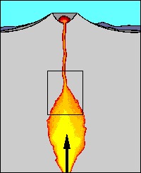
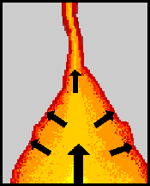
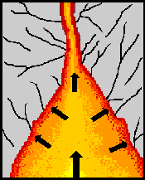
Earthquakes
Formation of earthquakes by rising magma
Magma rises into reservoir
beneath volcano
Rising magma and volcanic gases exert pressure
High pressure causes breaks rocks, triggering earthquakes
Notes:
Moving magma and volcanic fluids can cause earthquakes. Earthquake activity increases before an eruption because liquid magma, hot fluids, and gases are less dense than the surrounding rocks and they force their way through the crust to reach Earth’s surface. Most volcanic earthquakes:
have a magnitude <3;
Occur shallower than 10 km; and
occur in swarms (lots of earthquakes, close together).
Image from USGS Volcano Hazards Program: “Monitoring Volcano Seismicity.” http://volcanoes.usgs.gov/activity/methods/seismic/index.php Retrieved 14 December 2011.

Slide 18
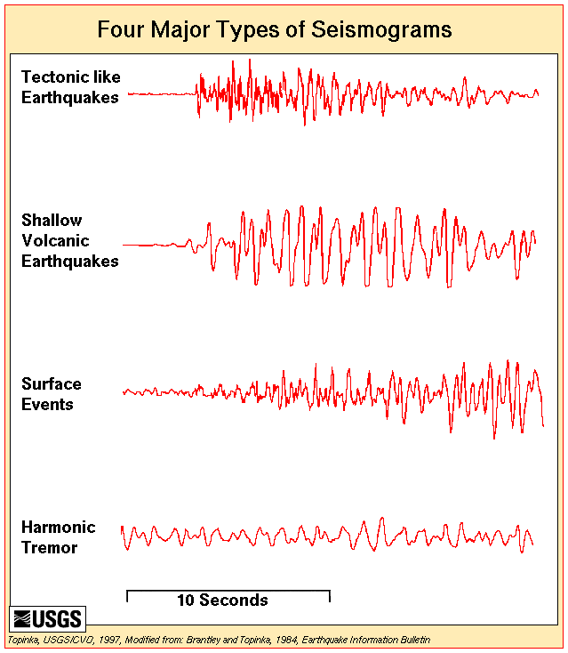
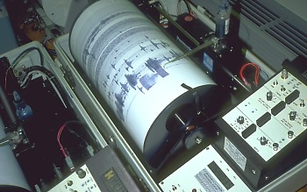
Earthquakes
Detecting earthquakes
Notes:
Seismometers detect ground vibrations from geological causes like earthquakes or rock falls, as well as from man-made causes such as heavy trucks driving nearby, explosions, and exploration for oil and gas. Different sources of vibrations cause different patterns on a seismometer.
Scientists can detect magma on the move by looking for the pattern of magmatic earthquakes called “harmonic tremors” or “volcanic tremors”. By clicking on the record of the harmonic tremor on the lefthand picture, you can see the record of one that occurred April 2, 1980 on Mount St. Helens.
The righthand image shows a seismometer (the instrument) recording a seismogram (the record) during an eruption of Mount Pinatubo, Philippines. The lefthand image shows seismograms from a variety of geological causes. The bottom one is a harmonic tremor .
Image from USGS Volcano Hazards Program: “Monitoring Volcano Seismicity.” http://volcanoes.usgs.gov/activity/methods/seismic/signatures.php. Seismograms from Brantley and Topinka, 1984, “Volcanic Studies at the David A. Johnston Cascade Volcano Observatory”. Earthquake Information Bulletin, March-April 1984, v.16, n.2 http://vulcan.wr.usgs.gov/Volcanoes/MSH/Publications/EIB84/EIB84.html Retrieved 13 December 2011.
Image of seismometer from Tyson, P. 2000. NOVA Online “Can We Predict Eruptions?” http://www.pbs.org/wgbh/nova/vesuvius/images/predict23.jpeg Retrieved 14 December 2011.
Linked seismogram from USGS Cascade Volcano Observatory Photo Archives: Mount St. Helens, Washington: Volcano and Hydrologic Monitoring Images, 1980-2004. http://vulcan.wr.usgs.gov/Imgs/Jpg/MSH/Seismicity/MSH80_seismogram_RAN_harmonic_tremor_04-02-80_med.jpg Retrieved 2 January 2012.

Slide 19
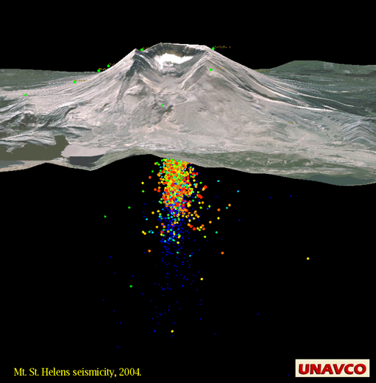
Earthquakes
Notes:
Scientists can tell where Mt. St. Helens’ magma source is by looking at its pattern of earthquakes. Each dot represents the focus of an earthquake—where it originated. Where they are clustered, we assume there is a body of magma. Different colored dots represent XXXXXX. The vertical scale in this image is the same as the horizontal scale.

Slide 20
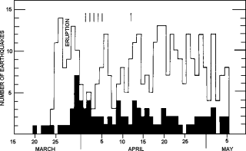
Earthquakes
Mount St. Helens earthquakes
Notes:
In this graph, the upper jagged line represents the number of earthquakes with a magnitude greater than 3.4. The bottom line (where the graph is filled in with black) shows earthquakes with a magnitude greater than 4.0. The short vertical lines show when there were harmonic tremors. This data was collected at the Newport, OR observatory, 360 km away from the volcano.
Between March 1980 and May 1980 an average of ten magnitude 3.5 or greater earthquakes were recorded per day at Mt. St. Helens. Swarms of hundreds of smaller earthquakes occurred daily. Earthquakes continue to be common at Mt. St. Helens since dome rebuilding began in 2004.
Image from Smithsonian National Museum of Natural History. (n.d.) “Global Volcanism Program: St. Helens Index of Monthly Reports”. http://www.volcano.si.edu/world/volcano.cfm?vnum=1201-05-&volpage=var#sean_0509 Retrieved 15 December 2011.

Slide 21
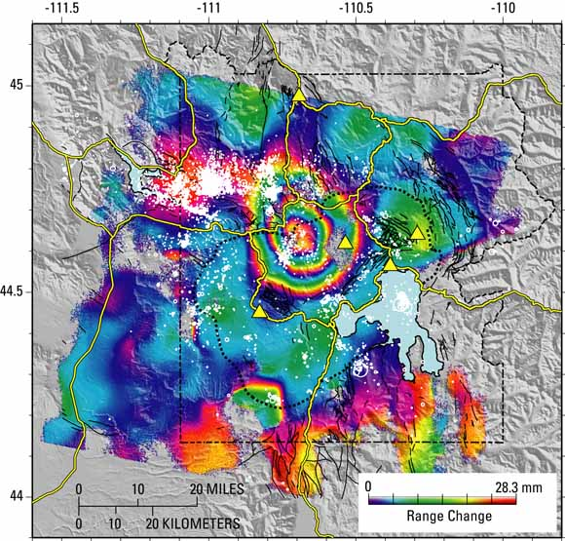
Ground Deformation
Satellite measurement of ground deformation
Notes:
Volcanoes change shape before, during, and after eruptions. They inflate (bulge) and deflate (sink) from trapped and pressurized gases or fluids.
Scientists measure changes in the ground surface as well as monitor gas emissions and the patterns of earthquakes. Deformation can be a sign that magma is rising.
This image is of Yellowstone. A satellite collected the data by using a relatively new technique called Interferometric Synthetic Aperture Radar, or InSAR. Computers compare two radar images of the area taken at different times and show changes in elevation with the colors you see. This image shows changes between 1996 and 2000.
The colored rings represent uplift—each set of colored bands from red to violet reflects 28 mm of uplift. Count how many bands of color you see and determine how much uplift occurred between 1996 and 2000.
The black dotted line marks the caldera boundary. Yellow triangles mark permanent GPS stations. White dots and circles show the epicenters of earthquakes between 1996 and 2000.
Image from USGS Fact Sheet 100-03. 2004. “Tracking Changes in Yellowstone's Restless Volcanic System.” http://pubs.usgs.gov/fs/fs100-03/ Retrieved 27 December 2011.

Slide 22
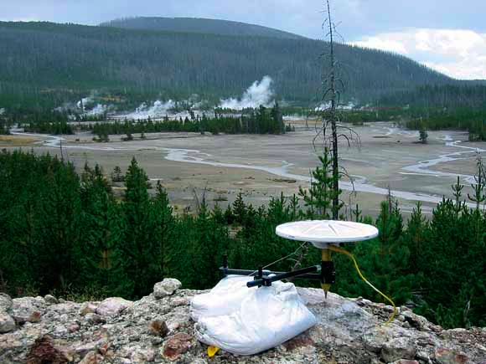
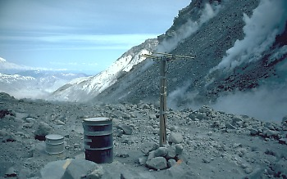
Ground Deformation
Measuring ground
deformation
Notes:
Deformation is also measured on the ground using:
Tiltmeters which work like a carpenter’s level and can be left in place;
Global Positioning Systems which use satellites to triangulate the position of a GPS receiver; and
Leveling Surveys in which scientists use survey equipment to measure position and then return periodically to make additional measurements.
The righthand photo is a permanent GPS site in Yellowstone. The lefthand one is a tiltmeter site on crater floor of Mount St. Helens.
Righthand photo from Puskas, C. USGS Fact Sheet 100-03. 2004. “Tracking Changes in Yellowstone's Restless Volcanic System”. http://pubs.usgs.gov/fs/fs100-03/ Retrieved 27 December 2011.
Lefthand photo by Brantley, S.R. 1982. USGS Volcano Hazards Program: “Tiltmeters help scientists predict eruptions at Mount St. Helens”. http://volcanoes.usgs.gov/activity/methods/deformation/tilt/msh.php Retrieved 15 December 2011.

Slide 23
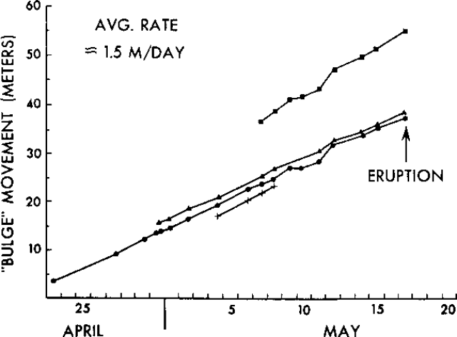
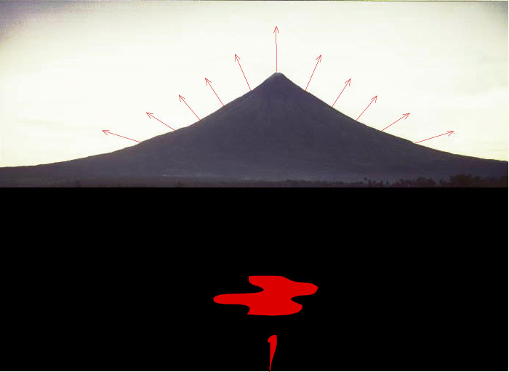
Ground Deformation
Deformation at Mount St. Helens
Notes:
This graph shows the outward displacement of four spots on the north side of Mount St. Helens. Rates of displacement were 1.5 to 2 meters per day. Between March 1980 and May 1980, Mount St. Helens’s north flank bulged as much as 60 meters. After an earthquake, this deformation gave way in a huge landslide that induced the pyroclastic flow, volcanic mudflow and ash eruption of 18 May1980.
Image from Smithsonian National Museum of Natural History. (n.d.) Global Volcanism Program:” St. Helens Index of Monthly Reports”. http://www.volcano.si.edu/world/volcano.cfm?vnum=1201-05-&volpage=var#sean_0509 Retrieved 15 December 2011.

Slide 24
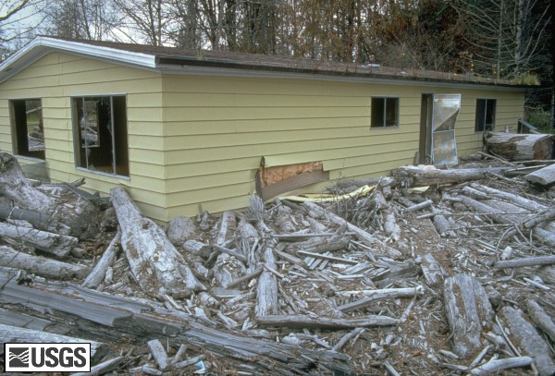
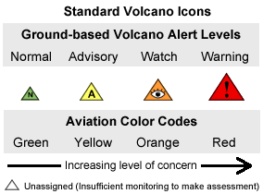
The Science of Prediction
Notes:
Even though scientists could not predict the exact moment Mount St. Helens would erupt, they saved lives by predicting that it would erupt.
This house was on the South Fork of the Toutle River in the evacuation zone of Mount St. Helens when the volcano became active again. The debris is from a mudflow that traveled down the river already choked with trees and sediment.
The symbols are a standardized warning system for the ground and for the air created by the USGS.
Photo from USGS. Topinka, L. 1981. Mount St. Helens, Washington: “A General Slide Set”. http://vulcan.wr.usgs.gov/Volcanoes/MSH/SlideSet/ljt_slideset.html Retrieved 15 December 2011.
Icons are from USGS Volcanic Activity Alert-Notification System. http://volcanoes.usgs.gov/activity/alertsystem/icons.php Retrieved 15 December 2011.

Slide 25
Sources
Driedger, C., Doherty, A., and Dixon, C. 2005. “Living with a Volcano in your Backyard -- An Educator's Guide with Emphasis on Mount Rainier”. U.S. Geological Survey and National Park Service, General Interest Publication 19. http://vulcan.wr.usgs.gov/Outreach/Publications/GIP19/framework.html.
Smithsonian National Museum of Natural History (n.d.) Global Volcanism Program: St. Helens Index of Monthly Reports http://www.volcano.si.edu/world/volcano.cfm?vnum=1201-05-&volpage=var#sean_0509
USGS. 2007. Volcano and Hydrologic Monitoring Techniques http://vulcan.wr.usgs.gov/Monitoring/techniques.html#seismic_monitoring
USGS. 2002. Volcano Hazards Program: “Strategy for Reducing Volcanic Risk”. vulcan.wr.usgs.gov/Hazards/RiskPosters/RiskPoster2.pdf
USGS. 2004. Fact Sheet 100-03: “Tracking Changes in Yellowstone's Restless Volcanic System” http://pubs.usgs.gov/fs/fs100-03/

