Slide 1
Lake Louise Field Trip
Photographs (Boggs, 1996)
See notes for photograph captions

Slide 2
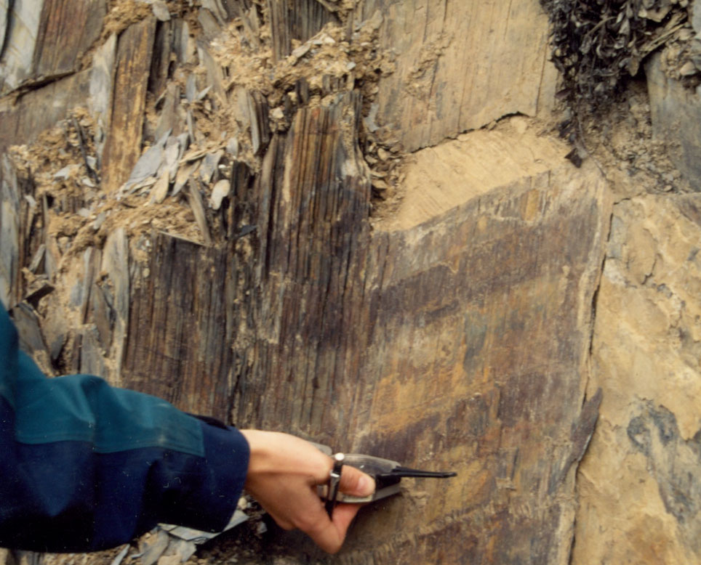
Notes:
Photograph I: Cleavage-bedding relationship at Station 303. The cleavage here is vertical, and the bedding is represented by the colour change from dark brown to light brown dipping approximately 30° towards the arm.

Slide 3
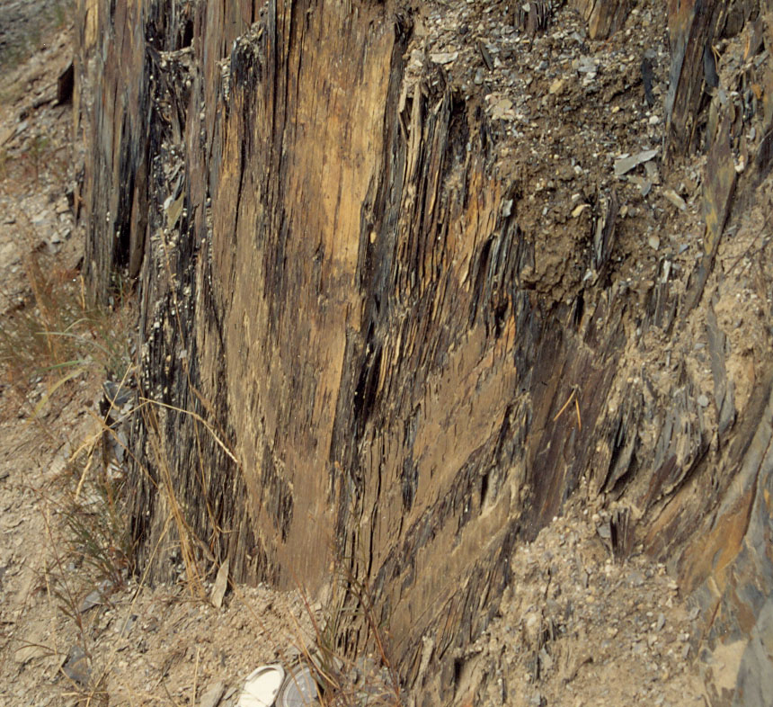
Notes:
Photograph II: Cleavage-bedding-axial planar relationship at station 302. The cleavage here is almost vertical, parallel to the axial plane through the syncline traced out by the bedding. This fold was approximately 1m wide with parallel boundaries and preserved stratigraphic thickness.

Slide 4
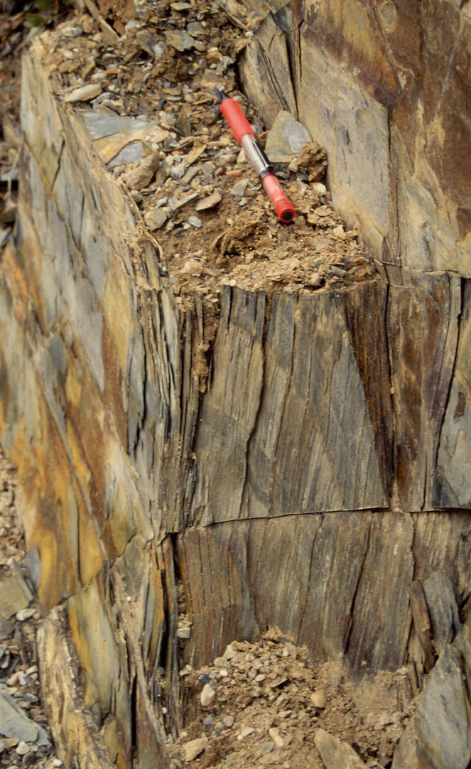
Notes:
Photograph III: Vertical cleavage parallel to the axial plane of a small anticline (less than 1m wide) from station 302c. This fold demonstrates the parallel boundaries and preserved stratigraphic thickness typical of the concentric folds from the Rocky Mountain Front Ranges.

Slide 5
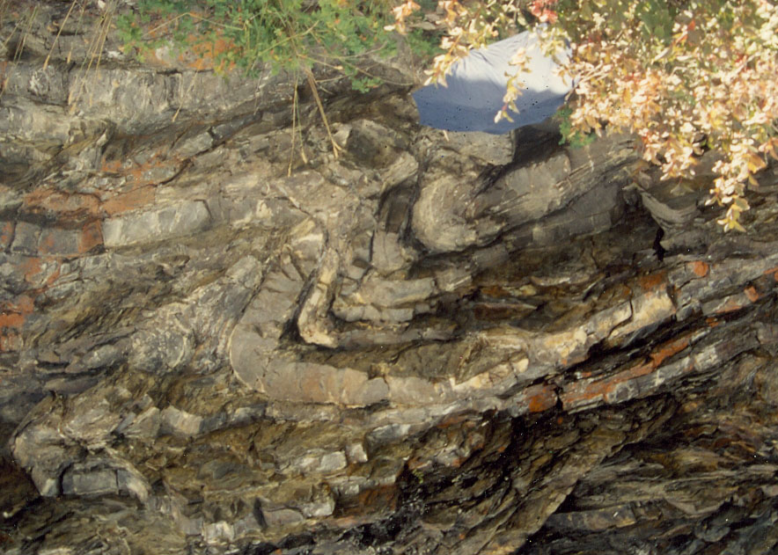
Notes:
Photograph IV: Small syncline-anticline pair from station 203. The blue object for scale is an umbrella. These folds repeat the regional concentric style of folding. In the cores of these folds traced out by the limestone beds, the slates developed parasitc folding to compensate for the room problem produced by more competent layers squeezing a less competent layer into a tight concentric fold.

Slide 6
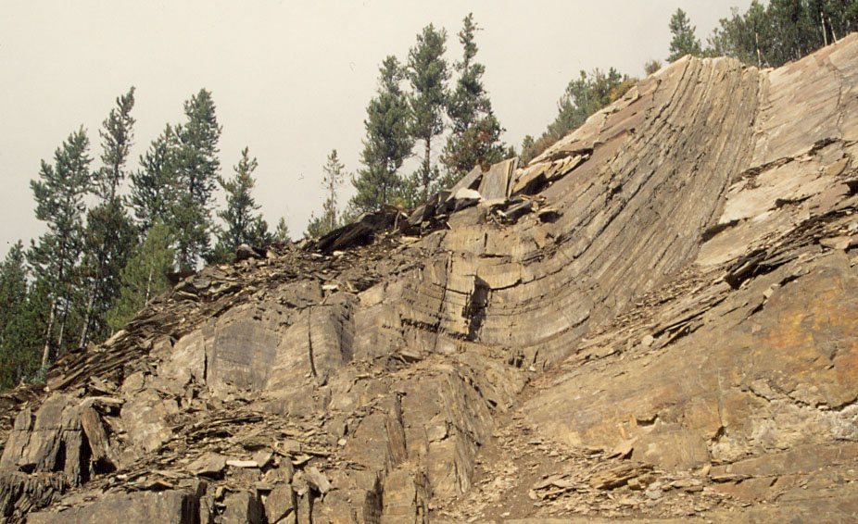
Notes:
Photograph V: Large (~20m wide) syncline from station 309. This fold demonstrates the likely scale of the regional folds. Even these larger folds are typically concentric in style. Unfortunately a large portion of this outcrop has been removed by construction.

Slide 7
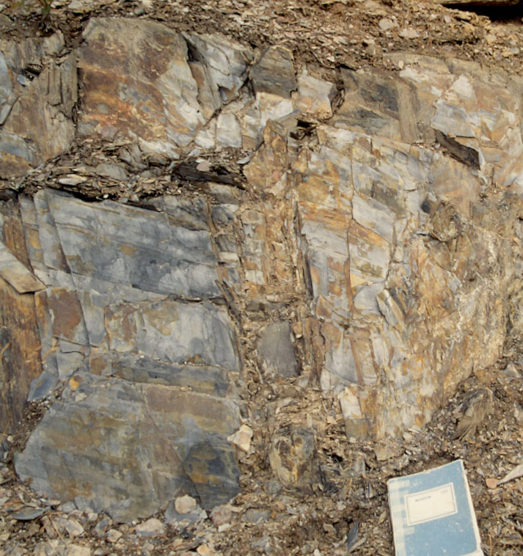
Notes:
Photograph VI: Small faults with < 10cm offset. These faults likely developed due to room problems in the cores of the faults.

