Slide 1
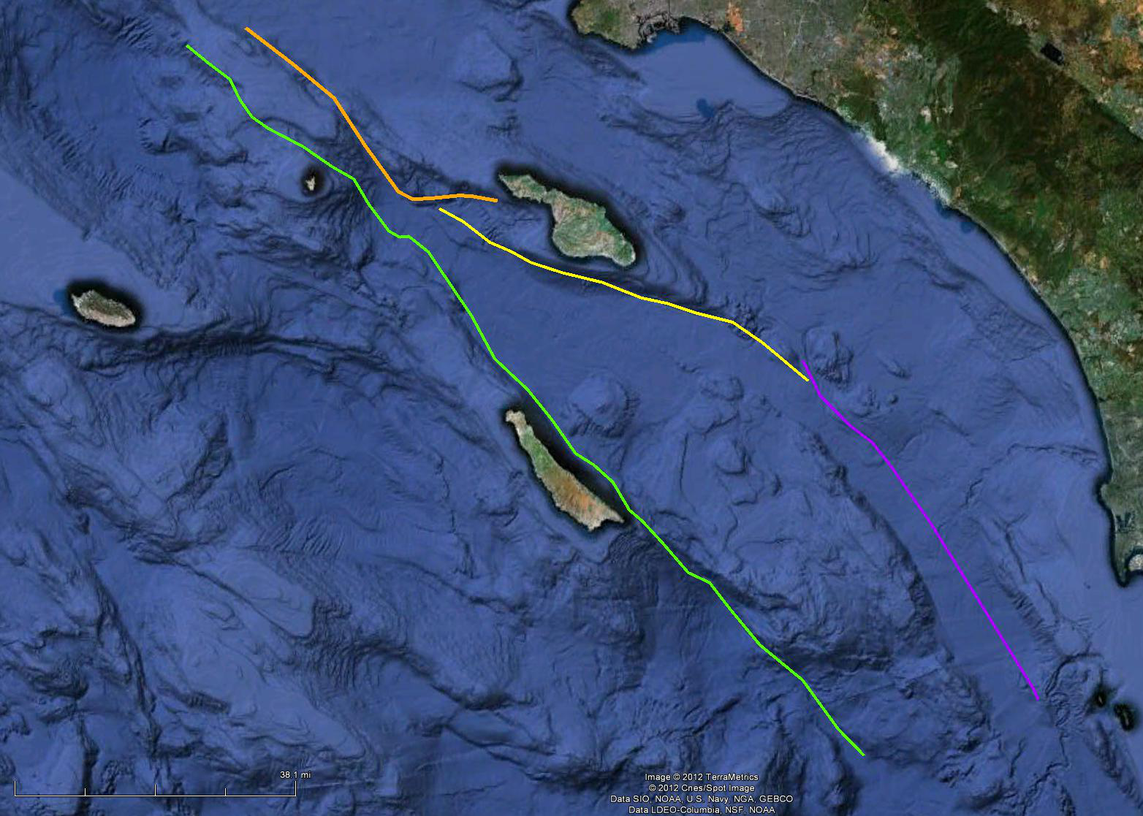
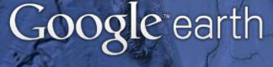
Santa Cruz-Catalina Ridge
Fault Zone
San Clemente
Fault Zone
Catalina
Fault Zone
San Diego Trough
Fault Zone
N

Slide 2
All of the fault zones shown on the map are right lateral strike slip faults. Fault traces were obtained from the USGS quaternary fault database at http://earthquake.usgs.gov/hazards/qfaults/google.php
Name:
1. Briefly describe the terrain just north of the Catalina Fault Zone.
2. The Catalina Fault Zone bends noticeably in the vicinity of the blue arrow. Would this be considered a releasing bend or a restraining bend? Explain your reasoning, including a general discussion and map view sketch of the local stresses in that location.
N
Catalina Fault Zone

