Slide 1
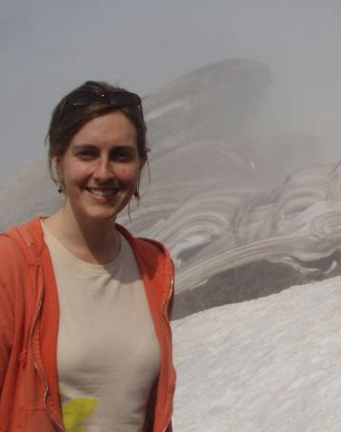
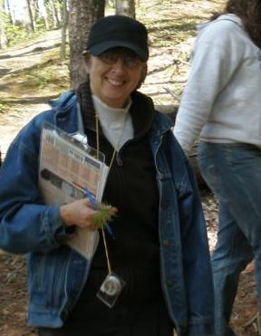
Teaching science in the community: service learning opportunities for elementary education majors
Stephanie Maes
maess@strose.edu
Mary Cosgrove
cosgrovm@strose.edu
The College of Saint Rose
Albany, NY

Slide 2
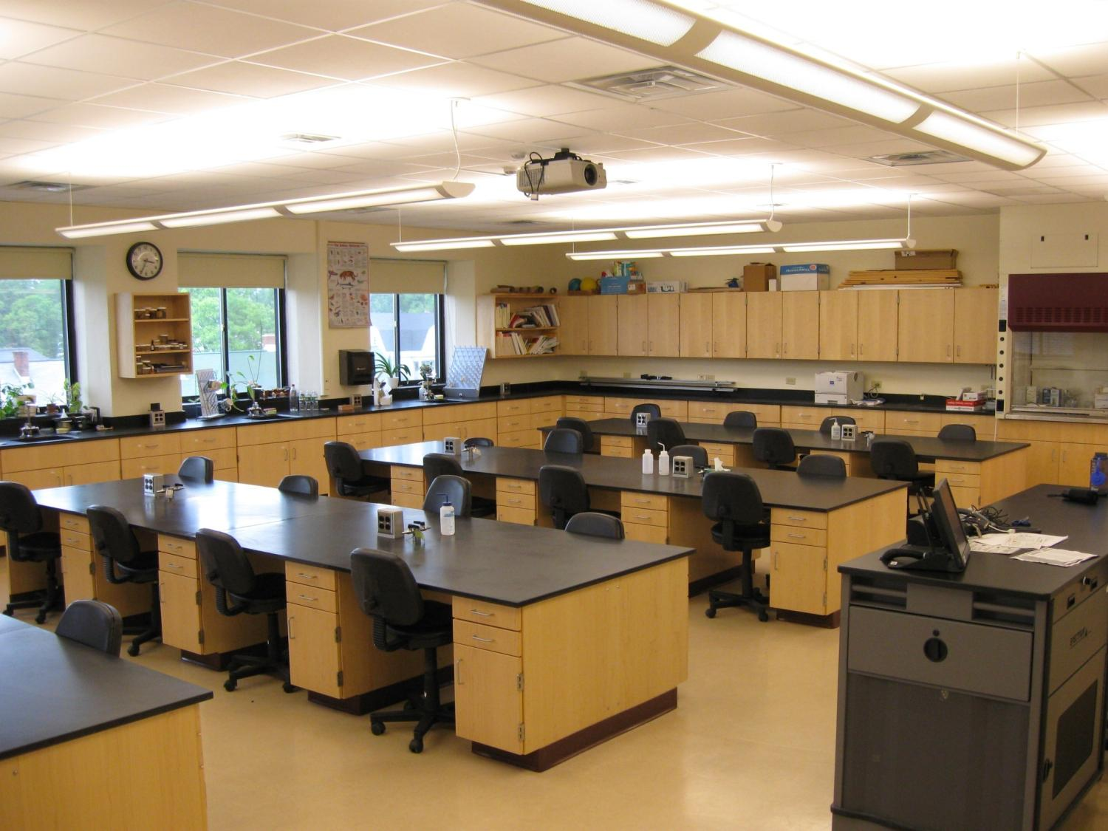
Science 100 and 200: Fundamentals of Science
A Brief Description of Our Program:
Required course for elementary and special education majors who are non-science concentrators
Team taught integrated lectures
  Science 100 – Physics & Chemistry
  Science 200 – Earth Science & Biology
Laboratory
Peer-led workshops
Service learning component
Notes:
A Brief History of Our Program
Team-Taught Integrated Lectures
Laboratory
Peer-Led Workshops
Service Learning
Challenges and Questions

Slide 3
100 Strong (and Growing!) – Fall 2009
78 Students
78 Students
13 Peer Leaders
4 Faculty Members
2 Graduate Assistants
2 Work/Study Students
1 Learning Specialist
1 Learning Specialist
13 Peer Leaders
2 Work/Study Students
4 Faculty Members
2 Graduate Assistants

Slide 4

Integration Around a Theme – Climate Change
SCI 100 topics
US dependence on fossil fuels
Physics / chemistry of fossil fuels
Making electricity
Global climate change/acid rain/ozone
Alternative energy sources
SCI 200 topics
General biology and earth science
Environmental responses to global climate change/acid rain/ozone
Notes:
Importance of Learning science content in context
Basic content is the same, but its being taught in context

Slide 5
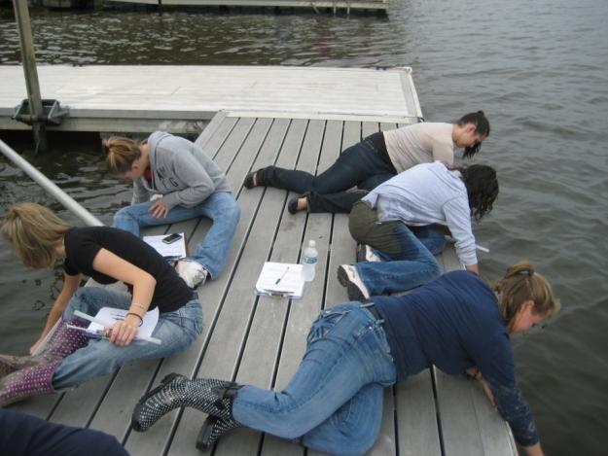
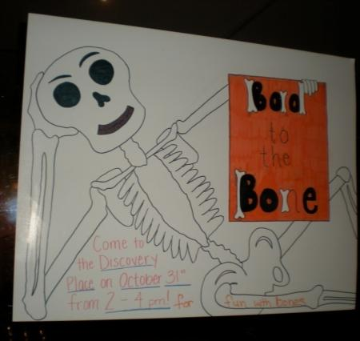
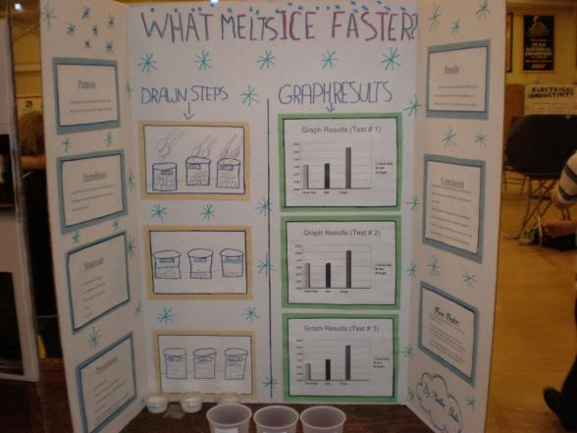
Our Service Learning Community Partners
Joseph Henry Science Fair
Help Yourself Academy
Friday Knights
New York State Museum
Pine Bush Discovery Center
BOCES Transition Program
Local school district classrooms
A Day in the Life of the Hudson River
Notes:
Friday Knights – Elise activity about oil spills and pollution in the ocean

Slide 6
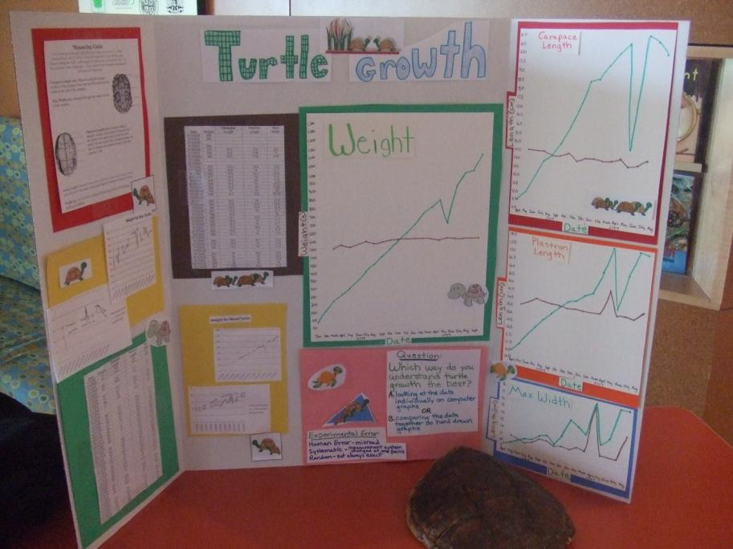

Pine Bush Preserve Discovery Center
Visited previously on a field trip - learned about glacial history and the ecology of the preserve
Used data about turtle growth (weight & length) to put together a display
How do children learn best?
Poster by Jennifer Henrikson and Meghan Coffey
Notes:
Visited previously on a field trip
Discuss glacial history of the area & ecological links

Slide 7
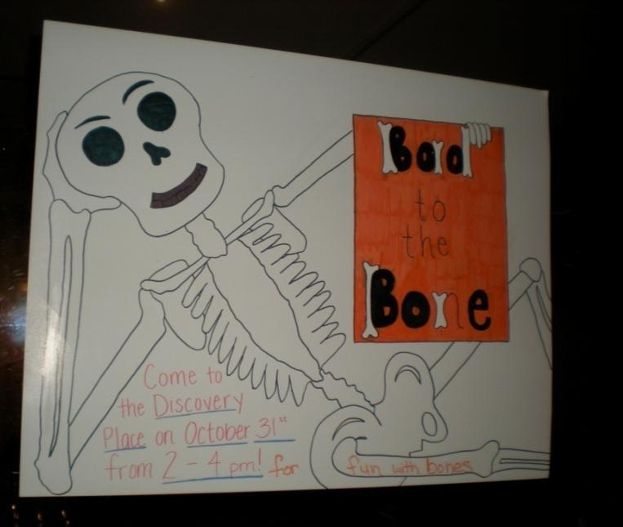
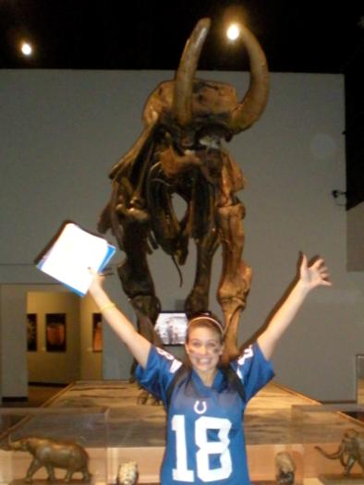
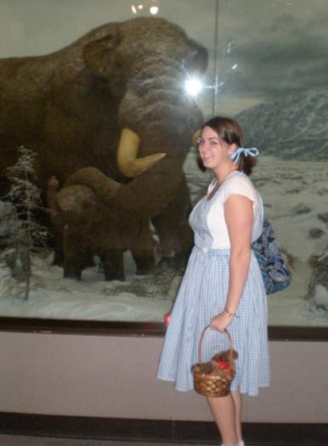
New York State Museum Discovery Place
Halloween weekend
Developed and presented a program for children about bones
Poster by Lindsey Kraus and Diana Erben

Slide 8
New York State Museum Discovery Place
Student Reflections:
“Science 200 is not only about teaching science, but is about learning how to teach science to children. Doing this activity at the Discovery Place opened up my eyes to different ways of teaching science”
“It was amazing to see how fast some of the children could put it together, which reminded me not to underestimate the knowledge of children”

Slide 9
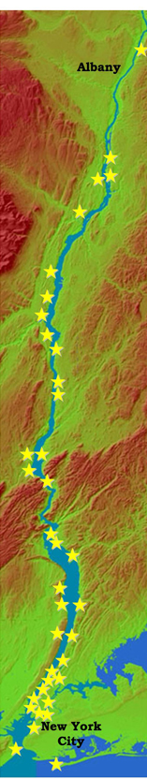
A Day in the Life of the Hudson River
(Snapshot Day)
New York State Department of Environmental Conservation Hudson River Estuary Program and Lamont-Doherty Earth Observatory
61 sites along the Hudson River held activities
Findings contribute to ongoing research
  chlorophyll – river productivity
  sediment core analysis
  water collection – trace metal studies
www.ldeo.columbia.edu/edu/k12/snapshotday/images/HRES_snapshot_poster.jpg/Slide1.jpg
Notes:
Attending training at an environmental education center prior to the day
Students went into a 3rd and 5th grade classroom and taught students how to use the equipment
During snapshot day, teachers were in charge of a particulary and younger students collected the data

Slide 10
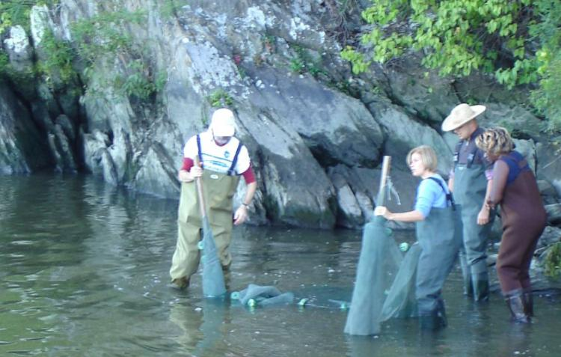
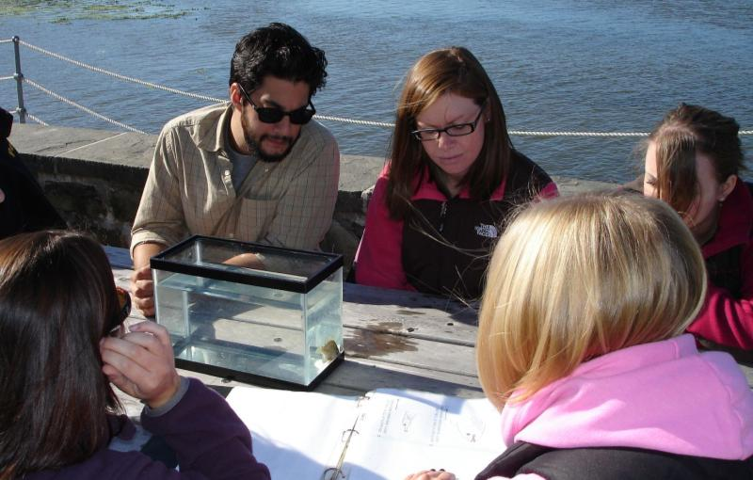
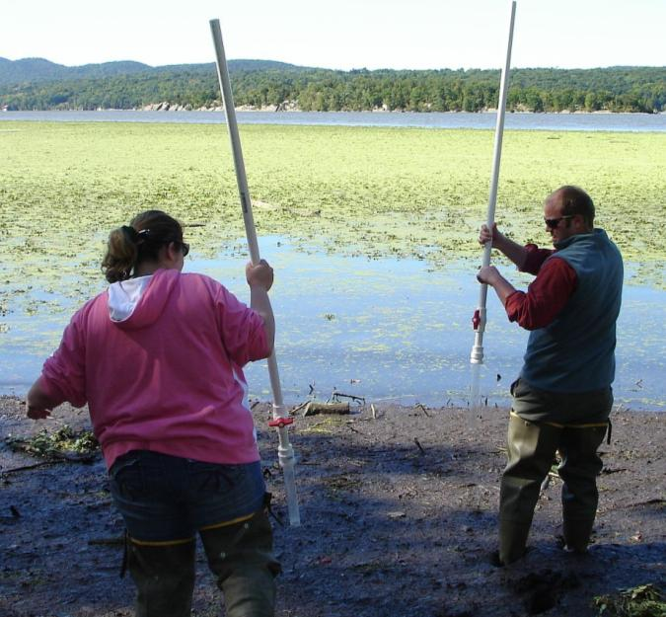
A Day in the Life of the Hudson River (Snapshot Day)
Saint Rose students attend a pre-event workshop at Norrie Point Environmental Center to learn standardized protocols
Notes:
List of Activities

Slide 11
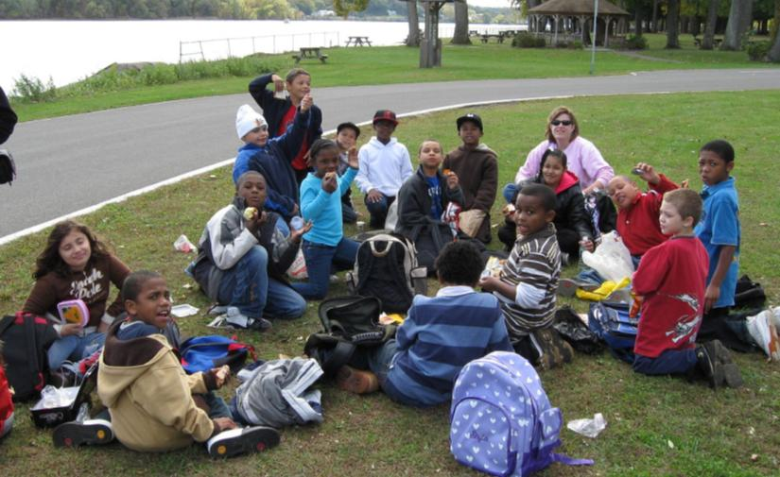
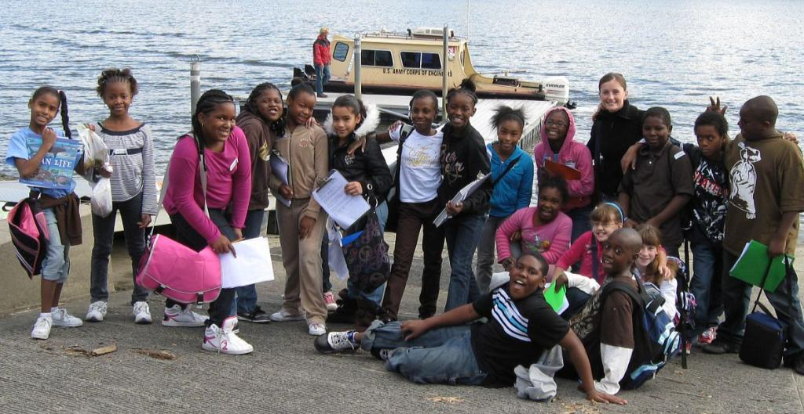
A Day in the Life of the Hudson River (Snapshot Day)
Saint Rose students work with 3rd and 5th grade students from Delaware Community School
Notes:
Attending training at an environmental education center prior to the day
Students went into a 3rd and 5th grade classroom and taught students how to use the equipment
During snapshot day, teachers were in charge of a particular activity and younger students collected the data

Slide 12
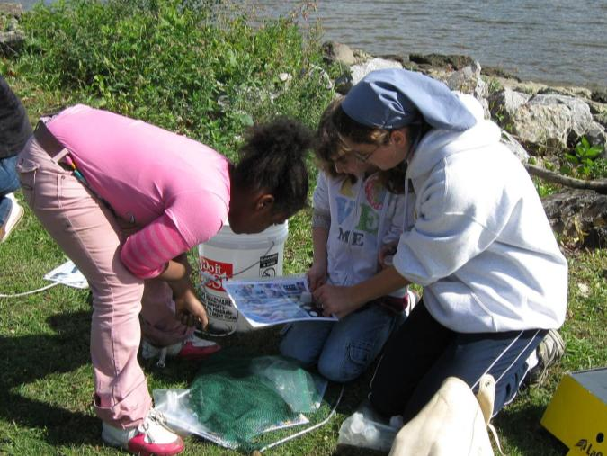
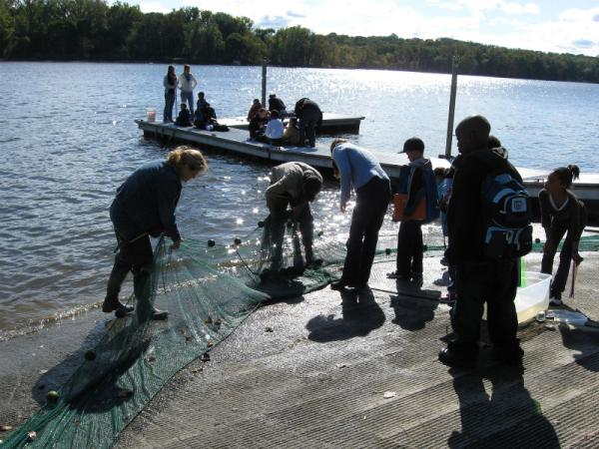
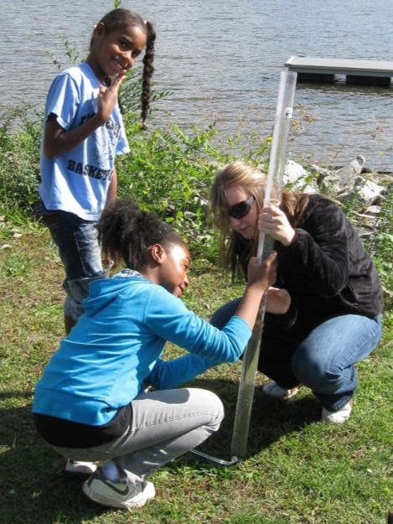
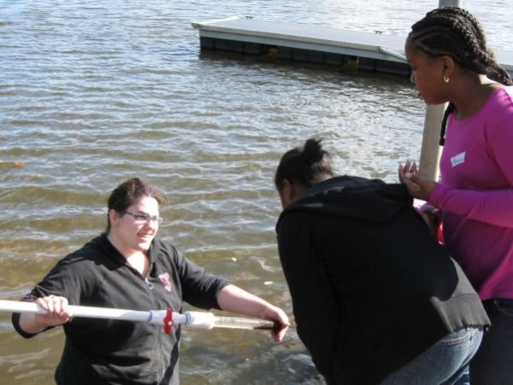
A Day in the Life of the Hudson River (Snapshot Day)
Saint Rose students working with 3rd and 5th grade students
Notes:
Students can use collected data in science-based, multidiscipline lesson (available online)

Slide 13
A Day in the Life of the Hudson River (Snapshot Day)
Student Reflections:
“ The children asked many questions that I did not expect….Teachers must be prepared for anything”
“It was a great experience for my peers and I because we got to teach science. It was my first time teaching science first hand and I definitely learned a lot”
“After the activity, I was very excited not only about becoming a teacher, but also about teaching science lessons to my future students. This activity helped me realize that science can be fascinating for students, and that it is my responsibility to foster that fascination”

Slide 14
Assessment of Service Learning
Based on a written reflection
Category | Questions | Weight
Requirements | 1. Describe the site of your community service. 2. Indicate how many students were impacted. 3. Provide a complete description of the project plan. 4. Describe the role you had in the project. | 15%
Content | Indicate the connection it has with the content or skills learned in Science100 or Science 200. | 40%
Reflection | 1. Describe the impact that the activity had on your own learning and the children’s learning. 2. Indicate if you think the activity was a success, give evidence to support your position. 3. Give several reasonable suggestions for ways to improve this activity. | 40%
Writing Style and Mechanics | The writing style and the writing mechanics should be correct and appropriate. | 5%
Notes:
How do you provide a grade for ‘service’?

Slide 15
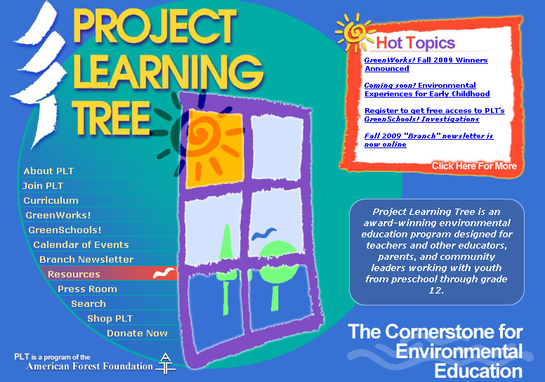
Where do we go from here?
Standardized activity – Project Learning Tree
  More control over the outcome but…
  Less contact with our other community partners
http://www.plt.org/

