Slide 1

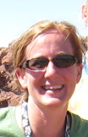
Making Recycling Work on Campus and in the Community
A service learning project for Introductory Environmental Geology
Ephraim, Utah
Renée Faatz
Associate Professor of Geology

Slide 2
Snow College Mission and Goals states:
The mission of Snow College is to
  educate students, inspire them to love learning, and lead them to serve others.
GOALS: #8.
  Enrich our communities through service learning, volunteer service, civic engagement, cultural and athletic events, community education, and outreach services.

Slide 3
To this end:
Service Learning Committee
  Representatives from each academic “division” and Student Life
  Part of Utah Campus Compact
Service Scholar Recognition Award
  Students may choose this option
  Must complete the following:
    An Integrated Service Project (ISP)150 Service Hours (100 from outside the ISP)
    8 Credit Hours of Service Learning Courses
Specific courses with SL suffix

Slide 4
Finding Community Partners
Service Learning Committee seeks and nurtures relationships with community:
  http://www.snow.edu/servicelearning/partnerlist.html
Ultimately individuals are uniquely qualified to find Community Partners for projects related to their discipline.

Slide 5
Finding Community Partners
Easy to find partners for others – social sciences, education.
My challenge has always been finding service learning opportunities and partners related appropriate for introductory, non-majors geology courses.

Slide 6
Project – Expand Recycling on Campus and in the community
My goals:
  to expand recycling on campus then later the community with the help of students from Environmental Geology class
  To integrate service learning in recycling to concepts of Energy, Waste and Resources in Environmental Geology
My partners:
  Bob Oliver - Snow College Director of Facilities
  Mike Duncan – Snow College Grounds Forman
  Paul Gardner – Snow College -Professor of Biology/Advisor Dead Cats/Campus Sustainability Committee Chairman
  Ephraim City Recycling Coalition
  Seven States Recycling

Slide 7
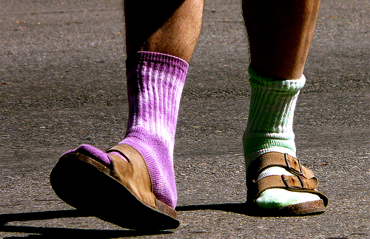
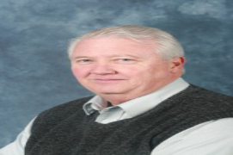
Some Background:
Obstacles:
  Snow College is located in a very rural community
  Landfill space is NOT an issue
  Conservative political views – recycling is for liberals
Advantages:
  A landfill 20 miles from the college
  Encourages recycling on campus
  A facilities director who supports recycling and is part of the Utah Recycling Coalition – Bob Oliver

Slide 8
Defining Goals/Finding Partners
1) Contact Director of Facilities – Bob Oliver
  What are we recycling on campus?
  Can we do more?
    What are the obstacles?
  Bob was very helpful in answering all these questions and directing me to the right people to help expand our project:
2) Contact Grounds Forman – Mike Duncan
  Mike is over white paper pick-up on campus
  Mike was very supportive and helped us expand white paper pick-up.

Slide 9
Defining Goals/Finding Partners - Continued
3) Contact Dr Gardner:
  Dead Cats Society already recycles aluminum
  Sustainability Committee – supports expanding recycling
4) Ephraim City Recycling Coalition
  Establishes a Recycling Center for “city”
  Arranges a company to pick up plastics, all paper, glass
5) Seven States Recycling
  Buys our aluminum
  Randy Keisel offers to bring aluminum container to campus and pick up there.

Slide 10
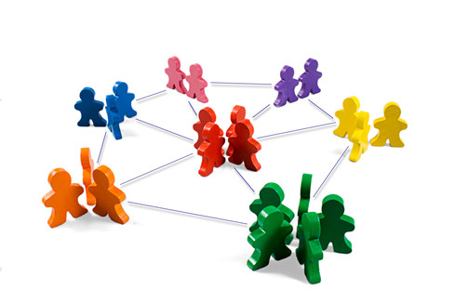
How did I find all these partners?

Slide 11
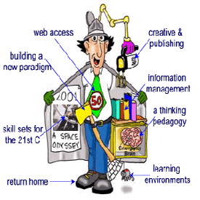
Maintaining Communications
Sustainability Committee and Recycling Coalition helped.
Ultimately it was up to me.
Finding the time!

Slide 12
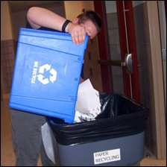
How students interacted with Partners
In this case the students interacted with:
  The recycle bins
  Faculty and Staff on campus
    (established office by office pick up for paper)
  Community
    Volunteered at Recycling coalition drop-off site

Slide 13
Advice on Finding and Keeping Partners
Establish need
  Discuss with partners what their dreams are
Establish goals/plan
  Attempt to meet their goals, not yours
  To what extent do they want student involvement?
  Are they willing to train students?
Feedback
  Communicate during the project
  Evaluate project and re-set goals for next time
Build face-to-face relationships
  Example: On-campus Aluminum bin
Add to the project SLOWLY
  Problems with Community recycling

Slide 14

More advice courtesy of http://www.phoenixgymnastics.ie
City Recycling “failed”
-Lack of company to pick up

Slide 15
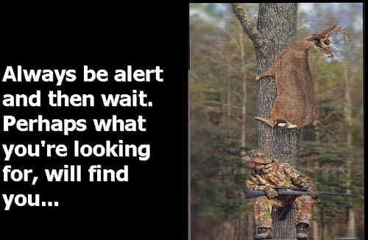
City Recycling failed (for now), but we discovered a company that will pick up ALL paper

Slide 16
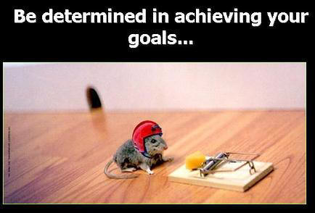
With Bob Oliver’s help we continue to look for opportunities to increase recycling for the campus and the community.

