Slide 1
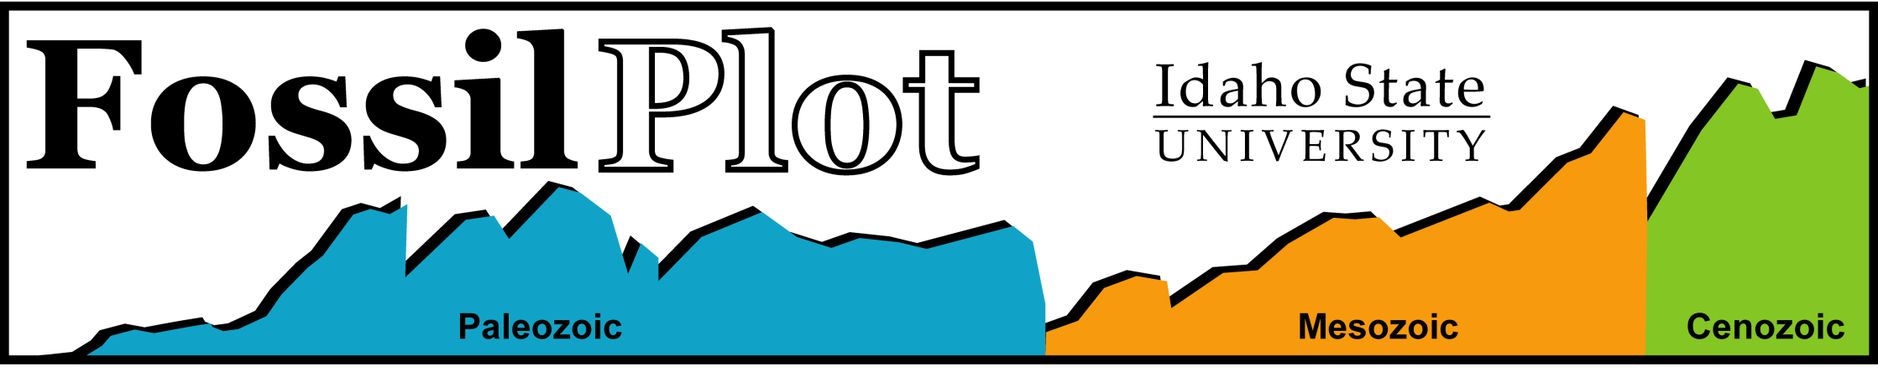
Ver. 1.1 Excel
Ver. 2.0 Web
John J. Sepkoski Jr. (University of Chicago)
  Database of ~36,000 genera (Bull. Amer Pal., 363)
  Lists taxonomy and stratigraphic ranges
  Marine animals only
  Limitations:
    Few soft-bodied animals
    No plants, algae, fungi, bacteria
    No terrestrial animals
  Used for recognizing evolutionary patterns

Slide 2

Make graphs of Sepkoski data
Static database, using current GTS, designed for student audience
Ver. 1.1 for MS Excel
Ver. 2.0 online Website
http://geology.isu.edu/FossilPlot/
4 main functions
DOX: Diversity, origination, extinction
  Count, Rate
Stratigraphic range
Limited time intervals
Limited of 4000 genera analyzed at one time.
http://www.fossilplot.org/
Previous DOX functions, with new
  Sepkoski Curves (Evol. Faunas)
  Rate calculations more flexible
New Period-specific graphs
Overall greater flexibility for time units
Greater computing capacity
  server-side computation permits all 36,000 to be analyzed
Funded by NSF through 2010.

Slide 3
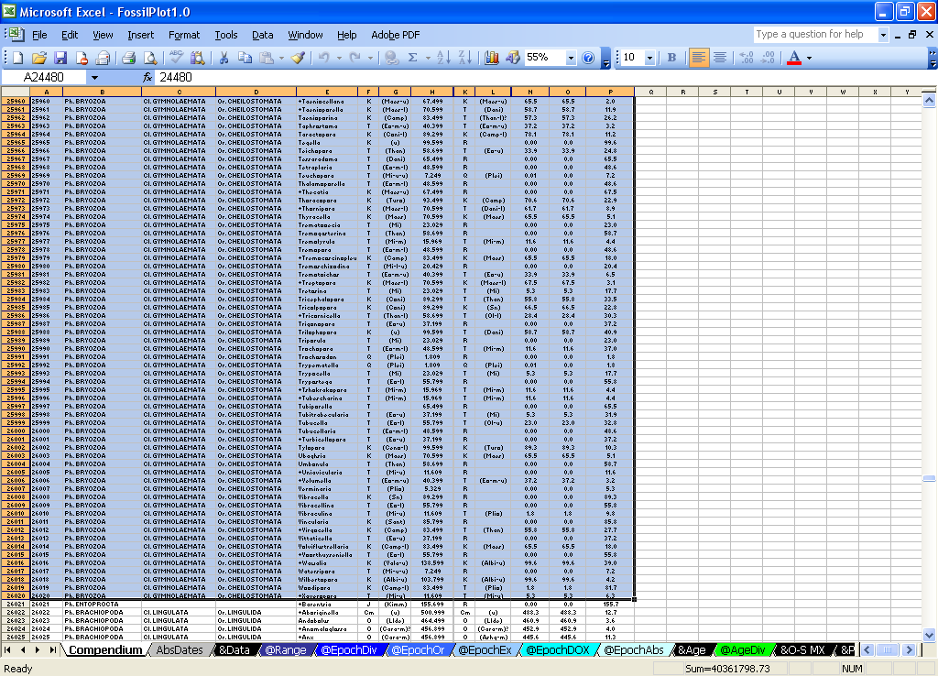
Speciation
Ver. 1.1 for Excel
Get your data
Select and copy group
from Compendium

Slide 4
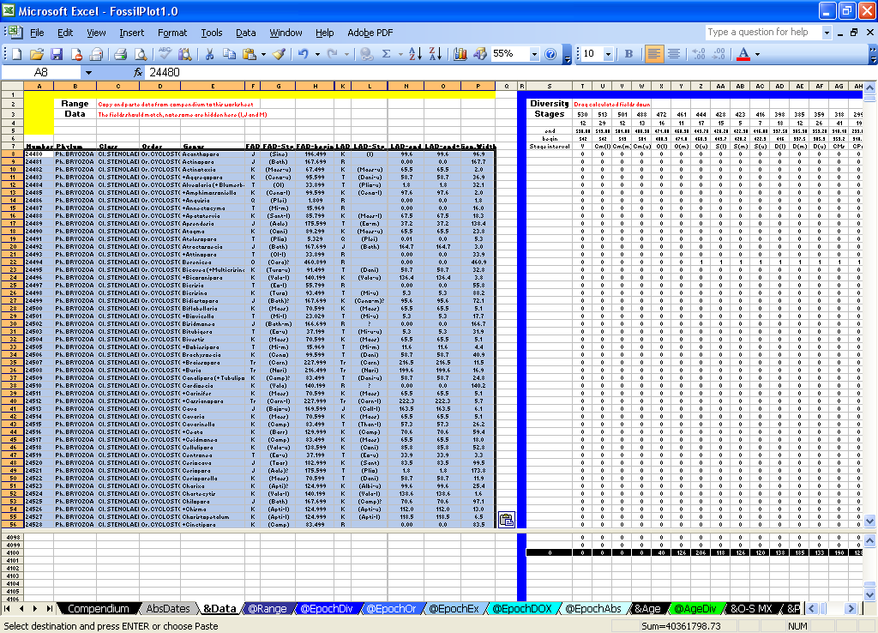
Speciation
Ver. 1.1 for Excel
Transfer the data
A8
Copy/Paste group in &Data at Cell A8

Slide 5
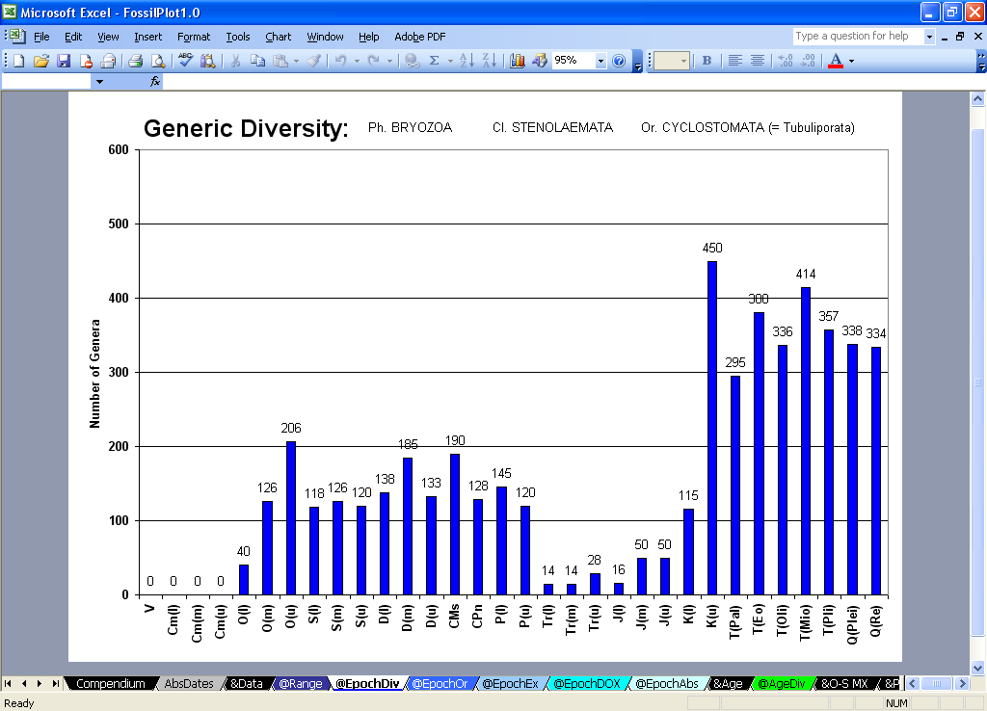
Speciation
Ver. 1.1 for Excel
Other graphs made by &Data

Slide 6
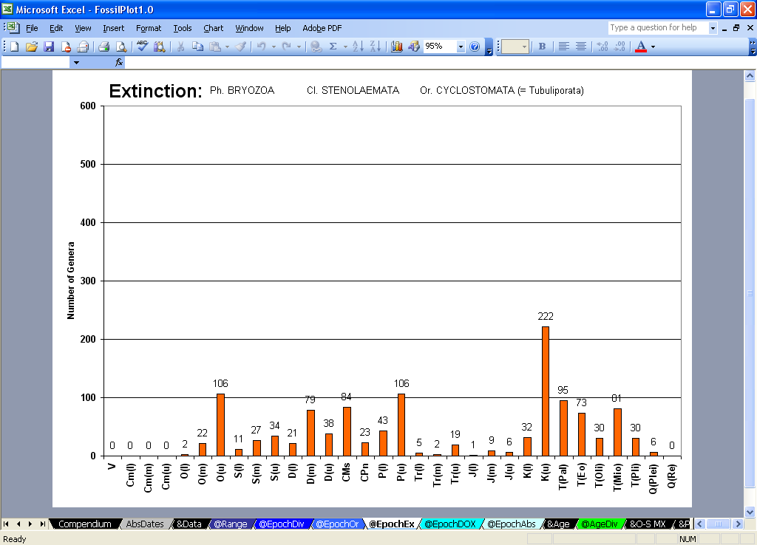
Speciation
Ver. 1.1 for Excel
Other graphs made by &Data

Slide 7
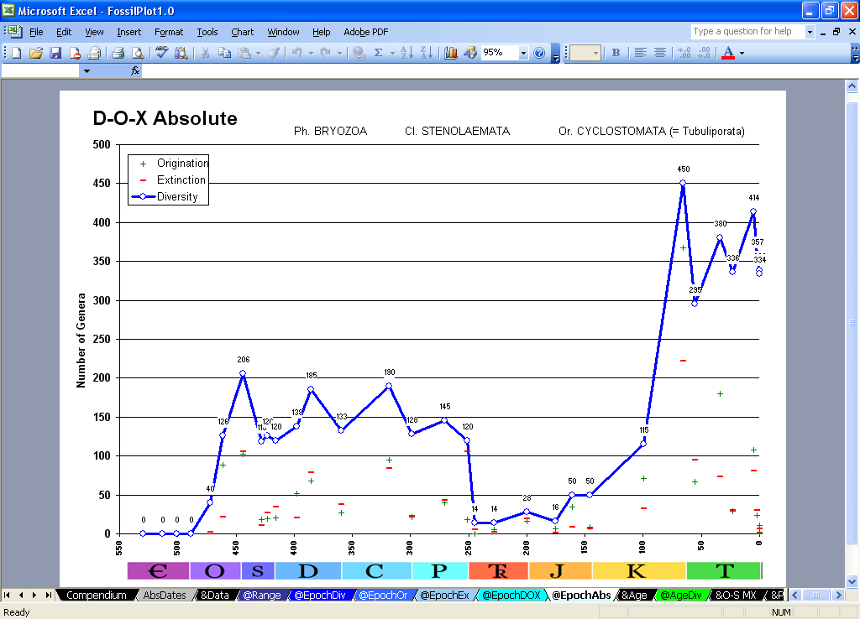
Speciation
Ver. 1.1 for Excel
Other graphs made by &Data

Slide 8
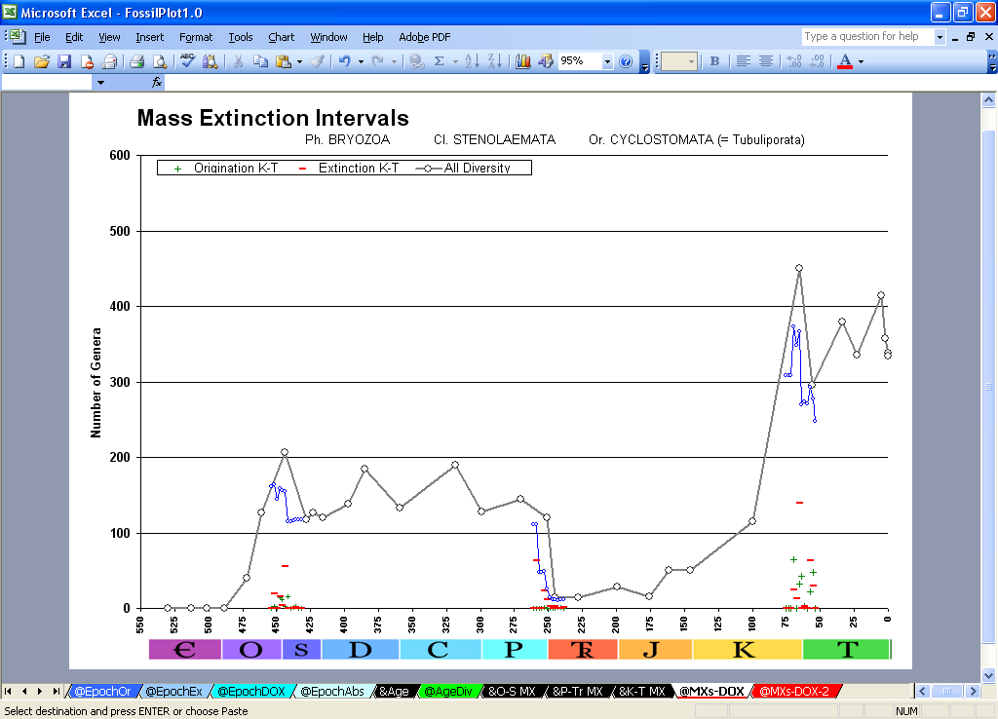
Speciation
Ver. 1.1 for Excel
The 3 Big mass extinctions
Blue line shows diversity at 2Ma interval, gray line shows Epoch intervals

Slide 9
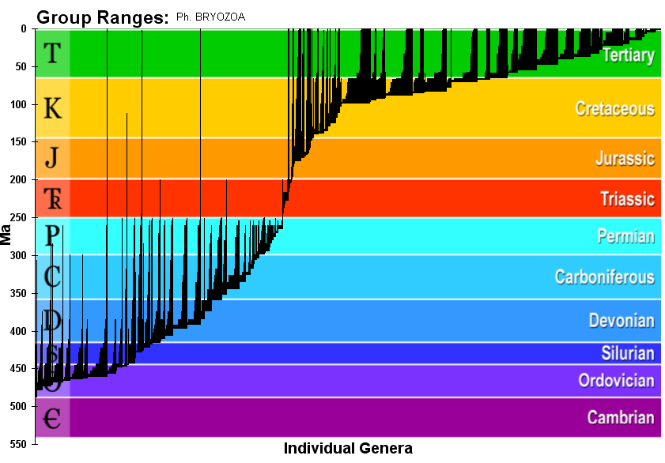
Paleography
Ver. 1.1 for Excel
Stratigraphic Ranges

Slide 10
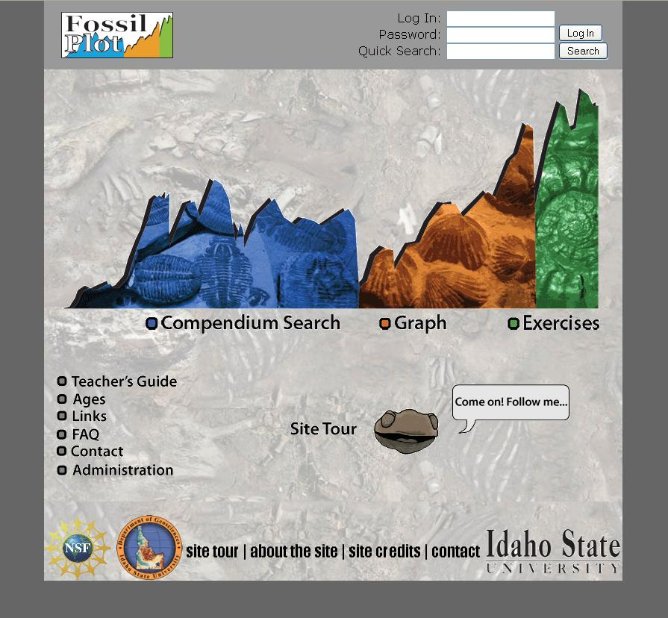
Ver. 2.0 Web
http://www.fossilplot.org/

Slide 11
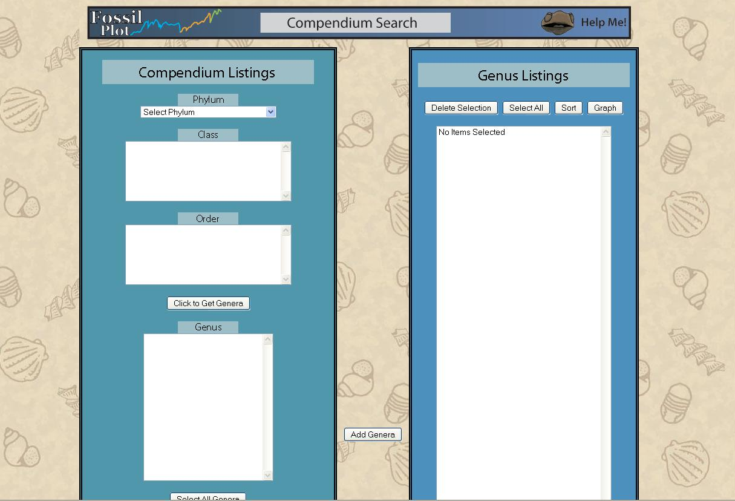
Ver. 2.0 Web

Slide 12
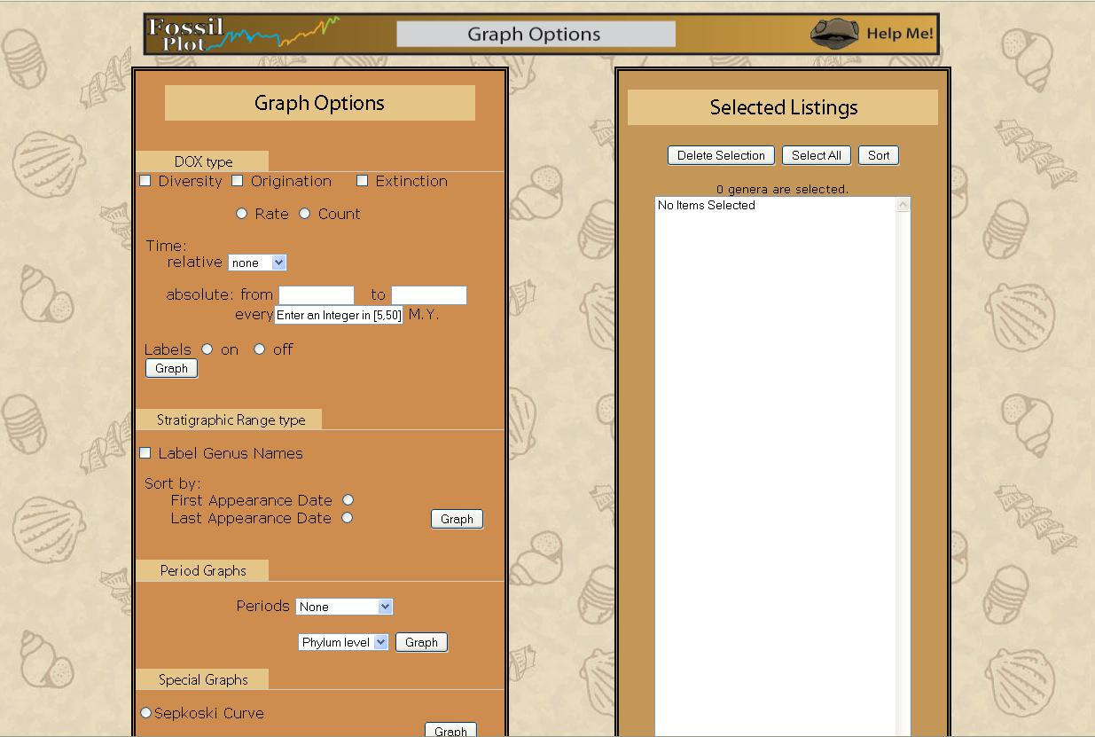
Ver. 2.0 Web

Slide 13
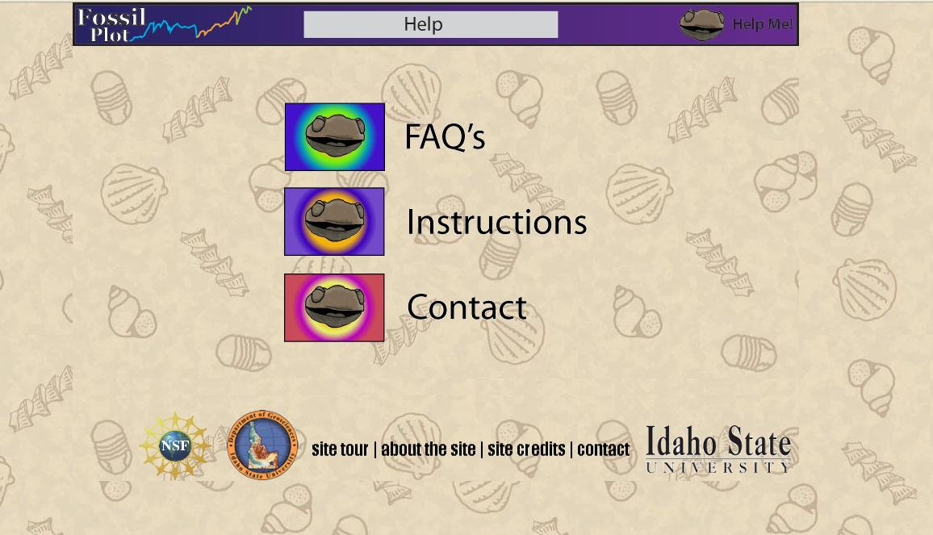
Ver. 2.0 Web

Slide 14
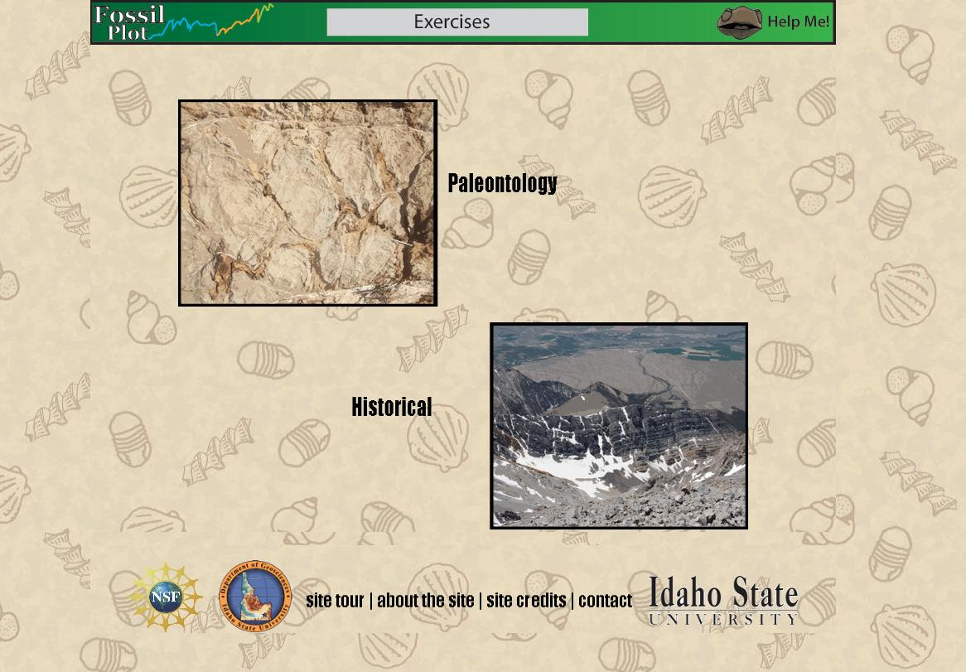
Ver. 2.0 Web

Slide 15
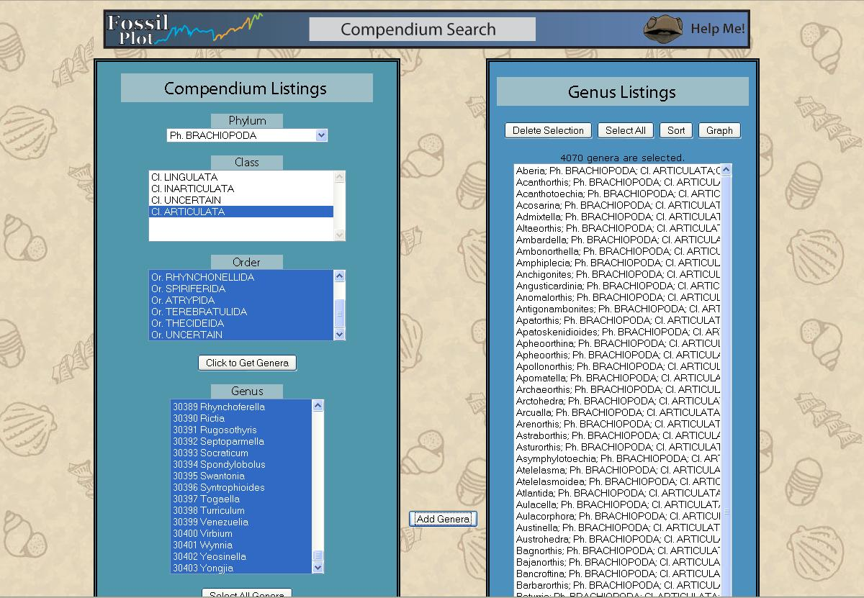
Ver. 2.0 Web

Slide 16
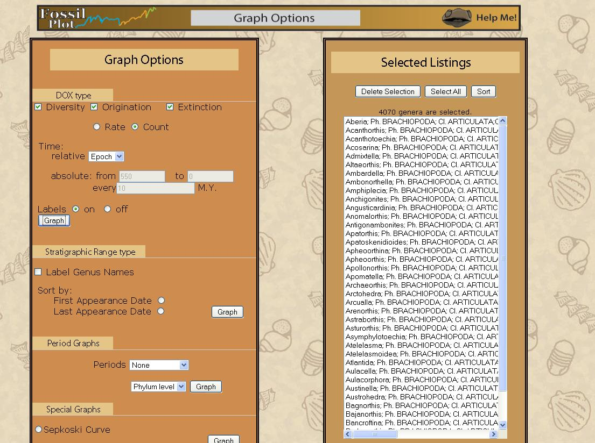
Ver. 2.0 Web

Slide 17
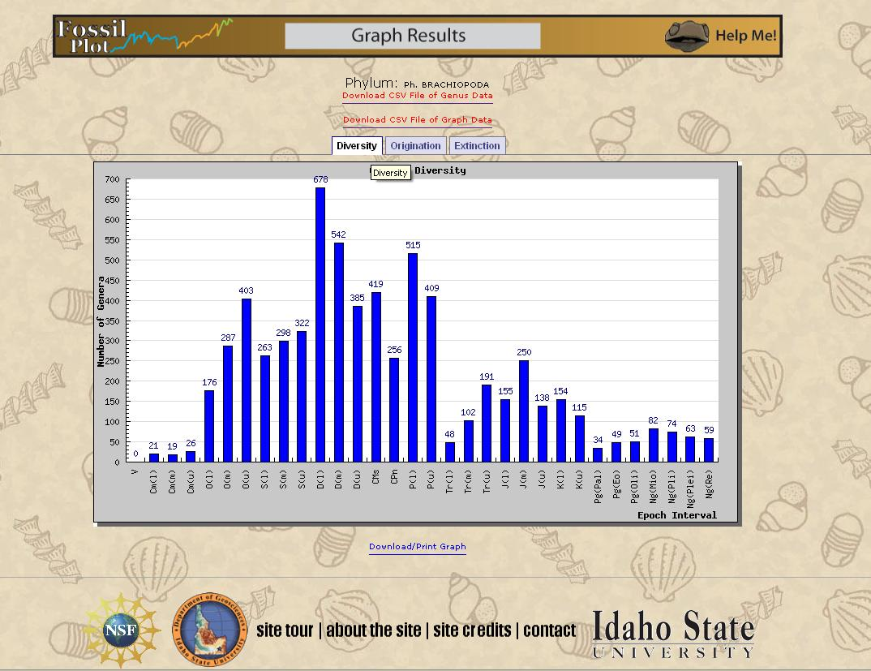
Ver. 2.0 Web

Slide 18
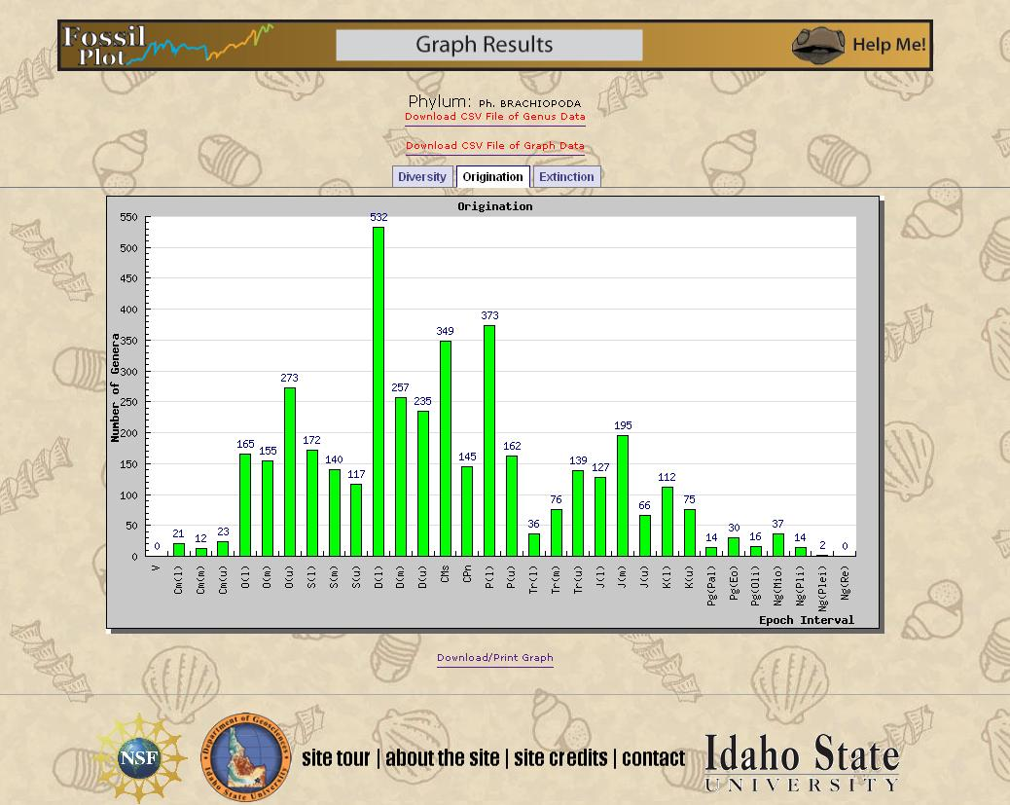
Ver. 2.0 Web

Slide 19
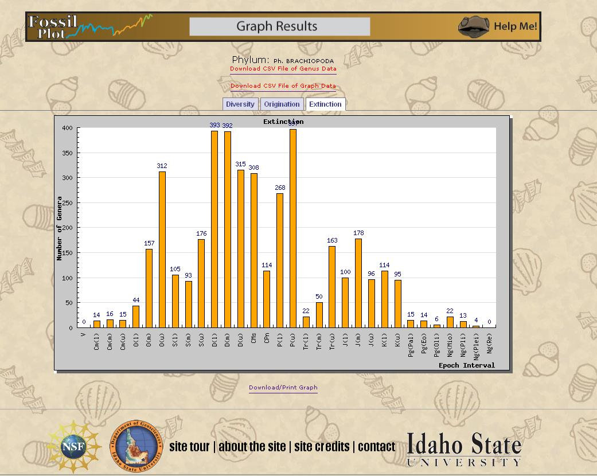
Ver. 2.0 Web

Slide 20
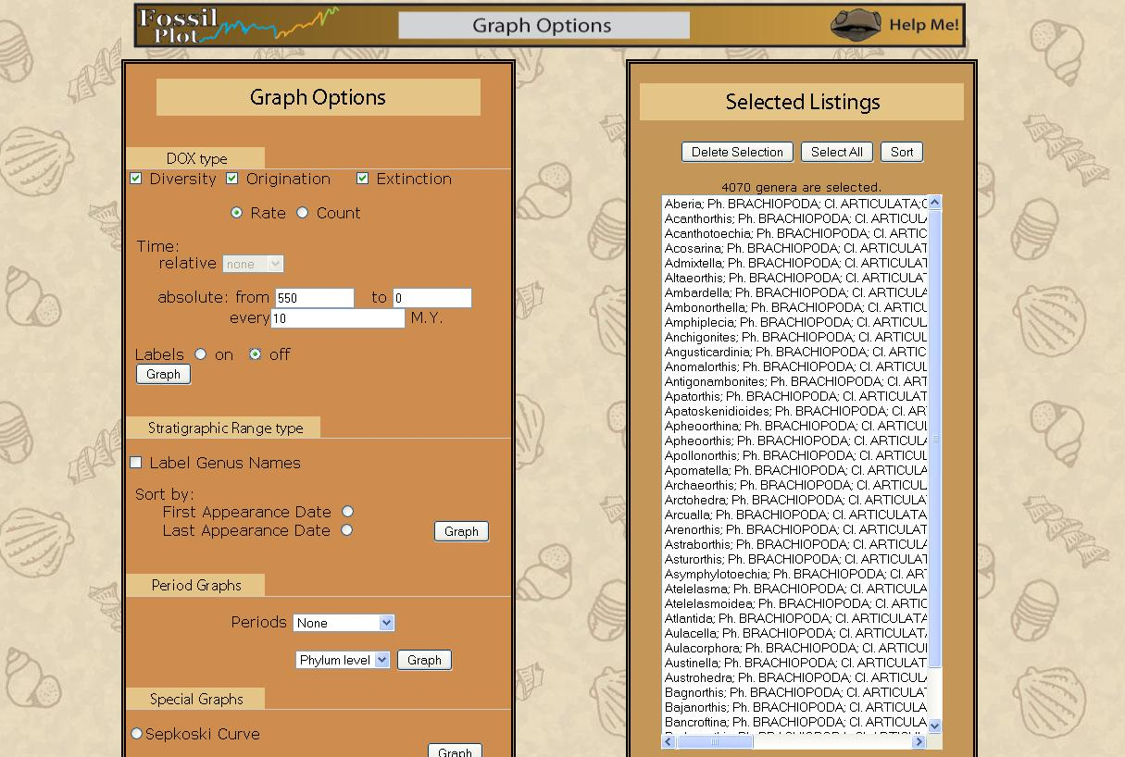
Ver. 2.0 Web

Slide 21
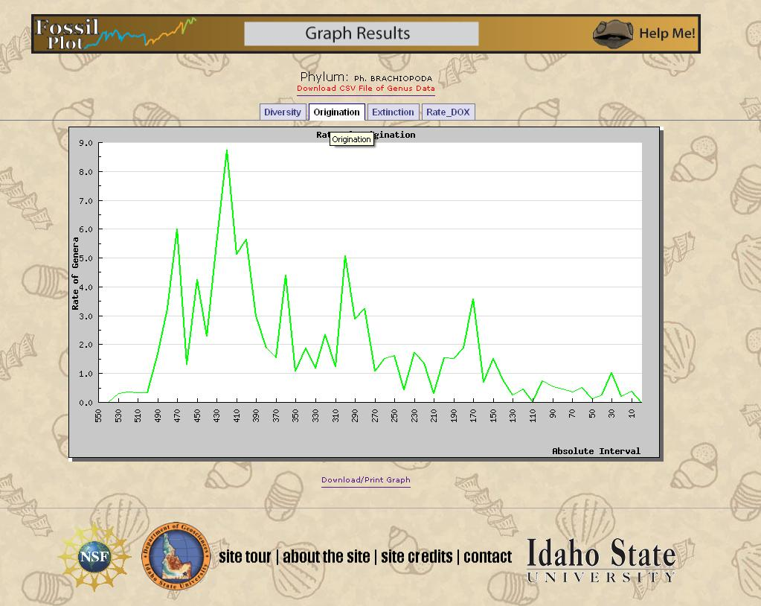
Ver. 2.0 Web

Slide 22
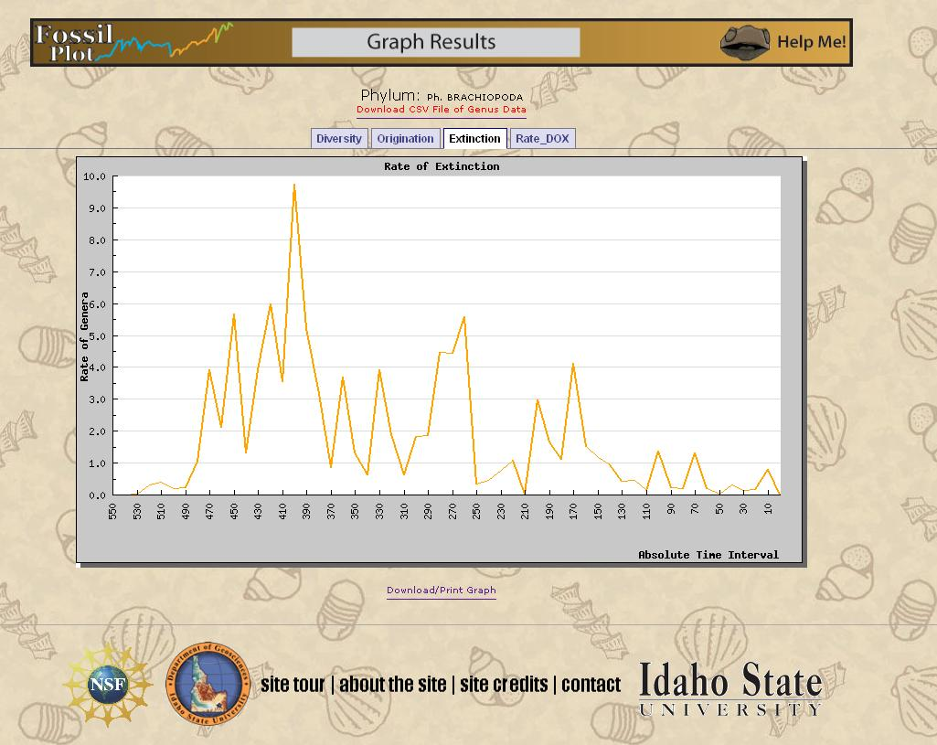
Ver. 2.0 Web

Slide 23
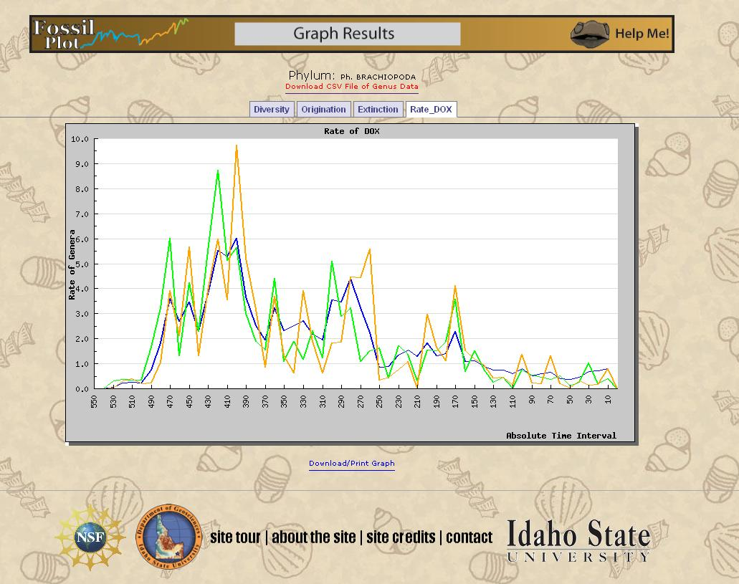
Ver. 2.0 Web

Slide 24
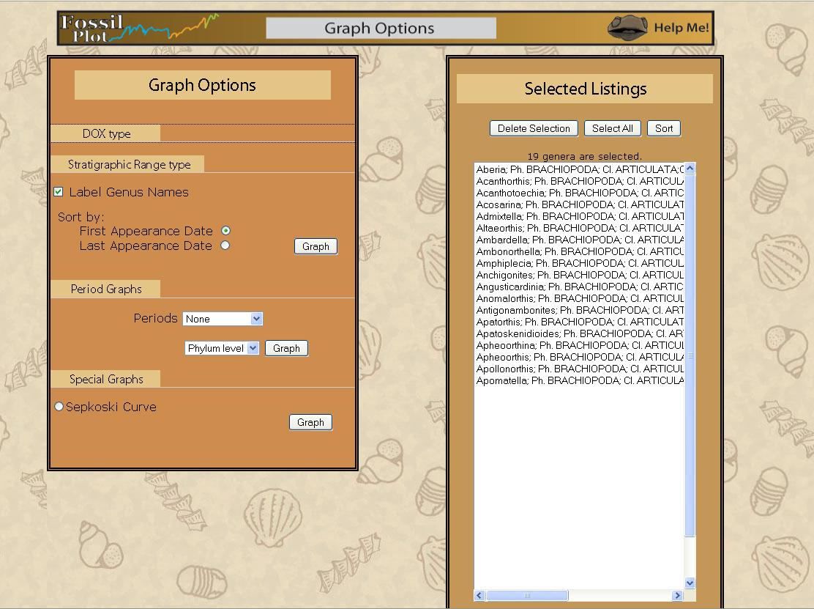
Ver. 2.0 Web

Slide 25
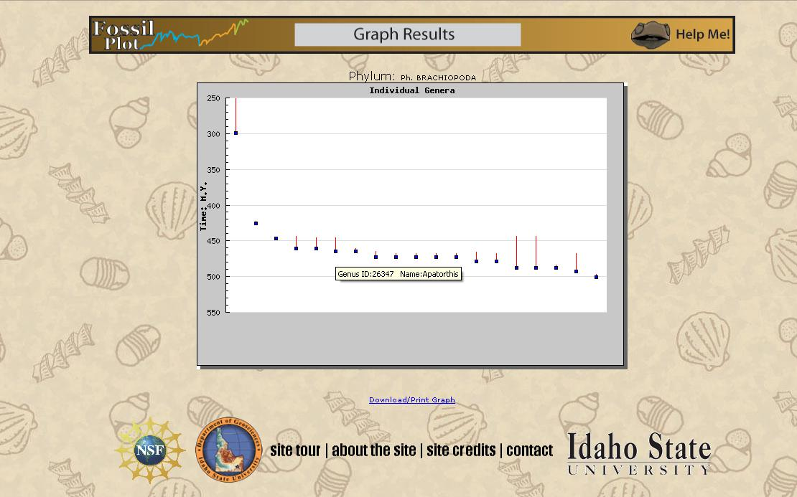
Ver. 2.0 Web

Slide 26
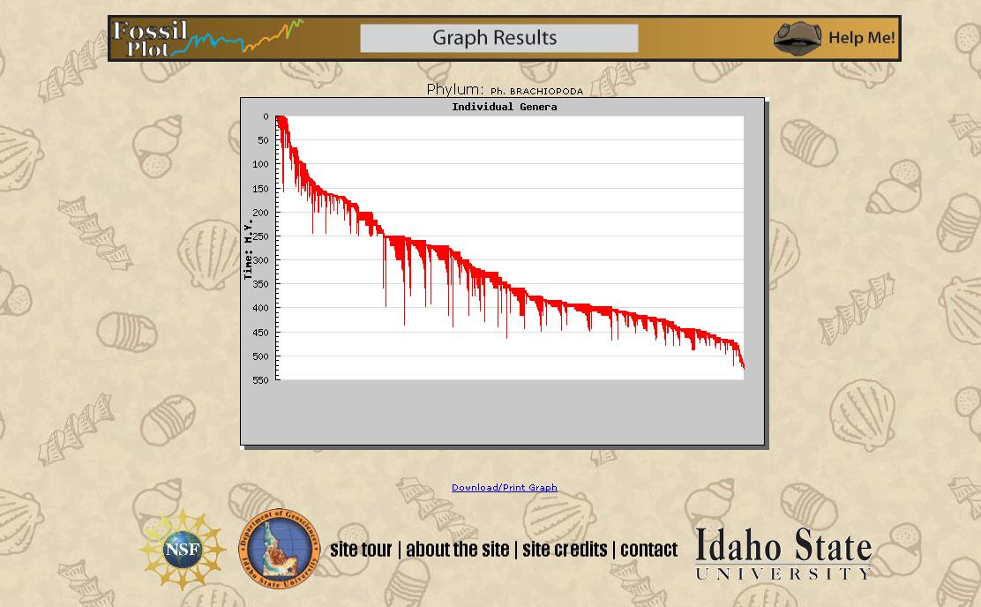
Ver. 2.0 Web

Slide 27
Ver. 2.0 Web

Slide 28
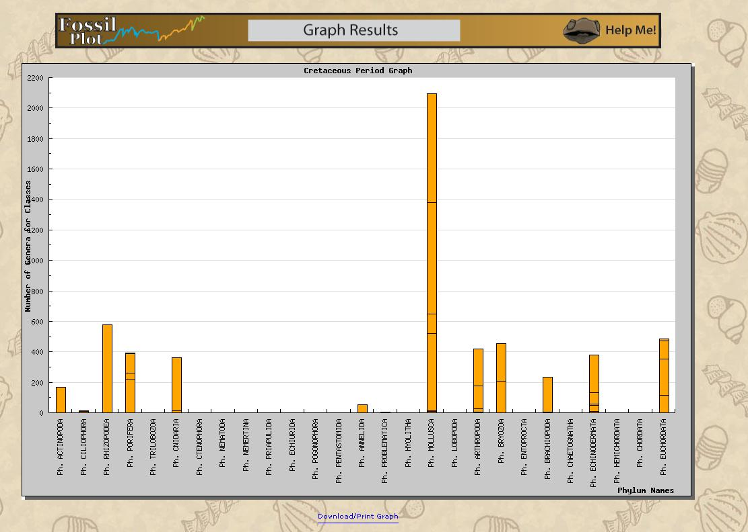
Ver. 2.0 Web

Slide 29
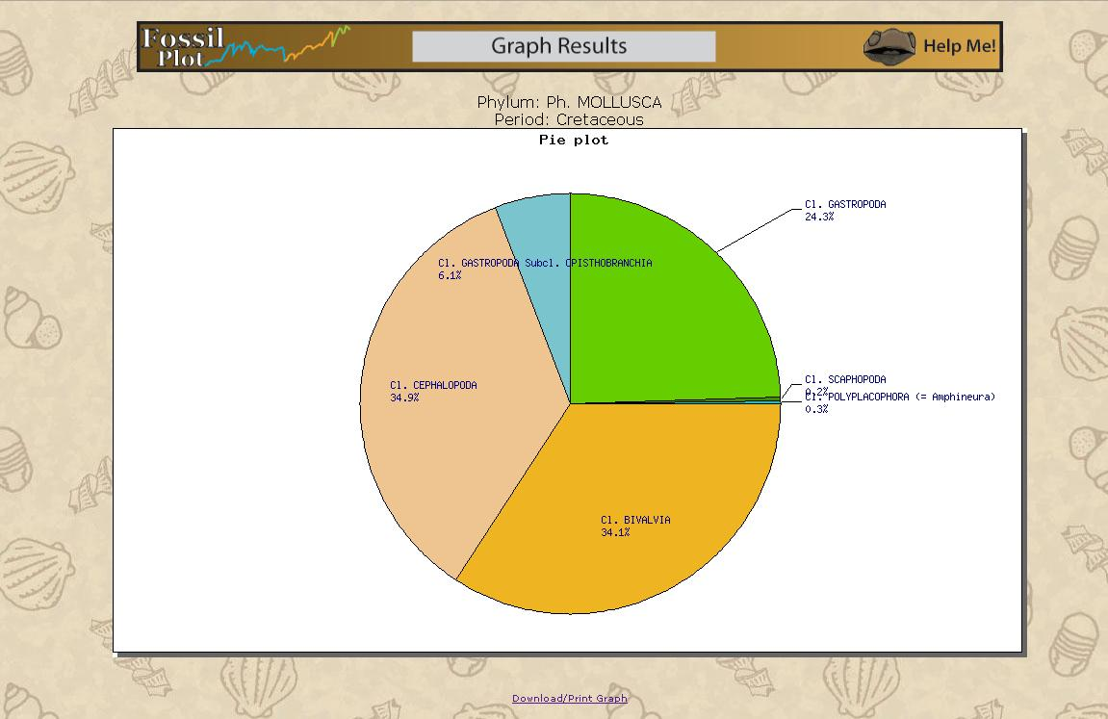
Ver. 2.0 Web

Slide 30
Ver. 2.0 Web

Slide 31
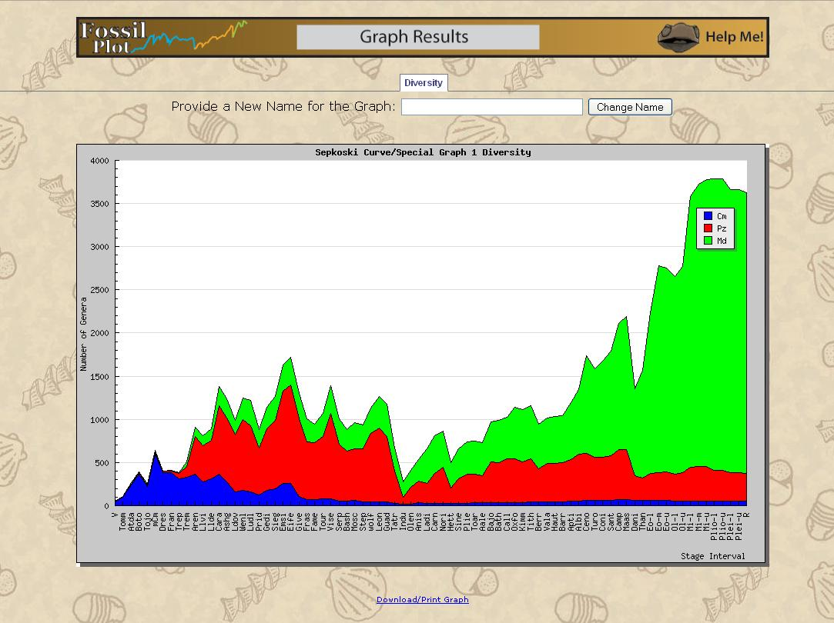
Ver. 2.0 Web

Slide 32
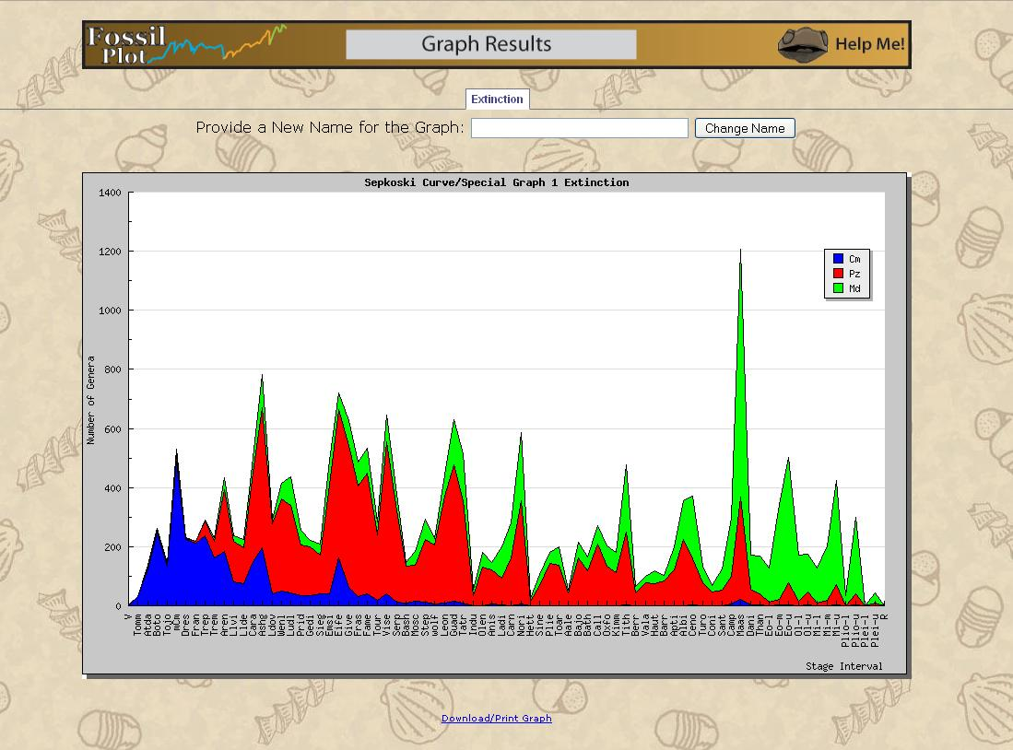
Ver. 2.0 Web

Slide 33
Sepkoski Curve E.F.s
Cambrian
Paleozoic
Modern
Polychaeta
Hyolitha
Orthothecimorpha
Hyolithomorpha
Tergomya
Heliconelloida
Trilobita
“Inarticulata”
Eocrinoidea
“Hyolithida” indet.
Anthozoa
Cephalopoda
Ostracoda
Stenolaemata
"Articulata"
Asteroidea
Crinoidea
Blastoidea
Demospongia
Gastropoda
Bivalvia
Malacostraca
Gymnolaemata
Echinoidea
Chondrichthyes
Osteichtheyes

