Slide 1
Range-Through Chart and Diversity Curve Lab
Dr. Kate Bulinski
Bellarmine University

Slide 2
Geology for Non-Science Majors
Meets for 2 hours twice a week
First hour lecture, second hour lab
Lab reinforces concepts introduced in lecture
Limited to 20 students
Students work in groups of 3-4

Slide 3
Objectives of Lab
Reinforce knowledge about major paleontological events
  Diversifications
  Mass Extinctions
Increase familiarity with the geological time scale
Increase familiarity with major groups of organisms
Implement the use of Microsoft Excel for graphing

Slide 4
Next:
Sample Lecture Slides

Slide 5
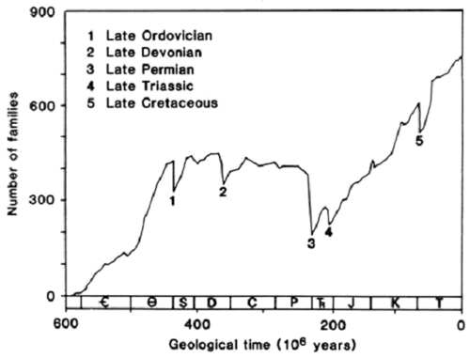
Fossil Diversity Through Time
The Jack Sepkoski Curve

Slide 6
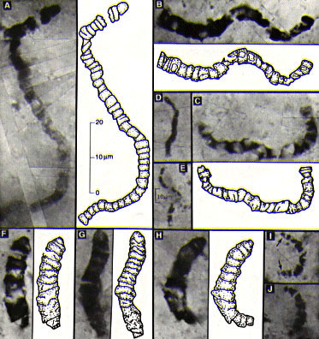
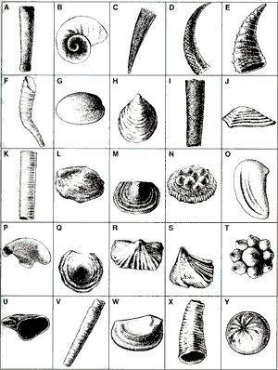
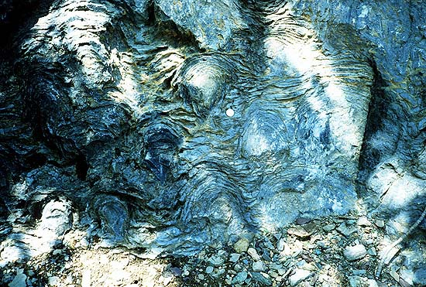
Precambrian
-3.8 billion years ago, earliest evidence of life
-First fossils, 3.4 billion years ago
Stromatolites

Slide 7

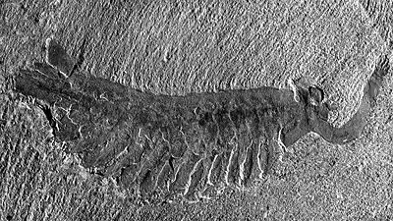
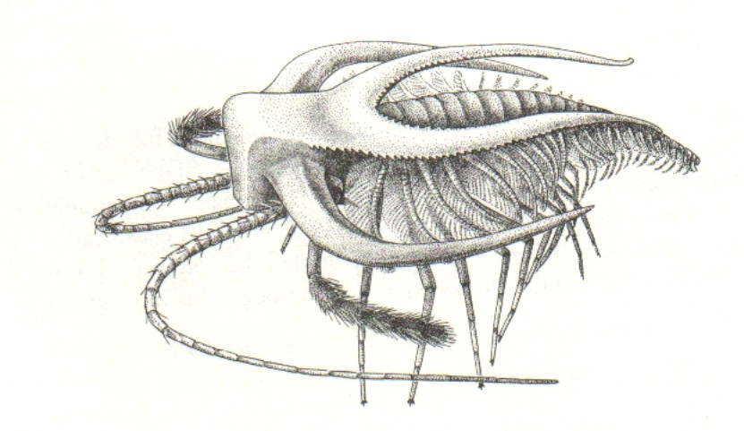
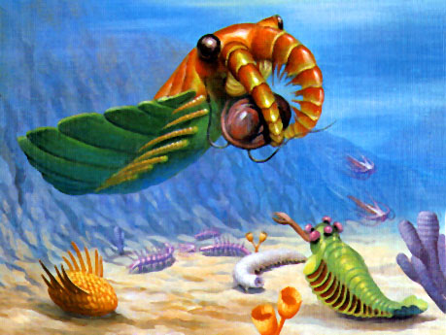
Cambrian Explosion
-Major diversification of muticellular life
-Many bizarre animals that went extinct

Slide 8
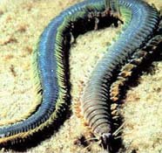
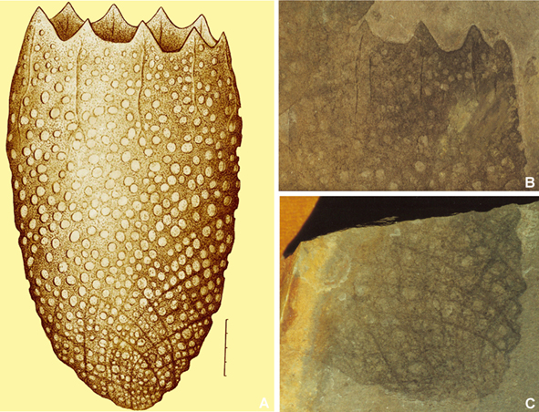
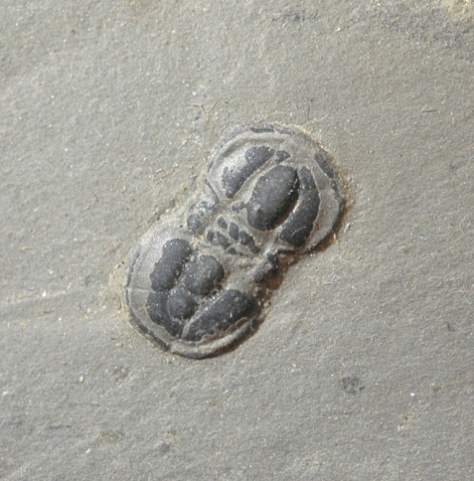
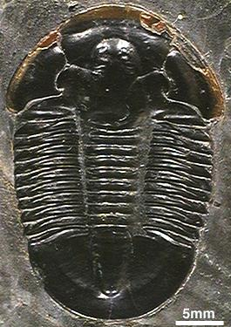
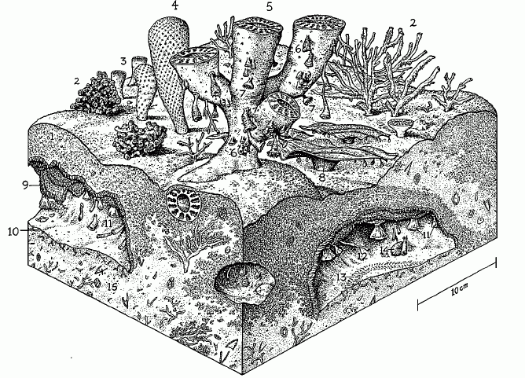
Cambrian

Slide 9
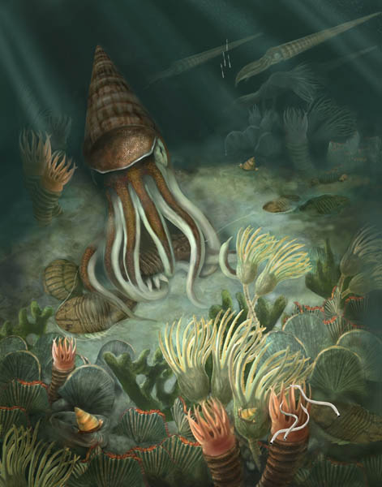
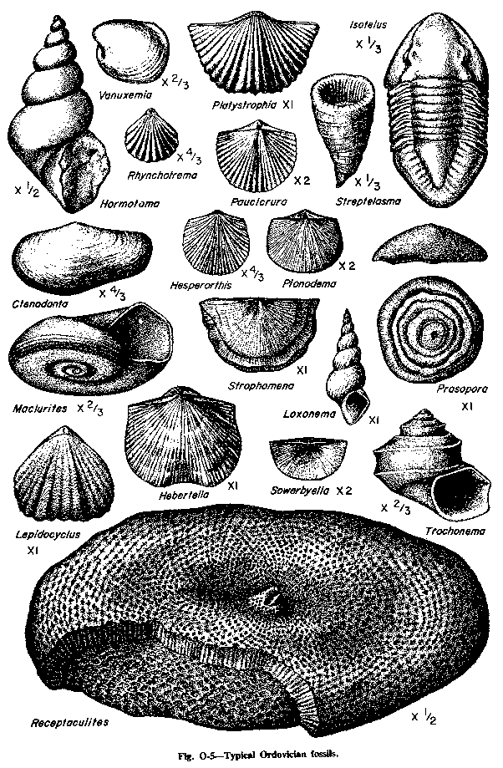
Ordovician Radiation
-Second major diversification

Slide 10
Lab Components:
Understanding the concept of “Range”
Time of Origination
Time of Extinction
Persists throughout interval even if not found consistently
Difference between fossil record and biological record

Slide 11
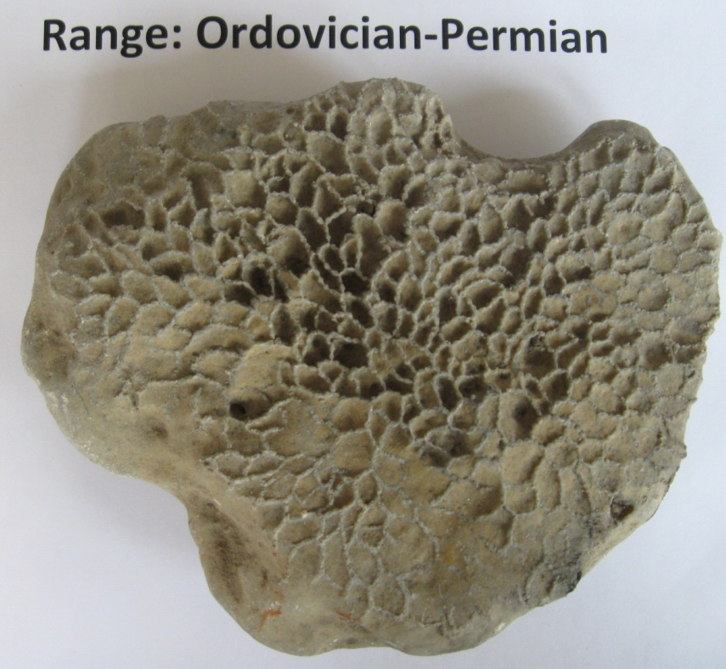
Linking Names to Fossils
Previous knowledge obtained from systematics lab can be reinforced here:
  Students must correctly identify hand specimens to pair times of origination and extinction with names of fossil groups

Slide 12
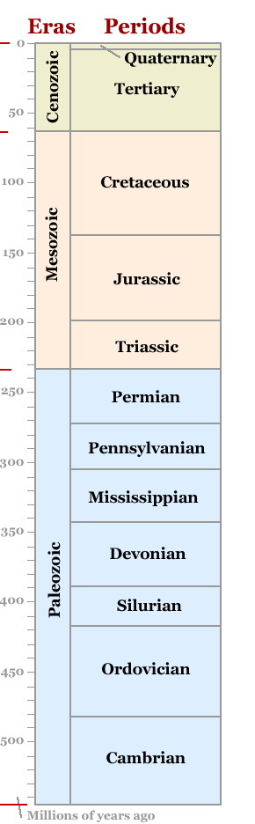
Plotting
Ranges
Geological
Time Scale
(modified from geology.com)
Range Through Chart
Carboniferous
Write Taxon Names Here→

Slide 13
Plotting
Ranges
Geological
Time Scale
(modified from geology.com)
Range Through Chart
Fossil 1 Class Edrioasteroidea Range: Cambrian-Permian
Fossil 2 Class Articulata Range: Cambrian- Recent
Fossil 3 Subclass Ammonoidea Range: Silurian-Cretaceous
Fossil 4 Order Rugosa Range: Ordovician-Permian
Fossil 5 Order Tabulata Range: Ordovician-Permian
Fossil 6 Class Blastoidea Range: Ordovician-Permian
Fossil 7 Class Rostroconchia Range: Cambrian-Permian
Fossil 8 Class Gastropoda Range: Cambrian- Recent
Fossil 9 Class Stenolaemata Range: Ordovician-Recent
Fossil 10 Class Trilobita Range: Cambrian-Permian
Fossil 11 Order Scleractinia Range: Triassic- Recent
Fossil 12: Class Crinoidea Range: Ordovician- Recent
Fossil 13 Class Echinoidea Range: Ordovician-Recent
Fossil 14 Class Bivalvia Range: Cambrian-Recent
Fossil 15 Subclass Nautiloidea Range: Cambrian- Recent
Fossil 16 Class Stromatoporata Range: Ordovician-Cretaceous
Fossil 17 Class Eurypterida Range: Cambrian-Permian
Fossil 18 Class Graptolithina Range: Cambrian-Carboniferous
Fossil 19 Class Conodonta Range: Cambrian-Triassic
Fossil 20: Class Insecta Range: Silurian-Recent
Carboniferous
Write Taxon Names Here→

Slide 14
Plotting
Ranges
Geological
Time Scale
(modified from geology.com)
Range Through Chart
Fossil 1 Class Edrioasteroidea Range: Cambrian-Permian
Fossil 2 Class Articulata Range: Cambrian- Recent
Fossil 3 Subclass Ammonoidea Range: Silurian-Cretaceous
Fossil 4 Order Rugosa Range: Ordovician-Permian
Fossil 5 Order Tabulata Range: Ordovician-Permian
Fossil 6 Class Blastoidea Range: Ordovician-Permian
Fossil 7 Class Rostroconchia Range: Cambrian-Permian
Fossil 8 Class Gastropoda Range: Cambrian- Recent
Fossil 9 Class Stenolaemata Range: Ordovician-Recent
Fossil 10 Class Trilobita Range: Cambrian-Permian
Fossil 11 Order Scleractinia Range: Triassic- Recent
Fossil 12: Class Crinoidea Range: Ordovician- Recent
Fossil 13 Class Echinoidea Range: Ordovician-Recent
Fossil 14 Class Bivalvia Range: Cambrian-Recent
Fossil 15 Subclass Nautiloidea Range: Cambrian- Recent
Fossil 16 Class Stromatoporata Range: Ordovician-Cretaceous
Fossil 17 Class Eurypterida Range: Cambrian-Permian
Fossil 18 Class Graptolithina Range: Cambrian-Carboniferous
Fossil 19 Class Conodonta Range: Cambrian-Triassic
Fossil 20: Class Insecta Range: Silurian-Recent
Carboniferous
Write Taxon Names Here→

Slide 15
Constructing Diversity Curve
Tally up the number of genera present in a period
 | Extant Genera
Cambrian | 11
Ordovician | 17
Silurian | 19
Devonian | 19
Carboniferous | 19
Permian | 18
Triassic | 12
Jurassic | 11
Cretaceous | 11
Cenozoic | 9
Recent | 9

Slide 16
Diversity Curve
 | Extant Genera
Cambrian | 11
Ordovician | 17
Silurian | 19
Devonian | 19
Carboniferous | 19
Permian | 18
Triassic | 12
Jurassic | 11
Cretaceous | 11
Cenozoic | 9
Recent | 9
Geologic Time Labled at Ends of Periods

Slide 17
Discussion and Short-Answer Lab Questions
1) Based on the range chart you constructed, when does the largest extinction event occur and how many of the twenty organisms go extinct then?
2) What caused this extinction?
3) Which major extinction caused ammonoids to go extinct? What caused this extinction?
4) During what geological period do the most taxa originate and what is the name of this origination event?
5) During what geological period to the second largest number of taxa originate and what is the name of this event?

Slide 18
Discussion and Short-Answer Lab Questions
6) Notice when the three orders of coral originate and go extinct. Explain in a few sentences what the fossil record of corals looks like.
7) How many of the 20 taxa are extant today?
8) Provide three similarities and three differences between the diversity curve you generated and the Sepkoski Curve. Why are they different?
9) If you constructed a range through chart of fossil genera, would you expect their ranges in the fossil record to be longer or shorter? Why?
10) Why do you not find many fossils in the rock record before the Cambrian?

Slide 19
Potential Modifications
For intro-level students:
Use specific taxonomic group to construct a diversity curve
  (e.g., genera within Class Bivalvia)
Genera of fossils found within a given rock interval
Index fossils vs. non-index fossils

Slide 20
Potential Modifications
For upper-level students:
-each group or individual is assigned a class of organisms and must construct a genus-level diversity curve for comparison with other groups
-students will determine genus ranges using the Paleobiology Database (www.paleodb.org)
-provide guidelines for:
-number of genera to include
-resolution of the geological time scale
(i.e., epochs vs. periods vs. PaleoDB 10my time bins)

Slide 21
Questions?

