Slide 1
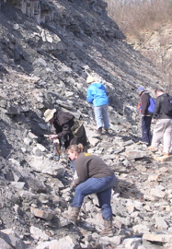
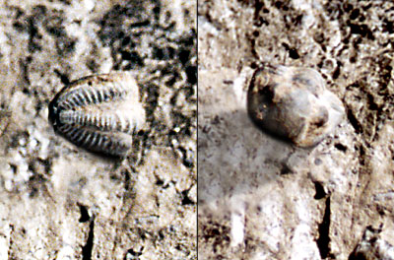
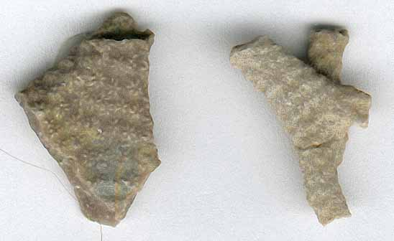
Geology 350/Biology 350 INVERTEBRATE PALEONTOLOGY
FIELD PROJECT: FOSSIL COLLECTING, IDENTIFICATION, AND REPORT WRITING
Stephen A. Leslie, Department of Geology and Environmental Science, James Madison University, Harrisonburg, VA
INTRODUCTION
The primary purpose of this exercise is to assemble a collection of fossils and to gain experience in fossil identification. This exercise is designed to sharpen the observational skills that students are steadily developing through examination of laboratory specimens. Further students apply the scientific method of hypothesis formulation and testing in the identification process. Lastly, this exercise will help students to develop writing, computer drafting and organizational skills.
Grading of the reports is based on accuracy of the identifications, readability of the illustrations, report language, and adherence to guidelines.
LOCALITY
I take the students to the field trip is to highly fossiliferous localities in the Cincinnati arch area to collect Ordovician fossils. There are generally plenty of areas near most universities. When I was at Little Rick, I used a Pennsylvanian locality and provided primary literature to help the students.
Specific locality information and stratigraphic units is discussed the field trip. To help identify the fossils that I have the students use:
Davis, R.A. (ed). 1985. Cincinnati Fossil: an elementary guide to the Ordovician rocks and fossils of the Cincinnati, Ohio, region. Cincinnati Museum of Natural History., Popular Publication Series, No. 10. 61 p.
Holland, S.M. 2001. www.uga.edu/~strata/cincy/ This is a web page by Steve Holland that is an excellent resource.
PROCEDURE
Students must collect at least 8 fossil genera representing 4 different “major groups” are to be collected and illustrated.
  Examples of major groups are: Porifera, orders within Cnidaria, classes within Bryozoa, orders within Brachiopoda, Hemichordata, Problematica, trace fossils, classes within the Arthropoda, and classes within Mollusca.
  Illustrations should be either drawings or good photographs (high-quality, contrasty, black-and-white images). If necessary, students may want to enhance the quality of the lines on their drawings with a thin black pen.
Final report must be single-spaced and arranged in this manner: title page, location and stratigraphy, fossil identifications, reference(s) cited, plate description, plate. It must be word-processed, handwritten and typewritten reports are not acceptable. If students do not own a computer, machines are available for your use in the JMU Computer Lab and the Geology Computer Lab. The report should not exceed seven pages; verbosity will not be appreciated.
  The title page must list your name, title of project, semester, and year.
  The location and stratigraphy section must indicate where your fossils were collected, when they were collected, and from what stratigraphic unit(s) they were collected. If more than one locality was used to assemble the collection, you must also indicate in the fossil identification section the locality and stratigraphic unit that yielded each specimen you illustrate.
  The fossil identification section must include an identification of each illustrated specimen, illustration number, a concise general description of the specimen (including whether it is a piece of a larger specimen), why you assigned it to the genus that you did, what published source you consulted for the identification, and, locality and stratigraphic information. Avoid long descriptions, wordiness, etc. Identifications should be to the genus level, although in some cases you also may be able to identify the species. If you are not sure of the generic identification, you may use a question mark following the name (this indicates the type of uncertainty that is common in scientific studies). As long as the identification is reasonably close, students receive credit. The description should be short, concise, and in this general format (the description is just an example):
Phylum Arthropoda
Class Trilobita
Order Polymerida
Family ?
Kaskia sp.
Pl. 1, fig. 1
A small trilobite cephalon is similar to specimens illustrated in Freeman (1966). The specimen has an expanded glabella and a very reduced frontal area; large palpebral lobes; opisthoparian facial suture; genal spines are 2 cm long. Collected from the Pitkin Limestone, Van Buren County, Arkansas, Locality 1.
  Reference(s) cited must be a single, separate page, listing all the published papers you consulted in order to identify you fossils. If you used only one source, list it.
  Plate description must be a single, separate page, with concise descriptions of figures in the following format. Magnification of the illustration must be indicated.
Plate 1
Illustrations need not be perfect, but should be sufficiently clear and detailed so that I can check the identifications without looking at the actual fossils. Illustrations should be assembled onto a single plate.
Number each illustration on the plate (1, 2, 3, ..., 7). Use a sans-serif font, such as Helvetica or Geneva; point size should be 12 or 14.
Figure 1
Figure 2
Figure 3
Figure 4
A Few Thoughts
I have done this project each time I have taught a paleontology course for the past 14 years. My experience is that students enjoy collecting the material themselves, that they enjoy the challenge of identifying what they have collected, and that they retain much more of the information that I teach in lab by applying the terminology learned to specimens that they collected. I have done a variety of formats of this exercise, including doing 3 trips to areas in Arkansas that have each evolutionary fauna. I have reverted back to traveling to Ohio and the Ordovician there (which I did twice from Arkansas) because students were more engaged when they could collect whole specimens rather than dealing with “parts.” Although as paleontologists we generally deal with incomplete specimens, at the undergraduate level, my experience is that students are not as appreciative of incomplete material.
Figure 5
Figure 6
Figure 7
Figure 8
Figure 1. Kaskia sp., trilobite cephalon, x3.
Figure 2. Constellaria sp., broken branch of bryozoan colony, x5.
Figure 3. ……

