Slide 1
Discussions: The Heart and Soul of Online Courses
Karin Kirk
Science Education Resource Center and
SUNY Empire State College

Slide 2
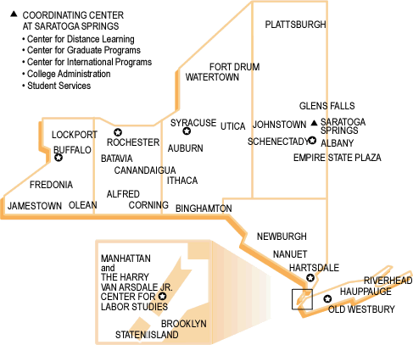
Empire State College is one of SUNY’s 13 colleges of arts and sciences
Designed to serve adult learners pursuing associate, bachelor’s and master’s degrees.
35 locations in New York state and abroad,
as well as entirely online.

Slide 3
Geology and the Environment
Intro course for non-majors
Majority of students are adult learners and tend to be highly motivated.
Most people take this course out of an interest in the natural world or environmental issues.
A significant portion of the students are pre-service or in-service teachers.
Definite presence of science-phobia, tech-phobia and going-back-to-school anxiety.

Slide 4
Inherited Course Design
Discussions worth 50% of course grade, really?
Written assignments = 40%
Attendance = 10%

Slide 5
But did not inherit any wisdom
How to manage discussions?
Do I jump in and post a lot or stay out of the way?
How do I break up arguments?
How do I revive a dead end discussion?
How the heck do I assign a grade to a discussion?
Are the discussions supposed to be a full-time job?

Slide 6
So here’s what I’ve learned...
Discussions are awesome!
By far my favorite part of the course.
Excellent tool to:
  disseminate content,
  dispel misconceptions,
  get to know students,
  share your own enthusiasm,
  assess students’ understanding,
  get a pulse on students’ feelings

Slide 7
Discussion Questions
Initial question shall be broad and totally open-ended
Then have backup questions ready
It took some 50 years for the ideas of Alfred Wegener to be widely accepted. What can a community do to accelerate the validation of new ideas and theories?
Do you think it’s always a good idea to accept new scientific ideas readily? Can you think of some recent examples that illustrate your point?
Is today’s controversy about climate change comparable to the reluctance to accept the theory of plate tectonics?

Slide 8
Other ways to keep discussion active
Throw out an easy question
  Name a hot spot that is not located in the ocean
Share a relevant anecdote
(self-deprecating ones, especially!)
Post frequently on varying scales. Study on student satisfaction shows that instructor interaction is the most significant contributor to perceived student learning. (Fredericksen et al, 2000)

Slide 9
Not all content needs to be unique
Have prepared content ready to paste in when the moment presents itself
(it always does)
  Clarify content
  Address misconceptions head-on
  Add a new facet to the topic at a timely moment
  Closing thoughts for each module

Slide 10
My Expectations
A post with factual information, data, or a synthesis of two or more ideas is the highest-scoring type of post. These posts add valuable new information to the discussion. Make sure the text is written in your own words, not just pasted in from a website. Also, be sure to give the references to where you got the information so people can seek more info if they want.
A reflection of relevant personal experience offers much more to the discussion than just an opinion. For example, if you lived in an earthquake-prone area and took steps to mitigate the risk, you would be able to offer your own personal insights on that matter. Likewise, an insightful post offers a new way of thinking about something. It may not be data-based, but it offers another side of the issue and is thoughtful and thought-provoking.
A question engages others in the discussion, and can take the discussion in a new direction so that is a good thing.
A link to an interesting site or pasting in material from a site is OK (with references cited), but not nearly as valuable as a summary of what’s on that site, which would put you in the top-scoring category.
An opinion is fine, we all have many opinions to offer!
A quick response or non-substantive post is usually a way to thank someone for their information or make a quick comment. These posts are valuable because they are interactive, but don’t overdo it.
I also evaluate if you are interactive. Do you respond to others’ questions and engage your classmates?

Slide 11
Encouraging Quality Content
Instructions/expectations are posted in many places and modes.
Respond to good posts pointing out why they are good.
Provide specific, individual feedback promptly at the end of each module.
Much better! I like that you added substance in this module. Your posts about the New Madrid quakes were factual and relevant. The post about the Arctic volcanoes was great too, and prompted lots of interest from others. Well done.

Slide 12
Assessment
factual information, data, or a synthesis of two or more ideas
A reflection of relevant personal experience or insight
A question
A link to a relevant site or pasted summary (properly cited)
An opinion
A quick response or non-substantive post
High scoring
Low scoring

Slide 13
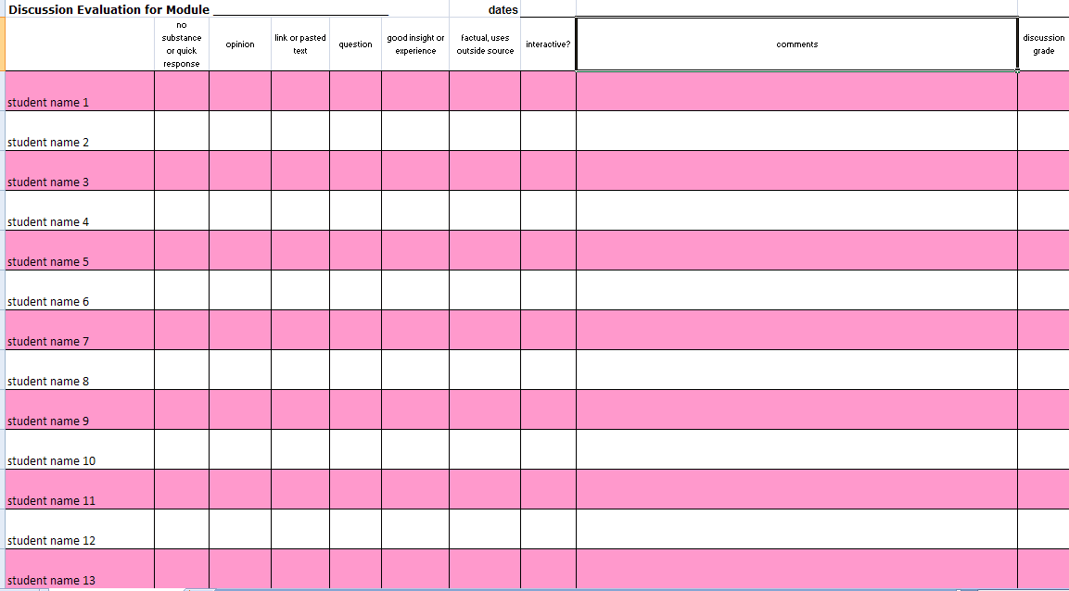
Assessment Template

Slide 14
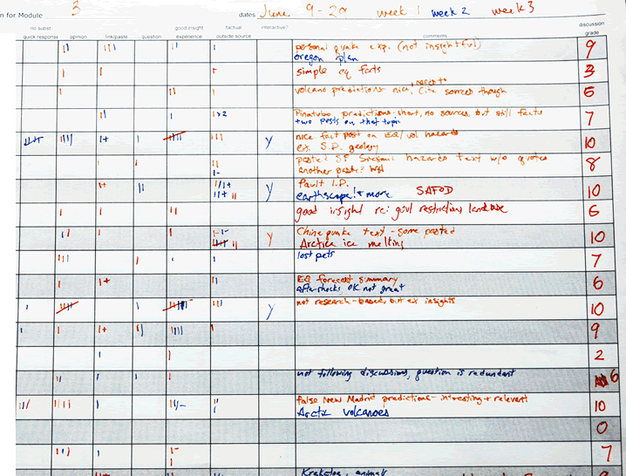

Slide 15
Hatch marks in each content category

Slide 16
Interactive?

Slide 17
Notes to myself; use these in the evaluation for each student

Slide 18
Color-coded for each week

Slide 19
discussion grade,
on a 1-10 scale

Slide 20
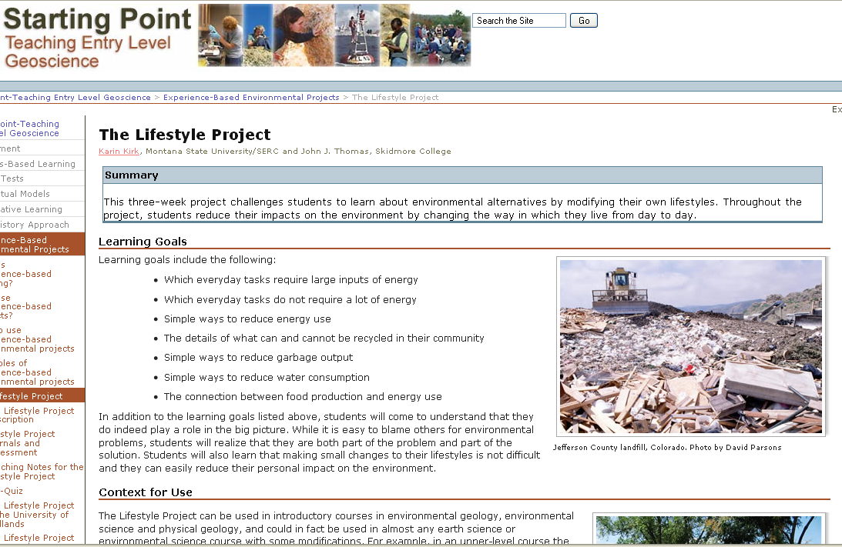
Example of a project that generates active discussions and serves as a cohesive experience
LP?
Eval quotes?

