Slide 1
Using Case Studies in On-line Classes: a Coastal Erosion Example
Dr. Eleanour Snow
University of South Florida
& University of Texas (adjunct)

Slide 2
What is a Case Study?
Presents an open ended question
Is posed as a real problem, although it may be made up
Builds over the course of several assignments
Engages in creative and/or critical thinking
Requires students to defend their thinking
Does not have a “right” answer

Slide 3
Why use Case Studies?
If well designed, they can assess students’ understanding of a topic
They engage students’ interest because they are told as stories
They require students to think and to provide reasons for their conclusions

Slide 4
Any Experience out there?
Have you used Case Studies in your on-line classes?
What do you find most challenging about doing that?

Slide 5
Challenges presented by doing case studies on-line
Timing: students need feedback from each step before going on to the next step
Discussion: case studies are most often used in collaborative learning environments

Slide 6
The Case of El C -- Organization
The case study is organized into three parts:
  Background – what do the students need to know about the topic to solve the problem
  Data – they dig into the data for this problem in particular
  Solutions – they research possible solutions, and propose and defend their favorite

Slide 7
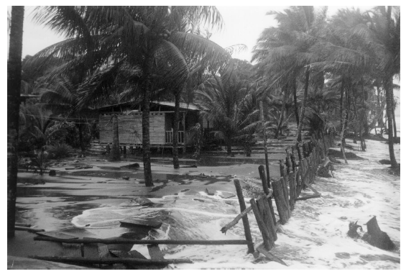
Part 1: Background
The Story
Mia looked around at the anxious faces of the villagers filling the room. She knew that they were worried about the future of their small, barrier island community. As a government scientist, she had come to El C. to evaluate the coastal erosion that had been pervasive in the last decade, and to advise the villagers on options for the future. Tonight she would listen.
“My name is Mia Garcia, and I am coastal geologist. I am here because you asked for help. Your village is threatened by coastal erosion; three homes were lost this past winter. I know that is frightening. My job is to learn what I can about your situation here, and help you decide on a course of action. Tonight, I just want to listen. Tell me what you have seen, and what are concerns you.”
Assignment: Research on coasts, coastal erosion – its causes and effects -- and on barrier islands.

Slide 8
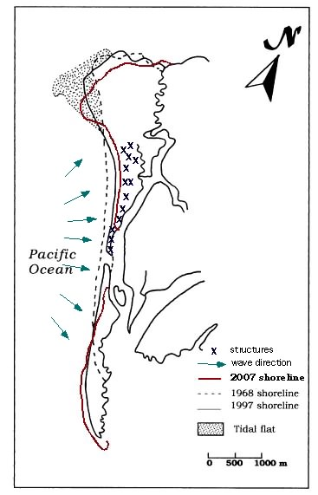
Part 2: Data
Your Assignment:
Consider what happened on El C, and why – use both the map and the beach profile data.
Create a graph of the beach profile showing how it has changed over time.
Calculate the rate at which the berm (the highest part of the beach profile) is moving toward shore, and how much height the berm has lost.
Include the graph and analysis in your paper.
Include the map of the island in your paper.

Slide 9
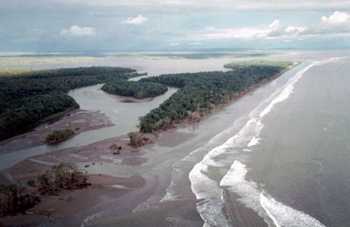
Part 3: Solutions
Mia, Ben, Kate, and Jose had spent the day talking to the villagers. They had presented their report, with all the options. At this point, it was up to the villagers to come to a decision. But now, sipping tea around Carlo’s table, they faced a tough question.
“I have listened, and I have read your report. I know it is not your job to decide, but before I decide there is one more piece of information I need. What would you do, and why? I want to hear your recommendation.”
“Alright” replied Mia. “Here is what I would do, and here is why.”
Assignment: Consider three types of solutions: replacing the sand, building a barrier, or moving the village. Choose one you would recommend, and explain why. Include a map of what you think the island would look like 10 years after your plan is implemented.

Slide 10
El C – Creating the Assignment
Based on a real case
Used the map and beach profile from a published paper
Made up beach profile data for the story
I reveal that the case is real, but I do not reveal the solution the villagers chose.

Slide 11
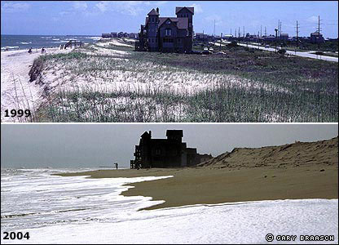
Variations on a Theme
Four Parts
Assigned research topics
Explain a specific coastal erosion problem or solution
Blog tool

Slide 12
A Word of Encouragement
I highly recommend case studies as an effective teaching and assessment tool.
It is easier than you think to create one.
There is lots of help out there, but one of my favorite resources is at SUNY Buffalo: The National Center for Case Study Teaching in Science.

