Slide 1
Adding Interactivity to Online Courses
Bill Hirt
Department of Natural Sciences
College of the Siskiyous

Slide 2
Learning Outcomes and Interactivity
Learning outcomes are stated in terms of what students are expected to be able to do, such as: solve problems, read maps, or interpret sequences of geologic events.
These activities afford students opportunities to do these things in a virtual environment and give instructors a basis for assessing how well they have done them.

Slide 3
Learning Styles and Interactivity
Interactive exercises appeal to folks who learn visually and kinesthetically.
They also provide opportunities to tie both computational and non-computational problem solving right into what students are doing on their computers (e.g., determining the slope and intercept of an isochron or overlaying GIS layers on a map).

Slide 4
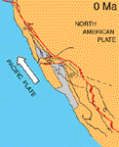
Interactive Activities: Animations
An animation is a “natural” in the virtual environment.
Consider how dynamic Tanya Atwater’s animations of the plate tectonic history of southern California during the past 20 Ma are compared to sequences of static images in textbooks.
Atwater (2010)

Slide 5
Interactive Activities: Animations
Simply watching an animation can be a passive activity.
So…encourage ‘active observation’ by posing specific questions about the process shown.
“Which direction have detached crustal blocks rotated as the southwestern margin of California has broken up during the past 20 Ma?”

Slide 6
Interactive Activities: Animations
“Which direction have detached crustal blocks rotated as the southwestern margin of California has broken up during the past 20 Ma?”
Clockwise
Counterclockwise
Both
Rotating? They’re not rotating!

Slide 7
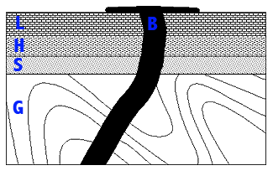
Interactive Exercises: Practice
Some exercises give students opportunities to solve problems by applying the principles they’ve studied and offer simple feedback that helps them learn from their mistakes.
An example is Athro’s Geologic Sections site for learning about relative dating principles.
Athro, Inc. (1999)

Slide 8
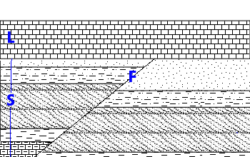
Interactive Exercises: Practice
Follow up with an assessment that asks students to interpret the history of a similar, but unfamiliar, section by using familiar principles.
Athro, Inc. (1999)
“According to the principle of cross-cutting relationships, is the fault older or younger than the erosional unconformity beneath L?”

Slide 9
Interactive Exercises: Instruction
These activities are more comprehensive, and enable students to learn about a principle or technique through both instruction and interaction.
Virtual Courseware is a great source for these activities on topics ranging from radiometric dating to river flooding.

Slide 10
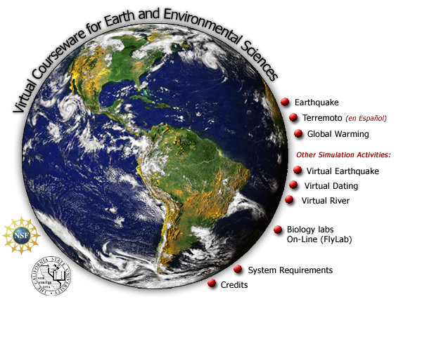
Interactive Exercises: Assessment
Some Virtual Courseware exercises, like Earthquake, include their own summative assessments.

Slide 11
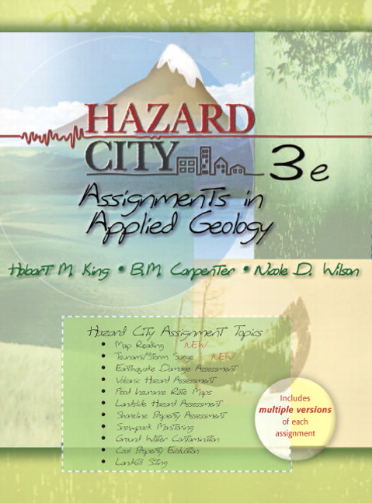
Interactive Exercises: External Media
Many textbooks come with CDs or companion websites, and some include interactive exercises that can be fit into online courses.
The Hazard City CD, for example, gives students background and data on environmental geology problems, and asks them to analyze the situations and make geologic recommendations.

Slide 12
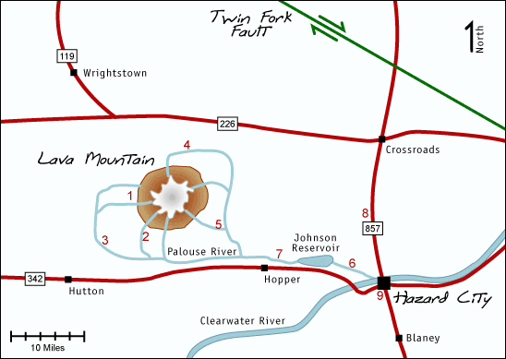
Interactive Exercises: External Media
Assessments can be based on the questions from the exercises, or supplemental questions that challenge students to further analyze or make inferences from the data.
“If a west wind blew during an eruption, which other hazards might pose increased threats?”
King et al. (2008)

Slide 13
Interactive Exercises: External Media
“If a west wind blew during an eruption, which other hazards might pose increased threats?”
Lava flows and volcanic gases
Pyroclastic flows and lava flows
Tephra and lava flows
Volcanic gases and tephra
King et al. (2008)

Slide 14
Interactive Activities: Concerns
Encourage students to start their lessons promptly so that if any hardware/software problems arise they can be dealt with well ahead of the due date.
Bear in mind that some external media will add to the cost of the materials the students must purchase for the course.

Slide 15
Interactive Activities: Summary
Interactive activities that can be integrated into online courses range from animations to exercises that include both instructional and assessment components.
They help students learn by making careful observations and ‘doing’.
They promote online discussions and student interactions not unlike those in a face-to-face class. Plus, students enjoy them!

