Slide 1





What’s In the Water?
An Inquiry-Based Activity Based on Chromophoric Dissolved Organic Matter (CDOM) Research
Bob Chen
School for the Environment, UMassBoston

Slide 2
What’s in the water?
San Francisco Bay water
  Write down some ideas
Mystery solution?
Student samples
Sample from 4 km depth
Sample from under the Arctic ice

Slide 3
What’s In the Water?
Individual Investigation
What is in your vial? (30 seconds)
How confident are you (1-10)?
What can you do to test your prediction? What further observations can you make? (1 min)

Slide 4
Group Investigation
Now form a group with others that have the same color solution
Share ideas and observations in an attempt to figure out what is in each vial (3 min)
You will report out your conclusions to the whole class (1 min)

Slide 5
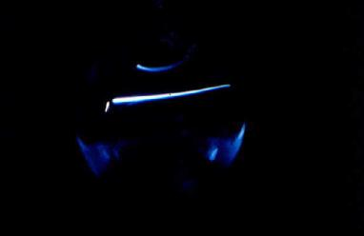
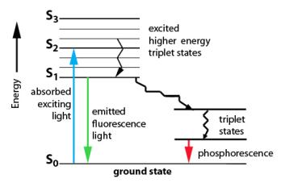
Extensions
Associated activities
  Dropping sand in water
  Dissolving sugar in water
  Placing teabag in water
  Testing natural waters
  Lab measurement of student waters
Used in WISP (Grades 6-8), COSEE (Grades 3-5), AP Bridge (HS), Earth Science 1
Use teabag analogy to explain my research to friends and family
Caffeine in Boston Harbor
Endocrine disruptors in sewage
LIF of pyrene
Coastal carbon cycling
Every element in the
Periodic table

Slide 6
What’s in San Francisco Bay water?
How do you know?
How does it change over time?
Is this good or bad?
What is the impact on ecosystem processes?
Where does it come from?
What can we do about it?

Slide 7
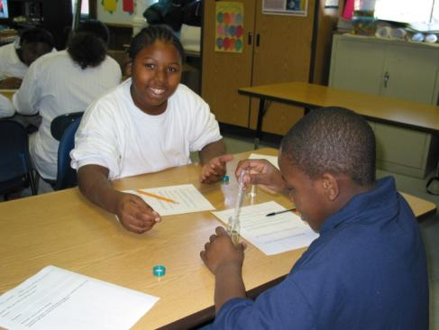
Inquiry
National Science Standards & Benchmarks
Massachusetts State Frameworks-Good for GenEd
  “Investigation, experimentation, and problem solving are central to science education”
  “Opportunities for students to reflect on their own ideas, collect evidence, make predictions, and discuss their findings are all crucial to growth in understanding”

Slide 8
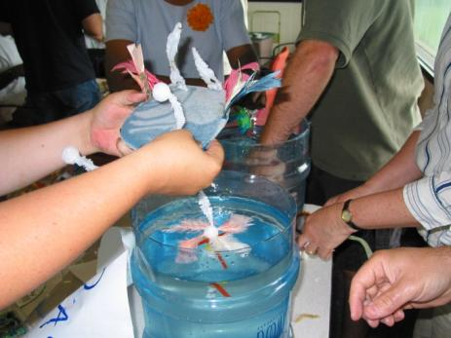
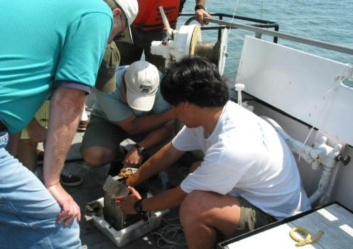
K-Gray Teaching
Experiential
  Engaging
  Memorable
  Common discussion point
Peer-Instruction
  Based on existing understanding
  Communication
Model for science (DOING)
  Replicates the scientific process

Slide 9
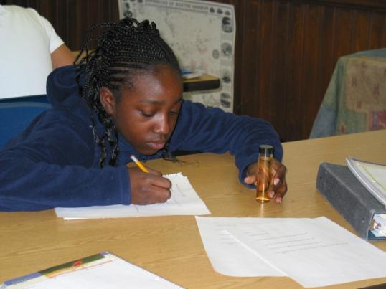
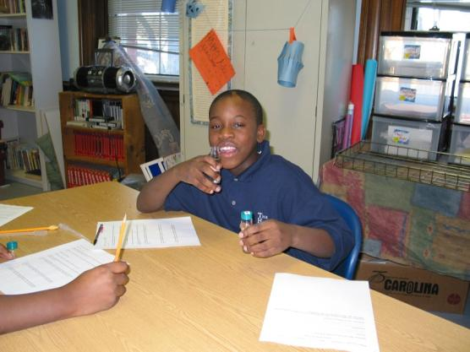
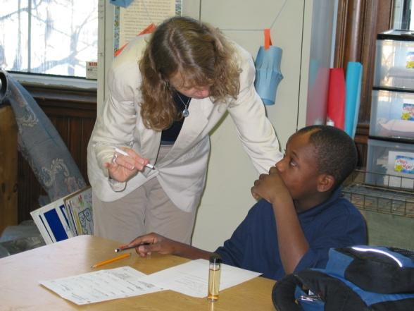
Mystery Solution
Writing
Observations
Discussion

Slide 10
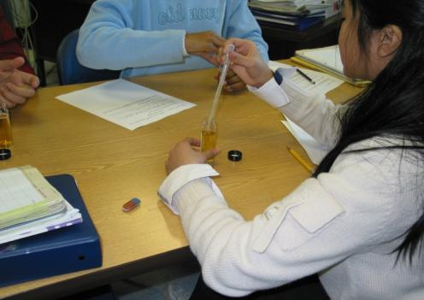
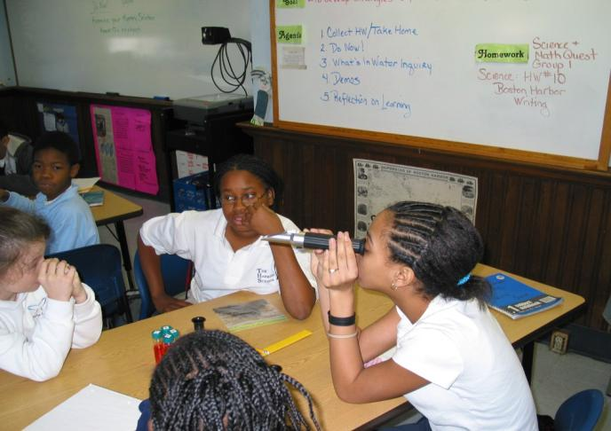
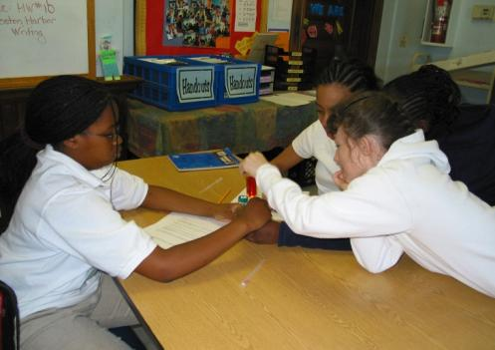
Testing
Group Work

Slide 11
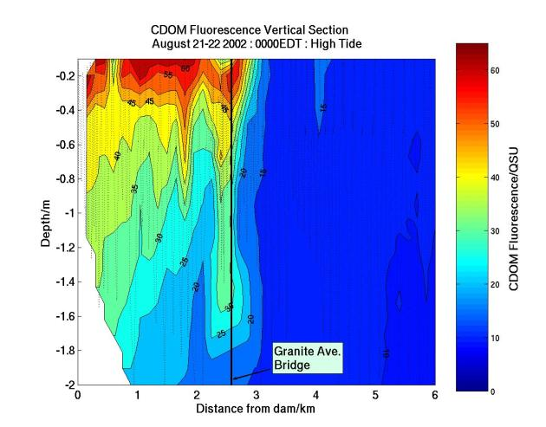
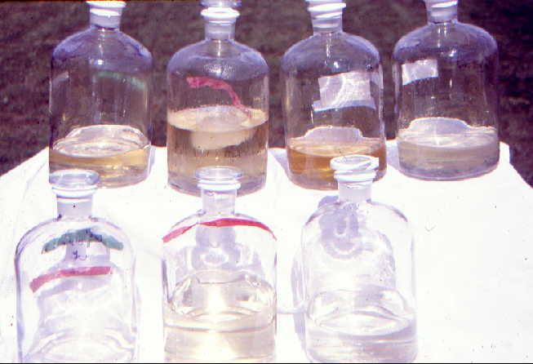
Chromophoric Dissolved Organic Matter (CDOM)
Solubility, dissolved substances, density, conservation of mass
Observations, testing, scientific process

Slide 12
Impacts
Students engaged in inquiry
Simple yet memorable
Connected to students’ prior experiences
Students exposed to research techniques
Common experience with many transferable applications
Activity finds many audiences
People understand what I do better!

