Slide 1
Is That True?
Ask students to research the "truth" behind statements from recent news articles and provide their opinion about what is "true". Examples include statements about hurricane intensity increases due to global warming, Coriolis effect and southern hemisphere, etc.
Appropriate for all level courses.
Use to introduce new topics, explore data sets/graphing, encourage critical thinking…
Variety of assessments - written responses, group presentations, graph, etc.

Slide 2


Is That True?

Slide 3
In a news release Tuesday, Sept. 18, Dr. Joe Bencloski, Department of Geography and Regional Planning at IUP, announced his belief that Indiana may actually have more annual precipitation than Seattle, which is infamously known for its rainy days.
Is this true? Search the web for climatological data about Indiana’s and Seattle’s weather. To justify your conclusion, provide the following:
A. Average Annual Precipitation for Indiana, PA
Average Annual Precipitation for Seattle, WA
Does this value change from year to year? Plot this value over time for each city.
B. Plot the monthly total precipitation for each location. Does this statement hold true for all months? for none of them? for only part of the year? Does it change over a period of the last 10 years?
What about number of days which rain occurred regardless of how much rain fell? Is it “rainier here, than in Seattle”? Make a plot (of your choice) to demonstrate/justify your conclusion

Slide 4
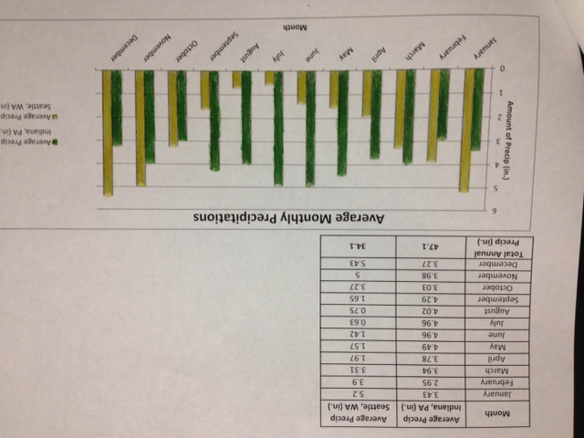
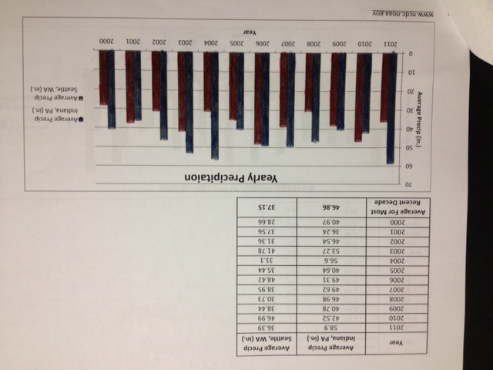
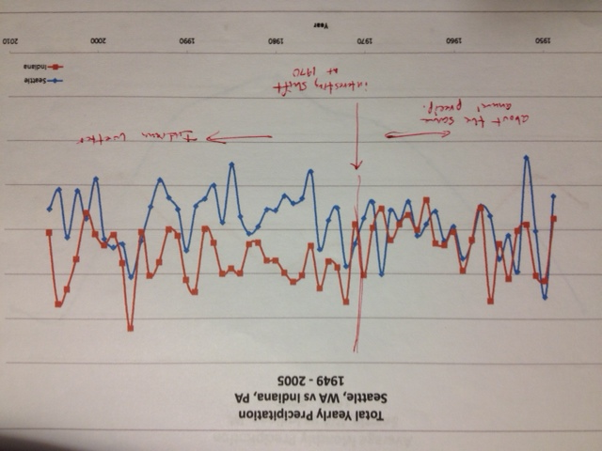

Slide 5
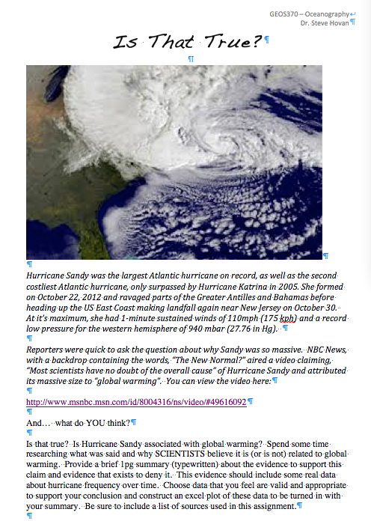
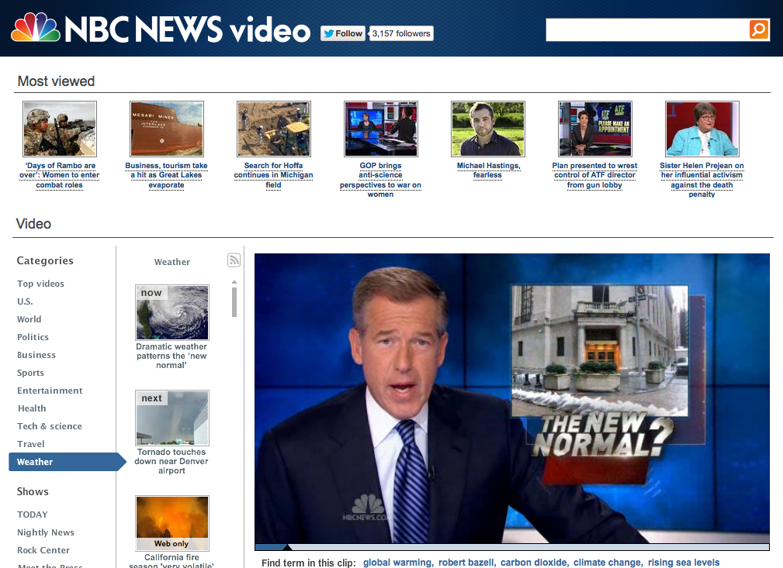
Hurricane Sandy – The New Normal?

Slide 6
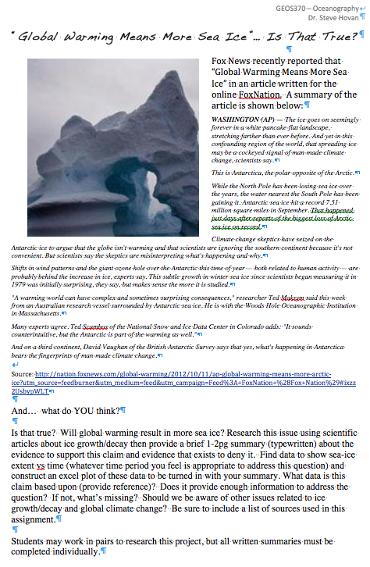

Slide 7
