Slide 1

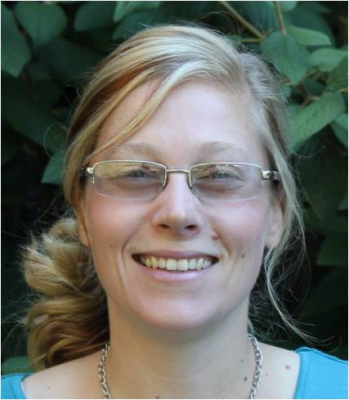
Teaching Oceanography in Landlocked Regions:
Challenges and Solutions
Dave Kobilka, Geoscience faculty, Central Lakes College, Brainerd, MN. Teaches introductory oceanography lecture (40 – 60 students) for mostly non-science majors. Also teaches 1-credit stand-alone oceanography lab.
Janelle Sikorski, Department of Geology and Environmental Earth Science, Miami University, Ohio, teaches a large enrollment (90-
person) introductory oceanography lecture course for mostly non- science majors.

Slide 2
Goals:
To illustrate the essential difference between coastal and inland colleges and identify the challenge this creates for educators in landlocked classrooms.
To share our experiences with teaching oceanography in a landlocked classroom.
To provide you the opportunity to reflect on the challenges you face when teaching oceanography in a landlocked classroom.
To develop a short list of resources, strategies, and/or activities that help address those challenges.

Slide 3
Teaching Oceanography in Landlocked Regions: challenges and solutions
What is the essential difference between coastal and inland colleges?

Slide 4
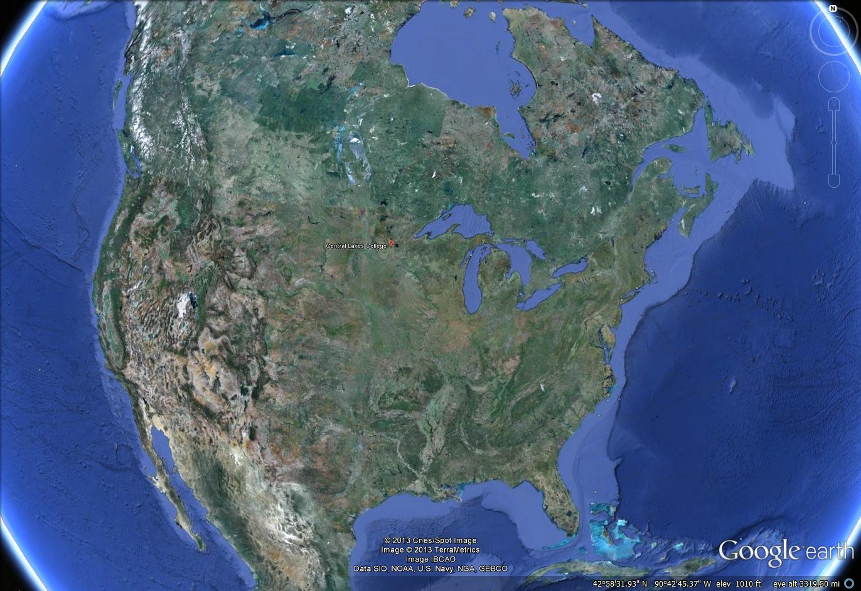
Central Lakes College, Brainerd Minnesota
Texas A&M University,
Galveston, Texas
Brainerd Minnesota, a very continental place versus TAMU Galveston.
Notes:
I would like to juxtapose the situation where I work against the college where I attended grad school.

Slide 5
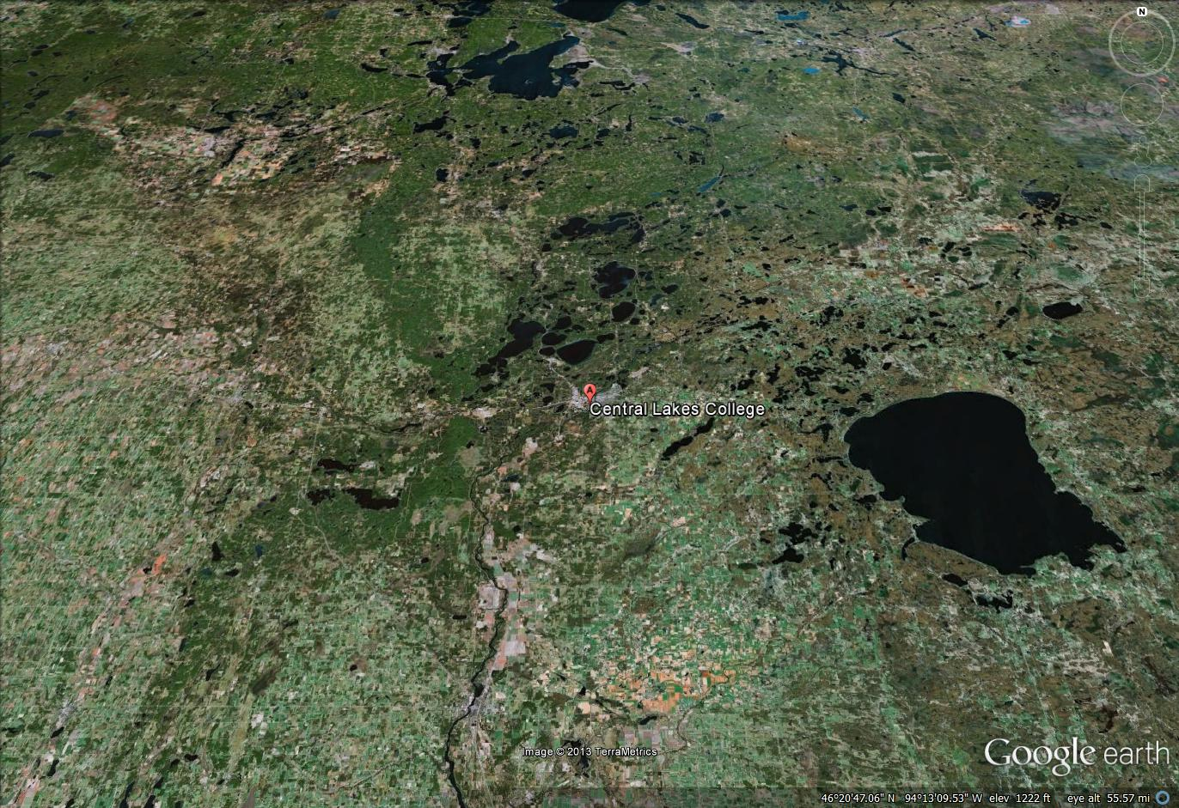
Near Brainerd, there is MUCH water! But in Brainerd, people “go to” the lake. If you are not near a lake, you hardly know they are there.
Notes:
To get to the water here, people “go to the lake” Lakes are thought of as a playgrounds. The water is rarely regarded as a significant environmental feature. The economic value to it is in the way of tourism.

Slide 6
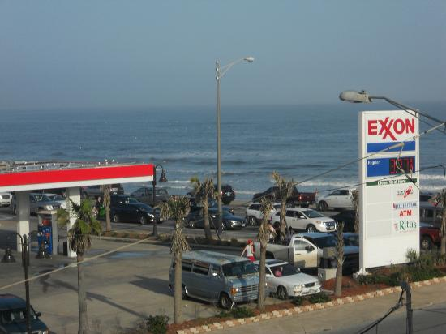
Whereas in Galveston you live your life never very far from the water.
Notes:
I include this rather mundane photo to illustrate the point that people live their lives on the water. Even if you never go out on a boat; even if you do not even like the water, your life is directly affected by it all the time.

Slide 7
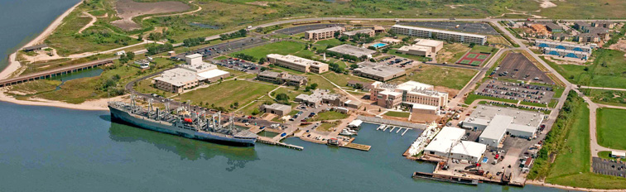
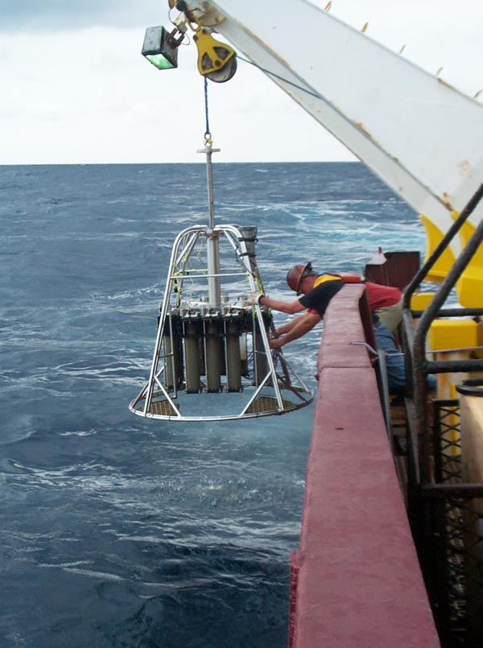
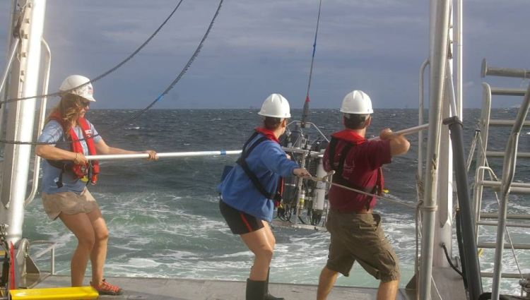
TAMU Galveston Campus
Typical student experiences, TAMU Galveston
Notes:
Students at TAMUG have a completely different experience than typical students at inland colleges. Even if you are not an ocean science student, ocean science is infused throughout the curriculum. When you take your science courses, ocean science will be in there. And the ocean is there all the time. You can hear it. You can feel it.

Slide 8
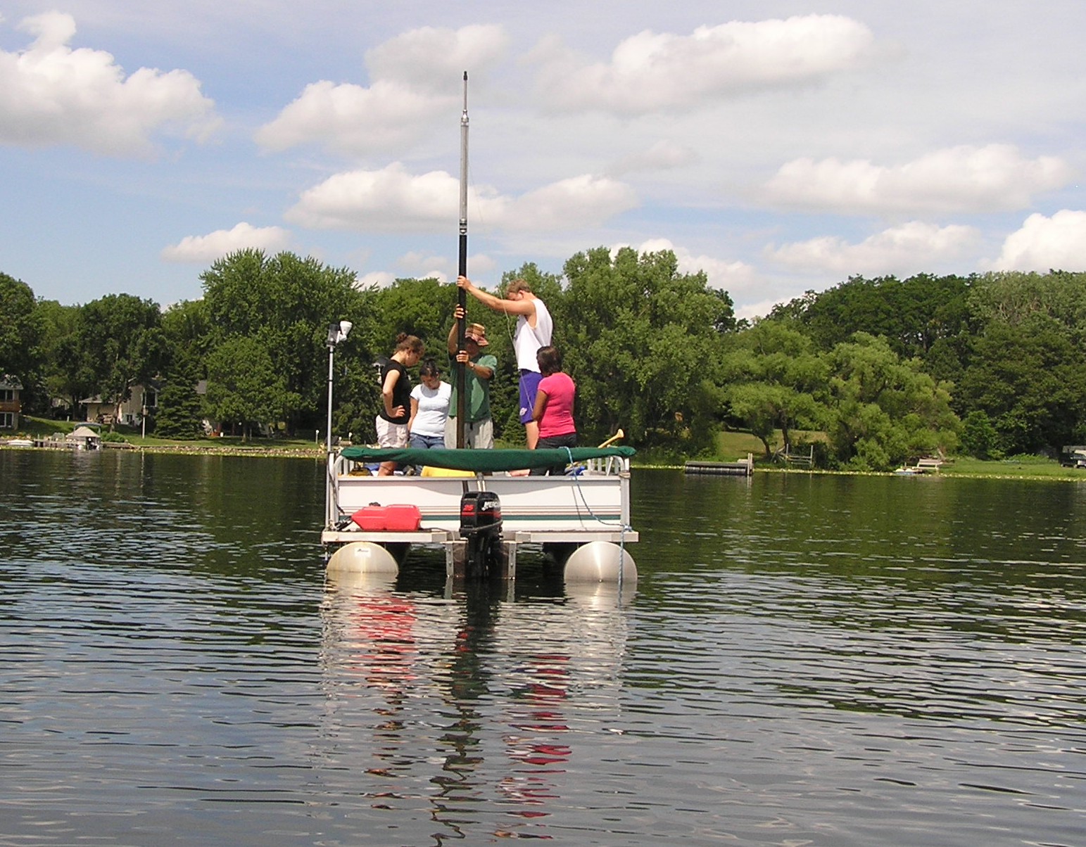
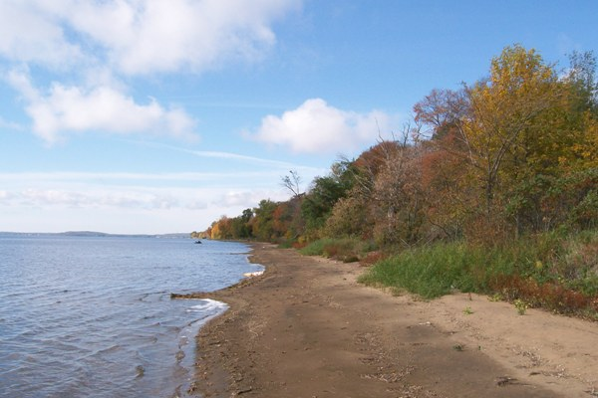
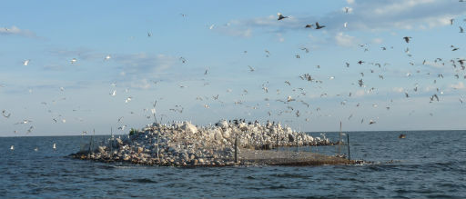
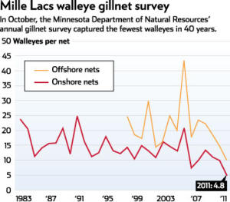
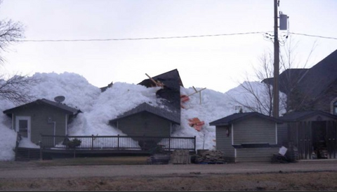
Sediment coring on freshwater lake.
Beach on Lake Mille Lacs
Mille Lacs NWR
Ice-Out Damage Lake Mille Lacs, May 2013
Notes:
Field opportunities for simulating oceanography in fresh water environments abound, and we use them! But that’s not what this is about. This is about the classroom.

Slide 9
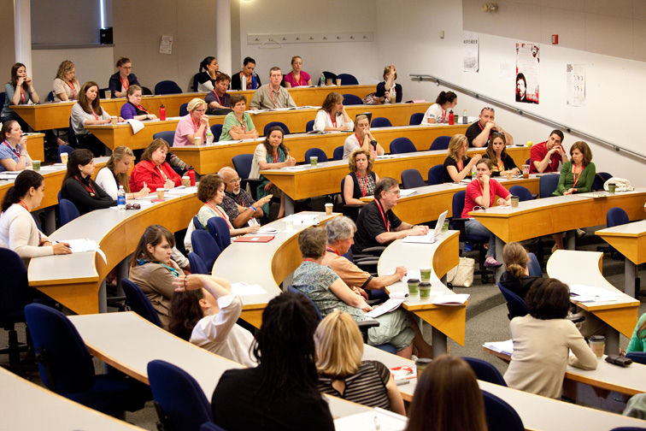
Notes:
When we limit our conversation to the classroom, we get this. Lecture sections take place in (often windowless) lecture halls. Are those environments different? They don’t look that much different.

Slide 10
Aside from having direct and immediate access to the ocean, why would an Oceanography lecture class at a coastal college be any different than that at an inland institution?
After all, lecture sessions are typically indoors, in (sometimes windowless) lecture halls. How would anyone know the difference?
So how is the lecture teaching environment at the inland institution different from the coastal college?

Slide 11
The oceanography scientific community is not present at the inland institution.
At my college, I am the only person I know with a degree in Oceanography. Because it is a small college, at most there are two sections of Oceanography in a semester. More often, it is only one section. At meetings and campus workshops, I work with faculty from all disciplines, but never other Oceanography faculty.

Slide 12
The collective body of knowledge held by the students is different.
If I surveyed my class with the following response items, (or if you did) what do you think the answers would be?
I have seen an ocean.
I can see the effects of climate change in my home community.
I feel like I know the ocean.
I regularly eat food from the ocean.
I have dove a coral reef.
I have conversations with friends/family that have something to do with the ocean.
I have my suspicions. I have asked questions like “Why did you take this course?” Typical responses run the spectrum of;
“I had to.”
“I need a science class.”
“It sounds interesting”
It is extremely rare to see this response:
“I will seek a degree in ocean science.”

Slide 13
So why does this matter?
Embodied in that collective knowledge of the ocean that coastal students have is a level of understanding that professors can build on from the very first day of class. The professor can assume his students know what the ocean is, that it is a great provider of resources, that people’s lives and livelihoods depend on it, and that occasionally it brings great danger onto land.
I wonder if this understanding is present with students from inland colleges.
So how do we replace that?
How can we bring the riches of the oceanography community to the classroom and raise our inland students to the level of understanding the students of coastal colleges might find intuitive?
I think this is the challenge.

Slide 14
Teaching Oceanography in Landlocked Regions: challenges and solutions
Example: Miami University,
Oxford, Ohio
“We were a university (1809) before Florida was a state (1845)”

Slide 15
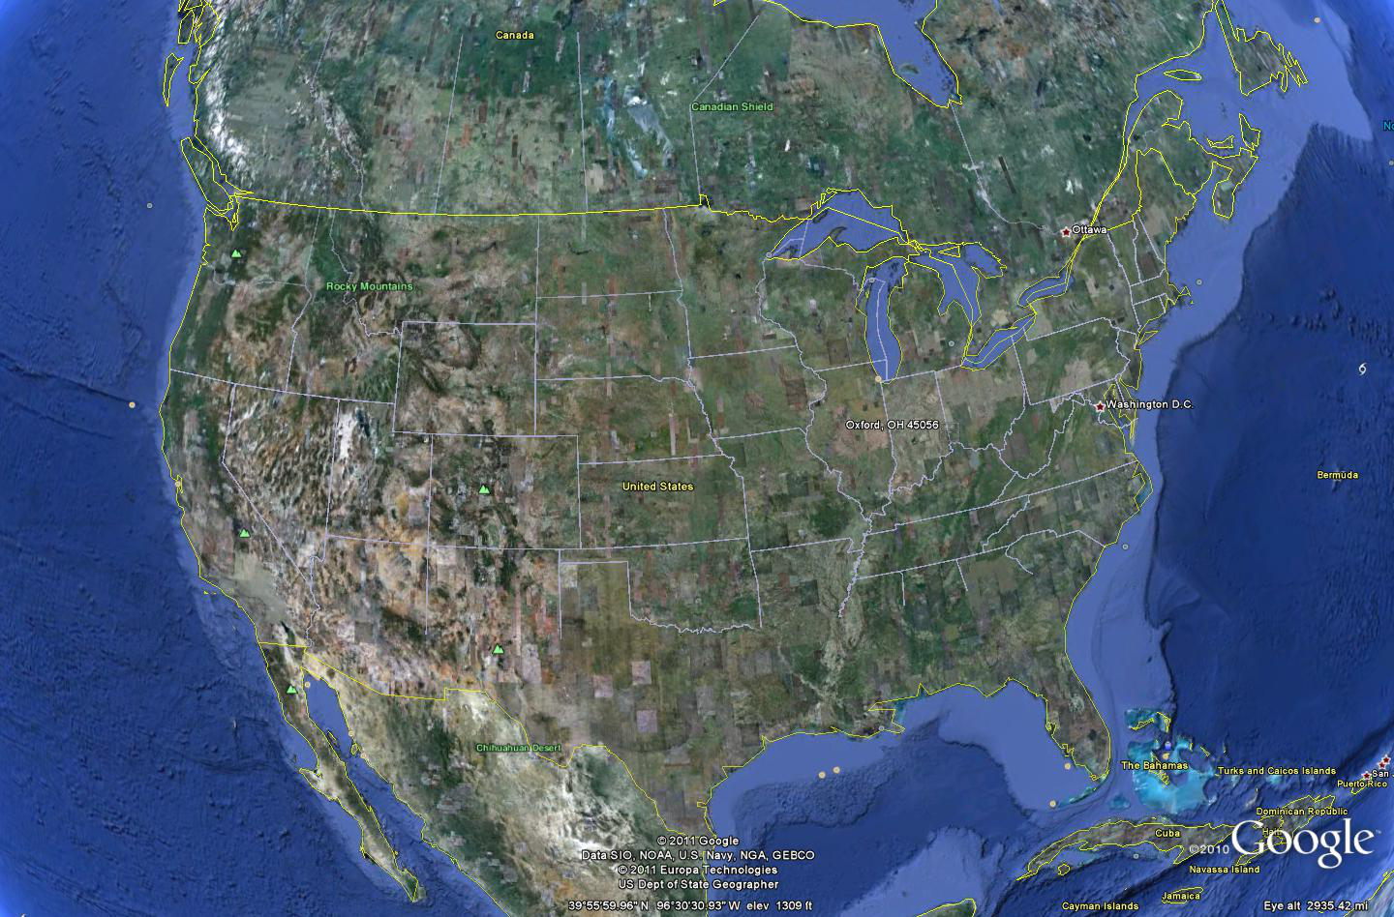
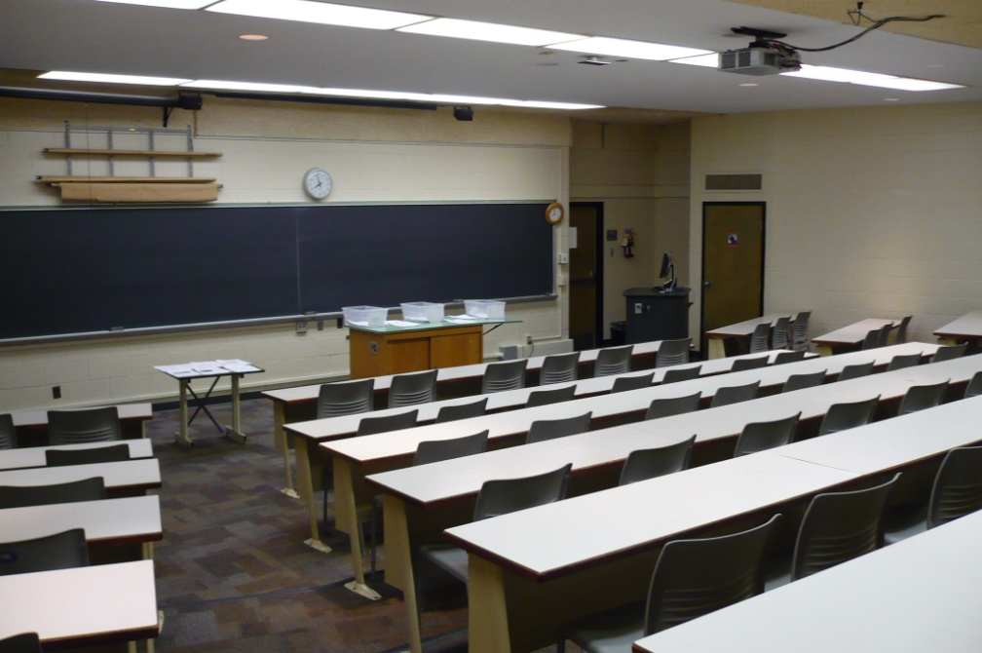
Teaching Oceanography in a Landlocked Classroom: Miami University
Oxford to West Coast: 1,900 mi
Oxford to Gulf Coast: 660 mi
Oxford to East Coast: 500 mi
Oxford to Lake Erie: 160 mi
Miami University
Oxford, OH

Slide 16
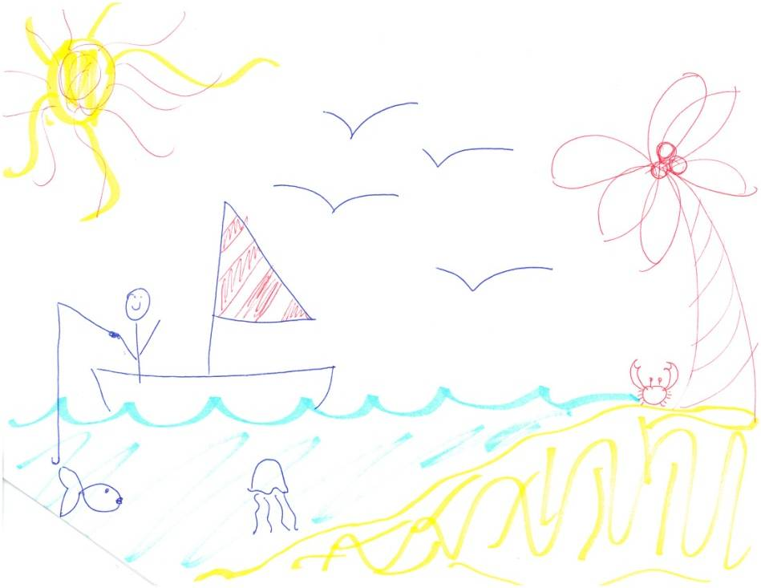
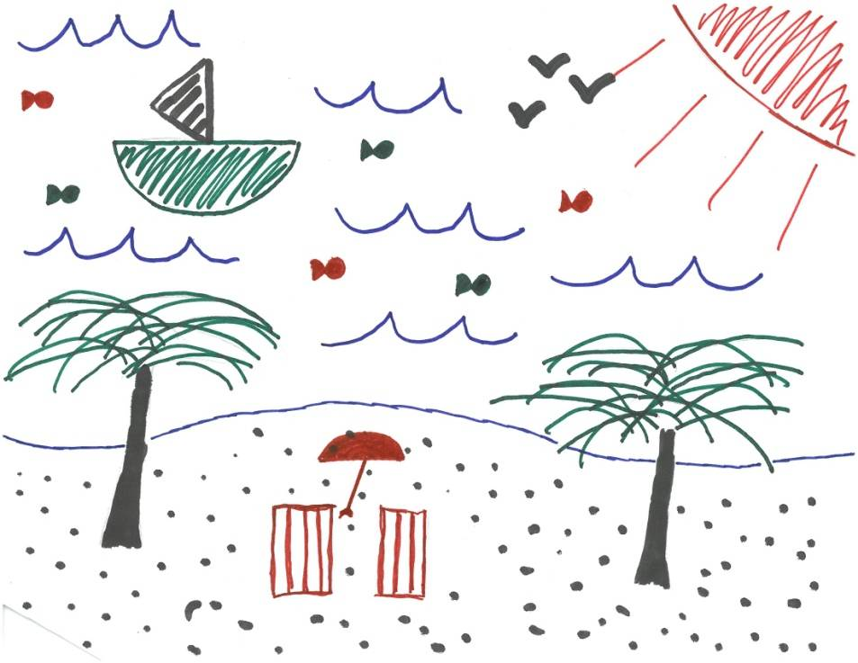
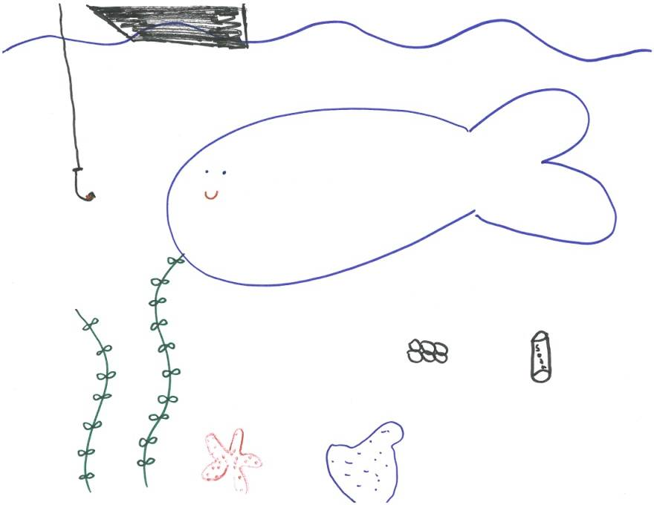
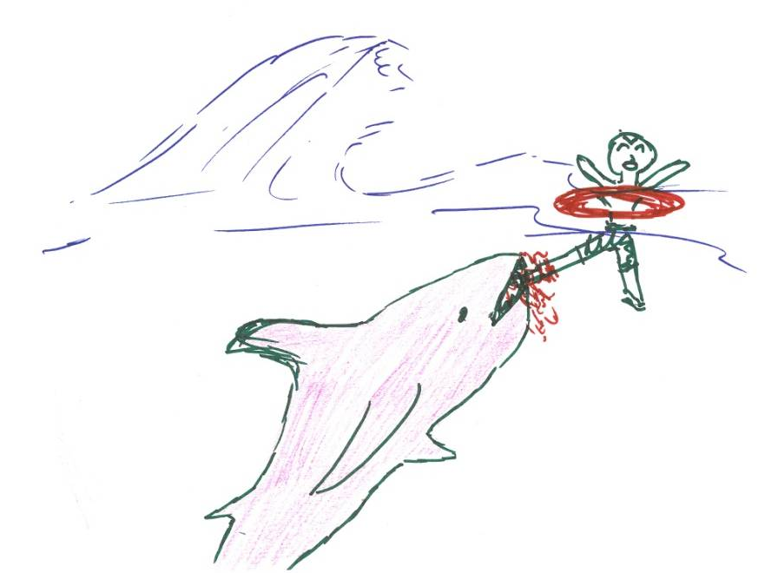
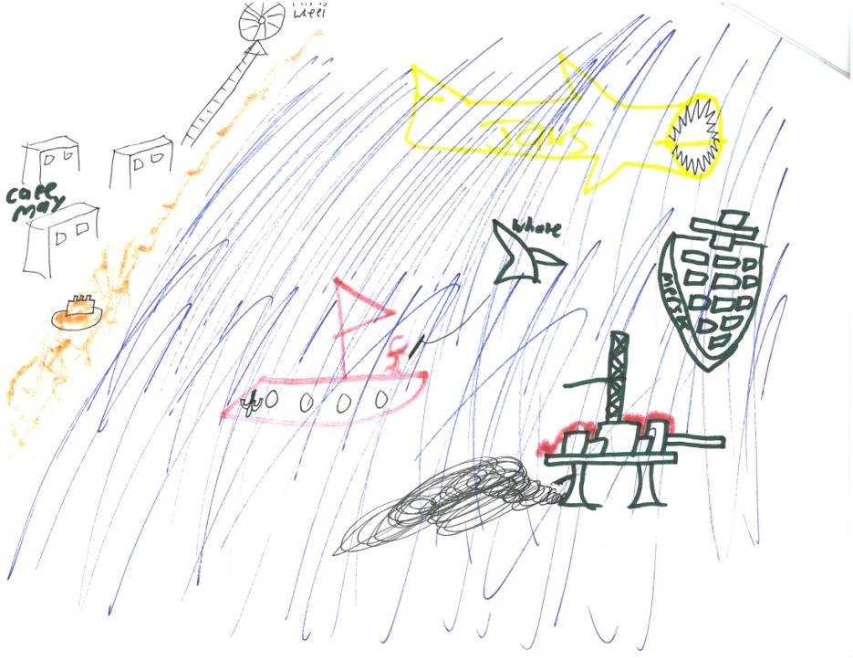
What do students in a landlocked classroom think about the ocean?

Slide 17
How often do students in a landlocked classroom think about the ocean?
Based on a survey completed by my students on the first day of class:
In general, students are thinking about the ocean or an ocean-related topic only once a month.
Students believe they are connected to the ocean through their hobbies/recreation, travel, military service, news, movies and TV shows, and family.

Slide 18
What should students in a landlocked classroom think about the ocean?
Based on my teaching experiences I became worried that my students were not being provided the optimal opportunity to increase their ocean literacy.
Specifically, I wanted to address the principles that the ocean and humans are inextricably interconnected and the ocean is largely unexplored (Ocean Literacy, 2005).

Slide 19
To address this challenge I made three significant changes to my course:
I constructed all new learning outcomes for the course.
I developed several new course activities to support the new learning outcomes.
I redesigned the course from a traditional lecture format to a more active learning environment.

Slide 20
What were my new learning outcomes?
Students should be able to:
1. Compare and contrast the fundamental methods used by scientist to explore the ocean.
2. Categorize the geologic features found on the seafloor and summarize their significance as natural resources.
3. Analyze several case studies to assess the types of relationships that exist between society and the ocean.
4. Illustrate habits that lead to a more sustainable relationship between society and the ocean.
The shift in learning outcomes toward ocean literacy principles centered on ocean exploration and the interactions between society and the ocean motivated a change in course pedagogy.

Slide 21
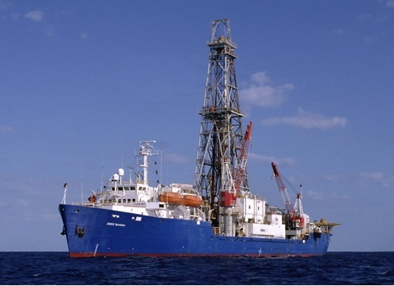
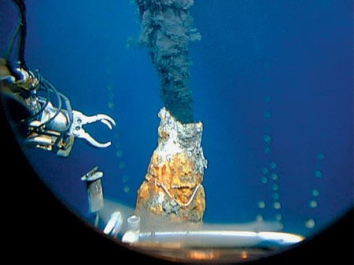
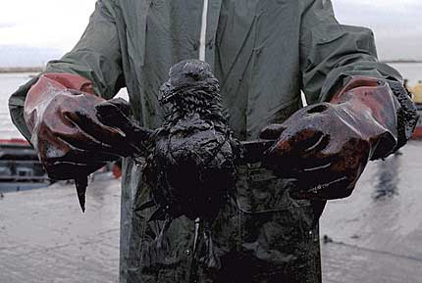
Redesign of my Introductory Oceanography Course
Course Description: Course material is structured to explore three general themes, including scientific ocean exploration, geologic features and active processes of the seafloor, and an exploration of a few of the challenges facing our ocean, such as climate change, pollution, overfishing, and oil spills.
Ocean Exploration
How do we know what we know?
Ocean Features and Processes
What do we know?
Ocean Challenges
Why don’t we do better?

Slide 22
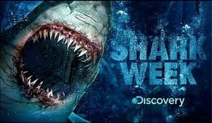
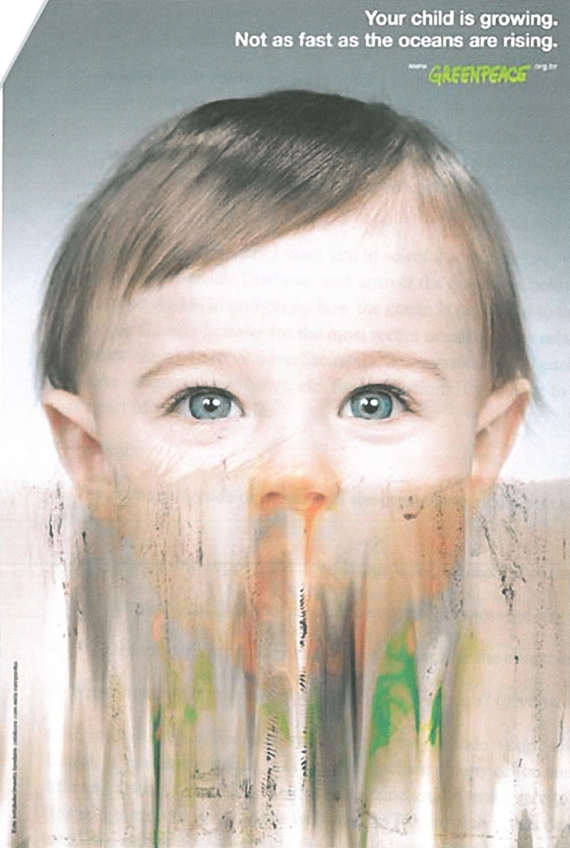
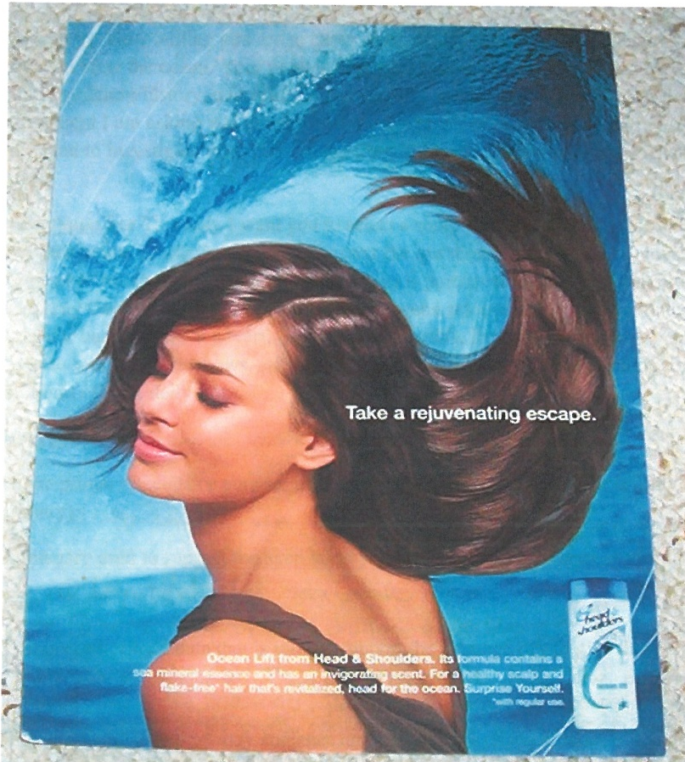
Activities Developed to Help Increase Student Ocean Literacy
Assignment Example #1: Analysis of media that uses ocean-related content.
Students are asked to explore the ways in which the ocean is portrayed to us on a daily basis in the media and to analyze these images, videos, song, text, etc. and report what that product indirectly or directly teaches us about the ocean.
This assignment creates the opportunity to discuss any contradictory or inaccurate messages being presented in the media in the context of course content.

Slide 23
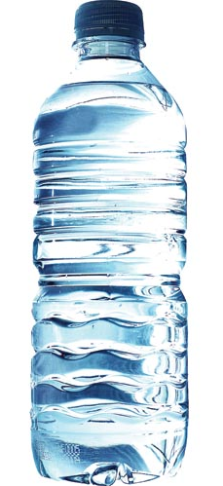

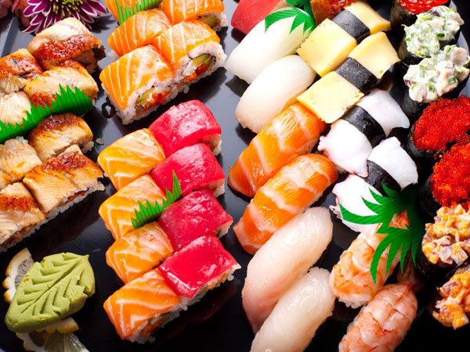

Activities Developed to Help Increase Student Ocean Literacy
Assignment Example #2: Food Diary.
Students are asked to keep a food diary for 24 hours and then asked to analyze the products they consumed in terms of the ocean resources needed to make and deliver that product. (This activity is posted on the workshop website).

Slide 24
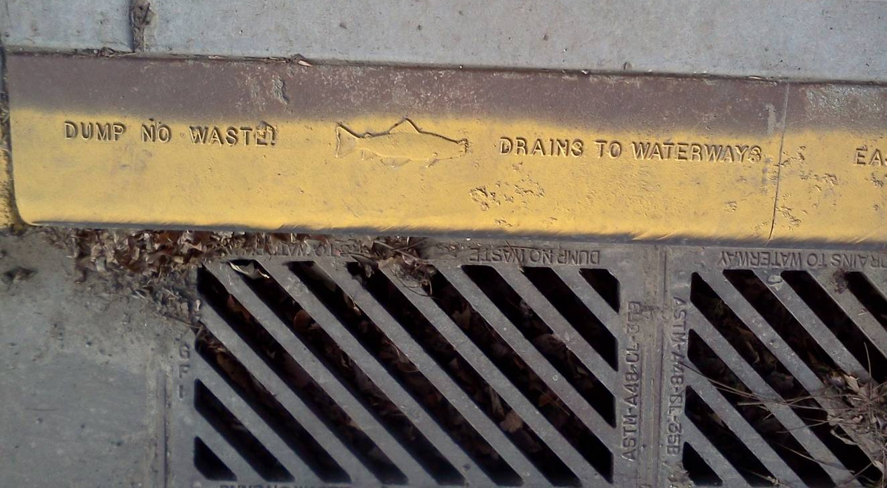
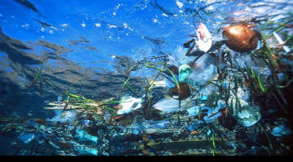
Activities Developed to Help Increase Student Ocean Literacy
Assignment Example #3:
Local Litter Collection
This activity is completed in class at the conclusion of our ocean circulation and marine debris lesson.
Students are asked to demonstrate their connection as a college student at a landlocked university to the larger environmental issue of marine debris accumulation zones.
I will be presenting this activity at the “Share Fair” tomorrow.

Slide 25
Experiences Teaching Oceanography in a Landlocked Classroom:
The Challenges
What do you think is the biggest challenge you face as an educator teaching oceanography in a landlocked classroom?
Can you recall an unsuccessful classroom experience? What obstacles to student learning can you identify in that experience?

Slide 26
Experiences Teaching Oceanography in a landlocked classroom:
The Solutions
What is one strategy or activity you use to improve student learning of ocean-related content in a landlocked classroom?
Can you recall a successful classroom experience? What strategy did you use that helped improve student leaning?

Slide 27
References Cited:
Ocean Conservancy (2013). International Coastal Cleanup. http://www.oceanconservancy.org/our-work/international-coastal-cleanup/ (last accessed June 2013).
Ocean Literacy (2005). Ocean Literacy: The essential principles of ocean sciences K-12. Ocean literacy through science standards. On-line, National Geographic Society, National Oceanic and Atmospheric Administration, Centers for Ocean Sciences Education Excellence, National Marine Educators Association, College of Exploration.

