Slide 1
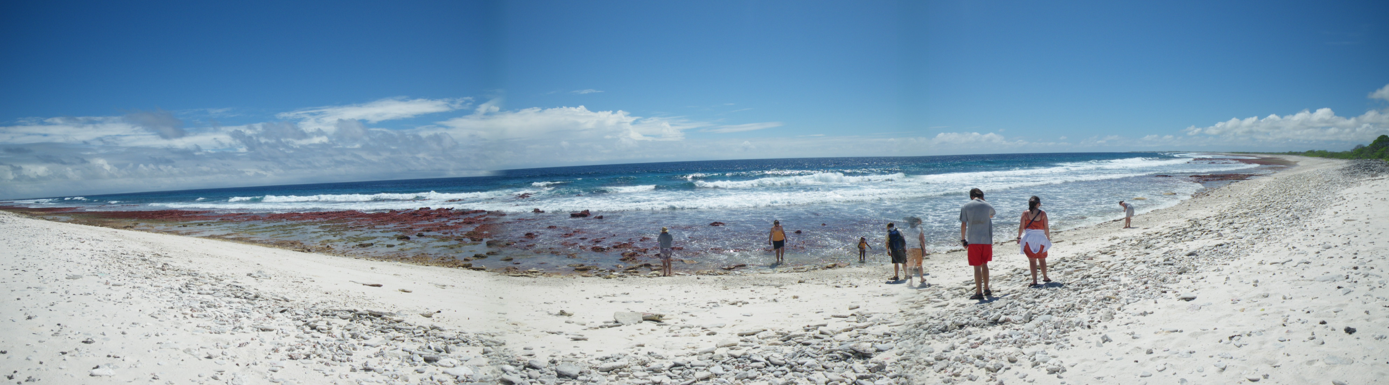
Student Misconceptions about the Ocean
Christmas Island
For: Teaching Oceanography Workshop
H. Lackey, S. Jaeger, K. Hoppe
6/18/13

Slide 2
Session Overview
Intro to Misconceptions – why we should care
Ocean literacy & data from pre & post student assessments
Break-out into small groups
Summary & Wrap-up

Slide 3
Student misconceptions/preconceptions about ocean science. Why we should care:
Preparation: Most high schools lack oceanography; many students have not had Earth Science....so where are they getting their information?

Slide 4
Why we should care.
Preparation
Assessment: If we know what they know/don’t know in the beginning, we can better assess what they’ve learned at the end.
Notes:
future recall is enhanced by the creation of additional conceptual frameworks and reinforcement of prior frameworks

Slide 5
Why we should care.
Preparation
Assessment.
Conceptual framework for learning: Future recall is enhanced by reinforcement and refinement of prior framework(s).
Notes:
future recall is enhanced by the creation of additional conceptual frameworks and reinforcement of prior frameworks

Slide 6
Why we should care.
Preparation
Assessment.
Conceptual framework for learning
Creating an informed public: Public misconceptions about science get reinforced, become (incorrect) common wisdom. We want a scientifically literate society.
Notes:
future recall is enhanced by the creation of additional conceptual frameworks and reinforcement of prior frameworks

Slide 7
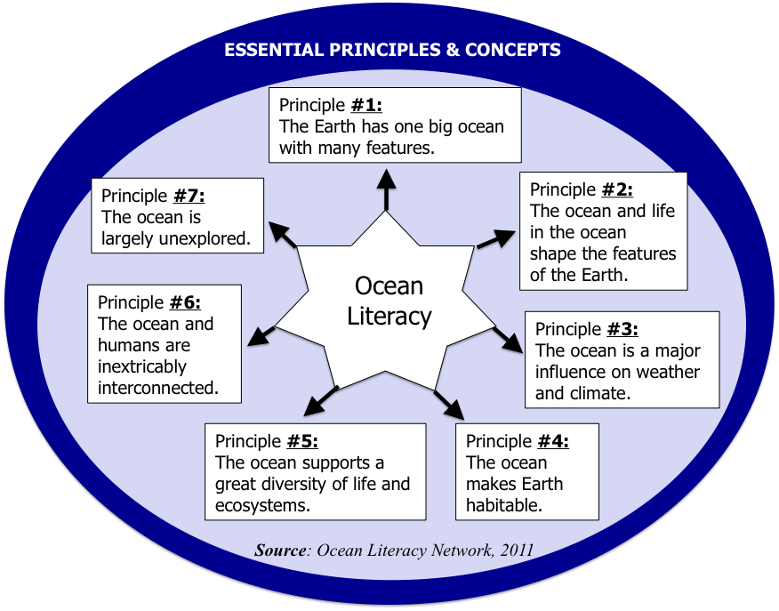

Slide 8
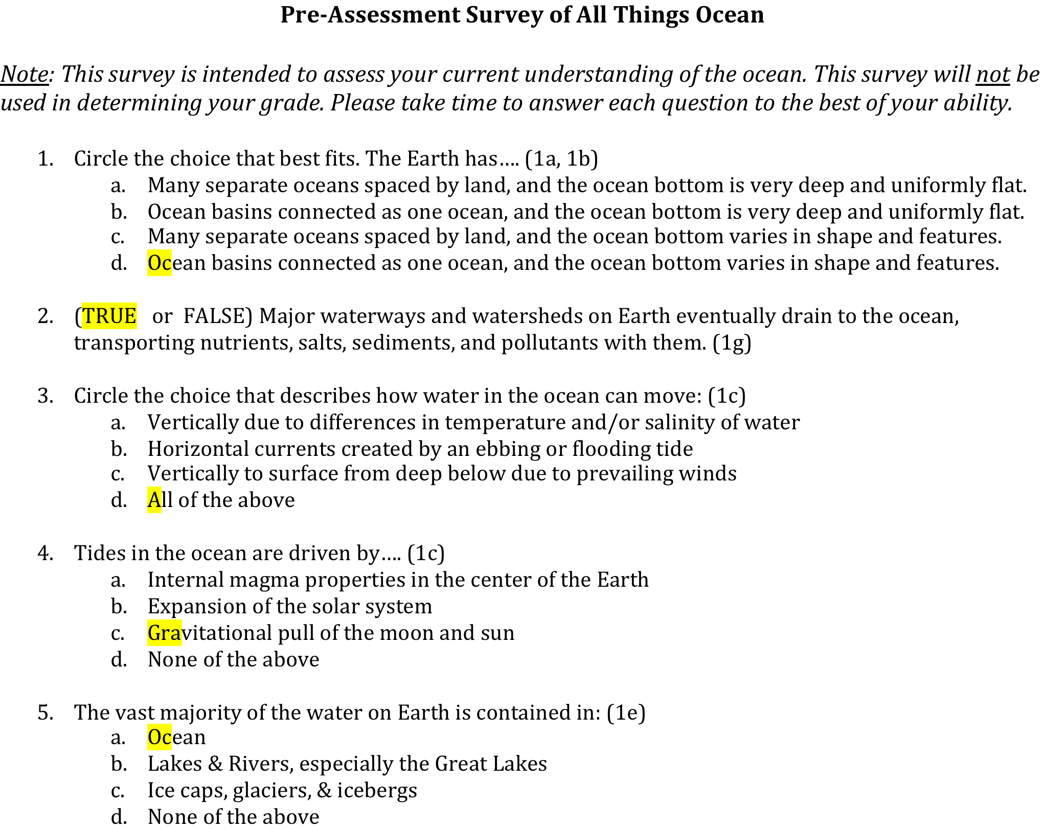
Brief survey given before & after course

Slide 9
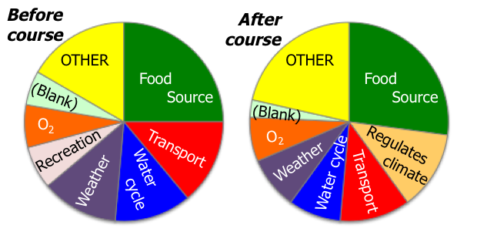
What important roles does the ocean play in our lives? (open-ended response, Fall 2012)

Slide 10
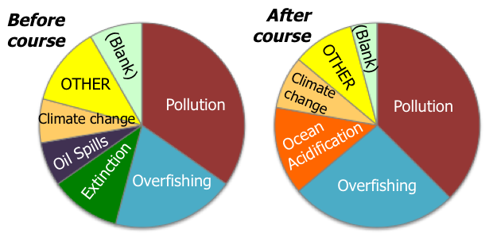
What negative impacts do humans have on the ocean? (open-ended response, Fall 2012)

Slide 11
Multiple-choice Survey Results (Fall 2012)
Principle #1.a&b 1.g 1.c 1.c 1.e 2.a 3.b 4.a 3.a 5.e 5.b 7.a
Percent of Correct Student Responses
Question #:
  Average Score:
  BEFORE the course: 8.9 out of 12 points, or 74%
  AFTER the course: 9.5 out of 12 points, or 79%

Slide 12
Where did students get it right before the course?
Q#2 – Major waterways drain to the ocean, transporting “stuff” with them
Q#9 – Local weather is influenced by the ocean

Slide 13
Where did students go wrong?
  Q#6 – Sedimentary rocks found on land may have formed from lava (instead of ancient ocean organisms)
  Q#10 – Much less living space and diversity in oceans due to challenging conditions
  Q#12 – The majority of the ocean has been explored and the bottom has been mapped

Slide 14
How can we use this information?
Recognize students start the class with many perspectives on the ocean – are they on the right track? How hard is it to break through misconceptions?
Gauge how major topics are understood in a course & focus on learning outcomes that are most important

Slide 15
What value do students place on ocean issues? (Fall 2012 results)
Number of Students
Scale:
No interest in ocean issues & not personally effected
Extremely interested & must help to protect ocean

Slide 16
Resource on Ocean Literacy:
Ocean Literacy Network. (2011). Ocean Literacy, understanding the ocean’s influence on you and your influence on the ocean. College of Exploration, Potomac Falls, VA. [Online]. Available: http://oceanliteracy.wp2.coexploration.org/

Slide 18
Misconception Topics…
“The ocean is seen as separate from the continents and largely unaffected by human activity and what happens on land.”
2. “The oceans have already been explored. There is not much more to discover about the ocean realm and its life.”
3. “I understand everything I need to know about global warming.”
4. “I can’t do science.” (How can students get meaningful research experience?)

Slide 19
What has been your experience with these misconceptions? What strategies have you used to address this that have worked?
“The ocean is seen as separate from the continents and largely unaffected by human activity and what happens on land.”
2. “The oceans have already been explored. There is not much more to discover about the ocean realm and its life.”
3. “I understand everything I need to know about global warming.”
4. “I can’t do science.” (How can students get meaningful research experience?)

