Slide 1
Student Learning Outcomes in Intro Oceanography
Session Goals
Rethink & Improve Goals for Student Learning
Find Assessments (effective, yet easy to grade)

Slide 2

Essentials:
What should students learn?
Student Learning Outcomes in Oceanography
Image: Tsahi Levent-Levi via Creative Commons

Slide 3

What are students learning?
Student Learning Outcomes in Oceanography
Image: Paurian via Creative Commons

Slide 4
Assessment Purpose
Student Learning Outcomes in Oceanography
Improve Student Learning through…
Better Course Focus & Organization
Valuable Feedback
Guiding Search for Best Teaching Practices
Exploratory & Dynamic Process

Slide 5
Assessment Purpose
Student Learning Outcomes in Oceanography
Should NOT be Used for Instructor Evaluation because…
Conflicts with goal of Finding Best Practices
Thwarts Exploratory Nature = Stagnation
Incentive to Set Limited Goals
(e.g. Memorization over Critical Thinking)
Incentive to Create Limited Assessments

Slide 6
Assessment as Instructor Evaluation
Student Learning Outcomes in Oceanography
➔ When used for instructor evaluation, it is no longer a tool for improving student learning!

Slide 7
Course Alignment
Student Learning Outcomes in Oceanography
Define Learning Goals
1 [General Circulation]
2 [Nutrient Cycling]
3 [Food Webs]
4 …etc.
Create & Match
Assessments with
Learning Goals
Embedded Questions
Pre-post Questions
Projects
Reports
Presentations
…etc.

Slide 8
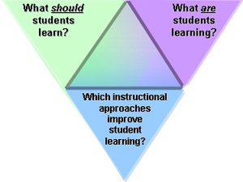
THE CARL WIEMAN SCIENCE EDUCATION INITIATIVE
Student Learning Outcomes in Oceanography
Interactive Feedback Web!
http://www.cwsei.ubc.ca

Slide 9
Course Alignment:
Basic Questions
Student Learning Outcomes in Oceanography
Logistics Questions
Do I have assessments for all goals?
Do I have too many assessments for any goals?
Do the assessments really measure what I want?
Are assessments valuable?
Are assessments easy to use?
Notes:
UBC example of alignment…too many silicate weathering questions, not enough atm radiation.

Slide 10
Course Alignment:
Basic Questions
Student Learning Outcomes in Oceanography
Interpretation Questions
What are students learning?
Why?
Next: Consider Course CONTENT
(pedagogy and time)

Slide 11
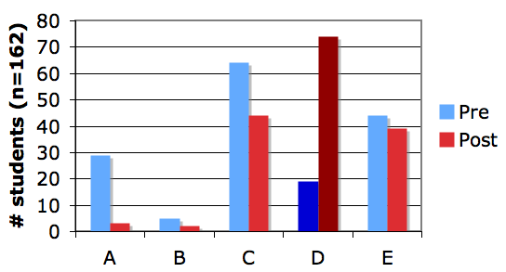
Using Assessments
Student Learning Outcomes in Oceanography
Learning goal: DESCRIBE how incoming and outgoing electromagnetic radiation interacts
with Earth’s surface and its atmosphere
Which of the following best describes how the greenhouse effect works?
A. Greenhouse gases absorb incoming solar energy
B. Greenhouse gases reflect incoming solar energy
C. Greenhouse gases absorb solar energy reflected from Earth
D. Greenhouse gases absorb energy radiated by Earth
E. Greenhouse gases reflect energy radiated by Earth
Harris, S., et al. AGU Fall Meeting, Dec. 2011
Notes:
Consider Course CONTENT (pedagogy and time): Worse-than-expected post-test results. Even at the end of term, fewer than half answer this correctly. Students arrive with various mental models of the greenhouse effect. Important verbs are poorly understood. Room for improved learning opportunities.

Slide 12
Student Learning Outcomes in Intro Oceanography
Session Goals
Rethink & Improve Goals for Student Learning
Find Assessments (Effective, yet easy to grade)
Notes:
Leave this slide up as we move to next segment

