Slide 1

Experiment:
Ice cubes melting in fresh- and salt water
See also:
http://www.lawrencehallofscience.org/comsci/pdfs/2_Teaching_and_Learning.pdf
http://www.usc.edu/org/cosee-west/glaciers/Ice_Cube_ExptFINAL.pdf
http://www.cesn.org/cosee_CD/web/activity/Melting_Ice.pdf
Mirjam S. Glessmer (mglessmer@gmail.com)

Slide 2
Setup
Groups of 2-4 students
Find a space so that you are sitting around a flat surface that all of you can easily see
Clear that space (food coloring coming up!)
Nominate one person per group to be the one who will get up when you need to fetch things
Mirjam S. Glessmer (mglessmer@gmail.com)

Slide 3
Introduction
fresh water
salt water
Mirjam S. Glessmer (mglessmer@gmail.com)

Slide 4
Introduction
Ice cube
Ice cube
fresh water
salt water
Mirjam S. Glessmer (mglessmer@gmail.com)

Slide 5
Make a prediction:
When the ice cubes are added, which of the ice cubes will melt faster, the one in fresh water or the one in salt water?
Why?
Mirjam S. Glessmer (mglessmer@gmail.com)

Slide 6
Setup
Each group needs
  One beaker of salt water
  One beaker of fresh water
  Two ice cubes (ideally of the same size)
  Food coloring
Mirjam S. Glessmer (mglessmer@gmail.com)

Slide 7
Observe
What happens?
How quickly do the ice cubes melt?
Take the time from when you add the ice cubes until both have melted completely
Does one melt faster than the other?
Mirjam S. Glessmer (mglessmer@gmail.com)

Slide 8
Use this experiment to discuss:
Scientific method
Mirjam S. Glessmer (mglessmer@gmail.com)

Slide 9
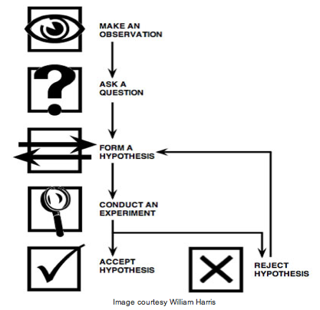
Use this experiment to discuss:
Scientific method
Mirjam S. Glessmer (mglessmer@gmail.com)

Slide 10
Use this experiment to discuss:
Scientific method
Lab protocol
Mirjam S. Glessmer (mglessmer@gmail.com)

Slide 11
Use this experiment to discuss:
Scientific method
Lab protocol
  How to document your experiments
  Writing down your hypothesis and how you are planning on testing it
Mirjam S. Glessmer (mglessmer@gmail.com)
Notes:
Now take your food dye and add one drop on each of the ice cubes!

Slide 12
Use this experiment to discuss:
Scientific method
Lab protocol
Oceanography
  Salt in the ocean
  Density driven currents / what else drives currents?
Mirjam S. Glessmer (mglessmer@gmail.com)

Slide 13
Use this experiment to discuss:
Scientific method
Lab protocol
Oceanography
  Salt in the ocean
  Density driven currents / what else drives currents?
Climate
  Importance of ocean currents
  Global warming and salinity / freshwater / THC
Mirjam S. Glessmer (mglessmer@gmail.com)

Slide 14
Alternative setups for different purposes
Structured activity
  Make prediction about which is going to melt faster, test, discuss
Problem-solving
  Get materials without knowing which cup contains the salt water; design experiment to figure out which cup contains what
Open-ended investigation
  Use materials to learn about S/F, W/C, density
Mirjam S. Glessmer (mglessmer@gmail.com)

Slide 15
Debrief – discussion points
Salt affects the freezing point
Salt crystals dissolve ice
Salt water is denser than fresh water
Less ice will be in contact with salt water
Buoyancy
“like dissolves like”
Relative heat capacity of water
Molecular structure of NaCl
Mirjam S. Glessmer (mglessmer@gmail.com)

Slide 16
Debrief
fresh water
salt water
Mirjam S. Glessmer (mglessmer@gmail.com)

Slide 17
Debrief
fresh water
salt water
Mirjam S. Glessmer (mglessmer@gmail.com)

Slide 18
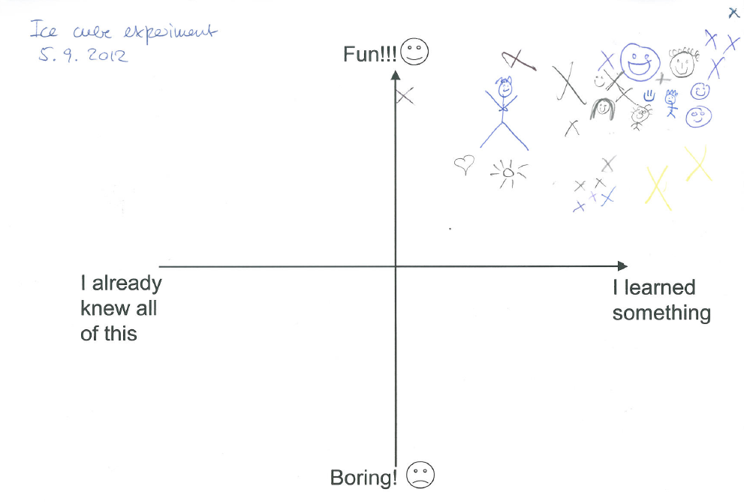
Evaluation
Mirjam S. Glessmer (mglessmer@gmail.com)

