Slide 1
On the Cutting Edge workshop on Teaching Oceanography
Sustainability; Stewardship; Ocean Resources, International Policy
San Francisco, CA
June 18-21, 2013

Slide 2

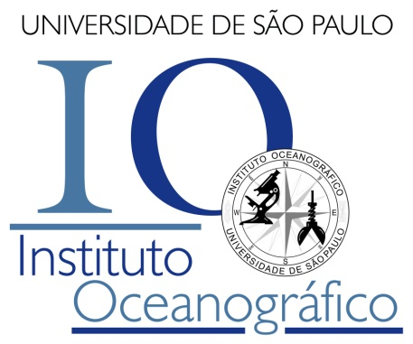

Ocean Governance
Undergraduate course on Oceanography
Integrated Management and Environmental Impact Assessment
Prof. Dr. Alexander Turra

Slide 3
Integrated Coastal Management
Concepts:
Sectorial integration
Social participation
Criticism
Problematic / Participatory / Dialectic / Heuristic
(Pedagogy of the oppressed – Paulo Freire)

Slide 4
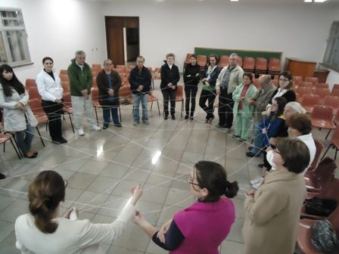
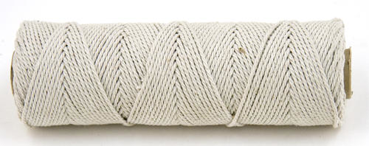
Integrated management and the social network (stakeholders)
Strategy
Presenting students
Capturing basic information
Network concepts
Need of cooperation
(30 minutes)

Slide 5
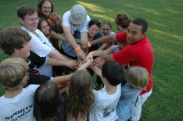
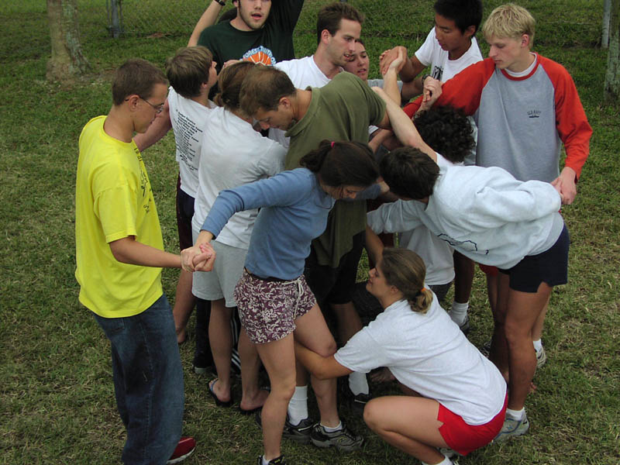

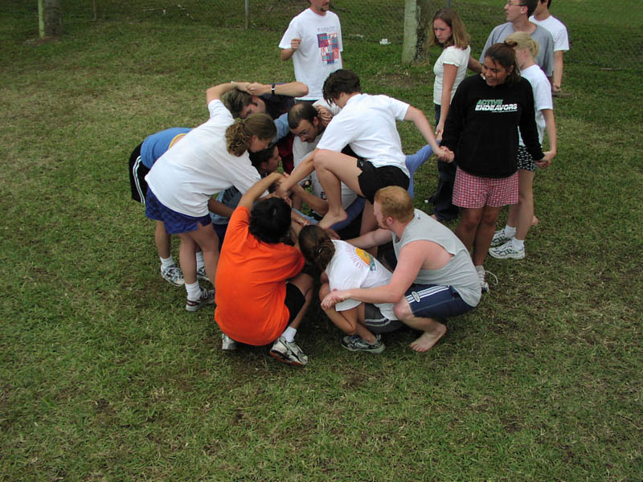
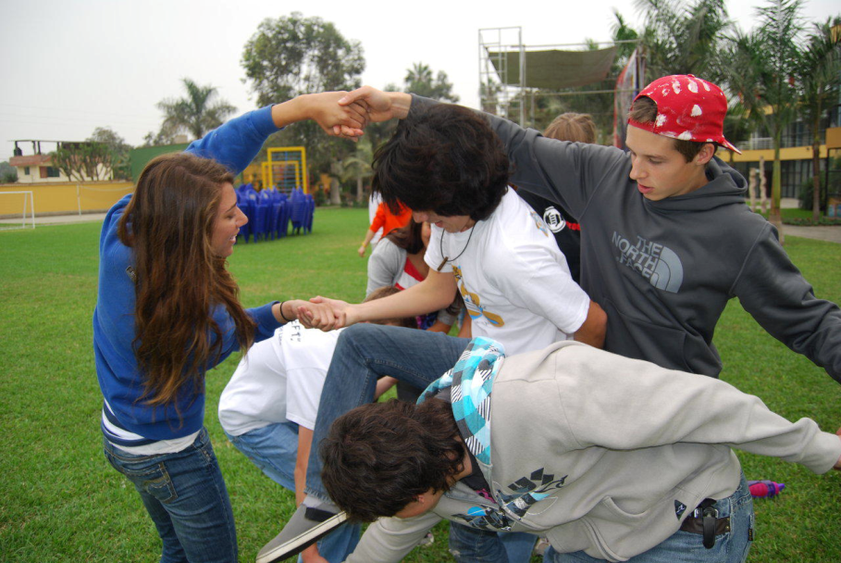
Integrated problem solving – The human knot
Strategy
Presenting students
Discussing joint problem solving
Need of cooperation
(30 minutes)

Slide 6
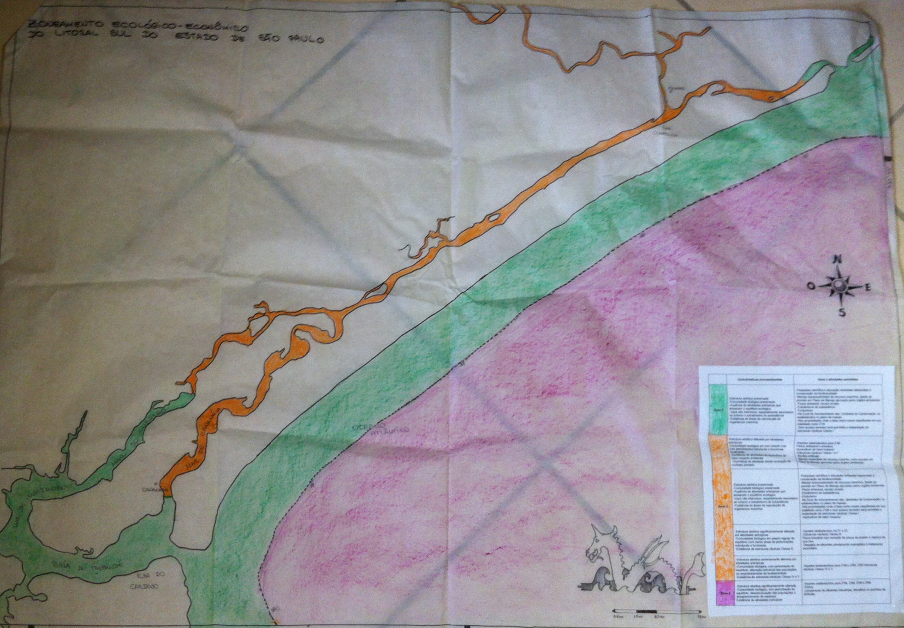
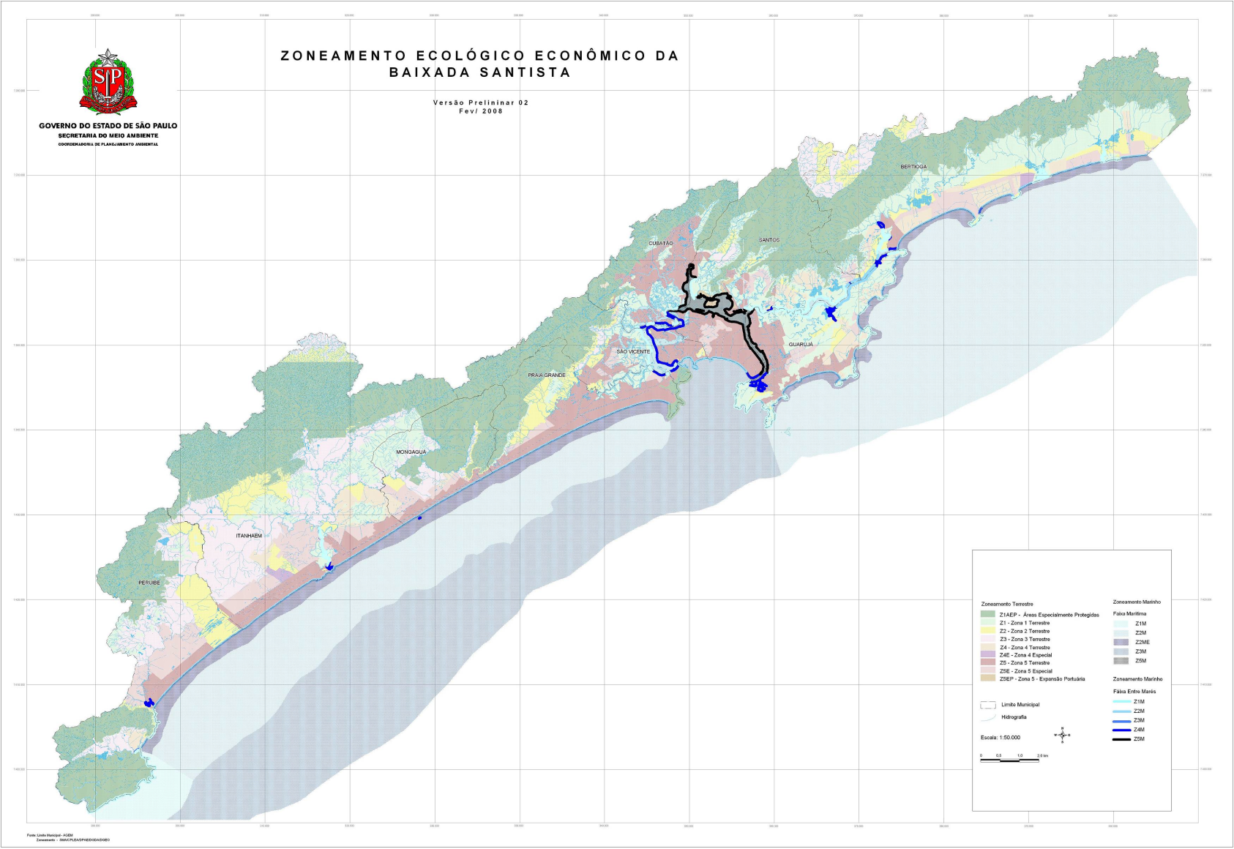
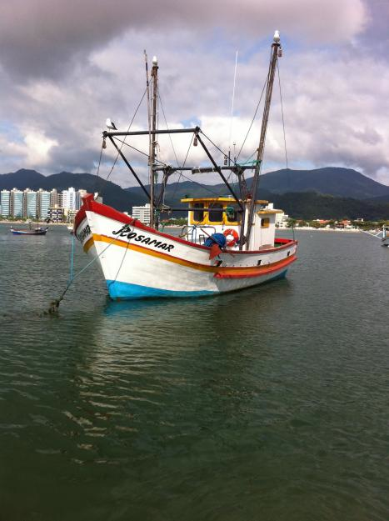
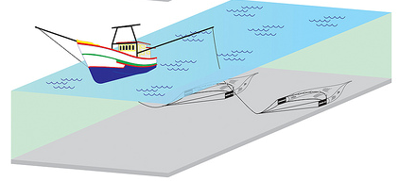
Coastal planning
Ecologic-Economic Zoning
Strategy
Group (homework) + Plenary
Science-Management integration
Need of cooperation
Possible vs. Ideal – Planning without information
(Several classes)

Slide 7
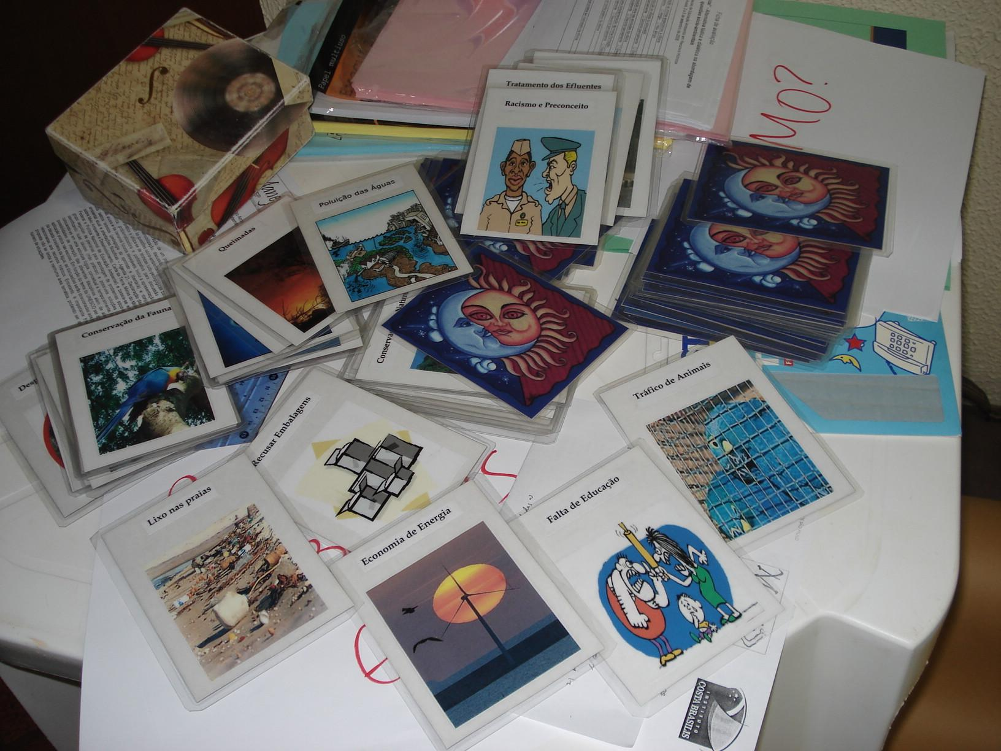
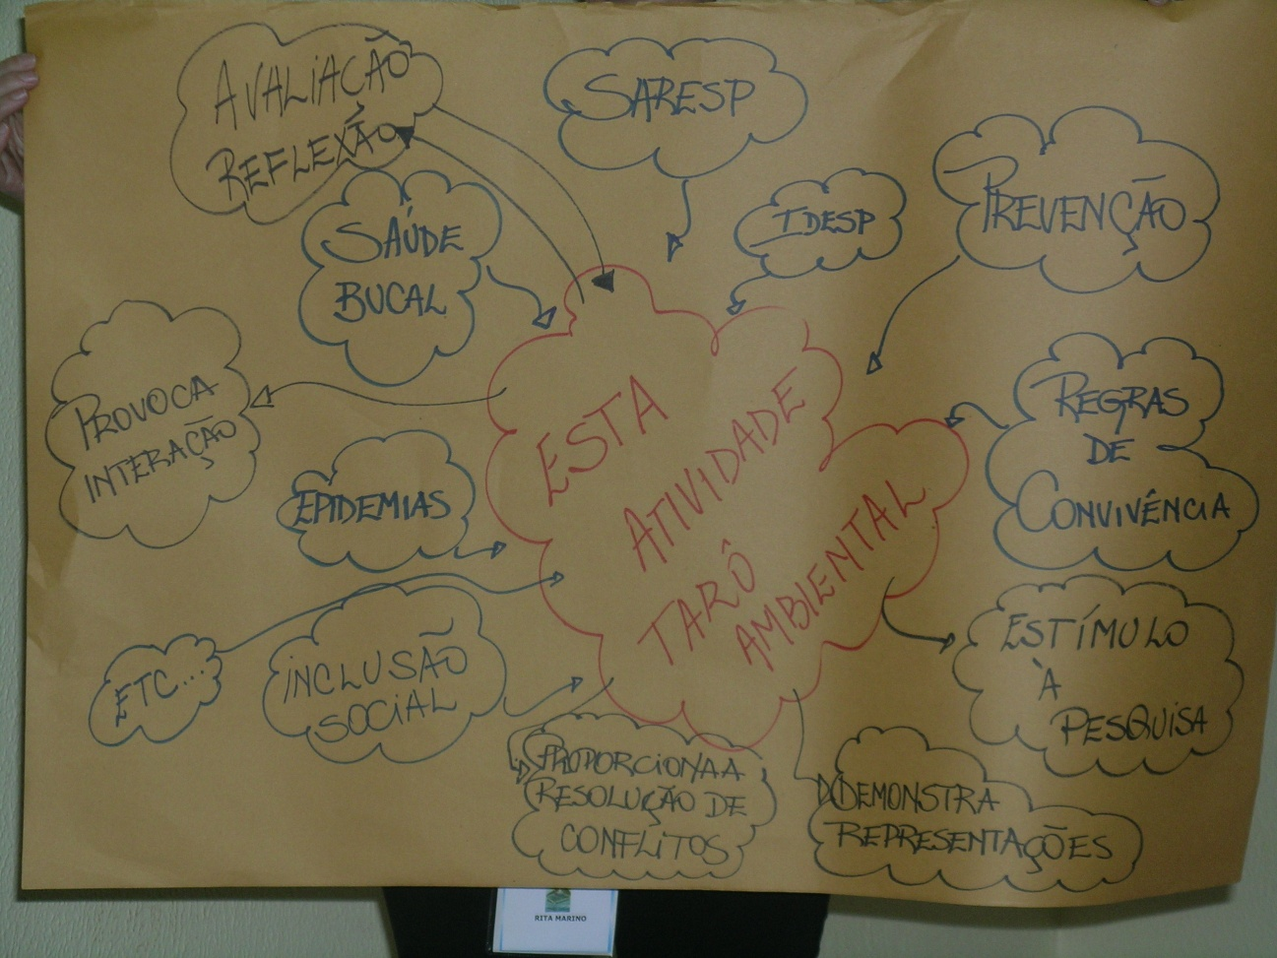

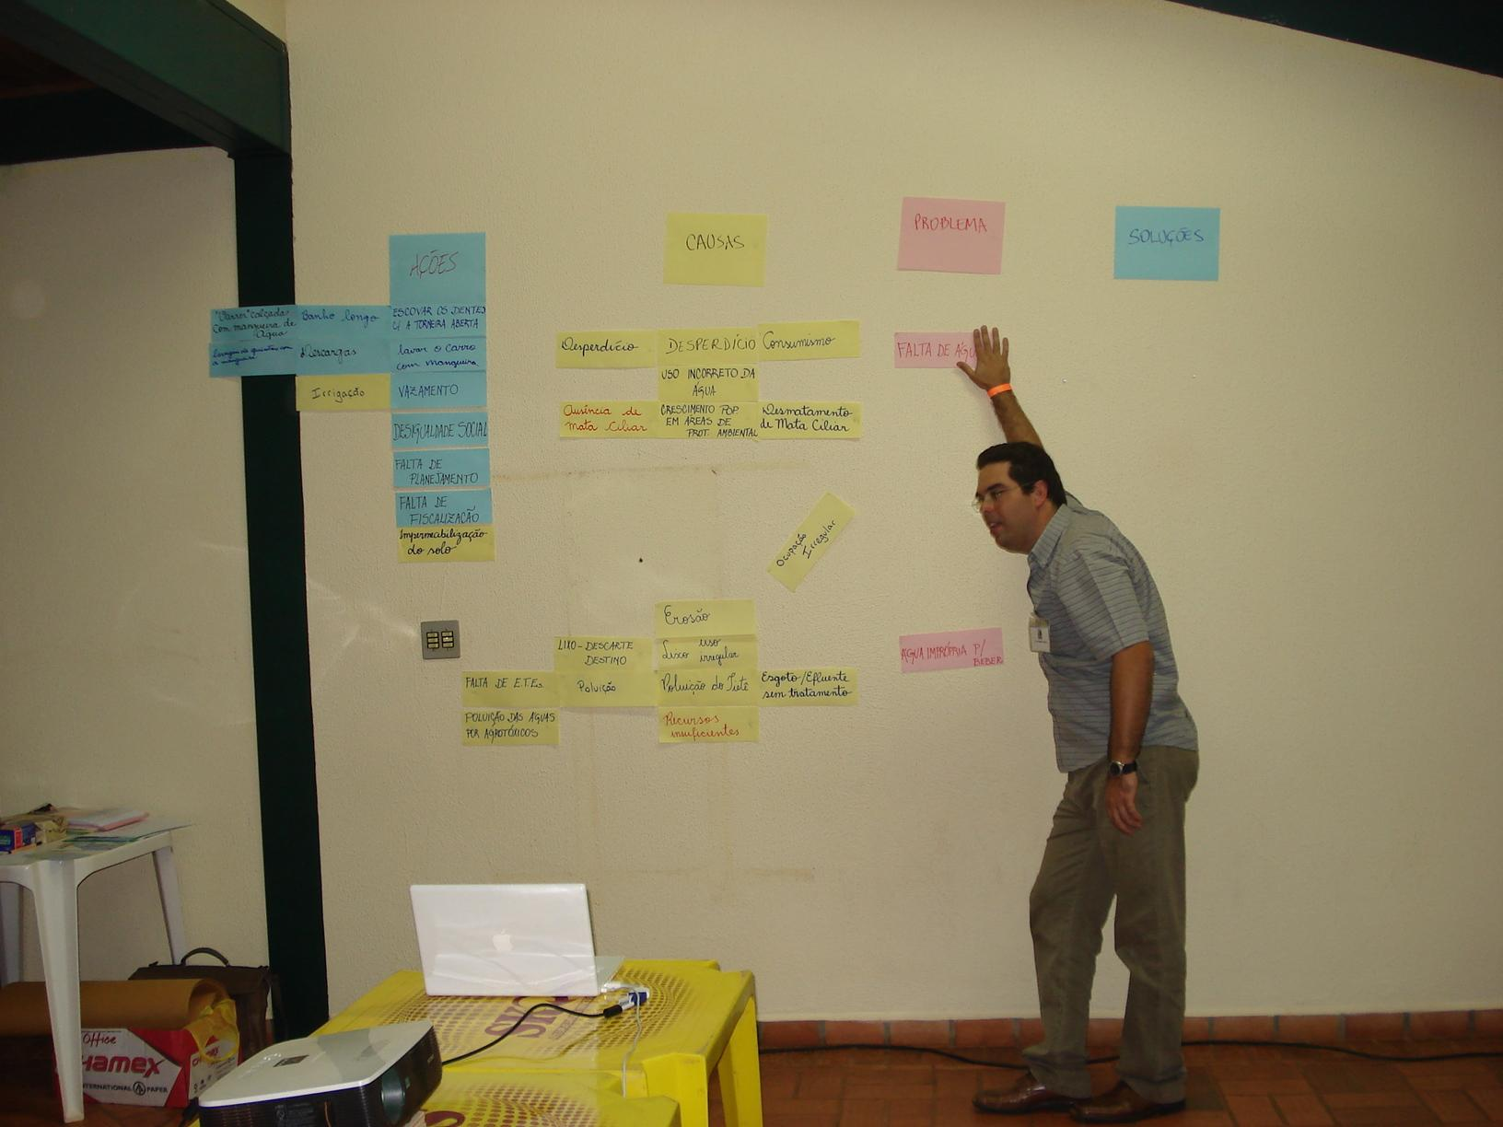
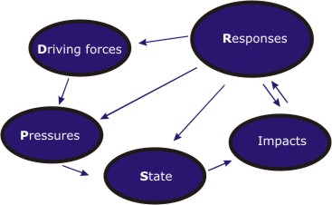
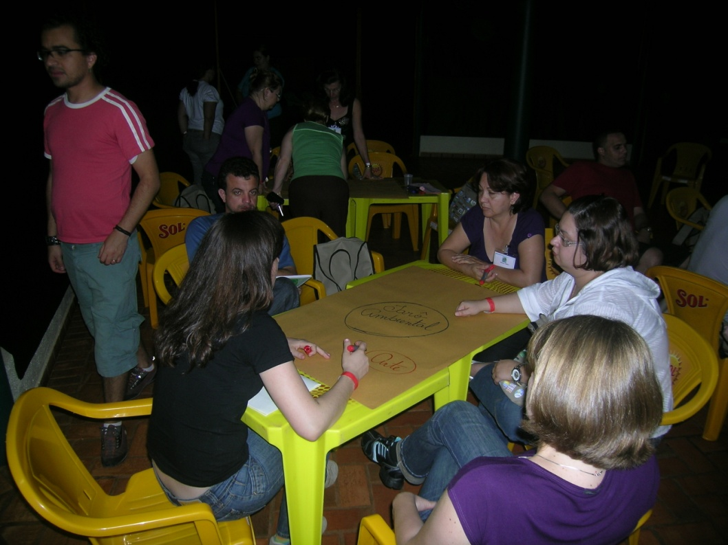
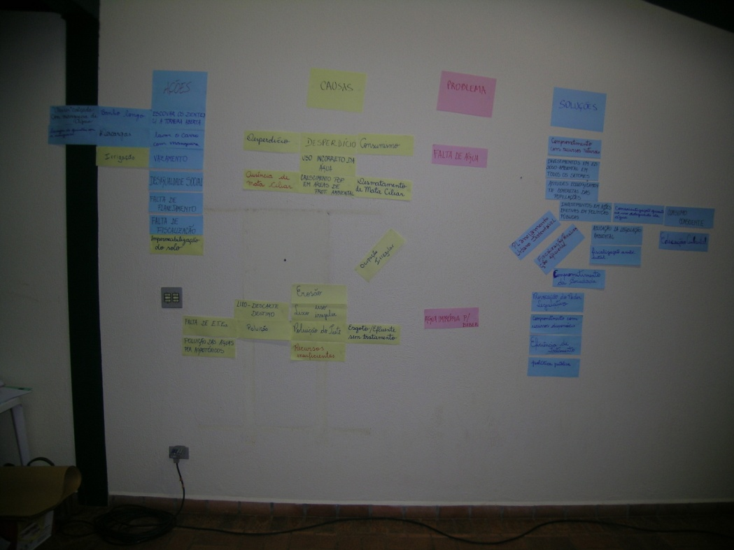
Participatory planning – The Environmental Tarot
Strategy
Workshop - Group + Plenary
Problem diagnosis
Identification of causes and solutions
Potential applications
(4 hours)

Slide 8
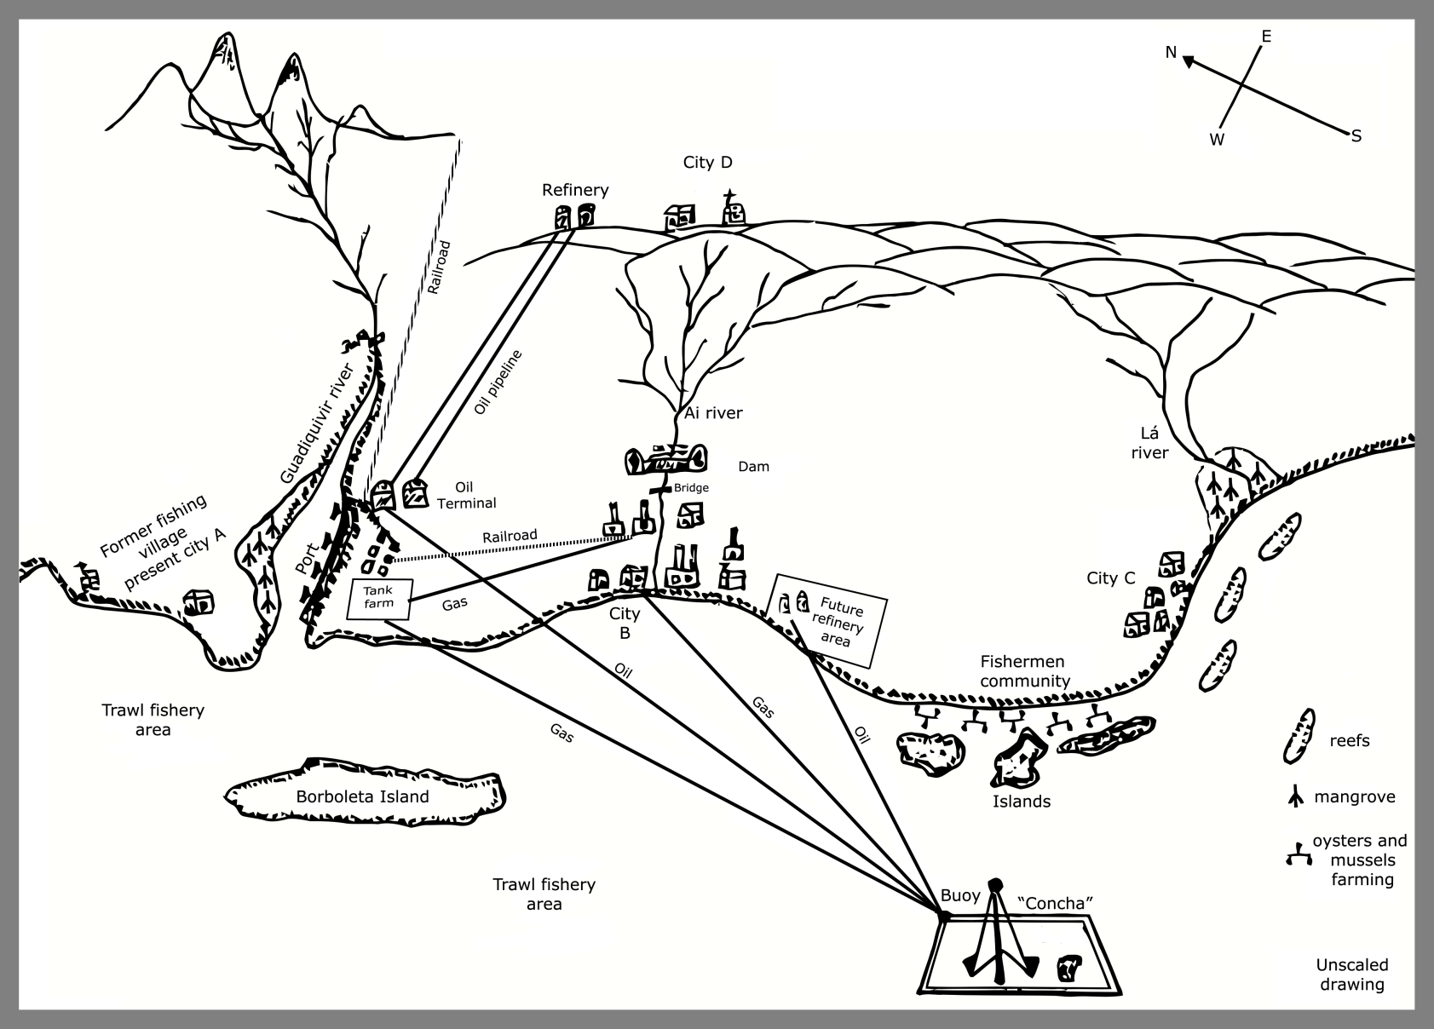
Environmental Impact Assessments – The Poponia exercise
Strategy
Directed discussions - Group + Plenary
Pros and cons of alternatives
Role of governmental technicians
Decision making without legal mark
(3 classes)

Slide 9
Synthesis
Goals
Motivate and engage students
Stimulate problem solving
Link basic disciplines
Project professional activities

