Slide 1
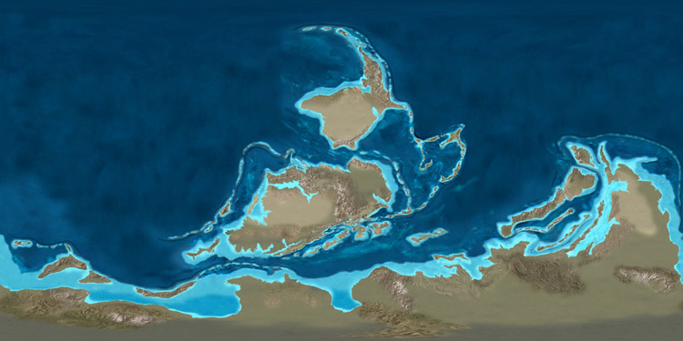
Mapping Paleocurrents:
Using the Past to Understand the Present
Laurie Grigg and David Westerman
Department of Geology and Environmental Science
Norwich University
Northfield, VT 05663
Image from http://www2.nau.edu/rcb7/rect_globe.html

Slide 2
Activity Goals/Outcomes:
To understand the processes that create surface currents and oceanic gyres;
To be able to evaluate how changes in the position of the continents alters surface currents;
To be able to create plausible patterns of surface currents based on what is known from the present;
To be able to evaluate how surface currents impact oceanic heat transport and climate.

Slide 3
In-class Activity or Lab
Currently used as part of a 2-hour lab – 5 paleomaps;
Could be shortened to an in-class, group activity by dividing maps among groups or just doing 1-2 maps.

Slide 4
Skills and Concepts Needed for this Activity
Understand large-scale patterns of global atmospheric circulation (Trade Winds, Westerlies, and the Polar Easterlies);

Slide 5
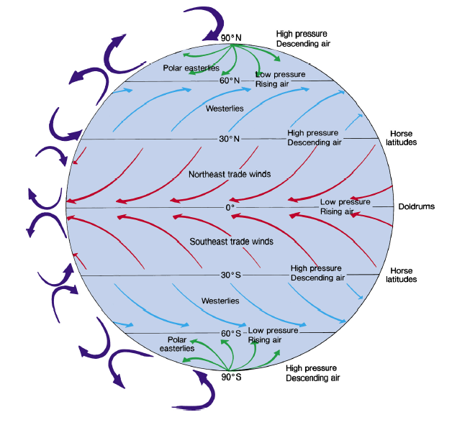

Slide 6
Skills and Concepts Needed for this Activity
Understand large-scale patterns of global atmospheric circulation (Trade Winds, Westerlies, and the Polar Easterlies);
Understand the impacts of wind stress, the Coriolis Effect, and surface friction on surface currents;

Slide 7
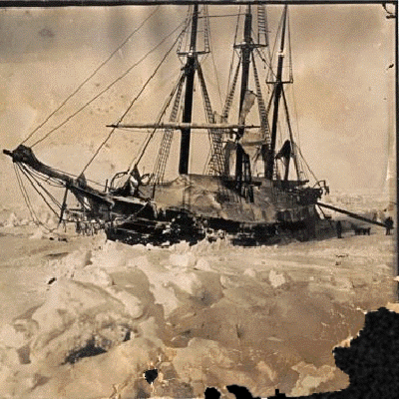
Fridtjof Nansen 1890s
Fram frozen for 6 yrs in Arctic Sea
Drift to North Pole
First noted offset between wind and ocean currents

Slide 8
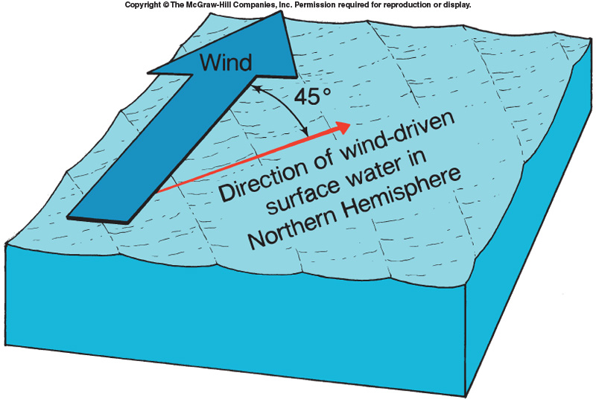

Slide 9
Skills and Concepts Needed for this Activity
Understand large-scale patterns of global atmospheric circulation (Trade Winds, Westerlies, and the Polar Easterlies);
Understand the impacts of wind stress, the Coriolis Effect, and surface friction on the creation of oceanic gyres;
Understand the difference between wind-driven surface currents and boundary currents;

Slide 10
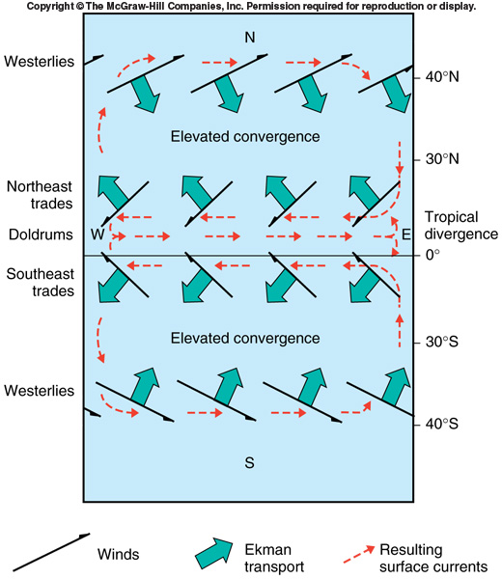

Slide 11
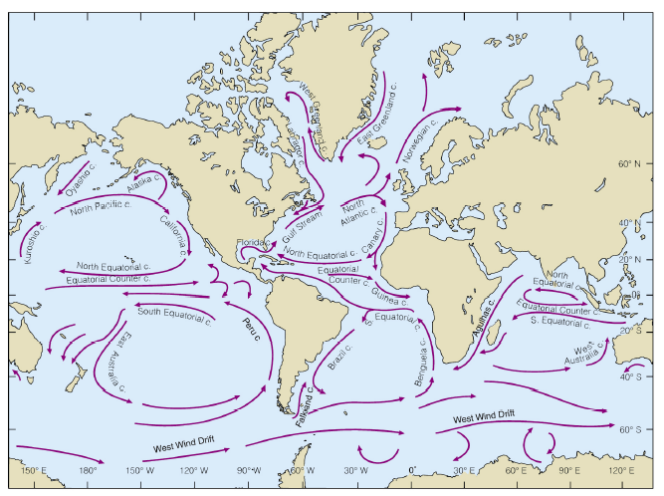

Slide 12
Skills and Concepts Needed for this Activity
Understand large-scale patterns of global atmospheric circulation (Trade Winds, Westerlies, and the Polar Easterlies);
Understand the impacts of wind stress, the Coriolis Effect, and surface friction on the creation of oceanic gyres;
Understand the difference between wind-driven surface currents and boundary currents;
Understand the concept of oceanic heat transport;

Slide 13
http://www.ospo.noaa.gov/data/sst/contour/global.cf.gif

Slide 14
Supplies
Maps from 2-5 geologic time periods with different configurations of continents;
Textbook or slides showing current patterns of surface currents and global atmospheric circulation for reference;
Pencils and colored pencils (blue and red).

Slide 15
Map Sources
Black and white with latitude and longitude grid lines;
What I use:

Slide 16
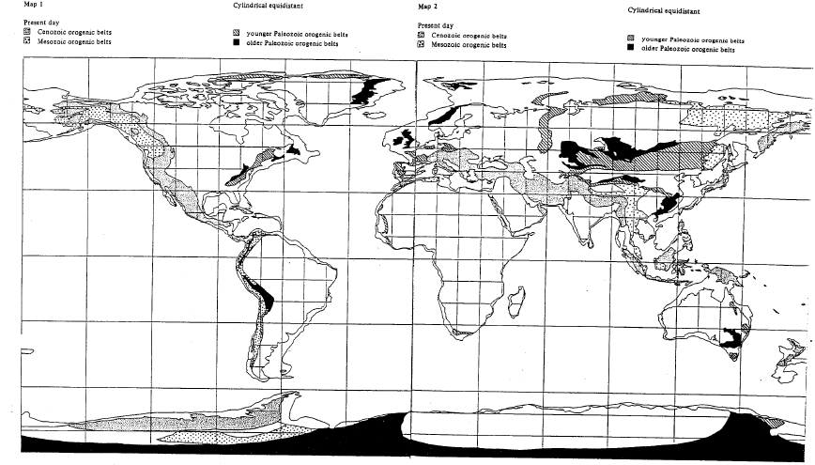
Present -Day
Scanned maps that I use

Slide 17
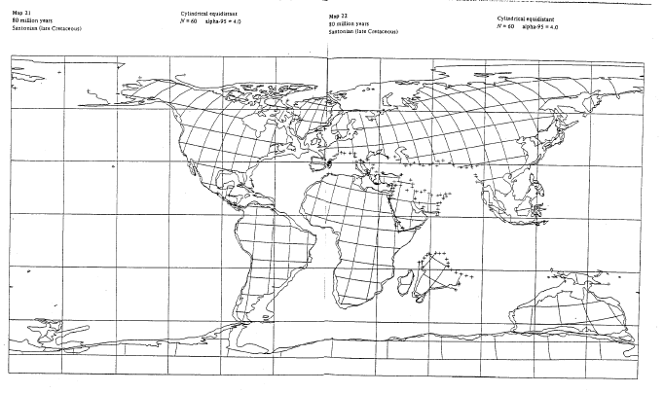
80 Million Years Ago

Slide 18
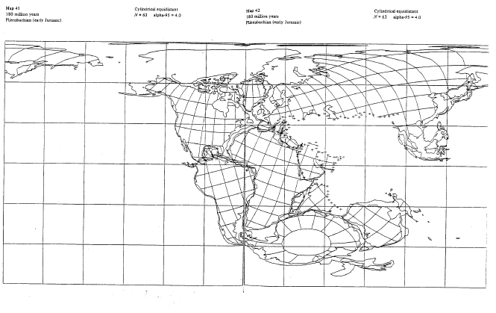
180 million Years Ago

Slide 19
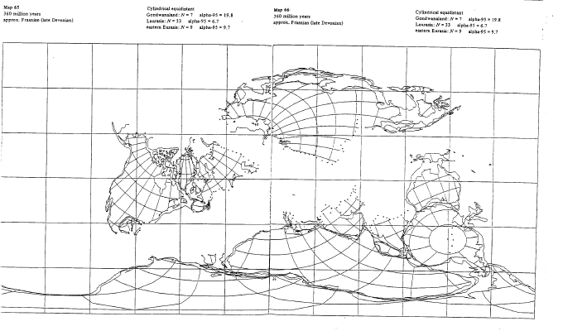
360 Million Years Ago

Slide 20
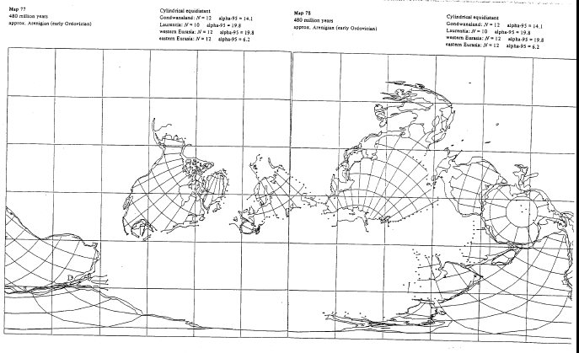
480 Million Years Ago

Slide 21
Map Sources
Black and white with latitude and longitude grid lines;
What I use:
Online sources:
  Library of Paelogeography by Ron Blakey; color images with grid lines for all time periods. http://www.cpgeosystems.com/mollglobe.html
  The Paleogeographic Atlas Project from the University of Chicago; nice maps with latitude and longitude grid lines but only for early Permian to Lake Cretaceous. http://www.geo.arizona.edu/~rees/PGAPhome.html
  Paleomap Project by Christopher R. Scotese; very nice color maps for all time periods but without grid lines, also has nice paleoclimate maps. http://www.scotese.com/earth.htm

Slide 22
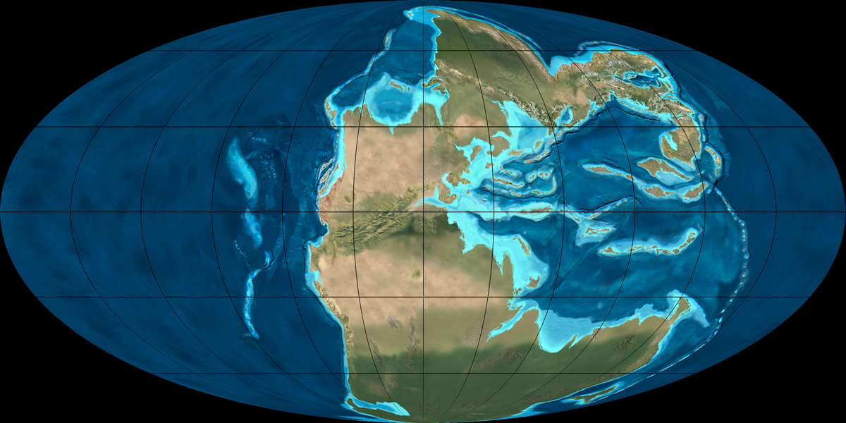

Slide 23
Some Important Assumptions
Assume that the Earth is tilted 23.5⁰ and has similar orbital parameters (eccentricity and obliquity) as today.
Therefore, distribution of insolation and global heating are similar to present.
Therefore, global atmospheric wind patterns are the same to present.
Note opportunity to mention this was NOT actually the case.

Slide 24
Basic Instructions
Draw in location of Trade Winds, Westerlies and Polar Easterlies in pencil (lightly and not too many arrows).
Draw in surface currents based on winds, location of continents, and accounting for the Coriolis Effect using red and blue arrows.
Shade in regions that are unusually cold or warm because they are cut off from heat transport of a gyre.
Repeat process for multiple time periods – good to start with the present.

Slide 25
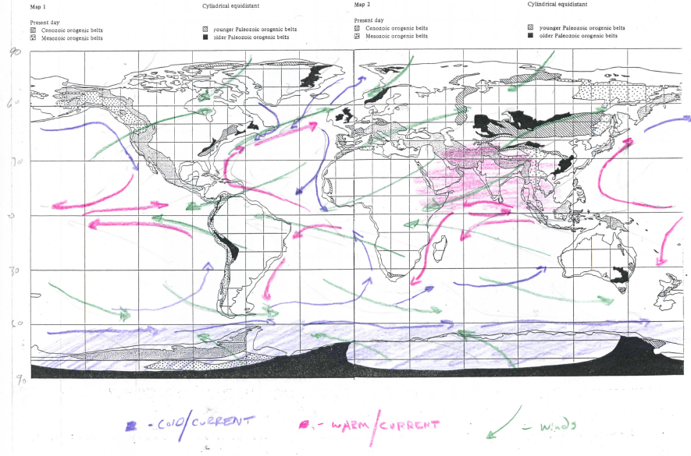
Student Examples: Present-day
Scanned examples

Slide 26
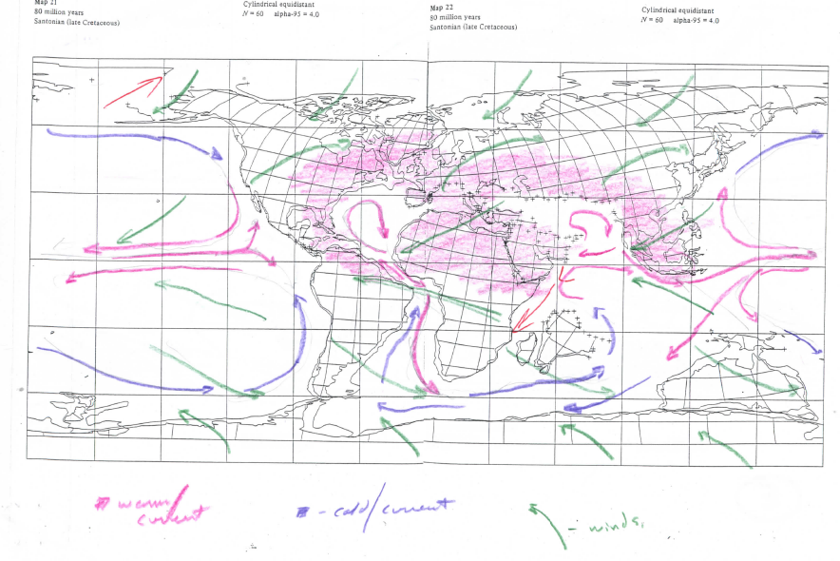
Student Examples: 80 Million Years

Slide 27
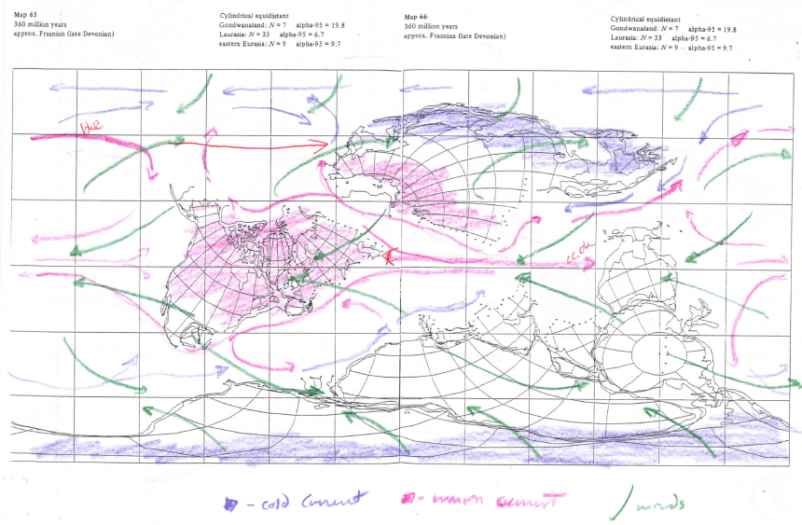
Student Examples: 360 Million Years

Slide 28
Assessment
In-class group presentation of proposed currents and/or hand-in group maps.
As a lab activity each students hands in a packet of 5 completed maps.
Are currents plausible and do they take into account winds, Coriolis Effect, surface friction, and interaction with the continents?
Is map neat and legible?

