Slide 1
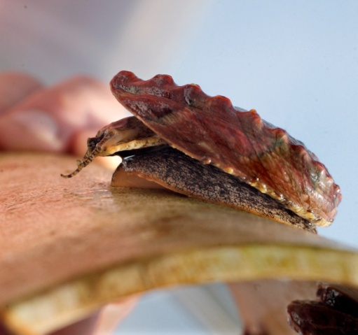
Critter du Jour:
A Way to Engage Non-Majors in a Mostly Physical Oceanography Class
Dr. Cynthia Venn
Dept. of Environmental, Geographical and Geological Sciences
Bloomsburg University of Pennsylvania

Slide 2
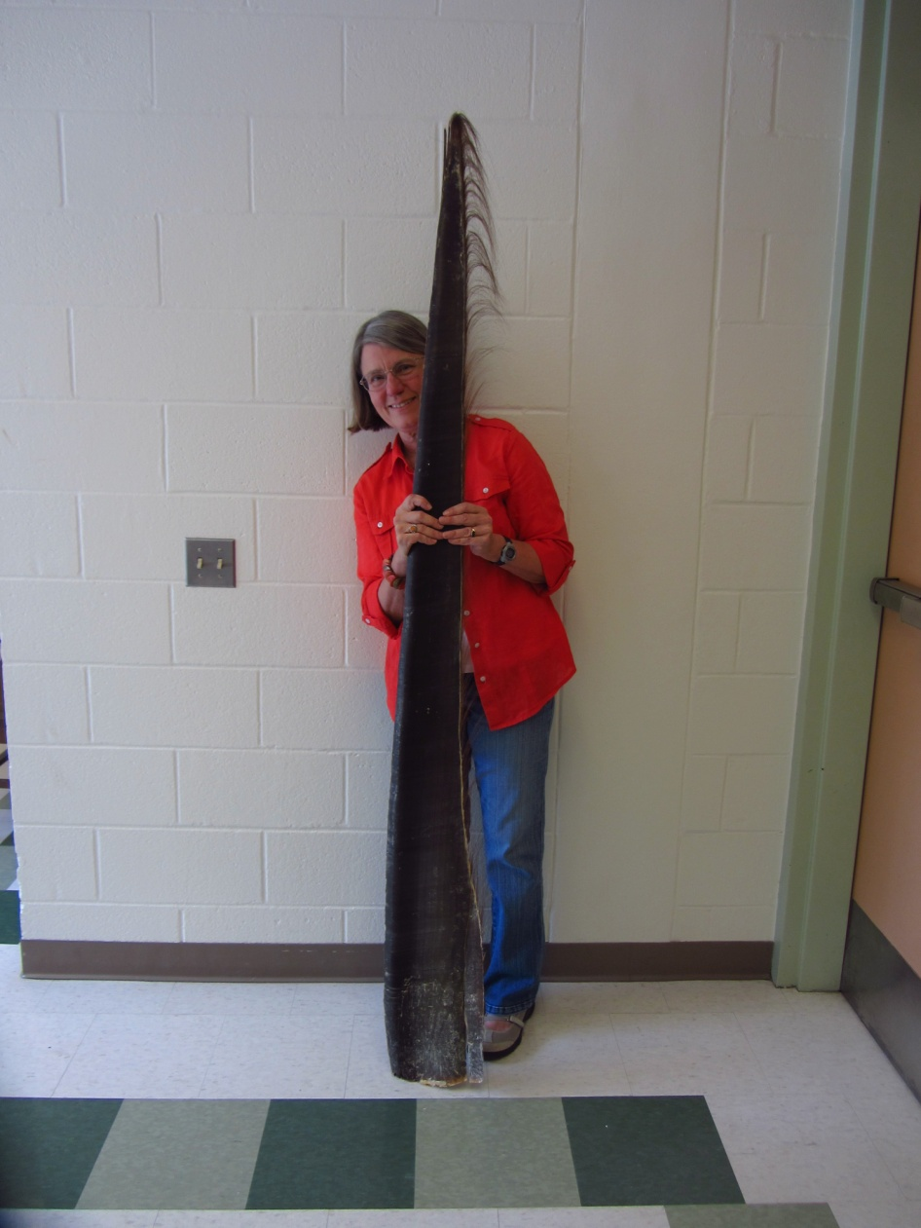
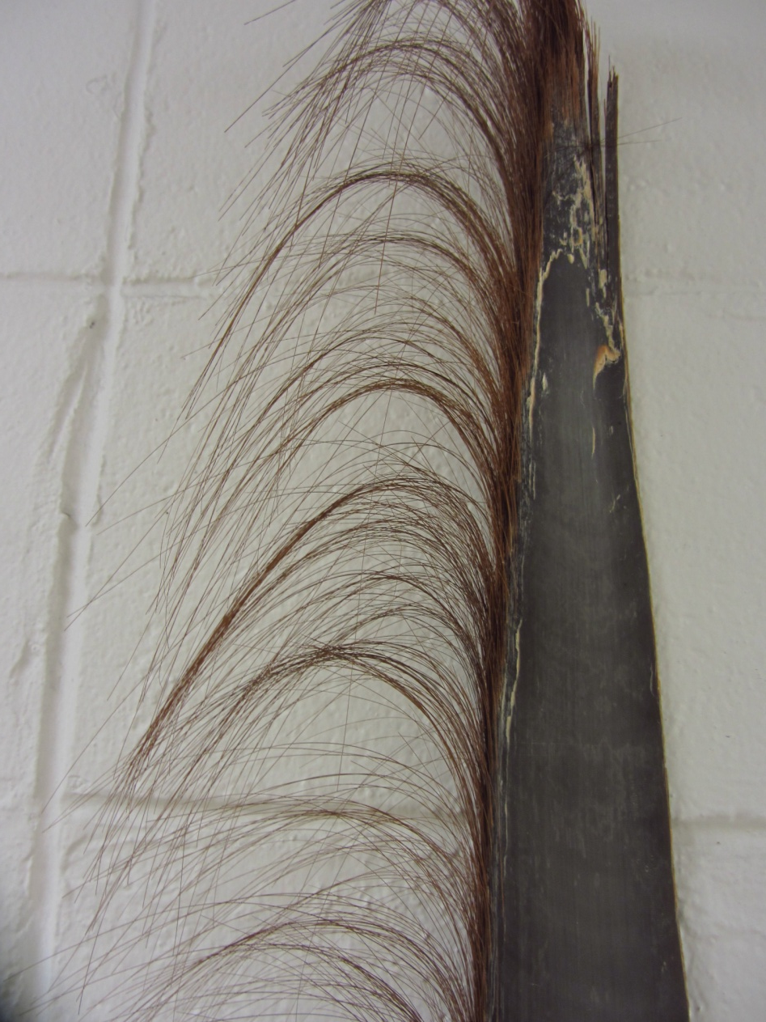
Critter Part #1 - Baleen

Slide 3
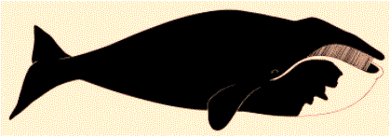
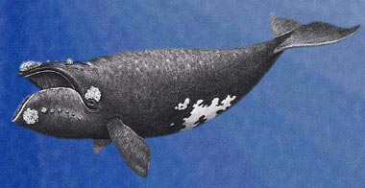
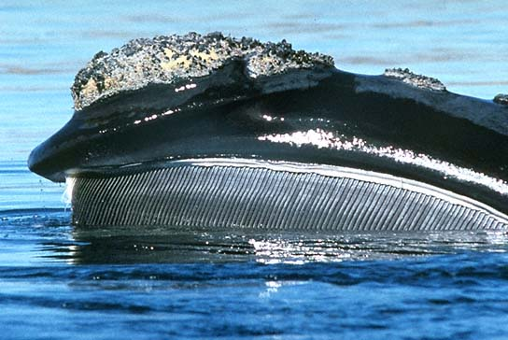
Bowhead or Northern Right Whale

Slide 4
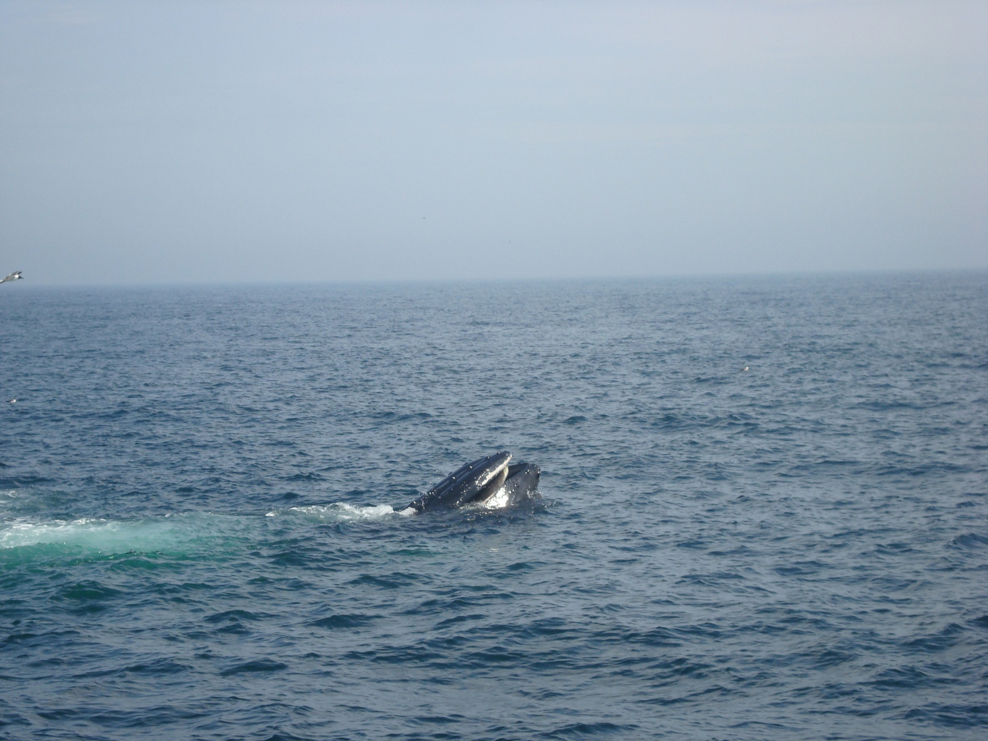
Baleen whale feeding

Slide 5
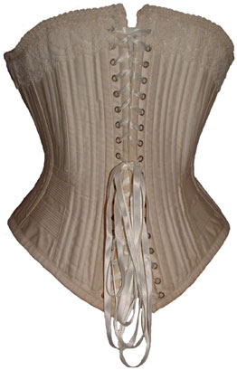
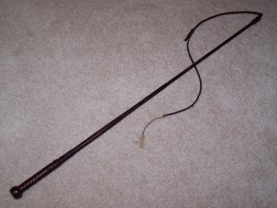
Whalebone - corsets, buggy whips

Slide 6
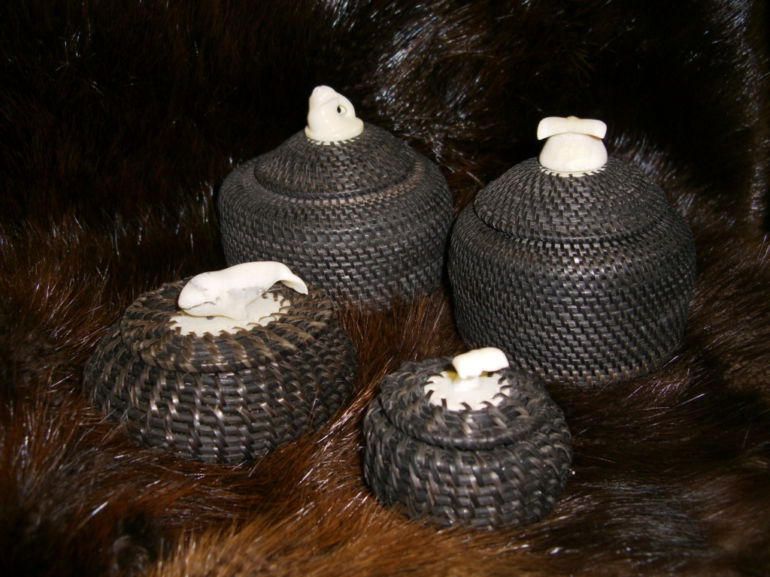
Baleen baskets

Slide 7
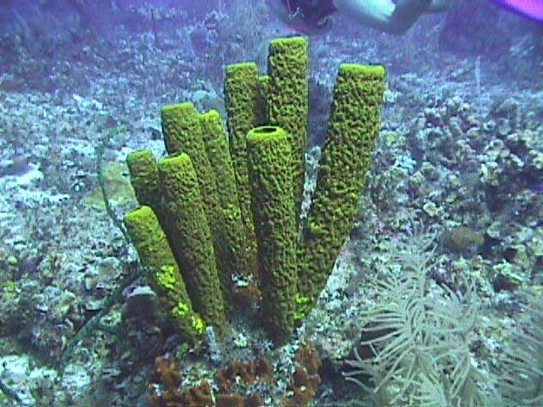
Critter #2 - Sponges

Slide 8
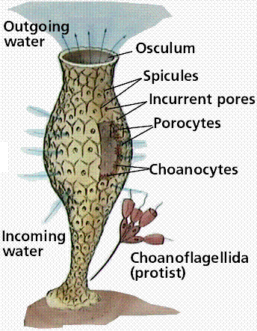
Sponge Anatomy

Slide 9
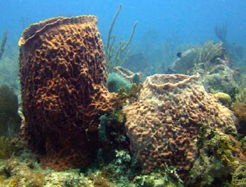
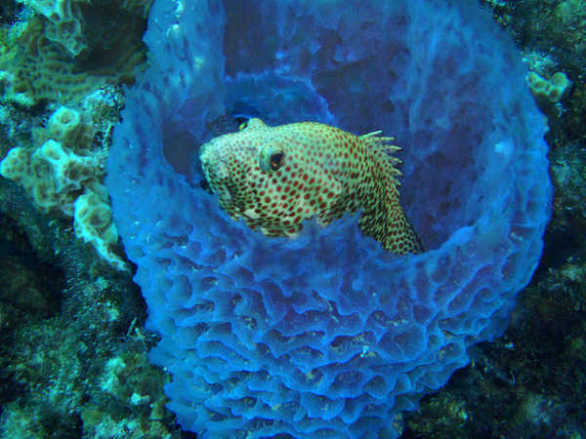
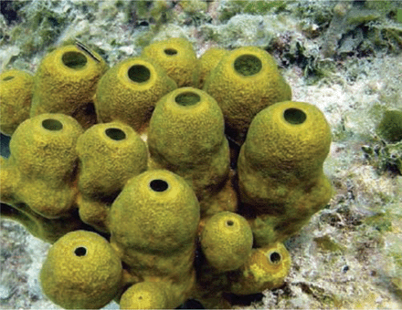
Sponge Symbionts

Slide 10
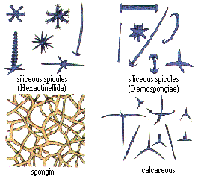
Sponge spicules

Slide 11
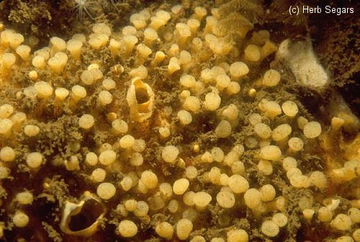
Boring Sponges

Slide 12
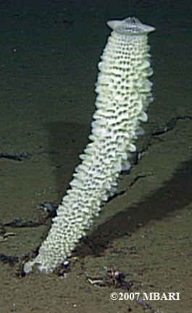
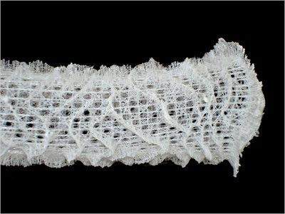
Glass Sponge – silica spicules (ouch)

Slide 13
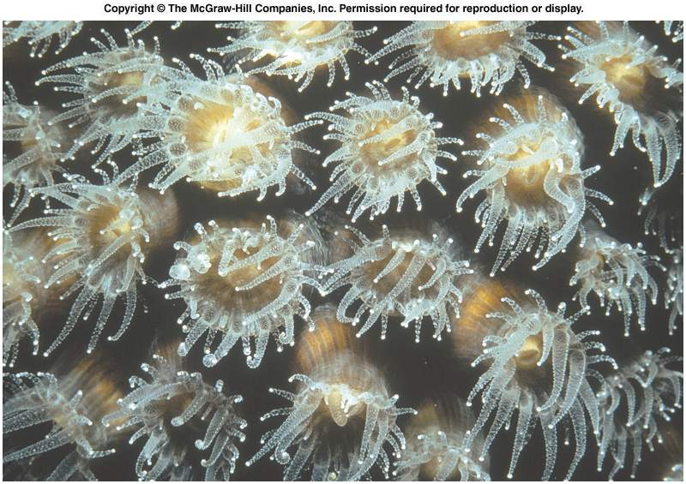
Critter #3 - Coral

Slide 14
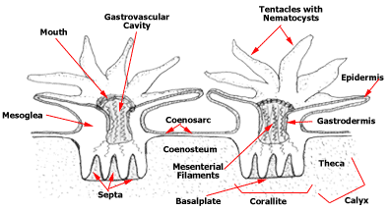
Coral Anatomy

Slide 15
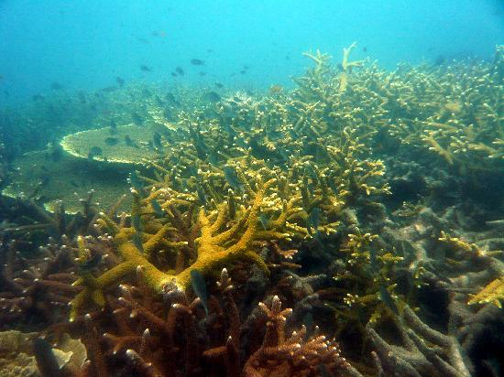
Staghorn Coral

Slide 16
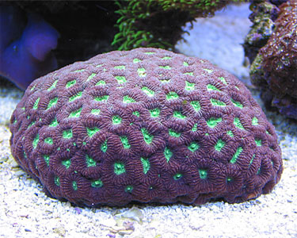
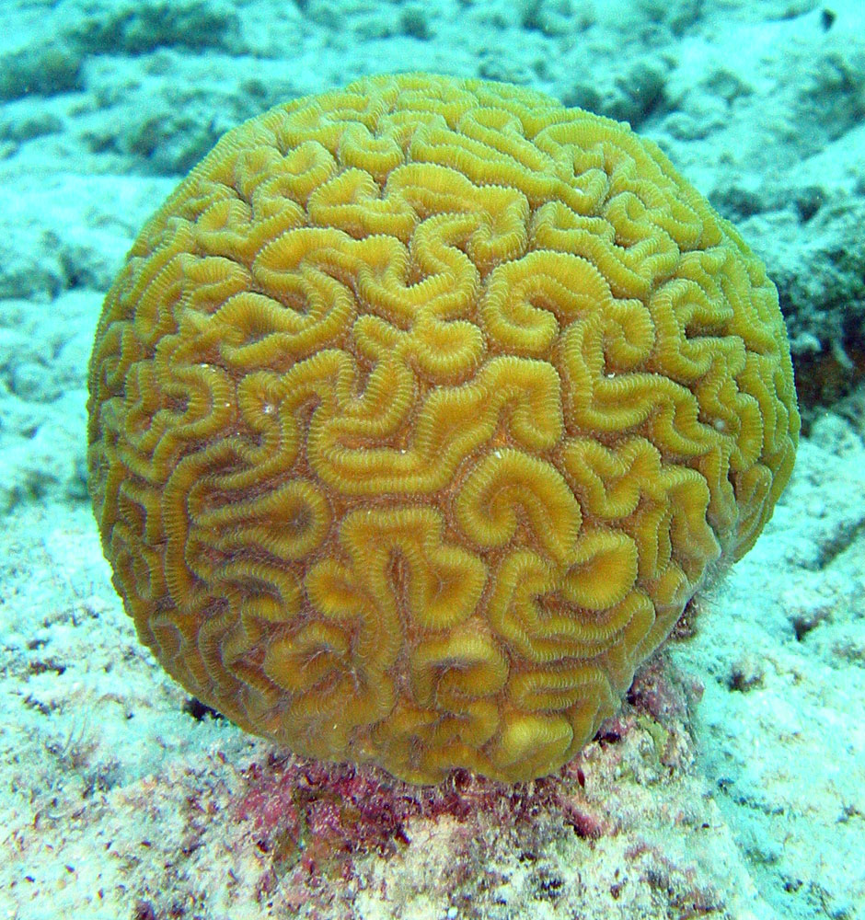
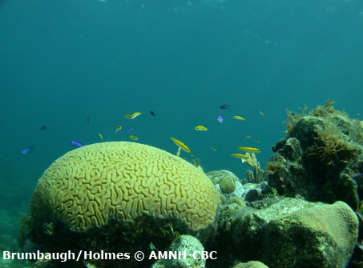
Brain Coral

Slide 17
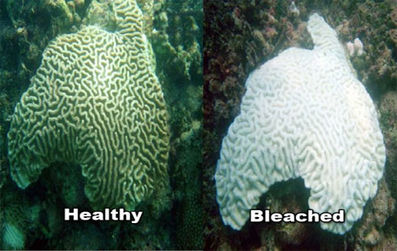
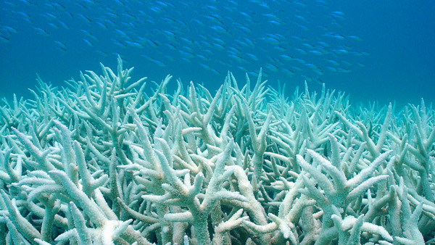
Coral Bleaching

Slide 18
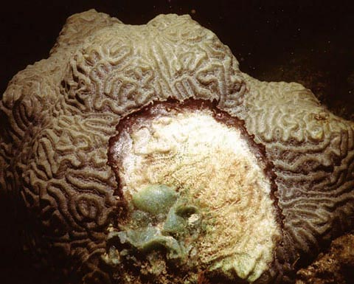
Black Band Disease

Slide 19
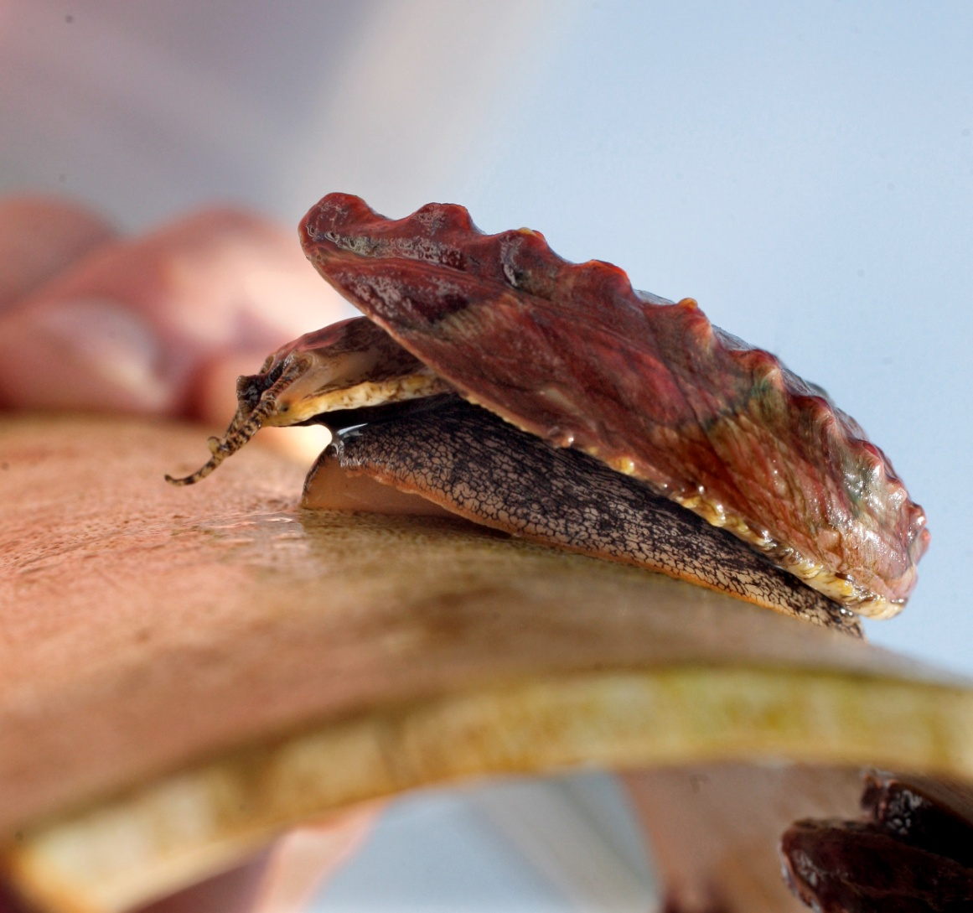
Critter #4 - Abalone

Slide 20
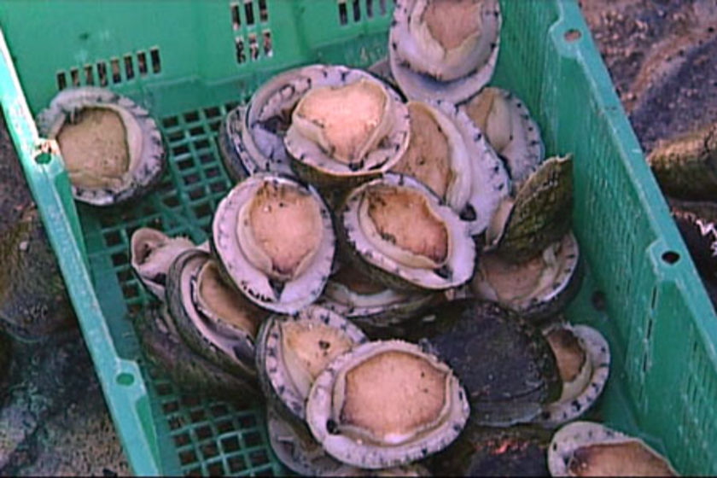
Harvested abalone

Slide 21
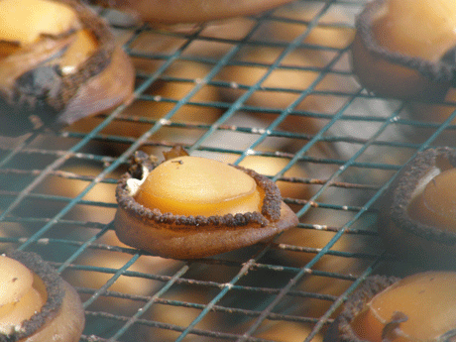
Shell-less abalone

Slide 22
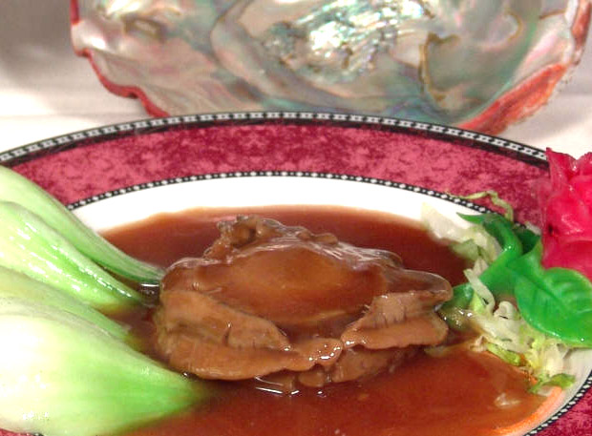
Braised abalone

Slide 23
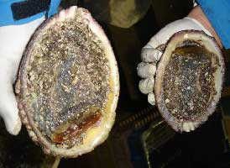
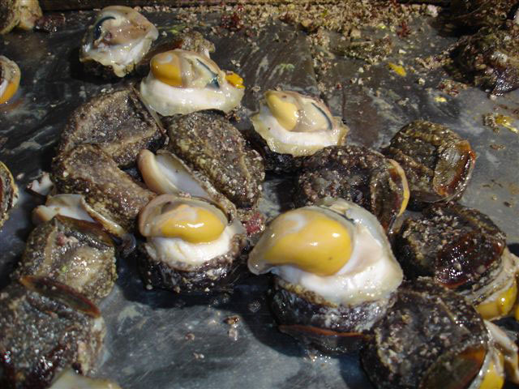
Chilean abalone ( “Locos”)

Slide 24
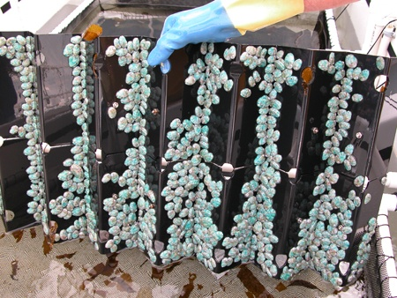
Abalone aquaculture

Slide 25
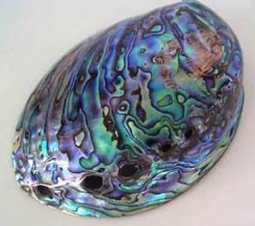
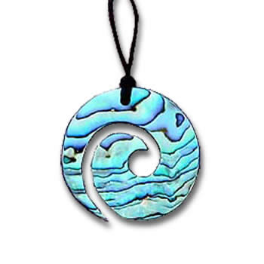
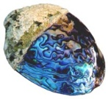
Paua – New Zealand abalone

Slide 26
Critter #5 - Barnacles

Slide 27
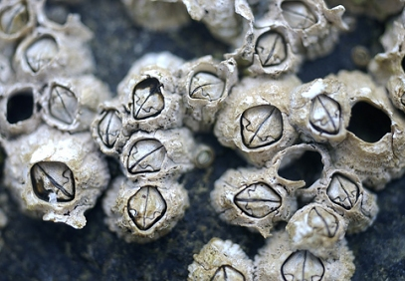
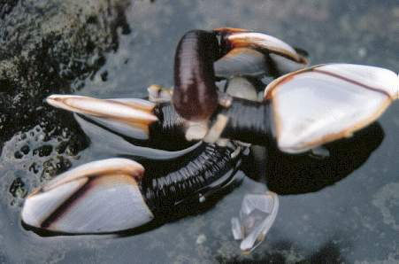
Acorn barnacles & Gooseneck Barnacles

Slide 28
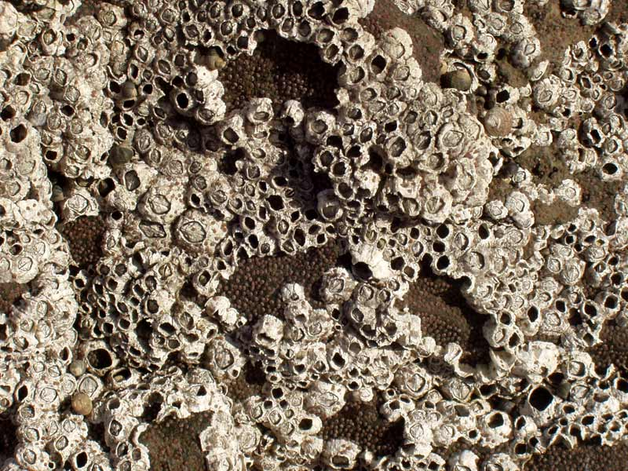

Slide 29
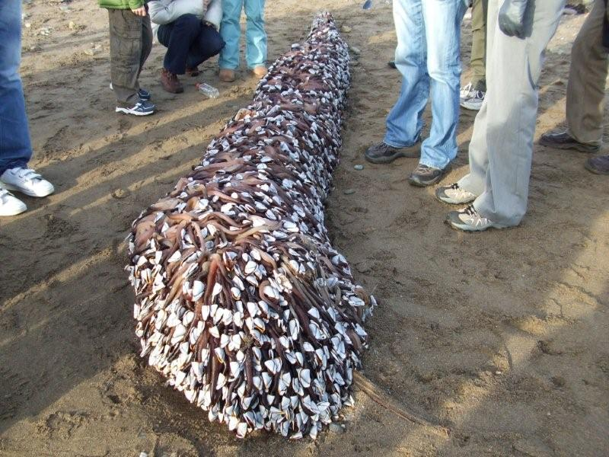

Slide 30
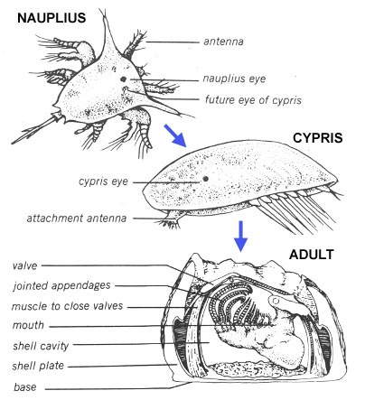
Life Cycle

Slide 31
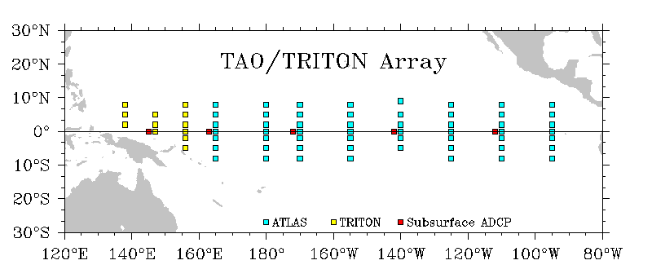
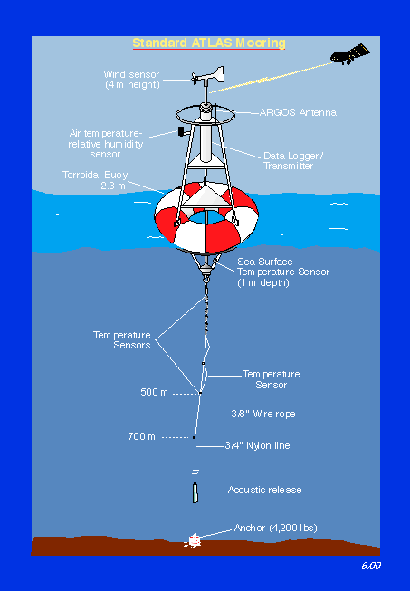
Standard TAO mooring
Courtesy of TAO Project Group, PMEL

Slide 32
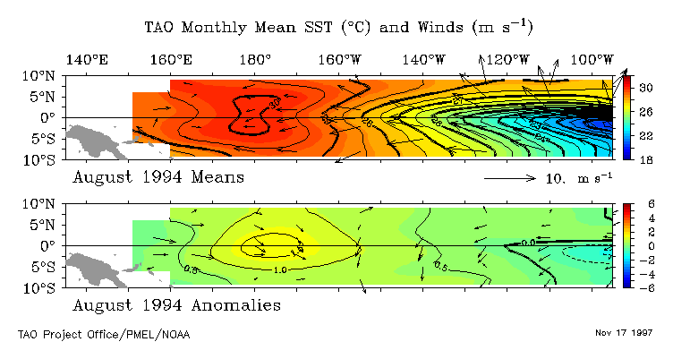
El Niño/La Niña Cycles
Normal Conditions

Slide 33
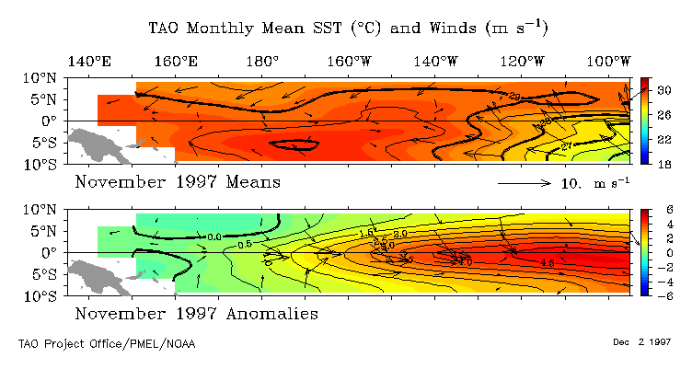
El Niño/La Niña Cycles
El Niño Conditions

Slide 34
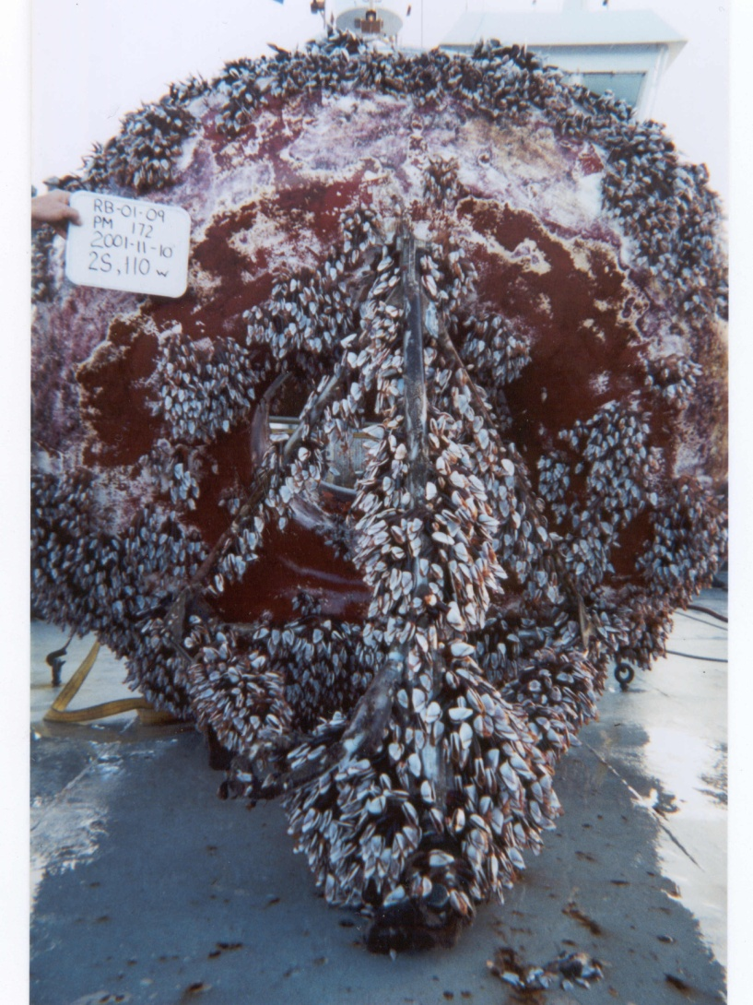
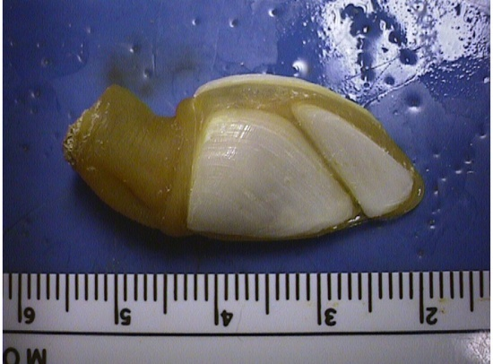
TAO Array
Typical Buoy from SE sector fouled with numerous Lepas hillii

Slide 35
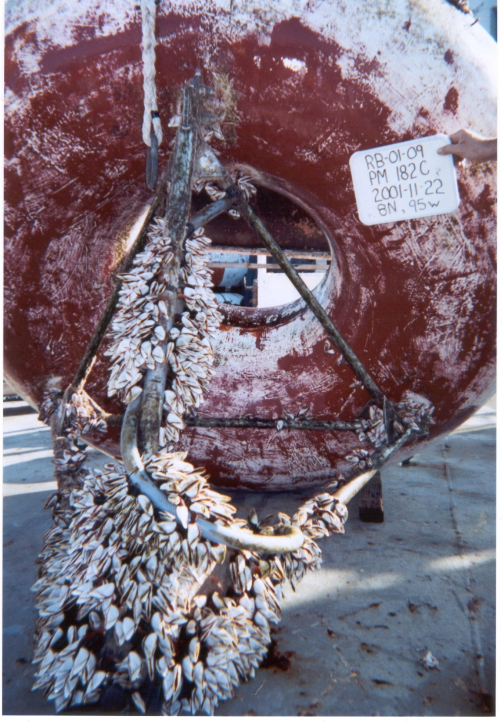

TAO Array
Typical buoy from 8°N, fouled with mostly Lepas anatifera

Slide 36


Lima, Peru
5 Aug 03
Tahiti
30 Oct 03
10 S
10 S
15 S
15 S
150
140
130
120
110
100
90
80

Slide 37


Raphaela’s problem
Barnacles recovered
from windsurfer hull
Lepas hillii
Conchoderma virgatum
Barnacles and other foulers
on the windsurfer hull

Slide 38


Barnacle Sex
http://www.coralmagazine-us.com/content/barnacle-sex-video

Slide 39
Thank you!!
Questions?

