Slide 1

Developing Interactive Lectures Using Active Learning Techniques
Al Trujillo
Department of Earth, Space, & Aviation Sciences
Palomar College San Marcos CA
atrujillo@palomar.edu
Presentation available at: http://www2.palomar.edu/users/atrujillo/
On the Cutting Edge Teaching Oceanography Workshop
San Francisco City College, San Francisco CA July 2013

Slide 2
Comparing Traditional vs.
Active Learning Classrooms
Traditional Classroom | Active Learning Classroom
Passive students | Active students
Quiet | Noisy
Instructor-focused | Student-focused
Information is conveyed from instructor to student | Information passes from student to student (peer instruction)
Students work as individuals | Student collaborate
Competitive learning environment | Supportive learning environment
Limited assessment opportunities | Multiple assessment opportunities
http://serc.carleton.edu/introgeo/interactive/howto.html

Slide 3

Why Use Active Learning?
Numerous studies indicate that students learn better and achieve higher assessment scores of key concepts through active learning*
Addresses various student learning modes
Students consider active learning “fun” and “interesting”
*Sources:
Science Education Resource Center (SERC) at Carlton College http://serc.carleton.edu/introgeo/interactive/why.html
National Association of Geoscience Teachers (NAGT) Journal of Geoscience Education (various articles) http://nagt.org/index.html

Slide 4
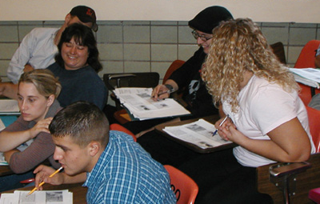
Interactive Lectures Using Active Learning: How It Works
Lecture is broken into short segments, separated by assessments (activities)
Students share their work with others in class
Activities include lecture tutorials, worksheets, analysis of graphics, group projects, etc.
Formative exercises during class are used to assess student understanding and progress
http://serc.carleton.edu/introgeo/interactive/howto.html

Slide 5

Active Learning: A Few Caveats
You give up some control of your classroom (comfort level?)
Suggestion: Don’t be afraid try new techniques, especially for topics you know your students aren’t getting
Active learning can consume large amounts of class time, so you might not be able to cover as much content
Suggestion: Strive for less content but deeper understanding of the topics that are covered

Slide 6
Demonstration of Selected
Active Learning Techniques
Think-pair-share
Conceptests
Working with real data
Predictive demonstrations
Muddiest point exercise
Question of the day
Wall walk
Visualizations/Animations
Lecture tutorials/Group work
Other techniques
Fill your toolbox!

Slide 7

1. Think-Pair-Share
Instructor poses a question and allows students to make individual responses (with time limit)
Students then work in pairs (or, if need be, trios) to discuss answers
Instructor asks for responses as report-out to class
Instructor can use responses to assess student (mis)under-standing and progress

Slide 8

1. Think-Pair-Share: An Example
Answer on an index card:
What 5 specific topics do you think are the most important for your introductory oceanography students to learn?
SERC’s Think-Pair-Share Page: http://serc.carleton.edu/introgeo/interactive/tpshare.html

Slide 9
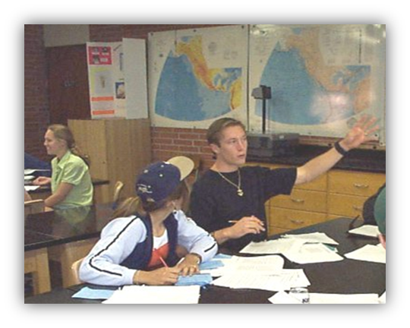
1. Think-Pair-Share: Why It Works
Every student thinks about the question
By verbalizing it with a partner, they get either verification or a correction to their answer
Much more willing to share with the class once they’ve discussed their answer with another student (“low-risk” leaning environment)
Promotes student interaction throughout the semester

Slide 10
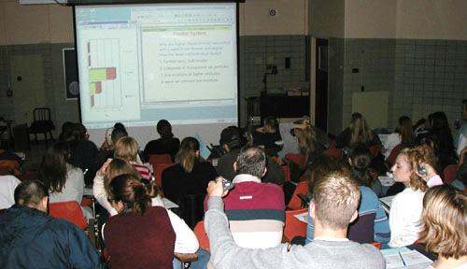
2. Conceptests
Students individually consider a question related to a prediction, image, or graph
Students write a response or select an answer
Can often be combined as a Think-Pair-Share activity or small group work
Can be either low-tech or high-tech
Use ABCD Handout

Slide 11
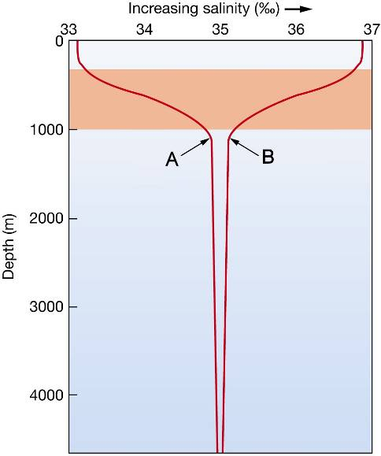
2. Conceptest: An Example
Examining the diagram to the right, which of the following statements is true?
A. Curve A shows a pycnocline
B. Curve A shows a thermocline
C. Curve A represents high latitudes
Curve A represents low latitudes
None of the above
Think-Pair Share: http://serc.carleton.edu/introgeo/interactive/tpshare.html

Slide 12
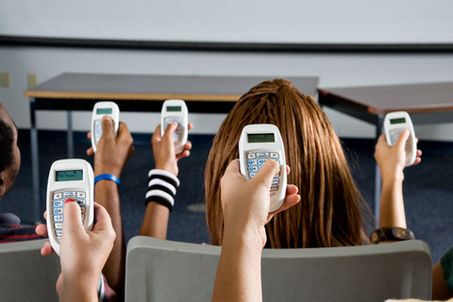
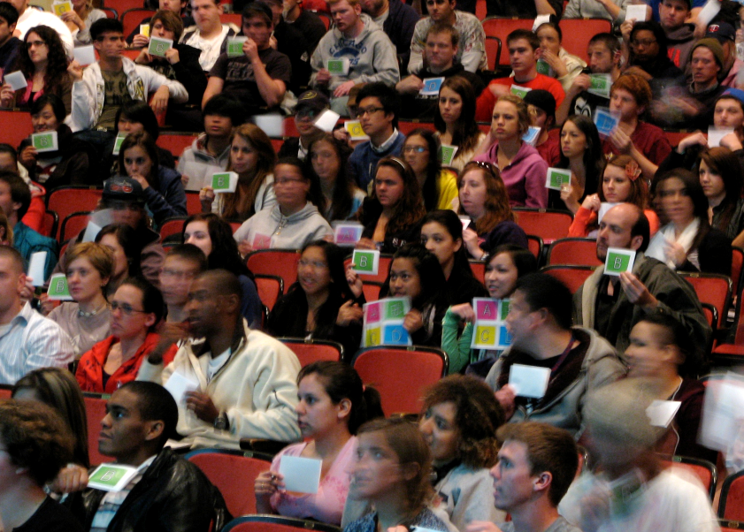
2. Conceptests: Options
Can use a compelling essay questions to stimulate group discussion (Small group work)
Can use voting cards, show of hands, online polling (www.polleverywhere.com) or use PRS “clickers” as polling devices

Slide 13
2. Best Practices: Conceptest Questions
Focus on a single concept
Do not require calculations
Have good multiple-choice answers that include misconceptions
Are clearly worded (short on text)
Recast concept in a way not covered directly in lecture
Refs: McConnell and Steer et al. 2006 Using ConcepTests to Assess and Improve Student Conceptual Understanding in Introductory Geoscience Courses. Journal of Geoscience Education v.54 #1 p.61.
SERC’s ConcepTest Page at: http://serc.carleton.edu/sp/library/conceptests/index.html
Notes:
Students work together in small groups determined by experience, skills, or demographic factors (e.g., gender)
Formative exercises during class used to assess student understanding and progress and to challenge students to think beyond comfort level
Classes incorporate most or all of 7 good practices
How can feedback devices produce learner-centered classes?

Slide 14

3. Working with Real Data
Brings realism to your classroom
Allows students to make their own observations and notice trends
Make sure the data ties into classroom topics but isn’t too complex
Warning: Students may have difficulty filtering data as scientists do!

Slide 15
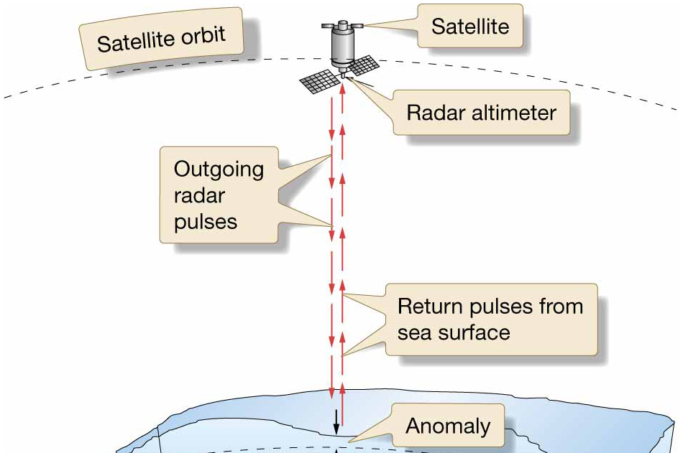
3. Working with Real Data: An Example
Q: Is sea level really level?
Measuring sea level from space: How the TOPEX-Poseidon satellite works ➔
Let’s look at some real data and do real science…
Ref: Maury Project: Sea Level Measurement, © American Meteorological Society

Slide 16
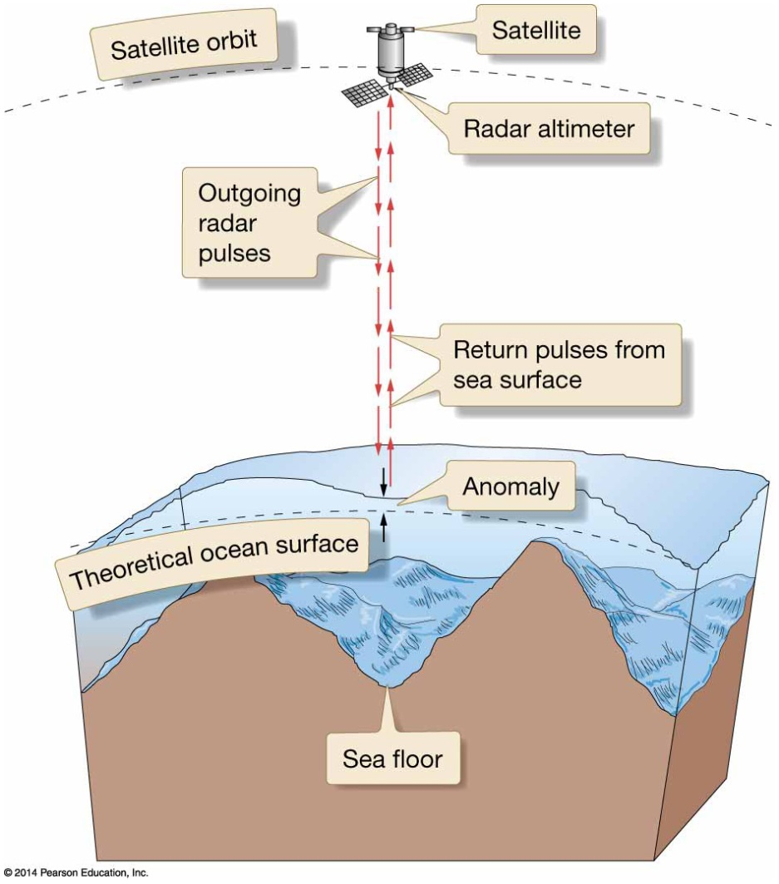
3. Working with Real Data: An Example
Q: Is sea level really level? NO!
Here’s why: More mass = more gravity
Note: it’s the shape of the sea floor that affects sea level
Shallow areas = more rock (less water) = more mass beneath = more gravity, so seawater piles up there
Ref: Trujillo and Thurman, Essentials of Oceanography 11th Edition, © 2014 Pearson Education Pubs., Fig. 3.4

Slide 17

4. Predictive Demonstrations
Normal demo:
Show and tell
Students observing but not necessarily engaged
Predictive demo:
Show and tell, but students predict results
Students active
Student responses help address misconceptions

Slide 18
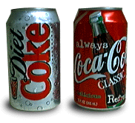
4. Predictive Demos: An Example
“Floatability” of diet Coke vs. regular Coke
Relates to how water masses are formed in the ocean

Slide 19
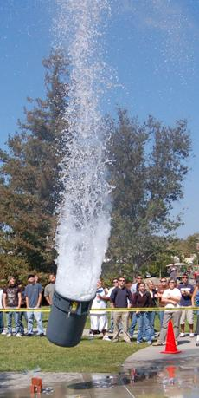
4. Predictive Demos: Best Practices
Relate to class topics
Use common items to enhance student interest (esp. food)
Can be used in large or small classes
Can be used with think-pair-share
Can be enlarged to be a guided discovery lab
“Showmanship” encouraged!
Simulated volcanic eruption using liquid nitrogen at Palomar College

Slide 20

5. Muddiest Point Exercise
Ex: “What aspect of today’s class did you least understand?”
Promotes metacognition
Involves students in their own learning
Provides a low-stakes method for students to interact with their instructor
Reveals class-wide trends
Provides a natural starting point for the next class meeting

Slide 21
6. Question of the Day
Short activities for the beginning of class that engage students with lecture material
You are at the beach and notice that the tide has come in. Is this a law, theory, observation, or hypothesis?
What would you do if you were driving and saw somebody throw their cigarette butt out the window from a car in front of you?
Review from last class: What are differences between an island arc and a hotspot?
Examples

Slide 22
7. Wall Walk
Students respond to statements
Stimulates class discussions
Place signs on 4 walls of the class: Agree, Disagree, Strongly Agree, Strongly Disagree
Establish rules (can change where you are standing, be courteous, raise hand, will be called upon, etc.; see Rules for…Wall Walk)
Project a statement about a topic to the class

Slide 23

7. Wall Walk: Best Practices
Controversial topics work well
Assign background readings about the topic beforehand
Do not let students stand in the middle (make them “take a stand”)
Instructor serves only as a moderator to encourage participation/clarify misconceptions

Slide 24
7. Wall Walk: Some Example Q’s
Instead of dumping harmful pollution in the ocean, we should dump it on land.
It is a good idea to add iron to the ocean to reduce the atmosphere’s greenhouse effect.
Scientific theories are never that certain and so they should not be believed.
We must protect the ocean by limiting the harvesting of marine fish.

Slide 25
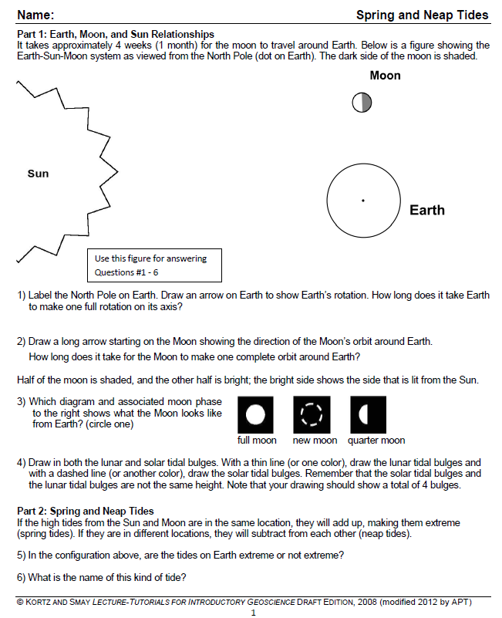
8. Lecture Tutorials
Tutorials covering concepts and misconceptions for students to work on in class after a short lecture
Can be done individually or in small groups
Ref: Kortz and Smay, Lecture Tutorials for Introductory Geoscience, © 2010, W. H. Freeman

Slide 26
9. Visualizations/Animations
Visualizations/animations help students understand important concepts and processes
Usually need to be shown multiple times and narrated
Animations helps students visualize how oceanographic processes work
Allows misconceptions to be addressed
Excellent teaching aid
Can be associated with worksheets

Slide 27

9. Visualizations/Animations
Ref: Trujillo and Thurman, Essentials of Oceanography 11th Edition, © 2014 Pearson Education
Notes:
27
To view this animation, click “View” and then “Slide Show” on the top navigation bar.

Slide 28
Your Turn to Come Up With an Active Learning Technique
On an index card, write down an active learning technique that you learned today that can be applied to an important topic that is covered in your introductory oceanography class (3 minutes)
Share with others: Hand-up, Stand-up
Report-out and analysis

Slide 29
10. Other Technique: Jigsaw Activity
Students work cooperatively in small groups to share data or different pieces of a puzzle
Students must rely on each other to complete the assignment

Slide 30
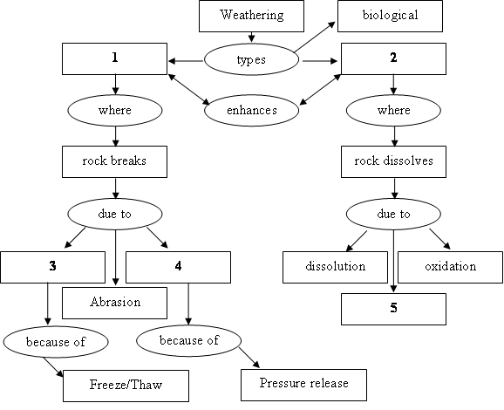
10. Other Technique: Concept Maps
A concept map is a graphical tool for organizing and representing knowledge
Shows the relationships among concepts
Ex: Complete the above concept map about weathering by selecting the correct term for the missing boxes #1-5

Slide 31
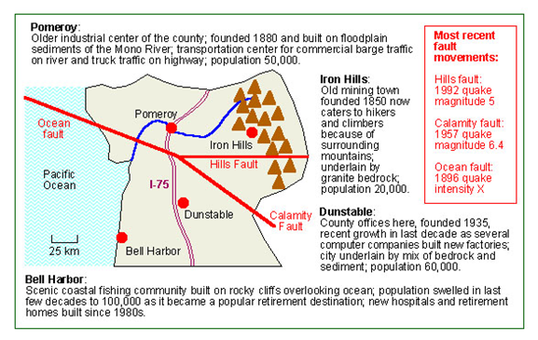
10. Other Technique: Role Playing
Students analyze a scenario and recommend specific courses of action consistent with scientific information
Q: Which city should get earthquake preparedness funding and why?

Slide 32
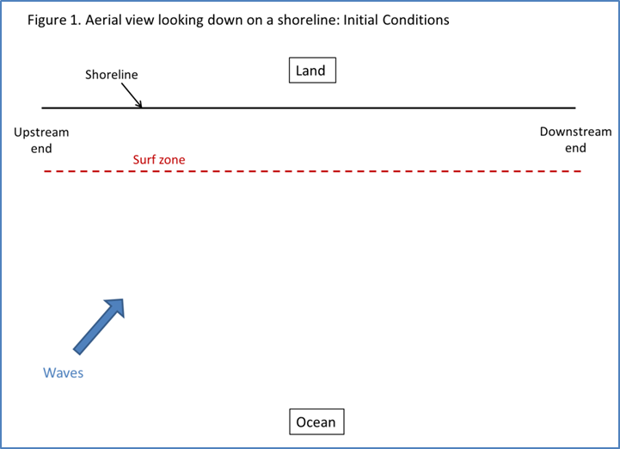
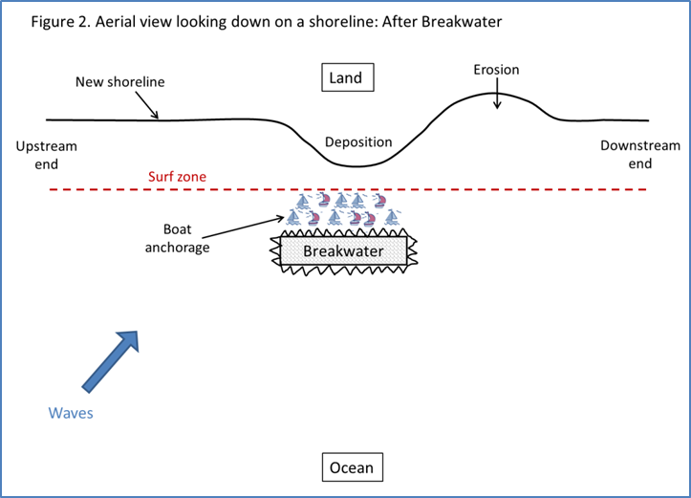
10. Other Technique: Case Studies
Students analyze different character’s ideas and rank them from “most feasible” to “least feasible”

Slide 33
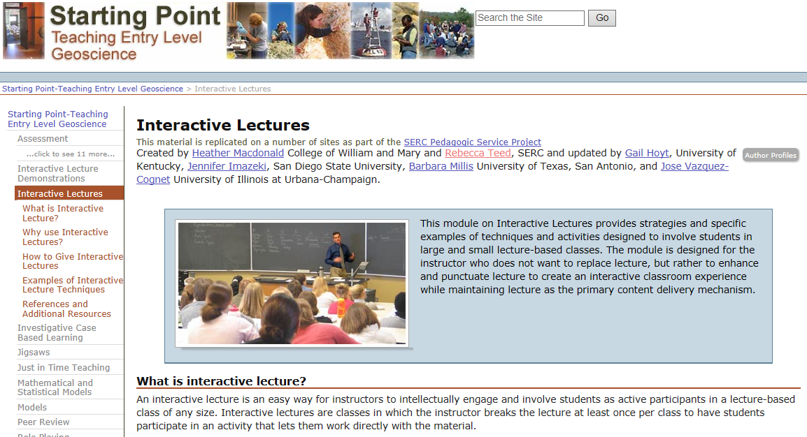
For More Information…
The SERC Carlton site on Interactive Lectures:
http://serc.carleton.edu/introgeo/interactive/index.html

Slide 34
Developing Interactive Lectures Using Active Learning Techniques
Al Trujillo
Department of Earth, Space, & Aviation Sciences
Palomar College San Marcos CA atrujillo@palomar.edu
Presentation available at: http://www2.palomar.edu/users/atrujillo/
with special thanks to
David Steer, Department of Geology & Environmental Sciences The University of Akron OH
On the Cutting Edge Teaching Oceanography Workshop
San Francisco City College, San Francisco CA July 2013

