Slide 1


RESOURCES FOR
OCEAN CAREER INFORMATION
Developed by Jan Hodder, Oregon Institute of Marine Biology jhodder@uoregon.edu

Slide 2
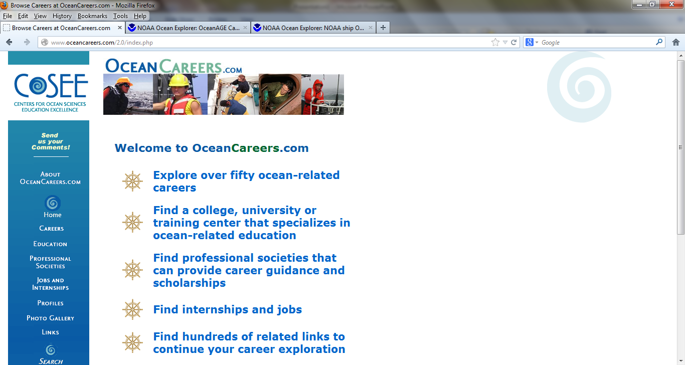

http://www.oceancareers.com/2.0/index.php

Slide 3
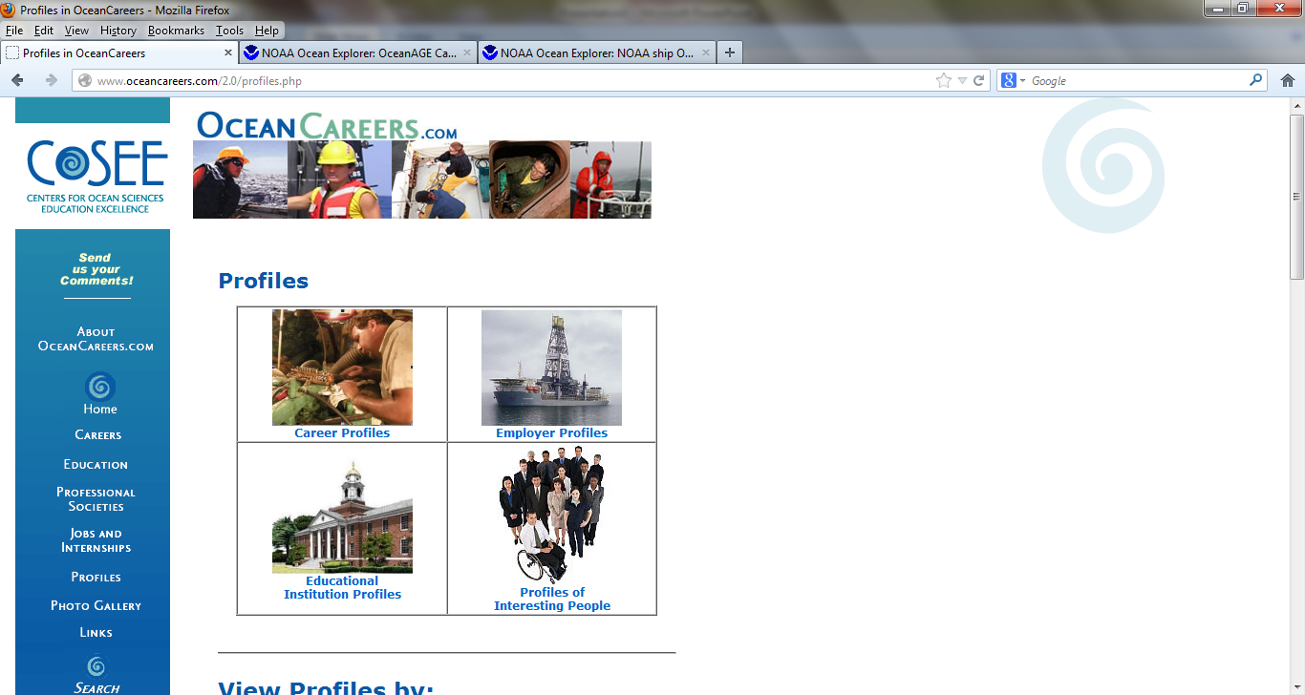

Slide 4
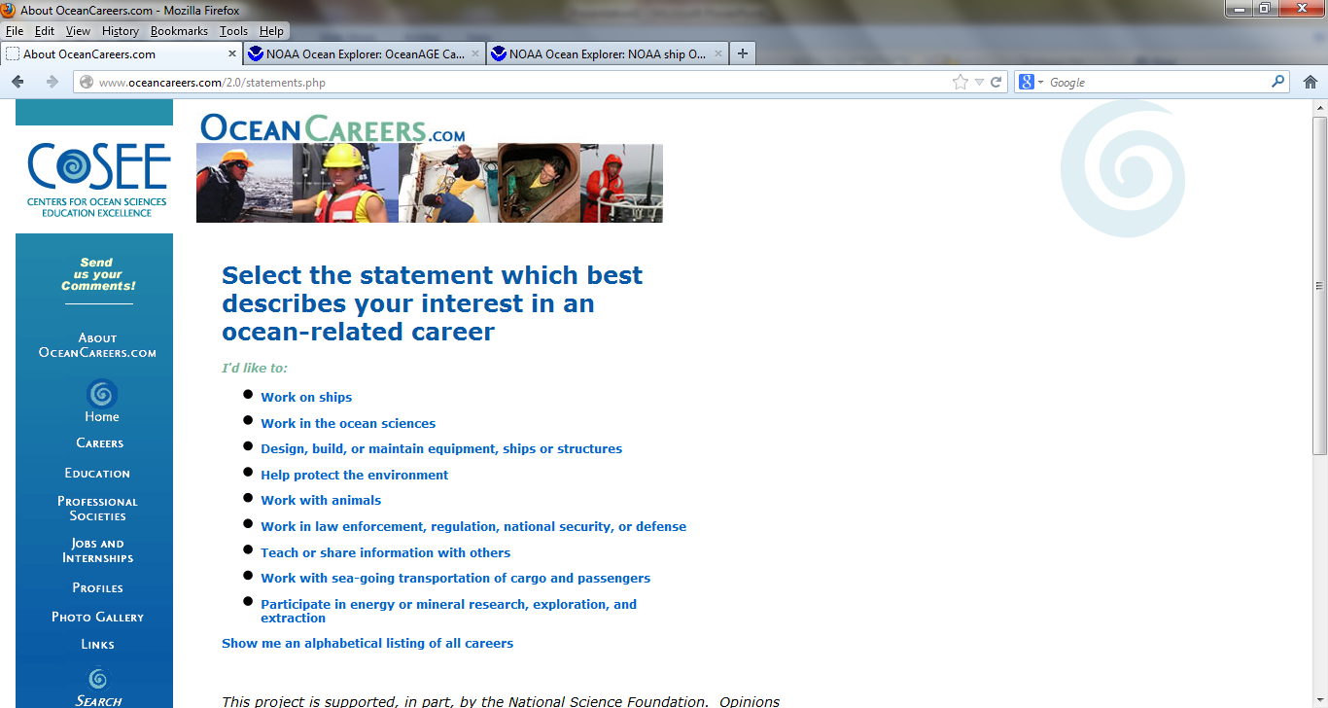

Slide 5
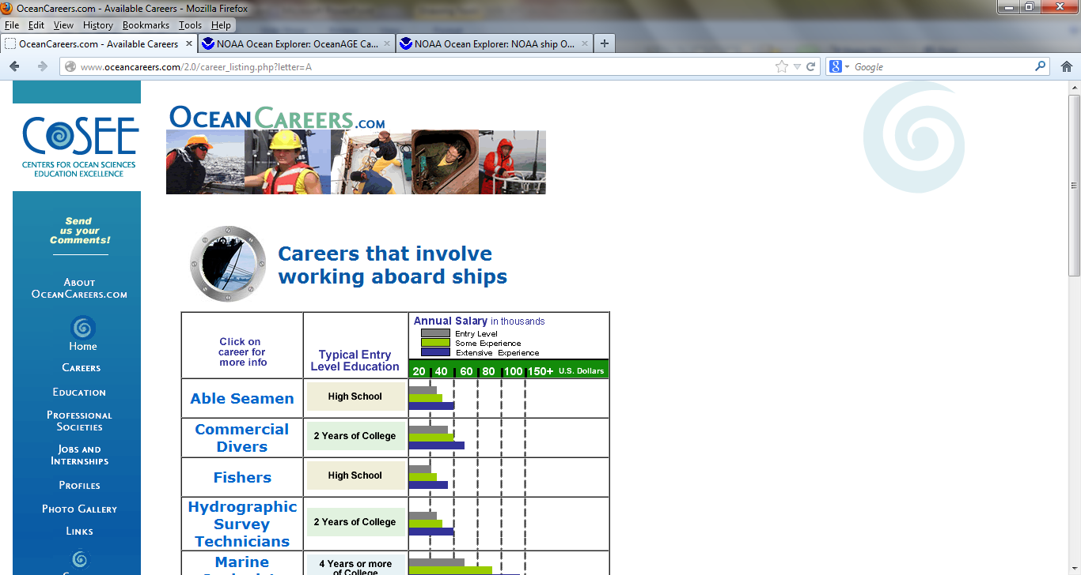

Slide 6
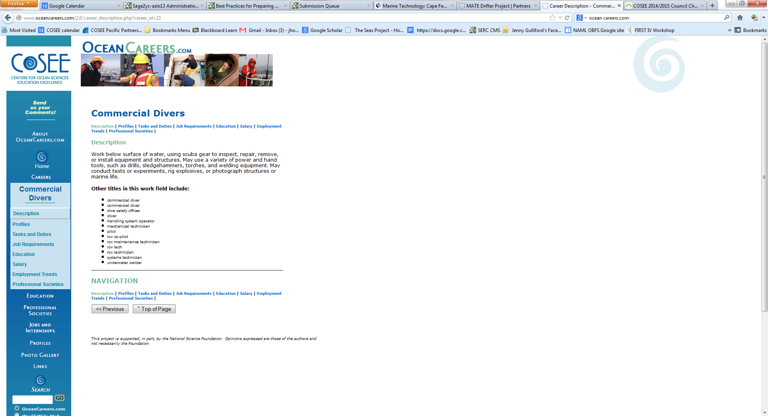

Slide 7
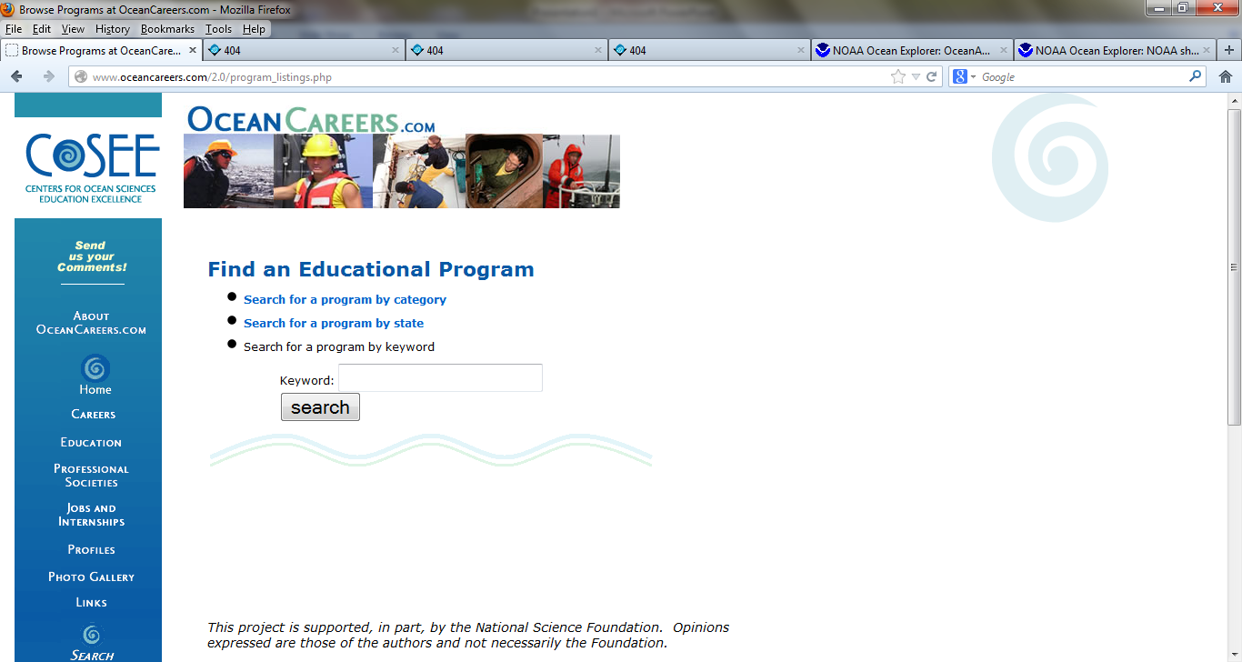

Slide 8
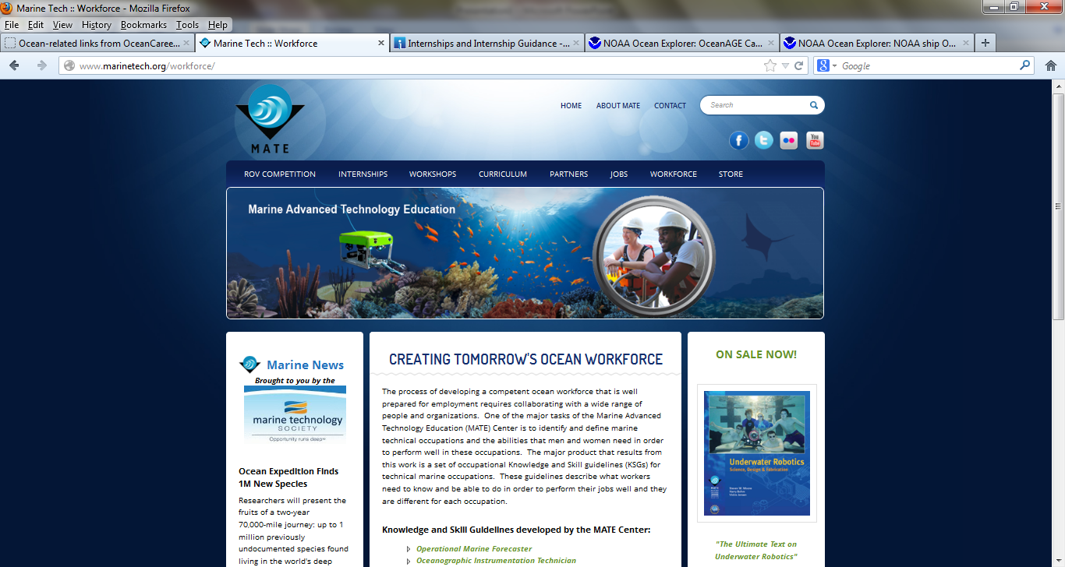
http://www.marinetech.org/

Slide 9
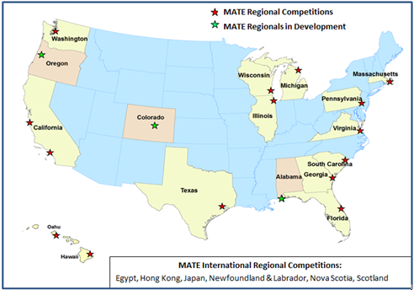
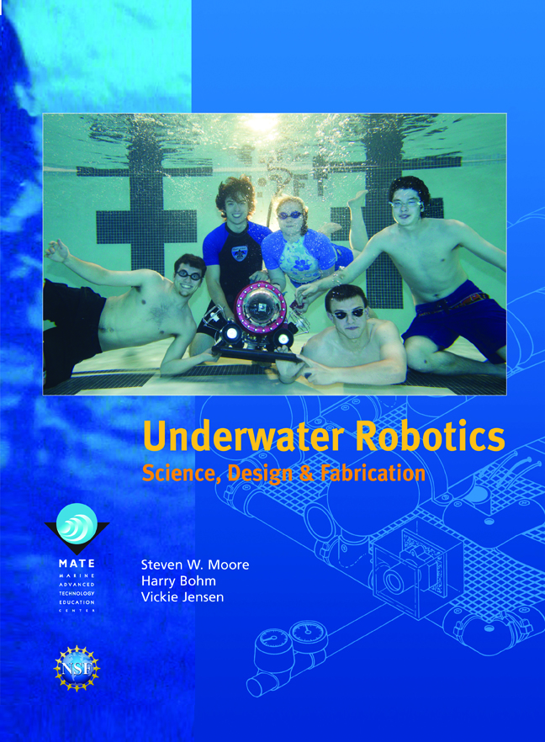
Underwater Robotics Competitions

Slide 10
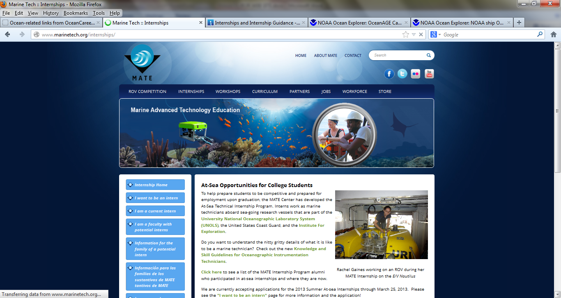
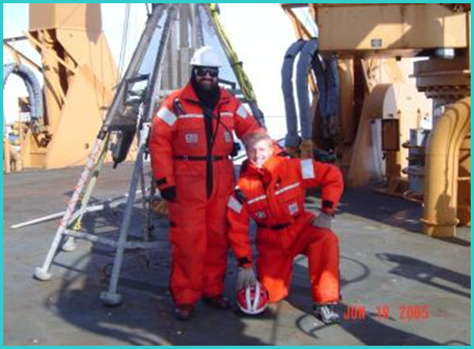
http://www.marinetech.org/internships
MATE Center’s Technical Internship Program

Slide 11
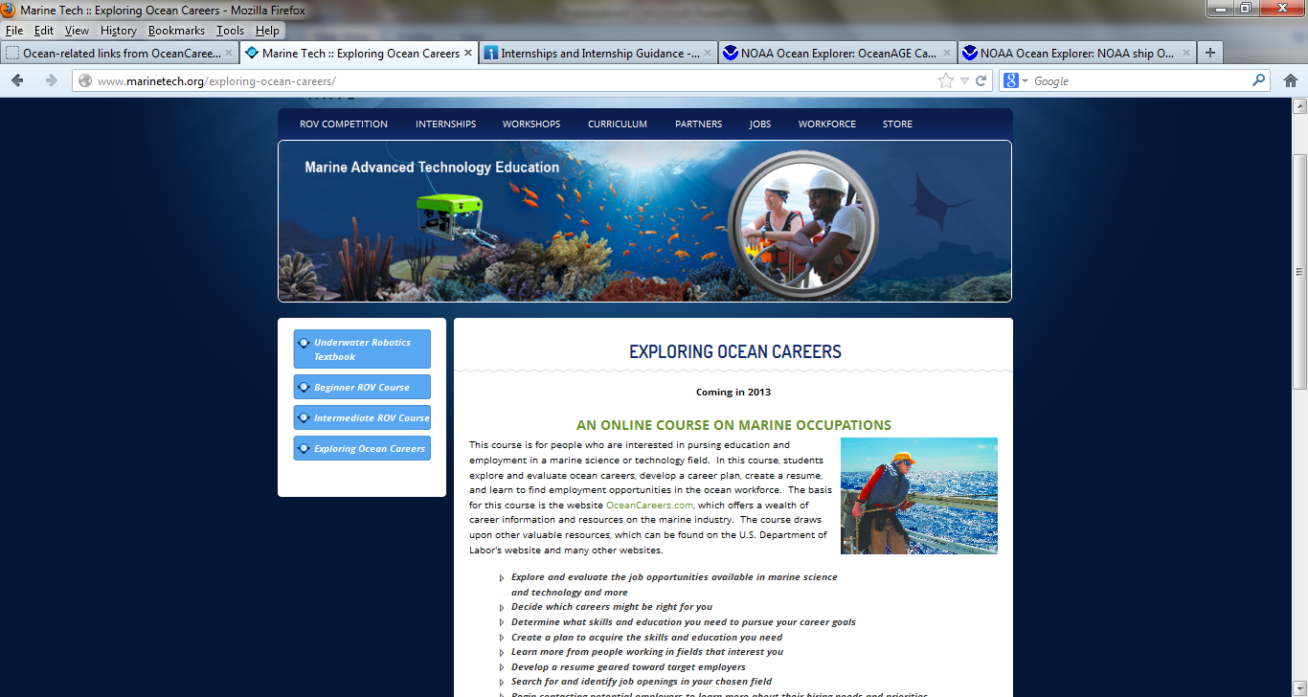

Slide 12
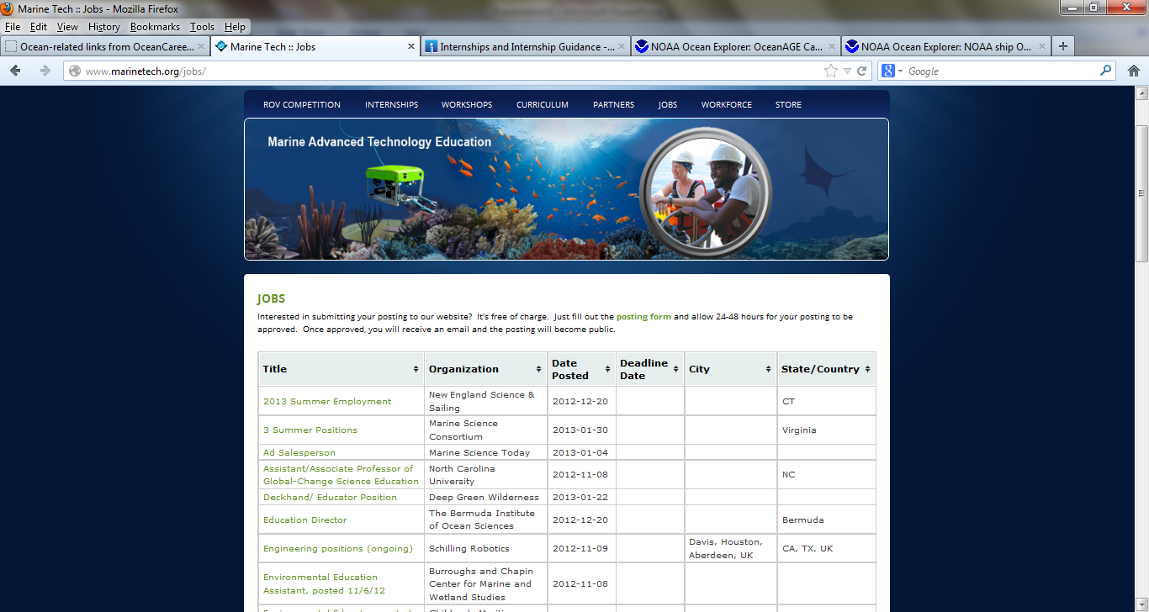

Slide 13
Knowledge and Skills Guidelines for Marine Science and Technology
Aquaculture Technician
Hydrographic Survey Technician
Marine Technician
Oceanographic Instrumentation Technician
Operational Marine Forecaster
ROV Technician

Slide 14
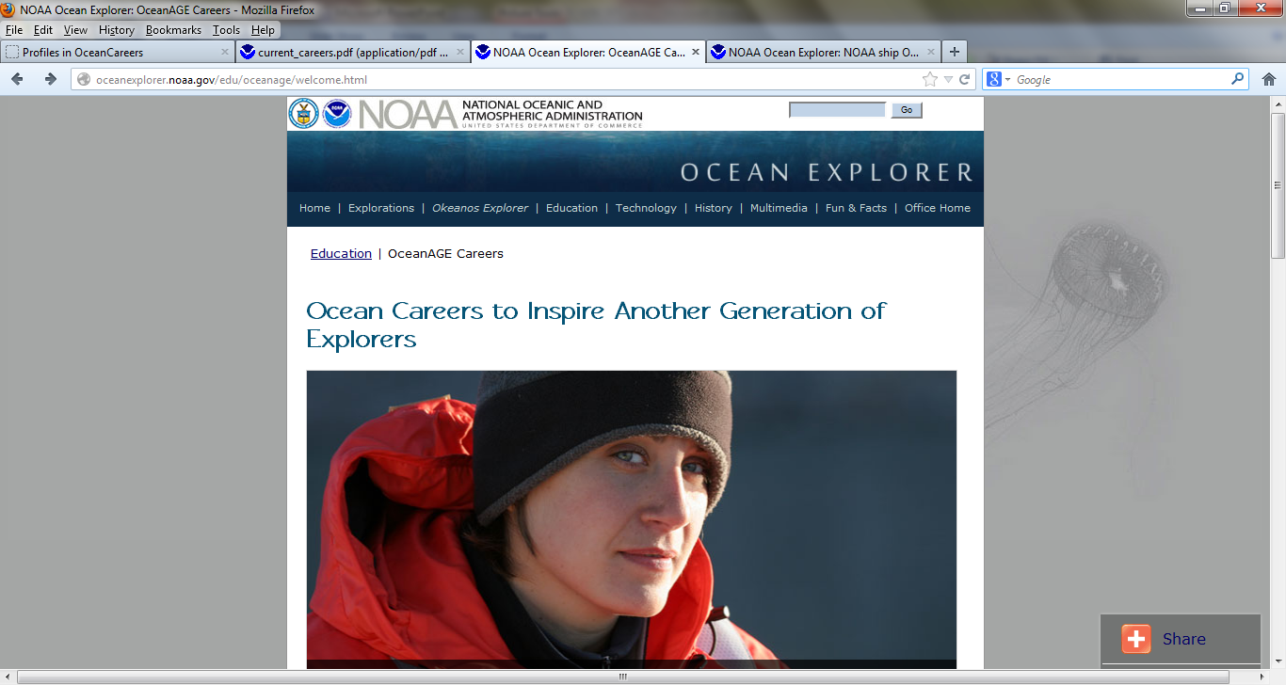
http://oceanexplorer.noaa.gov/edu/oceanage/welcome.html

Slide 15
OceanAGE Careers
Ocean Careers to Inspire: Another Generation of Explorers
OceanAGE is an interactive online ocean careers offering that inspires students from all backgrounds to learn more about oceanography and to pursue the mathematics, science and technology coursework required to become more ocean literate.
Collection of interviews from scientists and crew in Ocean Explorer research expeditions.
http://oceanexplorer.noaa.gov/edu/oceanage/
and http://oceanexplorer.noaa.gov/edu/oceanage/interviews/welcome.html

Slide 16
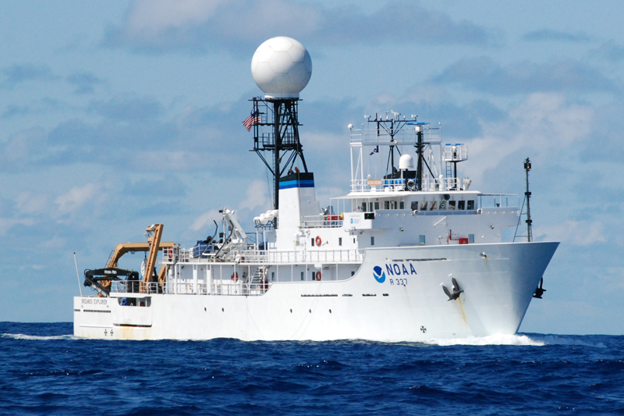
Careers on the NOAA ship Okeanos Explorer
http://oceanexplorer.noaa.gov/okeanos/explorers/explorers.html

Slide 17
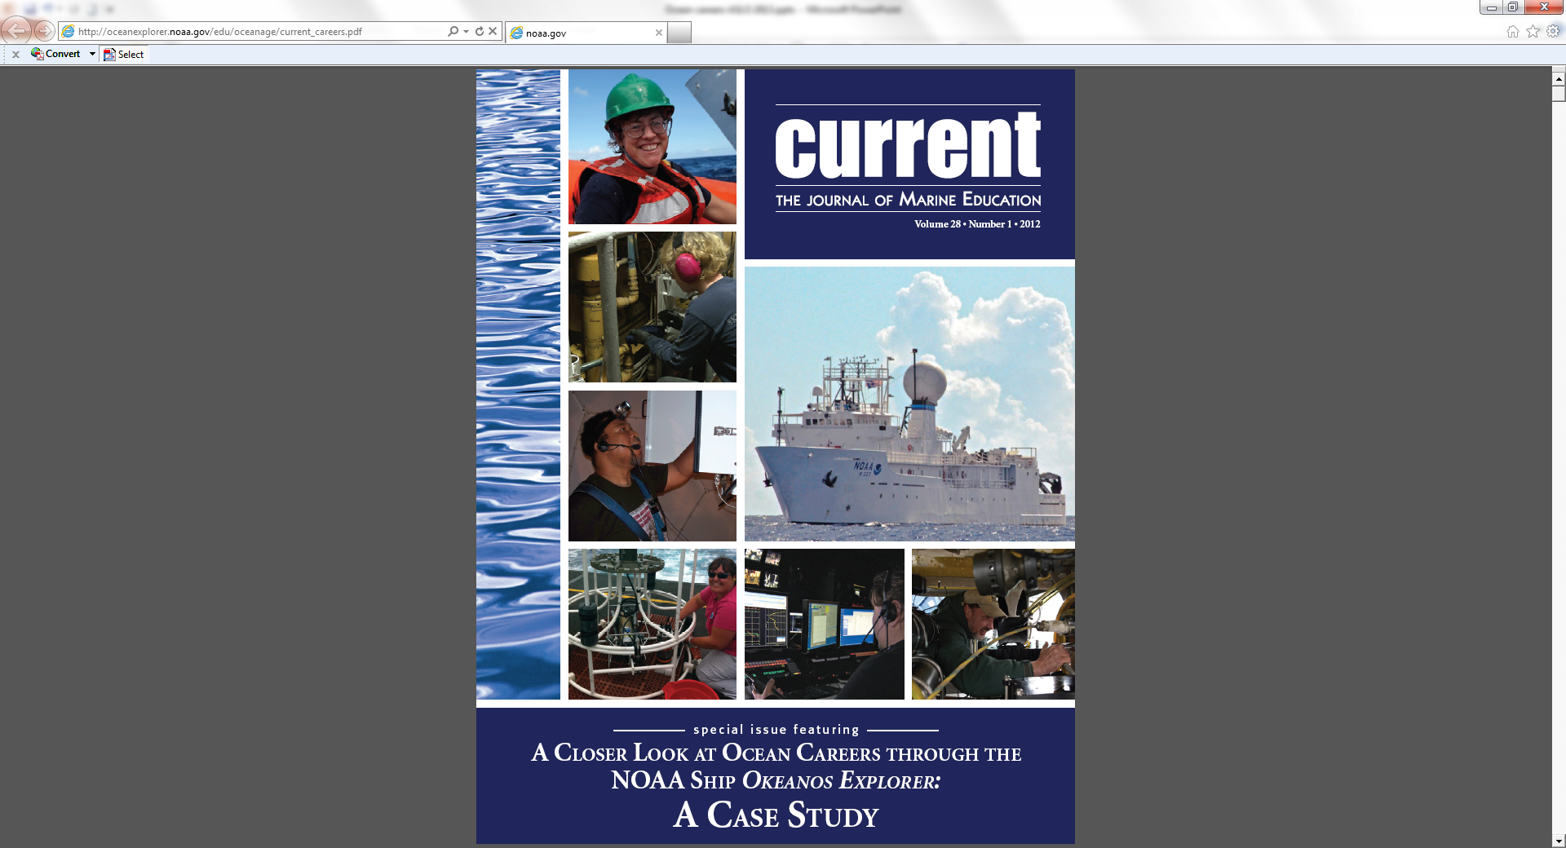
A special issue of Current
The Journal of Marine
Education
Available on line at:
http://oceanexplorer.noaa.gov/edu/oceanage/current_careers.pdf

Slide 18
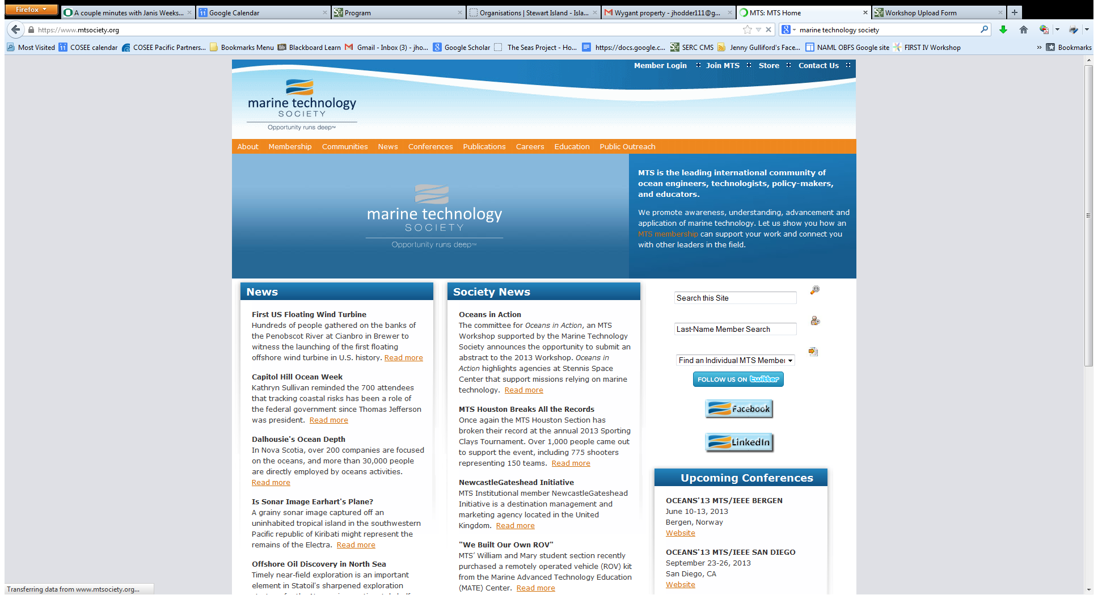
https://www.mtsociety.org/

Slide 19
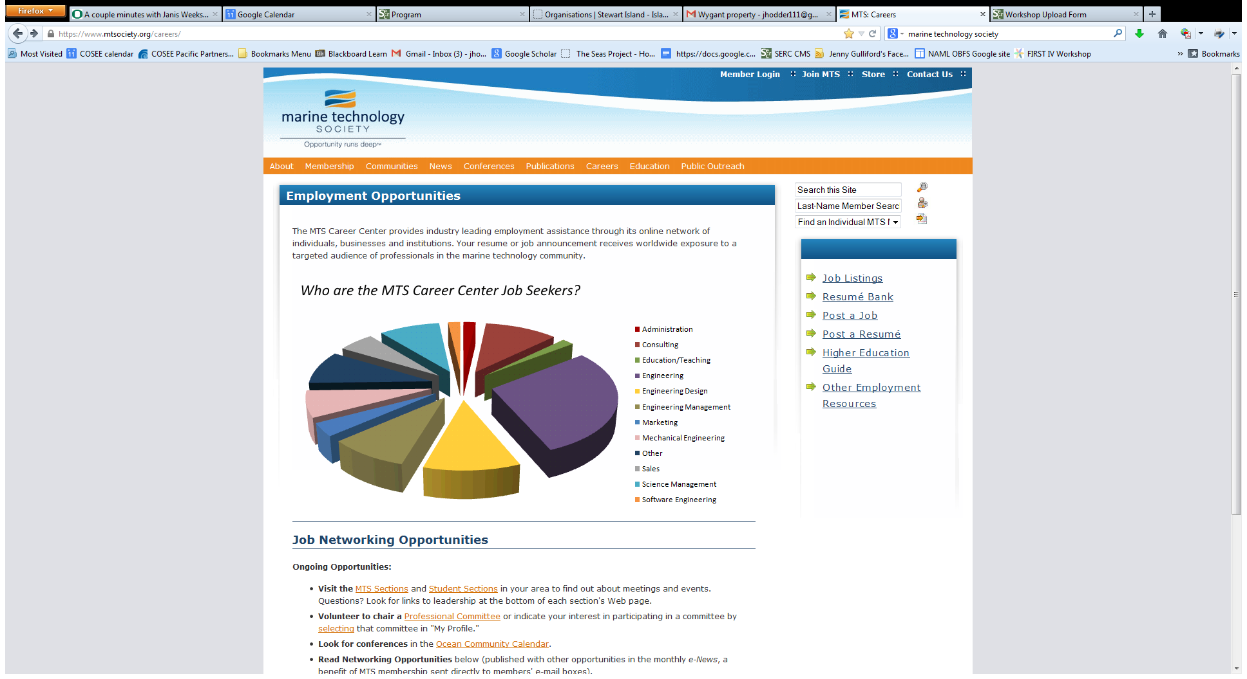

Slide 20
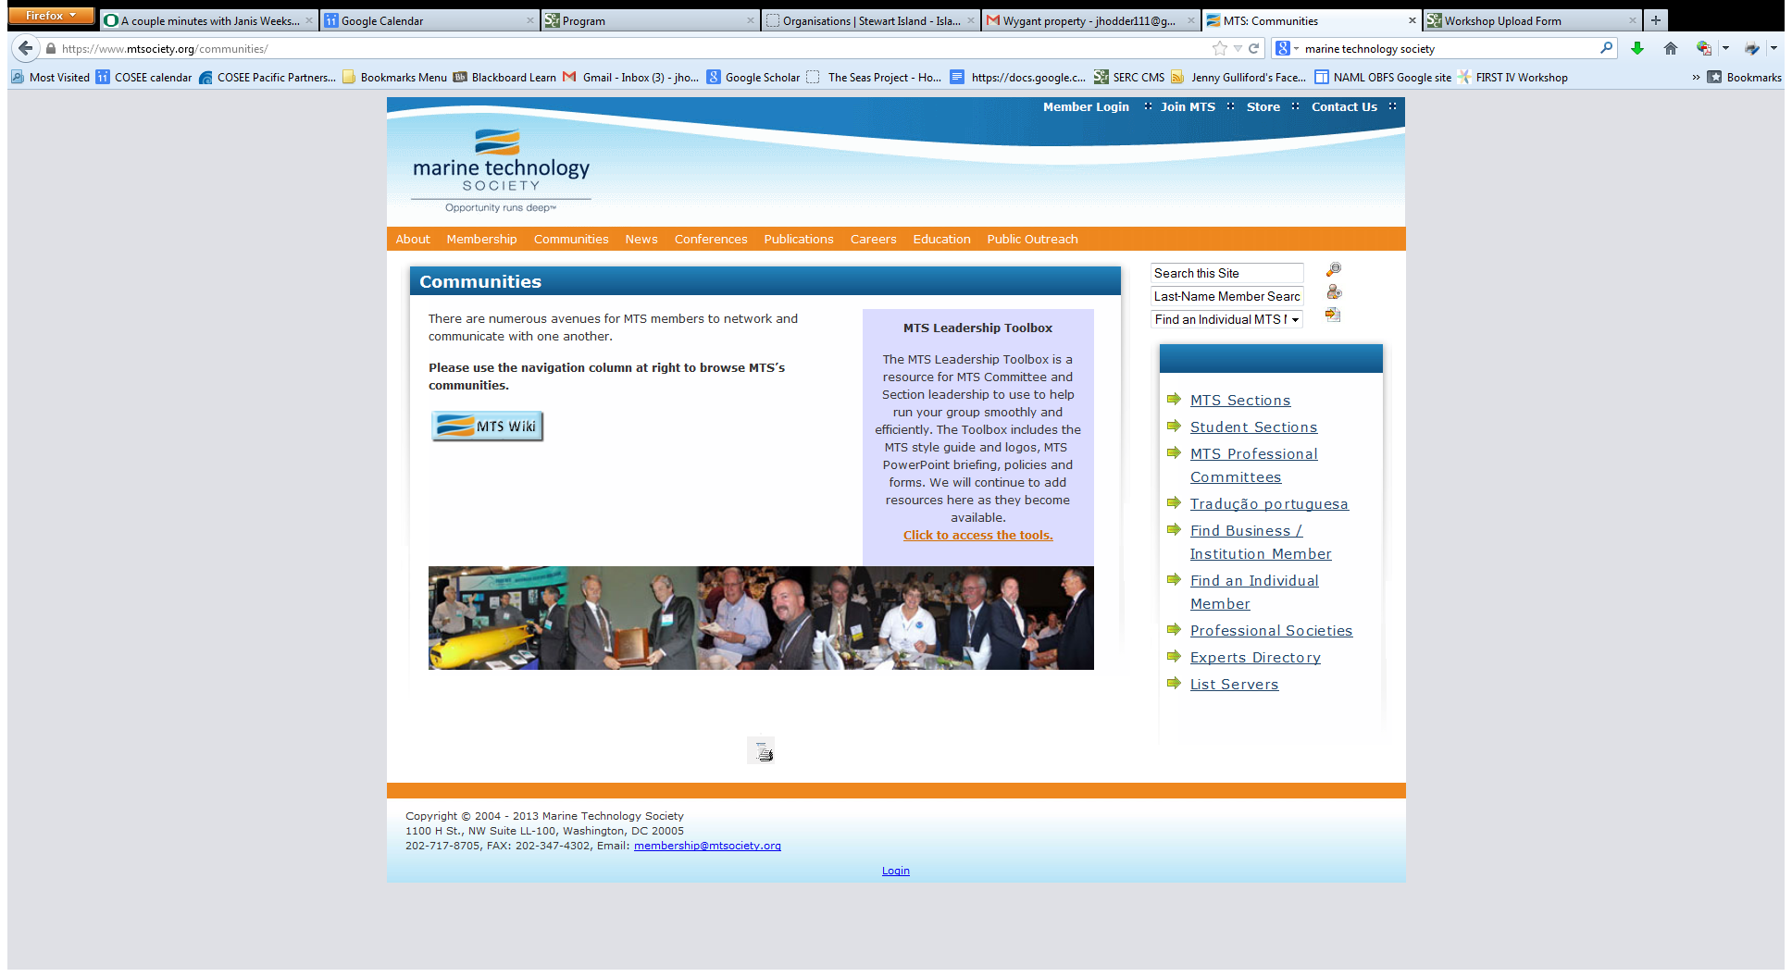

Slide 21
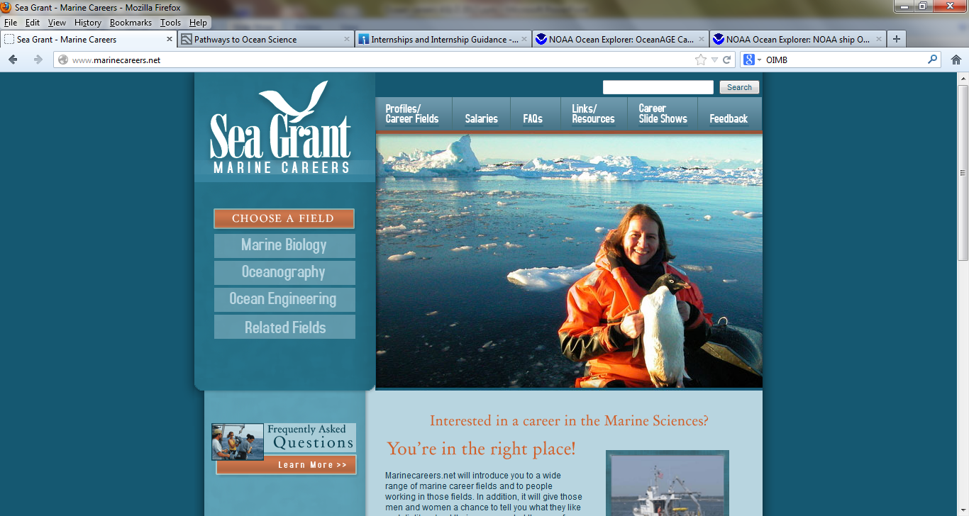
http://www.marinecareers.net/

Slide 22
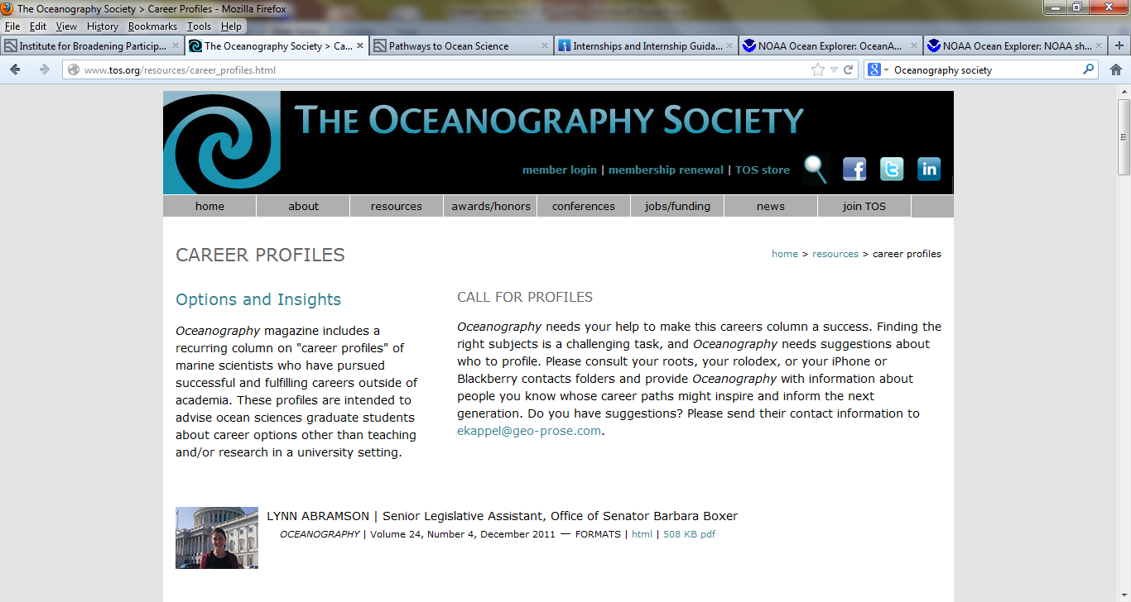
http://www.tos.org/resources/career_profiles.html

Slide 23


OCEANOGRAPHY ONLINE
Instant, Open Access
to Every Article

Slide 24
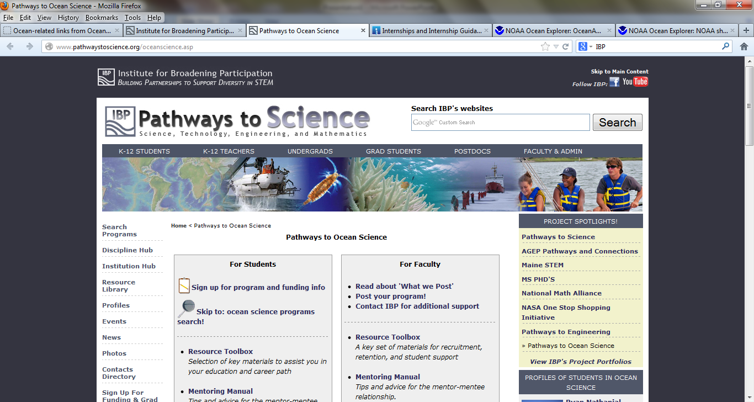
http://www.pathwaystoscience.org/oceanscience.asp

Slide 25
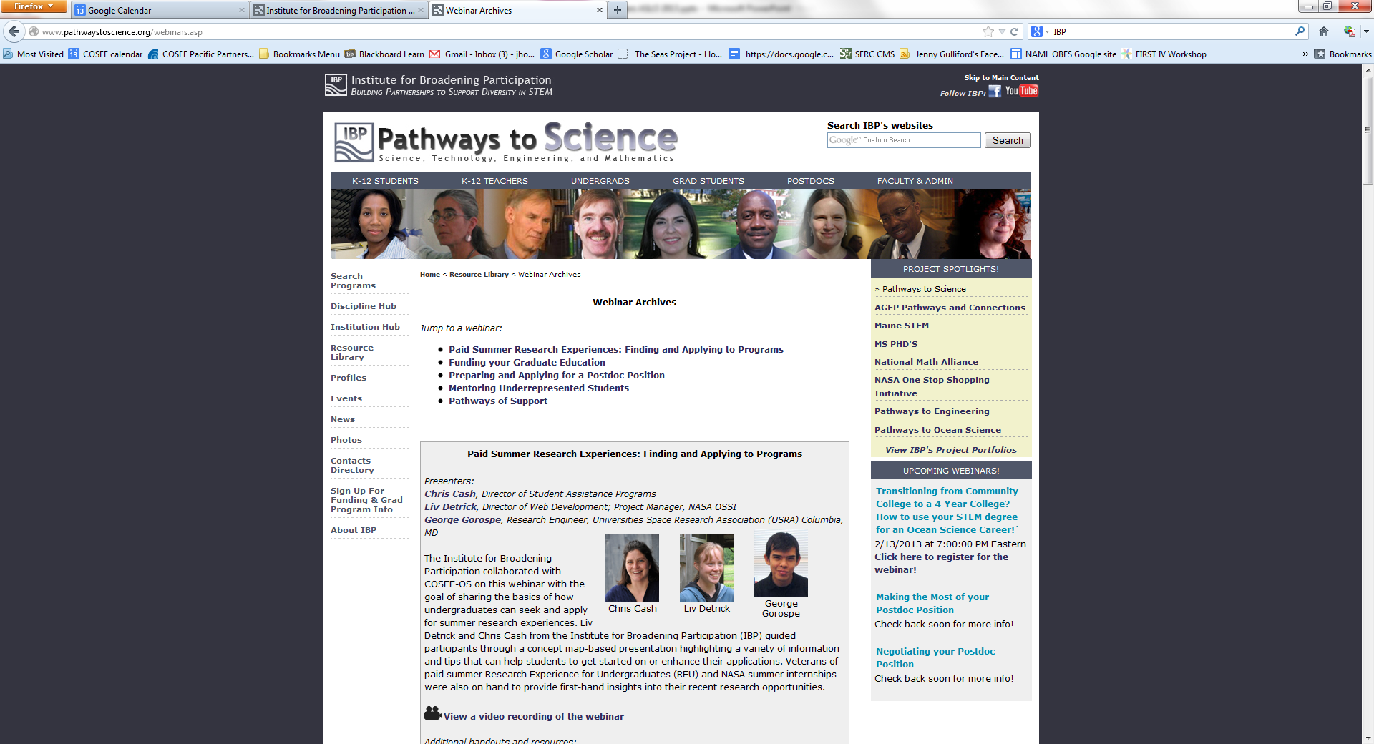
http://www.pathwaystoscience.org/webinars.asp
IBP webinars

Slide 26
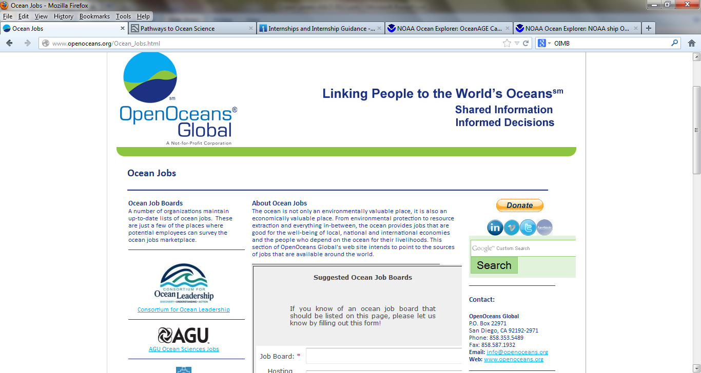
http://www.openoceans.org/Ocean_Jobs.html

Slide 27

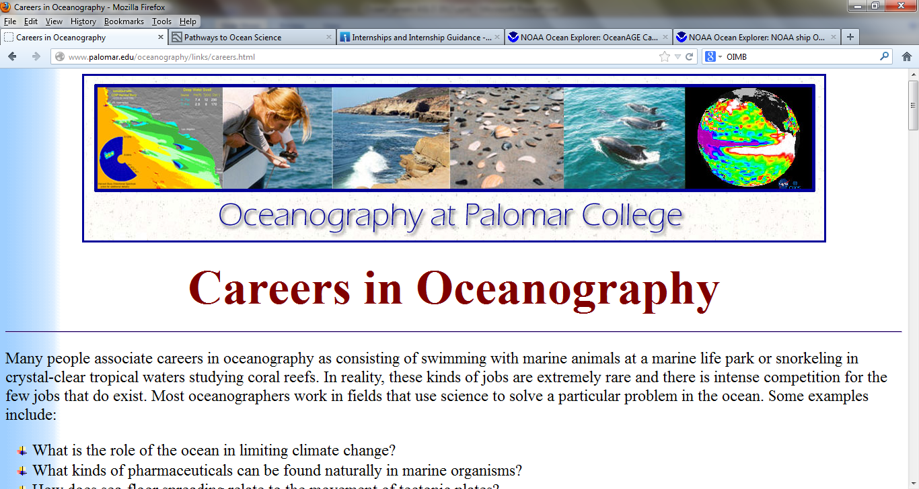
http://www.palomar.edu/oceanography/links/careers.html

Slide 28
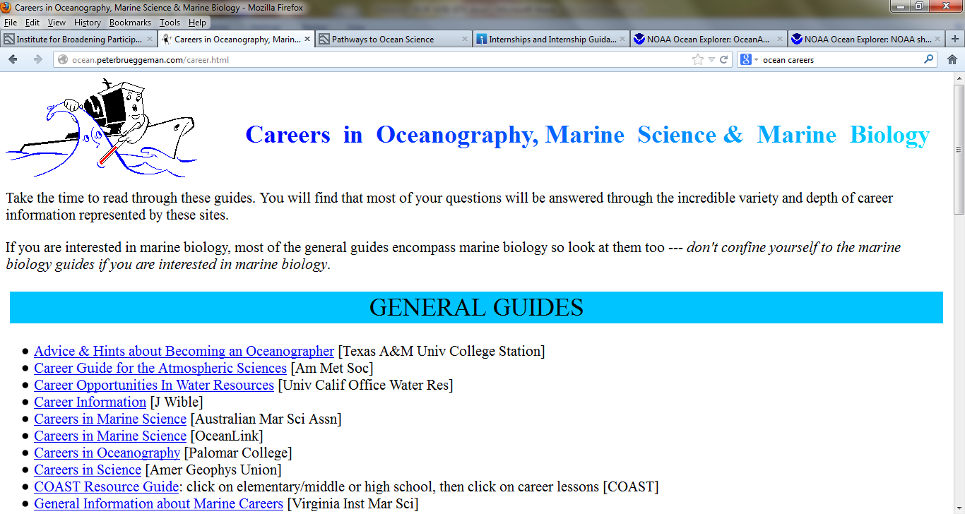
http://ocean.peterbrueggeman.com/career.html

Slide 29
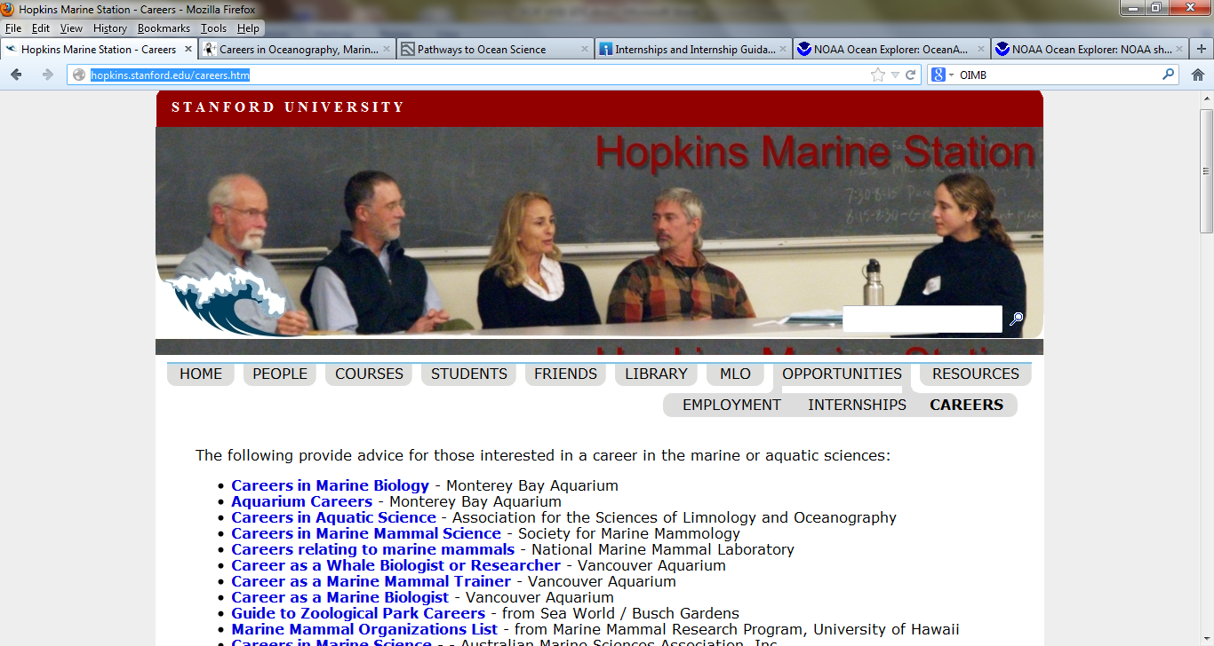
http://hopkins.stanford.edu/careers.htm

Slide 30
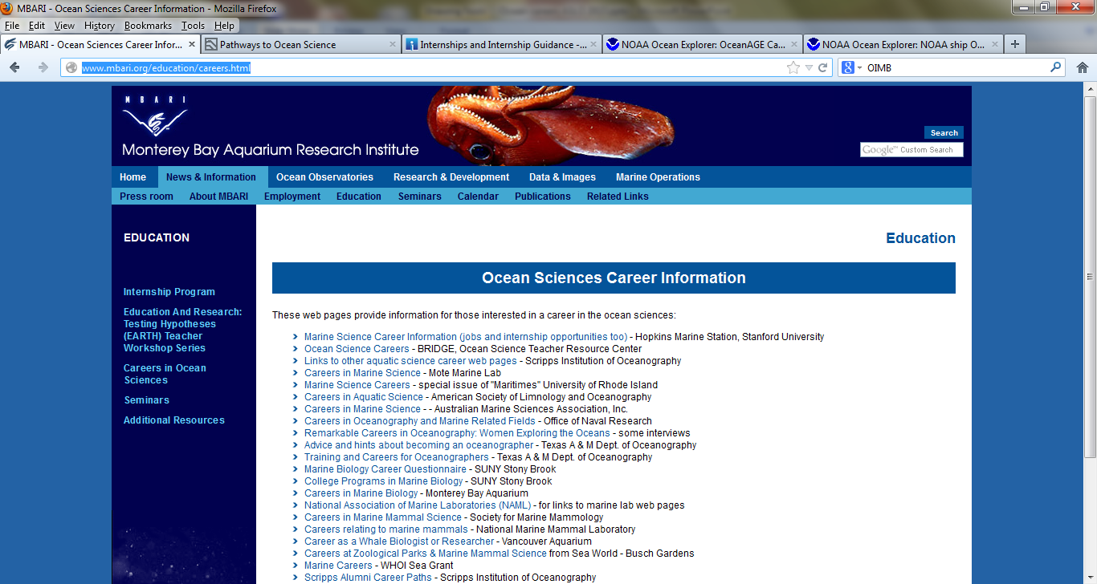
http://www.mbari.org/education/careers.html

Slide 31
HOW DO WE USE THESE RESOURCES?
Incorporate them into a class activity or homework assignment
Explore an internship opportunities with your students
Explore a job posting with your students
Group research projects on career topics
Plan a career exploration with webquests or a scavenger hunt
Students interview professional ocean scientists and those working
on the ocean
Other ideas?

