Slide 1

What Will They Remember
Know in Five Years?
Putting the Focus on Learning in Mineralogy, Petrology, and Geochemistry
Dexter Perkins
University of North Dakota
Karl Wirth
Macalester College
Teaching Mineralogy, Petrology, and Geochemistry in the 21st Century
University of Minnesota
August 2011

Slide 2
Goals of [your name here]’s Class
Content goals
Write one essential content goal

Slide 3
Goals of [your name here]’s Class
Content goals
“Professional” skills

Slide 4
Goals of [your name here]’s Class
Content goals
“Professional” skills
Intellectual development

Slide 5
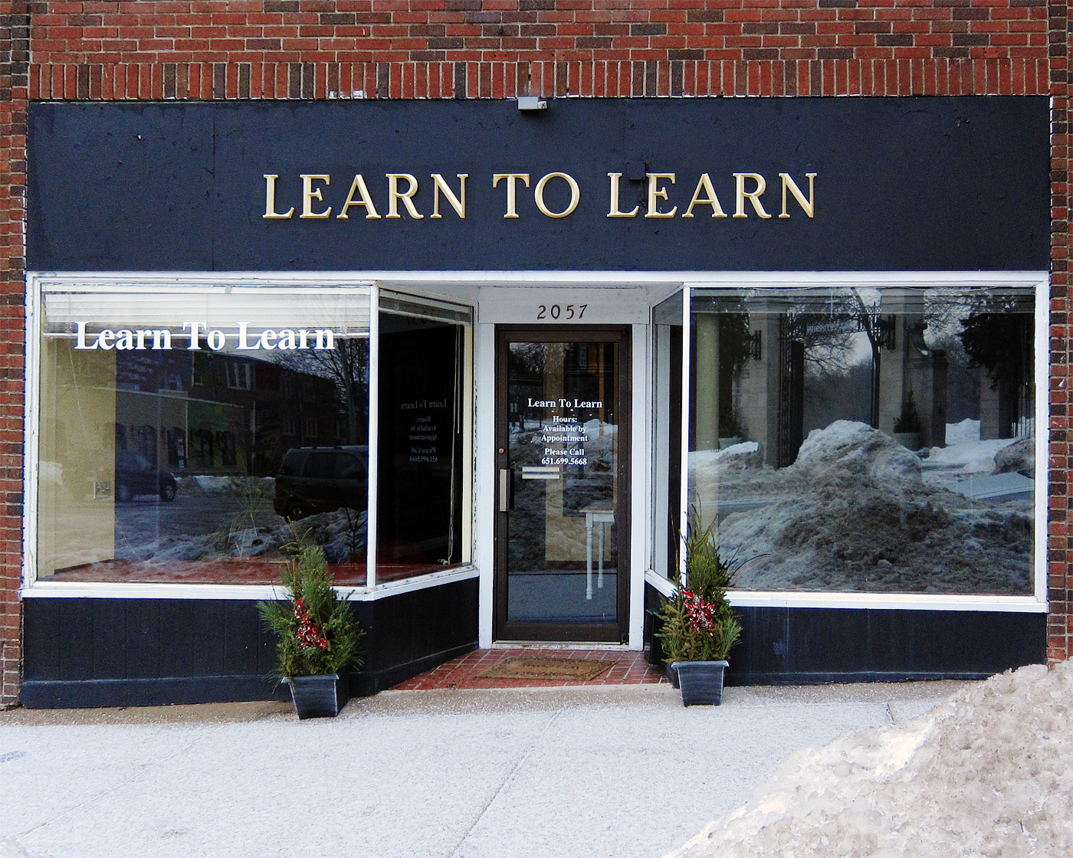
Reflective Prompt
What do you MOST wish your students knew and understood about their thinking and learning?

Slide 6
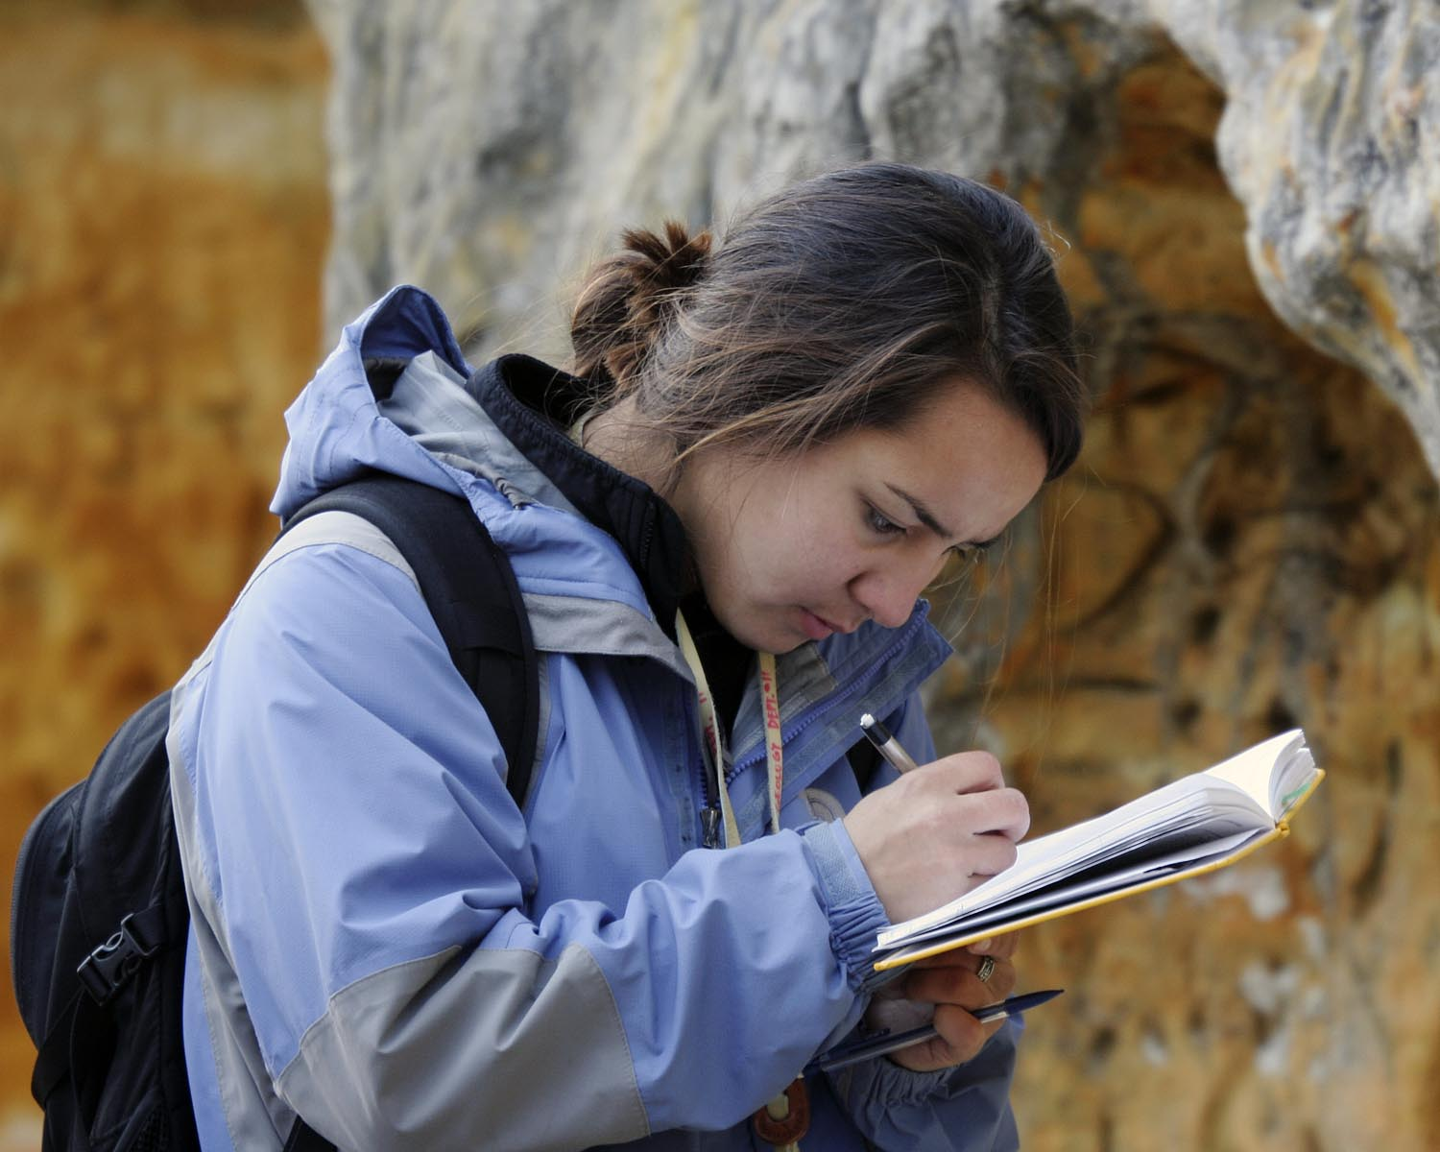
Reflective Prompt
What thinking and learning skills/habits do you want your students to develop?

Slide 7
Solving a Problem
Elapsed Time (mins) | 0 | 2 | 4 | 6 | 8 | 10 | 12 | 14 | 16 | 18
Read
Analyze
Explore
Plan
Implement
Verify
Novices
Elapsed Time (mins) | 0 | 1 | 2 | 3 | 4 | 5 | 6 | 7 | 8 | 9 | 10 | 11 | 12 | 13 | 14 | 15 | 16 | 17 | 18 | 19
Read
Analyze
Explore
Plan
Implement
Verify
Experts
Schoenfeld (1987)

Slide 8
How can we make this happen?

Slide 9

Three Principles of Learning
1. Recognize/Address Preconceptions
2. Expert Knowledge
  Deep foundation
  Contextual framework
  Organizational structure
3. Metacognition is Important
Bransford et al. (2000)

Slide 10
Metacognition Involves Reflection
Elapsed Time (mins) | 0 | 1 | 2 | 3 | 4 | 5 | 6 | 7 | 8 | 9 | 10 | 11 | 12 | 13 | 14 | 15 | 16 | 17 | 18 | 19
Read
Analyze
Explore
Plan
Implement
Verify
What kind of problem is this?
What is the best strategy for solving it?
How will I know if I solved it?
How could I do it better next time?
What additional information do I need?
What use is this new information?
How can I use my new understanding to solve different kinds of problems?
Notes:
Wirth - Cutting Edge Metacognition Workshop
8/7/11
10

Slide 11
Reflection Continuum
Dimension | Description
Habitual Action | Minimal thought and engagement; memorization is emphasized; correlated with surface learning; tasks treated as unrelated activities; an attitudinal state of unreflectiveness
Understanding | Focuses on comprehension without relation to one’s personal experience or other learning situations; book learning that is understanding-oriented; learning stays within boundaries of preexisting perspectives
Reflection | Learning is related to personal experience and other knowledge; involves challenging assumptions, seeking alternatives, identifying areas of improvement; active engagement; characteristic of deep approaches to learning
Critical or Intensive Reflection | Highest level of reflective learning; learners are aware of why they think, perceive, or act as they do; as a result, learner likely alters or changes firmly held personal beliefs and ways of thinking
Kember et al. (2000) modified from Mezirow (1991)
Notes:
Wirth - Cutting Edge Metacognition Workshop
8/7/11
11

Slide 12
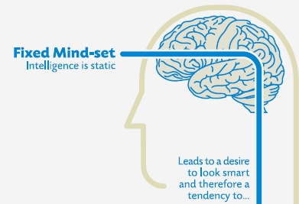
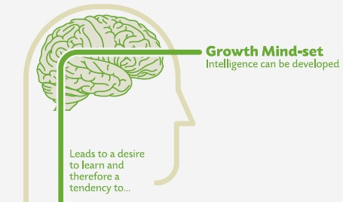
Another Example – Beliefs
avoid challenges
give up easily
see effort as fruitless
ignore feedback
be threatened by success of others
embrace challenges
persist in face of setbacks
see effort as path to mastery
Iearn from criticism
find lessons and inspiration in success of others
Dweck (2006)
Notes:
Wirth - Cutting Edge Metacognition Workshop
8/7/11
12

Slide 13
Expert Learners - Reflection
Metacognitive Knowledge
(declarative, procedural, conditional)
Metacognitive Control
(self-regulation)
Personal
Resources
Prior Knowledge
Available Strategies
Task
Requirements
Type of Learning
Appropriate Strategies
Plan
Reflection
Goals
Beliefs
Attitudes
Motivation
Reflection
Evaluate
Monitor
Reflection
Reflection
Modified from Ertmer and Newby (1996), Butler (1997), Winne and Hadwin (1998), Pintrich (2000), Lovett (2008)
Notes:
Strategies: cognitive, motivational, environmental
Strategies: self regulation, planning, monitoring, correcting errors, self-assessment

Slide 14
Metacognitive Reflections
Activity | Metacognitive Knowledge or Skill
How I Earned an “A” | Goal-setting
Reading Reflections | Monitoring & Evaluation
Critical Thinking | Strategies for Thinking
Learning Reflections | Evaluation & Planning
Exam Wrappers | Evaluation & Planning

Slide 15
Goal-Setting:
Reflection-for-Action

Slide 16
Planning and Goal-Setting
Journal Activity:
Write a letter describing what you accomplished in this course. The letter should be dated for the end of the semester and written in the past tense. Tell me what you did, how you did it, and how your thinking and understanding changed.
Begin your letter with:
I earned an “A” in this course because…
The Art of Possibility (Zander and Zander, 2000)

Slide 17
Example Responses
“When it came time for me to do assignments… I also pondered the reasons my professor assigned them and what I should be have been learning by doing them.”
“I have challenged myself to think… in strange and new ways.”
“I have also realized that seeking help, especially from my peers, is an important step in the academic process...”
Notes:
Wirth - Cutting Edge Metacognition Workshop
8/7/11
17

Slide 18
Reading Reflections:
Supporting Content Learning with Reflection-in-Action

Slide 19
Strategic Reading
Expert Readers:
read with a purpose and in “extensive mode”
accomplished in use of prior knowledge
utilize a wide variety of strategies for monitoring and comprehension (e.g., prediction, integration, self-questioning, reflecting)
Novice Readers:
focus on decoding single words or phrases
fail to adjust for different texts or purposes
seldom use text-processing strategies
Paris et al. (1996)

Slide 20
Reading Reflections
Completed after each reading assignment
Short responses to three questions
Submitted online before class
Credit awarded for “reflective” submissions
What is the main point of this reading?
What did you find surprising? Why?
What did you find confusing? Why?

Slide 21
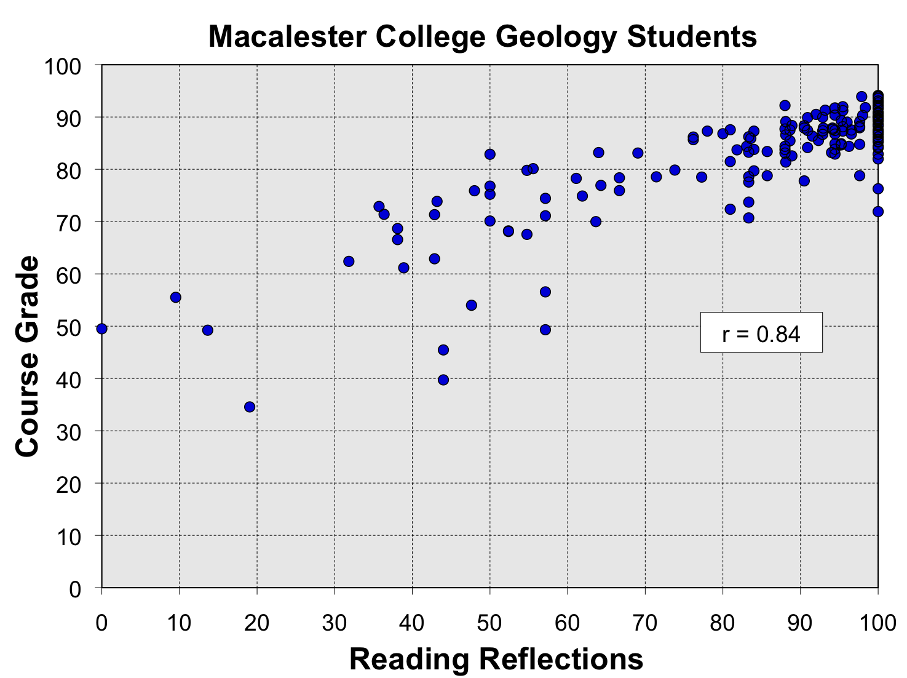
Initial Observations
Pearson = 0.842
p-value = <0.001

Slide 22
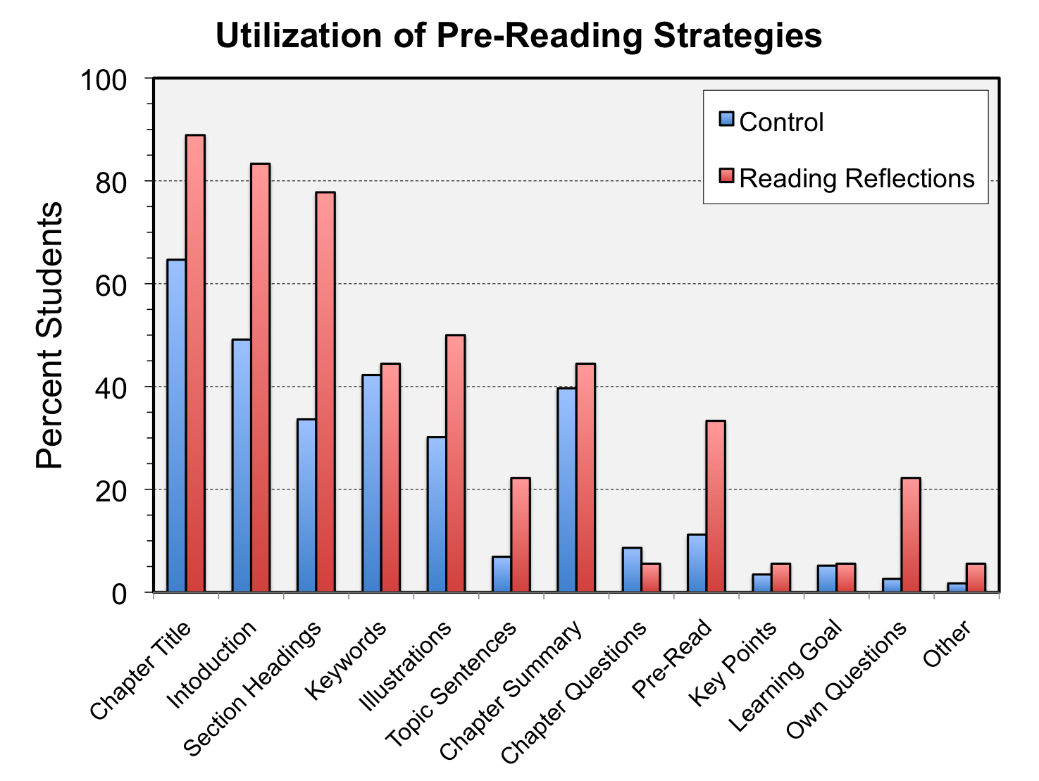

Slide 23
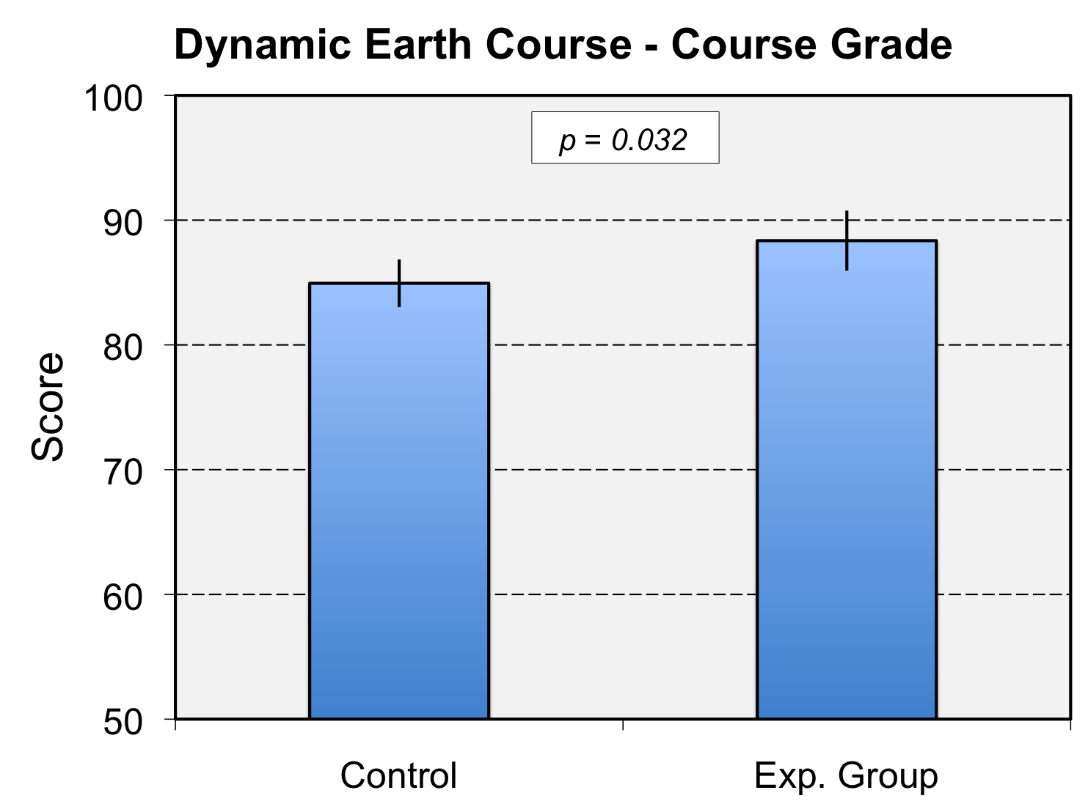
Effect Size = 0.71 (Large)

Slide 24
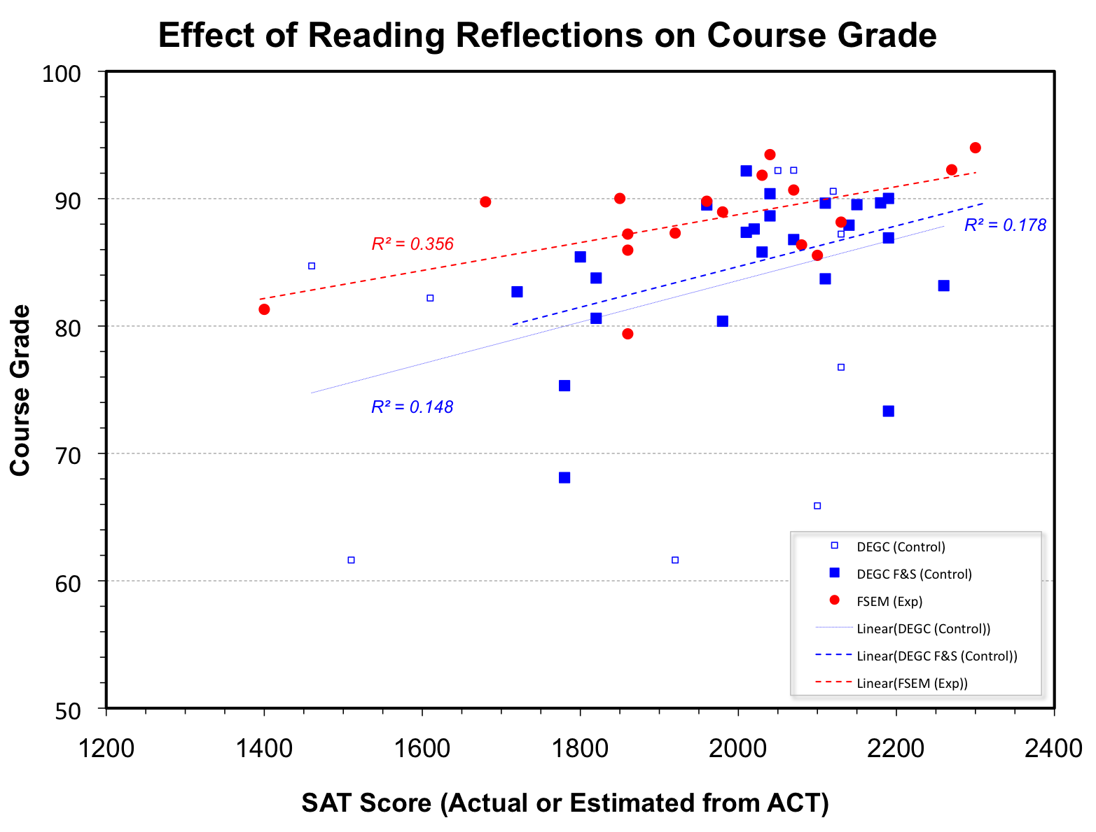

Slide 25
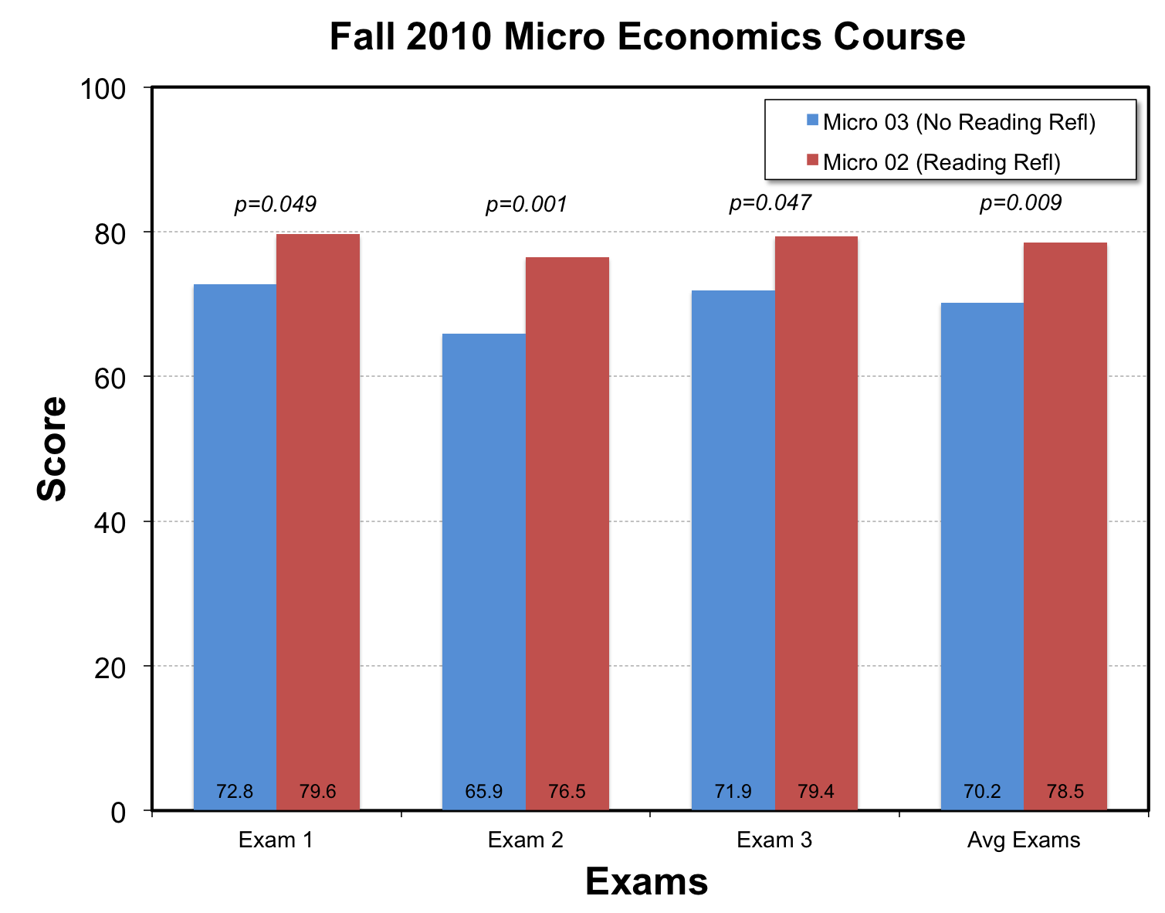

Slide 26
Critical Thinking:
Tools and Dispositions for Reflection

Slide 27
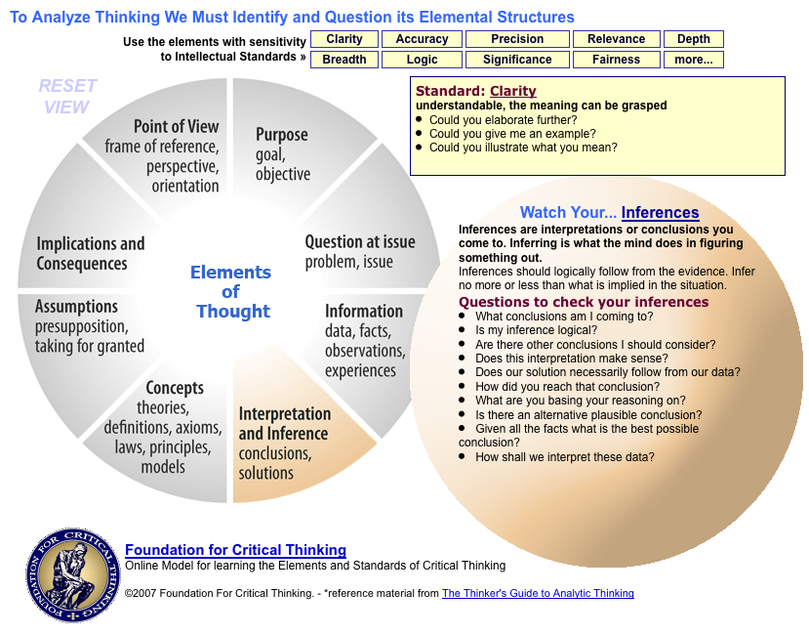

Slide 28
Learning Reflections:
Supporting Learning with
Reflection-on-Action

Slide 29
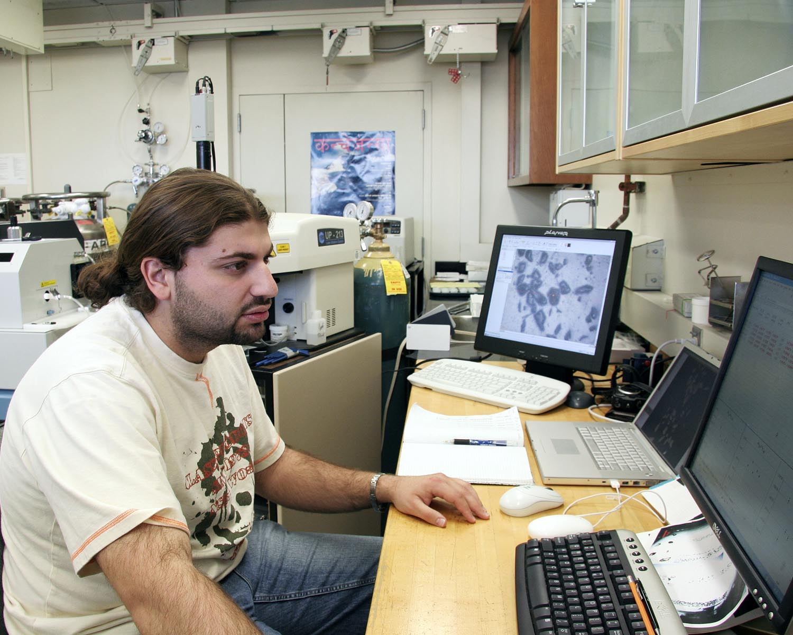
Reflecting on Learning
What are the three most important things you have learned? Why?
Describe the learning
strategies that you are using.
How might they be adapted
for more effective learning?
How does learning in this course relate to other courses?

Slide 30
Wrappers:
A Structured Reflection-for-Action

Slide 31
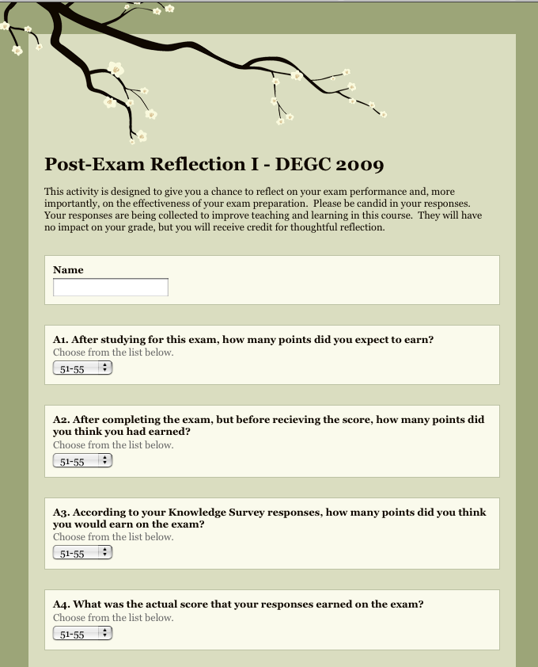
Exam “Wrapper”
Self Evaluation
Preparation Strategies
Performance Analysis
Planning
Achacoso (2004)
Lovett (2008)
Notes:
Wirth - Cutting Edge Metacognition Workshop
8/7/11
31

Slide 32
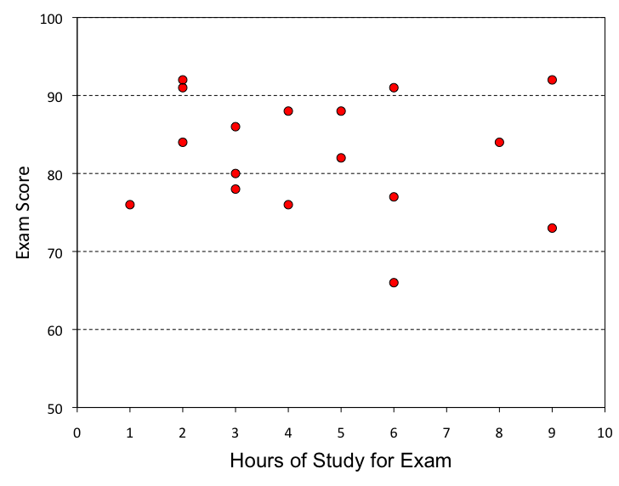
Exam Preparation

Slide 33
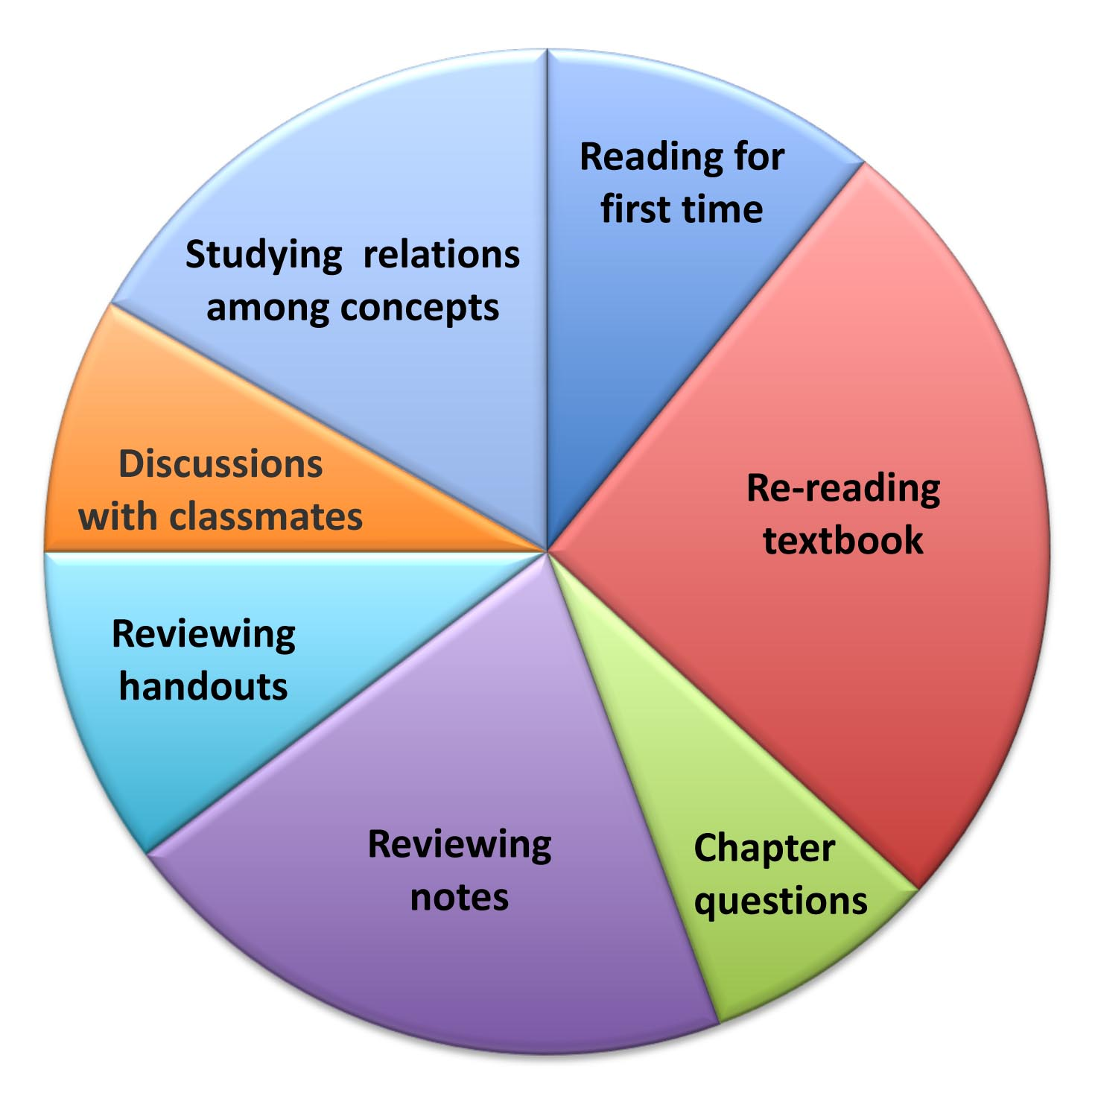
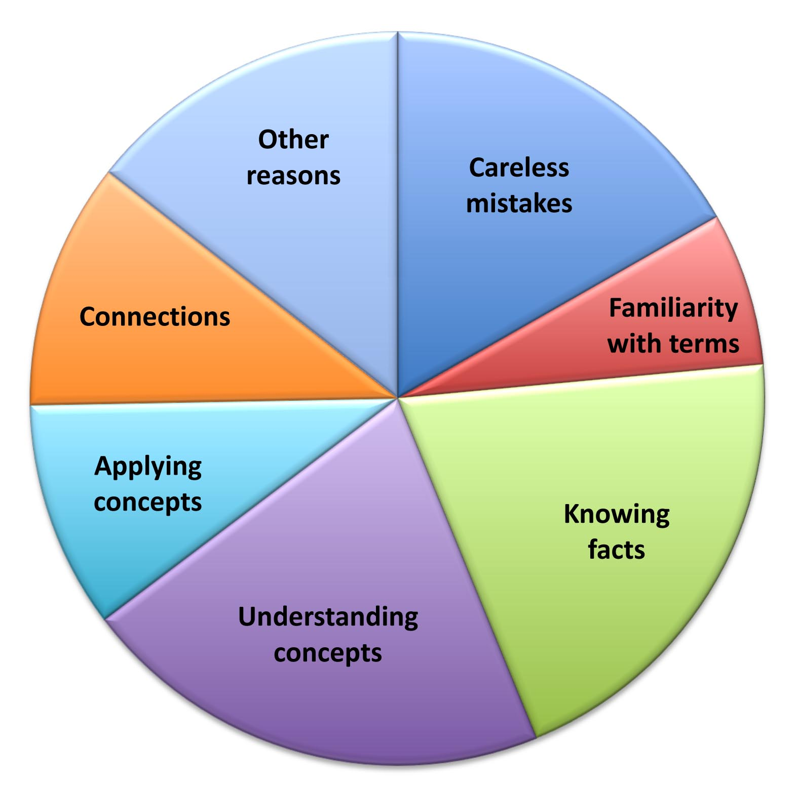
Exam “Wrapper” Results
Study Strategies
Analysis of Errors
Notes:
Wirth - Cutting Edge Metacognition Workshop
8/7/11
33

Slide 34
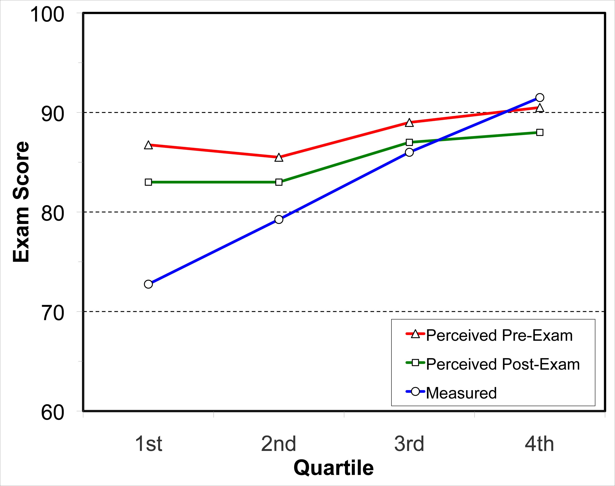
Exam “Wrapper” Results
Notes:
Wirth - Cutting Edge Metacognition Workshop
8/7/11
34

Slide 35
What will YOU do to improve student learning?

Slide 36
