Slide 1
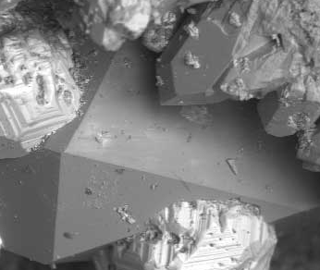
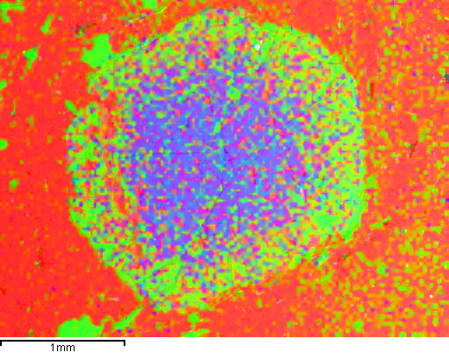
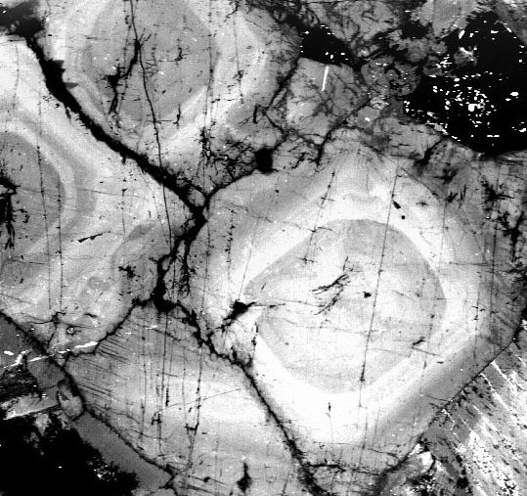
Using the SEM to Enhance Learning
Rachel Beane, Bowdoin College
John Goodge, University of Minnesota Duluth

Slide 2
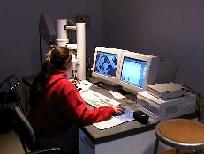
Outline
How does the SEM complement other learning modes?
Variety of inquiry options
Examples of projects
Varied learning goals for different projects
Bowdoin undergraduate using SEM for mineralogy
project, photo by R. Beane

Slide 3
How does the SEM complement other learning modes?
Alongside light optics, with SEM analysis students can
Add another way of looking (e.g., BSE)
Add spatial resolution & depth
Reinforce mineral composition & texture
Quantitatively evaluate texture
Reveal temporal history (mineral growth sequence, mineral zonation, x-cutting relations, etc.)
Question, test hypotheses, solve problems…
Notes:
Separate into 2 pages with images of students using SEM, or example images to talk from or give examples of exercises that show how students would learn these

Slide 4
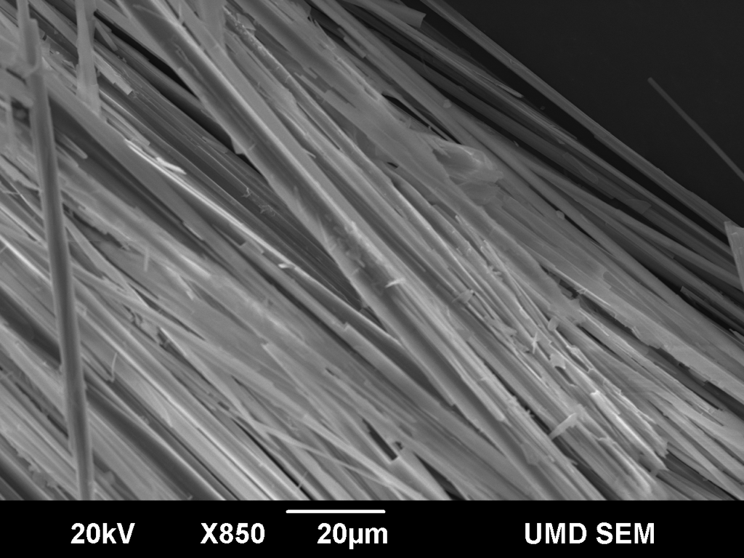
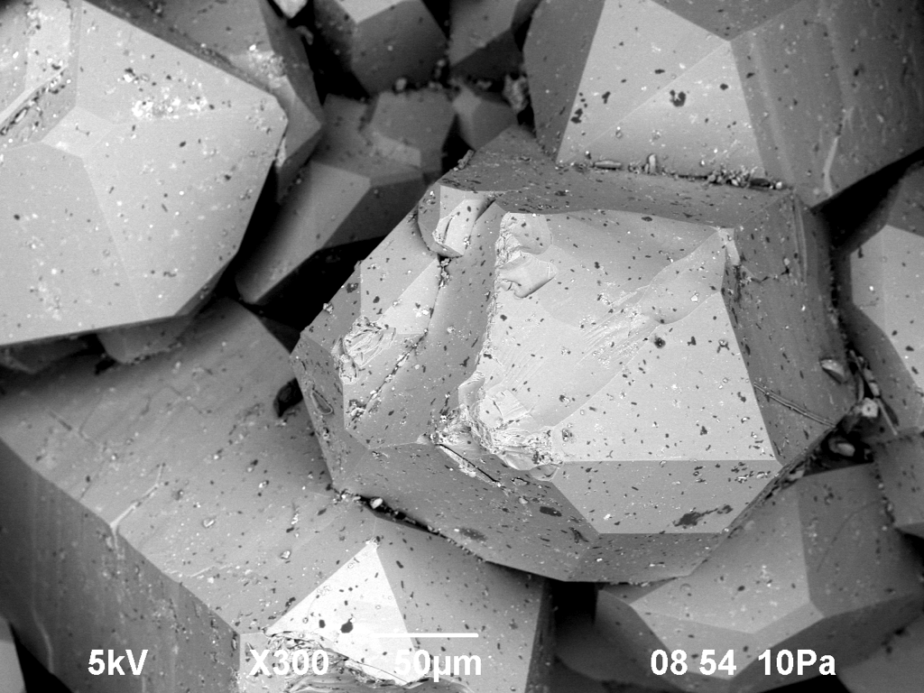
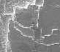
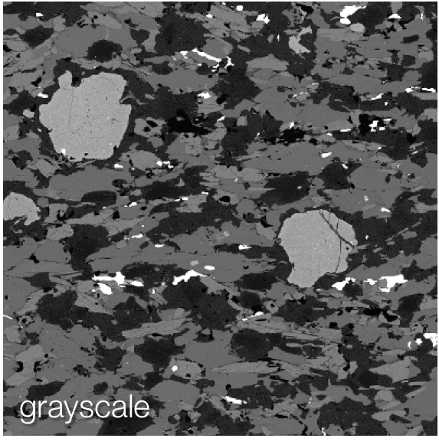
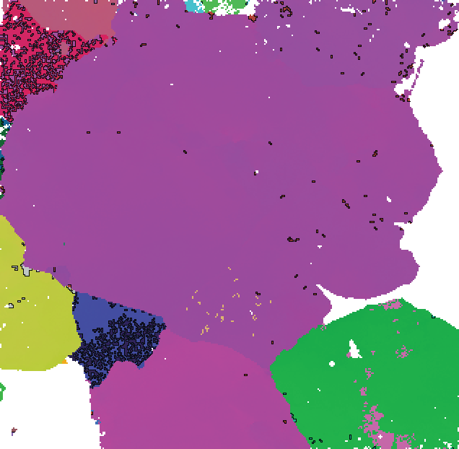
Variety of analytical options: Detectors
Secondary electron imaging (SEI)
Back-scattered electron imaging (BSE)
Energy-dispersive spectroscopy (EDS)
Electron back-scattered diffraction (EBSD)
Cathodoluminescence (CL)
Notes:
Spell out – explain – show corresponding images

Slide 5
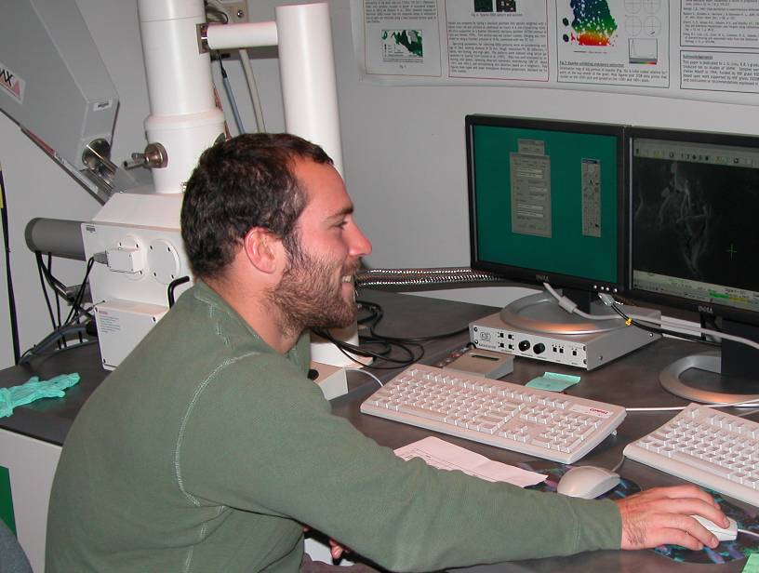
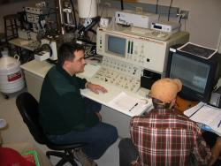
Variety of accessibility options: operating SEM
In-person operation
Remote operation
Virtual operation
Bowdoin undergraduate using SEM, photo by C. Field.
Montana State University students using SEM, photo from D. Mogk.
Notes:
Add images, explain for what class sizes, set ups or goals these might be most useful

Slide 6
Examples of projects:
EXTENDING MINERALOGY WITH BSE & EDS
Learning goals
  Learn physics of electron interactions & comparison with light optics
  Use SEM to acquire BSE (phase) images
  Use mineral textures & compositions (EDS) to ID phases present
  Review mineral compositions & consider effects of solid solution
  Acquire quantitative data (EDS or WDS) for mineral recalc’s and apply with geothermobarometers to solve metamorphic problems
Execution of exercise
  Describe SEM basics & e-beam applications
  Prepared thin section of metapelite with
  Qtz, Pl, Grt, Ms, Bt, Ky, St
  Start with BSE (# of phases), then EDS
  I do this in one 2-hr lab period! ☹
  (follow-up lab to recalc mineral formulae in Excel)
Assessment of learning
  Student interactions
  Follow-up application in
  study of rock suite
Images from UMTC Electron Microprobe lab.
Notes:
The electron beam strikes the specimen
Scattering produces backscatter electrons in all directions, most intensely downward & outward
Electrons that travel along a crystallographic plane trace generate Kikuchi bands whose widths are dictated by the Bragg Law and specimen-to-phosphor screen distance.
The electrons hit the imaging phosphor and produce light

Slide 7
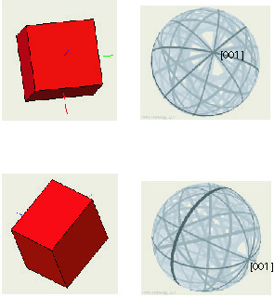
Examples of projects:
EBSD and crystallography
Learning goals
  Operate SEM to acquire and analyze EBSD patterns
  Describe how SEM works and applications of EBSD
  Observe mineral symmetry through Kikuchi bands (acquired & simulated)
  Predict minerals/crystal systems based on BSE images & EBSPs
  Make connections between EBSPs, stereonets, Miller indices…
Execution of exercise
  Describe SEM basics & how I use EBSD in my research
  Prepared grain mount with quartz, tourmaline, topaz, zircon, galena, garnet, kyanite
  Groups of 4 students rotate through SEM lab
  (other students complete crystallography problems in min lab)
Assessment of learning
  Student observation
  Demonstrated performance in subsequent
  projects and quizzes
Figure from S. Sitzman
Notes:
The electron beam strikes the specimen
Scattering produces backscatter electrons in all directions, most intensely downward & outward
Electrons that travel along a crystallographic plane trace generate Kikuchi bands whose widths are dictated by the Bragg Law and specimen-to-phosphor screen distance.
The electrons hit the imaging phosphor and produce light

Slide 8
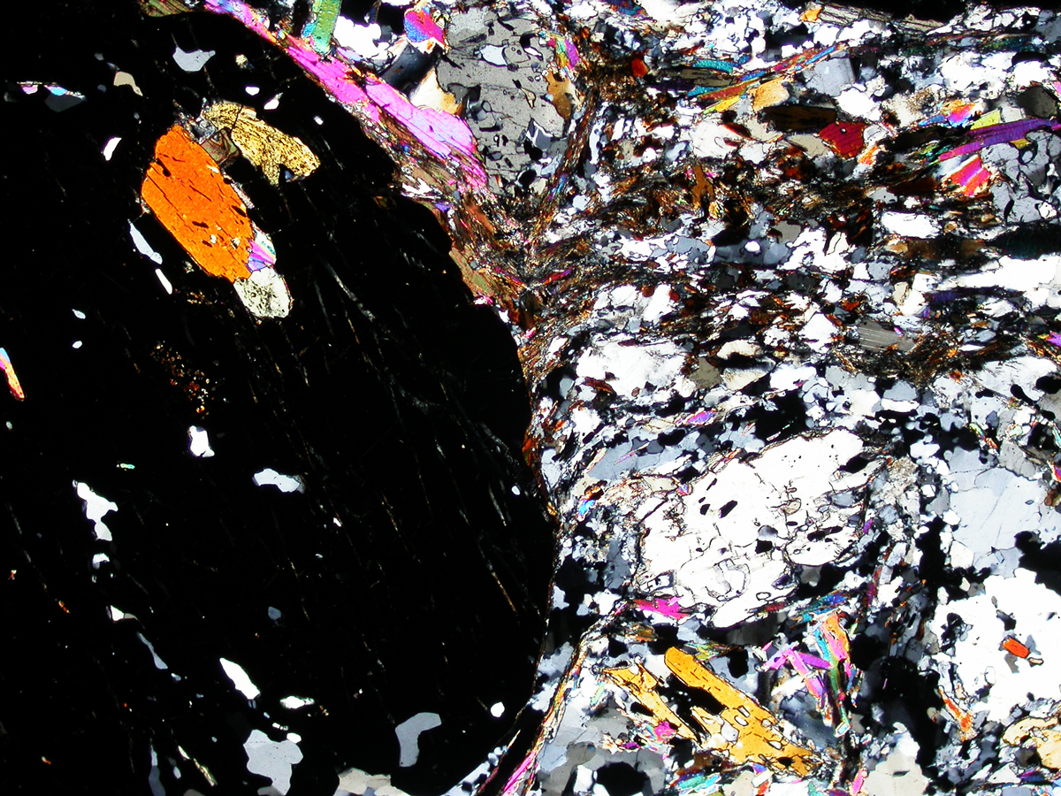
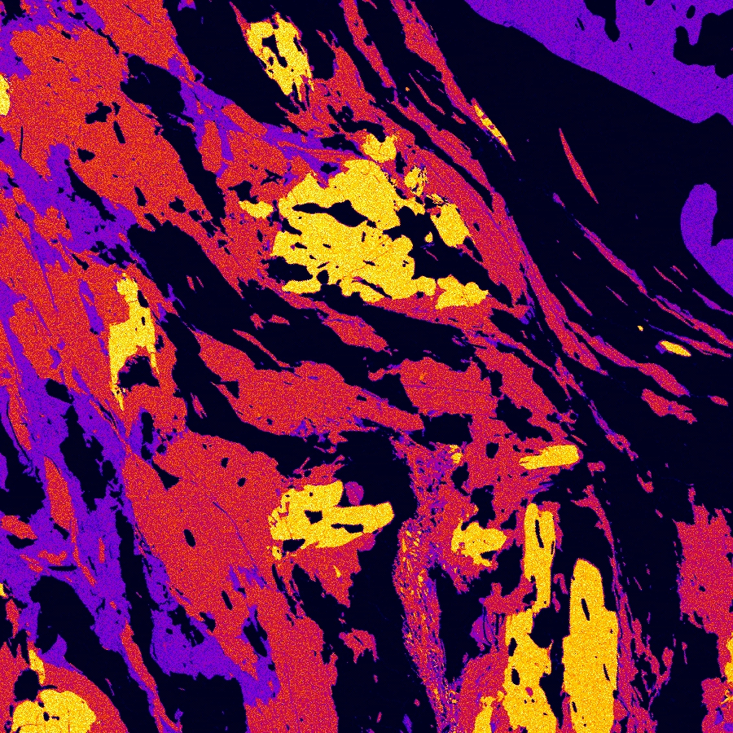
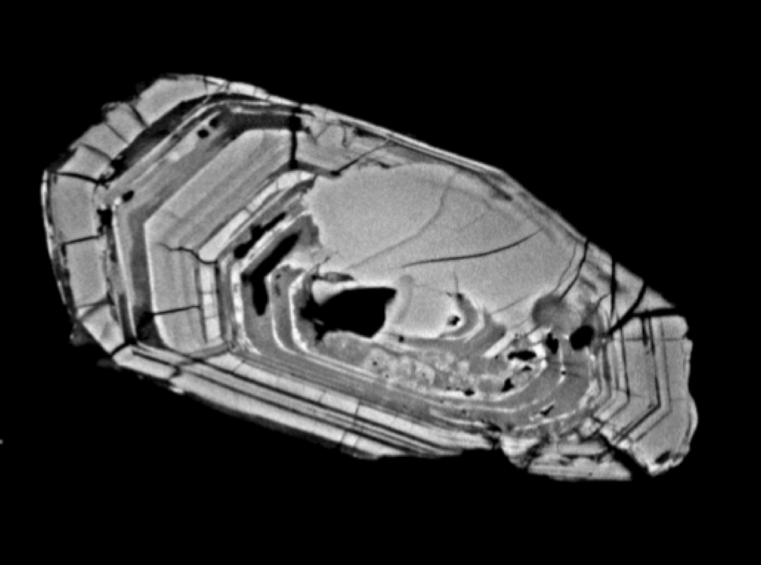
Examples of projects:
SEM STUDY OF SAMPLE SUITE
Learning goals
  Use SEM methods in combination with multiple samples from suite over period of time
  Progressively introduce various methods to address series of ?’s
  Repeat use & experience builds comprehension
Execution of exercise
  Introduce SEM/detectors & give basic training
  Integrate hand samples, thin sections & SEM analysis
  Study textures, mineral comps, microfabrics, mineral zoning, intersample comparison, etc.
Assessment of learning
  Development of understanding over time
Thin section of Grt pelite (image from UMD Petrotectonics lab).
Al element map (image from UMTC Electron Microprobe lab).
Zircon in BSE (image from UMD Scanning Electron Microscope lab).
Notes:
The electron beam strikes the specimen
Scattering produces backscatter electrons in all directions, most intensely downward & outward
Electrons that travel along a crystallographic plane trace generate Kikuchi bands whose widths are dictated by the Bragg Law and specimen-to-phosphor screen distance.
The electrons hit the imaging phosphor and produce light

Slide 9
Examples of projects:
How have you used the SEM to enhance learning?
Mineralogy:
Analyze exsolution texture and rehomogenize original phase
Compare optical observation of complex mineral (.ie., plagioclase) with internal chemical zoning to track changing P-T conditions
Halite-sylvite-quartz-opal-labradorite assemblage for comparison of diffraction patterns & microtechniques for different capabilities and choices of method
Olivine-garnet assemblage to measure lattice constants for compositions; then compare to EDS analysis
Mineralogical estimates of composition: specific gravity; pXRD; refractive indices, then compare to EDS ± EBSD
Differentiating minerals in reflected-light by BSE & EDS
Notes:
Ideas from the group

Slide 10
Examples of projects:
How have you used the SEM to enhance learning?
Petrology:
Volcanic texture analysis (welded to unwelded tuffs); pre-optical
Study sample suite: mineral assemblages, compositions, etc., for a semester-long project; compare compositions to AFM projection; complementary to optics (e.g., Duchess Cty)
Fictitious sample suite of rocks; thin section to e-beam analyses (BSE, EDS spot and traverses, element maps, etc.)
Part of a sequence of mineral analyses from hand sample to grain-mount and polished section methods
Remote use as classroom demonstration tool
Notes:
Ideas from the group

Slide 11
Varied learning goals for different projects
Individual or group?
Short labs or longer projects?
How do logistics influence choices?
  Machine access (in-house or remote)
  Room size
  Class size
  Availability of technician or TA
  Practical limits to training (ramp-up for turning on, tuning up, loading, software GUI, data acquisition, data archiving, etc.)
Notes:
Discussions

Slide 12
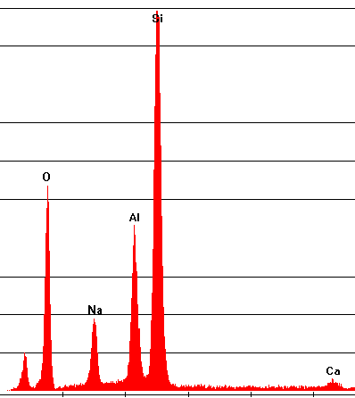
For more information and ideas:
Information about SEM instrumentation, detectors, and techniques:
    http://serc.carleton.edu/18411
Teaching Activities using SEM:
    http://serc.carleton.edu/NAGTWorkshops/search.html?search_text=SEM&q1=sercvocabs__13%3A1

Slide 13
For more information and ideas:
Some published references for student learning using the SEM:
Argast, Anne and Tennis, Clarence F., III, 2004, A web resource for the study of alkali feldspars and perthitic textures using light microscopy, scanning electron microscopy and energy dispersive X-ray spectroscopy, Journal of Geoscience Education v. 52, p. 213-217.
Beane, Rachel, 2004, Using the Scanning Electron Microscope for Discovery Based Learning in Undergraduate Courses, Journal of Geoscience Education, v. 52, p. 250-253.
Cheney, J. T. and Crowley, P. T., 1997, Introduction to the SEM/EDS or “Every composition tells a story”: in Teaching Mineralogy, eds. Brady J. B, Mogk, D. W., and Perkins, Dexter III, Washington, D. C., Mineralogical Society of America, 406pp.
Moecher, David, 2004, Characterization and Identification of Mineral Unknowns: A Mineralogy Term Project, Journal of Geoscience Education, v 52, p. 5-9.
Notes:
Others?

Slide 14
Variety of analytical options: QUESTIONS???
Secondary electron imaging (SEI)
Back-scattered electron imaging (BSE)
Energy-dispersive spectroscopy (EDS)
Electron back-scattered diffraction (EBSD)
Cathodoluminescence (CL)
Notes:
Spell out – explain – show corresponding images

