Slide 1


μRaman
Introduction and Applications in Raman Spectroscopy
Aaron Celestian

Slide 2
Uses of Raman Spectroscopy
Finger printing of compounds
  Crystalline or non-crystalline
  All materials have different Raman spectrums
Fast
  Data can be obtained in less than one second
  Mostly non-destructive
Ease of Use
  “Point-and-Shot” analysis
  No sample preparation
  Laser spot sizes down to 1 micron or less

Slide 3
Examples
Pigment Analysis
  contact your art department
Compositional Mapping
  Phenocryst zoning analysis
Fluid inclusion analysis
  Presence of N₂, CO₂, CH₄, H₂O
  Density of CO₂ (European Journal of Mineralogy 2008; DOI: 10.1127/0935-1221/2008/0020-1825)
Monitor mineralogical processes

Slide 4
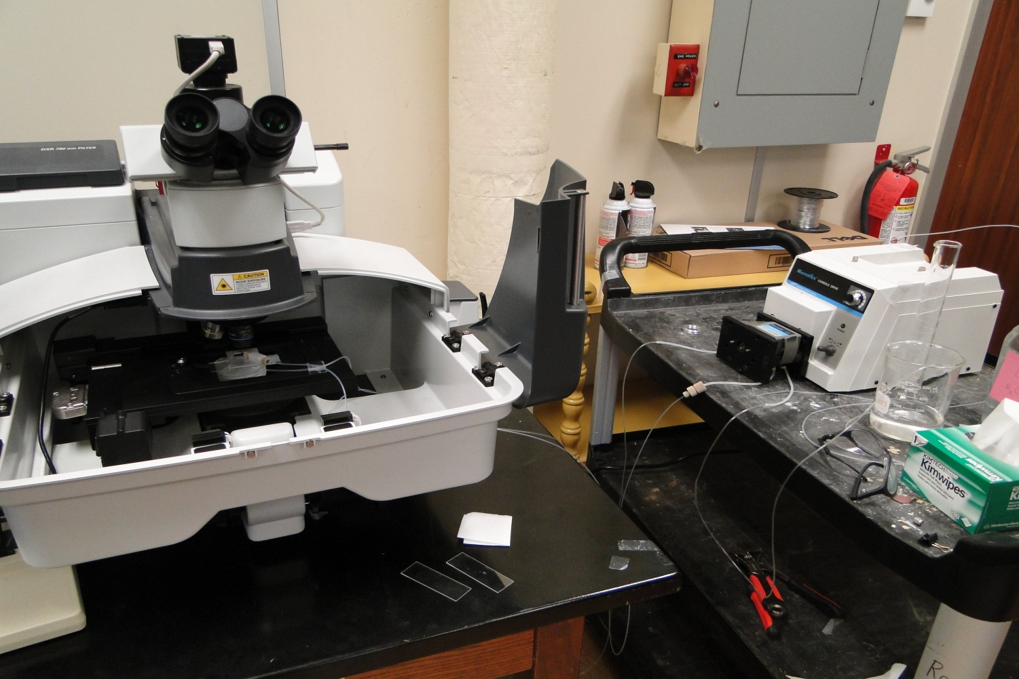
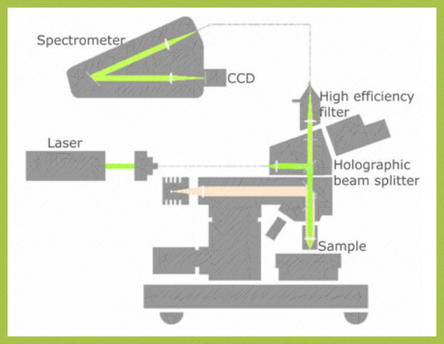

Dispersive Raman Microscope
Thermo DXR
Rigakuraman.com

Slide 5
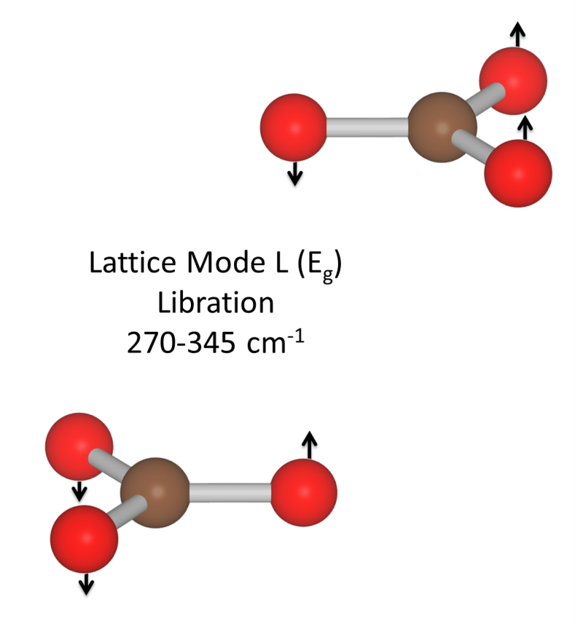
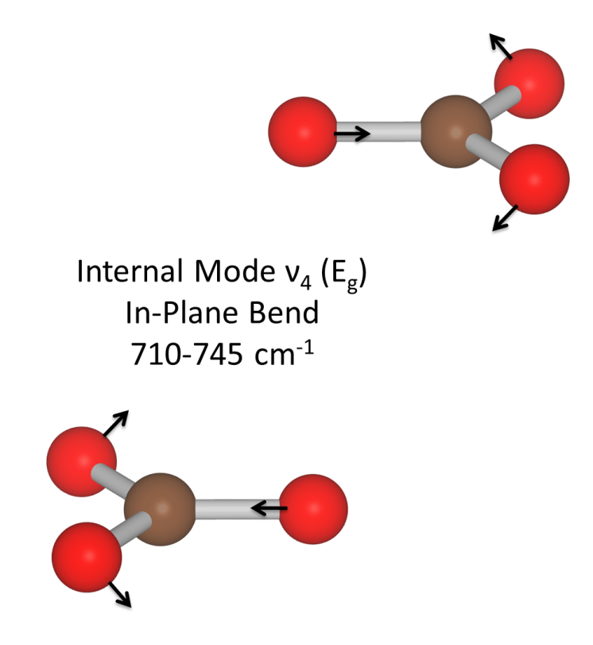

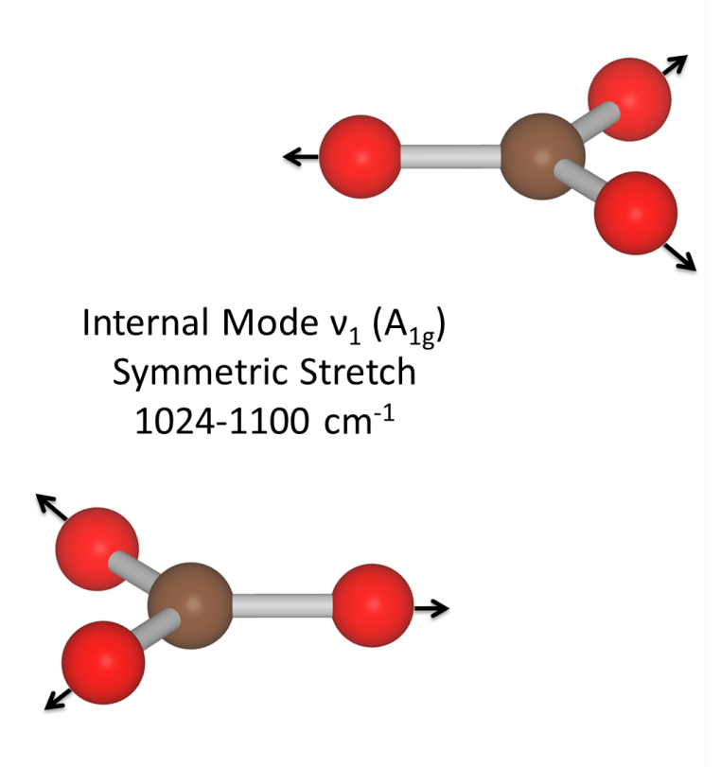
What information is in the spectrum?
Region of External Modes
External Modes
Rigid units
Internal Modes
Internal polyhedral bonds
Internal Modes

Slide 6
What information is in the spectrum?
Characteristic Raman frequencies tell you the composition of the materials.
Look up frequencies in a database
Chemical components
  CO₃
  CO₂
  SiO₄
Pattern of peak positions can identify compound

Slide 7
What information is in the spectrum?
Shifts in peak position:
Stress / strain
Changes in composition can induced stress

Slide 8
What information is in the spectrum?
Width of the peak:
Stress / strain state
  Quality of the crystal – degree of molecular order

Slide 9
What information is in the spectrum?
Change in intensity can be due to:
Crystal-Laser polarization directions
Amount of material being probed (thickness of sample)

Slide 10
Search and Match
Commercial Software
  Usually comes with the instrument
  Usually have to pay for the databases
  Usually do not contain minerals
CrystalSleuth (Robert Downs)
  Free (http://rruff.info/)
  Contains only minerals
Show search-match
with an ‘unknown 1’
Show search-match
with an ‘unknown 2’

Slide 11
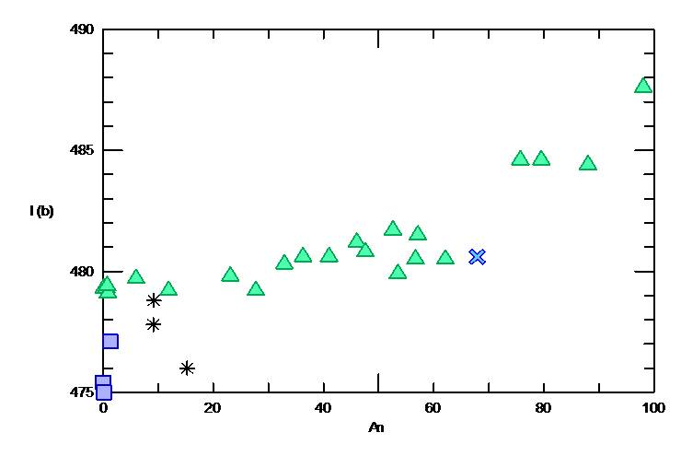
Zoned Alkali Feldspars
Albite – Anorthite
Elaine Flynn (S) and Andrew Wulff (P) mined data from the RRUFF database
Plot peak position as a function of composition
Data from RRUFF and Freeman et al. (2008) CHARACTERIZATION OF NATURAL FELDSPARS BY RAMAN SPECTROSCOPY FOR FUTURE PLANETARY EXPLORATION
The Canadian Mineralogist
Vol. 46, pp. 1477-1500
DOI : 10.3749/canmin.46.6.1477
Triangles = plag series Squares = Orthoclase
Asterisks = Ternary Feldspars X = unknown

Slide 12
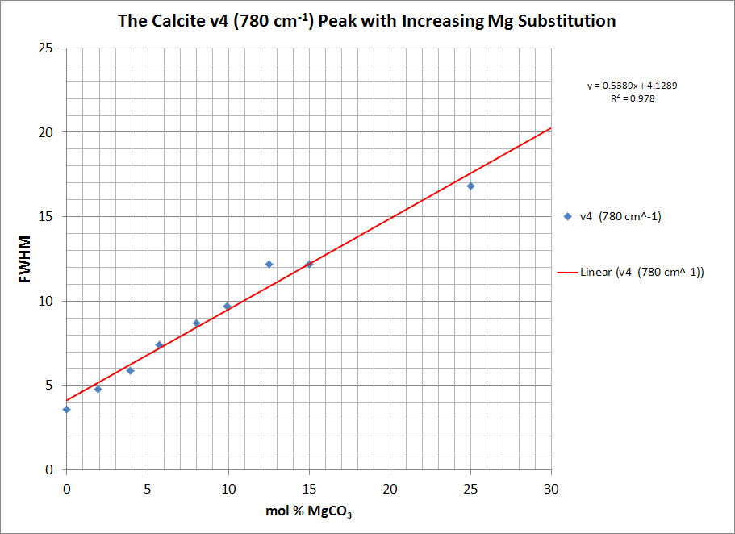

Data from Bischoff, Sharma, and Mackenzie (1985) American Mineralogist, 70, 581-589

Slide 13
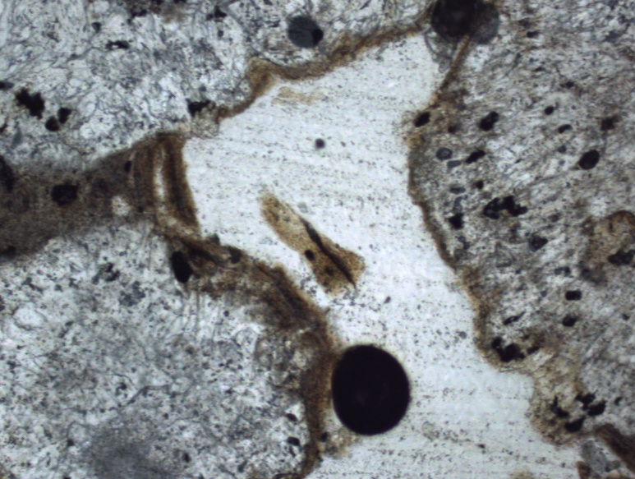
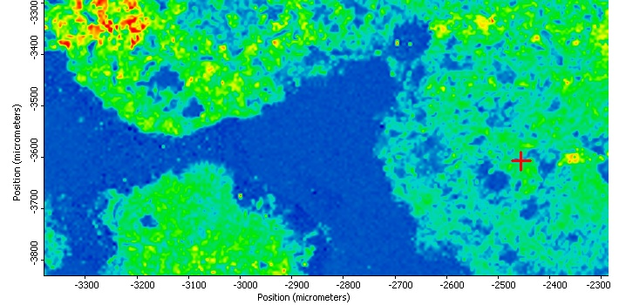
Tufa
Barstow, CA
100x
Organic Layers
Calcite Layers
Crystal Fabrics
Growth Patterns
Trace Minerals
500x

Slide 14
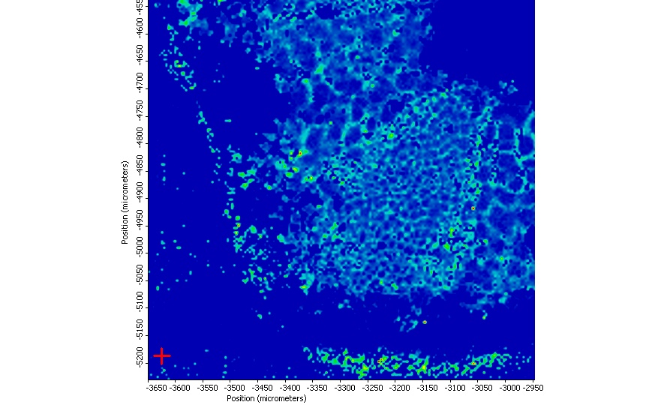
Raman Map of Crinoid Stem
(Dickson slide #107-41)
Skeletal Framework
~3 mol% MgCO₃
Darker blues are the stereom and lighter blues, yellows, and reds are the skeletal framework.
Intensity variations in this map just show where there is more calcite than in other areas.

Slide 15
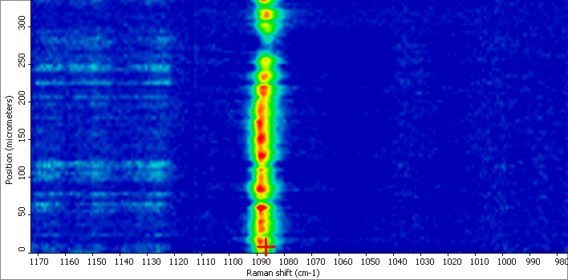
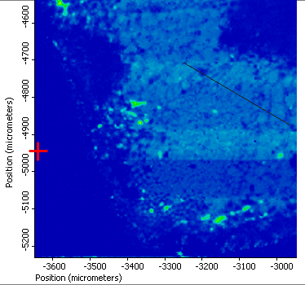
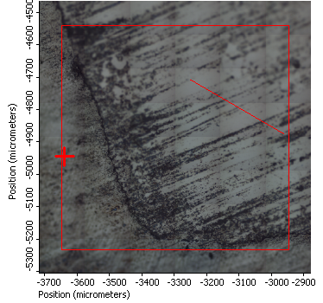
Close to the center of the channel, there isn’t much change with respect to Mg increase. Only a few mol %.
~2.3(1) mol% MgCO₃
~3.0(1) mol% MgCO₃
There is a very little difference in the peak position within the ambulacra and outside ambulacra
Extracted line profile from Raman Map
This correlates with the start and stop of the ambulacral grooves (roughly outlined in yellow by hand)
~2.3(1) mol% MgCO₃
Reflected Light

Slide 16
Ion Exchange
Zeolites and micro-porous molecular
Watch reactions taking place in real time
In Class Exercises:
  Use of various natural and synthetic microporous structures
  Nuclear waste sequestration (Cs and Sr)
  Water softening
  NH₄ removal

Slide 17
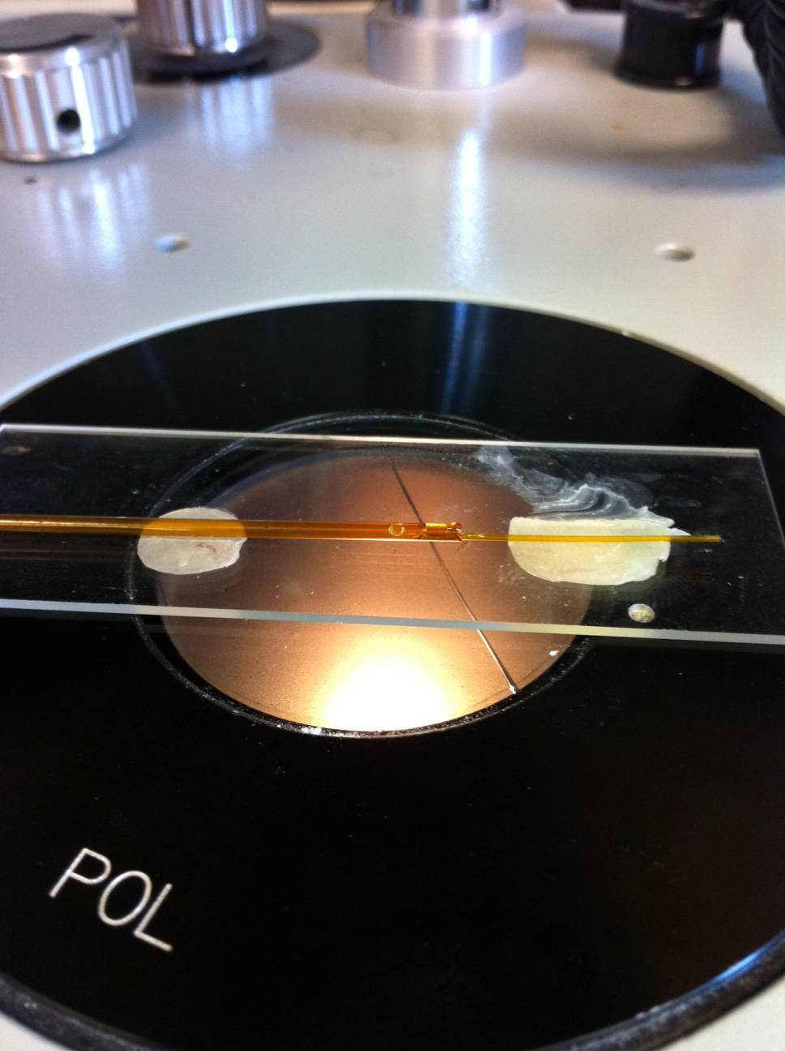
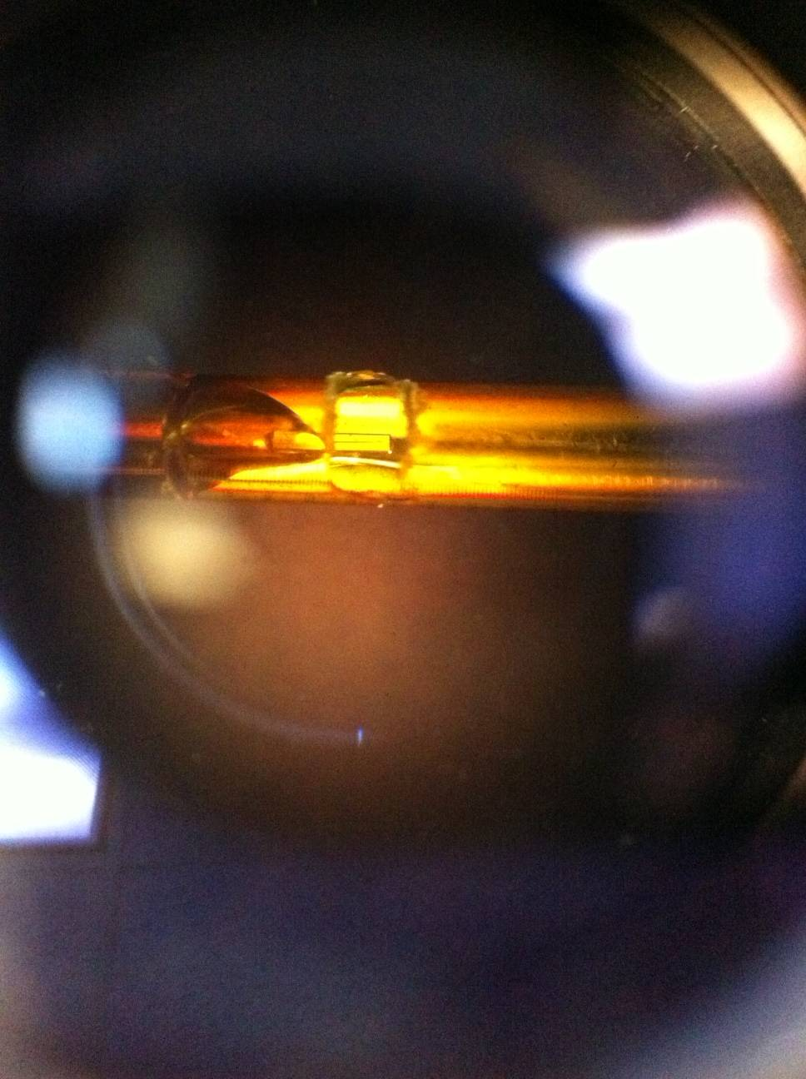
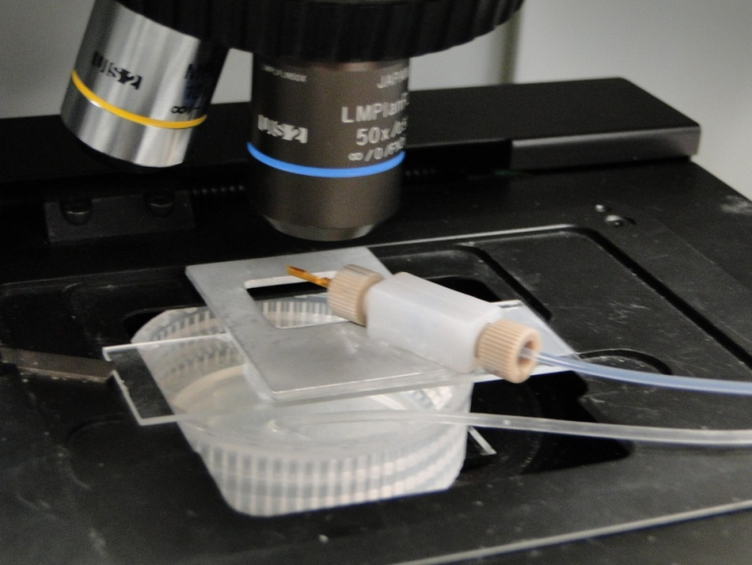
Experimental Setup for In Situ Raman Studies

Slide 18
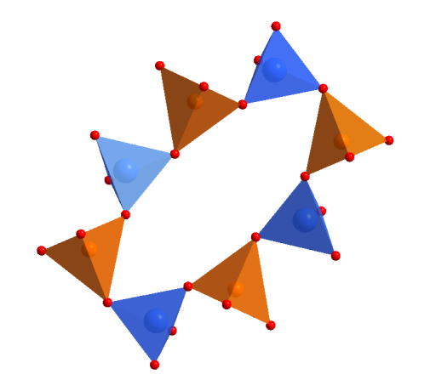
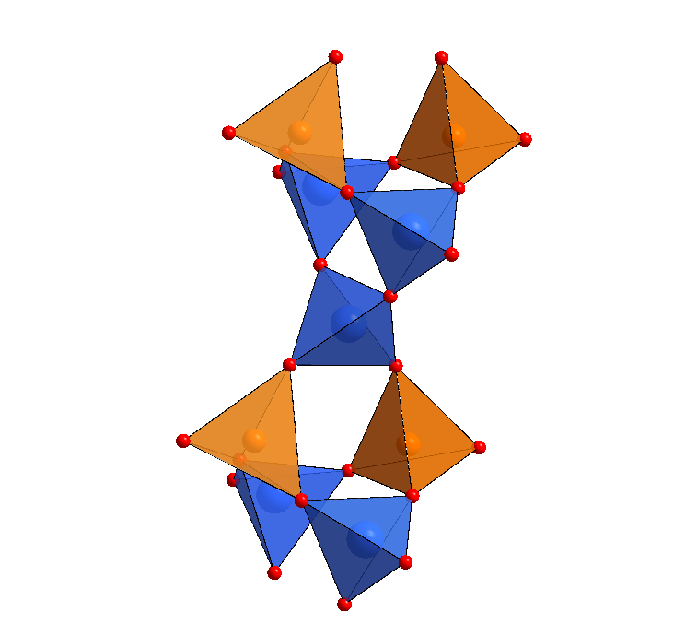
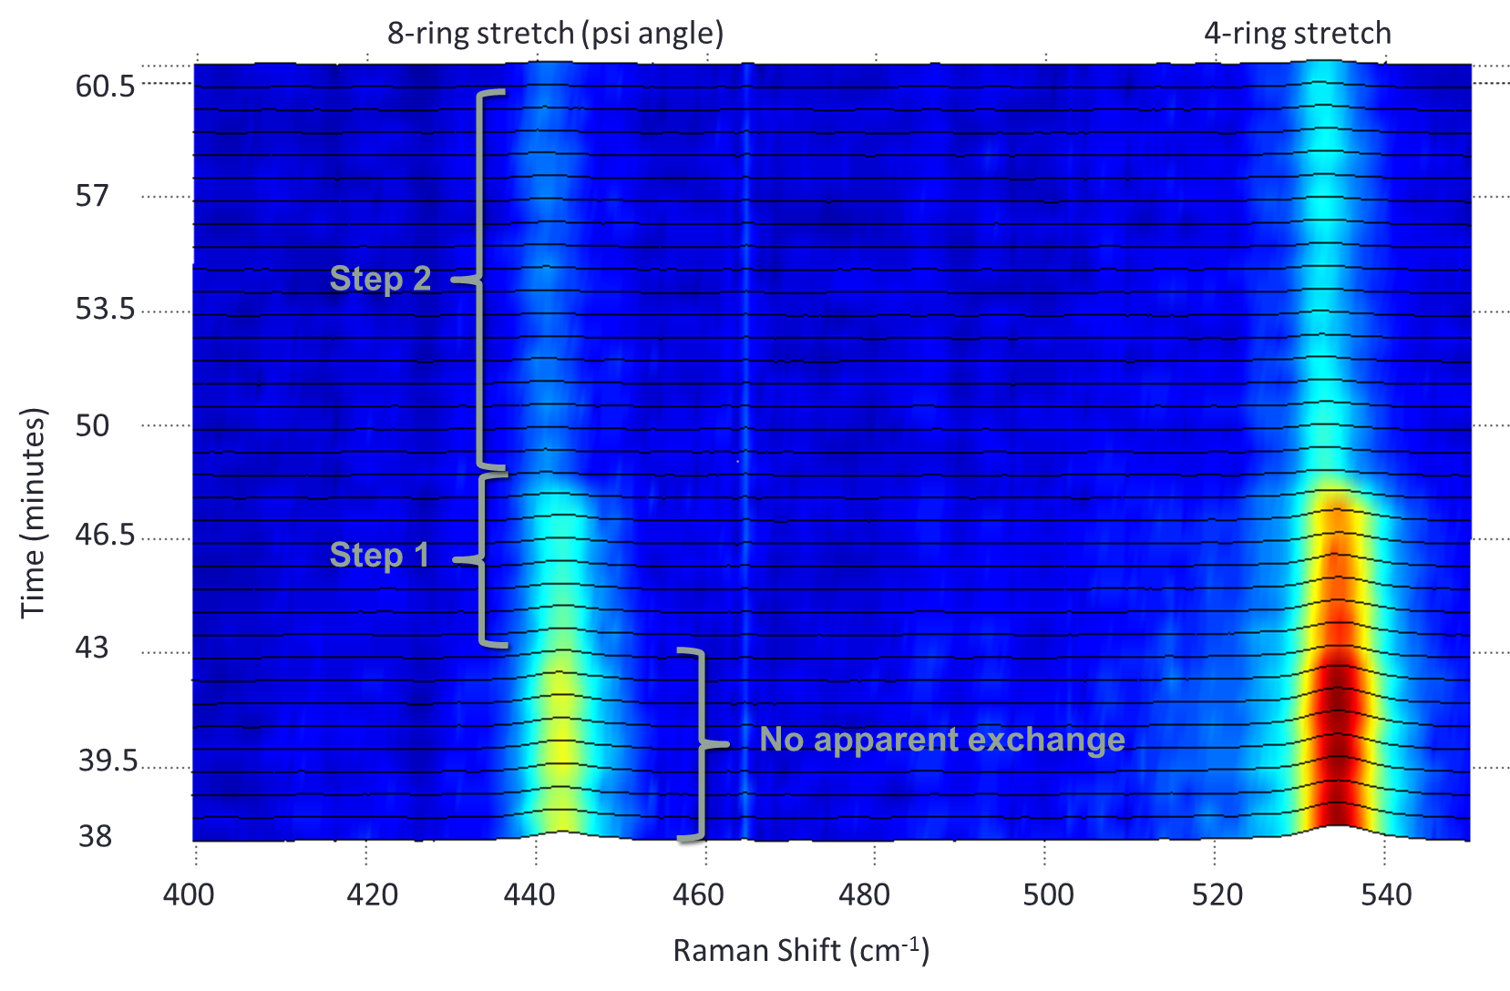
Time Resolved
K → Na-NAT
Time resolved data of K exchange into Na-natrolite. Note the two different exchange steps.
A decrease in peak intensity
Shift in peak position to lower wavenumbers

Slide 19
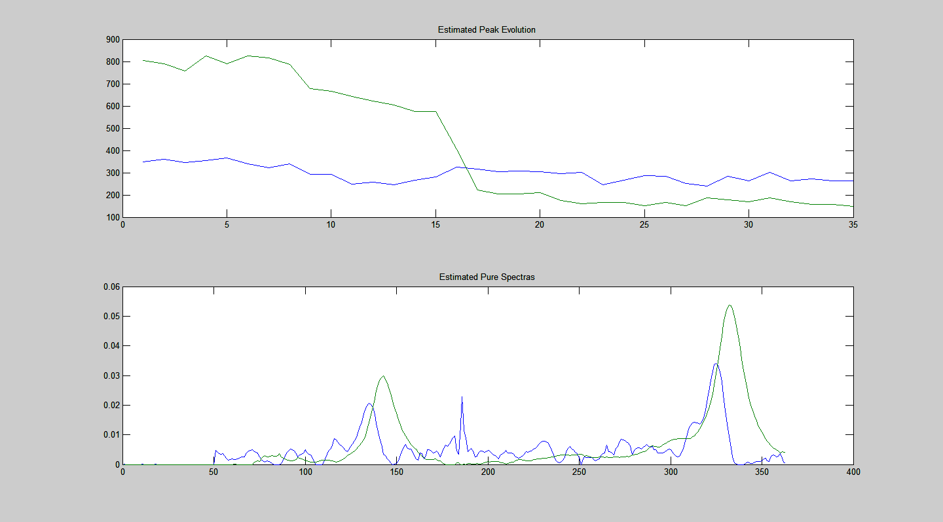
Home built ITTFA
Estimated Peak Evolution
Softening of the 8MR
Green = Na-NAT
Blue = K-NAT
Intensity
8MR changes to more circular
Frame number relative to frame 76
Estimated Pure Spectra Based on a Two Component ITTFA
Intensity Shift
X position
This is the Iterative Targeted Transformation Factor Analysis which helps determine when changes are occurring in the spectra.
Students still to do peak fitting and EPE deconvolution.

Slide 20
Summary of Raman
Non destructive
Fast
Little to no sample preparation
Experiments to accompany structural studies
Leaves students with a new tool and encourage undergraduate research

