Slide 1
“Granite” Countertops as a Teaching Tool
Liz Johnson, James Madison University (johns2ea@jmu.edu)
Thanks to Ron Phillips (purchase info) and Eric Pyle (point counting exercise)

Slide 2
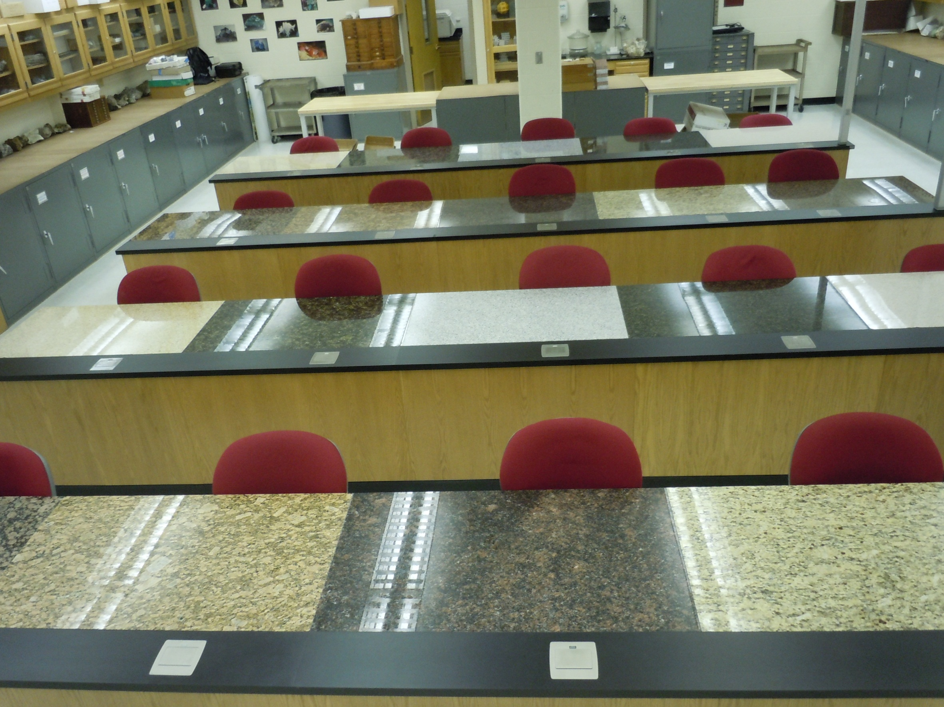
The Classroom

Slide 3
Cost of Installation
Invoice for countertops:
About $31 / sq. ft. plus installation
Comparable to cost of standard lab counters
Thin sections and geochemical analyses of all 10 samples (~$1000)
Alternatives:
  Install a smaller inset
  Use loose pieces as hand samples
Same effect?

Slide 4
Geology and Earth Science Courses
GEOL300 Introduction to Petrology
(BS) 4 credits
Jigsaw Project: Introduction to phaneritic igneous rocks
GEOL367 Genesis of Solid Earth Materials
(BA) 4 Credits
Macroscopic point counting: use plastic chicken fencing as a grid on countertop

Slide 5
Introductory Courses
“Field Trip” to this classroom with Geology majors as the guides
Introduce petrographic microscope and thin sections
Textures and crystallization history
Classification of rocks
Use of geologic knowledge in everyday life

