Slide 1
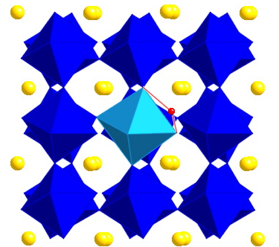

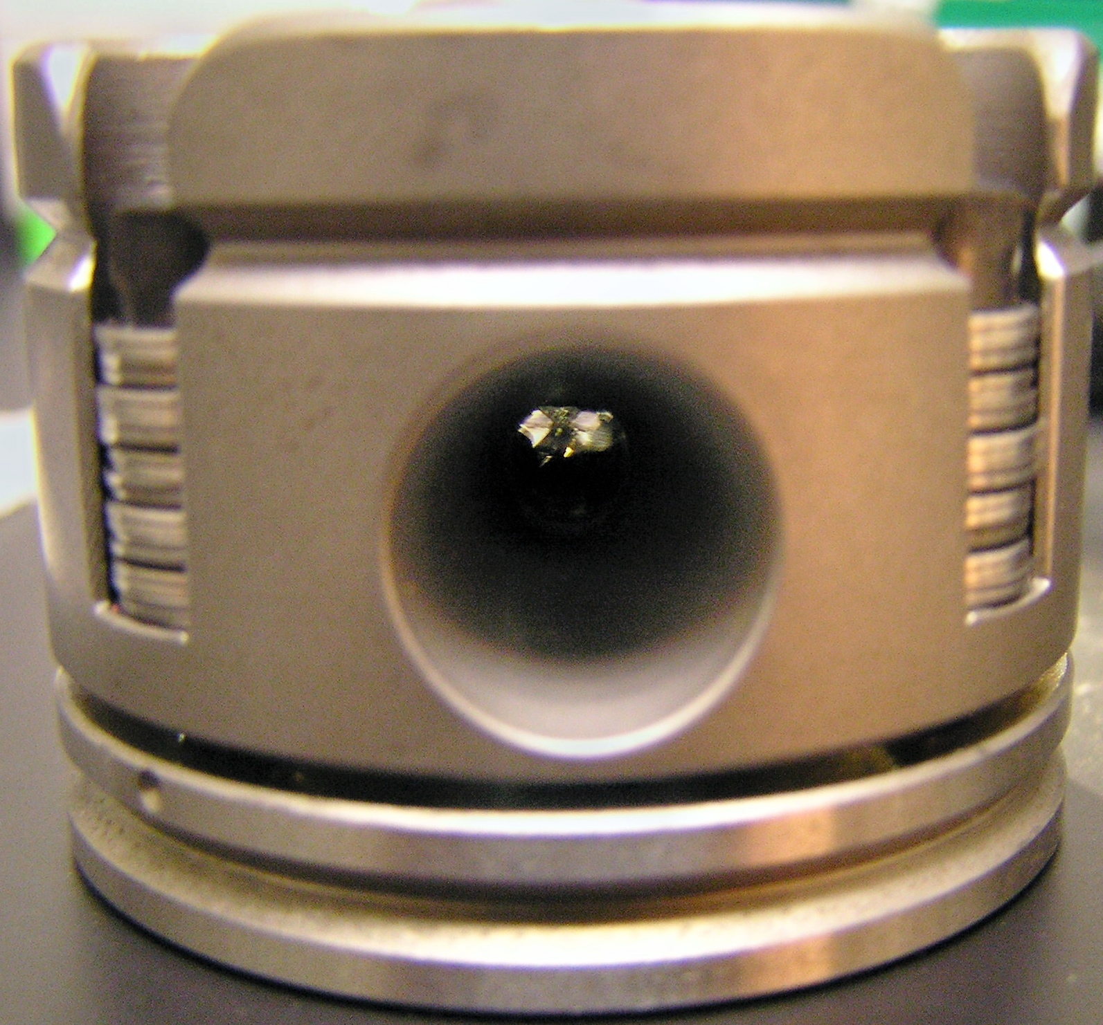
Integrating Mineral Physics into Geoscience Curricula
Pamela Burnley, UNLV
Wendy Panero, OSU
Notes:
Ha, not so fast… I caught you. ;)

Slide 2
Mineral Physics
The Physics (and often chemistry) of Minerals
Integration of solid-state and statistical physics, physical chemistry, mineral science
Elastic properties, thermodynamic stability, deformation, electrical and thermal conductivity, magnetic properties
Thermodynamic parameters: pressure, temperature, entropy, composition
For interpretation of
  Seismic wave speeds, including variations with depth as indications of phase transitions and lateral variations in T & composition
  Geomagnetic fields and paleo magnetism
  Electromagnetic fields & conductivity
  History of and fate of plate tectonics
  Earthquakes at intermediate to great depths

Slide 3
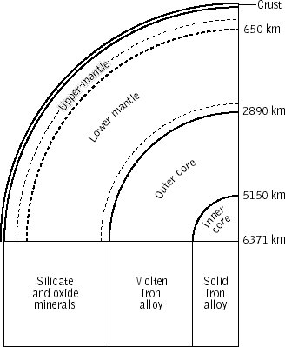
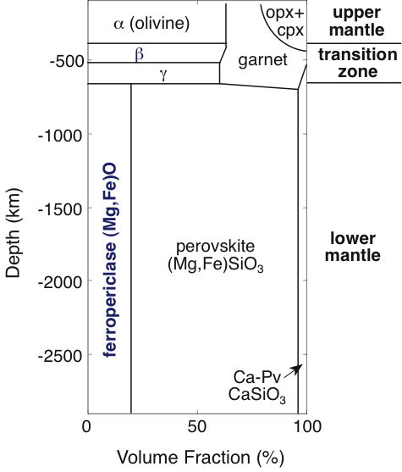
Mineral Physics in Mineralogy, Petrology, and Geochemistry
Structure of the Earth
Phase transitions

Slide 4

Pressure
Sumo Wrestlers in Stilettos (SWS)
Pressure = Force/Area
Force ~ 200 kg * 10 m/s²
Area ~1cm²= 10⁻⁴ m²
1SWS = 2x10⁷ Pa = 200 bar

Slide 5
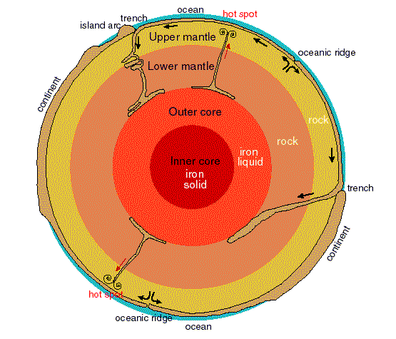

Pressure at the center of the Earth: 360 GPa = 3.6 MBar
18,000 SWSes
Experiments at high pressures:
increase the force
decrease the area

Slide 6
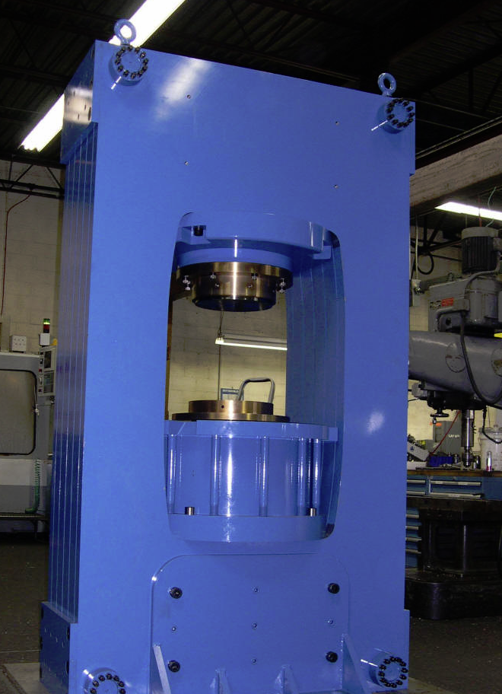
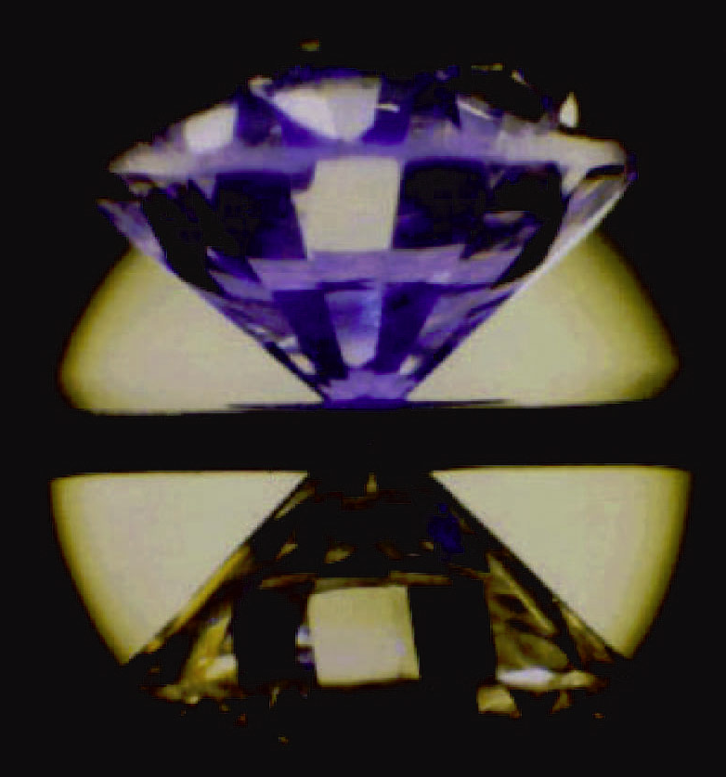
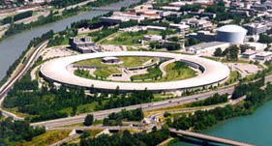
Instrumentation
Instruments to create high pressures and temperatures
Instruments to measure what happened
  XRD (now lots of synchrotron-based work)
  Spectroscopic measurements (e.g. infrared spectroscopy & Raman spec)

Slide 7
Theory
Thermodynamic modeling (a la Navrotsky)
  Appropriate for UG geochemistry
    Hand calculations
“Classical” modeling
  Treat atoms as springs and masses
    Within reach of upper division undergraduates
    Fast calculations with appropriate (free) software
Ab-initio or “first principles” calculations
  Requires significant physics background, including quantum mechanics and solid state physics
  Slow calculations for larger systems
  Requires either expensive software (>$3000) or pswcf is free significant computer/super computer know how. Or both.

Slide 8
Examples of integration into UG Curricula
“From Core to Crust” Barb Dutrow
  Emphasis on mineral structures and phase transitions from the simplest structures (hcp iron of the inner core) to lower mantle minerals (rock salt-structured MgO), phase transitions in the olivine system, etc
Build a Planet (UCLA)
  Abby’s upper division seminar on playing with EOS, mass radius curves, etc.
Where are the boundaries between “traditional” course content and mineral physics??

Slide 9
Tie in points for “enrichment” pieces
Traditional Mineralogy Topic | Mineral Physics Topic
Physical properties | Equations of State (density as a function of P, T & composition) Raman spectroscopy Mossbauer spectroscopy Ruby R-lines vs pressure
Pauling’s rules | Changes in coordination number with pressure
XRD | Synchrotron facilities
Phase equilibria | Cook and look in multi-anvil in-situ phase equilibria work Nucleation and growth kinetics
Structure of the earth | How we know what Earth is made of

Slide 10
Tie in points for “enrichment” pieces
Traditional Mineralogy Topic | Mineral Physics Topic
Olivine | Phase relations and transformation mechanism between olivine, wadsleyite and ringwoodite, perovskite and magnesiowustite
SiO₂/Quartz | Phase relations with coesite and stishovite
Garnet & Pyroxene | Transformation to perovskite
Filling of electrons in orbitals | Spin transition in Fe

Slide 11
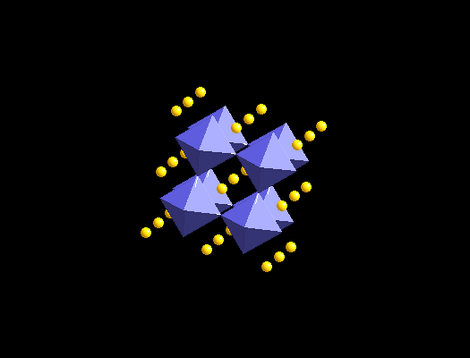
Example: Olivine
Phase transitions, coordination change, equations of state, structure of the Earth
Olivine
Perovskite
P<13 GPa
P>25 GPa

Slide 12
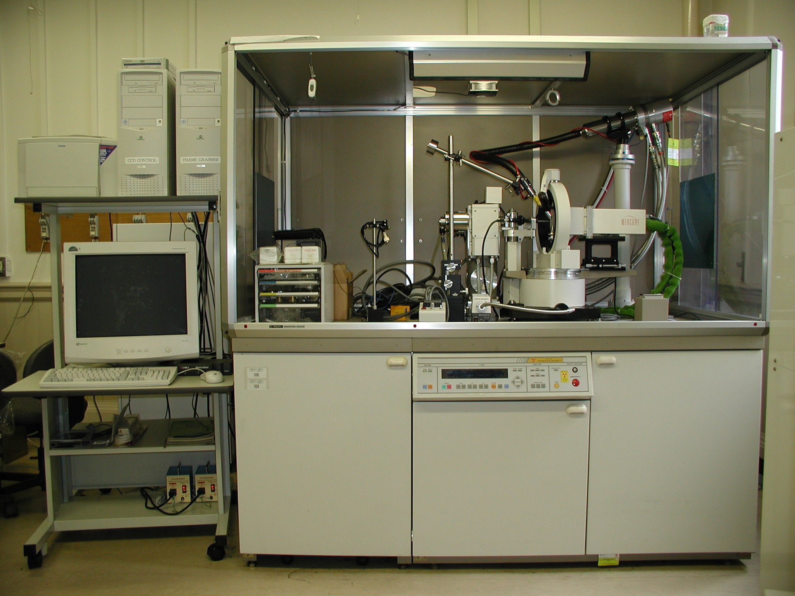
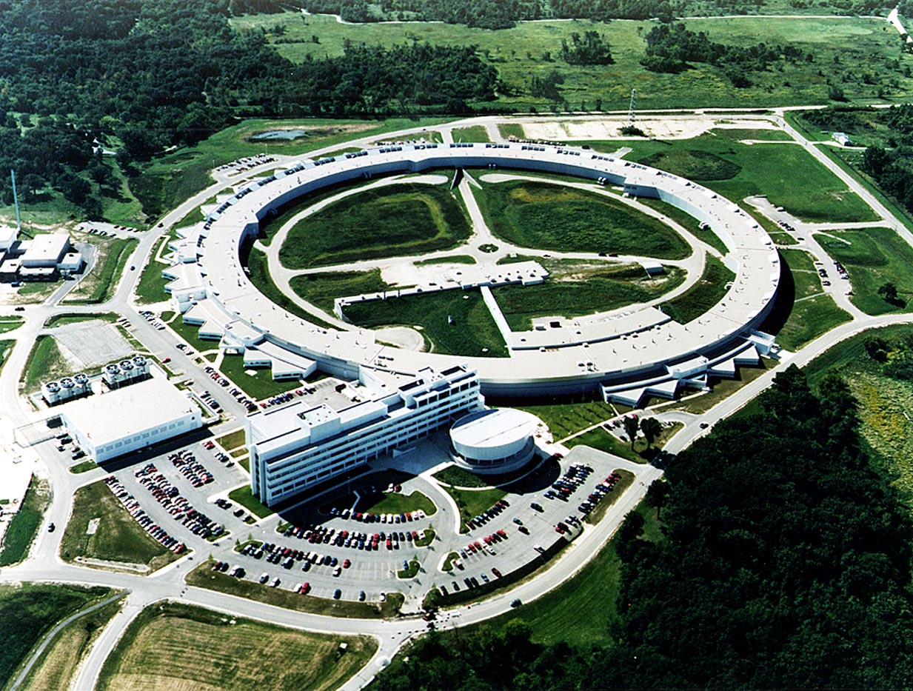
X-ray Diffraction
Lab-based XRD:
Bruker ~$100k
Diffraction pattern of 1000 μm³ in hours
Synchrotron-based XRD:
NSLS-II $1G
Diffraction pattern of 100 μm³ in <1 sec
>10¹⁰ the flux of lab-based XRD
Notes:
Guessing on numbers here. You might know better, Pam?

Slide 13
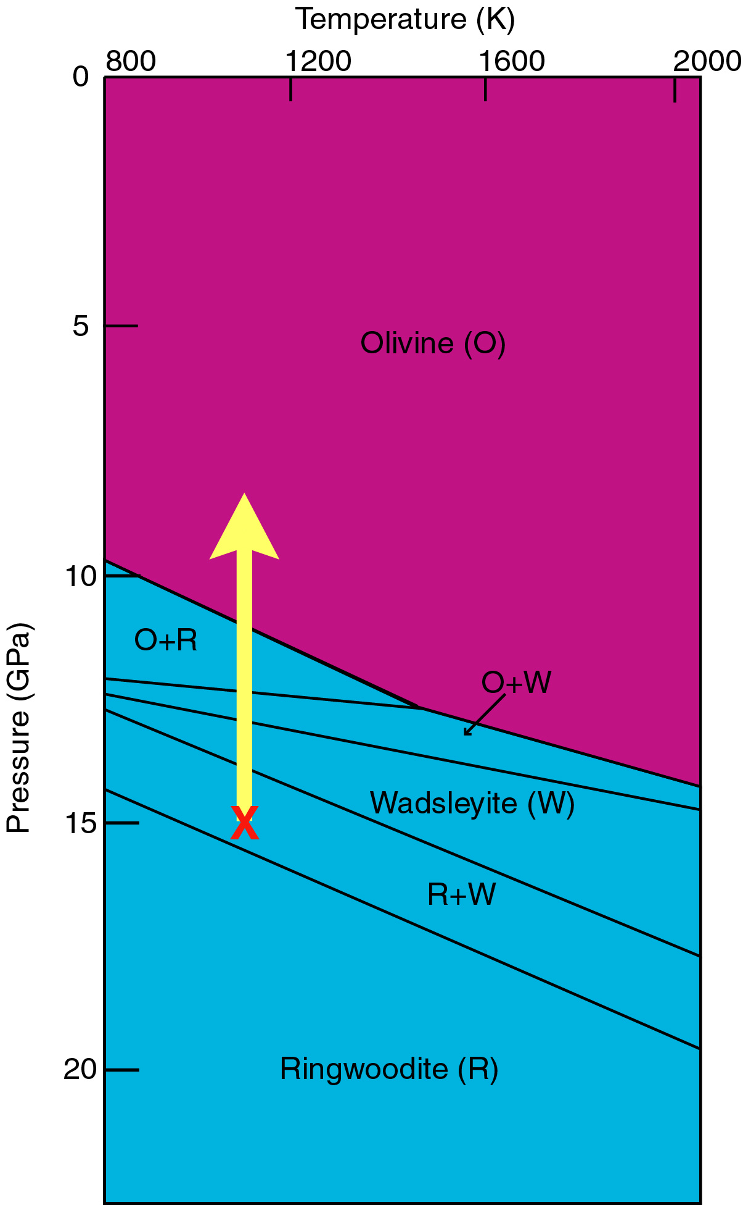
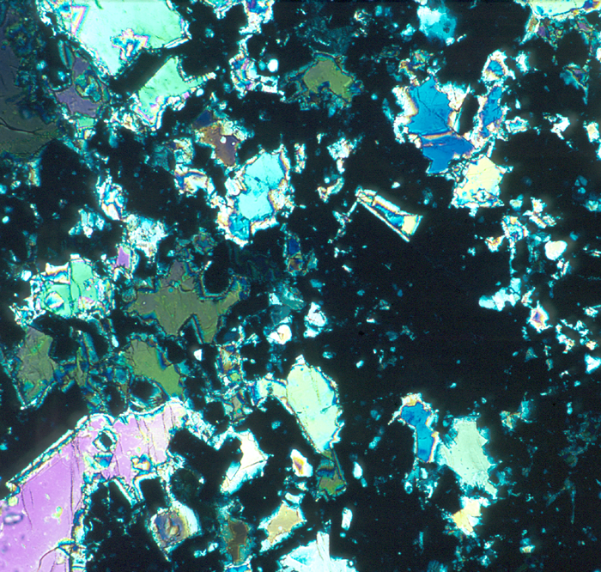
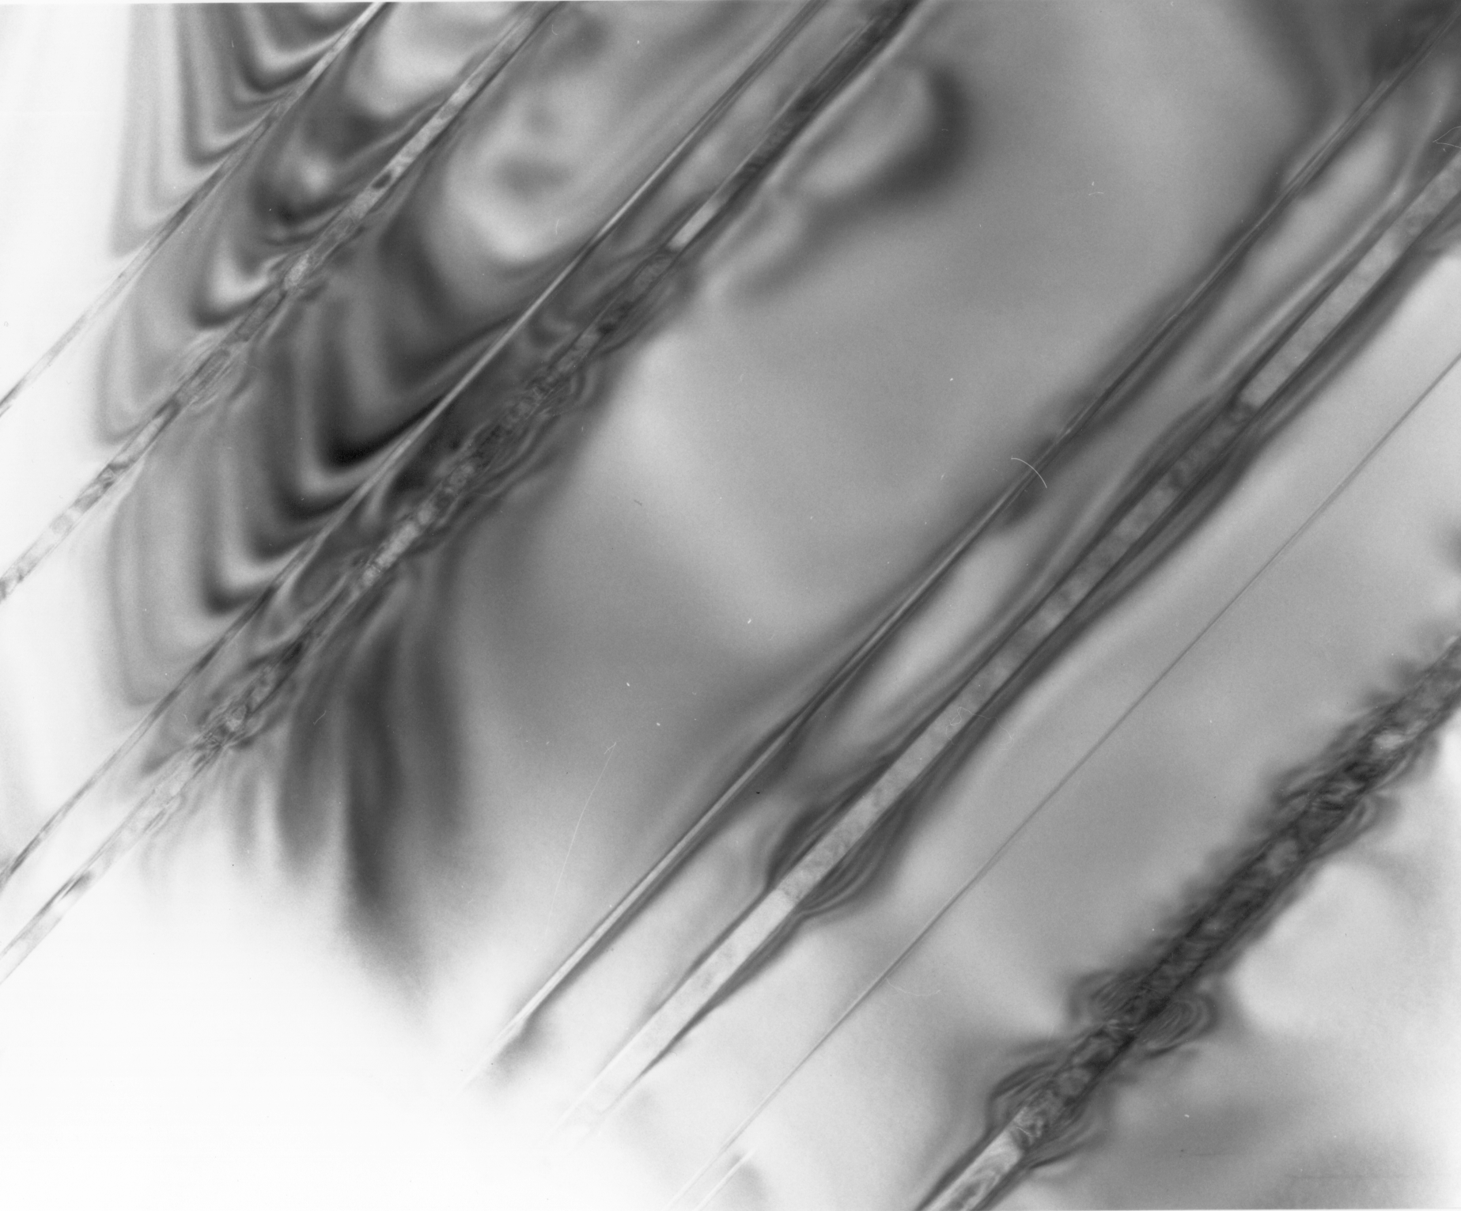
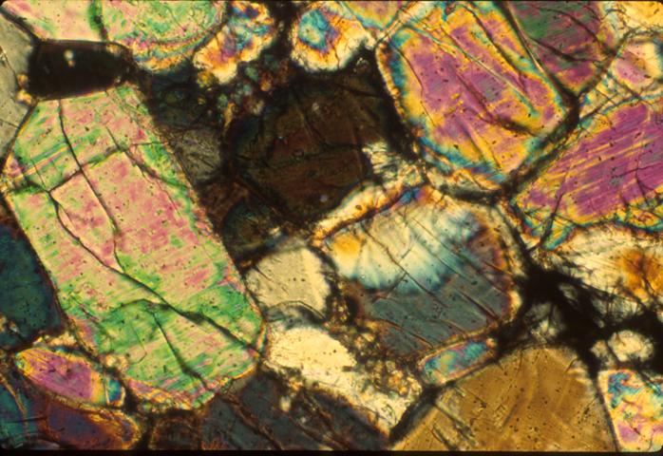
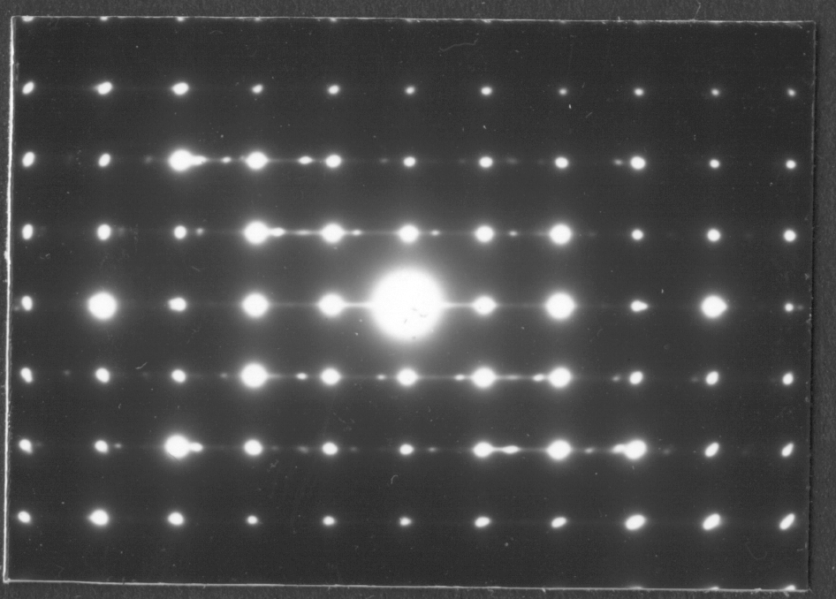
Olivine phase transformation mechanism
0.25 μm

Slide 14
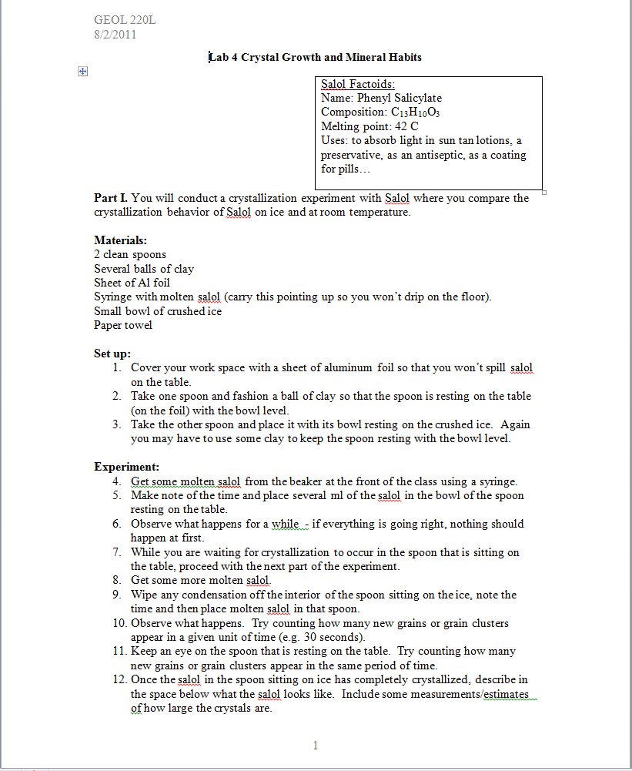
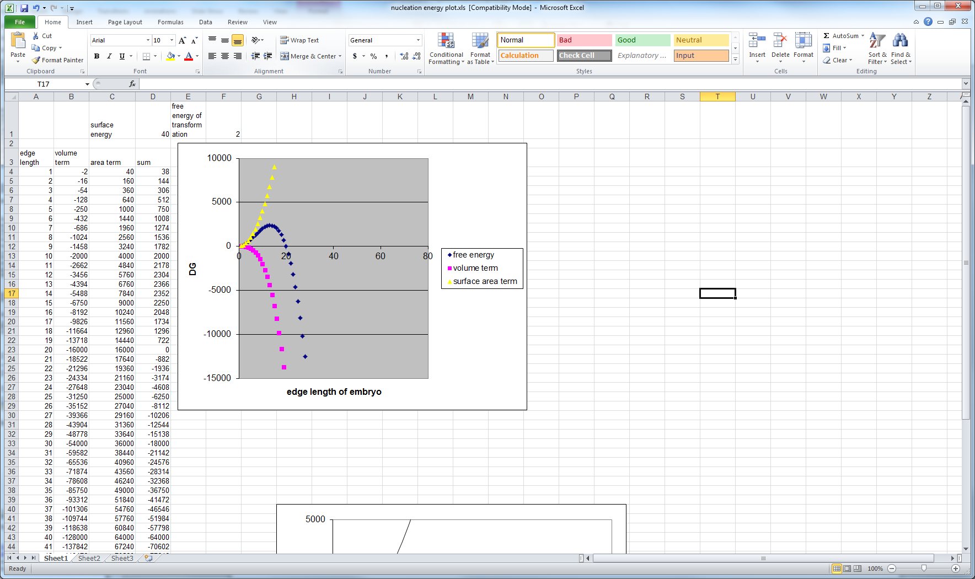

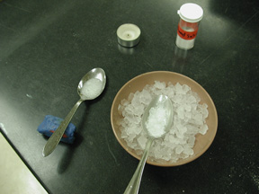
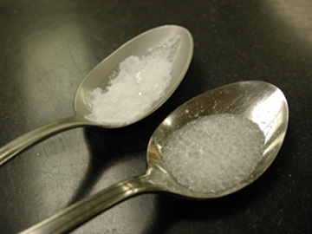
Nucleation and growth kinetics

Slide 15
Mineral Physics Educational Modules for Advanced Undergraduates and Graduate Students
Get mineral physics stuff out there
Create environment for collaborative teaching
Consists of materials & course
Currently under development, to run Spring 2012 for the first time.
http://serc.carleton.edu/NAGTWorkshops/mineralogy/mineral_physics/index.html

Slide 16
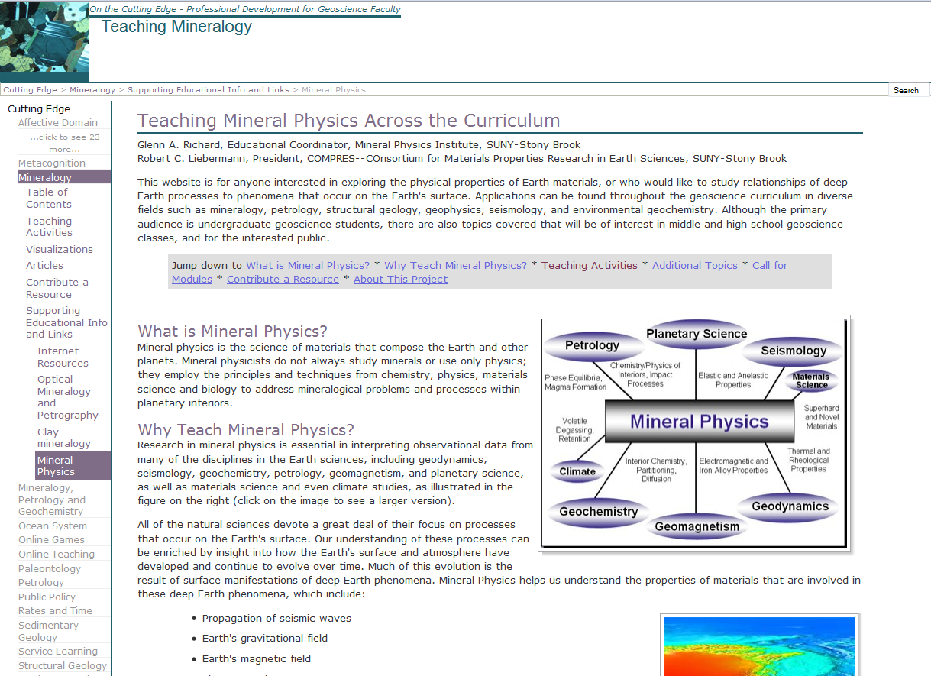
Existing Materials

Slide 17
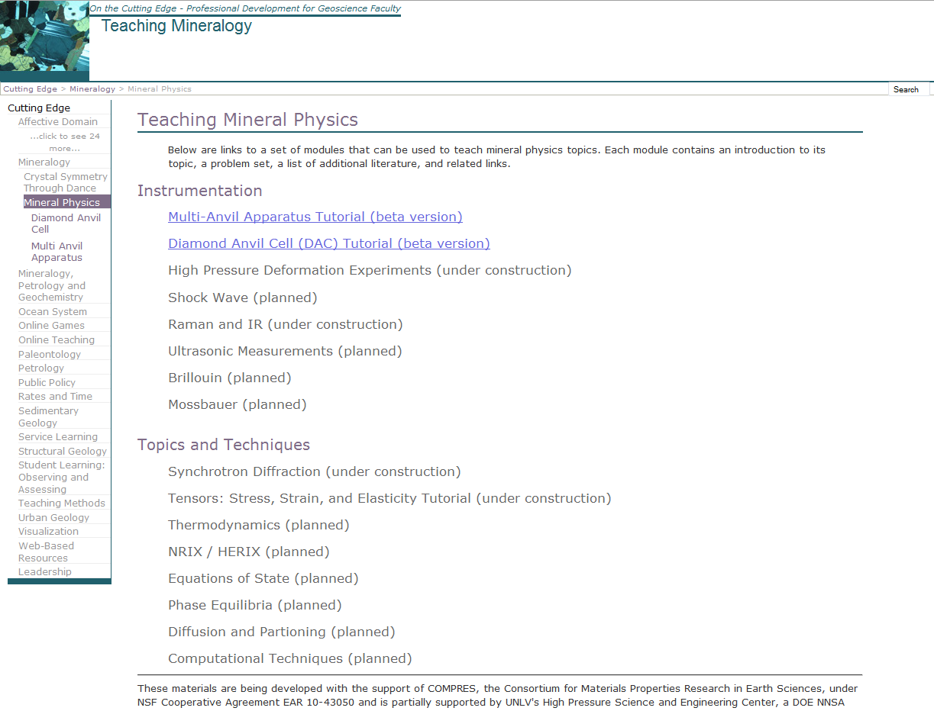
New Materials

Slide 18
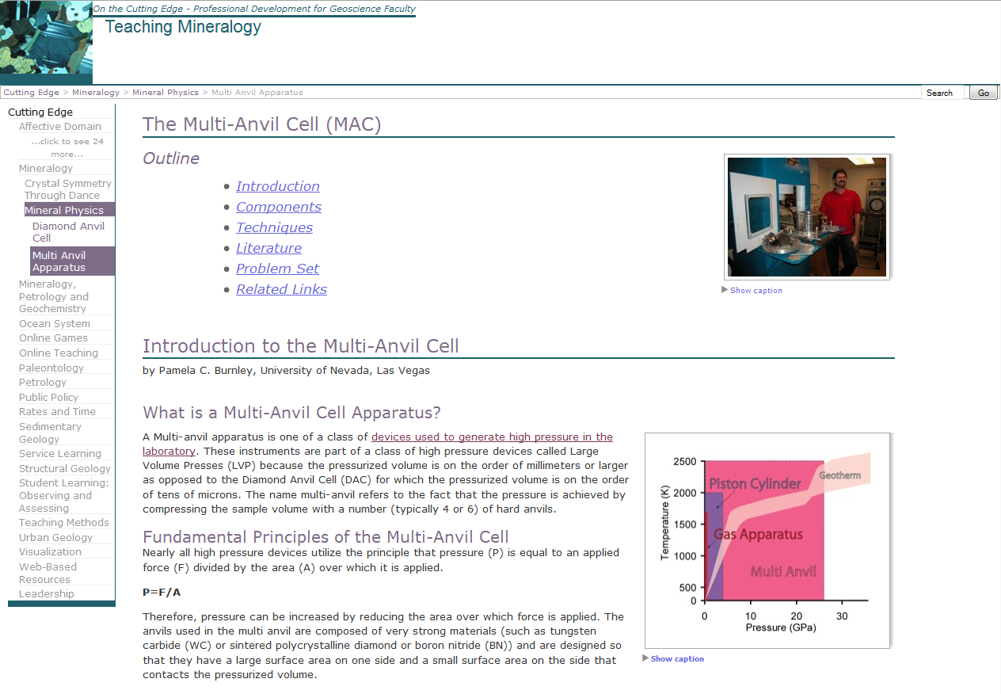

Slide 19
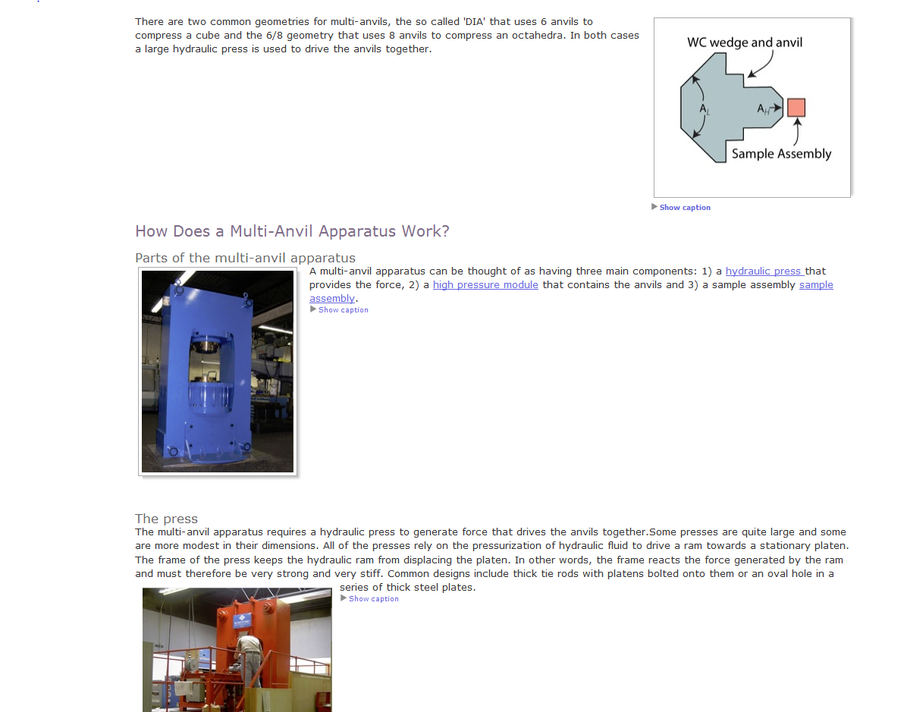

Slide 20
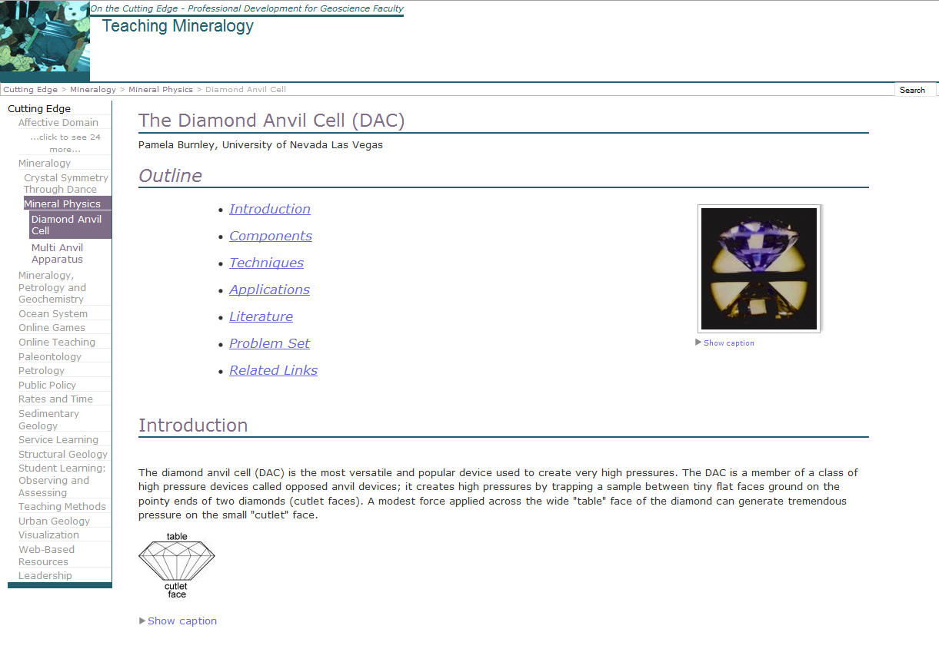

Slide 21
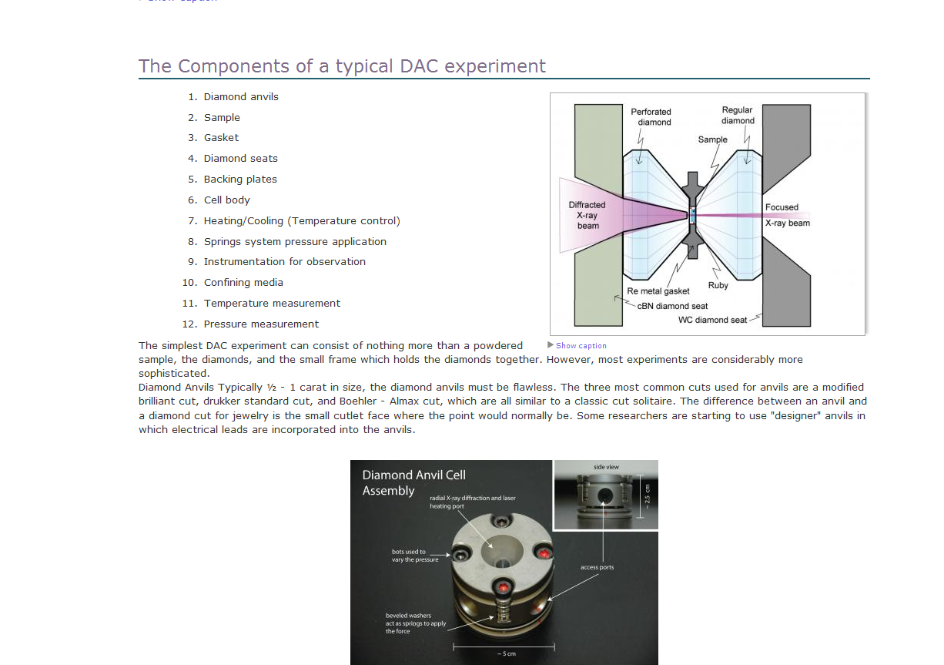

Slide 22
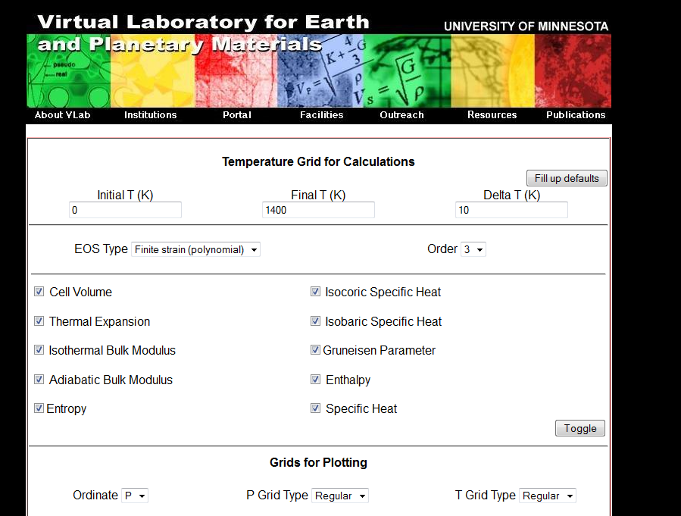

Slide 23
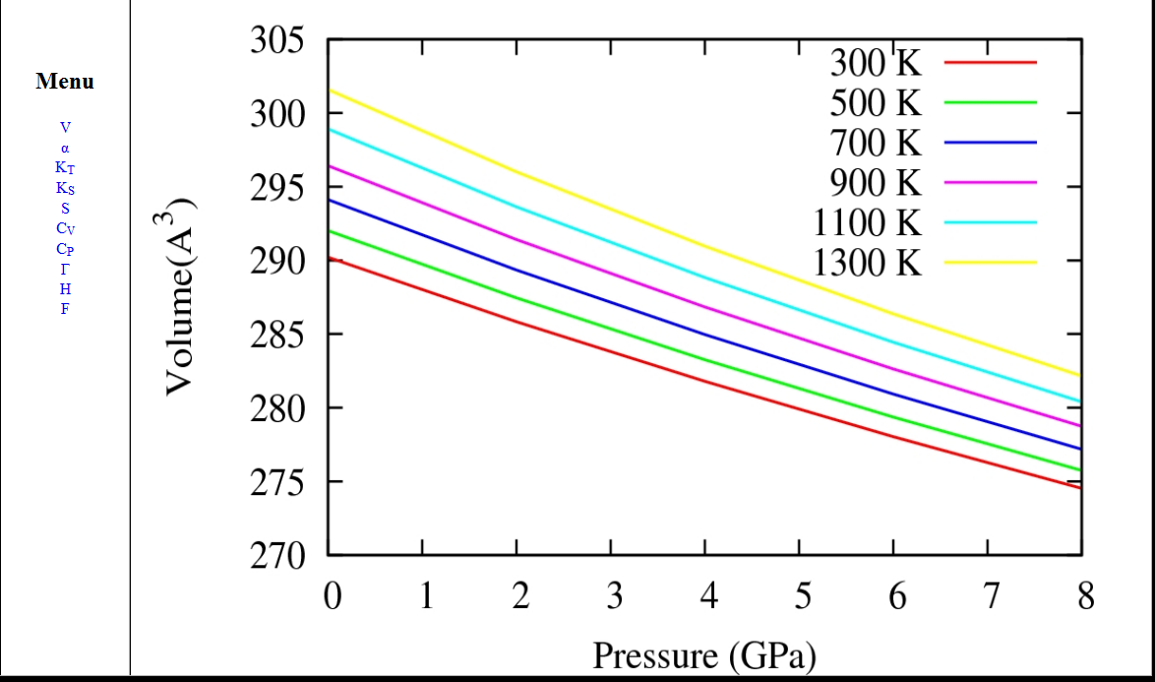

Slide 24
“Mineral Physics 101”
Weekly meeting on-line (e.g. skype)
Uses materials on Cutting Edge web site
Multi-institutional
  Efficiency of shared teaching
  Broader exposure for students
Format for capturing guest lectures
Planned for spring 2012 hosted by UNLV

Slide 25
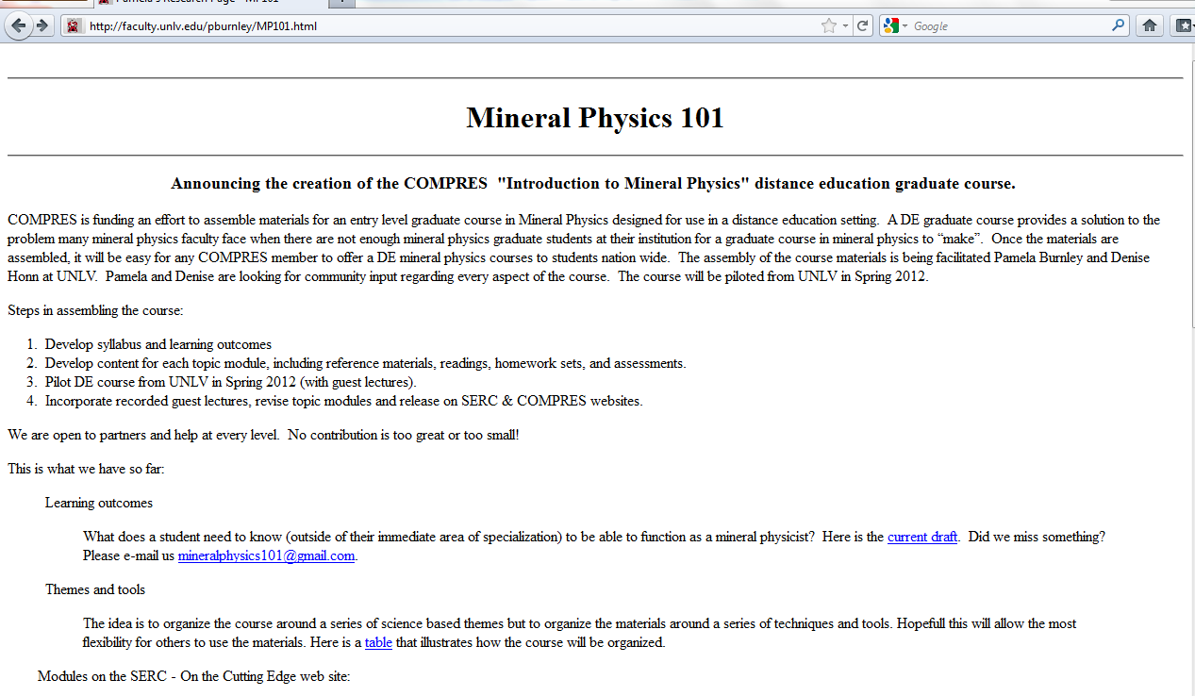

Slide 26
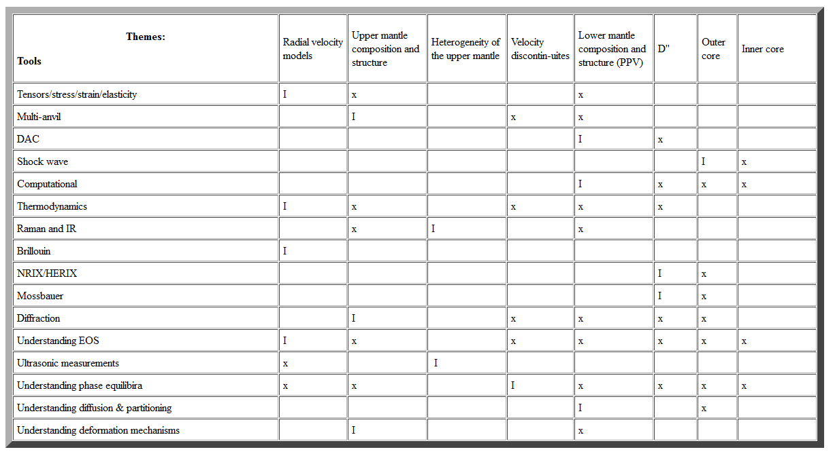

Slide 27
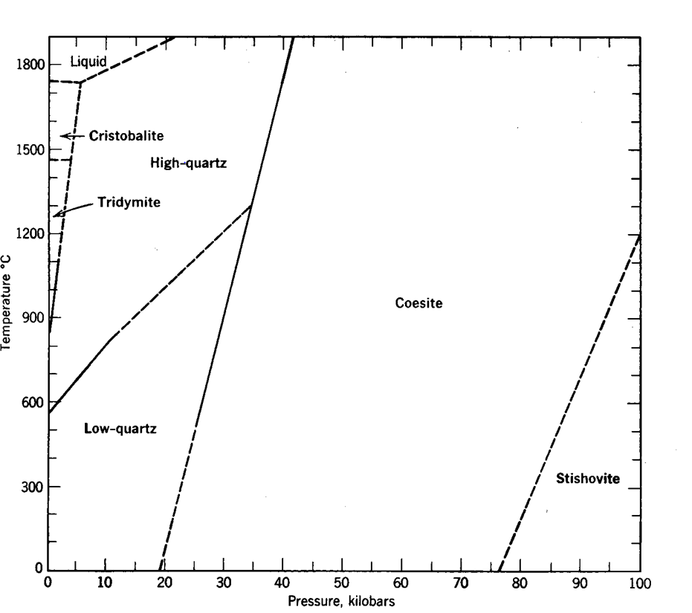
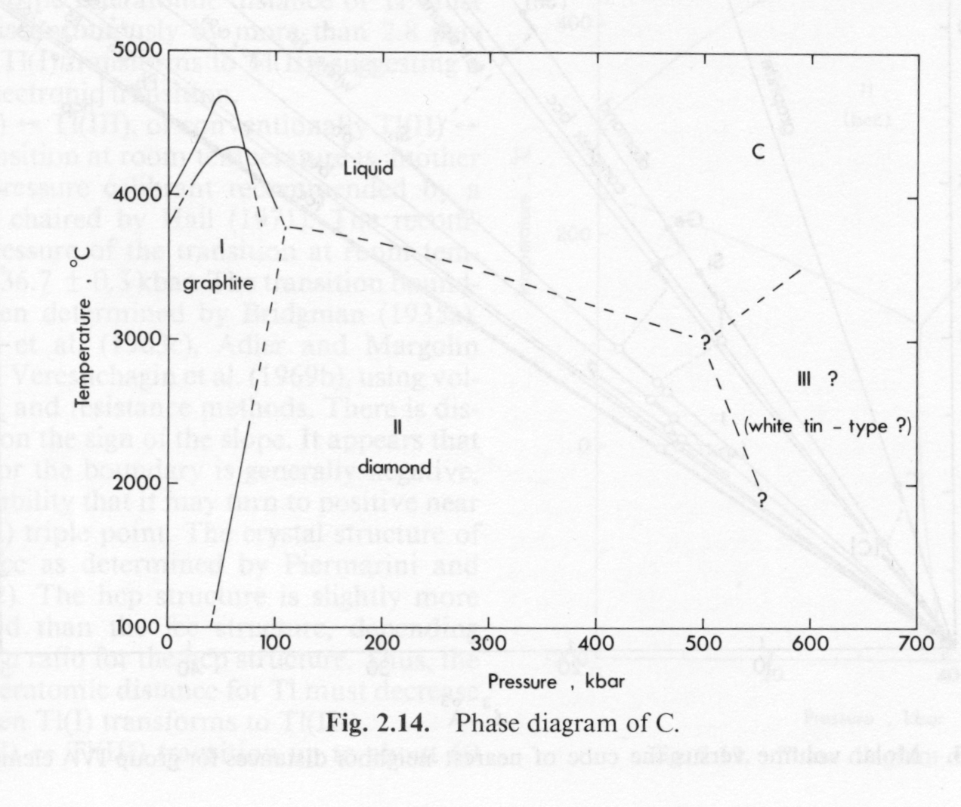
Phase equilibria
SiO₂
C

Slide 28
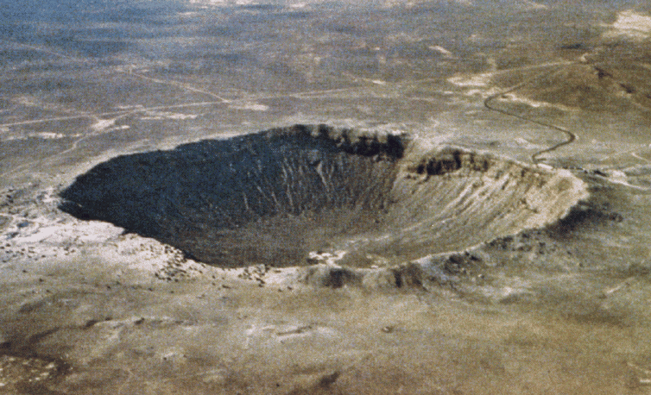
Aside: Meteorite Impacts

Slide 29
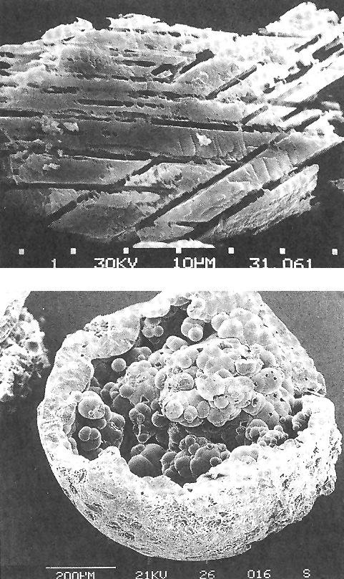
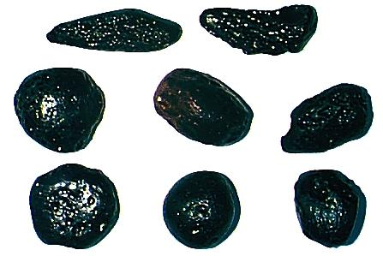
Shocked Quartz
Tectites

Slide 30
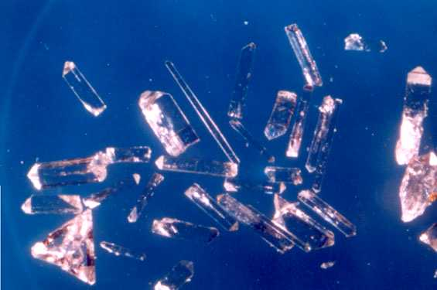
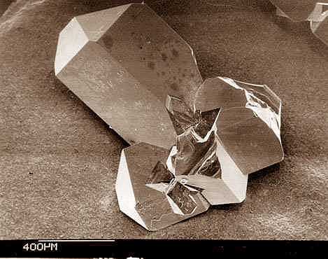
Synthesized at 9.5 GPa (95 kbar) 1200K
Stishovite
Isostructural with
Rutile (TiO₂)

