Slide 1
Guided Inquiry Instructional Models
John Farver
Department of Geology
Bowling Green State University

Slide 2
Herbart’s Instructional Model (early 1900s)
Phase | Description
Preparation | Teacher brings prior experiences to the student’s awareness.
Presentation | Teacher introduces new experiences and makes connections to student’s prior experiences.
Generalization | Teacher explains ideas and develops concepts for students.
Application | Teacher provides experiences where the students demonstrate their understanding by applying concepts to new contexts.
Notes:
Johan Herbart at the turn of the 20th century proposed two ideas as foundations for teaching: interest and conceptual understanding.
First principle of effective teaching consists of student’s interest in the subject.
Second principle is prior knowledge as the point of departure of instruction.
In 1901, Herbart proposed teachers should first guide, question, and suggest through indirect methods, then provide systematic explanation through direct instruction, and finally ask students to demonstrate their understanding by application of concepts to new situation.

Slide 3
Dewey’s Instructional Model (Circa 1930s)
Phase | Description
Sensing perplexing situations | Teacher presents an experience where the students feel thwarted and sense a problem.
Clarifying the problem | Teacher helps the students identify and formulate the problem.
Formulating a tentative hypothesis | Teacher provides opportunities for students to form hypotheses and tries to establish a relationship between the perplexing situation and previous experiences.
Testing the hypothesis | Teacher allows students to try various types of experiments, including imaginary, pencil-and-paper, and concrete experiments, to test the hypothesis.
Notes:
John Dewey (1910, 1933, 1971) described instructional approach based on experience and requiring reflective thinking. (ie, hands-on and minds-on).

Slide 4
Heiss, Obourn and Hoffman Learning Cycle (Circa 1950s)
Phase | Description
Exploring the unit | Students observe demonstrations to raise questions, propose a hypothesis to answer questions, and plan for testing.
Experience getting | Students test the hypothesis, collect and interpret data, and form a conclusion.
Organizing of Learning | Students prepare outlines, results, and summaries; they take tests.
Application of Learning | Students apply information, concepts, and skills to new situations.
Notes:
Heiss, Obourn and Haffman (1950) presented a “learning cycle” based on Dewey’s complete act of thought model.

Slide 5
Atkin-Karplus Science Curriculum Improvement Study (SCIS) Learning Cycle (1960s)
Phase | Description
Exploration | Students have an initial experience with phenomena.
Invention | Students are introduced to new terms associated with concepts that are the object of the study.
Discovery | Students apply concepts and use terms in related but new situations.
Notes:
Atkin and Karplus (1962) developed guided discovery materials as part of the Science Curriculum Improvement Study (SCIS).
Karplus and Their (1967) outline the three phases of the SCIS Learning Cycle.

Slide 6
Comparison of Phases of SCIS and Biological Sciences Curriculum Study (BSCS) 5E Models
SCIS Model | BSCS 5E Model
 | Engagement (new)
Exploration | Exploration (after SCIS)
Invention (Term introduction) | Explanation (after SCIS)
Discovery (Concept application) | Elaboration/Extension (after SCIS)
 | Evaluation (new)
Notes:
In mid-1980s with support from IBM, the Biological Sciences Curriculum Study (BSCS) 5E Instructional Model was developed (e.g., see Bybee and Landes, 1988). The model incorporated aspects of the SCIS Learning Cycle but added two new phases.

Slide 7
5Es in Geology
The American Geological Institute through Project CUES (Constructing Understanding of Earth Systems) have adopted a learning cycle based on the 5Es model. The phases are:
  Engaging with a concept
  Exploring with a concept
  Explaining a concept
  Applying a concept to a new situation
  Expanding a concept

Slide 8
Engagement
Stimulates student interest in the topic.
Provides assessment of prior knowledge of subject.
  Prior misconceptions can be identified and addressed.
  Excessive repetition of concepts previously master can be avoided.

Slide 9
Engagement
What Instructor Does | What Student Does
◊Creates interest. ◊Generates curiosity. ◊Raises questions. ◊Elicits responses that uncover what the students know or think about the concept/topic. | ◊Asks questions such as, Why did this happen? What do I already know about this? What can I find out about this? ◊Shows interest in the topic.

Slide 10
Exploration
Students engage in hands-on and minds-on discovery activities.
Students must articulate and discuss their observations with peers and instructor.
Students design and perform experiments.
Instructor guides activities with questions.
Notes:
Minds-on due to engagement activity

Slide 11
Exploration
What Instructor Does | What Student Does
◊Encourages students to work together without direct instruction. ◊Observes and listens to the students as they interact. ◊Asks probing questions to redirect the student’s investigations when necessary. ◊Provides time for students to puzzle through problems. | ◊Thinks freely but within the limits of the activity. ◊Test predictions and hypotheses. ◊Forms new predictions and hypotheses. ◊Tries alternatives and discusses them with others. ◊Records observations and ideas. ◊Suspends judgment.

Slide 12
Explanation
Instructor directed class discussion of scientific explanation of students’ observations.
Active-learning promoted by questions directed at identifying misconceptions.
Appropriate scientific terms introduced to describe students’ observations.

Slide 13
Explanation
What Instructor Does | What Student Does
◊Encourages students to explain concepts and definitions in their own words. ◊Asks for justification (evidence) and clarification from students. ◊Formally provides definitions, explanations, and new labels. ◊Uses student’s previous experiences as basis for explaining concepts. | ◊Explains possible solutions or answers to others. ◊Listens to and questions other’s explanations. ◊Listens to and tries to comprehend explanations the instructor offers. ◊Refers to previous activities. ◊Uses recorded observation in explanations.

Slide 14
Elaboration/Extension
Provides opportunity to apply information and experiences accumulated to explore and explain new topics/concepts.
Students develop extension activities that are shared with the class.
  Builds subject content knowledge and provides practice in developing, facilitating, and articulating inquiry-based activities.

Slide 15
Elaboration/Extension
What Instructor Does | What Student Does
◊Expects students to use formal labels, definitions, and explanations provided. ◊Encourages students to apply and extend the concepts and skills to new situations. ◊Reminds students of alternative explanations. ◊Refers students to existing data and evidence and asks, What do you already know? What do you think …? | ◊Applies new labels, definitions, explanations, and skills in new, but similar situations. ◊Uses previous information to ask questions, propose solutions, make decisions, and design experiments. ◊Draws reasonable conclusions from evidence. ◊Records observations and explanations. ◊Checks for understanding among peers.

Slide 16
Evaluation
Designed to determine the extent to which students have developed a meaningful understanding of the topic.
Evaluation occurs throughout all components of the activities.
Provides a [feedback] mechanism to gauge the effectiveness of instruction.

Slide 17
Evaluation
What Instructor Does | What Student Does
◊Observes the students as they apply new concepts and skills. ◊Assess student’s knowledge and or skills acquisition. ◊Looks for evidence that students have changed their thinking or behaviors. ◊Allows students to assess their own learning and group process skills. ◊Asks open-ended question. | ◊Answers open-ended questions by using observations, evidence, and previously accepted explanations. ◊Demonstrates an understanding or knowledge of the concept or skill. ◊Evaluates his or her own progress and knowledge. ◊Asks related questions that would encourage future investigation.

Slide 18
Rationale for Redesigning Rocks and Minerals Course
General call from prominent national science organizations for curriculum modifications to incorporate inquiry-based, active student learning strategies.
But, (in-service) teachers resisted implementing inquiry-based courses due to need for:
  Greater subject [content] knowledge.
  More training/practice in inquiry-based [pedagogy] methods.

Slide 19
Course Objectives
To enhance content knowledge in minerals and rocks.
To enhance inquiry-based pedagogy skills.
To develop student confidence in content and pedagogy.

Slide 20
Course Content
Course content is closely aligned with NSTA guidelines and the Ohio Competency Based Science Model goals.
Course addresses student concerns about content knowledge necessary to pass PRAXIS exams.

Slide 21
Course Format
Guided inquiry instructional format.
Patterned after 5-E’s instructional model.
  Engagement-Exploration-Explanation-Extension-Evaluation
Course meets twice a week for 3 hour lecture/laboratory (studio) session.
  Large blocks of time allow ample exploration and discovery time.

Slide 22
Student Evaluation Mechanisms
Scientific Journal of course activities.
Peer-evaluated student lead class activity.
In-class activities including worksheets and level of participation.
Practical examinations of content knowledge and skills development.
Peer-evaluated Pet Rock assignment.

Slide 23
Barriers to Implementation
For Instructors:
  Very time consuming
    Class/lab preparation time
      Need to have multiple activities prepared
    Set-up and tear-down time
    Evaluation and follow-up
      Assignments often require several iterations
  Challenges of developing and facilitating authentic activities (ie, not “canned” labs)
  Few tangible rewards (not recognized in tenure/promotion or merit)

Slide 24
Barriers to Implementation
For Institutions:
  Logistical demands
    Need dedicated classroom/laboratory
      Room design/layout must match pedagogy
  High resource needs per student
    Need more staffing, equipment, and consumables
  Scheduling large time blocks

Slide 25
Barriers to Implementation
For Students:
  Active learning requires more effort in class.
  Journals and other out-of-class activities are time consuming.
  Peer- and self-evaluations put students in awkward situations.
  Frustration of activities having no set directions or outcomes.
  Anxiety over unfamiliar evaluation techniques.
    Need good course grade which doesn’t always correlate with true learning.

Slide 26
Benefits of Implementation
Better student preparation
  Enhanced content knowledge
  Enhanced inquiry-base pedagogy skills
  Developed confidence in content and pedagogy
  Enhanced communication skills
Increased student satisfaction
  Students feel they are getting more ‘educational value’ for their tuition

Slide 27
A Sample Learning Cycle
General topic is diffraction.
Objectives of the activity include:
  Understanding of diffraction phenomena.
  Application of XRD to mineral identification and crystal refinement.
  Reinforce previous concepts of atomic packing, symmetry (Neumann’s Principle), Miller indices.

Slide 28
Engagement
Optical Diffraction Using Lasers (Adapted from Brady & Boardman,1995 and Lisensky et al., 1991).
Guiding Question/Action | Concept to be Developed
Look at laser spot through sieve. | Diffraction pattern (spot vs planes).
Look at white light through sieve. | Constructive interference. Monochromatic source.
Sieves with different spacings. | Reciprocal lattice spacing relationship.
Sieve at different distance from laser and screen. | Linear projection distance relationship.
What can we do with these observations? | Derive Fraunhofer relationship to determine spacing of sieve.
Different unit cells. | Symmetry of diffraction pattern.
Primitive vs centered square. | Systematic absences. Indexing of reciprocal lattice.

Slide 29
Exploration
Design and conduct experiment to determine the spacing of a sieve (or other grid like a TEM sample grid).
Determine the symmetry and unit cell dimensions of a single crystal from oriented (Laue) diffraction patterns from precession camera photos.
Collect an Xray powder diffraction pattern for a mineral of their choice.

Slide 30
Explanation
Compiled notes on diffraction linked to their observations and explanations.
Work through with them the symmetry and unit cell dimensions from the precession photos of the single crystal and indexing of the powder pattern of their mineral.

Slide 31
Extensions
Identify common minerals in rocks or household products (Dutrow, 1997) from their XRD patterns.
Determine the size of an atom in a common metal or ion in a common oxide (Brady et al., 1995) from their XRD pattern.
Also, chemical composition of solid solution minerals, monitoring phase transformations, and clay mineralogy as outlined in Brady et al. (1995)

Slide 32
Evaluation
Answers to questions and level of participation during activity.
Worksheets for exploration and extension activities.
Lab report for mineral identification.
Open-ended questions as part of the lab report/journal.
Reflection on activity and learning in lab report/journal.

Slide 33
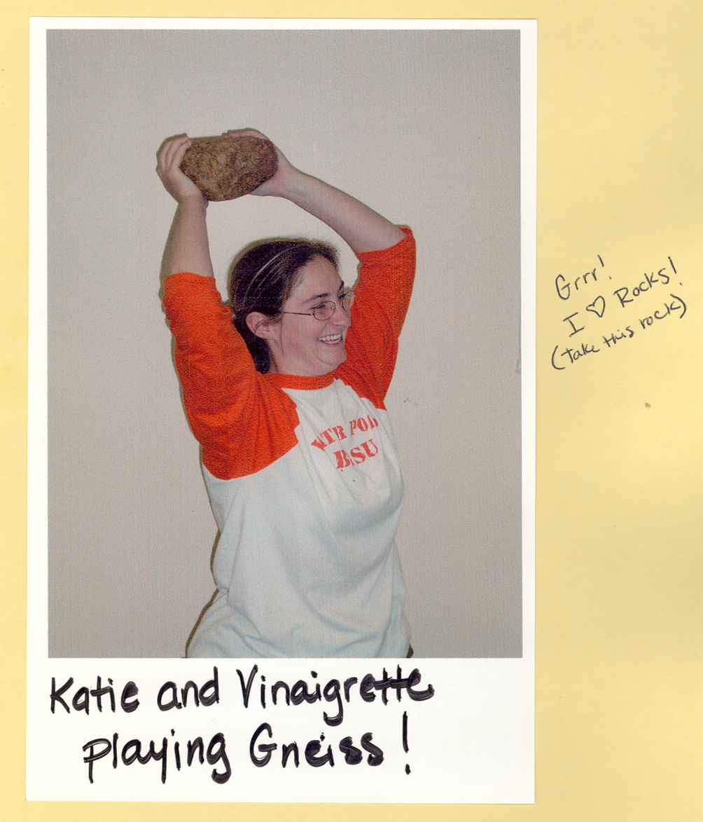
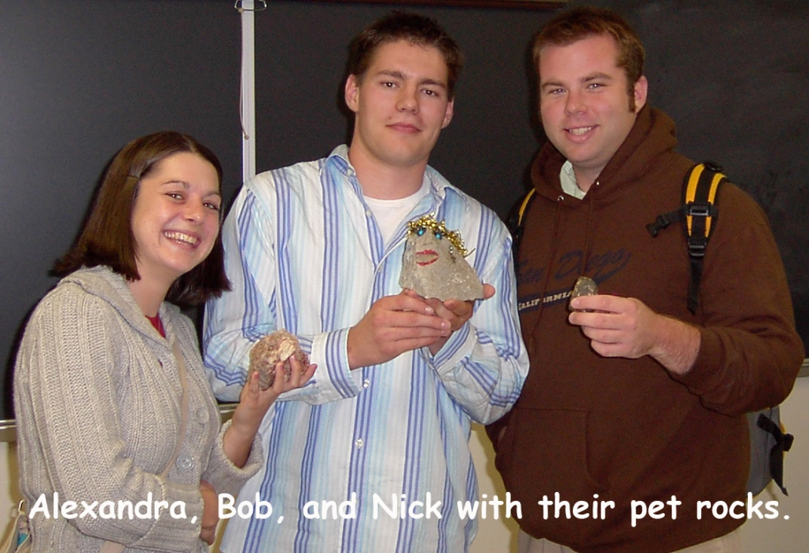
Thanks to:
Ohio Board of Regents and the Ohio Department of Education.
The students...

Slide 34
References
  Atkin, J.M. and Karplus, R. (1962) Discovery of invention? Science Teacher 29(5), 45.
  Bybee, R.W. and Landes, N.M. (1988) What research says about the new science curriculum. Science and Children, 25, 35-39
  Bybee, R.W., Taylor, J.A., Garner, A., Scotter, P.V., Powell, J.C., Westbrook, A., Landes, N., Spiegel, S., McGarrigle Stuhlsatz, M., Ellis, A., Resch, B., Thomas, H., Bloom, M., Moran, R., Getty, S., and Knapp, N. (2006) The BSCS 5E instructional model: Origins, effectiveness, and applications. Colorado Springs, CO: Biological Sciences Curriculum Study
  Duran,E., Duran, L., Haney, J., and Scheuermann, A. (2011) A learning cycle for all students. The Science Teacher, 56-60.
  Dewey, J. (1971) How we think, Henry Regnery Co, Chicago. Originally published in 1910.
  Heiss, E.D., Obourn, E.s., et al. (1950) Modern Science Teaching. Macmillan, NY, NY
  Herbart, J. (1901) Outlines of Educational Doctrine, trans. C. DeGarmo, ed. A Lange. Macmillan, NY, NY.
  Karplus, R. and Their, H.D. (1967) A new look at elementary school science. Rand McNally, Chicago.

