Slide 1
Composition and Structure of Earth through Hand Samples and Thin Sections
Liz Johnson, James Madison University (johns2ea@jmu.edu)

Slide 2

Take a Field Trip?

Slide 3
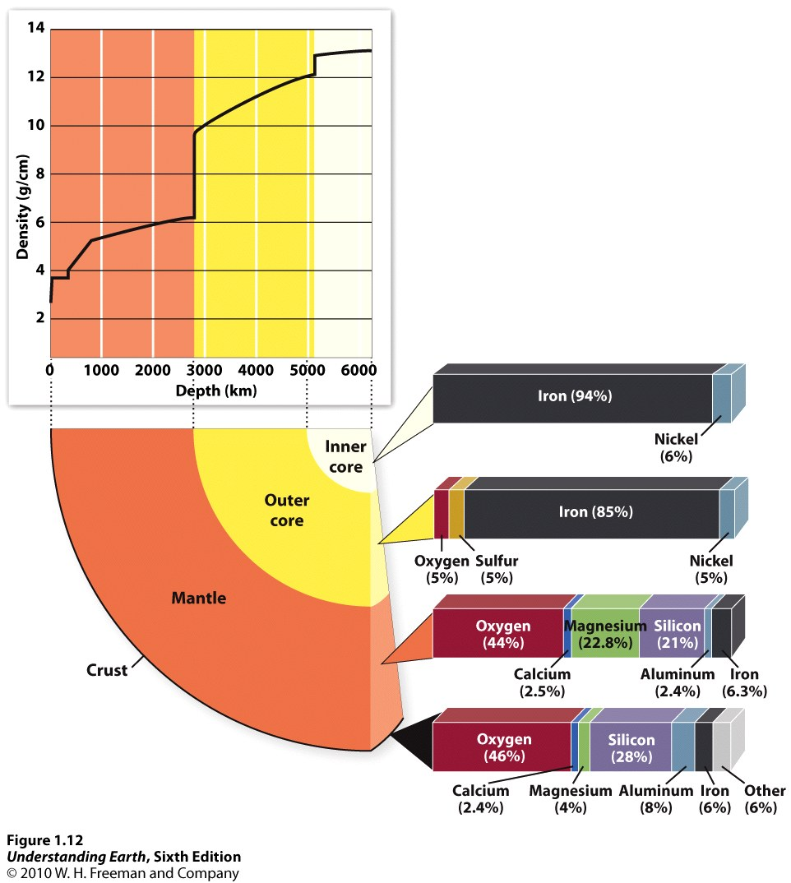
Motivation for sample-based exercise
Lack of retention of information about Earth’s interior
Classification of ultramafic rocks
New topics: mineralogy or textures of meteorites, mantle, core
Introduction to the concept of MASS BALANCE (lecture)

Slide 4
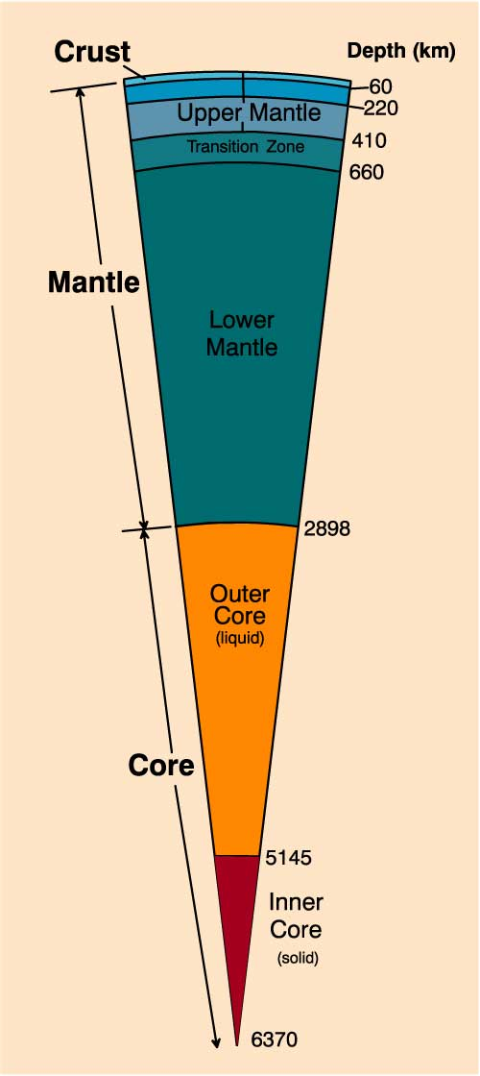
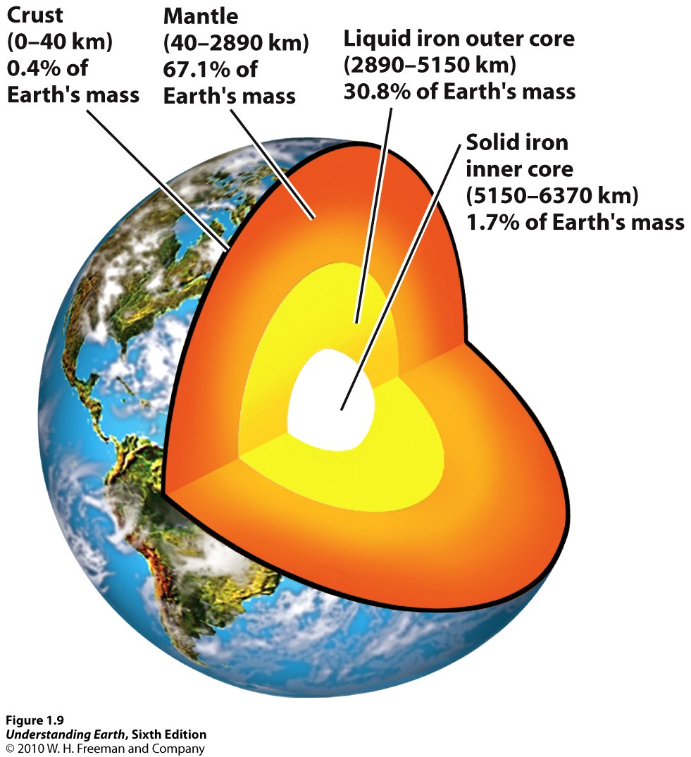
How much detail?
From Winter, Intro to Igneous and Metamorphic Petrology

Slide 5
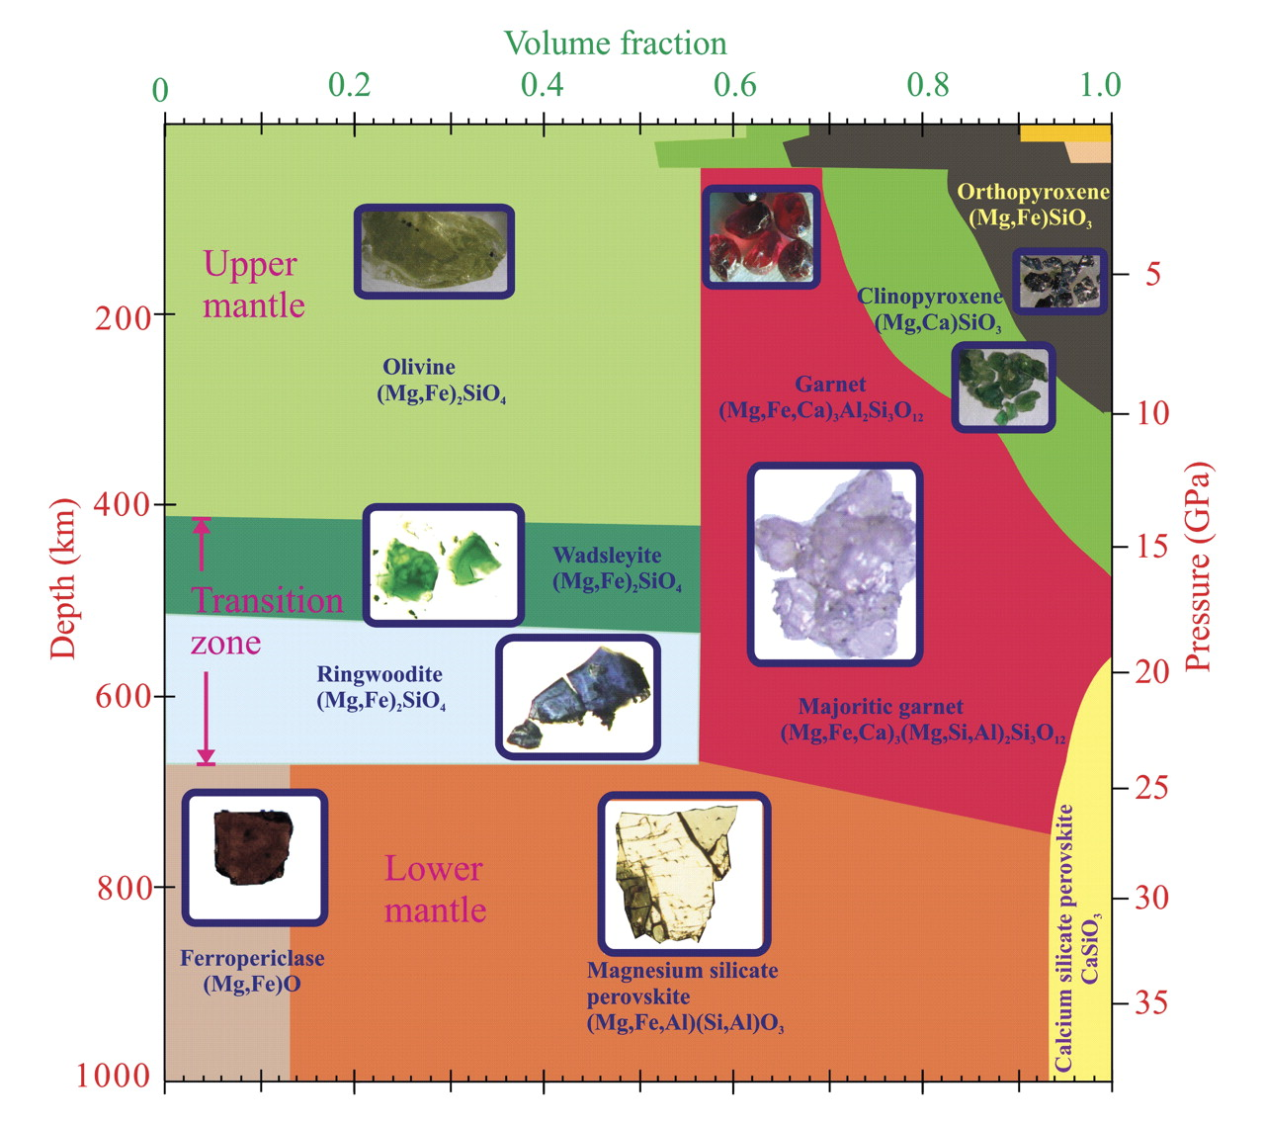
How much detail?
Frost, Elements 2008

Slide 6
Lab for Introduction to Petrology

Slide 7
This activity could be used in…
Igneous and Metamorphic Petrology
Earth Materials
Mineralogy
Introductory and general education courses
  Only hand samples / choose mantle or meteorites

Slide 8
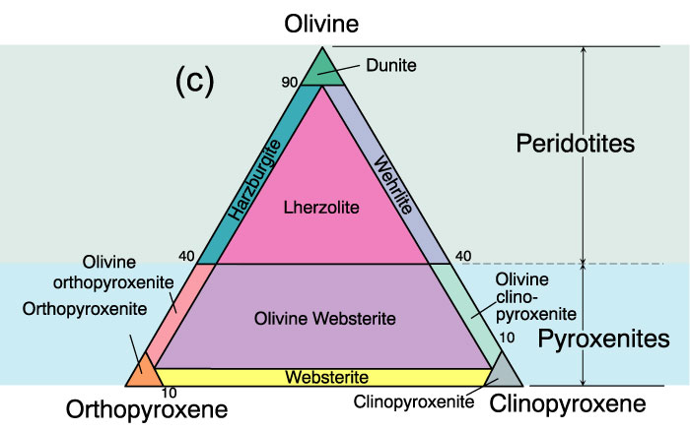
Classification of ultramafic rocks
Figure 2.2c. A classification of the phaneritic igneous rocks: Ultramafic rocks. After IUGS.
From Winter (2001)

Slide 9
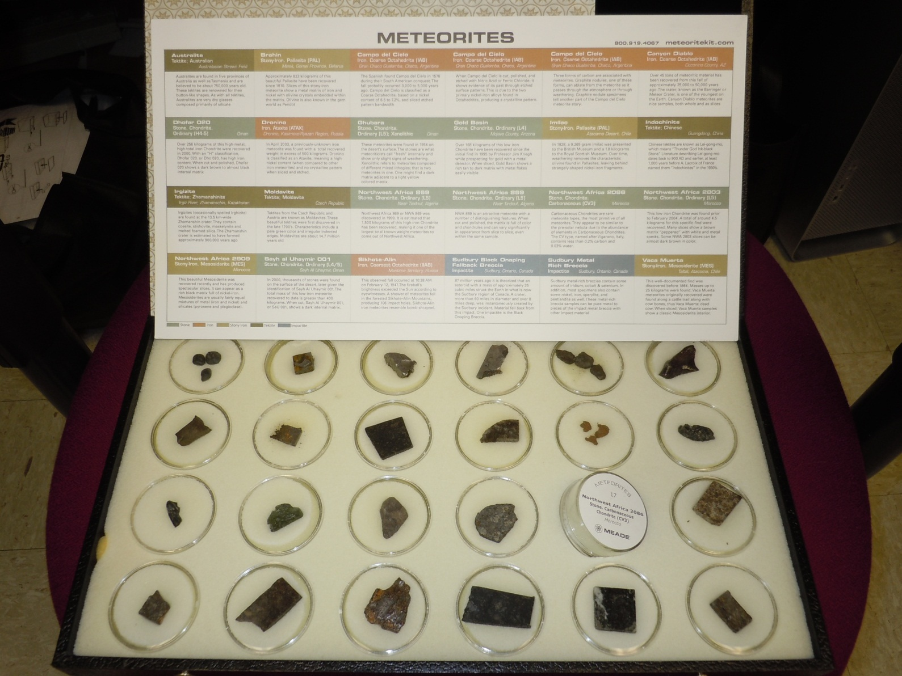
Obtaining Meteorite Samples
Hand Samples and Thin Sections: http://www.impactika.com/center.htm
Ebay?
Thin section images
http://web.pdx.edu/~ruzickaa/meteorites/gallery/gallery.html
Other Sources:

Slide 10
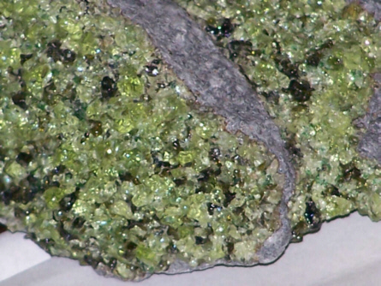
Obtaining Mantle Samples
Purchase samples from well-known localities like San Carlos? Wards or mineral dealers.
Sample exchange between universities?
I’d like to acquire some experimental runs or diamond inclusions – something to represent lower mantle.
http://all-geo.org/highlyallochthonous/

