Slide 1
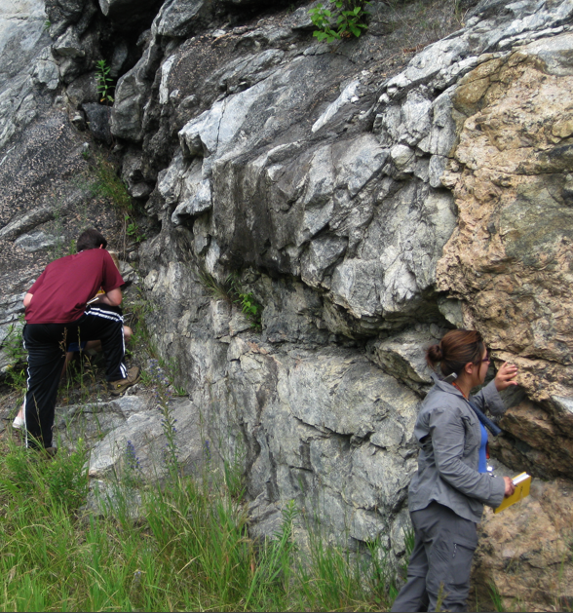
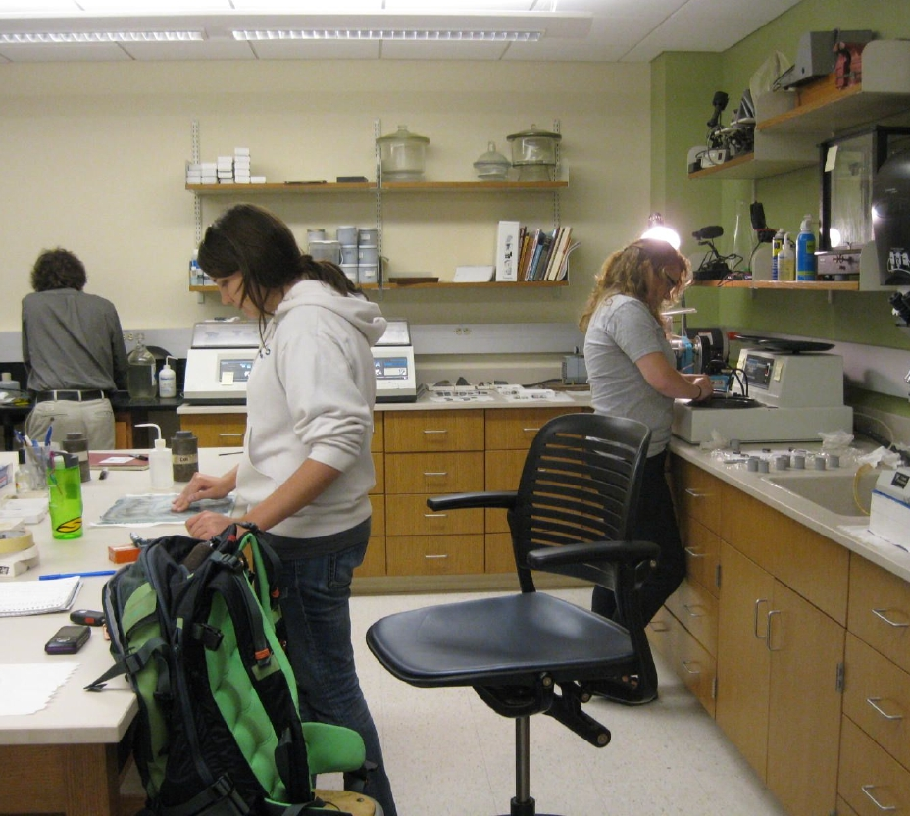
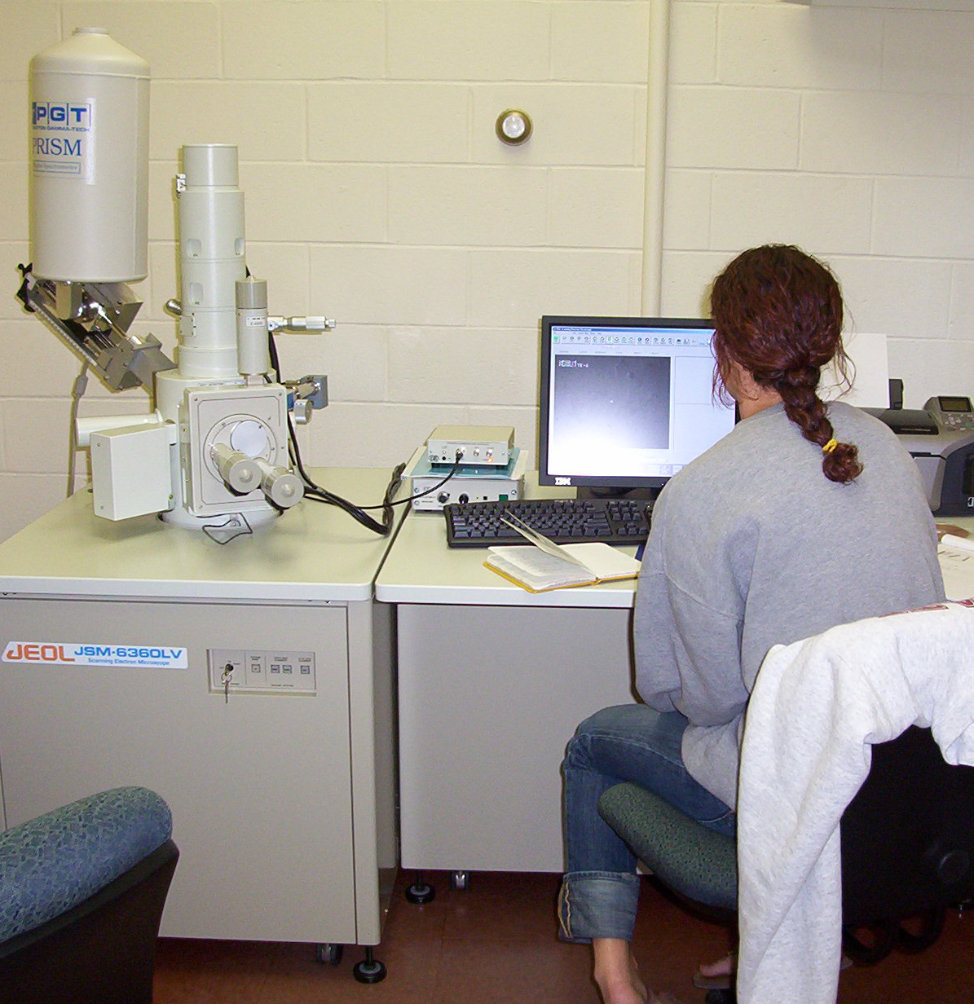
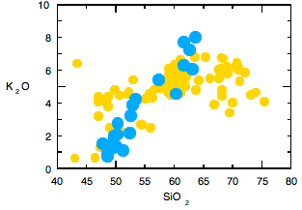
Projects in MPG:
Balancing Breadth and Depth
David Kratzmann
St. Lawrence University
William Peck
Colgate University

Slide 2
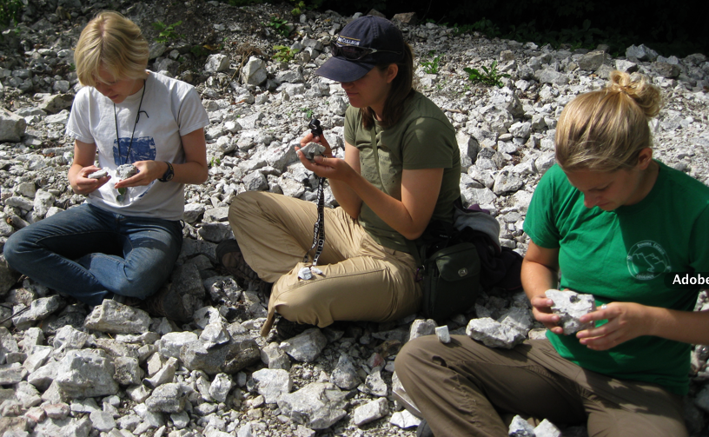
Why teach using projects?
-Active learning is more effective
-Motivation (sense of ownership, creation of new knowledge)
-Involves cooperative problem-solving
-Exposure to instrumentation + quant analysis (+plotting, stats, etc.)
-Teaches scientific problem-solving
-Develops time-management skills
-Promotes use of higher-order skills
(e.g. analysis, synthesis, evaluation)
Notes:
Bloom cognatitive levels: analysis, synthesis, evaluation

Slide 3
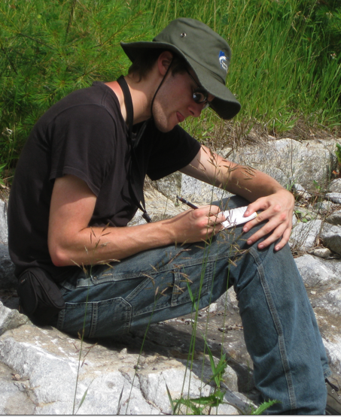
Difficulties and Common Pit-Falls
-Lack of access to appropriate samples or field areas
-Lack of access to sample preparation and analytical facilities
-Pacing of sample preparation and analysis during a 15-week course
-Difficulties in finding appropriate readings
-Group dynamics
-Projects that teach some topics well aren’t
as good at teaching other topics

Slide 4
Taxonomy of project-based teaching from SERC website
(with apologies)
Sonju Lake LMI Project (making TS, geochem)
Hudson Volcano Project (WR + Min geochem)
MOR Project
(TS+ WR Geochem)
Integrated across topics
Mesozoic dike Project (making TS)
Idaho Batholith Project (WR geochem)
Level of student data-collection
Notes:
MOR= Palisades Sill

Slide 5
Hudson Volcano Project
Major and trace element data provided
Site photos and sample descriptions avaliable
Great activity for petrogenetic modeling
No direct student involvement in:
  sample collection
  sample analysis
  data reduction

Slide 6
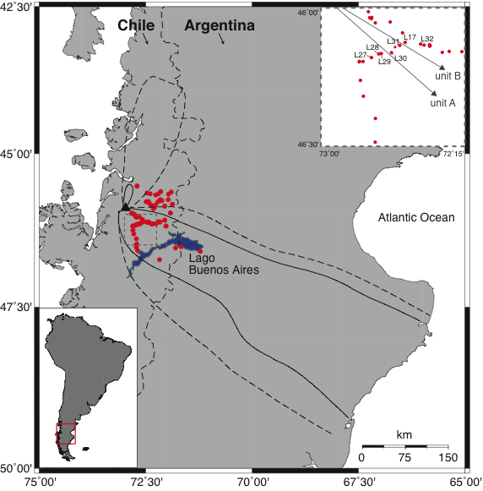
Hudson Volcano – sSVZ
Unique eruption in 1991
Compositionally and spatially distinct deposits
Phase I: bas-and → directed N - NNE
Phase II: trachyandesitic → directed SE
Notes:
Compositionally and spatial distinct make the 1991 eruption useful for student modeling of petrogenetic relationships.
Other major eruptions include the 6700 yrs BP, the 3600 yrs BP, and the 1971 (although much smaller than the rest)

Slide 7
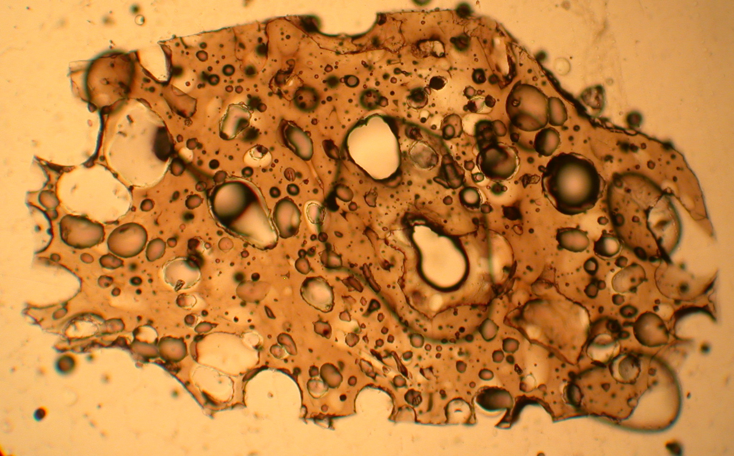
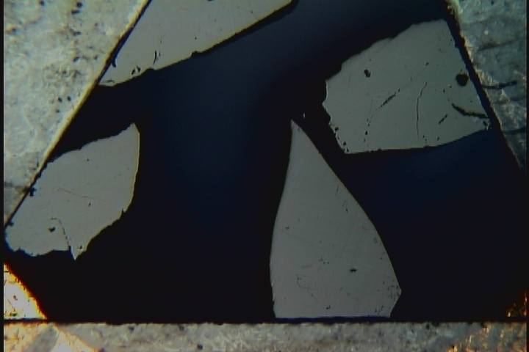
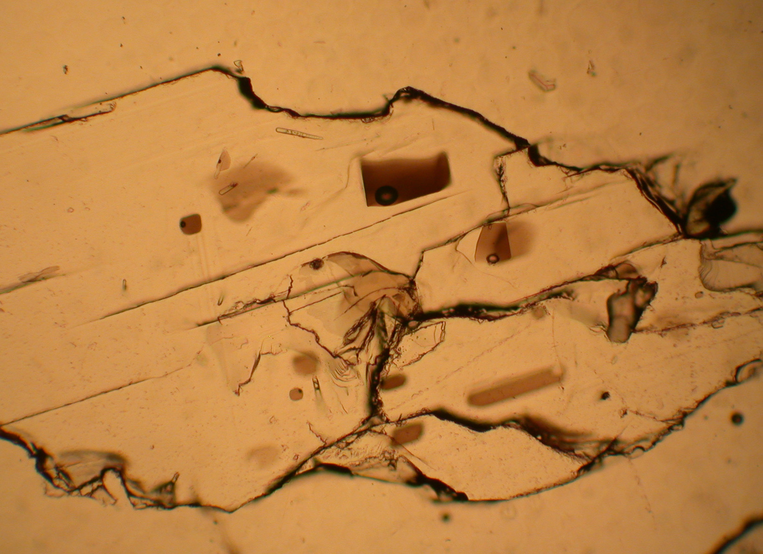
Types of Data
Whole rock ME & TE [from XRF]
Matrix glass ME & TE [from EPMA & LA-ICPMS]
Phenocryst ME & TE [from EPMA & LA-ICPMS]
Melt inclusion ME & TE [from EPMA & LA-ICPMS]
Matrix glass & MI volatile data [from FTIR]
Notes:
SEM images also available

Slide 8
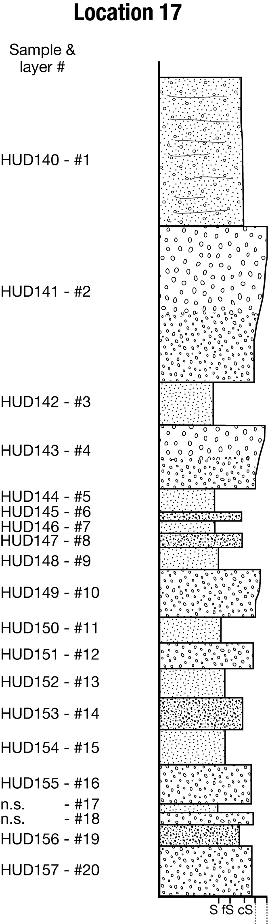
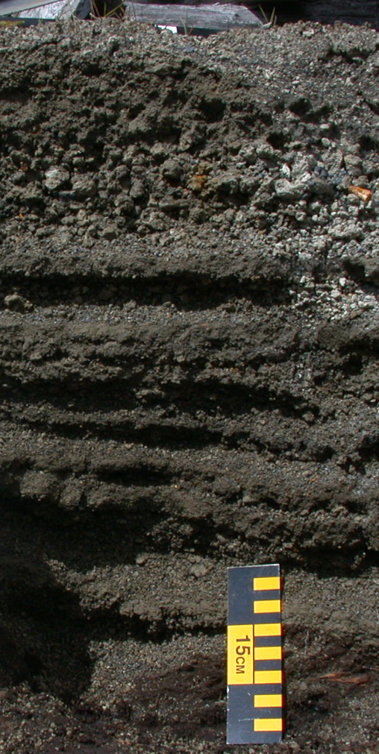
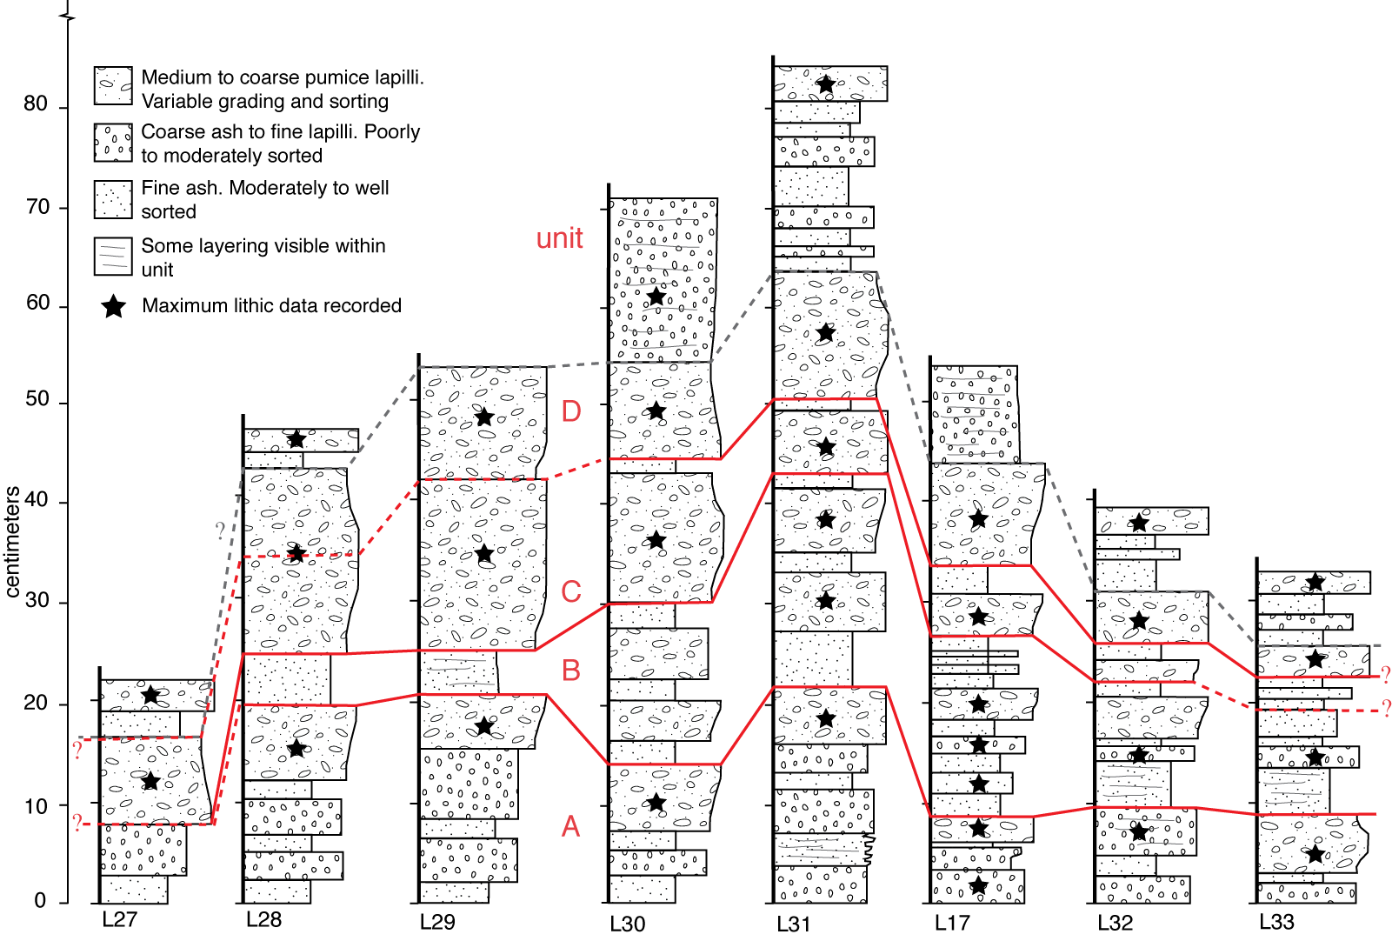
Supplementary Data
Site photographs
BSE & SEM images
Pre-eruptive T and fO₂
Notes:
Site photos and granulometric data for each sampling location also available

Slide 9
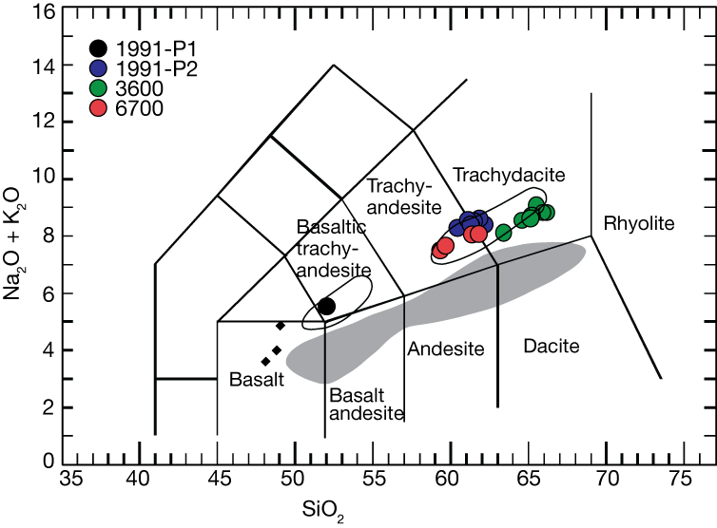
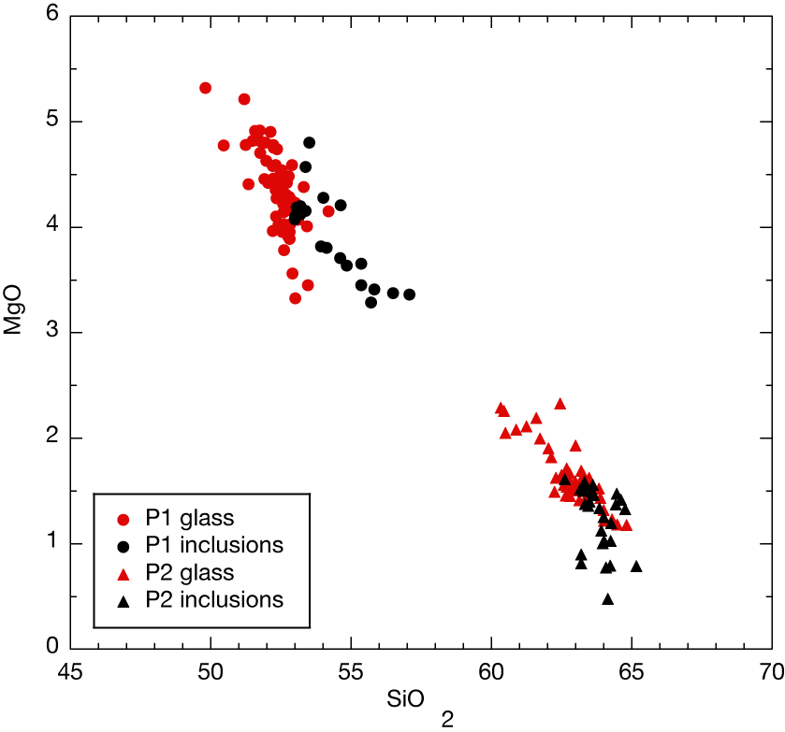
Modeling
Is the Phase I bas-and parental to the Phase II trachyandesite?
Can we explain this apparent LLD via magma mixing or FC or both?
The basic project for the students → model potential relationships between these magmas
Notes:
With a focus on the 1991 eruption only

Slide 10
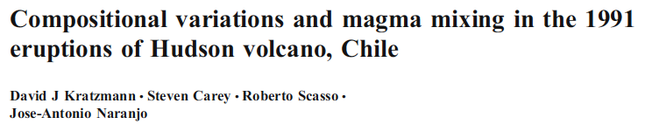

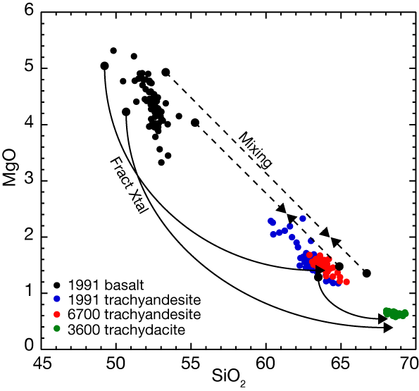
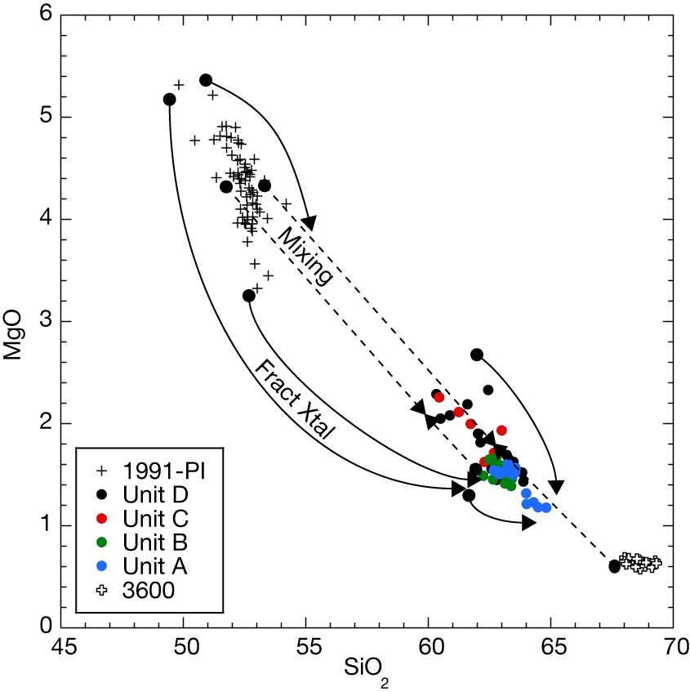
Modeling

Slide 11
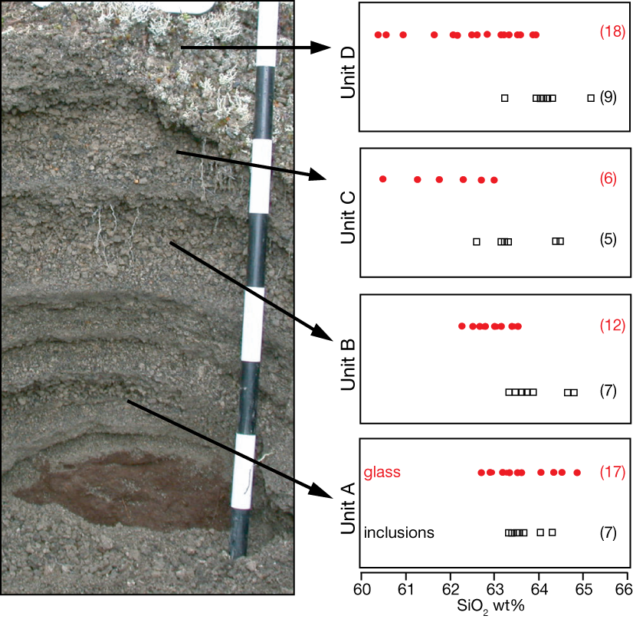
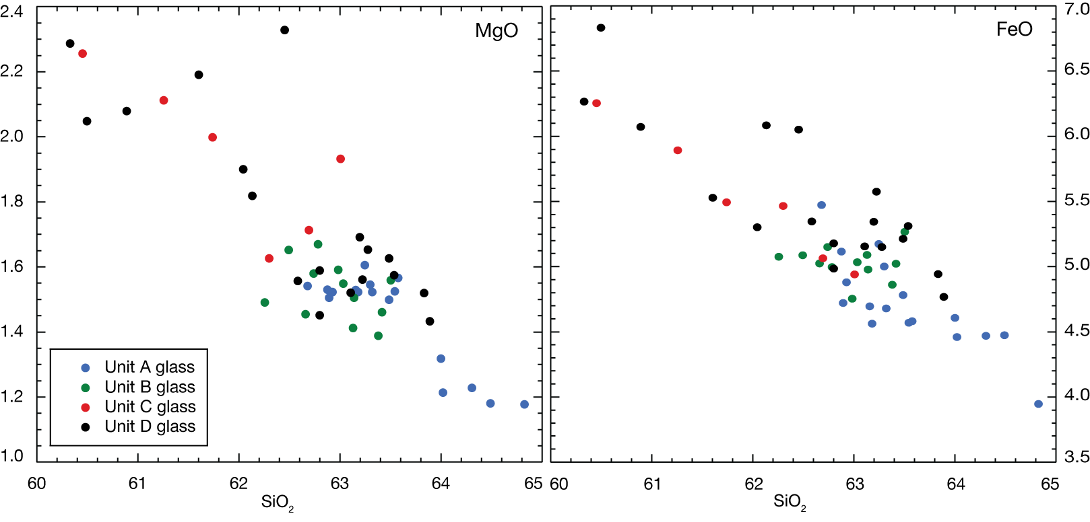
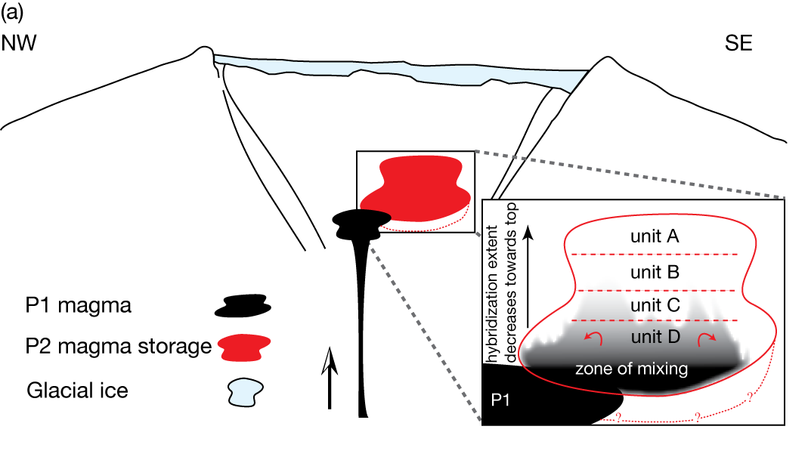
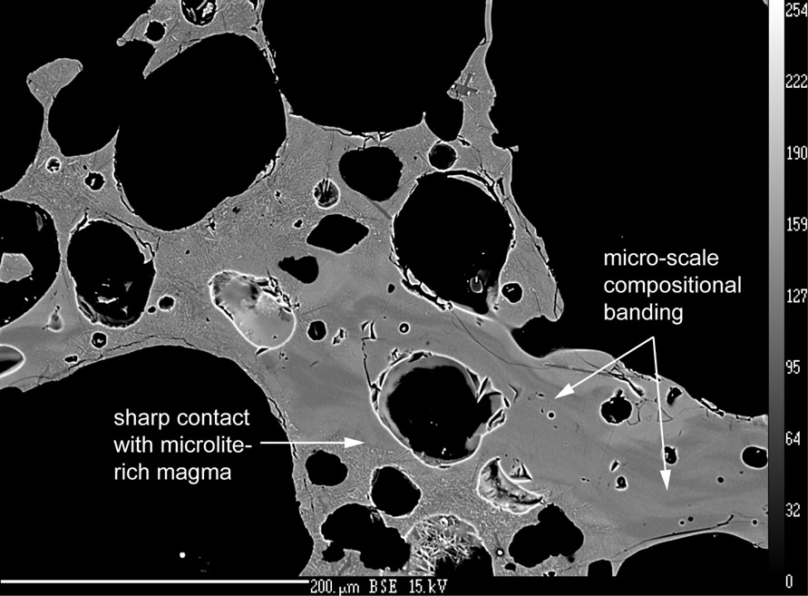
Higher-order thinking
Notes:
Appears to be indications of a stratified deposit, in terms of ME glass data → does this reflect a stratified chamber prior to eruption?
Also, there is a systematic shift in the range of SIO2 in the matrix glass up stratigraphy, students can be asked to explain this → zone of mixing at base of chamber, with the zone of mixing not reaching the upper levels of the chamber (bottom diagram)

Slide 12
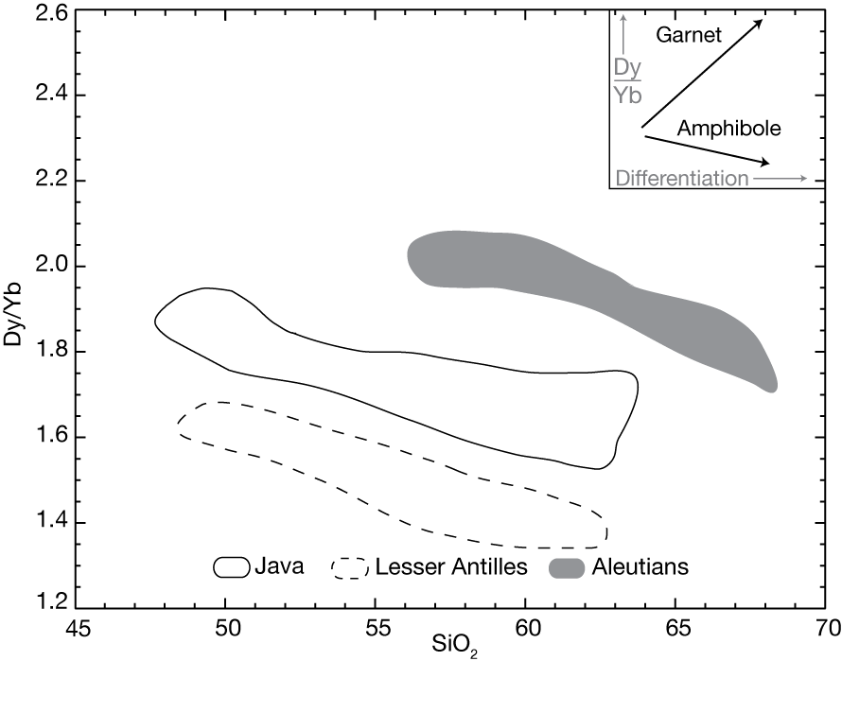
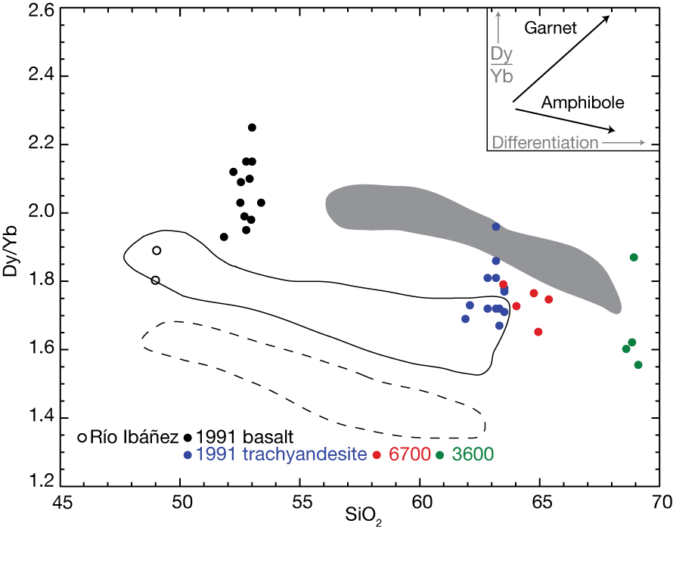
Higher-order thinking
Notes:
Introduction of trace elements as potential indicators of depth of differentiation possible.
Animated slide –
#1 data from Davidson et al 2007
#2 data from Hudson volcano (Kratzmann et al 2010)

Slide 13
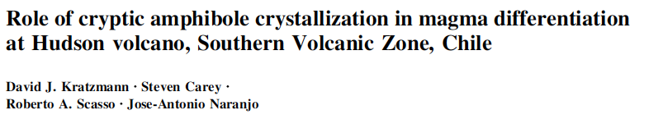

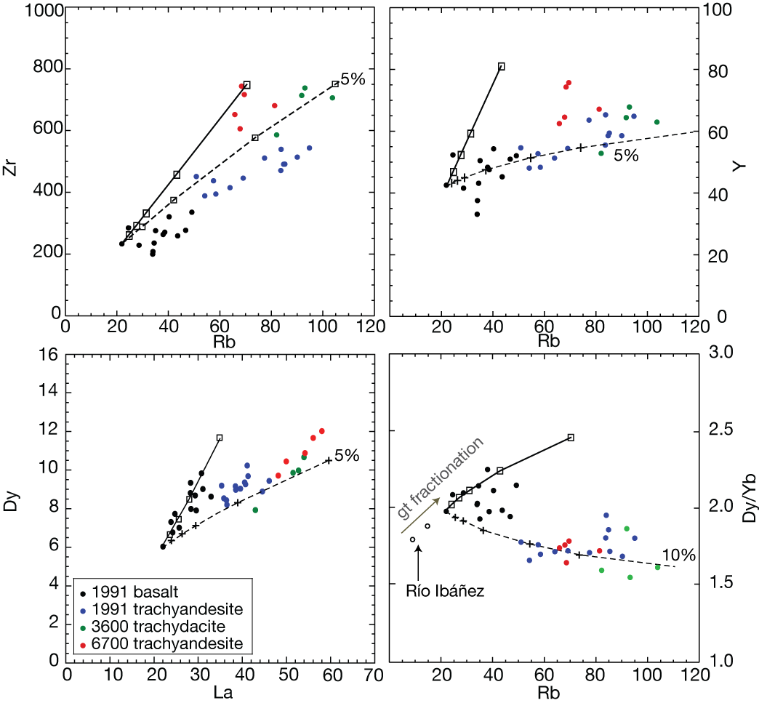
Modeling
Notes:
Trace element modeling, introducing partition coefficients and the bulk partition coefficients (calculating them).

Slide 14
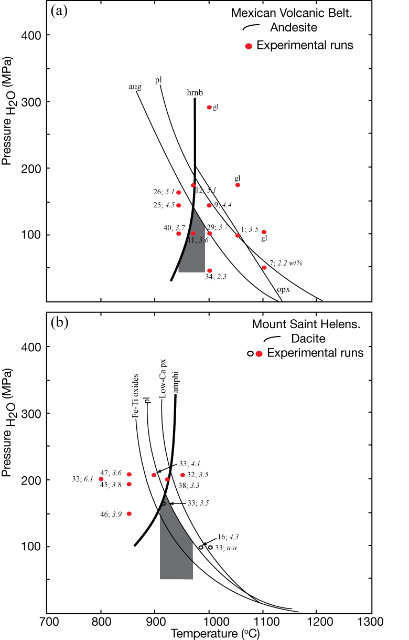
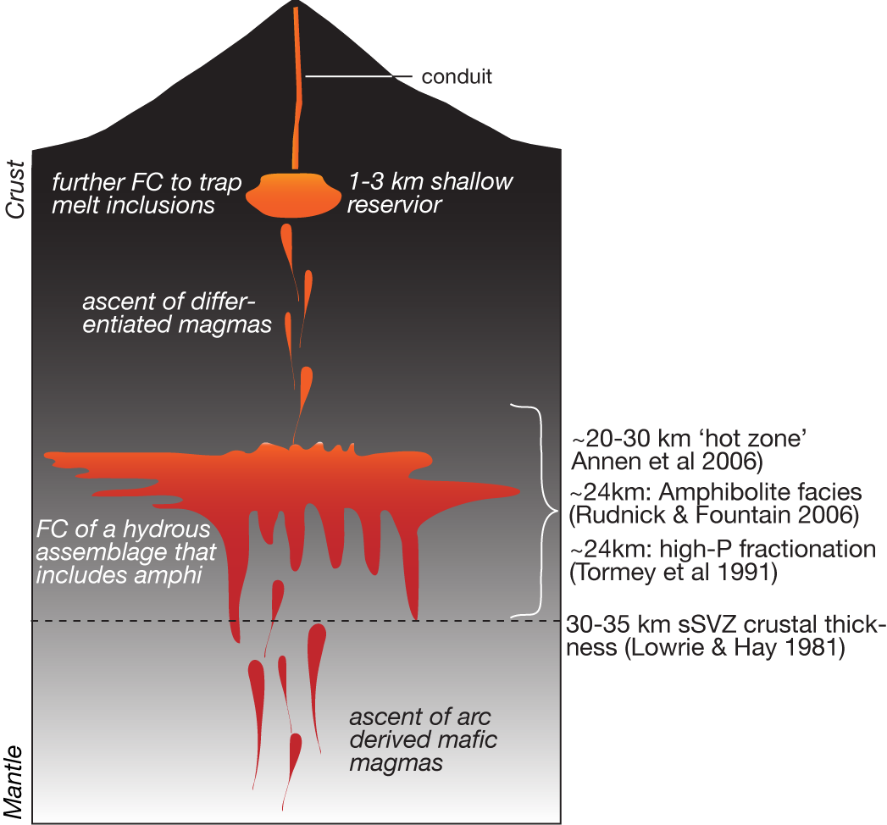
Higher-order thinking
Notes:
Introduction of trace elements as potential indicators of depth of differentiation possible.
Application of VolatileCalc or the solubility model of Moore et al to estimate depth of entrapment of melt inclusions.

Slide 15
Data Collection Lecture
ME & TE Lecture
FC Lecture
Modeling Lecture
ME & TE exercise
M&M lab exercise
Partition coefficients
Hudson Project
Analysis submitted for feedback
Return for resubmission & grade again?
Final Paper
Grade with feedback

Slide 16
Pros and Cons
Plethora of data available
Many problems available within the data set
Inquiry based problem solving
Promotes higher order thinking
No student involvement in sample or data collection
Previously published data – available online → how do we address
Potential time sink
Notes:
Wondering if no student involvement in sample collection and analysis is both a pro and a con ;-)

Slide 17
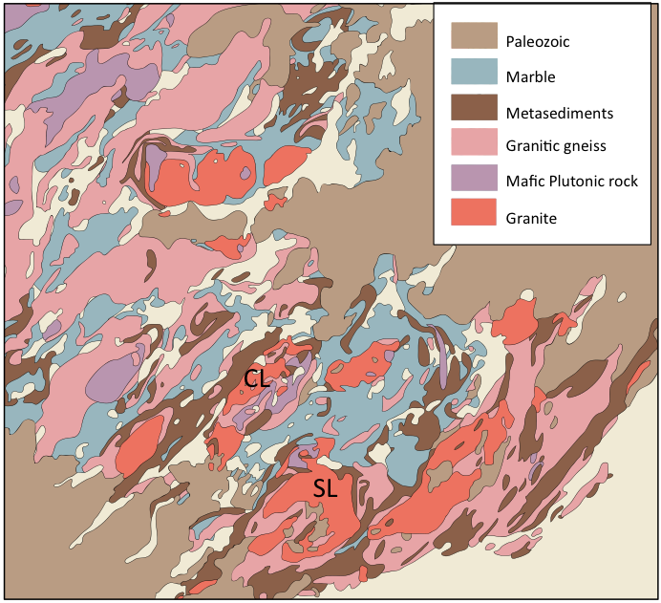
Colgate Grenville Project (2 Half-term Projects):
Igneous
Petrology of the
1.15 Ga Frontenac
suite
2) Metamorphic
Petrology of the
Frontenac terrane
•A-type granites
•Granulite-facies
Marble and pelite
Notes:
Colgate example petrology project

Slide 18

202/202L Petrology W. Peck This course deals with the origin and evolution of igneous and metamorphic rocks and their plate tectonic setting. The origin of magmas is examined as well as the processes involved in their differentiation. Metamorphic facies, mineral assemblages, and thermobarometry are studied. Petrology and melting of the mantle is discussed. These topics are unified by concepts of plate tectonics. Laboratories involve the study of rock suites from classic areas around the world. Three meetings and one laboratory per week, plus a weekend field trip. The required credit-bearing laboratory session GEOL 202L must be taken and passed concurrently with GEOL 202. Prerequisite: GEOL 201 or equivalent.
321 Analytical Methods in Geology K. Harpp Working in industry, government, and academia, geologists rely on modern instruments for rapid, accurate analysis of geologic materials and processes. This course examines the theory, practice, and application of analytical instruments in the geosciences. Emphasis is on equipment housed in the Department of Geology (atomic absorption spectrometer, scanning electron microscope-energy dispersive spectrometer, x-ray fluorescence spectrometer, x-ray diffraction spectrometer, inductively coupled plasma-mass spectrometer) but other analytical methods are discussed. Current geologic literature illustrating applications of the techniques is also discussed. During laboratories, students learn sample preparation and practical use of instruments while conducting short research projects.
Notes:
Taught as 2 courses: a petrology course and a methods course, so in addition to the geochem part there was a also lecture on analytical equipment and data processing

Slide 19
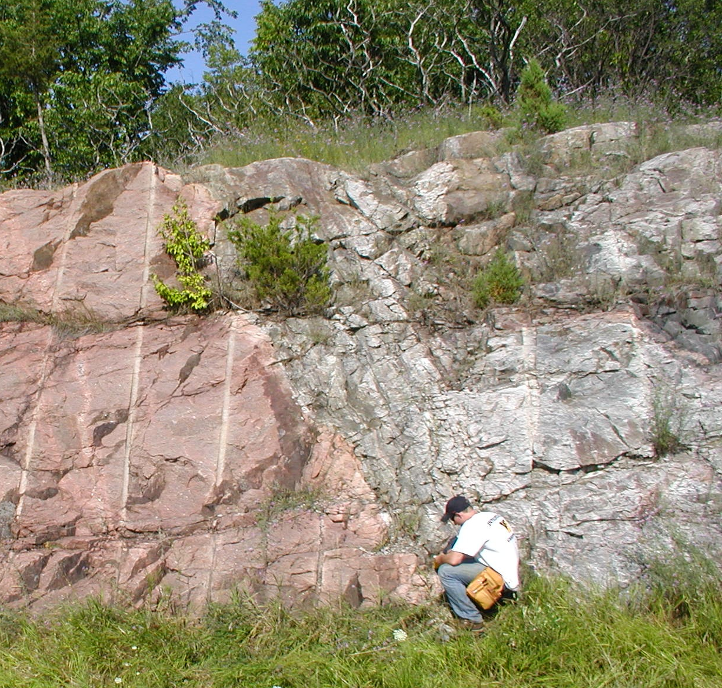
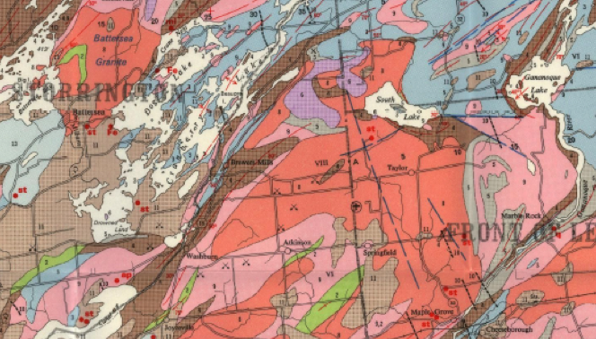
Fieldwork:
Day 1: General geology of area, formulation of sampling strategy
Days 2+3: Observations and sample collection
Each student collected two igneous samples and two metamorphic samples

Slide 20
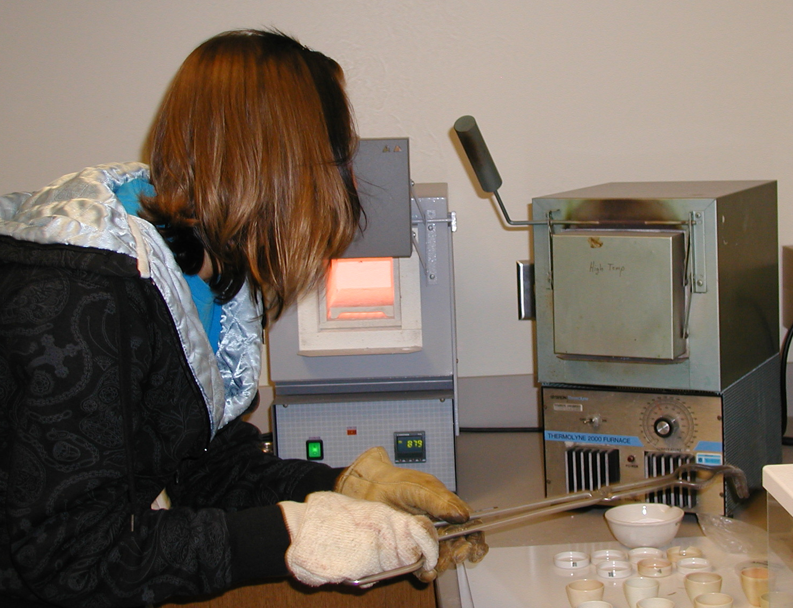
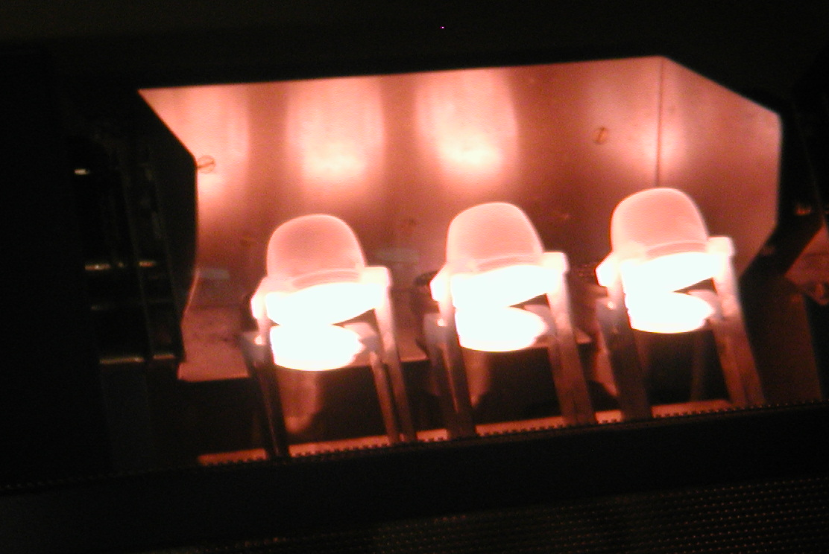
Lab Work
Thin section preparation
Rock Powdering
XRF for major elements
ICP-MS for trace elements
Notes:
In the metamorphic part there was also SEM and isotope work

Slide 21
Field Trip and Sample Collection
ICPMS Solutions
Rock Powders
Thin Sections
XRF Disks
ICMPS
Analysis
Petro-graphy
XRF
Analysis
Notes:
Issues: Sequencing of this lab work with lecture and traditional microscope labs, also how to grade?

Slide 22
Layered Mafic Intrusion Lecture
LMI Petrography Lab
Project Petrography
Granite Lecture
Granite Petrography Lab
Igneous Petrology Lectures
Fractional Crystallization
Lecture
Fractional Crystallization Problem Set
Fractional Crystallization Exercises
Trace Element Problem Set
Trace Element Lecture
Trace Element Exercises
Final Paper
Notes:
Lectures + homework/labs were tailored to help project work being done that week
Major parts of final paper were handed in as homework and graded w/feedback

Slide 23
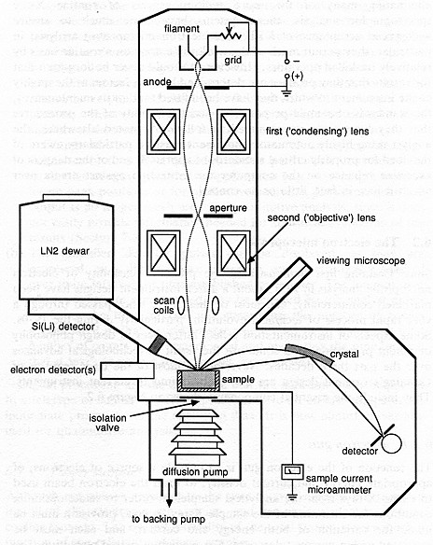
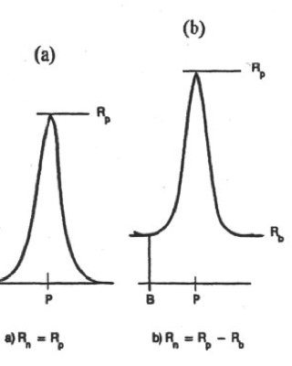
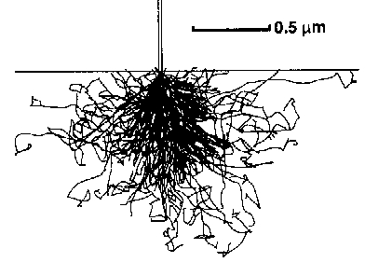
Peak ratio after overlaps, background
ZAF of both std and sample
Notes:
Also going on:methods part of the course, wouldn’t have time for much of this is a straight petrology course. Assessed w/problem sets and exams

Slide 24
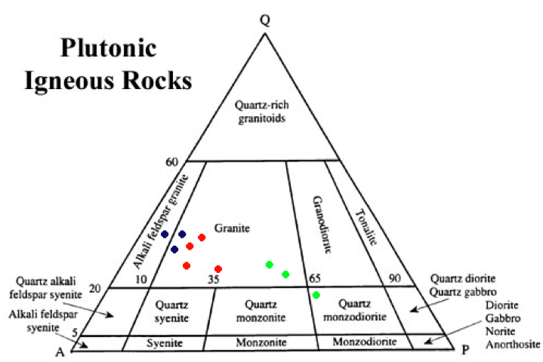
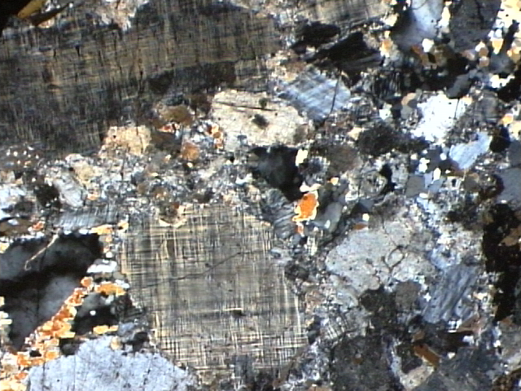
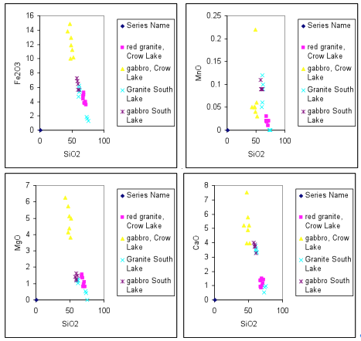
Notes:
Final papers. Integrative summary of ig (or met) pet of rx. Main external source was Winters book. Several articles made avaliable; not used much
Excel using petroplot

Slide 25
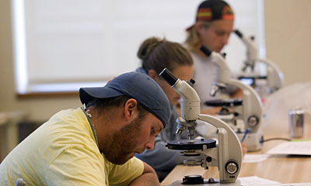
Student Comments?
“The work for these classes was very extensive – long labs, problem sets and a lot of time spent in the lab out of class time. The two exams encompass material [represented] a huge amount of material. I worked harder for this class than any class I have ever taken, it is not possible to put in more time and effort than we have put in.”
“The grading for both professors never reflected the amount of effort put in by the students.”
“My only complaint in this particular course would be that things seemed a little too off the cuff and rushed. It seemed like we could have gotten much more out of the course had it been better organized”

Slide 26
Student Comments (cont.)
“I have put more effort into these classes than any other class I have taken at Colgate, but I have also learned the most and received the most feedback and assistance.”
“The course was a really great mesh of petrology and analytical tools. I don’t think I would have understood the material nearly as thoroughly had I taken the courses separately.”
“This course taught me a lot about petrology and expanded my knowledge in geology by several orders of magnitude. I definitely learned how to think geologically (if that makes sense) and I feel confident that I could apply this knowledge outside of Colgate.”

Slide 27
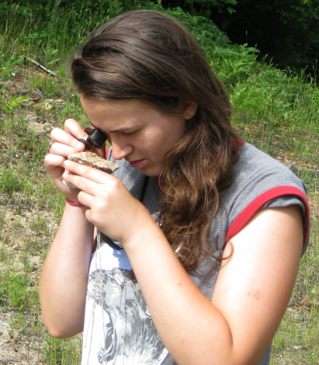
Why teach using projects?
-Active learning is more effective
-Motivation (sense of ownership, creation of new knowledge)
-Involves cooperative problem-solving
-Exposure to instrumentation + quant analysis (+plotting, stats, etc.)
-Teaches scientific problem-solving
-Develops time-management skills
-Promotes use of higher-order skills
(e.g. analysis, synthesis, evaluation)

Slide 28
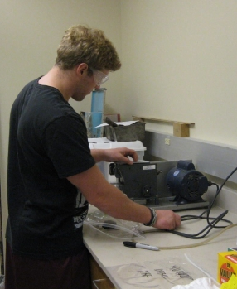
Negative and Unintended Consequences
-Less material covered, both in lecture and lab
-Emphasis on subset of traditional material, but with higher stakes
-Large workload, especially in ungraded lab work
-Difficult for some sophomores to integrate and synthesize
-Conflict with senior theses or seminar classes

