Slide 1



Active Learning Strategies for Geoscience Teaching
Steven Semken
Albuquerque • May 2012
Adapted in part from workshop materials developed by David Steer, University of Akron
Supported by grant 0716296 from the National Science Foundation

Slide 2
Warmup Activity
Rank these questions from least difficult to most difficult :
Which one of the following values best approximates the volume of a sphere with radius 5 m?
(a) 2000m³ (b) 1000m³ (c) 500m³ (d) 250m³ (e) 125m³
Design a method for mitigating the effects of acid mine drainage.
What is the capital of New Mexico?
How would you restructure the school day to reflect children’s developmental needs?
Contrast the floor of the Atlantic Ocean with the shape of a bathtub.
Which statements in the President’s 2012 State of the Union address were based on facts, and which were based on assumptions?
How did you determine the relative difficulty?

Slide 3
Introducing a useful tool for geoscience teaching
The Taxonomy for Learning, Teaching, and Assessing (Anderson et al., 2001; aka “Bloom’s Taxonomy”): a framework for scaffolding learning.
Where are you on this list?
Level 0: I have never heard of the Taxonomy.
Level 1: I can recall how many categories there are in the Taxonomy.
Level 2: I can place several categories of the Taxonomy in correct order.
Level 3: I can describe the six categories of the Taxonomy.
Level 4: I can explain how I might use the Taxonomy in planning a lesson.
Anderson, L. W., Krathwohl, D. R., Airasian, P. W., Cruikshank, K. A., Mayer, R. E., Pintrich, P. R., Raths, J., & Wittrock, M. C. (Eds.) (2001). A taxonomy for learning, teaching, and assessing: A revision of Bloom’s taxonomy of educational objectives. New York: Longman. ISBN 0-813-1903-X.

Slide 4
The Taxonomy usefully categorizes the cognitive process
The Taxonomy was developed to help us meaningfully order our teaching and learning goals….
recognize and recall
construct meaning
carry out or use procedure
take apart information
make informed judgments
generate, plan, produce
Remember
Understand
Apply
Analyze
Evaluate
Create
Text
ConcepTests
Lecture Tutorials
Concept Sketches
Evaluation Rubrics
Planning Exercises
Open-ended questions can be used for all categories.

Slide 5
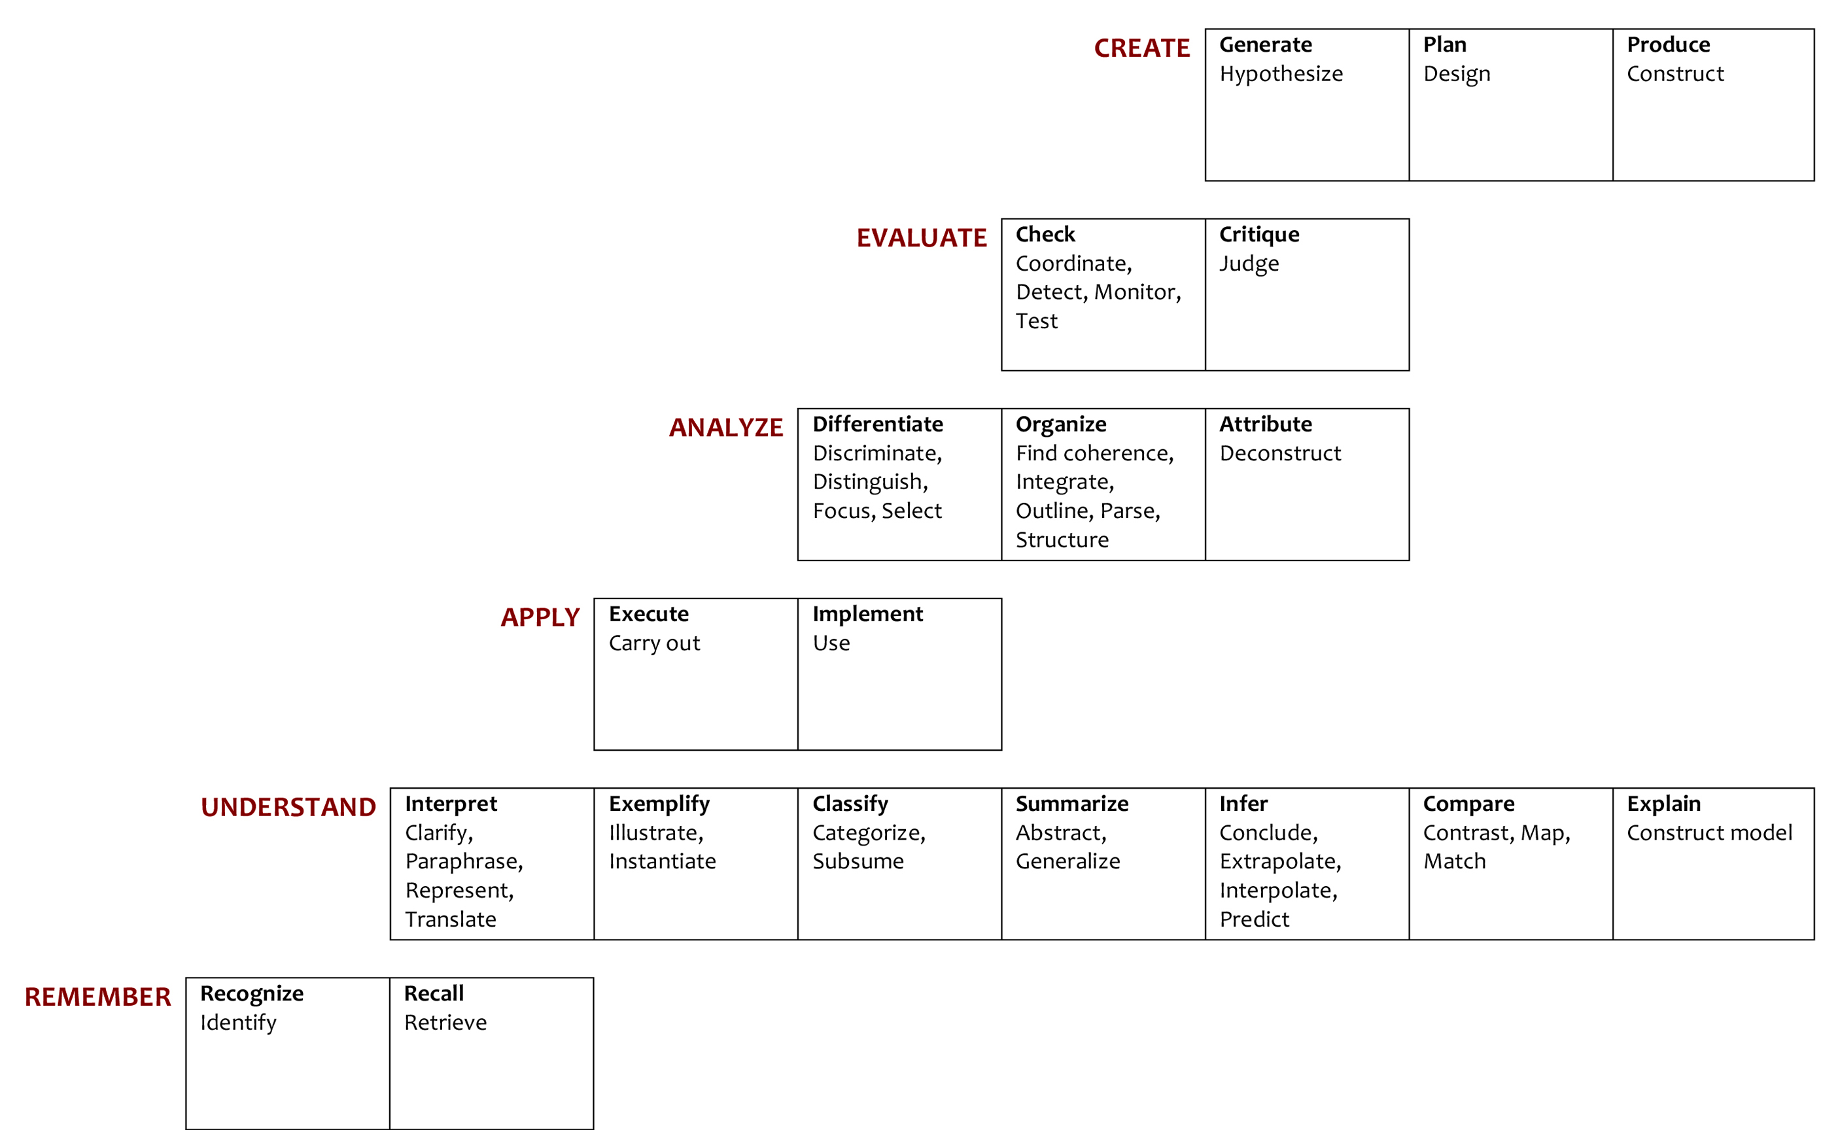
Categorizing the cognitive process
Each of the six categories
has a set of cognitive processes
associated with it.
Each process is identified
by one or more similar
terms (all verbs).
Anderson, L. W., Krathwohl, D. R., Airasian, P. W., Cruikshank, K. A.,
Mayer, R. E., Pintrich, P. R., Raths, J., & Wittrock, M. C. (Eds.) (2001).
A taxonomy for learning, teaching, and assessing: A revision of Bloom’s
taxonomy of educational objectives. New York: Longman. ISBN 0-813-1903-X.

Slide 6
Familiarize yourself with the Taxonomy
Work with a partner to complete the Taxonomy Exercise provided.
Note that some exercises may cross boundaries between cognitive-process categories.
Select the category that you think best corresponds to that exercise.

Slide 7
Creating activities and assessments representing all categories of the Taxonomy
Analyze and generate exercises corresponding to the cognitive process categories of the Taxonomy
Where are you on this list?
Level 1: I understand where multiple choice questions and essay questions might place in the Taxonomy.
Level 2: I can classify a series of simple questions in the Taxonomy.
Level 3: I can analyze how to classify a series of exercises based on the categories of the Taxonomy.
Level 4: I can make up questions representative of the six categories of the Taxonomy.

Slide 8
Practical Application of Exercises
Setting: A course you would like to change to be more interactive
Task: Construct simple assessments that a faculty member could use to assess student learning of core concepts in your field of expertise.
Standard: Scaffold concept assessments using the Understand, Apply, Analyze, and Evaluate cognitive process categories of the Taxonomy.

Slide 9
Traditional versus Active Learning
Traditional Class
Students are passive or distracted (e.g., FB, Twitter)
Quiet
Instructor-focused
Information from instructor-to-student
Students work as individuals
Competitive learning environment
Limited assessment opportunities
Active Learning Class
Students are active
Noisy
Student-focused
Information from instructor-to-student, student-to-student, student-to-instructor
Student collaboration
Supportive learning environment
Multiple assessment opportunities
What is Active Learning: http://serc.carleton.edu/introgeo/gallerywalk/active.html

Slide 10
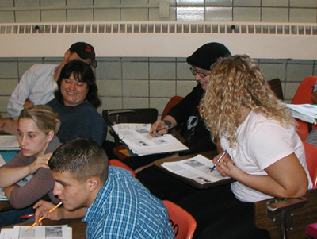
Interactive Lectures: Key Features
Pre-class reading or other tasks as homework or preparation for in-class quiz.
Lecture is broken into short segments, separated by activities or assessments.
Students work together in groups.
Formative assessments may be used during class to evaluate students’ learning progress.
McConnell, D. A., Steer, D. N., & Owens, K. (2003). Assessment of active learning strategies for introductory geology courses. Journal of Geoscience Education, 51(2), 205-216.
Interactive Lectures: http://serc.carleton.edu/introgeo/interactive/howto.html
Notes:
Students work together in small groups determined by experience, skills, or demographic factors (e.g., gender)
Formative exercises during class used to assess student understanding and progress and to challenge students to think beyond comfort level
Classes incorporate most or all of 7 good practices
How can feedback devices produce learner-centered classes?

Slide 11
Some Interactive Lecture Techniques
Think-pair-share or other small-group work
ConcepTests
Lecture tutorials
Predictive demonstrations
Wall walk
Concept sketches
Minute paper/muddiest point exercise
Fill your toolbox!
Variety is good!
Interactive Lectures: http://serc.carleton.edu/introgeo/interactive/howto.html

Slide 12

Interactive Lectures: Caveats
Interactive lectures can consume more class time than you might expect!
As a result, you might not be able to “cover” as much material as you do in a standard lecture.
You may need to strive for less content, but deeper understanding of the topics that are covered.
Remember that repetitive use of any one technique can become as deadening as a conventional lecture.
Interactive Lectures: http://serc.carleton.edu/introgeo/interactive/howto.html

Slide 13
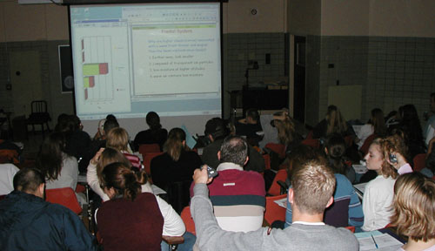
Think-Pair-Share
“Low-stakes” small-group activities that motivate and promote higher-level thinking
The instructor poses a question or task to the entire class.
Students ponder the question individually.
Students discuss the question in pairs or small groups before deciding on a final response.
Pairs or groups may or may not “report out.”
Think-Pair-Share: http://serc.carleton.edu/introgeo/interactive/tpshare.html
Notes:
Students work together in small groups determined by experience, skills, or demographic factors (e.g., gender)
Formative exercises during class used to assess student understanding and progress and to challenge students to think beyond comfort level
Classes incorporate most or all of 7 good practices
How can feedback devices produce learner-centered classes?

Slide 14
Applications of Think-Pair-Share
Think-pair-share can be adapted to many different types of questions and cognitive process categories. For example:
Recall prior knowledge of a topic (e.g., greenhouse effect).
Describe and interpret a digital or print image.
Brainstorm all things associated with a specific concept.
Propose a hypothesis to be tested (and how to test it).
Calculate an answer using data provided.
Think-Pair-Share: http://serc.carleton.edu/introgeo/interactive/tpshare.html

Slide 15
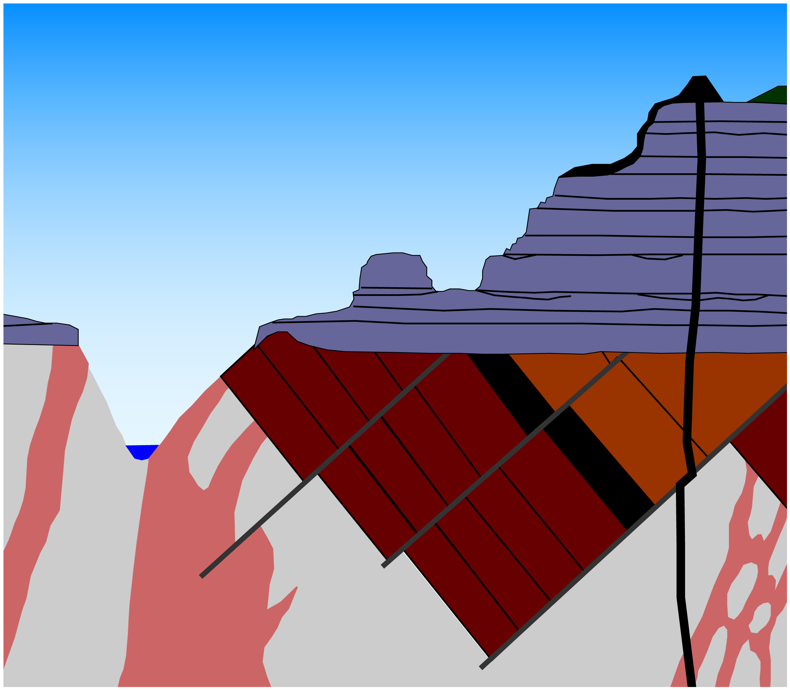
Brainstorm Think-Pair-Share questions for this image:
after Karlstrom & Crossey
C
D
E
F
G
H
A
B
I
Think-Pair-Share: http://serc.carleton.edu/introgeo/interactive/tpshare.html

Slide 16
Think-Pair-Share: Try It
With a partner, construct a think-pair-share question covering one key concept in each of your two primary disciplines that could be used in an introductory class. At a minimum include:
The think-pair-share question
Course
Level (non-major, intro, upper-division, etc.)
Concept
Category: Understand, Apply, Analyze, or Evaluate?
Approximate time required to complete

Slide 17
ConcepTests
Multiple-choice questions embedded in the lecture
Formative exercises used to assess student understanding and progress
Focus attention on key concepts
Frequently paired with peer instruction
Often used with an electronic Personal Response System (PRS) or “clicker”
McConnell, D. A., Steer, D. N., Owens, K. D., Knott, J. R., Van Horn, S., Borowski, W., Dick, J., Foos, A., Malone, M., McGrew, H., Greer, L., & Heaney, P. J. (2003). Using conceptests to assess and improve student conceptual understanding in introductory geoscience courses. Journal of Geoscience Education, 51(2), 174-183.
ConcepTests: http://serc.carleton.edu/sp/library/interactive/conctest.html
Notes:
Students work together in small groups determined by experience, skills, or demographic factors (e.g., gender)
Formative exercises during class used to assess student understanding and progress and to challenge students to think beyond comfort level
Classes incorporate most or all of 7 good practices
How can feedback devices produce learner-centered classes?

Slide 18
Good ConcepTests:
Test a single concept.
Recast the concept in a way not covered directly in lecture.
Do not require detailed calculations.
Have good multiple-choice answers that include misconceptions as distracters.
Are clearly worded (short on text).
McConnell, D. A., Steer, D. N., Owens, K. D., Knott, J. R., Van Horn, S., Borowski, W., Dick, J., Foos, A., Malone, M., McGrew, H., Greer, L., & Heaney, P. J. (2003). Using conceptests to assess and improve student conceptual understanding in introductory geoscience courses. Journal of Geoscience Education, 51(2), 174-183.
ConcepTests: http://serc.carleton.edu/sp/library/interactive/conctest.html
Notes:
Students work together in small groups determined by experience, skills, or demographic factors (e.g., gender)
Formative exercises during class used to assess student understanding and progress and to challenge students to think beyond comfort level
Classes incorporate most or all of 7 good practices
How can feedback devices produce learner-centered classes?

Slide 19
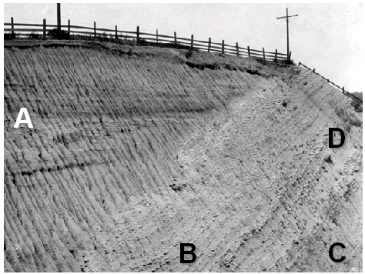
ConcepTests: An Example
In what order were the layers formed (from oldest to youngest)?
C, D, B, A
C, B, D, A
B, C, D, A
B, C, D, A
ConcepTests: http://serc.carleton.edu/sp/library/interactive/conctest.html

Slide 20
ConcepTests: Try It
With a partner, construct a conceptest question on one key concept in each of your two primary disciplines that could be used in an introductory class. At a minimum include:
The conceptest
Course
Level (non-major, intro, upper-division, etc.)
Concept
Category: Understand, Apply, Analyze, or Evaluate?
Approximate time required to complete

Slide 21

Lecture Tutorials
LTs are short worksheets that students complete during class between lecture segments.
LTs are designed to address student misconceptions.
They are typically done by student pairs or small groups.
They are easy to incorporate and can be used for formative assessment.
SERC
Kortz, K. M., Smay, J. J., & Murray, D. P. (2008). Increasing learning in introductory geoscience courses using lecture tutorials. Journal of Geoscience Education, 56(3), 280-290.
Lecture Tutorials: http://serc.carleton.edu/NAGTWorkshops/teaching_methods/lecture_tutorials/index.html

Slide 22
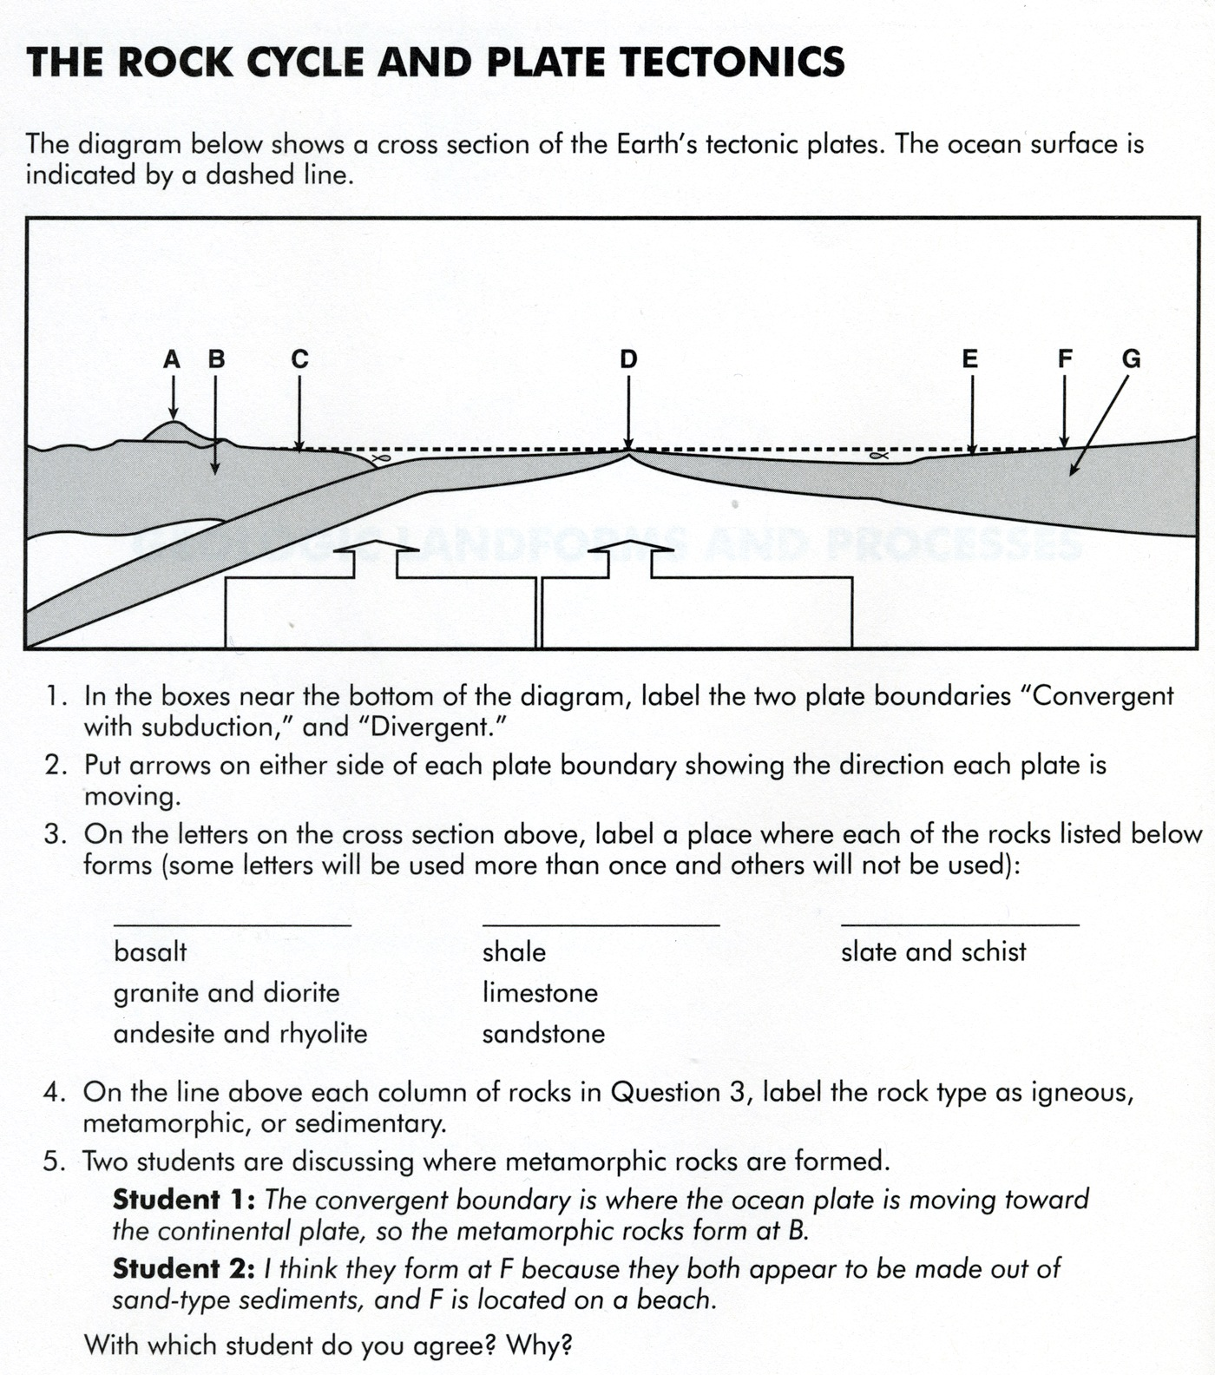
Lecture Tutorials: An Example
Kortz, K. M., & Smay, J. J. (2012). Lecture tutorials for introductory geoscience (2nd Edition). New York: W. H. Freeman. ISBN 978-1-4641-0105-2.
Lecture Tutorials:
http://serc.carleton.edu/NAGTWorkshops/teaching_methods/lecture_tutorials/index.html

Slide 23

Predictive Demonstrations
Normal demo:
Show and tell
Students observe, but are not necessarily engaged
Predictive demo:
Show but don’t tell
Ask students to predict results
Students are active
Student responses help address misconceptions
Interactive Demos: http://serc.carleton.edu/introgeo/demonstrations/index.html

Slide 24
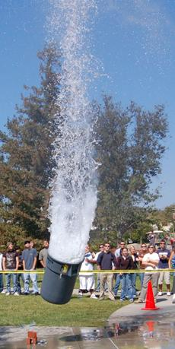
Predictive Demos: Best Practices
Predict the outcome; Experience the demonstration; Reflect on the outcome.
Best practices:
  Relate to class topics
  Use common items to enhance student interest (e.g., food)
  Be “showy” if you can (safely!)
Can be used in large or small classes and with think-pair-share
Can be enlarged into a guided discovery lab
Interactive Demos: http://serc.carleton.edu/introgeo/demonstrations/index.html

Slide 25
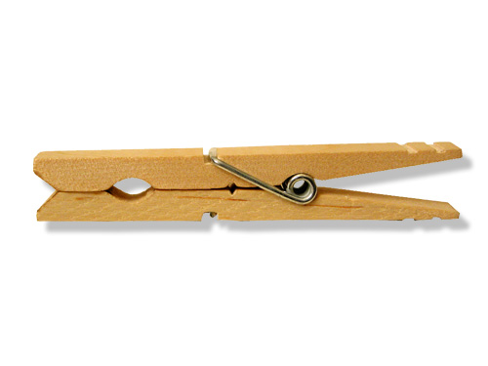
Predictive Demos: An Example
The Geologic Time (Clothes) Line
A scale representation of geologic time
4.6 m represents 4.6 billion years (4.6 Gy)
Direct students to use clothespins to mark significant events in the history of Earth and life (e.g., earliest life, first plants, Pangaea, dino extinction).
Allow them (individually or with class help) to decide where to mark time.
Correct as necessary and discuss the outcome.
Richardson, R. M. (2000). Geologic time (clothes) line. Journal of Geoscience Education, 48(5), 584.

Slide 26
Predictive Demo: Try It
With a partner, outline a predictive demo on one key concept in each of your two primary disciplines that could be used in an introductory class. At a minimum include:
Brief description of the predictive demo
Course
Level (non-major, intro, upper-division, etc.)
Concept
Category: Understand, Apply, Analyze, or Evaluate?
Approximate time required to complete

Slide 27
Wall Walk
Used to stimulate class discussions
On 4 walls of the class, place signs: Agree, Disagree, Strongly Agree, Strongly Disagree
Establish rules (you can change where you are standing, be courteous, raise hand, will be called upon, etc…)
Project a (controversial) statement about a class topic and direct students to choose the wall corresponding to their level of agreement

Slide 28
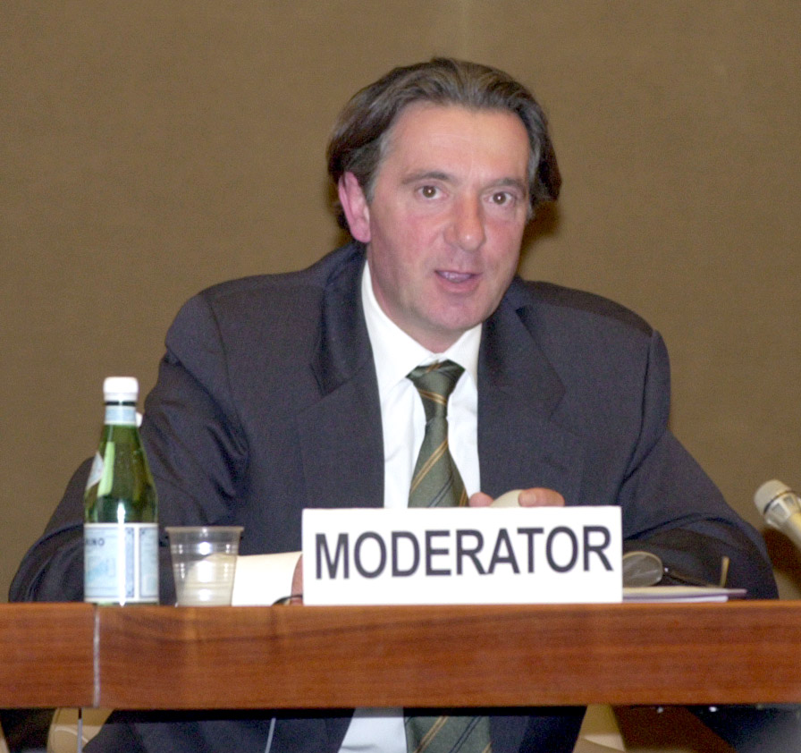
Wall Walk: Best Practices
Assign background readings about the topic beforehand.
Do not let students stand in the middle (make them “take a stand”).
Expect that students will make assumptions about the statement.
Instructor serves only as moderator or to clarify misconceptions.

Slide 29
Wall Walk: Sample Statements
Scientific theories are never certain, so they should not be believed.
We should increase our use of nuclear power to minimize greenhouse-gas emissions from burning fossil fuels for power.
We should not be spending money on space exploration as long as we have so many problems to solve down on Earth.
Grand Canyon began eroding about 6 (…or 65) million years ago.

Slide 30
Wall Walk: Try It
With a partner, develop a wall walk statement on one key concept in each of your two primary disciplines that could be used in an introductory class. At a minimum include:
The wall walk statement
Course
Level (non-major, intro, upper-division, etc.)
Concept
Category: Understand, Apply, Analyze, or Evaluate?
Approximate time required to complete

Slide 31
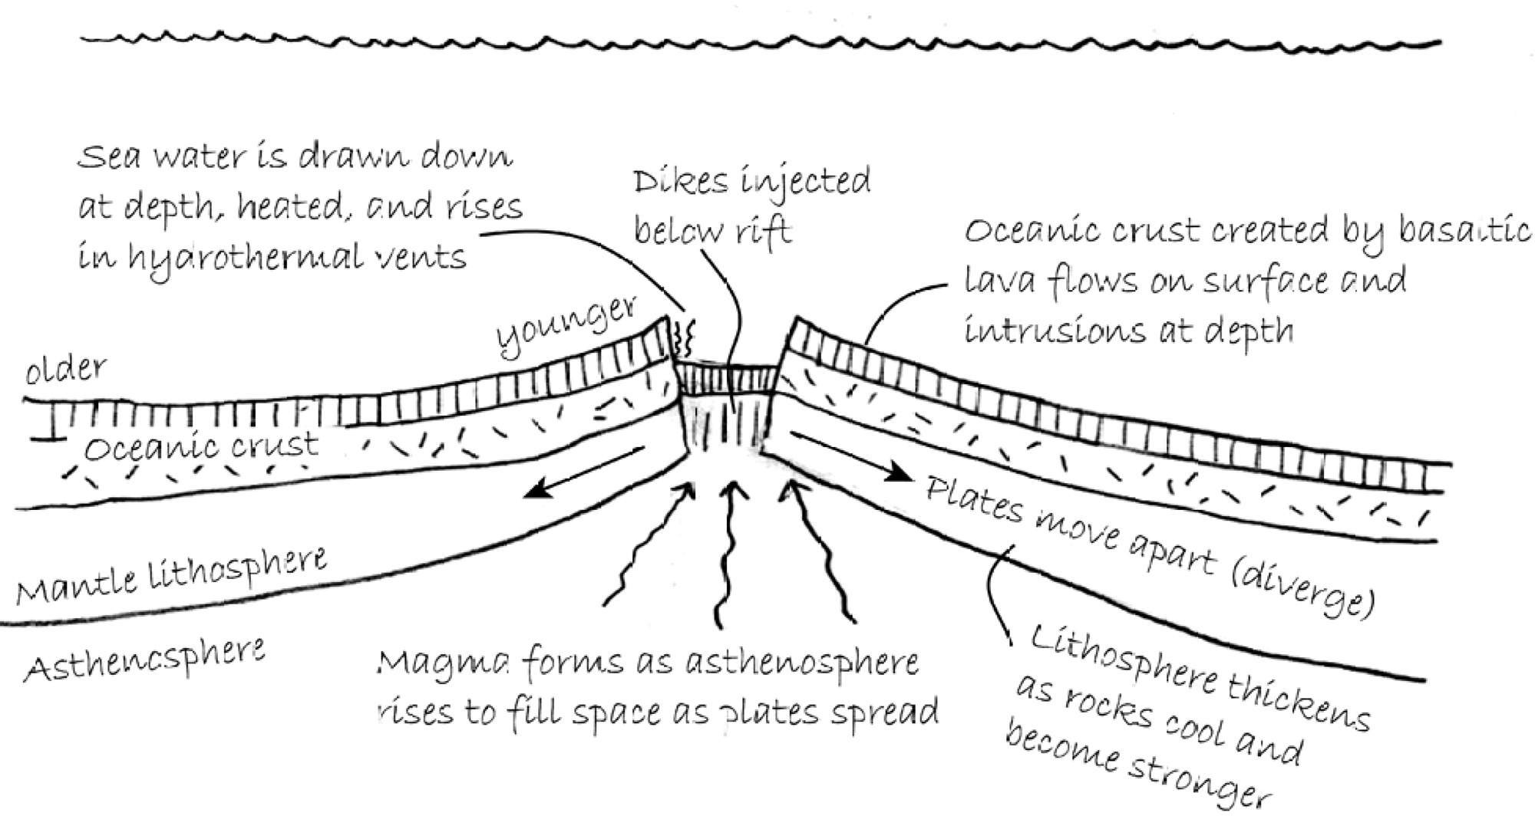
Concept Sketches
Concept sketches are student-generated or instructor-generated annotated sketches, intended to illustrate the important or meaningful aspects of a concept or a system.
Johnson, J. K., & Reynolds, S. J. (2005). Concept sketches—Using student‐ and instructor‐generated, annotated sketches for learning, teaching, & assessment in geology courses. Journal of Geoscience Education, 53(1), 85-95.

Slide 32
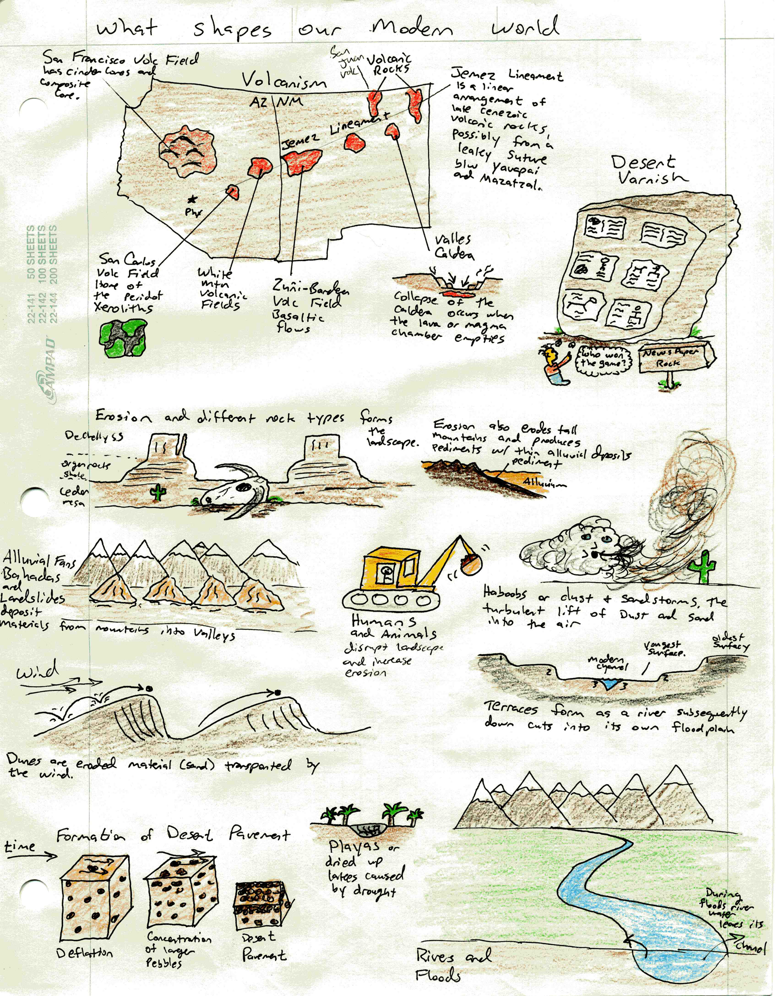
Concept Sketches
J. Coyan, 2006

Slide 33
Using Concept Sketches
Simplest application is to have students annotate a ready-made sketch in class or as an assignment
Having students create the entire concept sketch during class compels them to think more deeply the concept.
  Provide “prompts” (e.g., images, videos, hand specimens, maps) before the students begin sketching.
  Direct students to: list what they think are key features and processes and decide how these aspects are related to each other.
  Direct students to brainstorm how to depict the system or process.
  Finally, have them draw and annotate the sketch.
Any stage is amenable to pair or group work (share and compare lists, ideas, and their final sketches).
Johnson, J. K., & Reynolds, S. J. (2005). Concept sketches—Using student‐ and instructor‐generated, annotated sketches for learning, teaching, & assessment in geology courses. Journal of Geoscience Education, 53(1), 85-95.

Slide 34
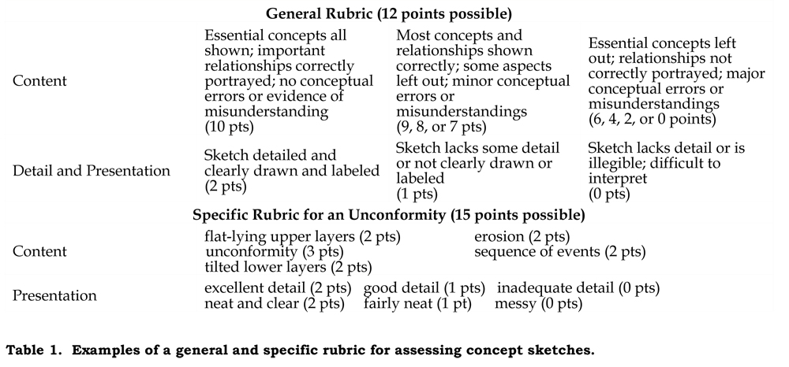
Assessing Concept Sketches
Johnson, J. K., & Reynolds, S. J. (2005). Concept sketches—Using student‐ and instructor‐generated, annotated sketches for learning, teaching, & assessment in geology courses. Journal of Geoscience Education, 53(1), 85-95.

Slide 35
Concept Sketch: Try It
With a partner, create a simple concept sketch illustrating one key concept in each of your two primary disciplines that could be used in an introductory class. At a minimum include:
The simple sketch: image plus annotation
Course
Level (non-major, intro, upper-division, etc.)
Concept
Category: Understand, Apply, Analyze, or Evaluate?
Approximate time required to complete

Slide 36
Question of the Day
Pose and discuss at the start of class to engage students with the topic(s):
You are at the beach and notice that the tide has come in. Is this an observation, law, theory, or hypothesis?
Which requires more water per kilowatt-hour of power produced: hydroelectric or coal-fired generation?
Where would you draw a boundary around the American Southwest region?
How do geologists know that the Earth is very old?

Slide 37
Muddiest Point Exercise
“What aspect of today’s (class/lab/reading/assignment) did you least understand?”
Promotes metacognition
Involves students in their own learning
Provides a low-stakes method of interacting with instructor
Can reveal class-wide trends
Makes a natural starting point for the next lecture
Angelo, T. A., & Cross, K. P. (1993). Classroom assessment techniques: A handbook for college teachers (2nd Edition). San Francisco: Jossey-Bass. ISBN 1555425003.

Slide 38
Closing Thank you!
Follow-up tasks
  Please submit an online workshop evaluation asap.
  Expand at least one of the active-learning techniques you worked on today into a full activity.
  Try it out in your class some time over the next year.
  Contribute it to the Cutting Edge collection: http://serc.carleton.edu/NAGTWorkshops/intro2012/share_activity.html (linked from the workshop pages)
  Let me (semken@asu.edu) know when you do!

