Slide 1

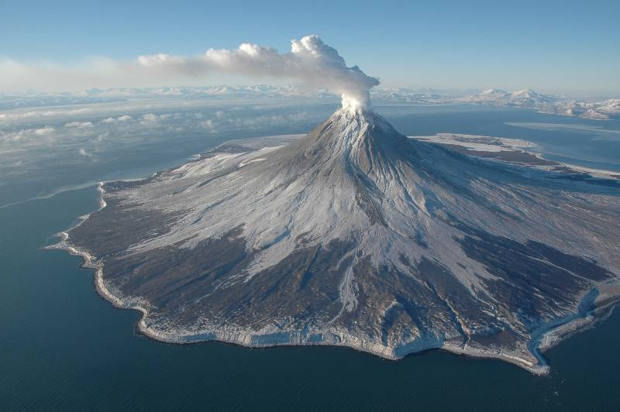
On the Cutting Edge Hazards Webinar Series
Volcanic Hazards in the United States
Peter F. Cervelli
Research Geophysicist
Volcano Science Center
U.S. Geological Survey
Menlo Park, CA
pcervelli@usgs.gov
Augustine Volcano, Alaska (Cyrus Read, USGS)
U.S. Department of the Interior
U.S. Geological Survey

Slide 2
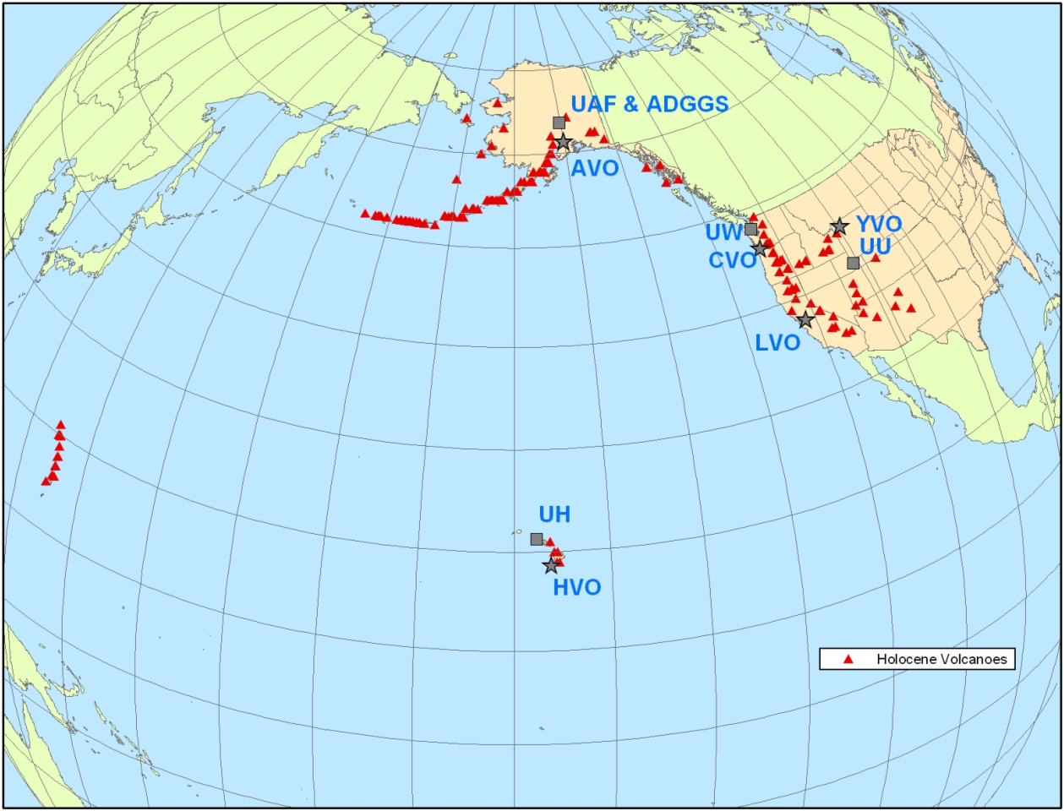
Volcano Hazards Program comprises 5 Volcano Observatories and associated partner agencies.

Slide 3
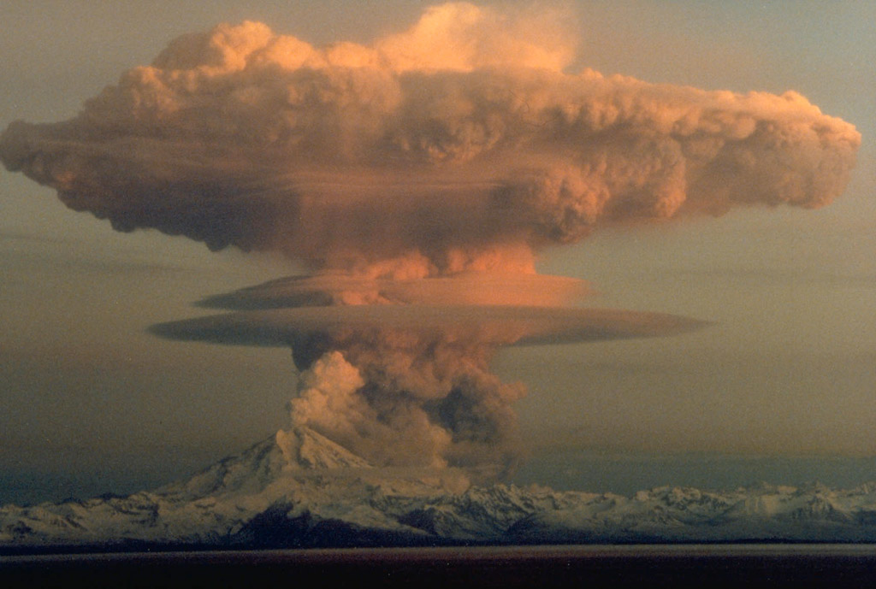
The VHP is responsible for monitoring all US volcanoes and issuing timely FORECASTS of volcanic hazard

Slide 4

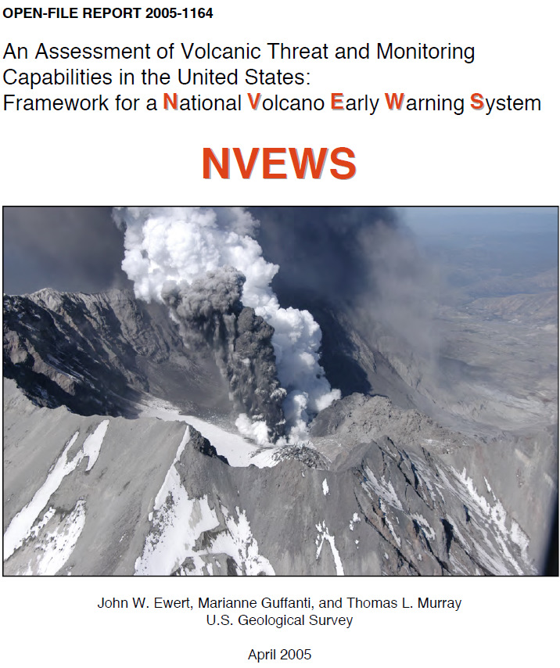
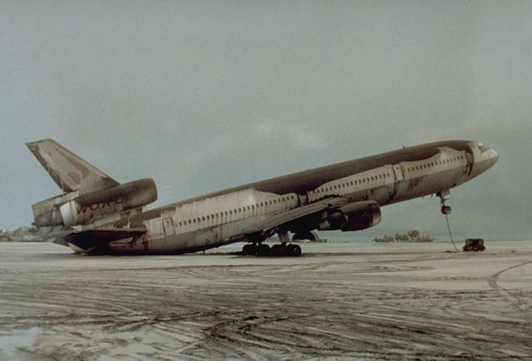
Quantitative Assessment of
The Nation’s Volcanoes
∼170 Holocene volcanoes (number changes based on new research and data)
Volcanoes binned by threat level (threat ≈ risk × exposure)
About 60 high or very high threat volcanoes, most in Alaska
Blueprint for future volcano research and monitoring efforts

Slide 5
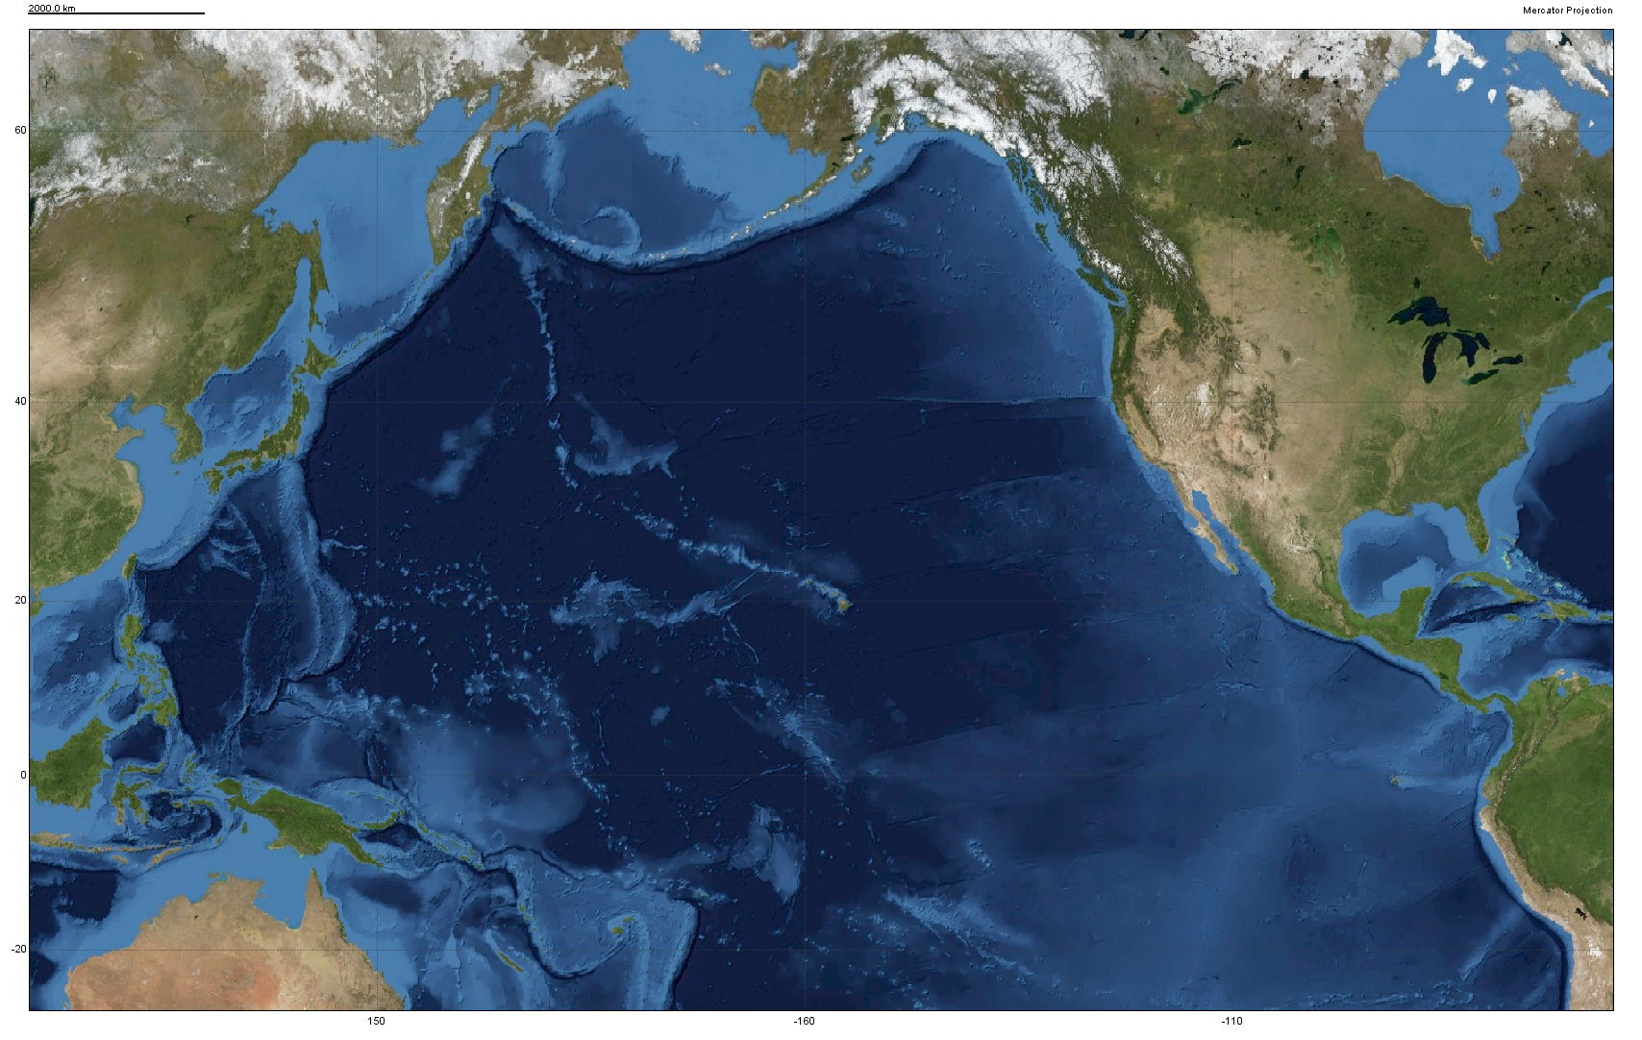
Thousands of people per day fly over the Aleutians
San Francisco to Seoul
Seattle to Tokyo
Los Angeles to Beijing

Slide 6
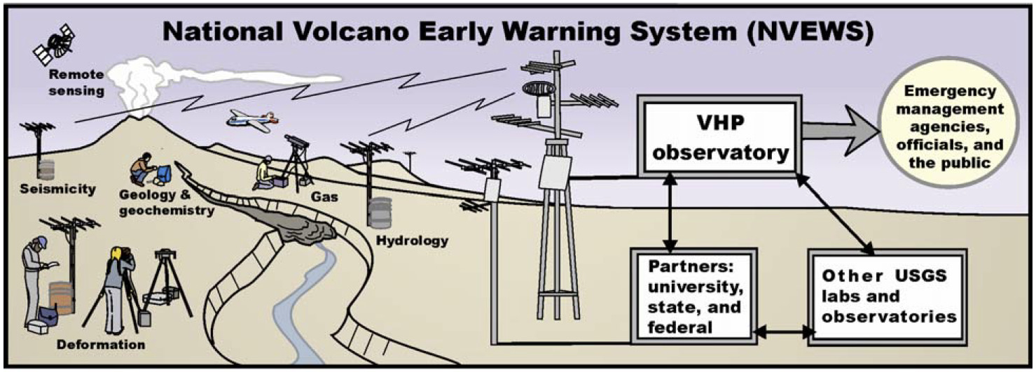
Forecasts result from interpretation of data from nearly 1000 continuous monitoring instruments, consisting of 10s of gigabytes per day.

Slide 7
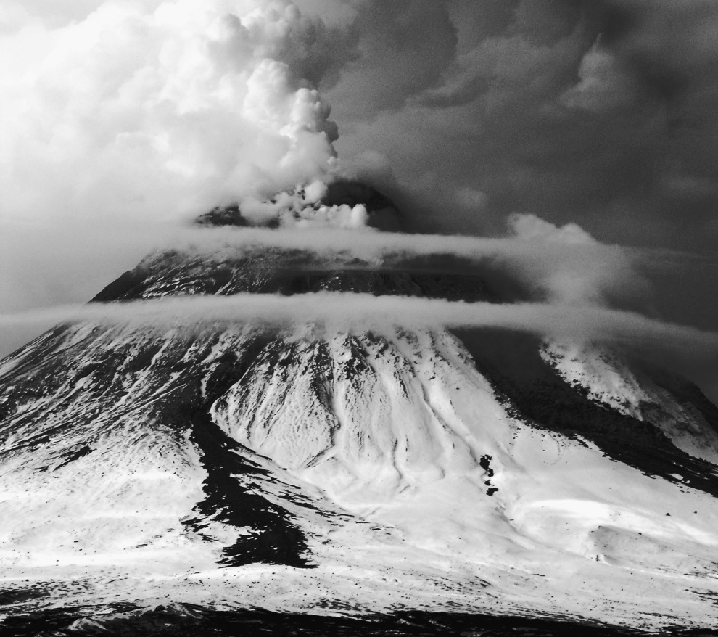
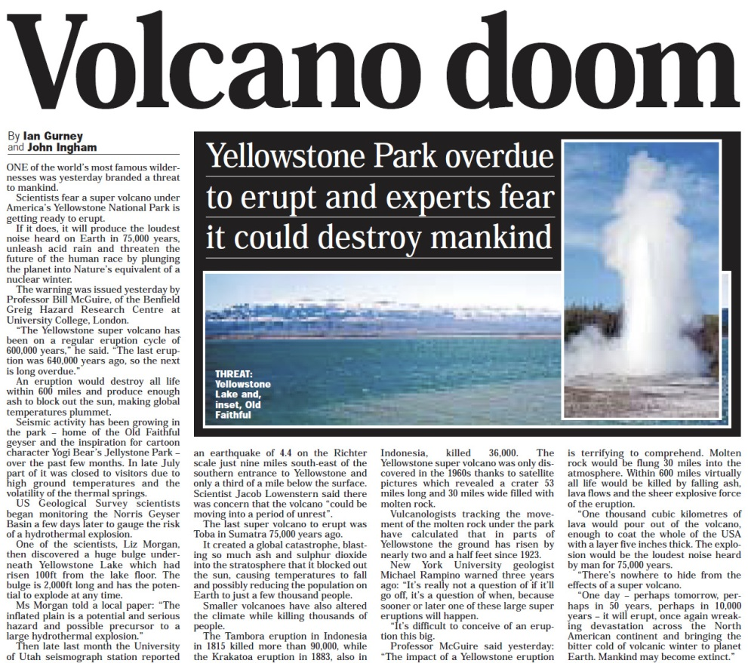
Instructive Case Studies
Augustine Volcano
Last Eruption: 2006
Yellowstone Volcano
Last Eruption: ∼70,000 years ago

Slide 8
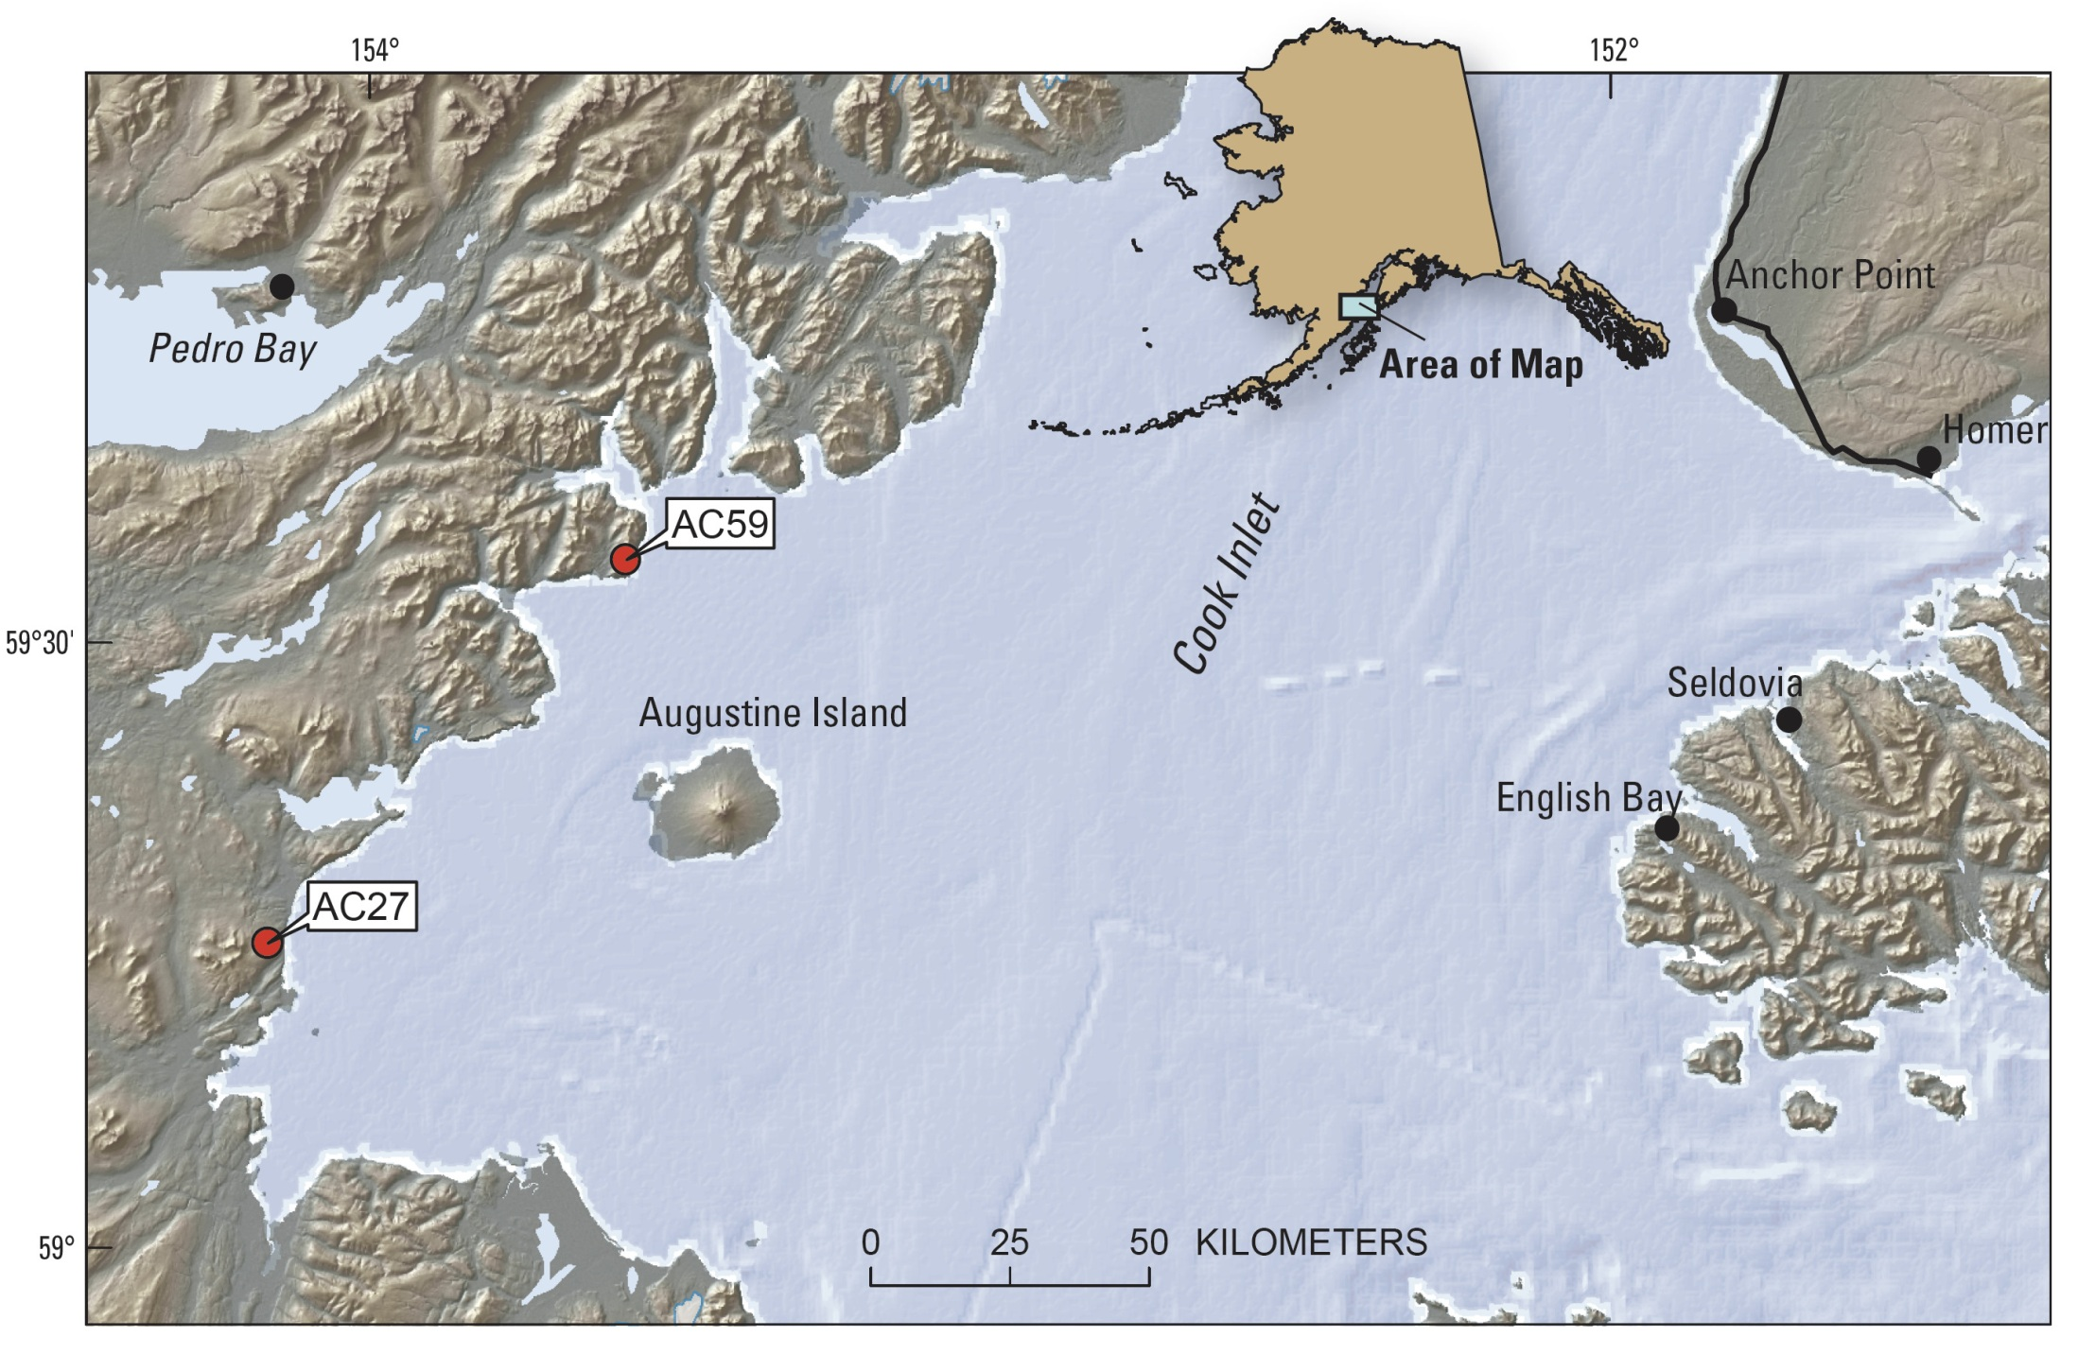
Anchorage: 150 km

Slide 9
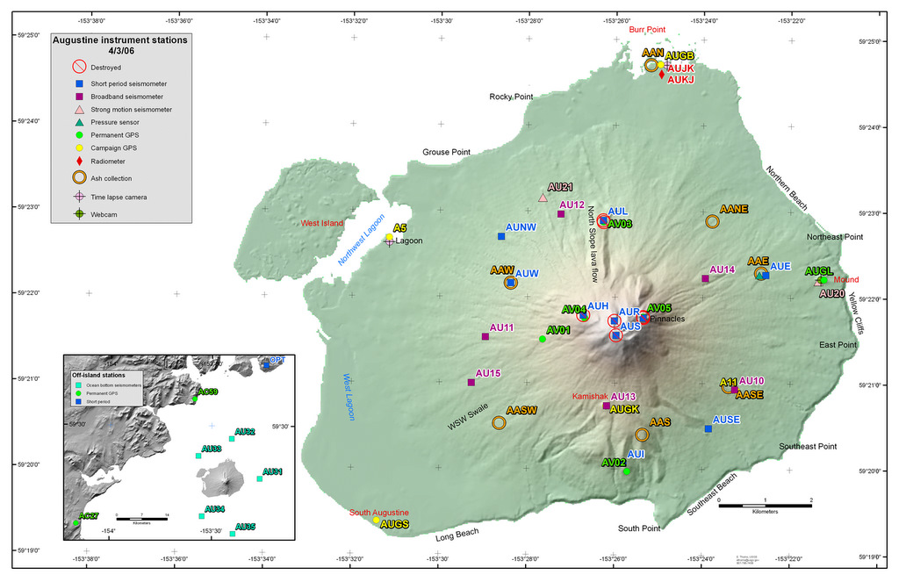
Credit: Evan Thoms
Instrumentation on Augustine Volcano in April, 2006

Slide 10
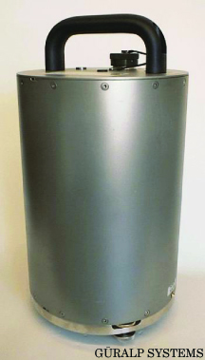
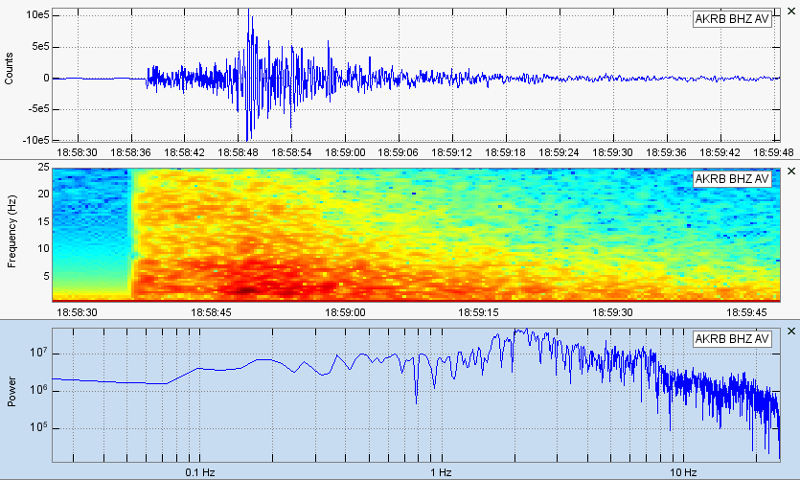
Instrumentation: Seismometers
Volcano and earthquake seismology share much common theory, but focus on different geological processes within the Earth.

Slide 11
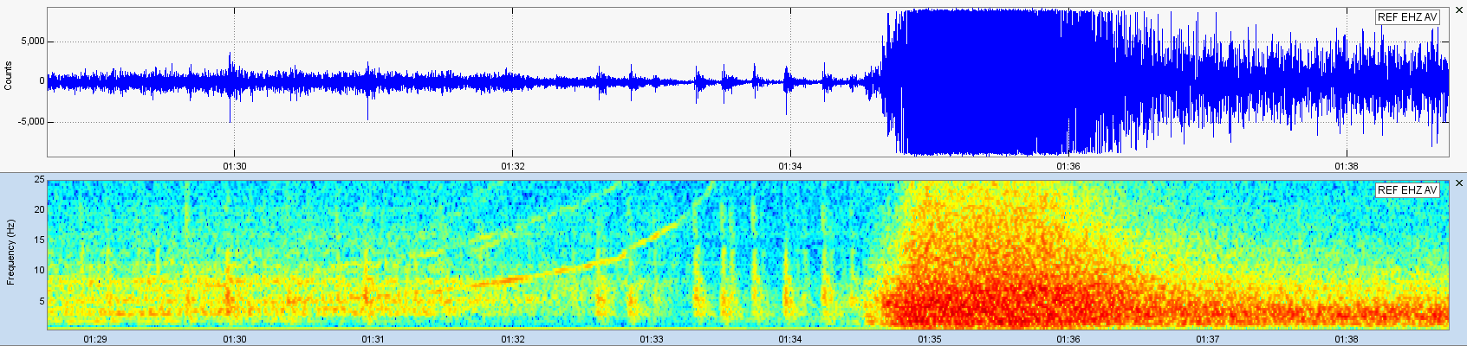
Volcano Seismology
Volcanic earthquakes often occur in “swarms” of small to moderate events, lacking the mainshock/aftershocks sequence typical of large tectonic earthquakes.
Seismometers on active volcanoes often record signals related to magma and fluid movement, rather than to brittle failure of rock.
Earthquake swarms can occur well away from the main volcanic edifice, resulting from stress changes created when magma rises through the upper crust.
Seismometers often record volcanic explosions.

Slide 12
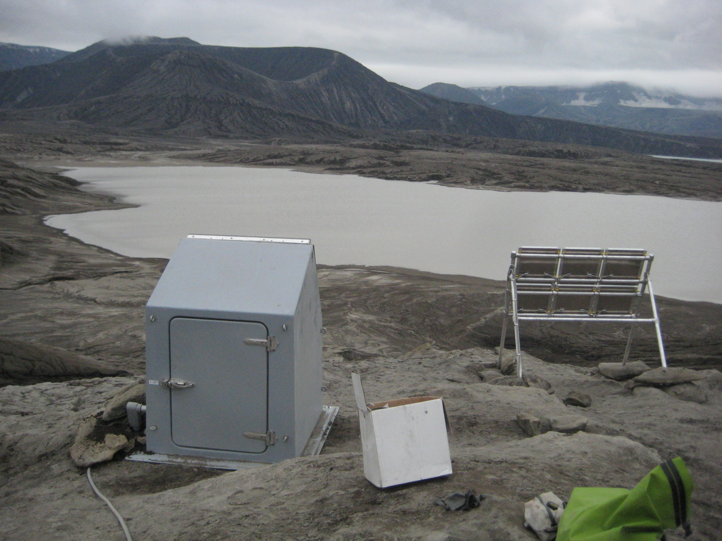
Typical Geophysical Instrumentation Site in Alaska

Slide 13
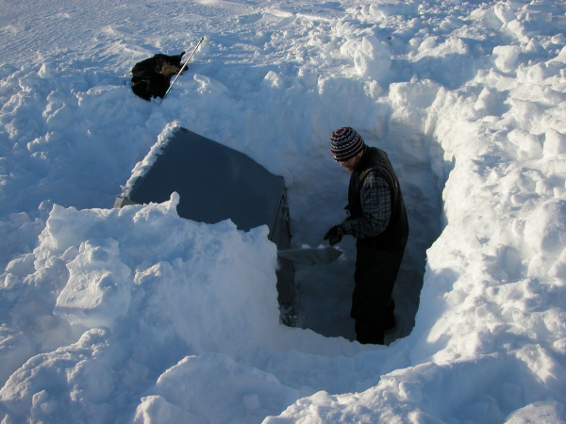
Winter Maintenance

Slide 14
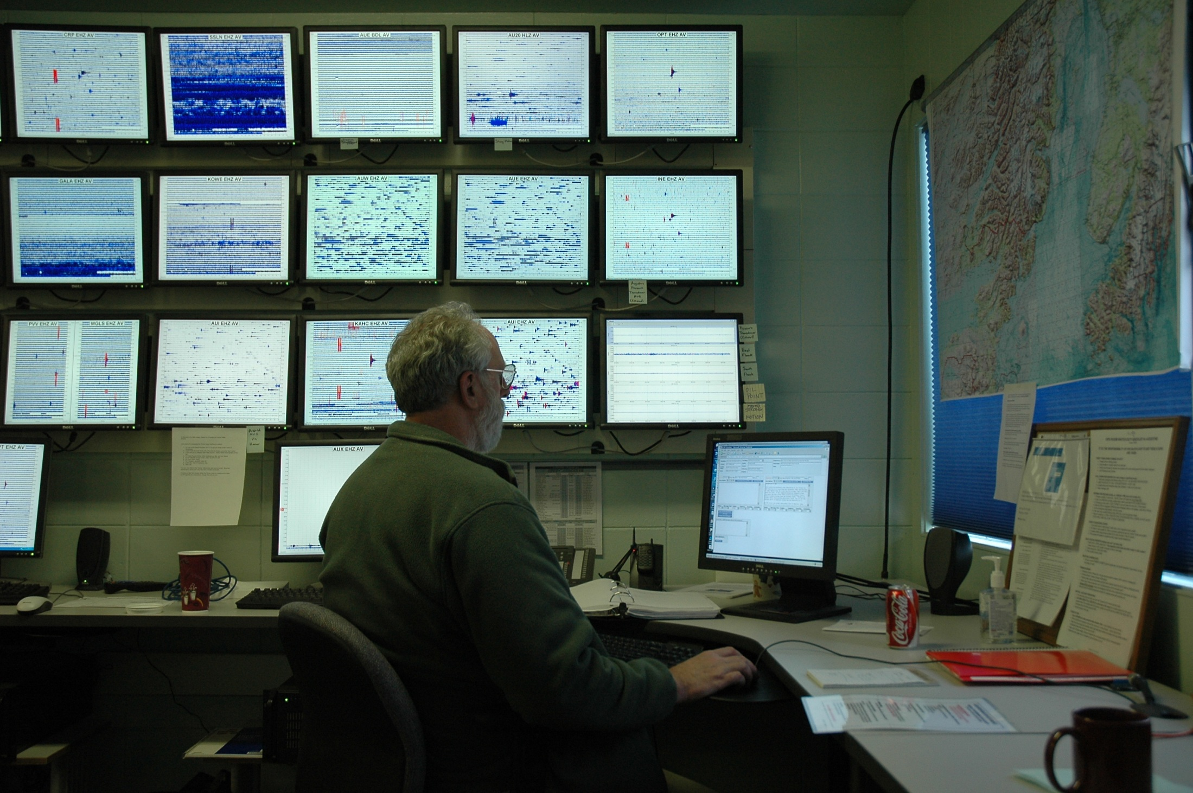
Seismic data on display at the Alaska Volcano Observatory

Slide 15
Credit: Evan Thoms
Instrumentation on Augustine Volcano in April, 2006

Slide 16
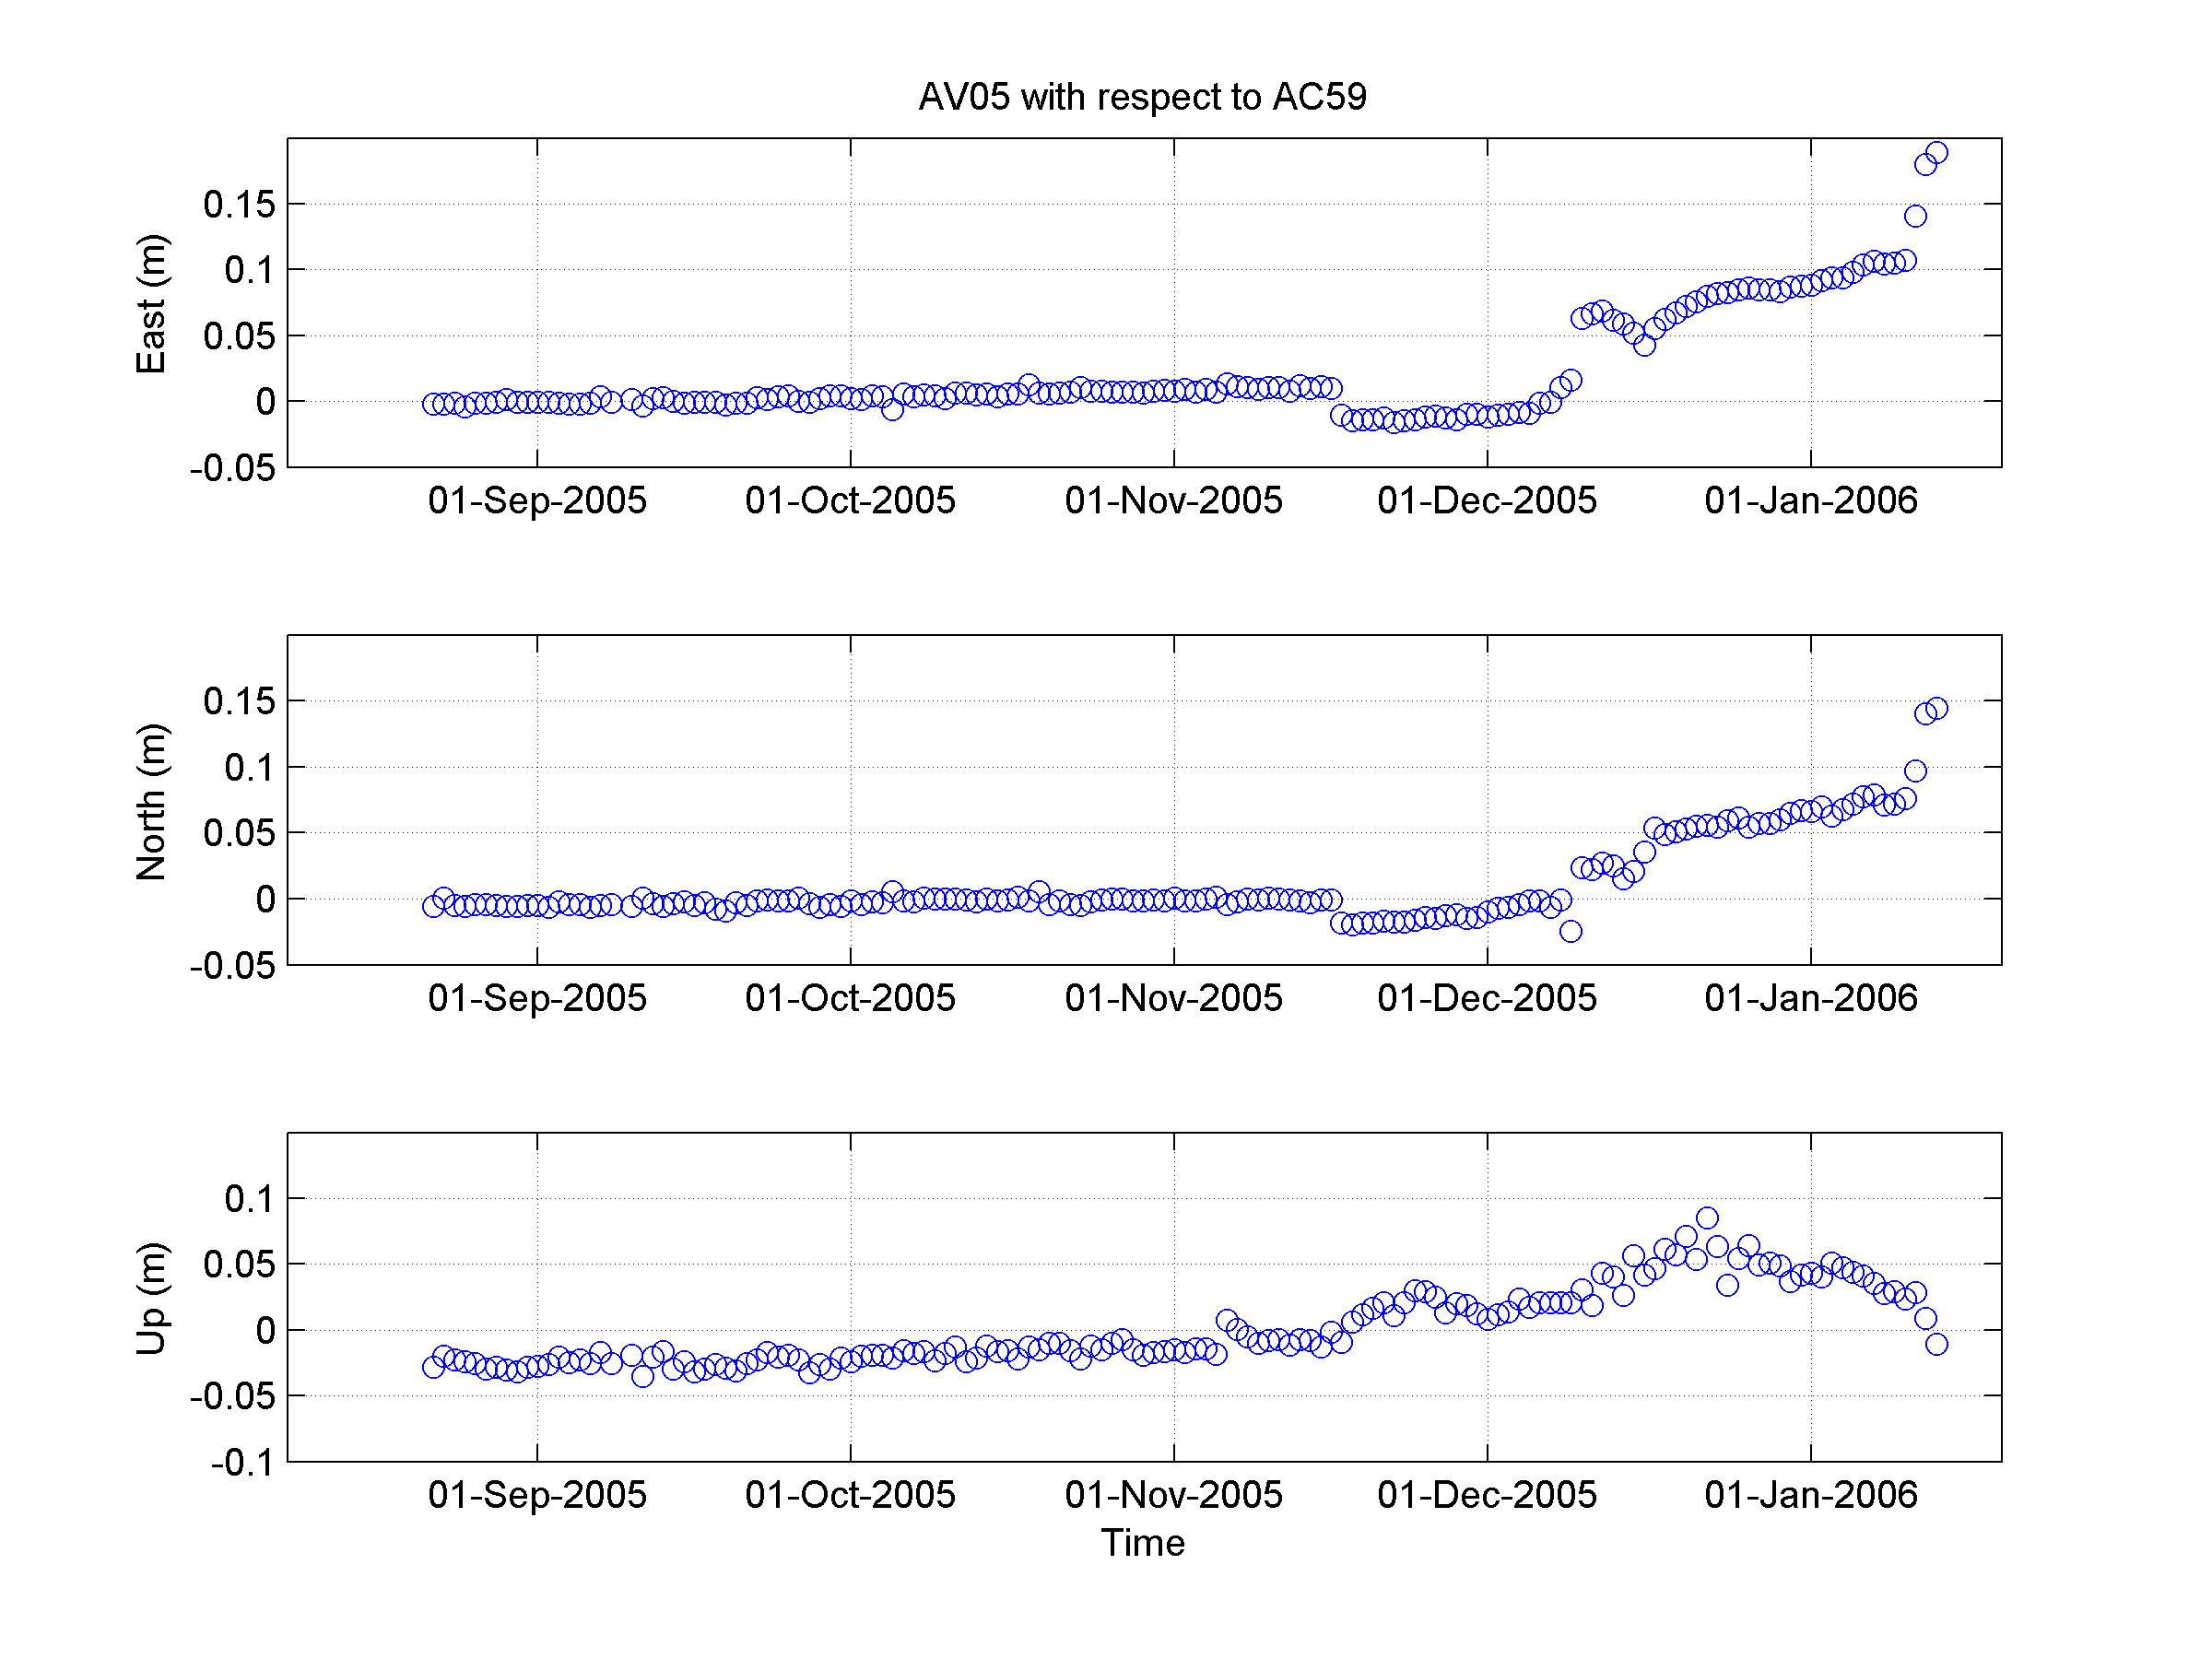
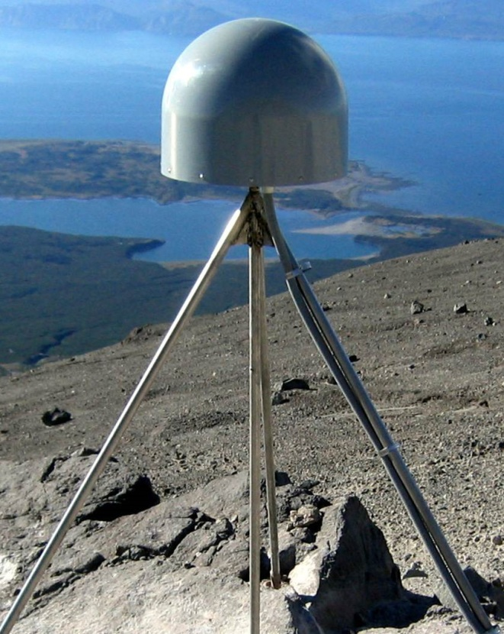
Instrumentation: GPS Receivers
GPS receivers detect and quantify small movements of the Earth’s crust. The movements can be used to infer the underlying geologic process.

Slide 17
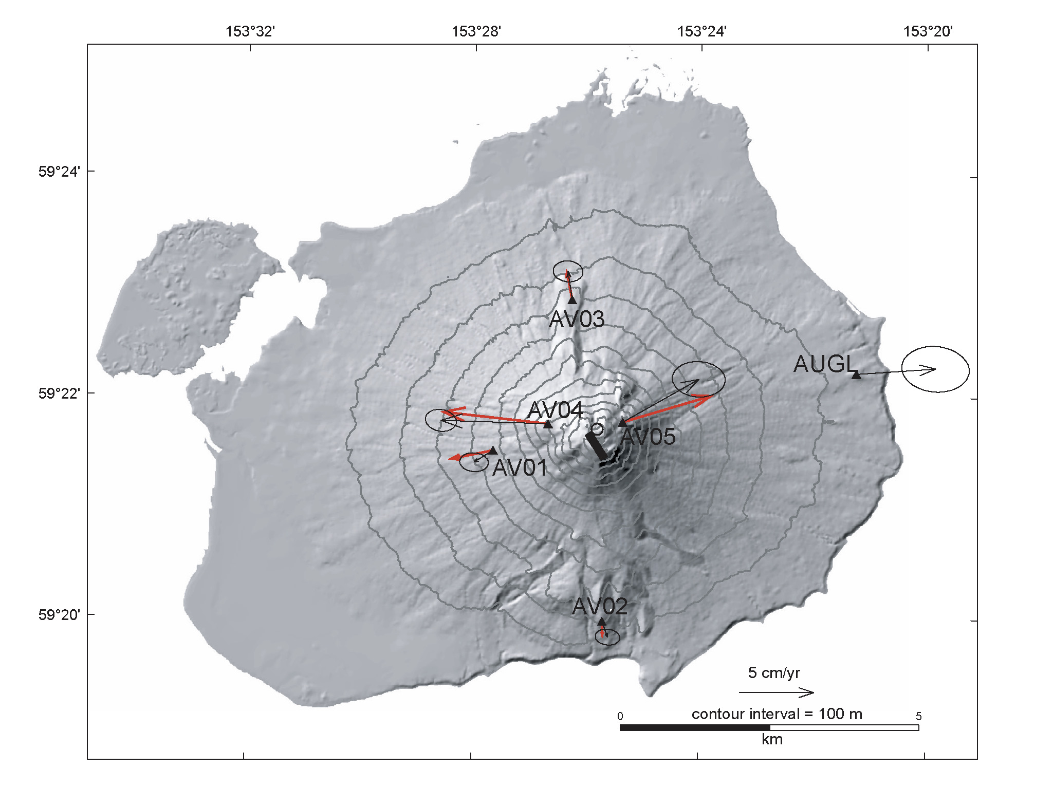
Pressurization at around sea level.
Velocities from 9/1 through 11/19, 2005.

Slide 18
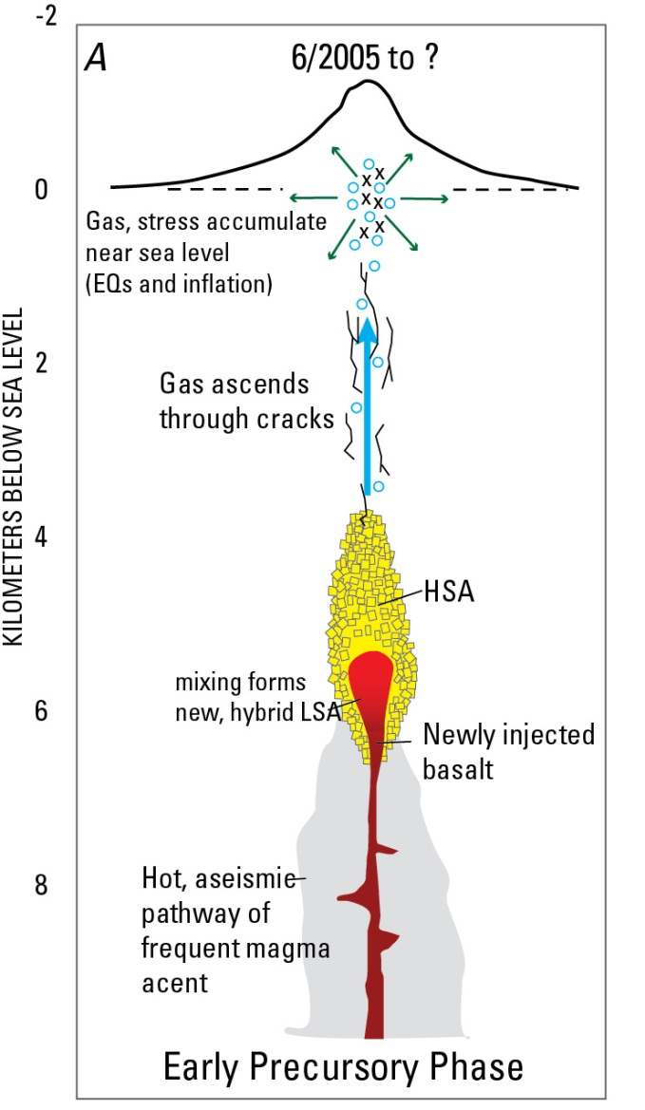
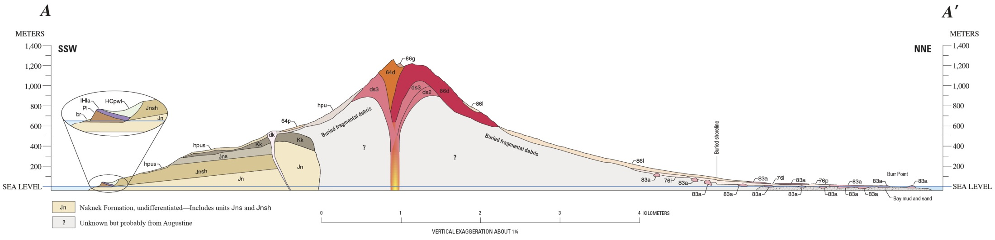
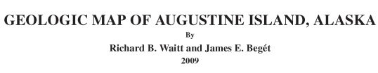
Interpretation of Precursory Pressurization
Inferred volume much too small to be the primary magma body.
Petrologic analysis suggests no significant magma storage at depth around sea level.
We suggest the pressurization arises from volatile accumulation beneath impermeable Naknek Formation.
Larsen et al., 2010

Slide 19
Big Change at Summit Stations in mid-November
Something happened here

Slide 20
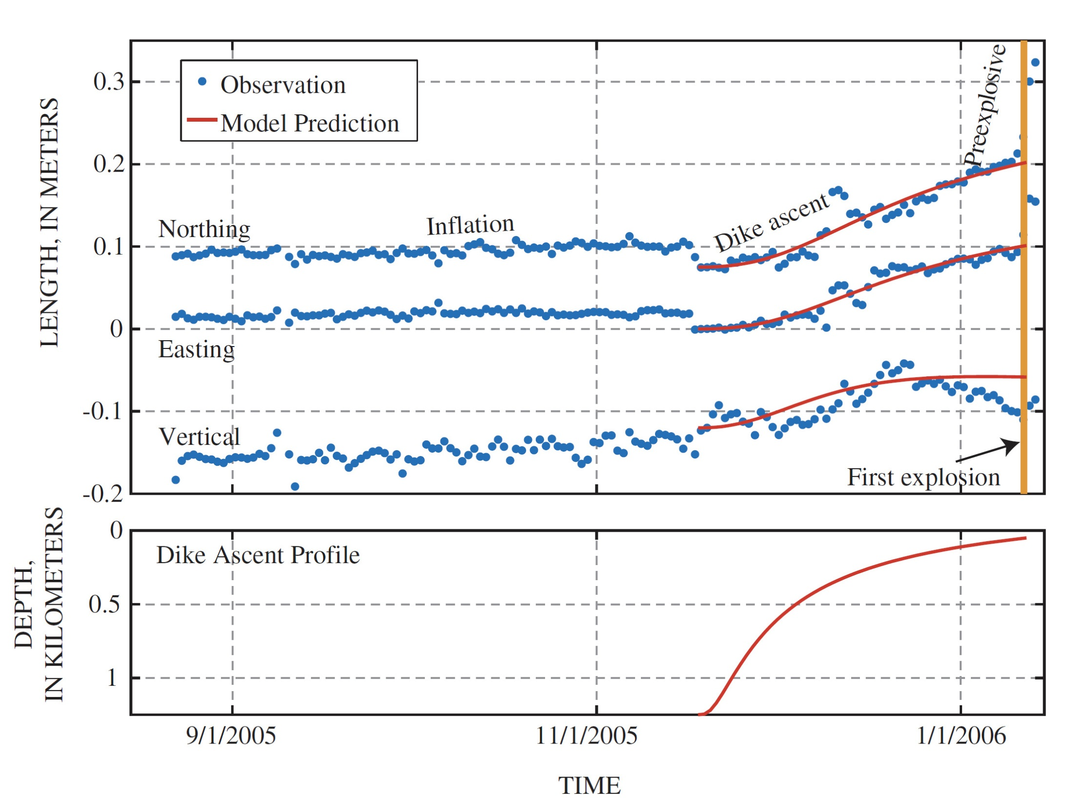

Slide 21
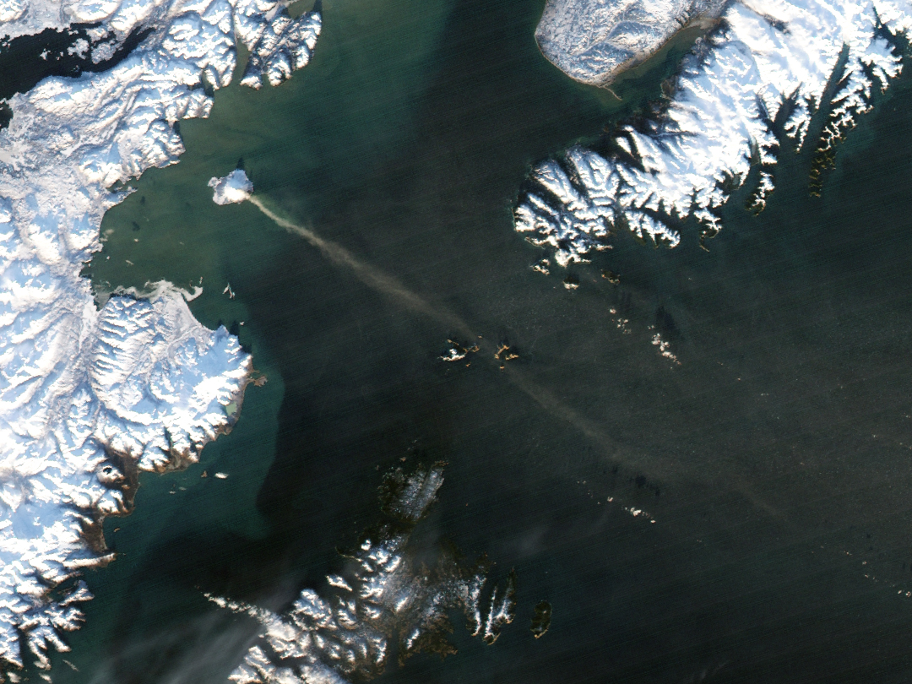
Implications of the Dike Interpretation
MODIS imagery from December 12, 2006
Model implies that dike came to within a few hundred meters of the surface by mid-December – explains heat, gas, and steam.

Slide 22
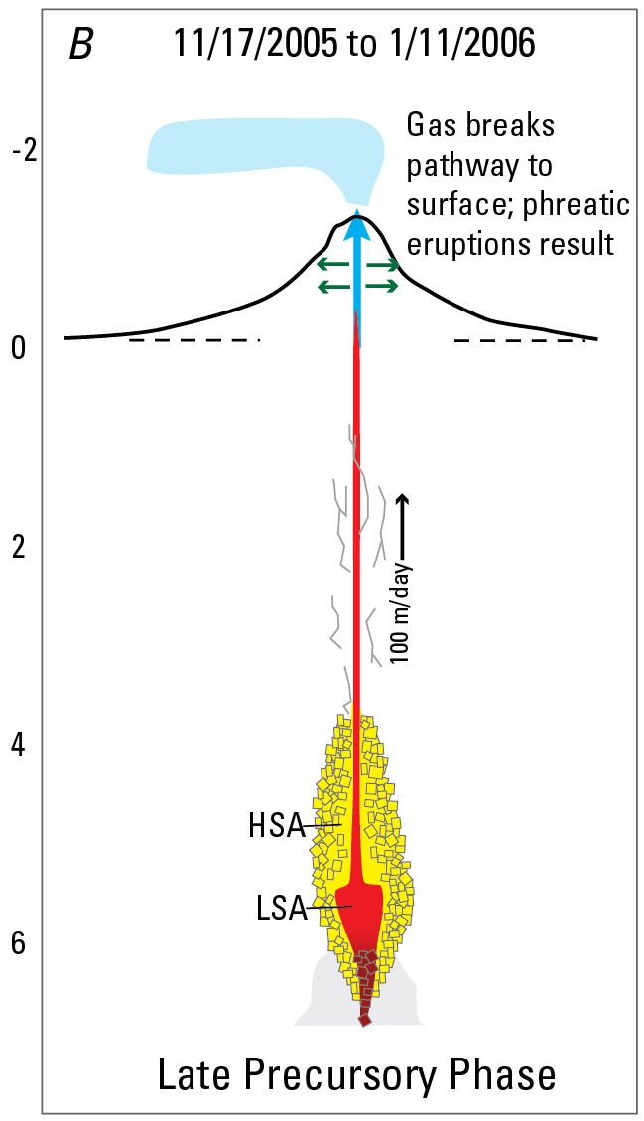
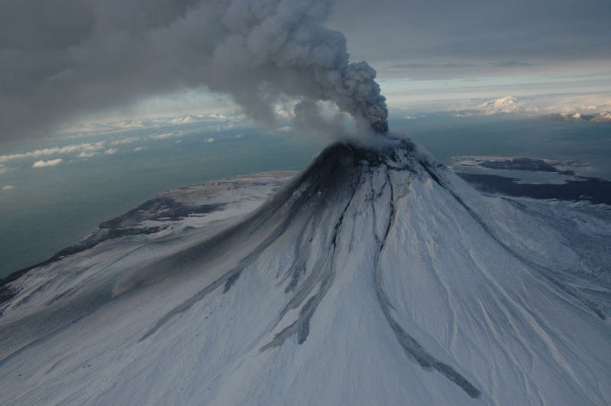
Implications of the Dike Interpretation
January 11, 2006 – the Eruption Begins
January 12, 2006
Brief explosions.
No juvenile material
Comparatively cool
Gas-rich
Larsen et al., 2010
So-called “throat clearing”.

Slide 23
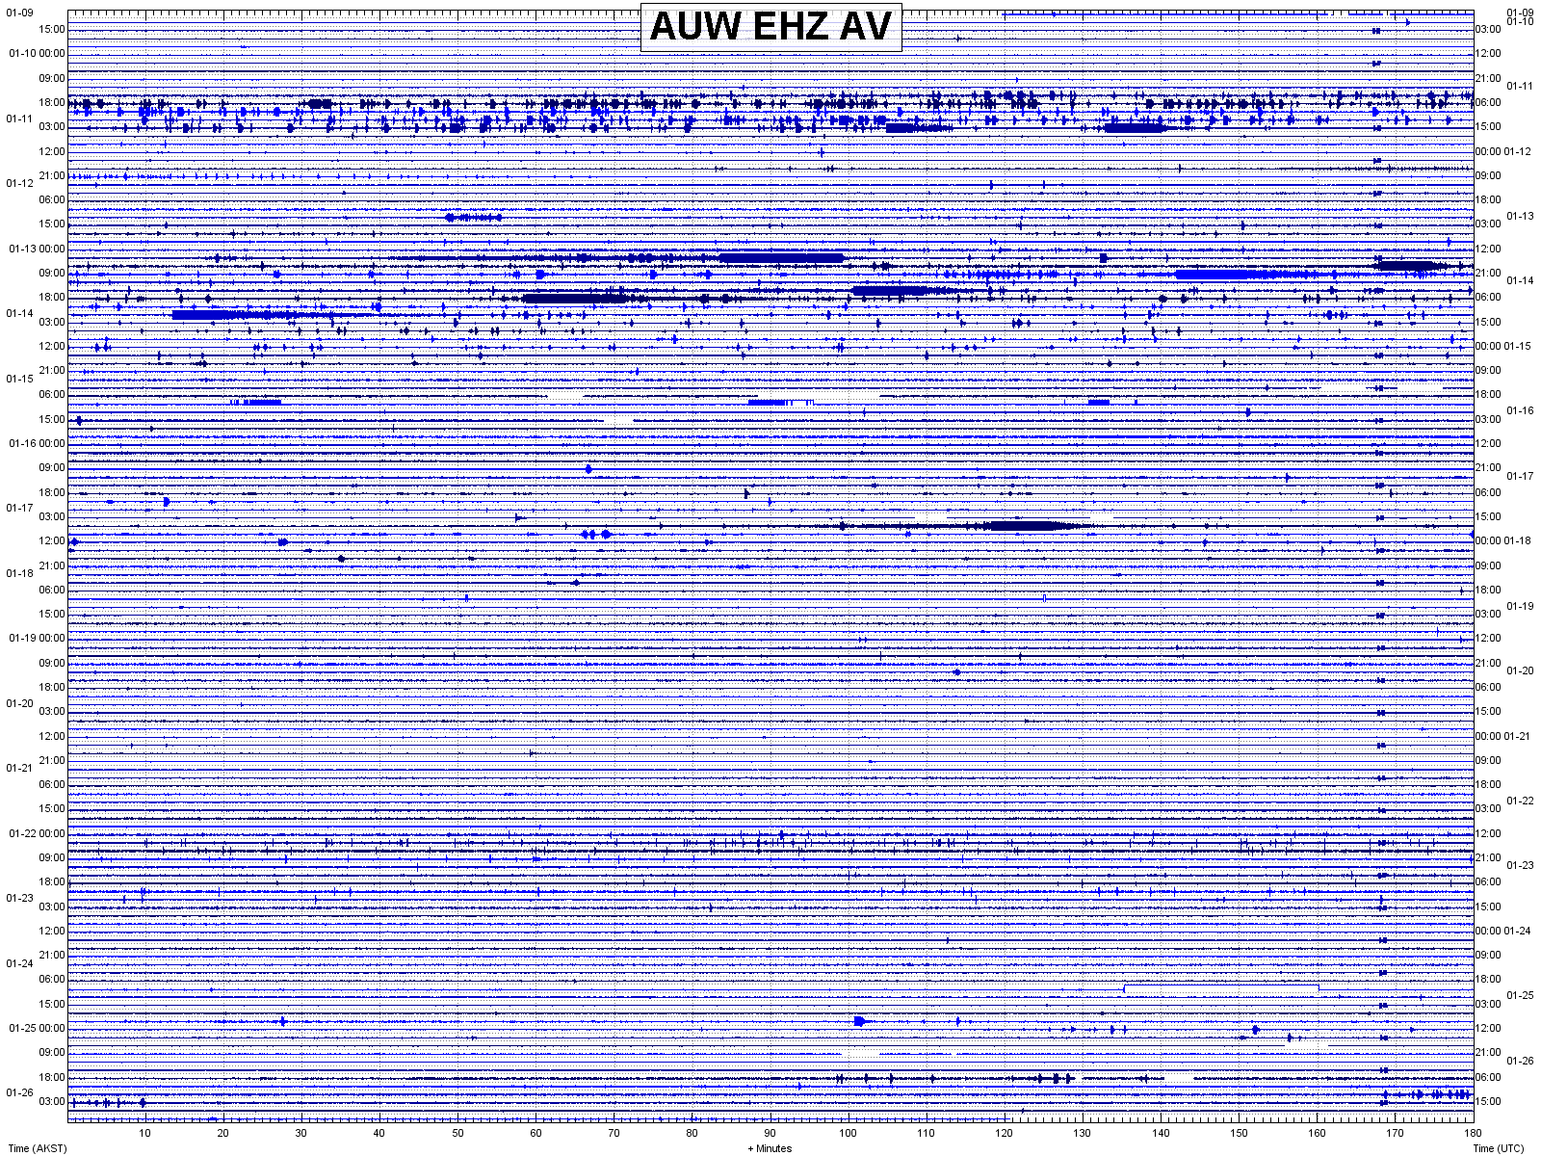
Phreatic Explosions
Juvenile Explosions
And then, 10 days of quiet…
Is it over?

Slide 24
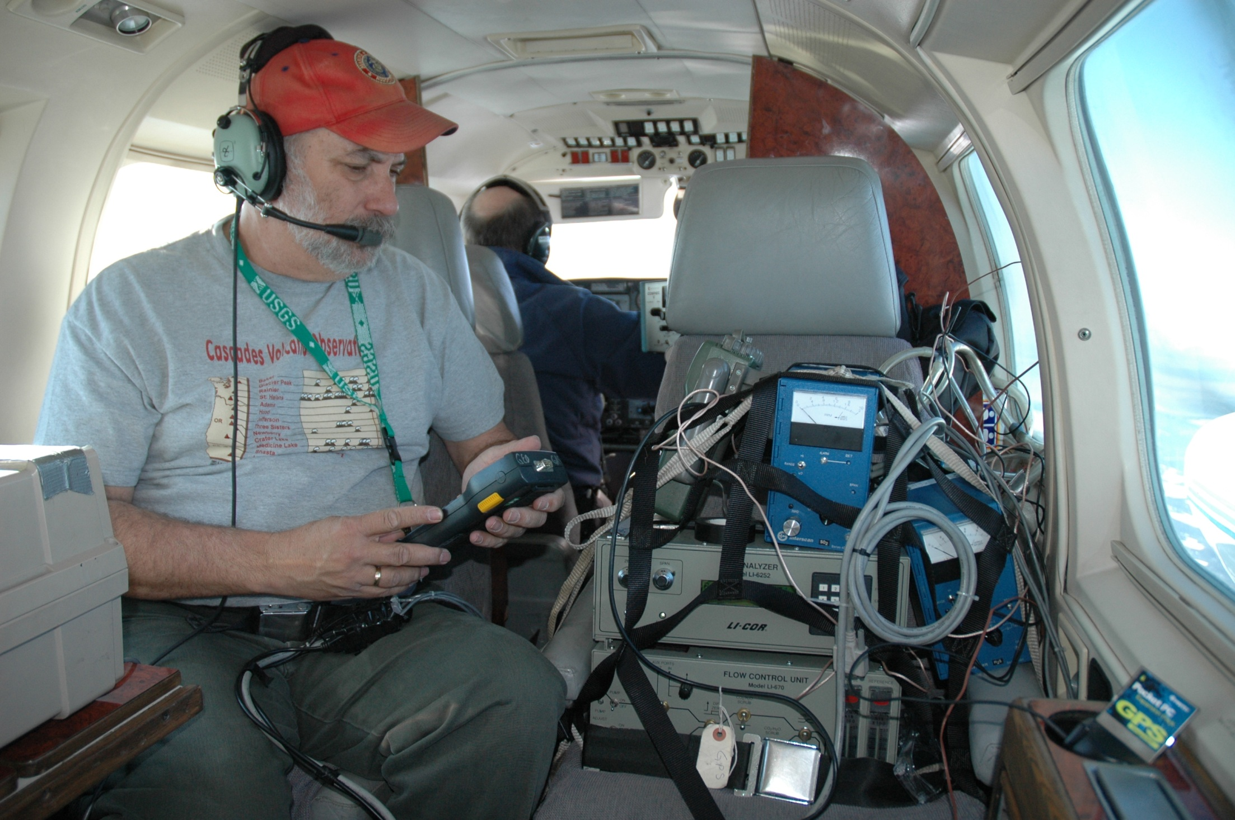
Airborne gas measurements show declining emissions

Slide 25
Credit: Evan Thoms
Instrumentation on Augustine Volcano in April, 2006

Slide 26
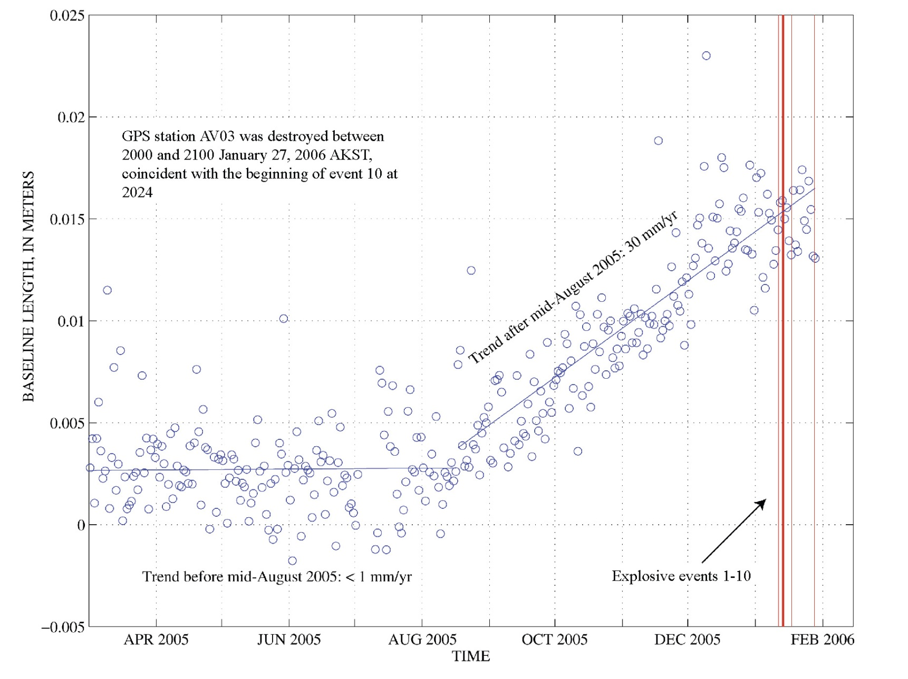
GPS Data Say: Pressurization Continues
The important observation was that the rate of extension had shown no sign of slowing or reversal, leading us to conclude that the eruption was not over.

Slide 27
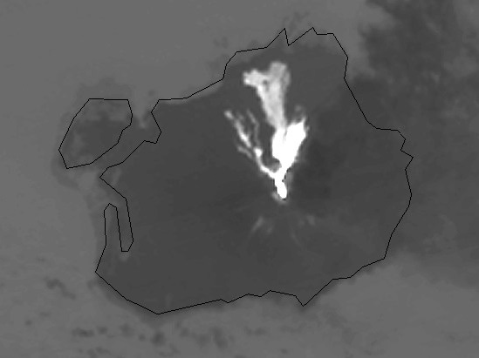
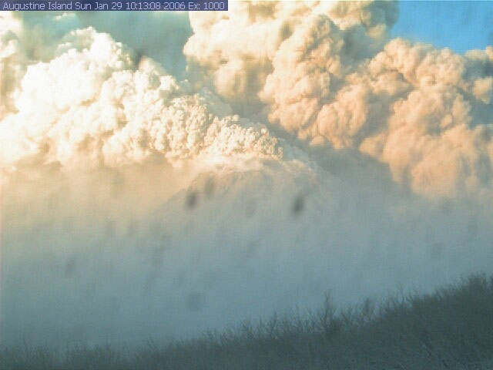
And the Eruption Continues
The Continuous Phase Begins
Continuous phase lasts from 1/27 through 2/10
Produced about 50% of the total erupted volume
Very strong geodetic signal
Mainly high-silica andesite
Night time ASTER thermal infrared data showing hot pyroclastic flow deposits, January 31, 2006, 22:50 Local Time
Webcam view of PF on 1/29

Slide 28
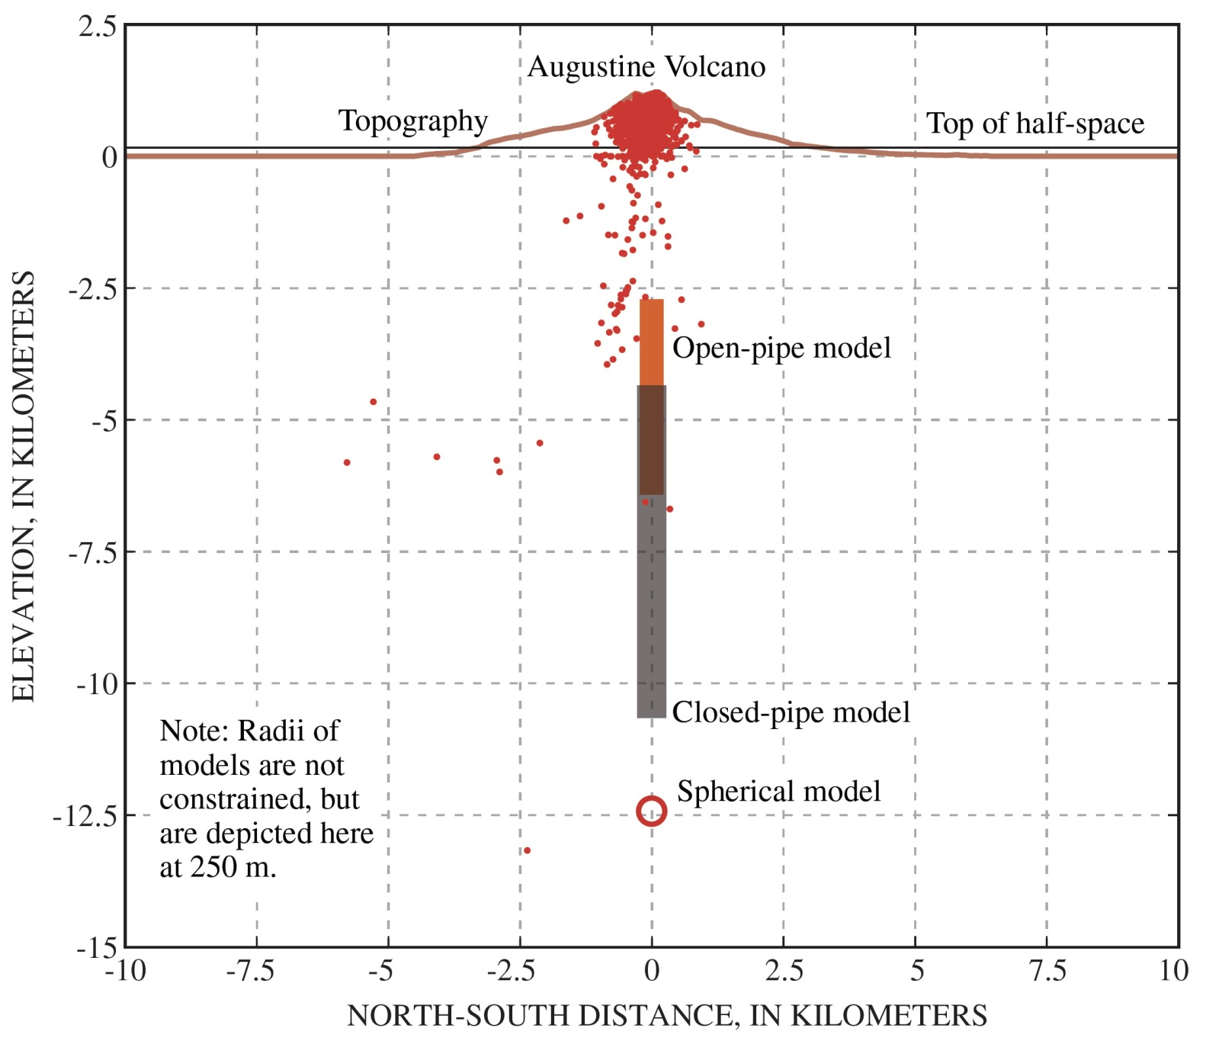
Comparing the Models in Cross-Section
Depth range inferred from melt inclusion analysis (Webster et al., 2010)

Slide 29
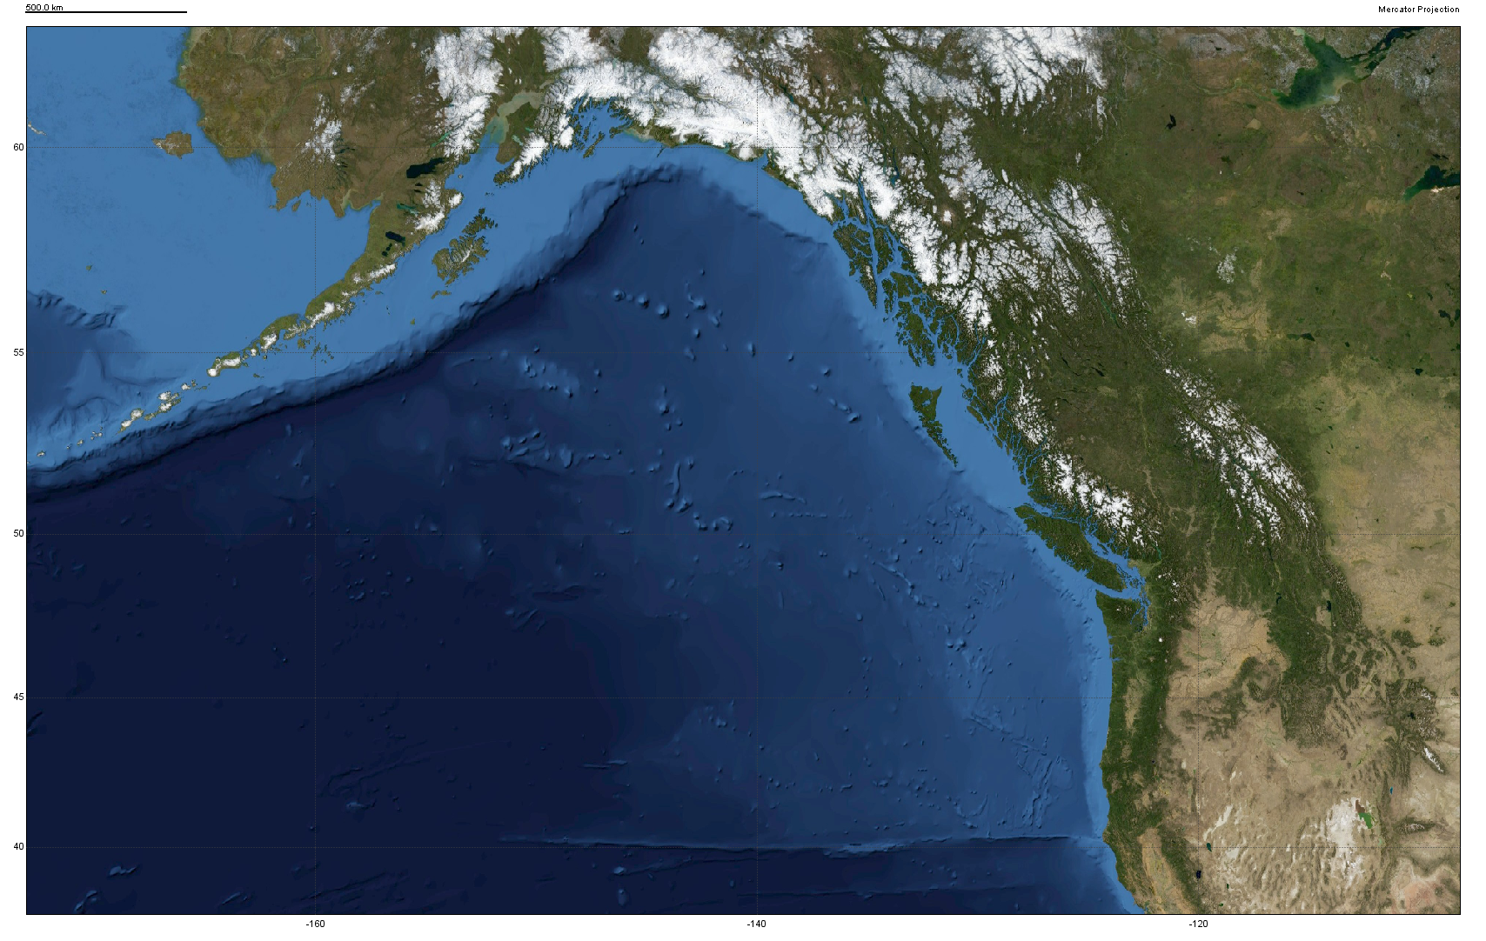
From Augustine to Yellowstone

Slide 30
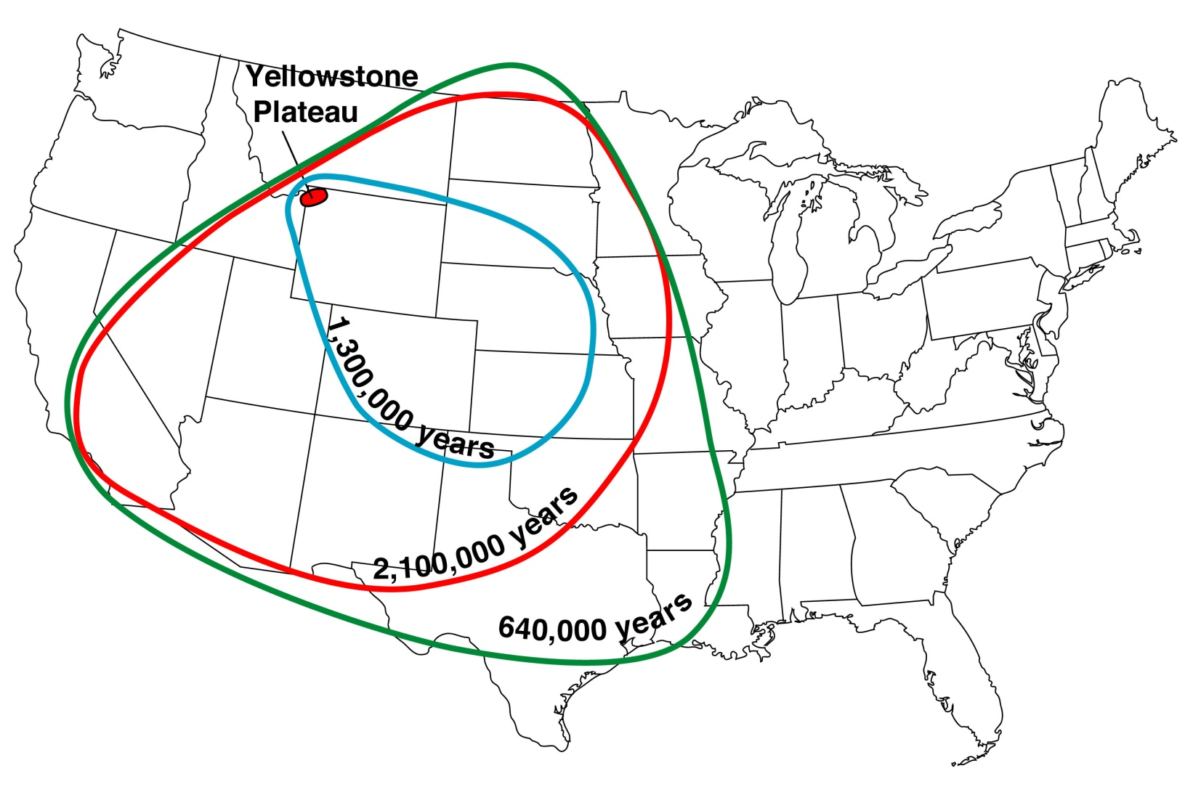
Hazards from Yellowstone
Caldera-forming Eruptions
Three events in the last 2.1 million years
Most recent 640,000 years ago.
Among the largest eruptions known to science.
Most Yellowstone eruptions are not caldera-forming!
280 km³
2500 km³
1000 km³
100,000 years
low
high
Frequency

Slide 31
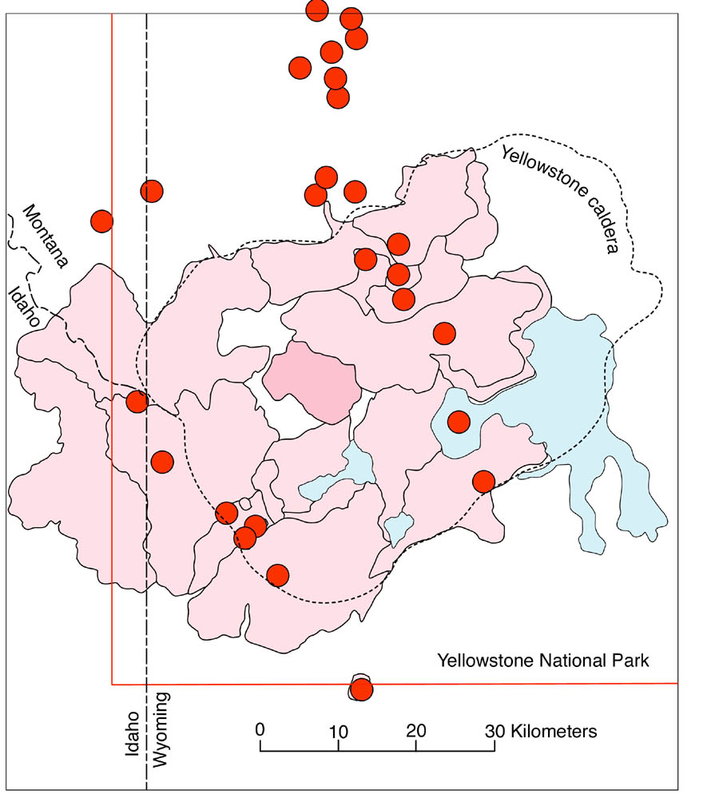
Hazards from Yellowstone
Large Lava Flows
About 30 eruptions in the last 640,000 years
Most recent was 70,000 years ago
Largest about 500 km² in area
Mostly rhyolite flows
10,000 years
low
high
Frequency

Slide 32
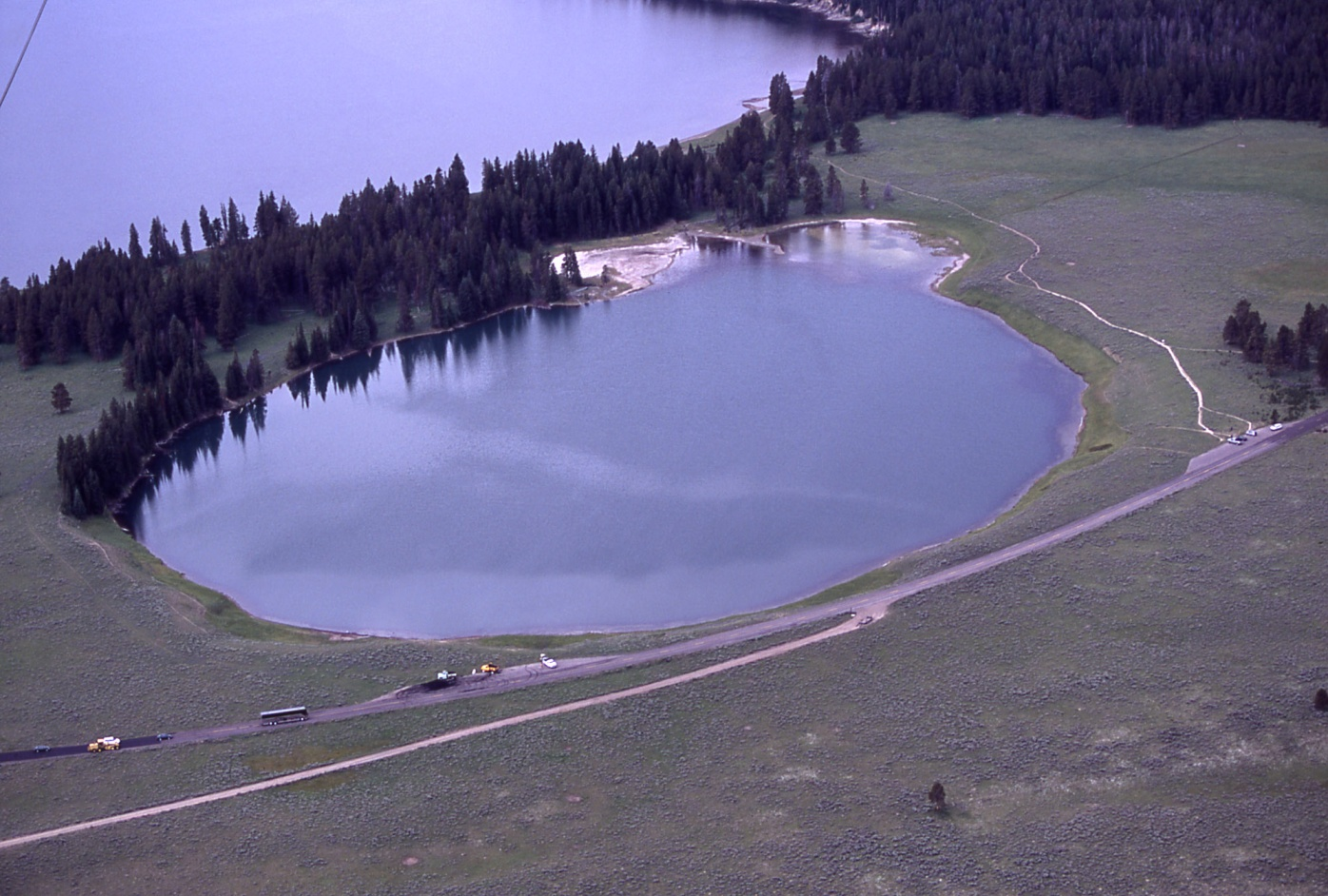
Hazards from Yellowstone
Large Hydrothermal Explosions
Between 5 – 10 in last 14,000 years
Mary Bay is about 3 km across.
The area around Yellowstone Lake is pock-marked with craters and susceptible to future explosions.
Indian Pond
1,000 years
low
high
Frequency

Slide 33
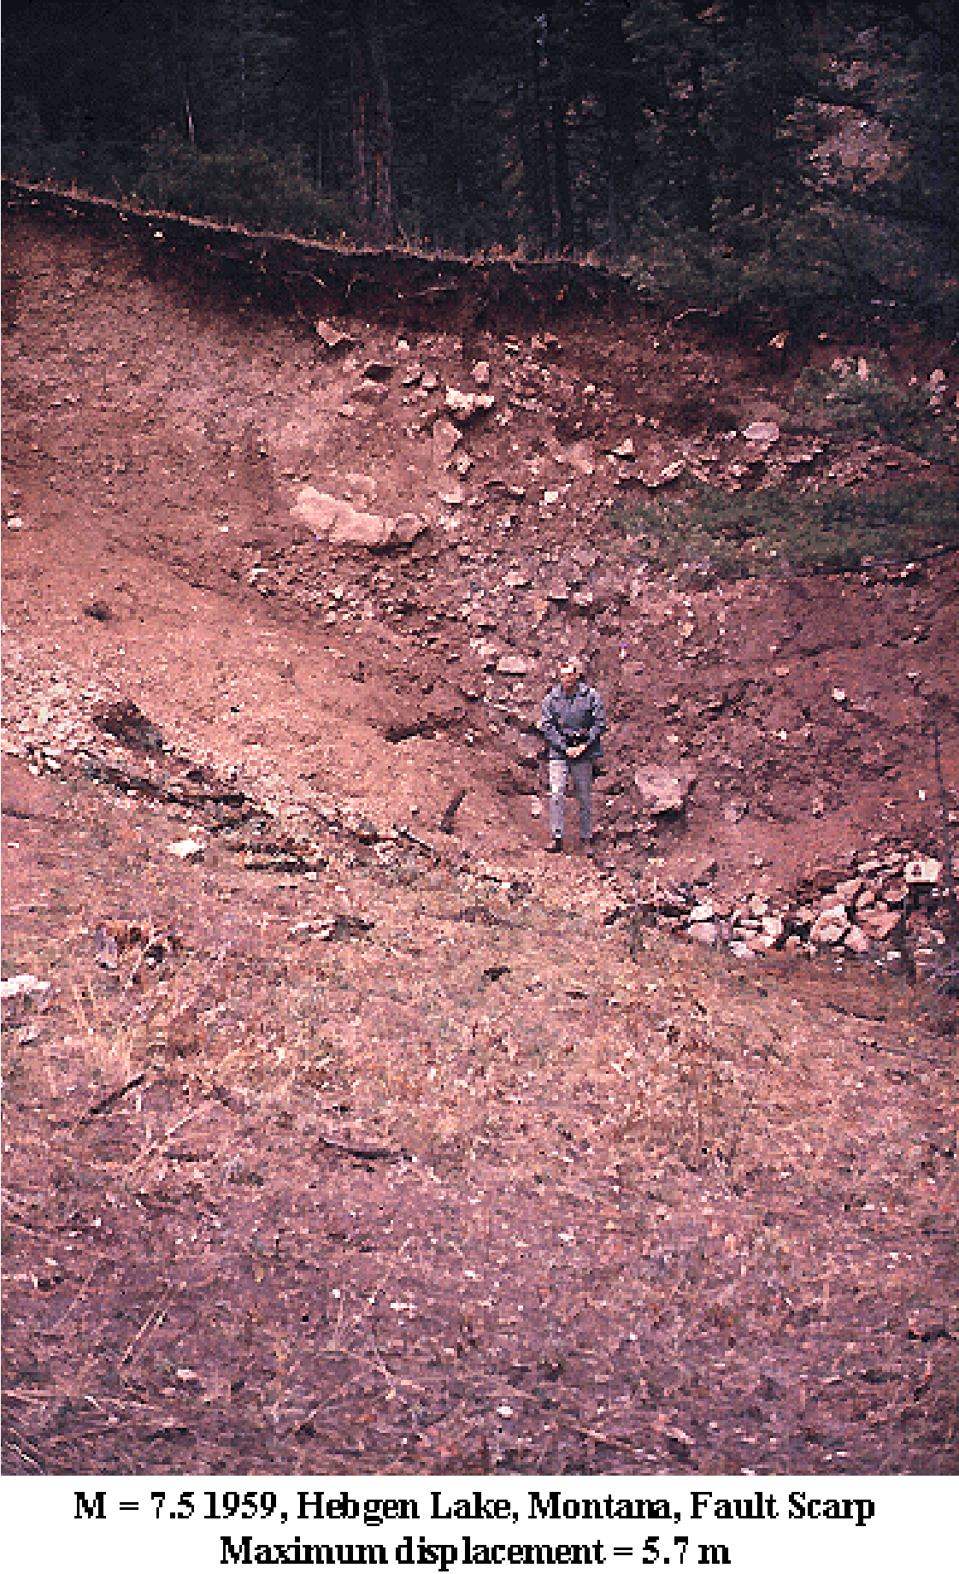
Hazards from Yellowstone
Large Earthquakes and Landslides
In 50 years, a M7.5 just outside the caldera, and an M6.5 inside.
Large, nearby earthquakes cause major changes to geothermal systems and can trigger hydrothermal explosions
Large, distant earthquake cause detectable changes to geothermal systems and trigger micro-earthquake swarms.
Fault offset is about 15 feet
∼100 years
photo by R. B. Smith, 1959
low
high
Frequency

Slide 34
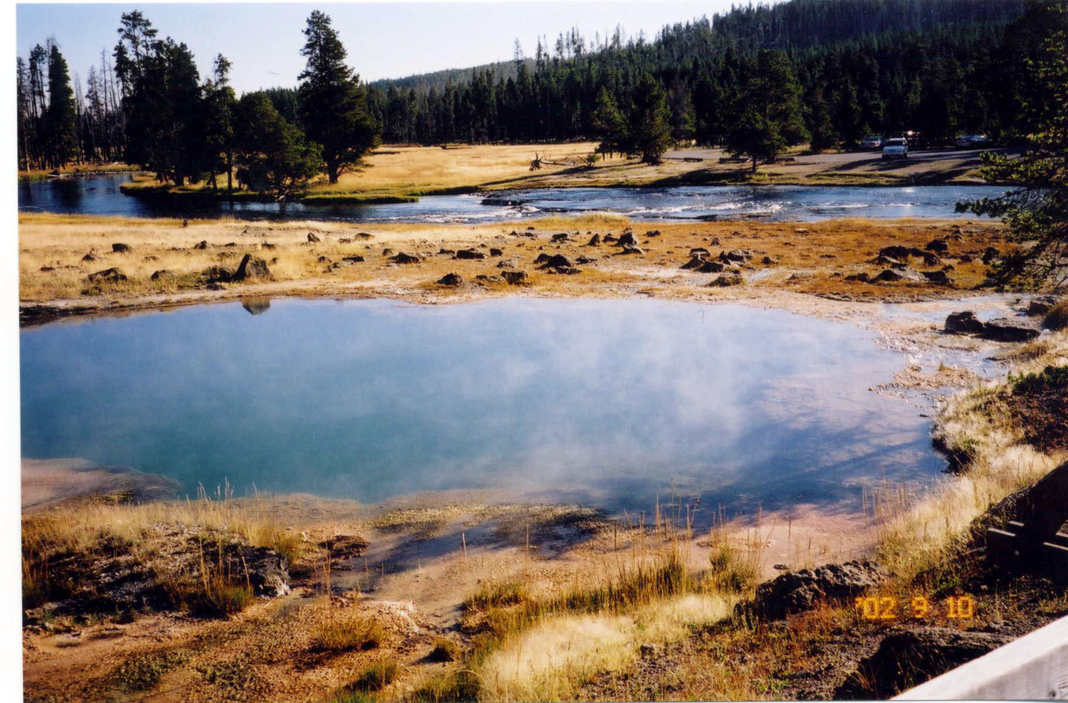
Hazards from Yellowstone
Small Hydrothermal Explosions
Every other year or so.
Potential for explosions in all geyser basins and geothermal areas.
Significant danger to visitors and may disrupt infrastructure (e.g., boardwalks).
Can be triggered by earthquakes.
Unpredictable and poorly understood.
Black Opal Pool, Upper Geyser Basin, Erupted 1932
1-10 years
low
high
Frequency

Slide 35
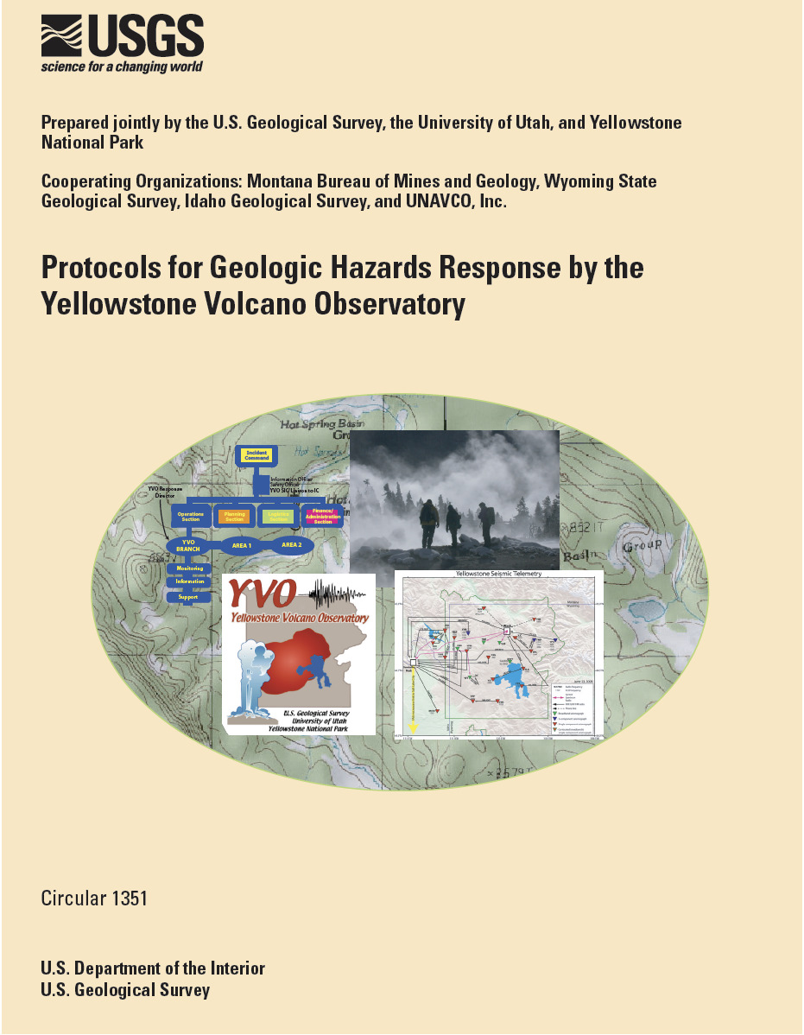
Preparing for the Worst
Drills and exercises reveal protocol weaknesses
Full-scale tabletop exercise in November 2011
Forthcoming USGS report on exercise results
Exercise scenario did not culminate in caldera-forming eruption

