Slide 1
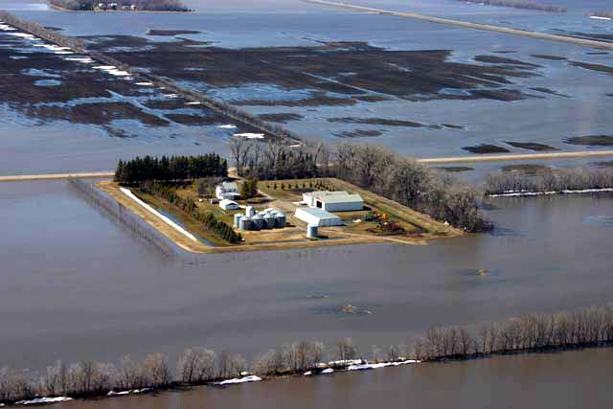
Climate change risk in an unknowable future
Ed Mathez
American Museum of Natural History
18 November 2011

Slide 2
1. Climate change as risk…
  case 1: common floods, protected property

Slide 3
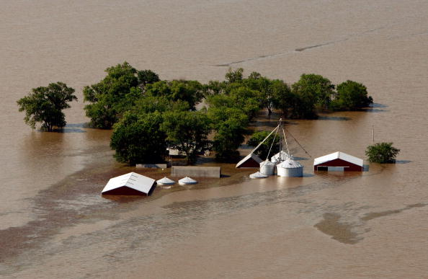
case 2: uncommon floods, no protection

Slide 4
case 2: uncommon floods, no protection
Risk determined by:
  (a) probability of an event occurring
  (b) and consequences if it does
  Risk = p_{e} x p_{d} x c
    p_{e} = probability of an event
    p_{d} = probability of damage
    c = consequence (cost in $, lives, etc.)

Slide 5
The nature of climate risk
Why future climate is unknowable
Why risks differ depending on nature of impact
Why risks depend on extremes
Why risks depend on natural climate variability
Positive feedbacks result in an inherent uncertainty in how the climate system responds to forcings
Could there be climate mega-events that pose risks similar to earthquake mega-events?

Slide 6
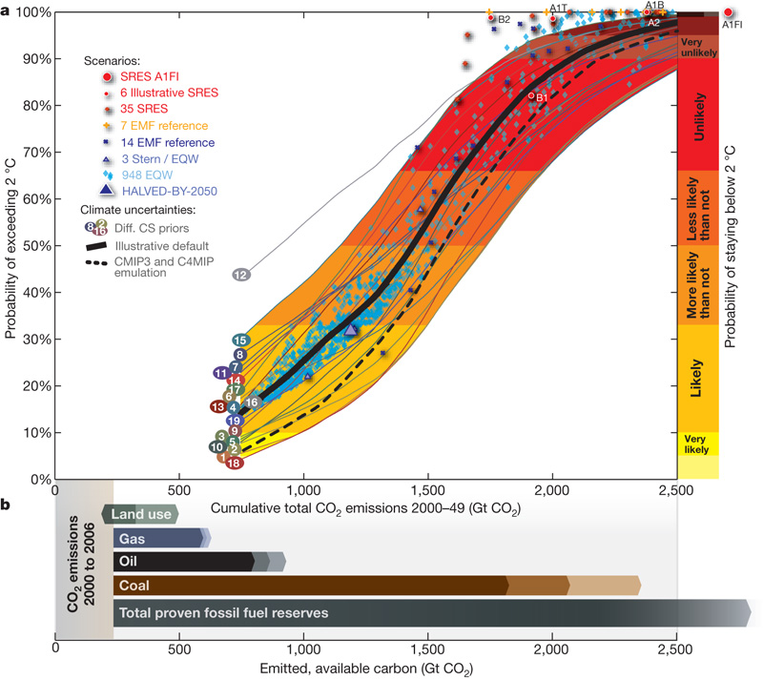
100%
1. Why future climate is unknowable
probability of exceeding 2°C
> preindustrial by 2100
50%
“illustrative default”
0%
uncertainty of climate sensitivity to CO₂ rise
0 500 1000 1500 2000 2500
Cumulative CO₂ emissions, 2000-2049, Gt CO₂
Meinshausen et al., 2009; Allen et al., 2009

Slide 7
100%
1000 Gt CO₂
probability of exceeding 2°C
> preindustrial by 2100
50%
42%
“illustrative default”
25%
10%
0%
uncertainty of climate sensitivity to CO₂ rise
0 500 1000 1500 2000 2500
Cumulative CO₂ emissions, 2000-2049, Gt CO₂

Slide 8
100%
88%
constant 2008 emissions
probability of exceeding 2°C
> preindustrial by 2100
global 80% cut from 2010
50%
42%
emission growth at 2% per yr
34%
20%
0%
developed countries 80% cut, developing 1% growth
0 500 1000 1500 2000 2500
Cumulative CO₂ emissions, 2000-2049, Gt CO₂

Slide 9
100%
88%
probability of exceeding 2°C
> preindustrial by 2100
global 80% cut from 2010
50%
emission growth at 2% per yr
20%
0%
uncertainty of climate sensitivity to CO₂ rise
(science)
uncertainty in emissions
(socioeconomic, technologic, political development)
0 500 1000 1500 2000 2500
Cumulative CO₂ emissions, 2000-2049, Gt CO₂

Slide 10
2. Why risks are different for different classes of impacts
According to the UN’s Framework Convention on Climate Change, avoiding “dangerous anthropogenic interference” means
  allowing “ecosystems to adapt naturally to climate change,”
  ensuring that “food production is not threatened,’
  and enabling “economic development to proceed in a sustainable manner.”
To help identify “dangerous anthropogenic interference,” the IPCC (2001)
  defined “reasons for concern”
  grouped them into categories reflecting different levels of risk

Slide 11
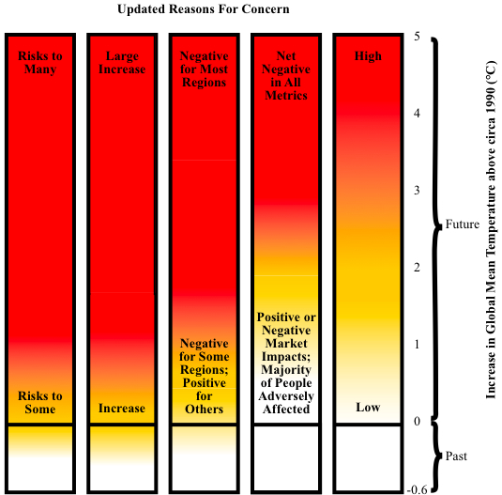
temperature, risk
Increased damage to unique and threatened systems
Single climate phenomenon with a major, world-wide impact
Number of extreme weather events with substantial consequences
Number of impact metrics that are negative
Proportion of world population (or region) experiencing negative impact
Smith et al., 2009

Slide 12
Different risks and different timeframes…
Possible consequences…
loss of biodiversity more likely mild this decade
loss of sensitive ecosystems
severe storms/floods
severe heat waves
severe droughts
large increase in human diseases
significantly reduced water supplies
damaging sea level rise
widespread famine less likely catastrophic several decades

Slide 13
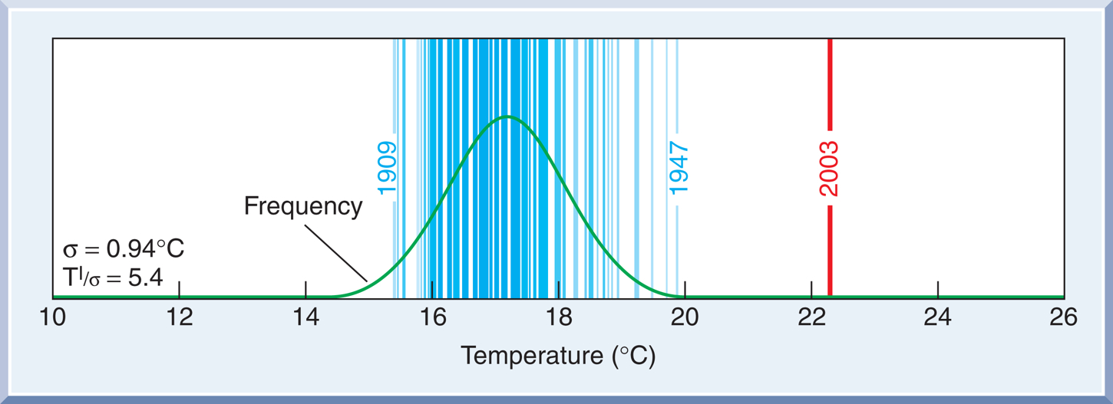
3. How risks are governed by extremes
The western European summer heat wave of 2003
The extreme summer temperature in 2003 compared with summer temperatures from 1864 to 2002, Switzerland
Mathez, 2009, after Schar et al., 2004

Slide 14
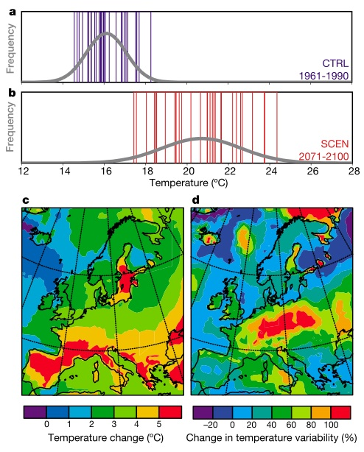
1864-2002 observed (CH)
1961-1990 JJA model simulation
2003
2071-2100 JJA model simulation (A2 scenario)
(c) SCEN - CTRL
and
(d) relative change in std deviation
Schär et al., 2004

Slide 15
1864-2002 observed (CH)
1961-1990 JJA model simulation
2003
While we usually talk about mitigation efforts in terms of average conditions, we must remember that
2071-2100 JJA model simulation (A2 scenario)
it is the extreme rather than average condition that determines the risk
tomorrow’s extreme (and thus risk) could be much larger than today’s
(c) SCEN - CTRL
and
(d) relative change in std deviation
Schär et al., 2004

Slide 16
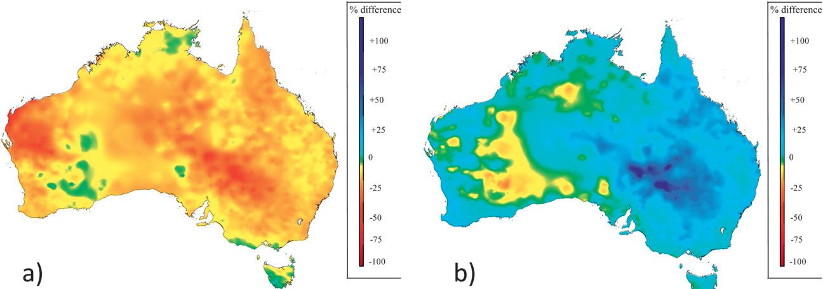
4. How risks depend on natural climate variability
El Niño spring-summer
La Niña spring-summer
Percent change in rainfall relative to 1900-2008 mean
Verdon-Kidd and Kiem, 2010

Slide 17
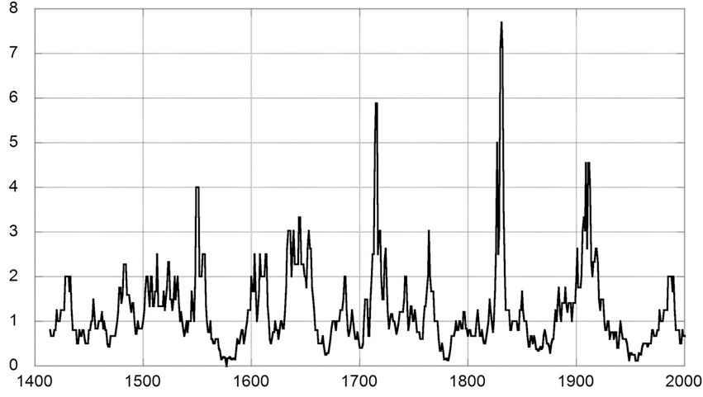
Multi-decadal variations in ratio of El Niño to La Niña years
(from tree-ring chronologies from American SW of D’Arrigo et al., 2005)
Ratio of El Niño to La Niña (in 15-year window)
Fifteen-year running window of relative El Niño to La Niña frequency
Verdon-Kidd and Kiem, 2010

Slide 18
5. The inherent uncertainty due to positive feedbacks
1. Consider an expression for the sensitivity of climate to changes in radiative flux,
ΔT = λ ΔR_{f}.
where
ΔT = equilibrium change in global mean surface air T (i.e., climate
sensitivity)
ΔR_{f} = increment change in downward radiative flux
λ = constant
When there are no feedbacks, λ = λ₀ and ΔT = ΔT₀, and
ΔT₀ = λ₀ ΔR_{f}. (1)
Roe and Baker, 2007

Slide 19
2. However, the system contains feedbacks, and those feedbacks are in total strongly positive, so ΔT/ΔT₀ > 1.
Assume that the change in forcing as a result of the feedbacks is C x ΔT (C= constant), i.e., CΔT is the added forcing due to the feedbacks. Then
ΔT = λ₀ (ΔR_{f} + CΔT) (2)
Substituting (1), ΔT₀ = λ₀ ΔR_{f}, into (2) allows us to express ΔT in terms of ΔT₀:
ΔT = ΔT₀ + λ₀(CΔT). (3)
Roe and Baker, 2007

Slide 20
3. Define a total feedback factor, f, with a magnitude
f = λ₀ C. (4)
Substituting (4) into (3), ΔT = ΔT₀ + λ₀(CΔT), and rearranging yields
ΔT = ΔT₀ / (1 – f) (5)
This expression relates ΔT and f . When f > 0 (positive feedback), ΔT/ΔT₀ > 1.
Roe and Baker, 2007

Slide 21
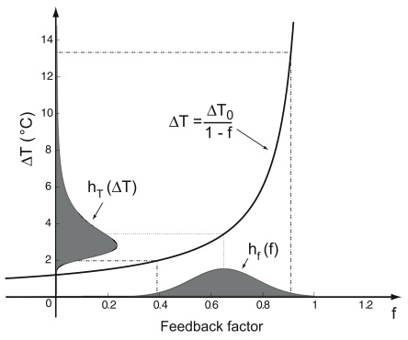
4.
h_{T}(ΔT) = probability distribution that climate sensitivity is ΔT
h_{f}(f) = probability distribution of f, e.g., a normal distribution
Roe and Baker, 2007

Slide 22
4.
h_{T}(ΔT) = probability distribution that climate sensitivity is ΔT
1. “Uncertainty is inherent in the system where net feedbacks are substantially positive.”
2. We can expect only limited improvement in our ability to reduce uncertainty in climate sensitivity.
h_{f}(f) = probability distribution of f, e.g., a normal distribution
Roe and Baker, 2007

Slide 23
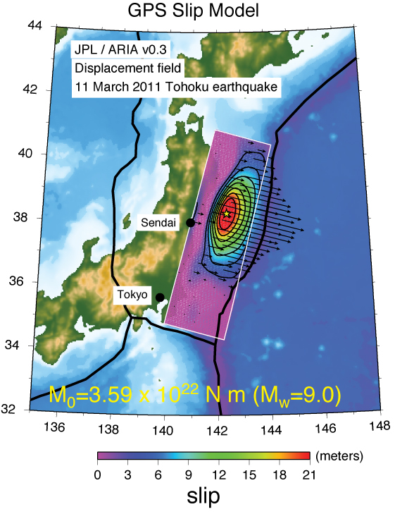
6. Mega-climate and mega- earthquakes events
Tōhoku (Honshu) earthquake
http://earthquake.usgs.gov/earthquakes/eqinthenews/2011/usc0001xgp/031111_M9.0prelim_geodetic_slip.php

Slide 24
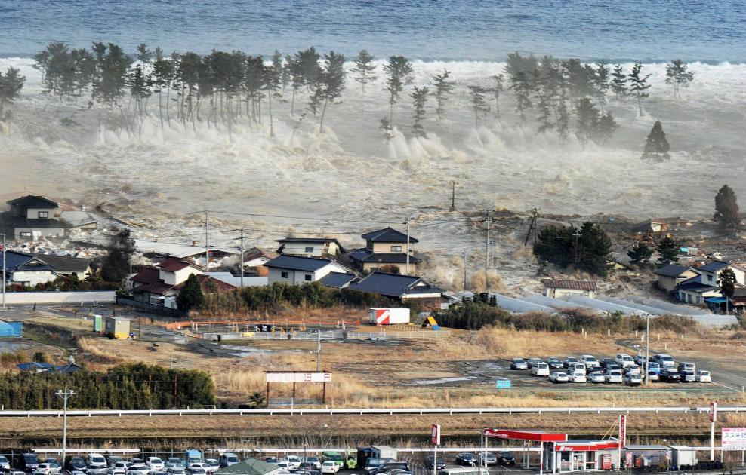
cascading consequences from a mega-earthquake

Slide 25
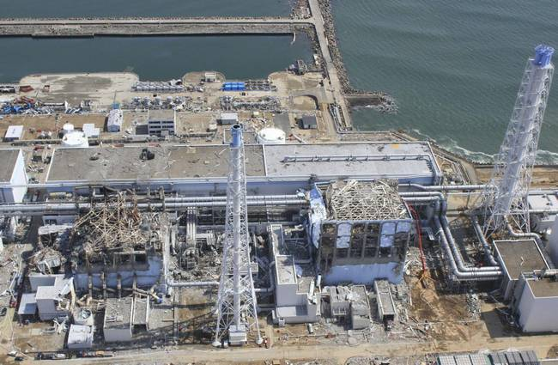
cascading consequences from a mega-earthquake

Slide 26
cascading consequences from a mega-earthquake

Slide 27
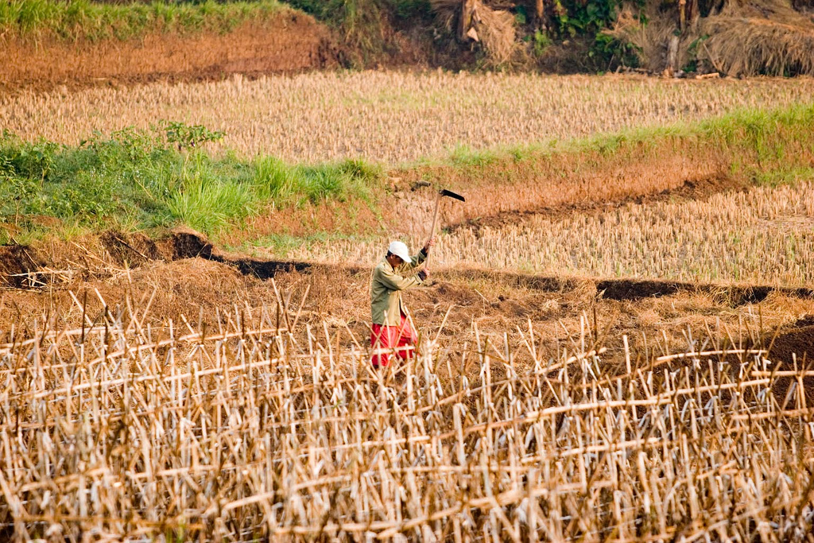
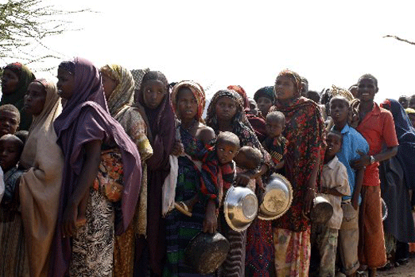
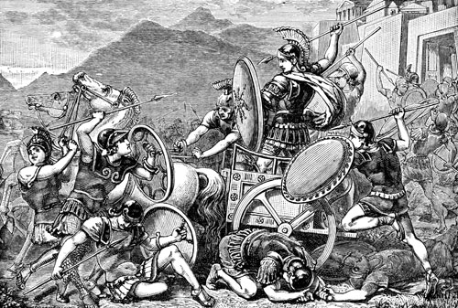
cascading consequences from a mega-drought?
Indonesia, 2009 (D. Mahendra, Flickr)
Mogadishu, 2011

Slide 28
To summarize…
Climate change should be popularly understood as an issue of risk, not an issue of science.
The major uncertainty in future climate is growth of emissions, which is impossible to predict because it depends on socioeconomic, technologic and political developments.
The risks associated with different impacts are different, e.g., destruction of sensitive ecosystems (high probability, limited consequence) vs world famine (low probability, severe consequence).
Risks depend on the extreme events and natural climate variability.
The probability distribution of climate sensitivity to GHG buildup displays a long tail on the high-T and a short tail on the low-T side. The distribution is inherent to systems with positive feedbacks, implying limited ability to reduce climate sensitivity uncertainty.
Climate risk displays some similarities to earthquake risk. In particular, mega-events may lead to cascades of consequences that are difficult (perhaps impossible) to predict.

Slide 29
What to show your parents…
http://www.youtube.com/watch?v=mF_anaVcCXg

Slide 30
Some references
Allen, M.R., et al., 2009, Warming caused by cumulative carbon emissions towards the trillionth tonne. Nature 458, 1163-1166.
Meinhausen, M., et al., 2009, Greenhouse-gas emission targets for limiting global warming to 2°C. Nature 458, 1158-1163.
Roe, G.H., and M.B. Baker, 2007, Why is climate sensitivity so unpredictable? Science 318, 629-632.
Schär, C., et al., 2004, The role of increasing temperature variability in European summer heatwaves. Nature 427, 332-336.
Smith et al., 2009, Assessing dangerous climate change through an update of the Intergovernmental Panel on Climate Change (IPCC) “reasons for concern”. PNAS 106 4133-4137.
Verdon-Kidd, D.C., and A. Kiem, 2010, Quantifying drought risk in a nonstationary climate. J. Hydrometeorology 11, 1019-1031.

