Slide 1

Global Atmospheric Circulation Patterns – Analyzing TRMM Data
Eugenio Arima
Environmental Studies Program

Slide 2
Audience
First/Second year undergraduate students
Global Climate Change Class
  Some “scared of” science
Environmental Studies majors/minors
  Many geoscience majors and a handful of humanities majors
Could be used in Intro to Climatology class
Disclaimer: I am NOT a climatologist, Geographer!

Slide 3
Goals
After completing the exercise, students should:
  Understand the most important global atmospheric circulation patterns and drivers
    Trade winds, regions of high/low pressure, Hadley cell, monsoonal circulation, orographic lifting, El Niño phenomena.
  Course textbook: Ruddiman’s Earth’s Climate Past and Future
    Chapter 2: Earth’s Climate System Today

Slide 4
GIS Lab using TRMM data
TRMM – Tropical Rainfall Measuring Mission
  Several Instruments on board satellite: Radars & Sensors
  Between 50 degrees North - South
1998 – today
  Daily product
  Monthly product 3B43
Lots of pre-processing prior to Lab:
  HDF to TIFF format
  Precipitation rate → Total
  Monthly → Annual

Slide 5
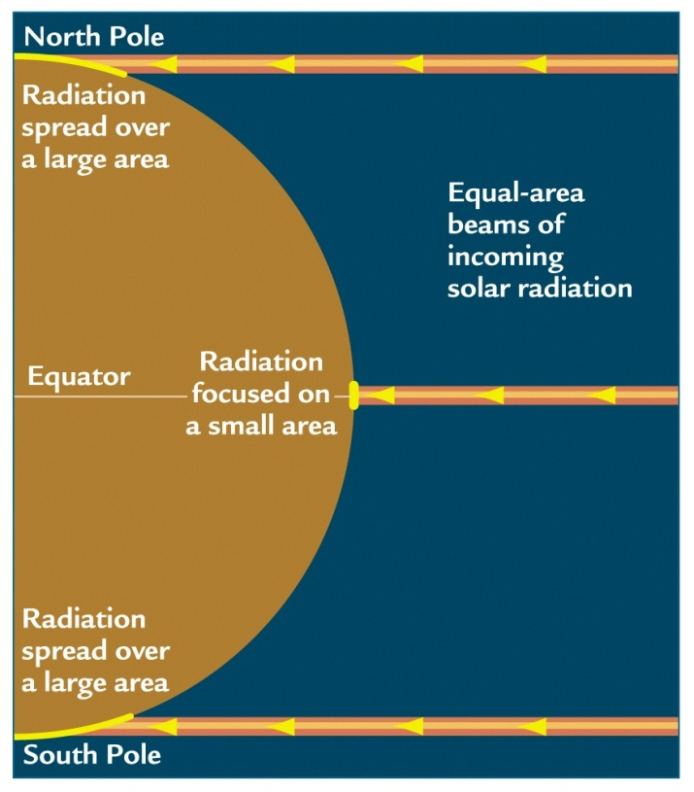
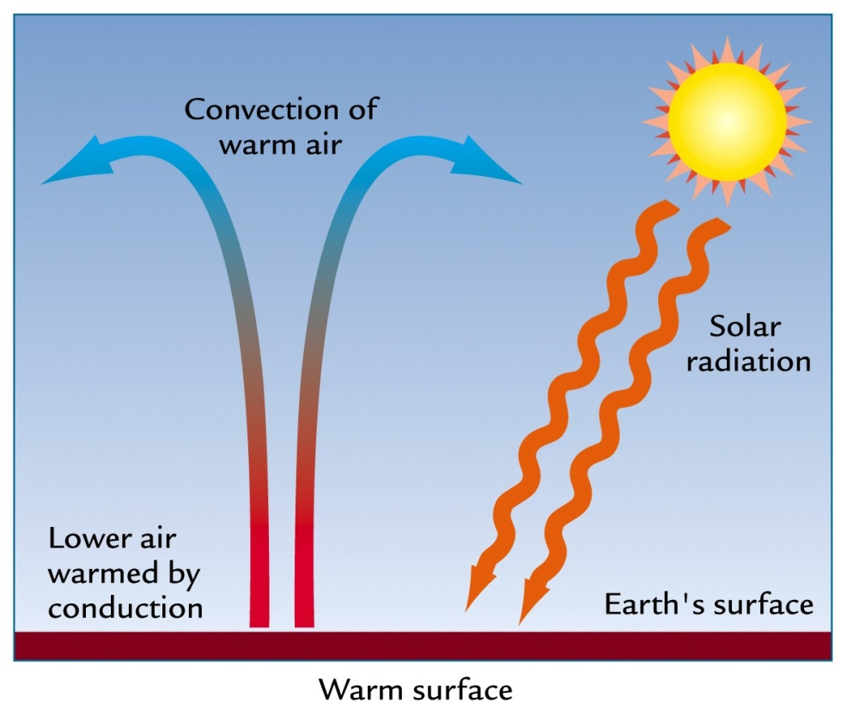
Important Concepts
Solar radiation: heat imbalances
Atmospheric circulation redistribute energy/heat
Source: Ruddiman (2001)

Slide 6
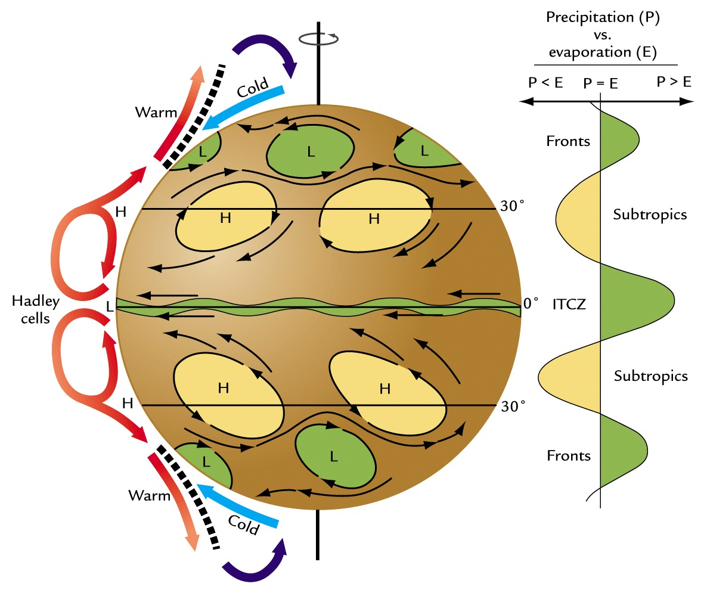
Important Concepts
Hadley Cell, ITCZ, High/Low pressure
Source: Ruddiman (2001)

Slide 7
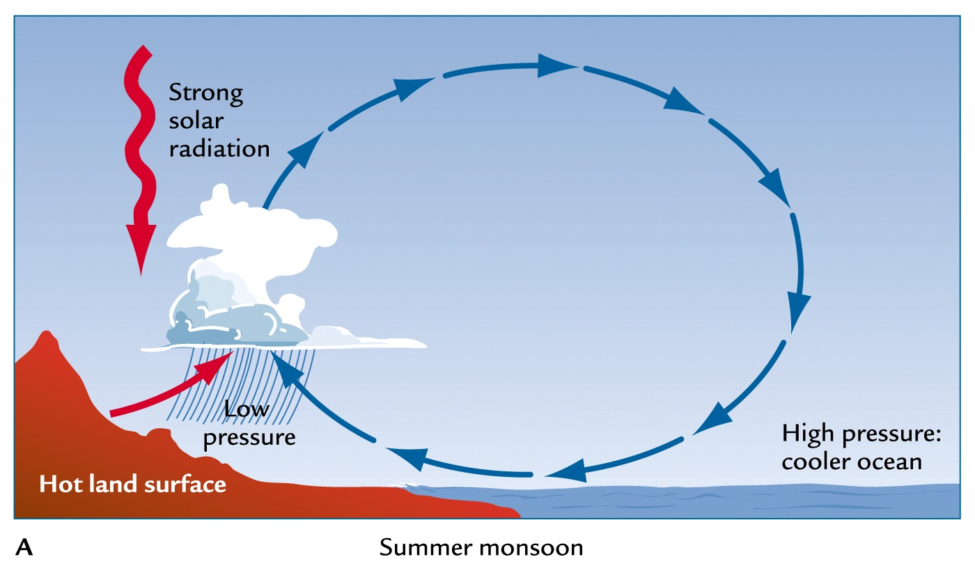
Important Concepts
Monsoonal Circulation
Source: Ruddiman (2001)

Slide 8
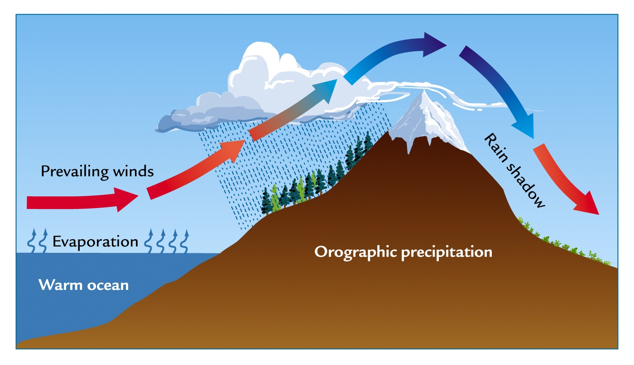
Important Concepts
Orographic precipitation
Source: Ruddiman (2001)

Slide 9
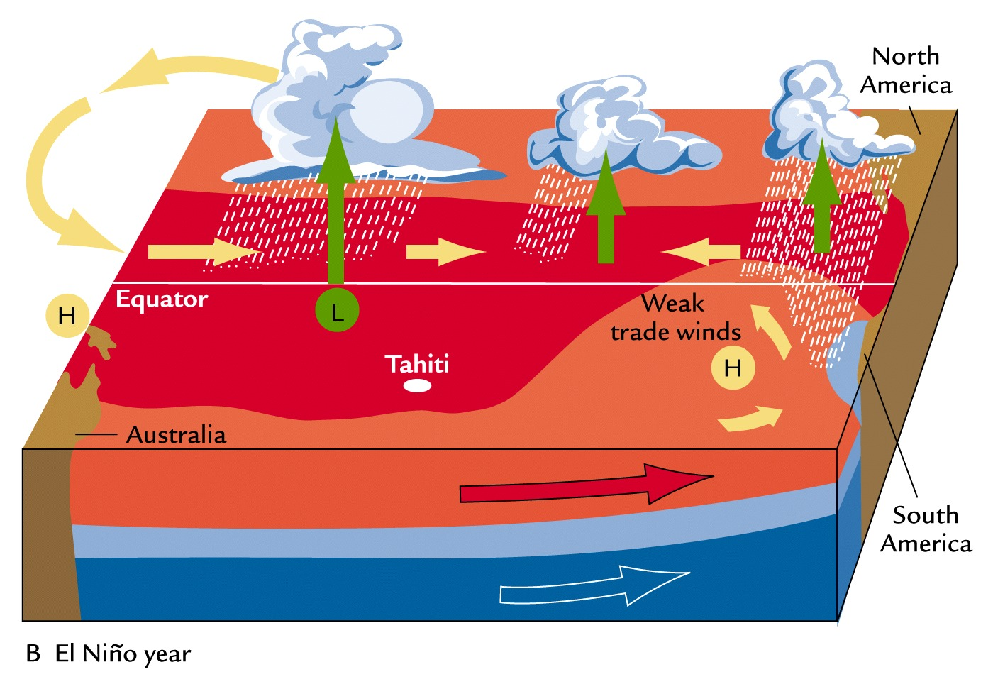
Important Concepts
El Niño
Source: Ruddiman (2001)

Slide 10
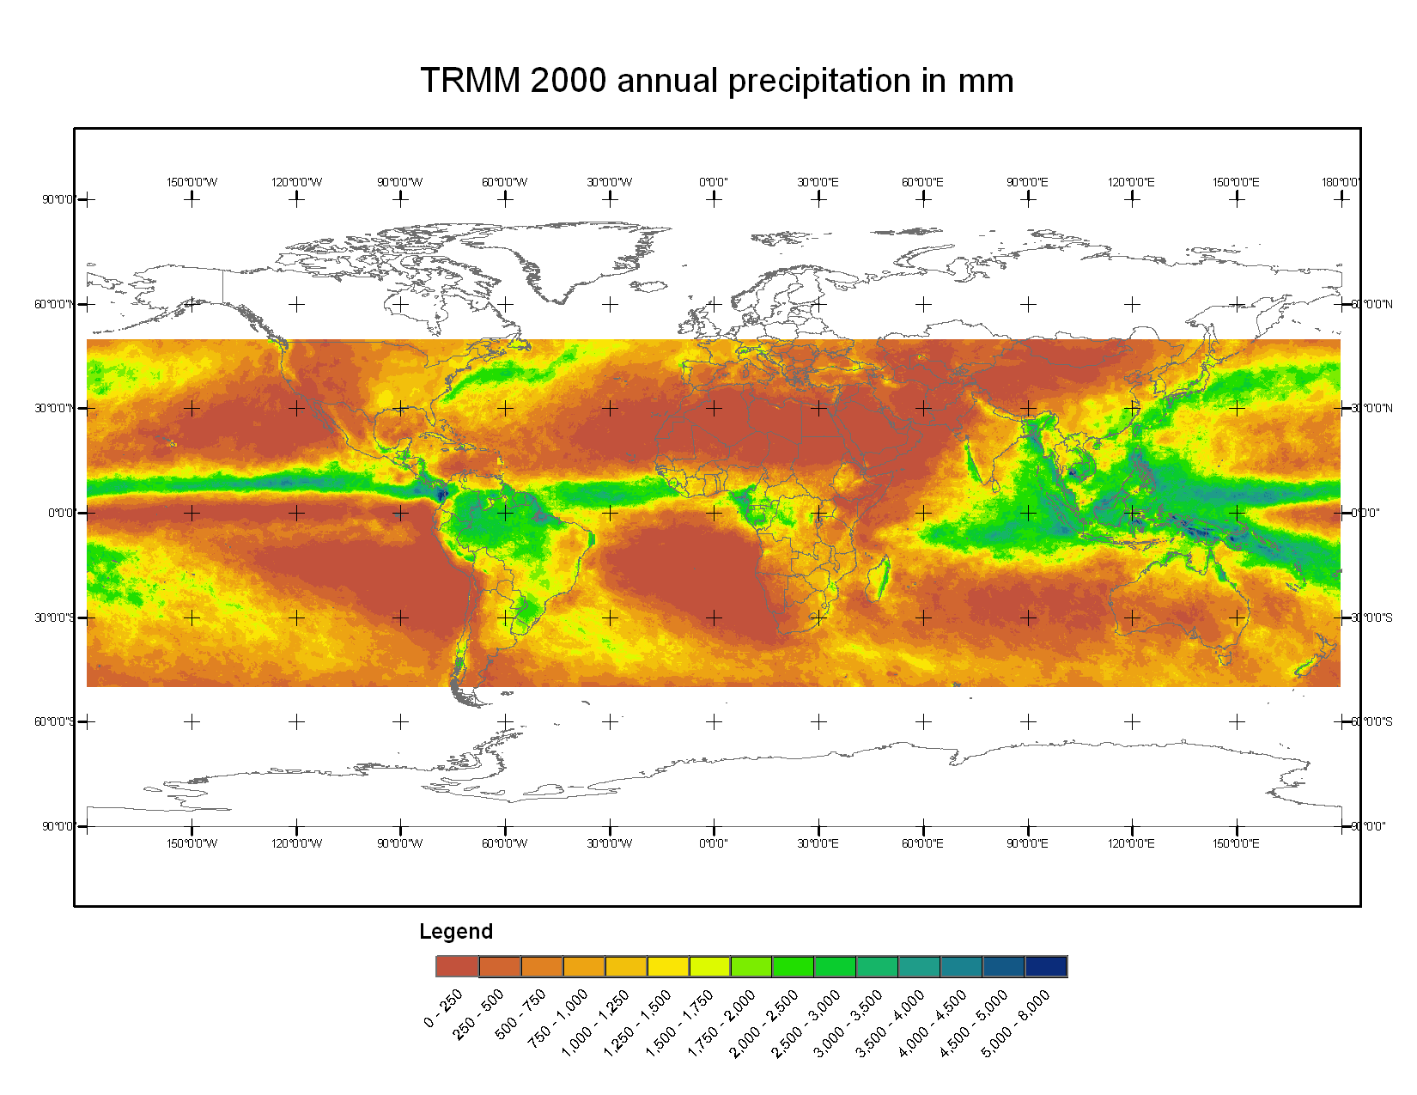
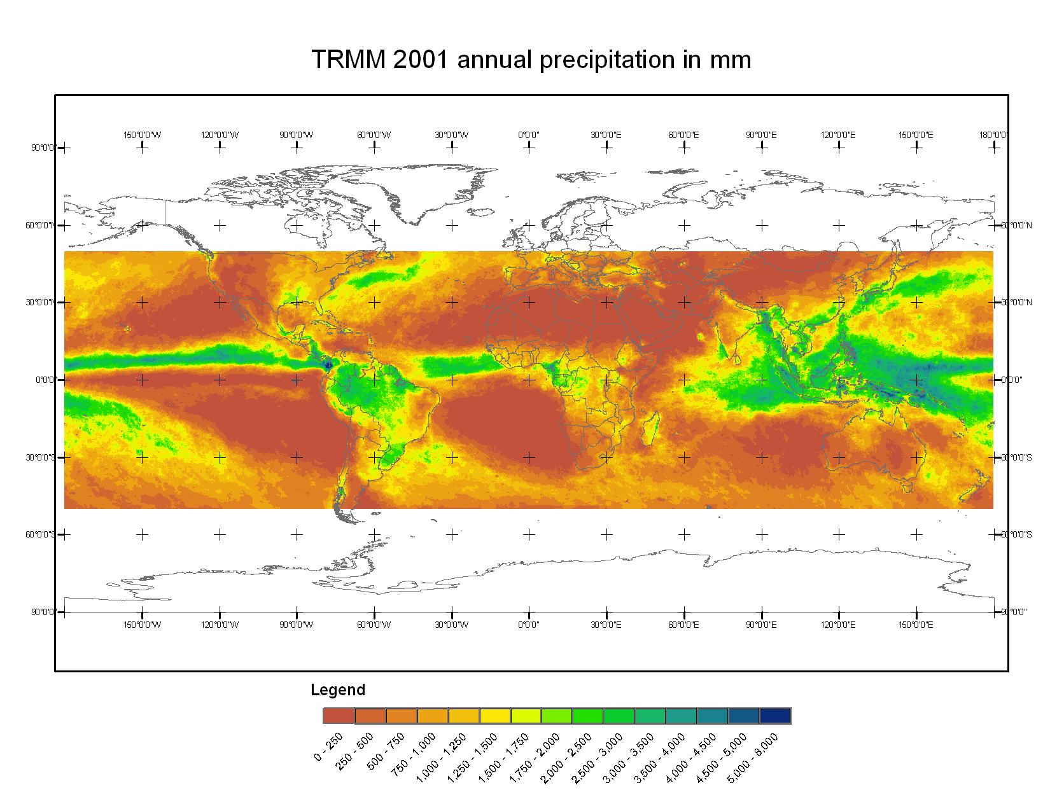
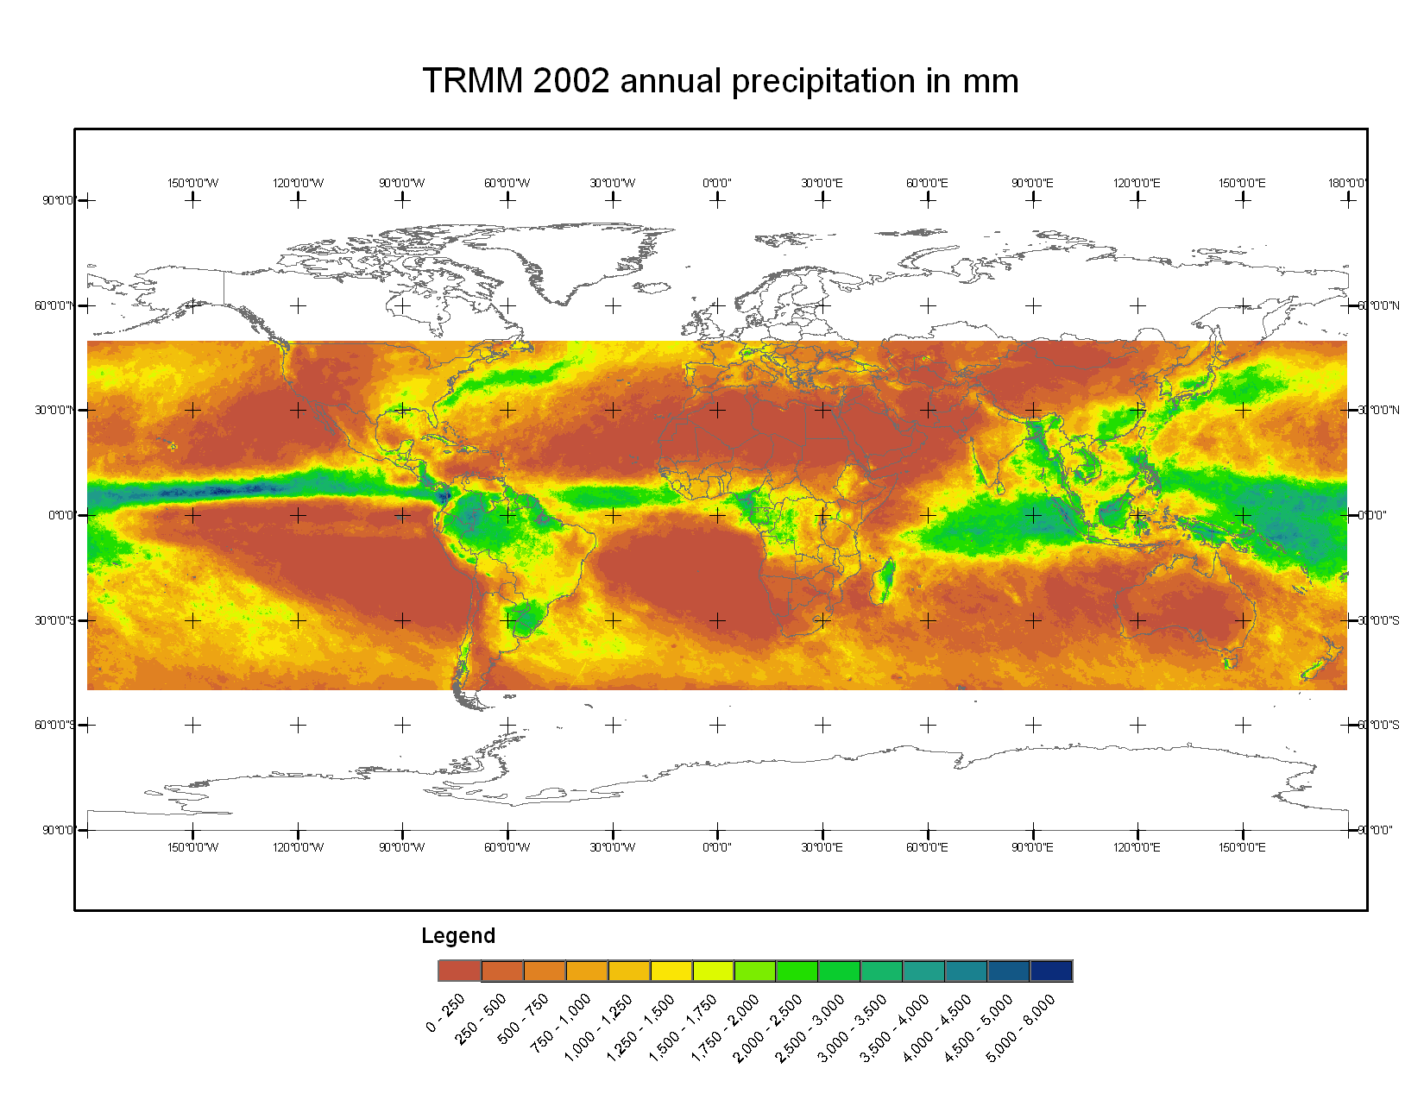
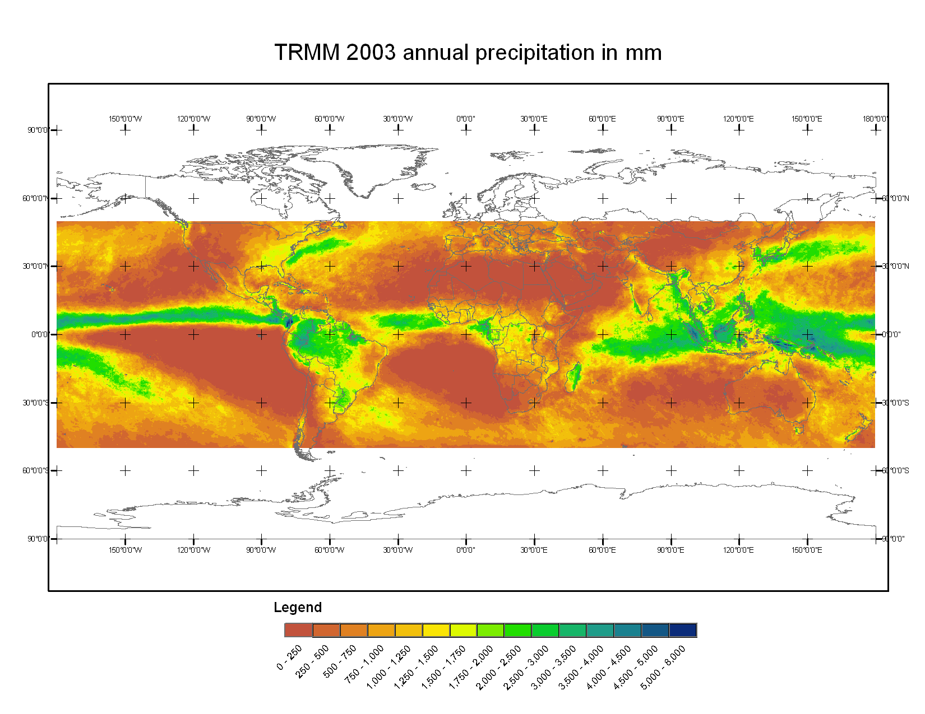
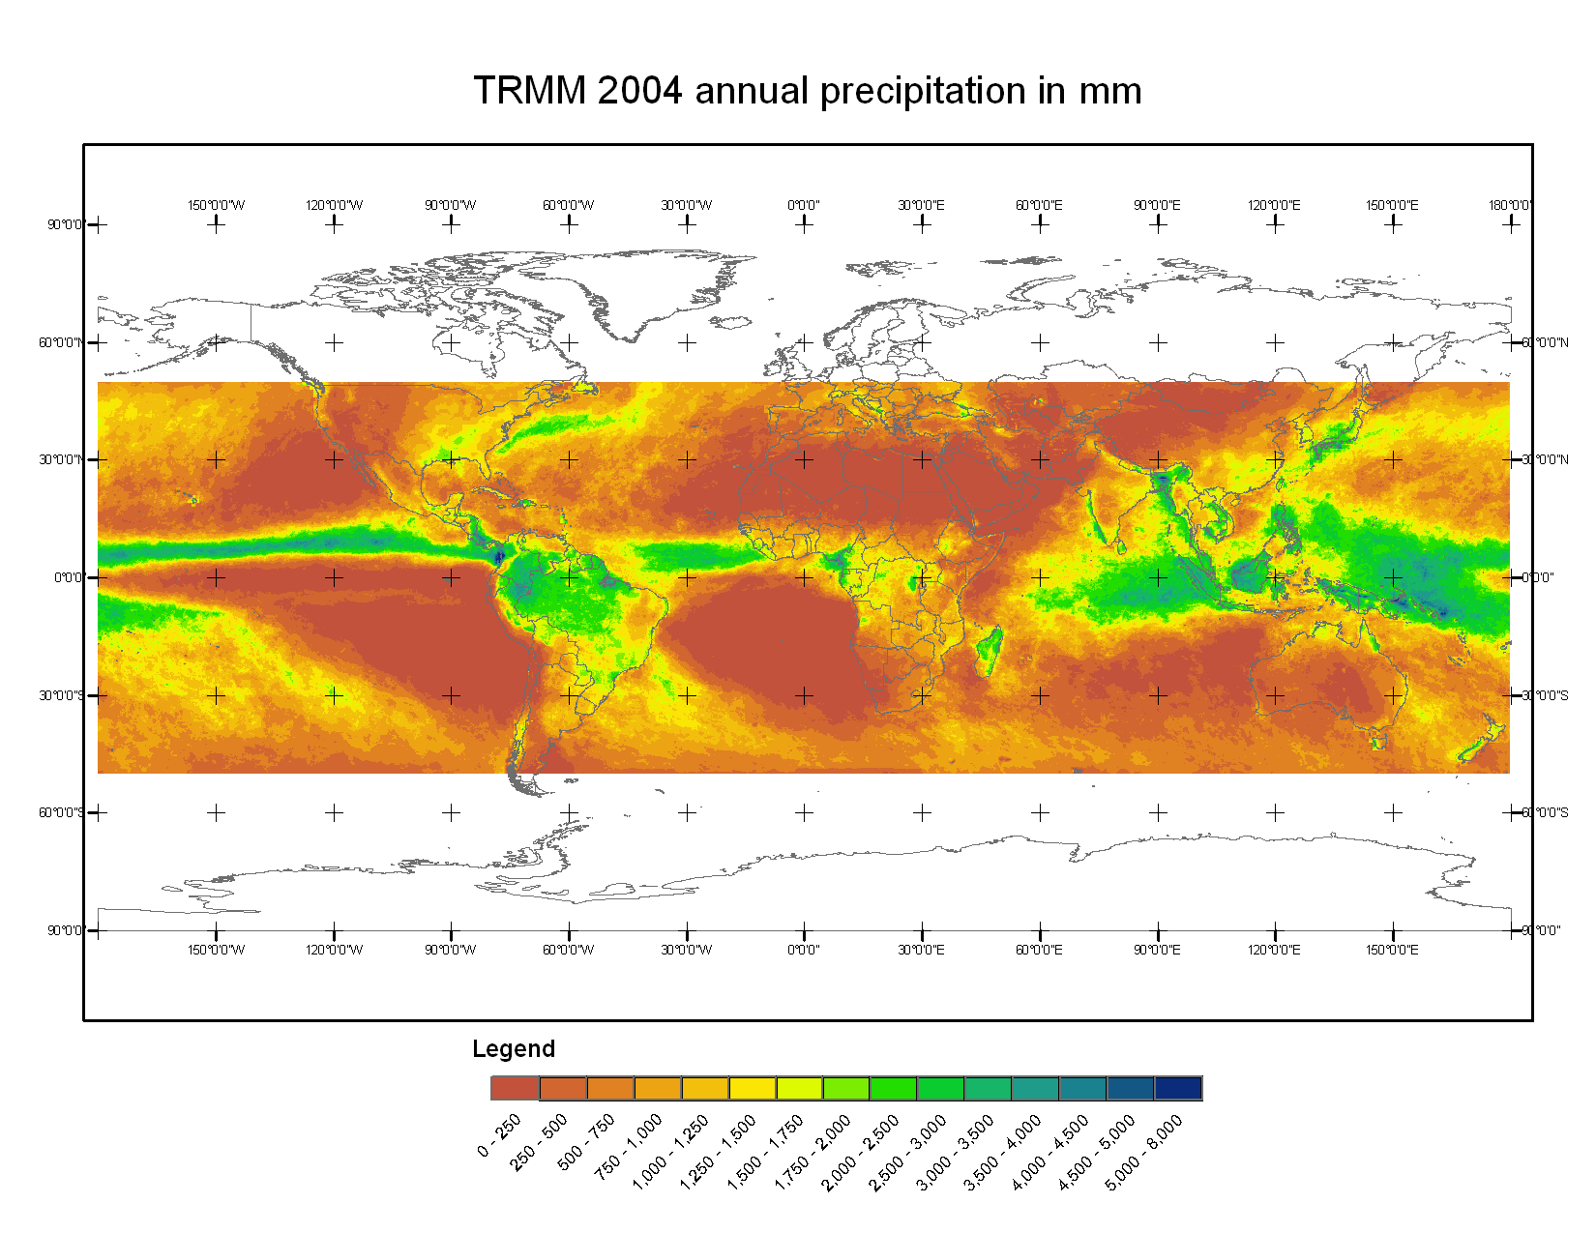

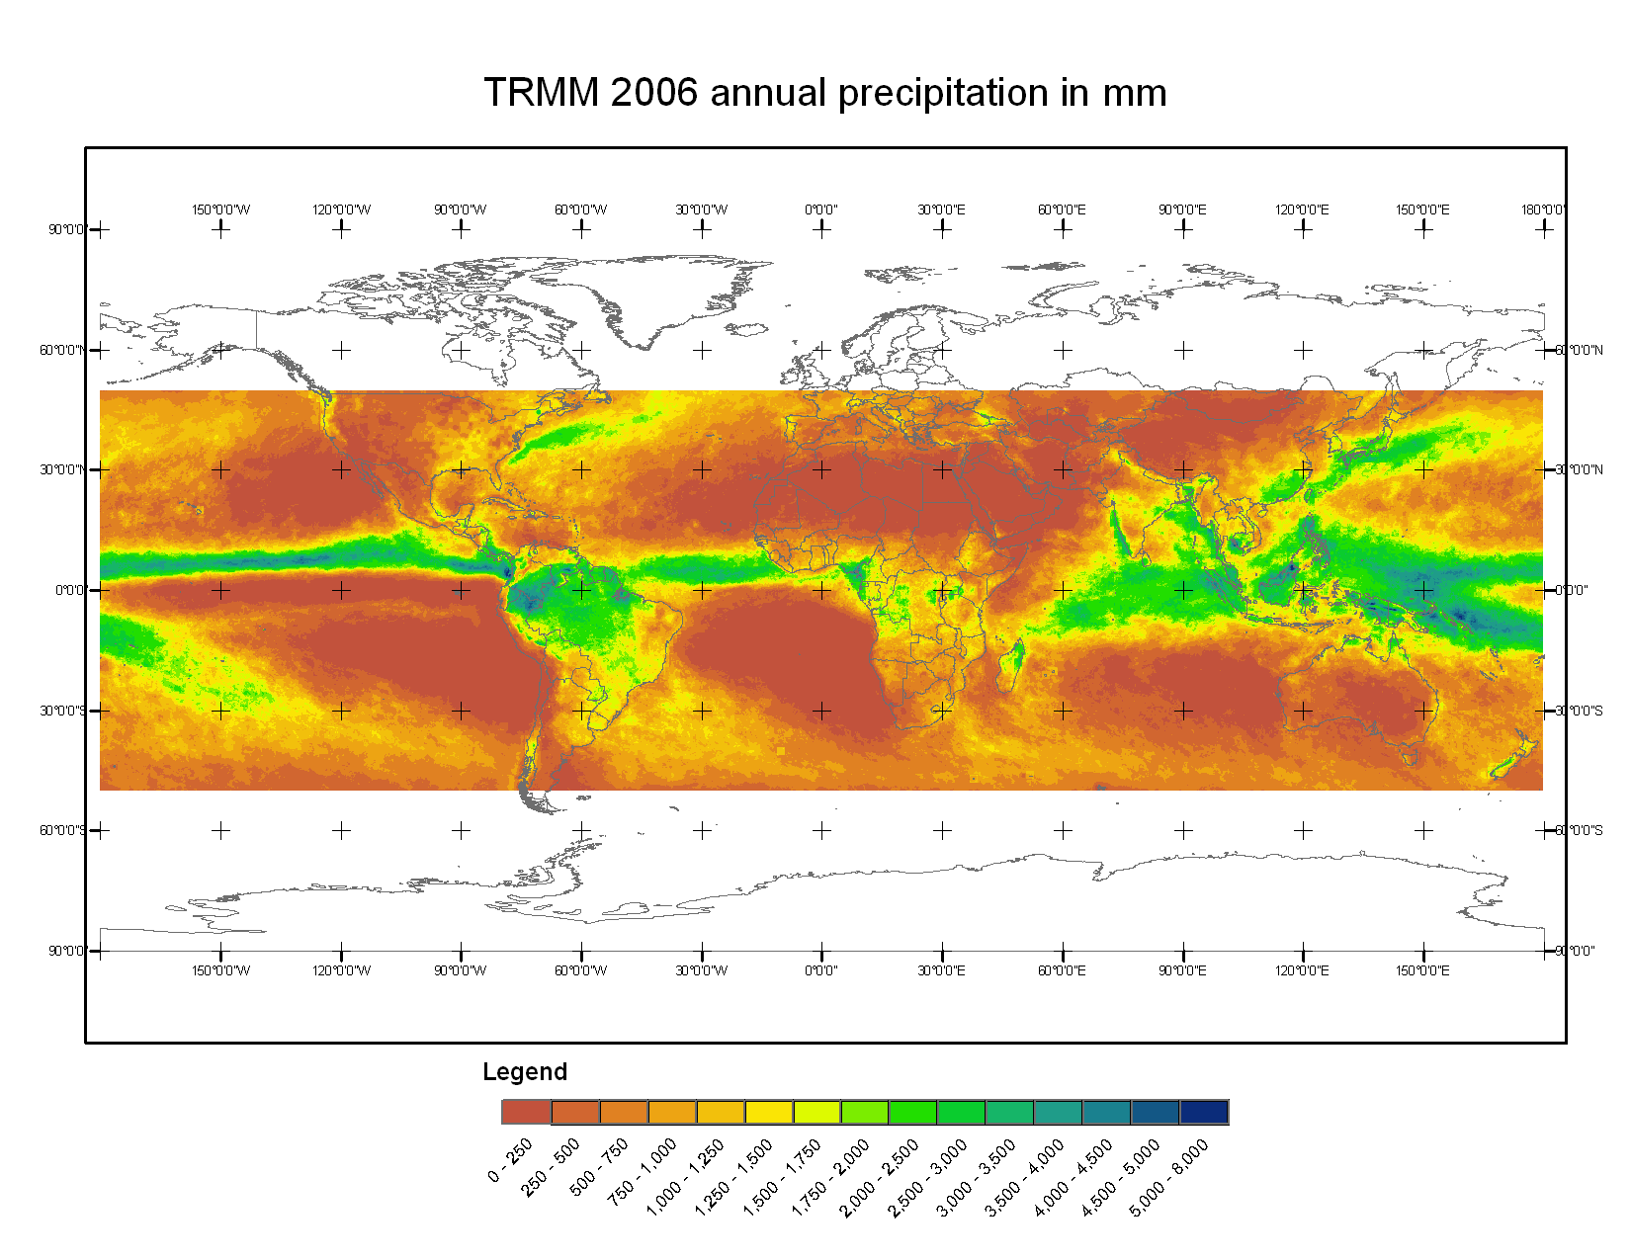
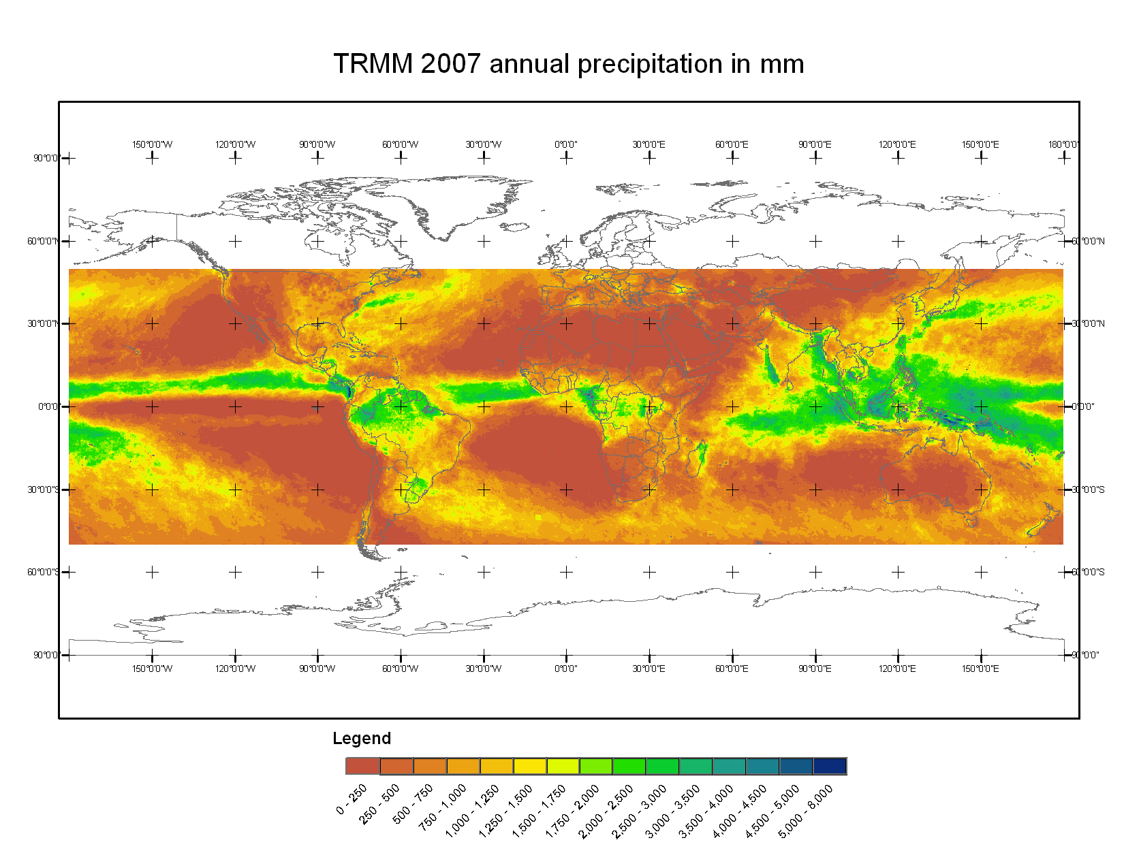
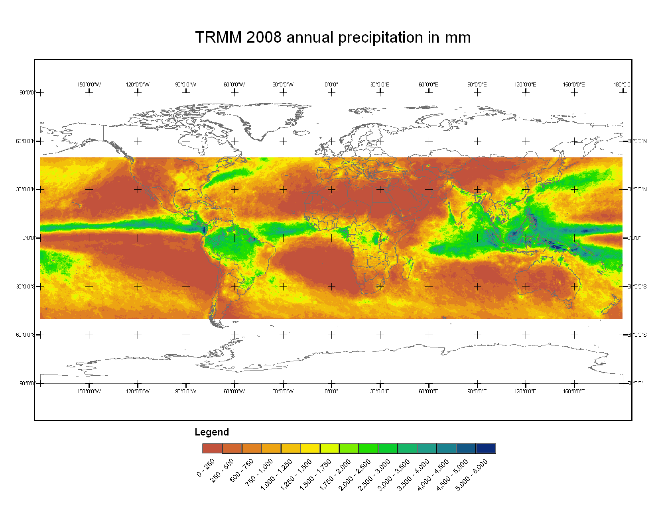
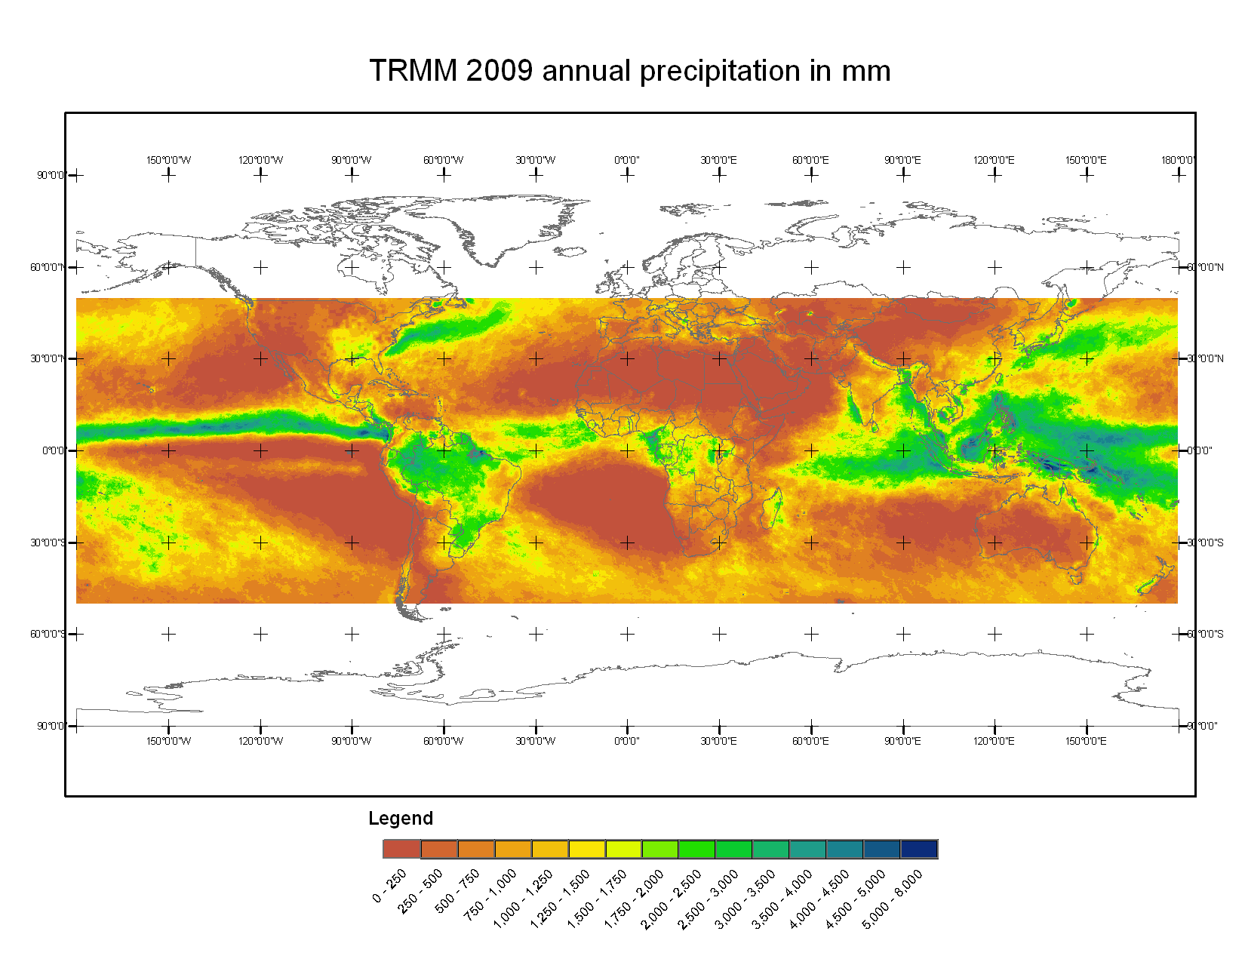
Annual Precipitation Rasters

Slide 11

Calculate Mean Precipitation (“Normal”)

Slide 12
Rasters Visual Analysis
Back to Concepts
  ITCZ
  Zones of high/low pressure
    Deserts
    Tropical regions

Slide 13
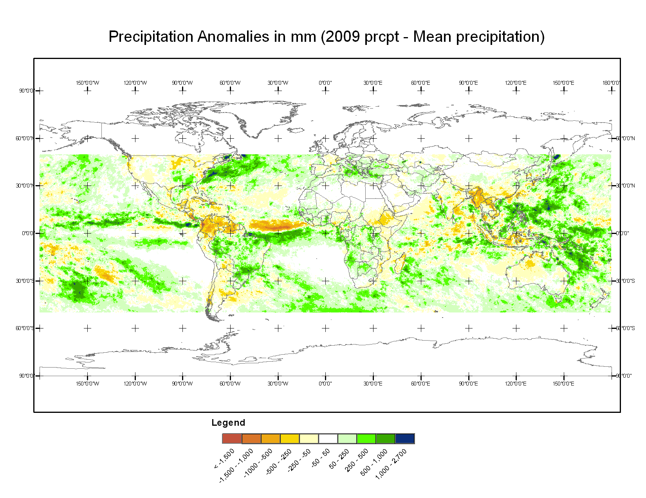
Anomalous Rainfall

Slide 14
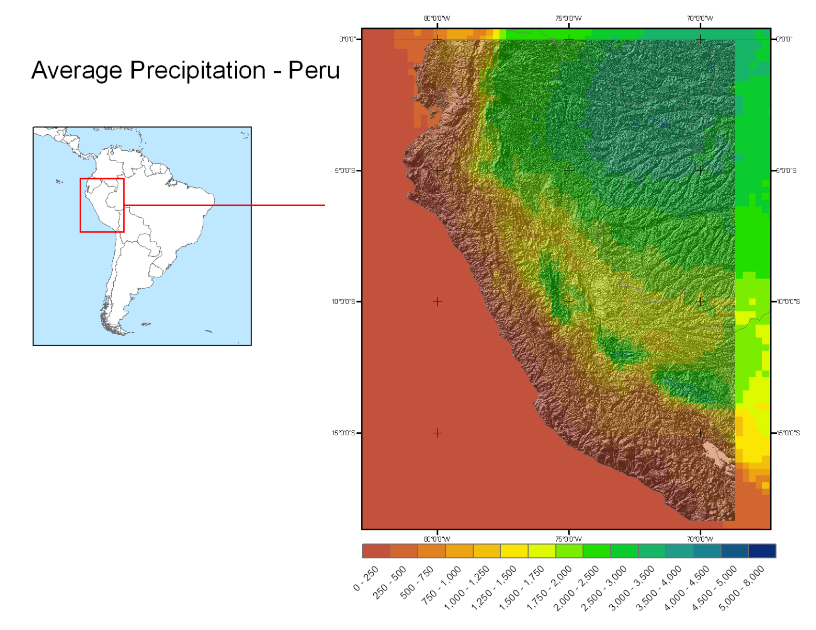
Topography and Rainfall
Orographic Lifting
Notes:
Ask what if questions:

Slide 15
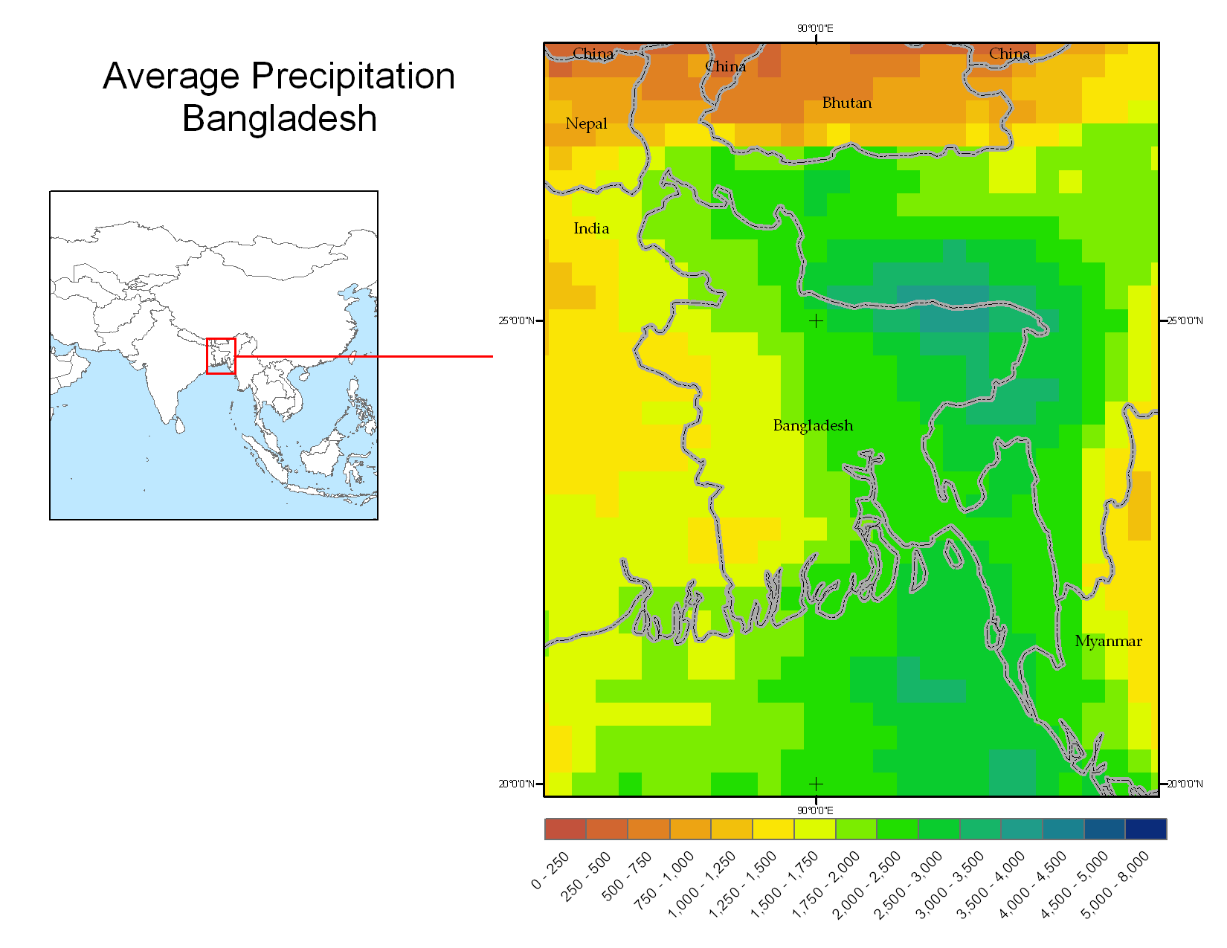
Monsoonal Precipitation

Slide 16
Sample of Questions Asked
Descriptive: describe main rainfall patterns
What if scenarios: if trade winds are weakened and waters off the cost of Peru get warmer, what would you expect to occur?
A little arithmetics: calculate how much liters of water in a given 0.25 x 0.25 degree cell.

Slide 17
How effective is the Lab?
I haven’t used this full lab version
I did use parts of it
  Students like to manipulate images (zoom in/out, see different layers)
  Better for visual analysis than figures in book
  Anecdotal evidence suggests concepts were well understood

