Slide 1
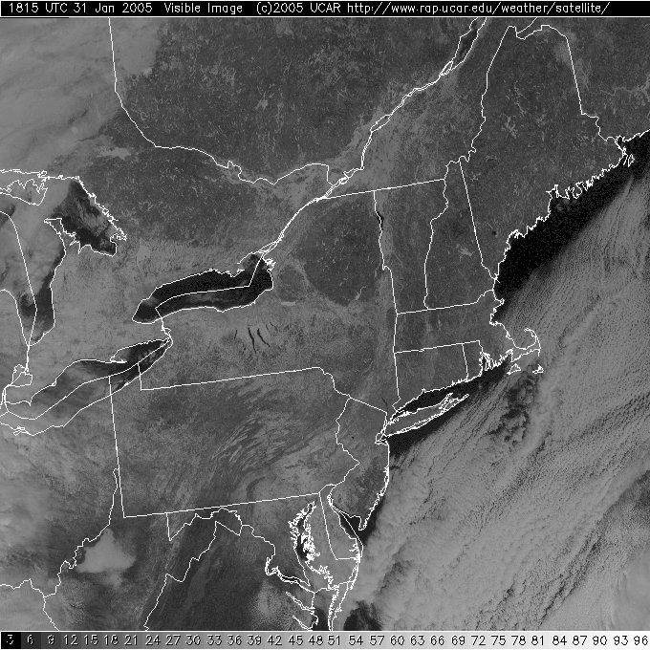
Slide 1
A
B

Slide 2
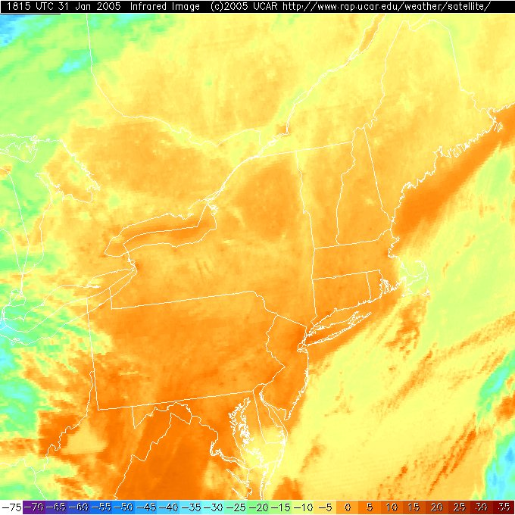
Slide 2
A
B

Slide 3
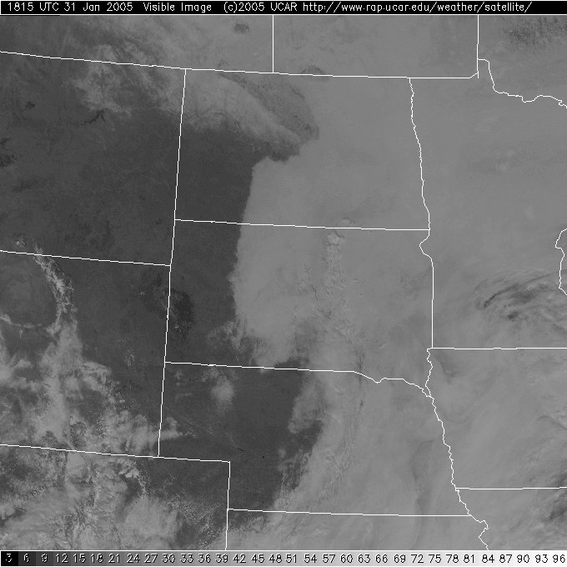
Slide 3
D
C

Slide 4
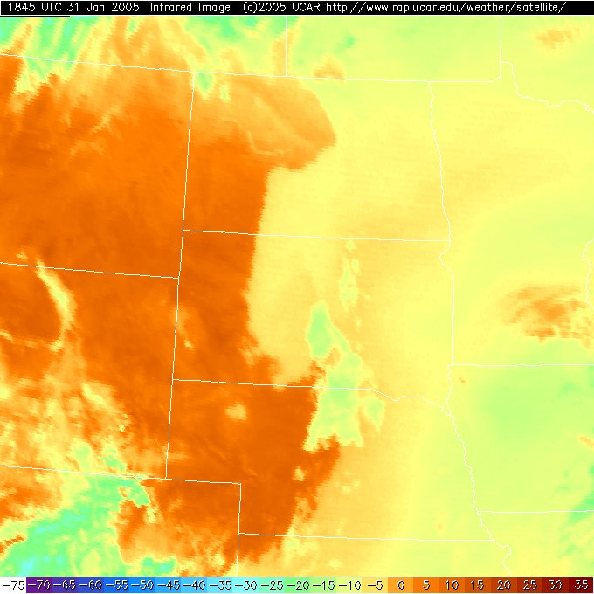
Slide 4
D
C

