Slide 1
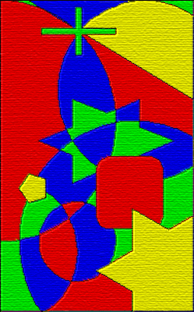
A four-color map. No two adjacent areas are
the same color.
http://commons.wikimedia.org/wiki/
File:FourColorMapEx.png

Slide 2
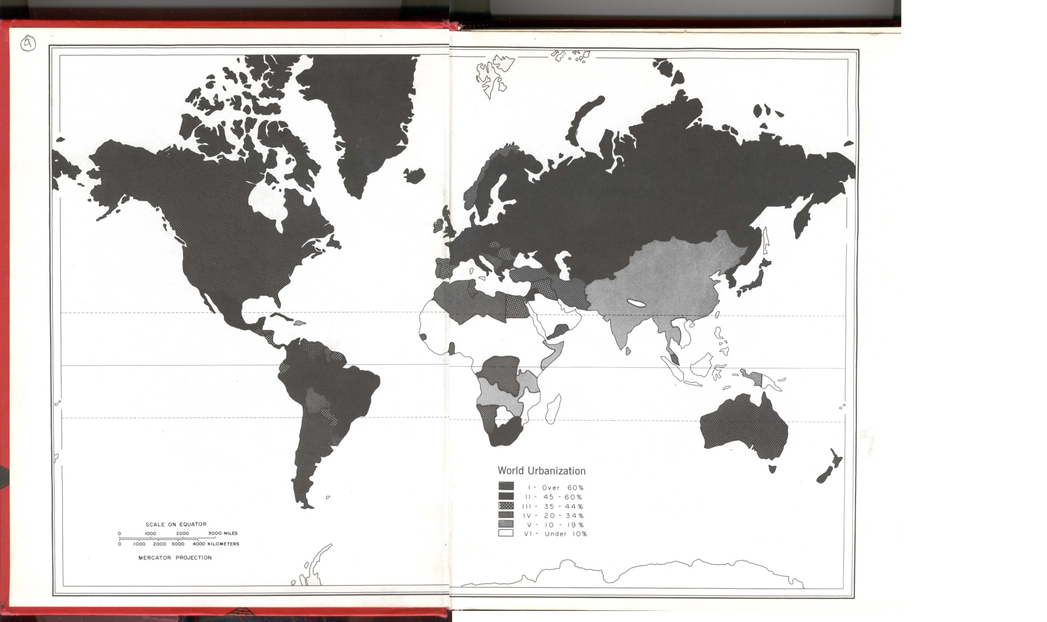
Source: http://www.facstaff.bucknell.edu/marsh/own_page/pix/baddestmap.jpg

Slide 3
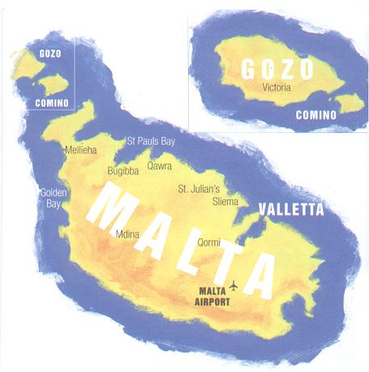
Source:
http://www.maltavista.net/en/list/photo/2203.html

Slide 4
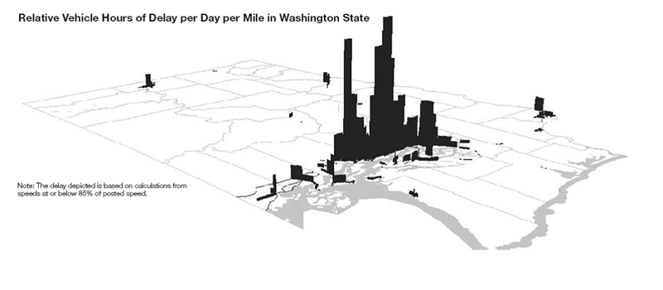
Source: http://bp3.blogger.com/_0rvWUKndkiU/SIkK1n-SxoI/AAAAAAAAEWk/FAjhbNobdnc/s1600-h/Washington+congestion.gif

Slide 5
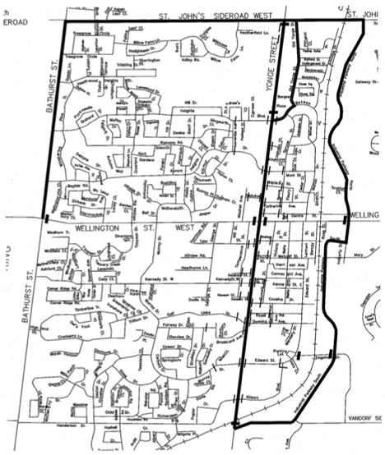
Parade route map.
Source: http://www.hubbers.ca/

Slide 6
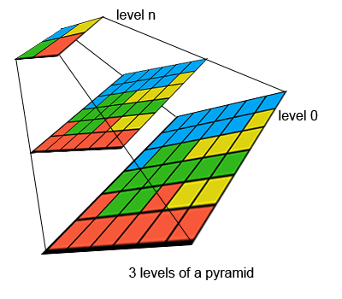
A raster pyramid.
http://edndoc.esri.com/arcsde/9.2/concepts/rasters/basicprinciples/pyramids.htm

Slide 7
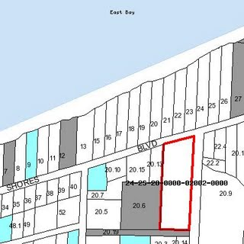
A portion of a cadastral map from
Santa Rosa County, California
http://mavance2000.blogspot.com
/2008/07/cadastral-map.html

