Slide 1
The Quake-Catcher Network:
Visualization
J.F. Lawrence¹, E.S. Cochran², C.M. Christensen¹,
A.I. Chung¹, C. Neighbors², J. Saltzman¹
¹Stanford University
²University of California, Riverside

Slide 2
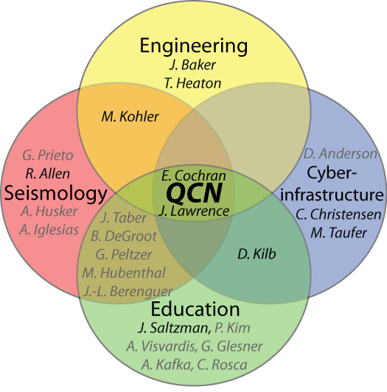
Primary Collaborators:
Additional Institutions:
Birch Aquarium
California Academy of Science
Caltech
GNS (New Zealand)
IRIS
NEES
NSF
SCEC
Stanford
USGS
UC Berkeley
UC Los Angeles
UC Riverside
UC San Diego
U. Delaware
U. Concepcion (Chile)
U. de los Andes (Columbia)
UNAM (Mexico)

Slide 3
The Quake-Catcher Network
The Goal: Increase the number of seismic records of earthquakes to improve everyone’s understanding of earthquake science and earthquake hazards
Method: Combined Cyber-Social-Seismic Network
  Connect low-cost (<$150) MicroElectroMechanical Systems (MEMS) accelerometers to volunteer internet-connected computers

Slide 4
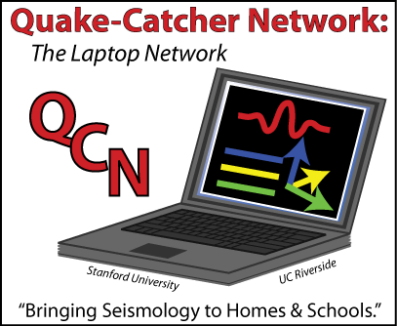
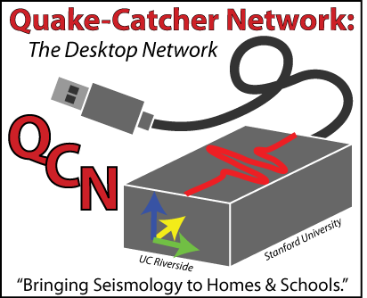
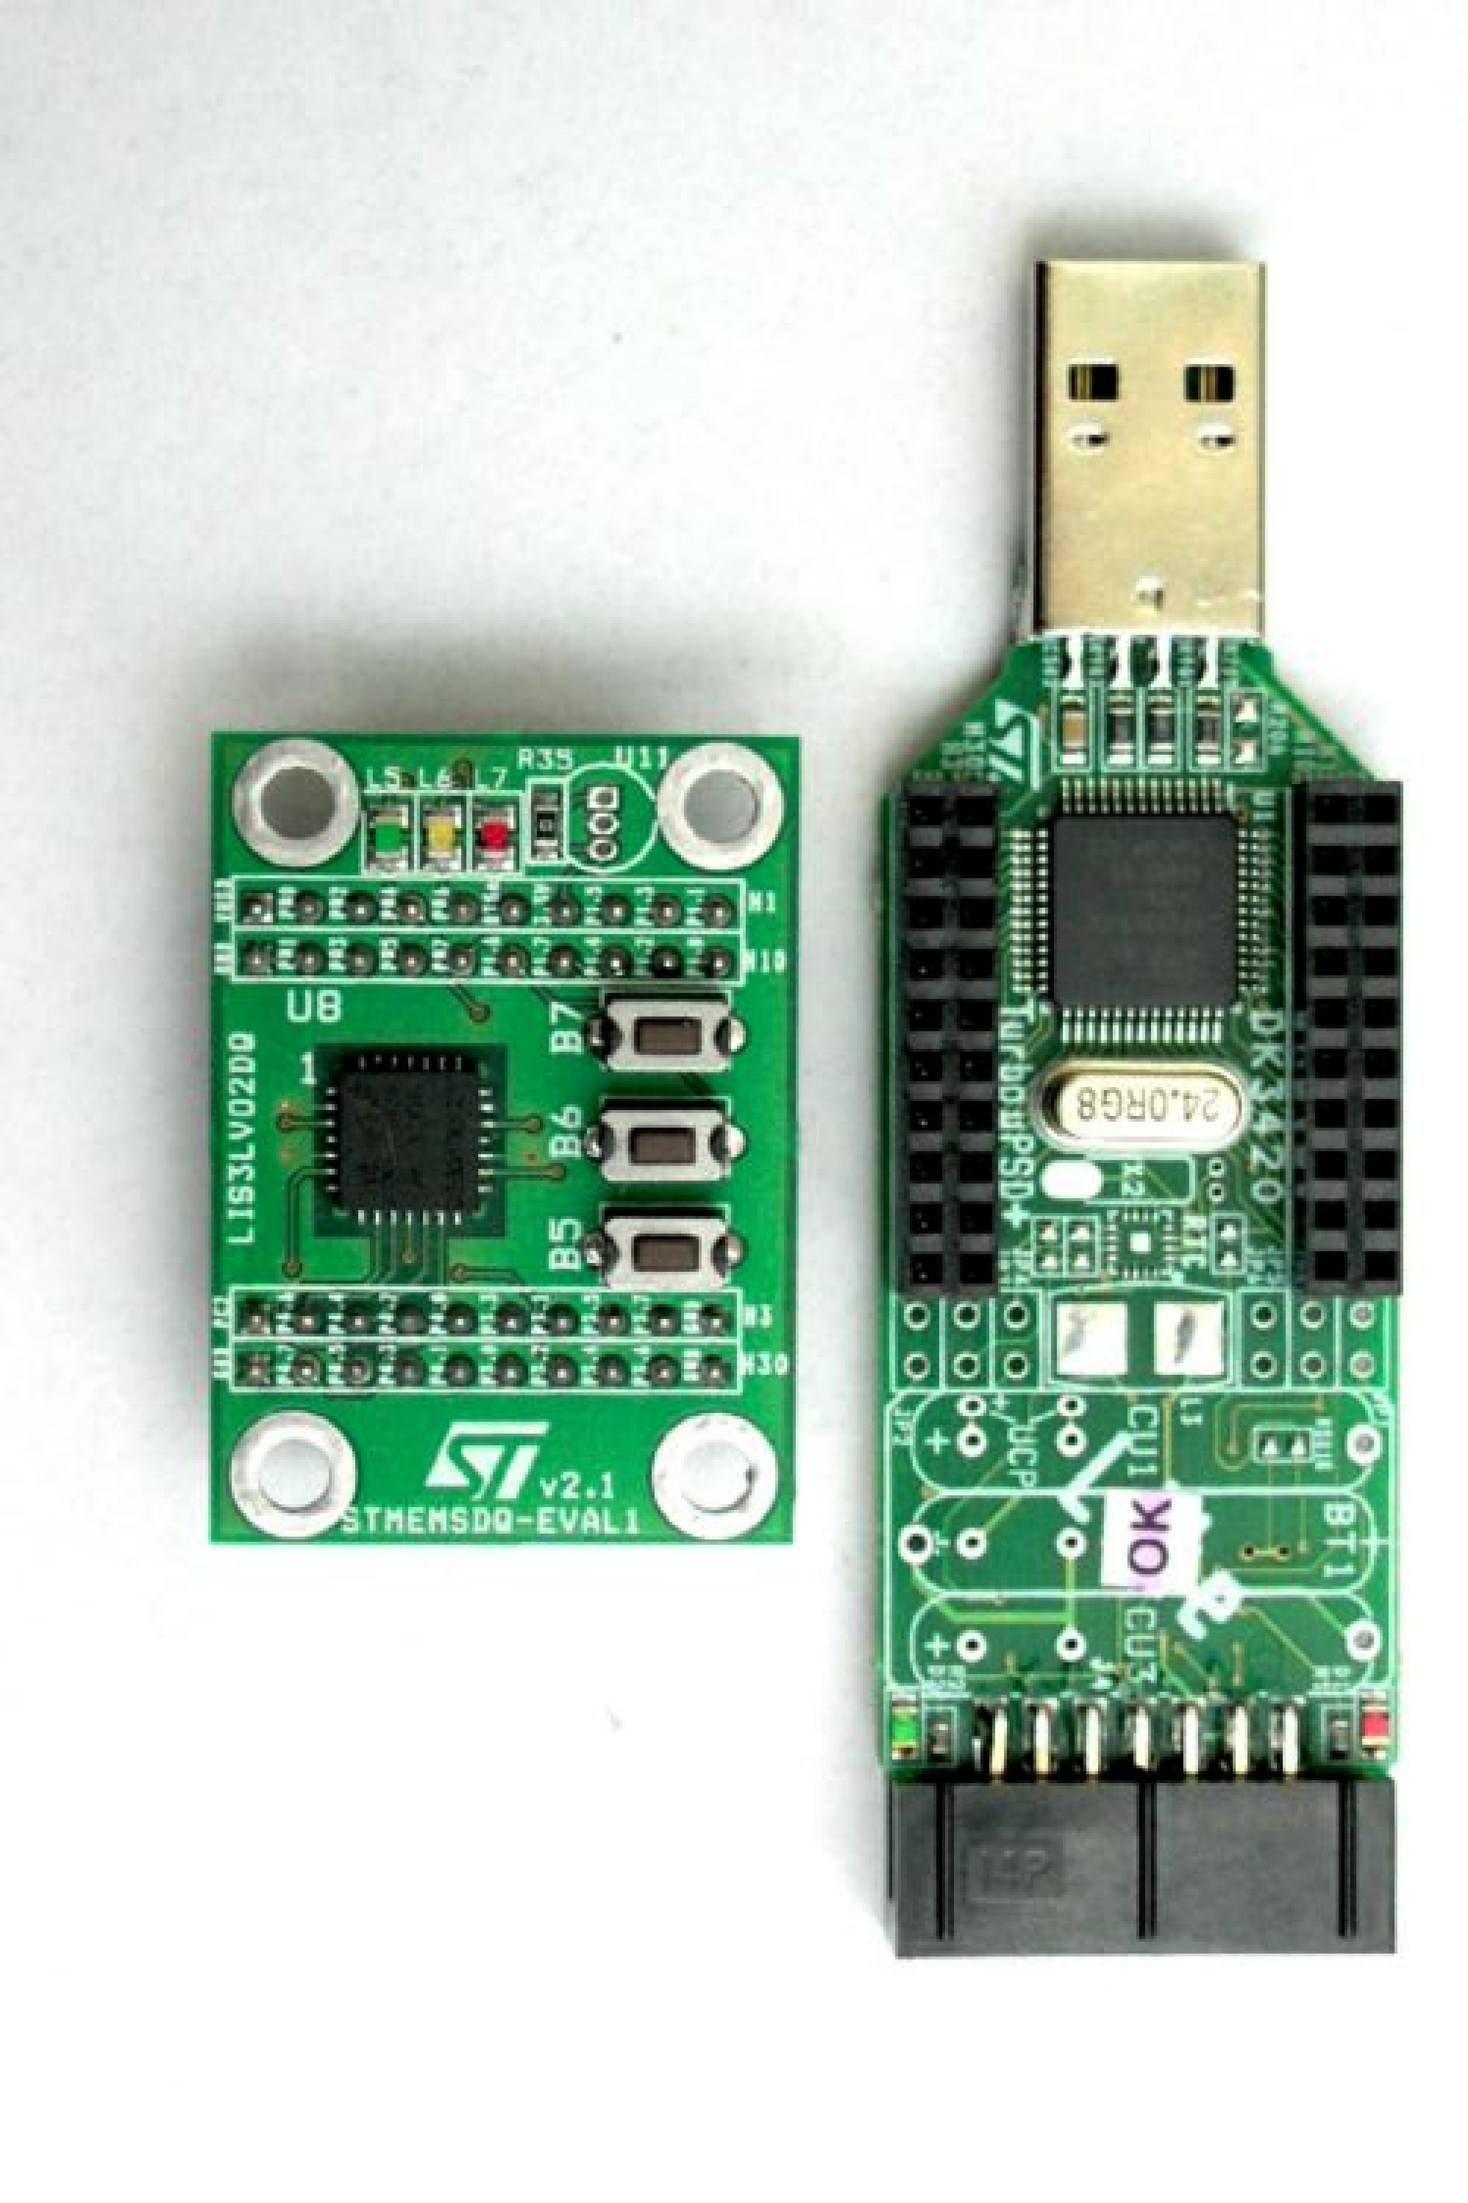
QCN Seismic Sensors
MEMS Accelerometers:
  Free (Apple & Thinkpad laptops) or low cost ($30-150)
  Easy to install on Windows & Mac computers (based on BOINC software - NSF funded)
  Host computer provides power, shelter, & Internet (no maintenance costs)
  Specs:
    3 axes with ±2g dynamic range (1g=9.8m/s/s)
    Sensitivity between 4×10⁻²g & 2.4×10⁻⁸g ($30-$150)
  Useful for strong motion data collection
  Useful for education
    Real time demonstrations
    Participation in scientific discovery

Slide 5
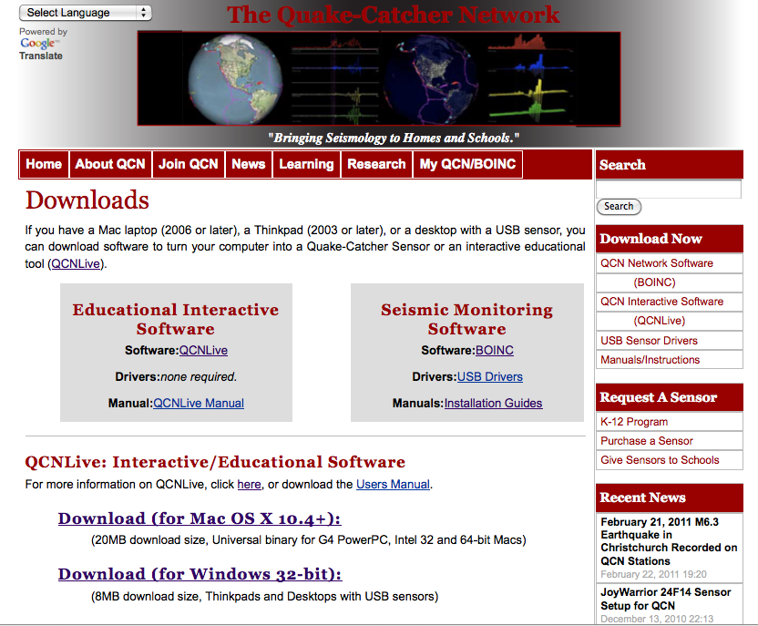
Download QCNLive
http://qcn.stanford.edu/downloads
Download QCNLive
Uncompress the zip file.
Open the directory
Double click QCNLive

Slide 6
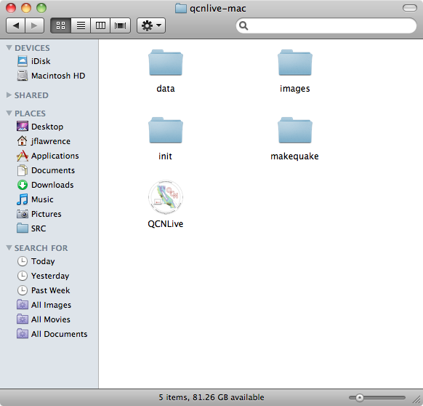
Install & Start QCNLive
http://qcn.stanford.edu/downloads
Download QCNLive
Uncompress the zip file.
Open the directory
Double click QCNLive

Slide 7
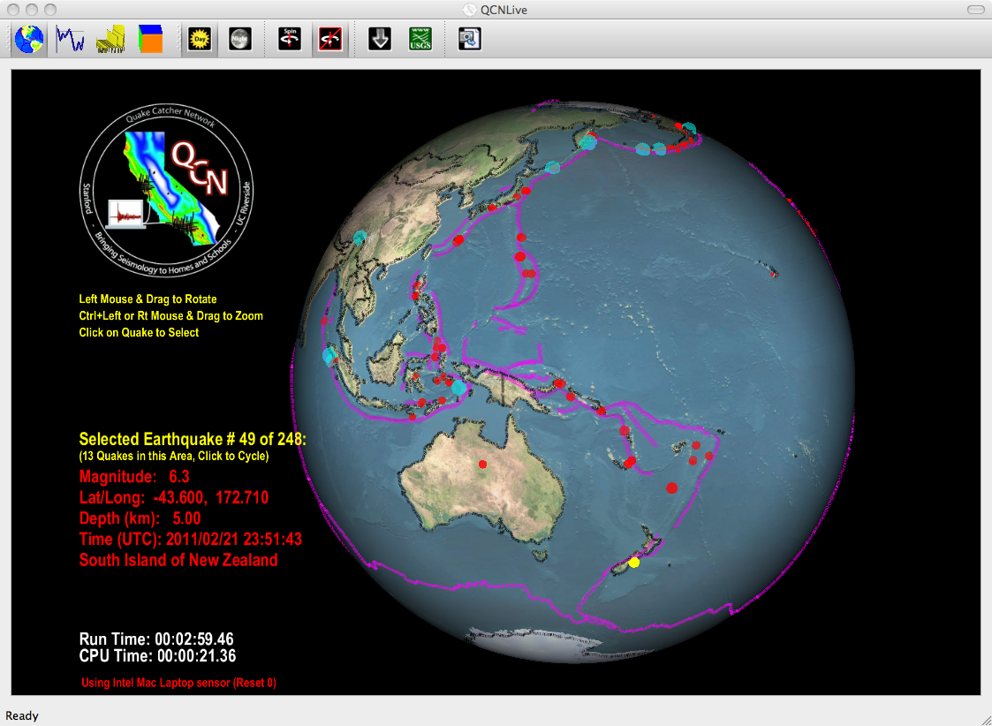
Earthquake Viewing:
http://qcn.stanford.edu/downloads
Circles:
  Blue: Historical
  Red: Recent
  Yellow: Currently selected
  Size increases with magnitude
Other:
  Pink: Plate boundaries
  Background: Topography

Slide 8
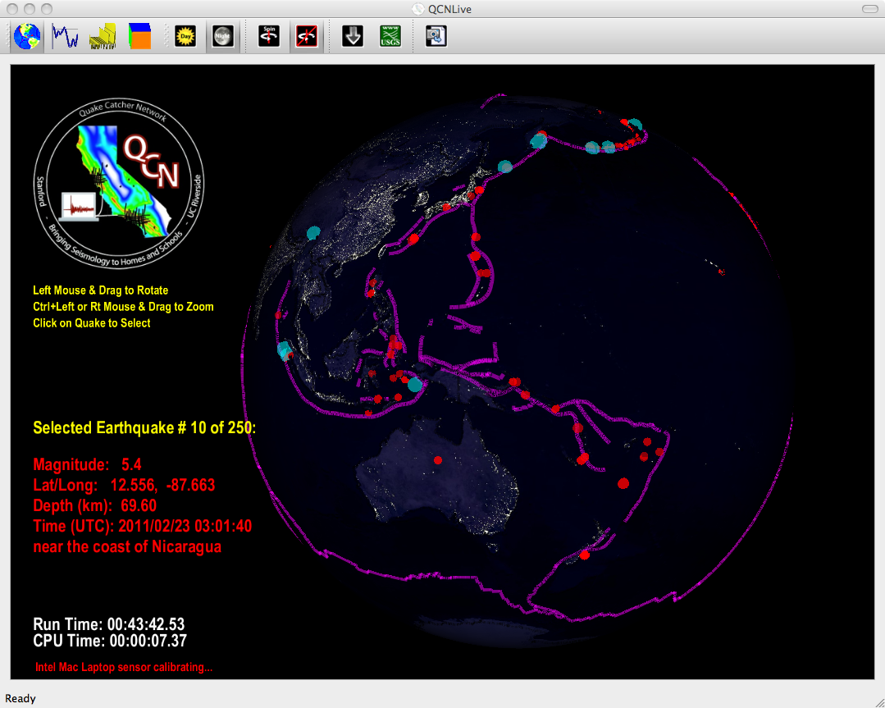
Earthquake Viewing:
http://qcn.stanford.edu/downloads
Circles:
  Blue: Historical
  Red: Recent
  Yellow: Currently selected
  Size increases with magnitude
Other:
  Pink: Plate boundaries
  Background: Topography

Slide 9
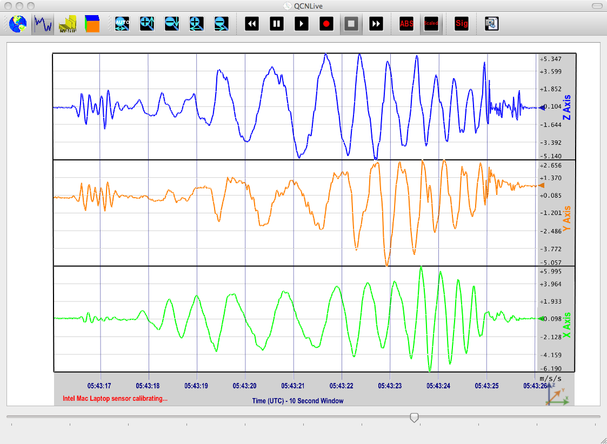
Sensor Viewing: Real-time view
Download QCNLive
Uncompress the zip file.
Open the directory
Double click QCNLive
Provides an alternative to SeisMac (Cheaper to replace a sensor than a laptop or phone)

Slide 10
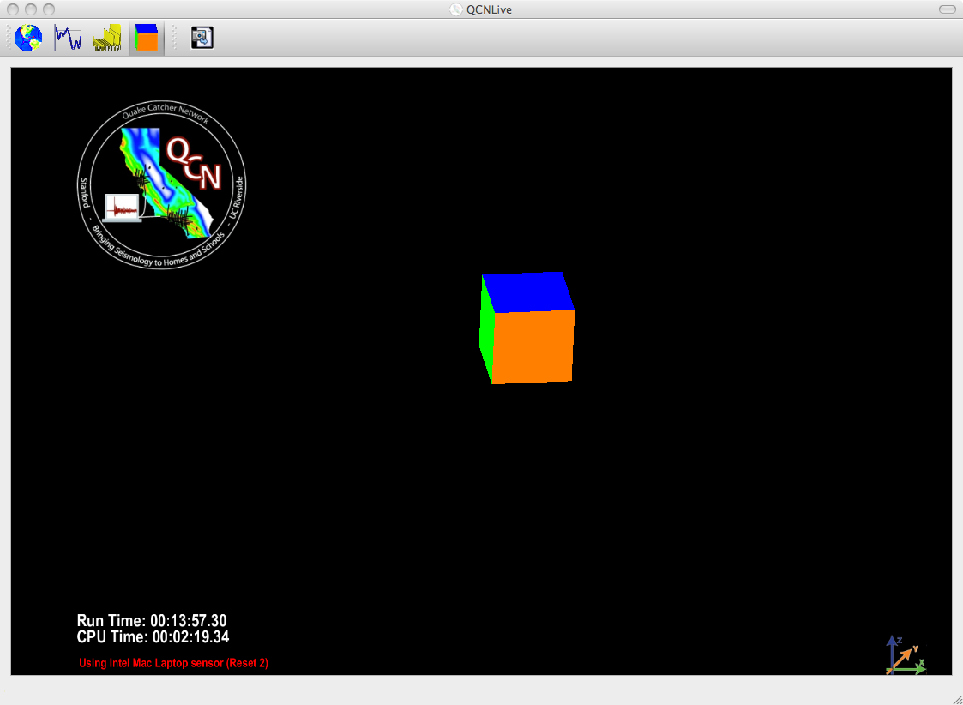
Bouncing Cube:
http://qcn.stanford.edu/downloads
Cube moves both left and right when you move the sensor sideways.
Difference between acceleration and displacement

Slide 11
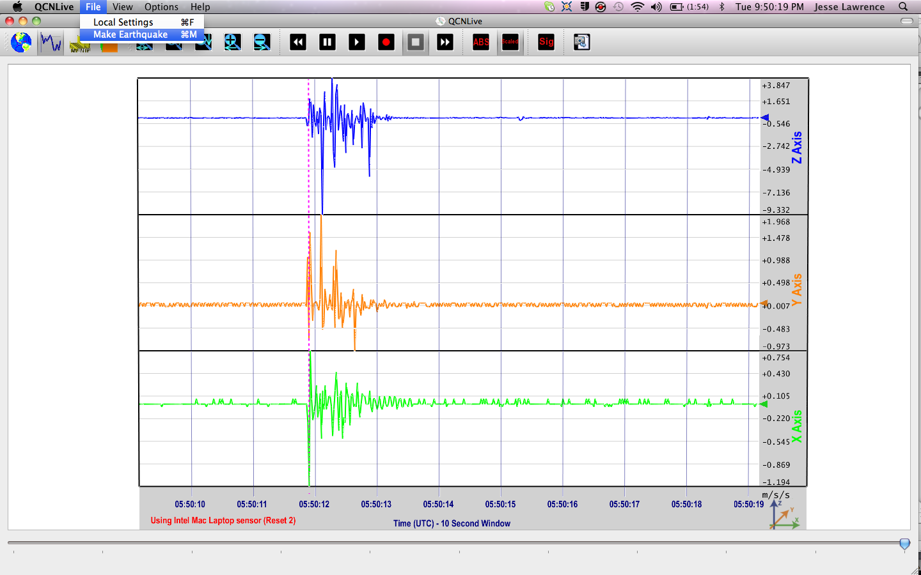
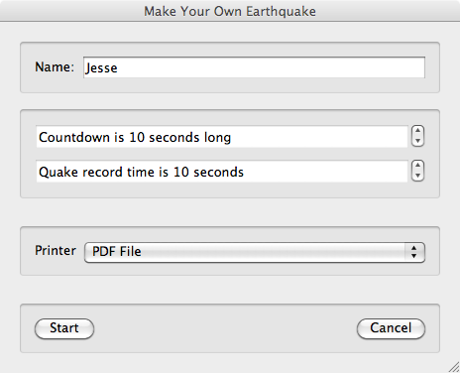
Make a Quake: In collaboration with NEES
Select File & Make Earthquake
Enter Your Name
For K-12 demonstrations

Slide 12
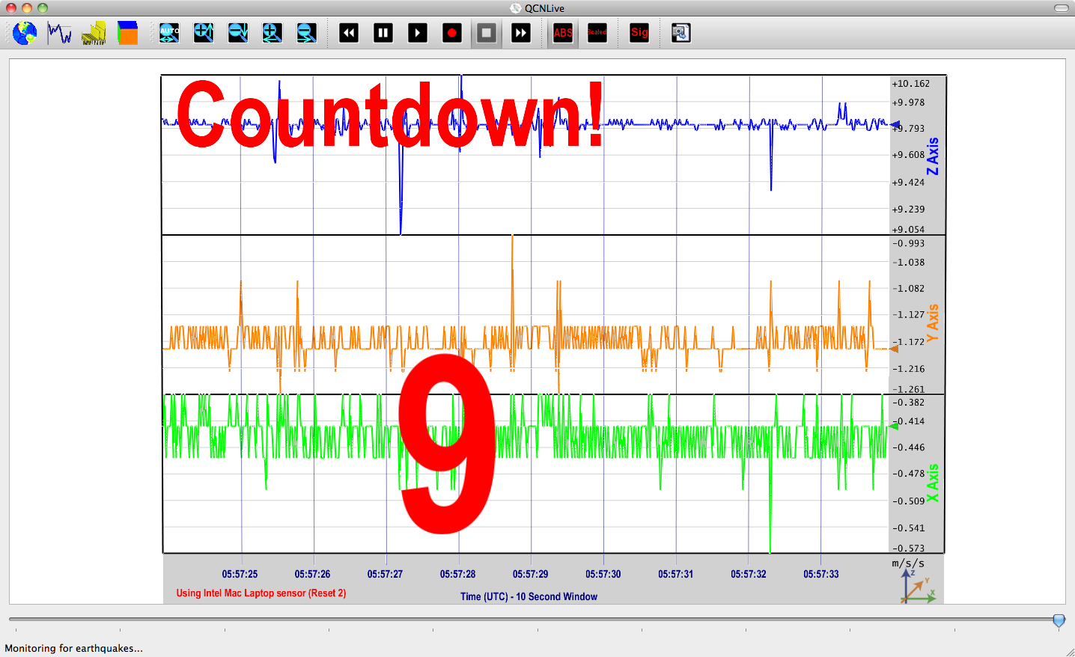
Make a Quake: In collaboration with NEES
Select File & Make Earthquake
For K-12 demonstrations
Fun way to get many students to interact: >400 in a day

Slide 13
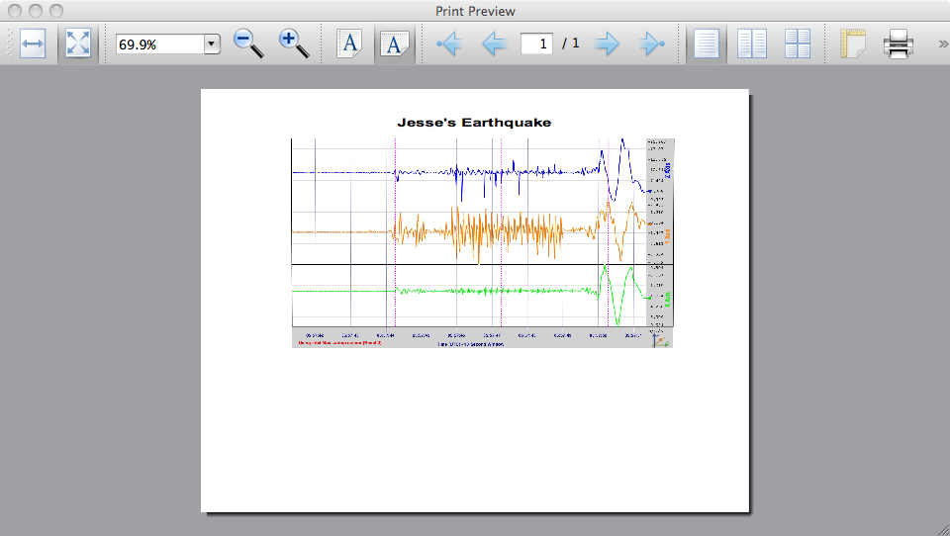
Make a Quake: In collaboration with NEES
Select File & Make Earthquake
For K-12 demonstrations
Fun way to get many students to interact: >400 in a day
Take home your own earthquake

Slide 14
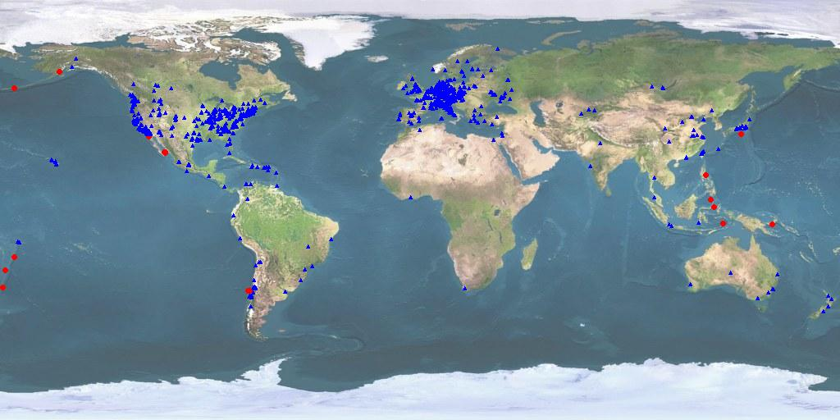
QCN’s Seismic Network
Participants
Earthquake Locations
October 27, 2010
Current Statistics
>1600 Seismic stations globally from >67 countries
Recorded earthquakes between M 2.5 – M 8.8

Slide 15
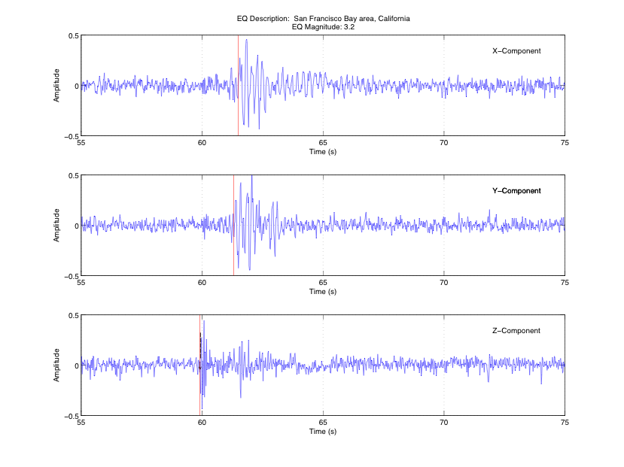
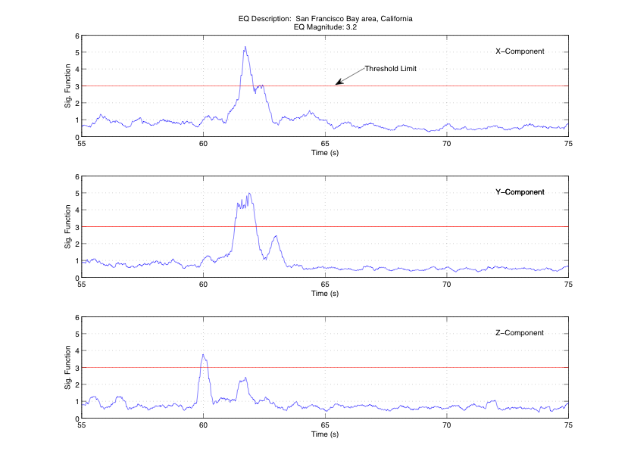
Automatic Trigger & Data Upload
Automatically detect strong new signals:
  Maximize true (earthquake) triggers
  Minimize false (man-made) triggers
  Use efficient triggering algorithm for rapid reporting
Example 1: M 3.2 Earthquake in San Francisco Region

Slide 16
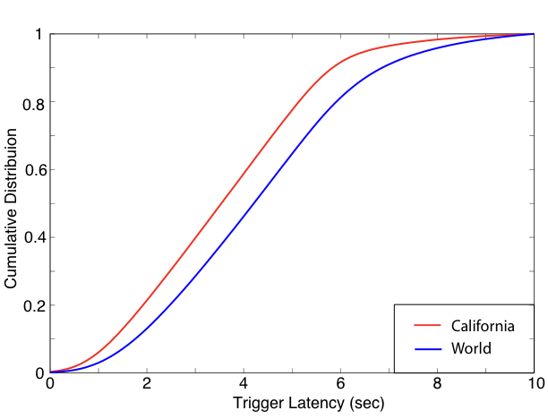
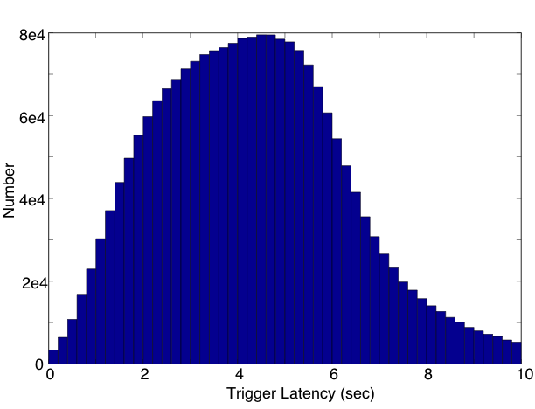
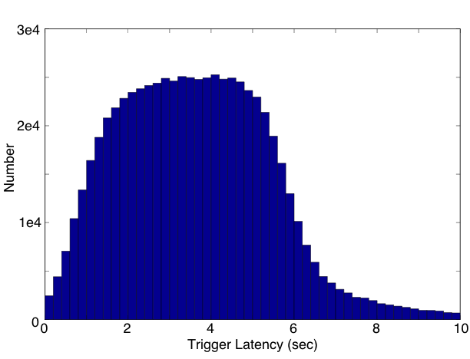
Data Transfer Latency
Transfer minimal data including:
  Time
  Amplitude on each component
  Significance
  Station information (location, sensor type)
Low mean trigger latency
  3.62 seconds within California
  4.29 seconds globally
California
World

Slide 17
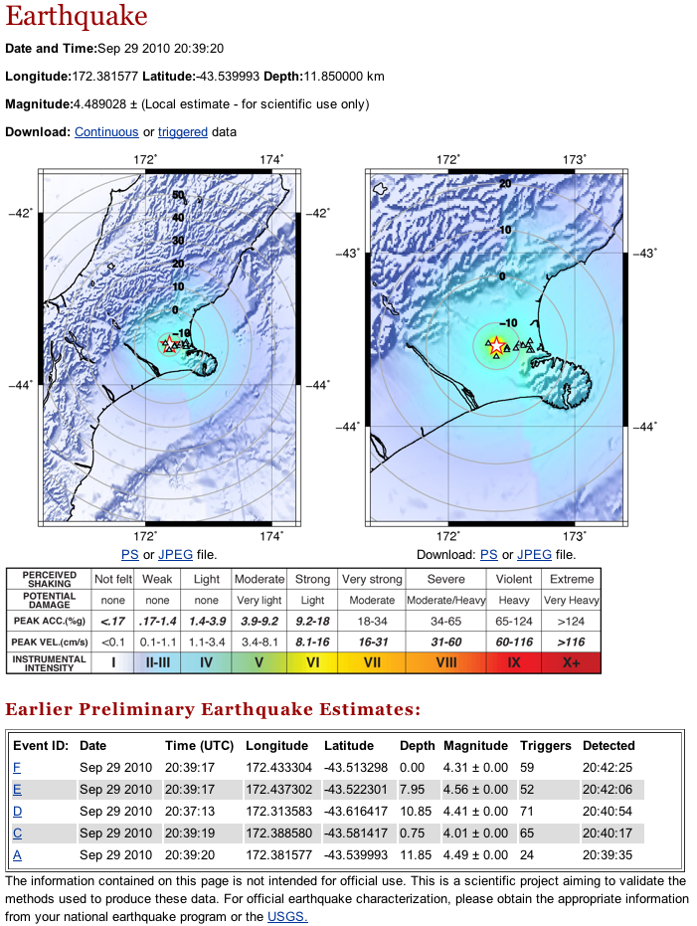
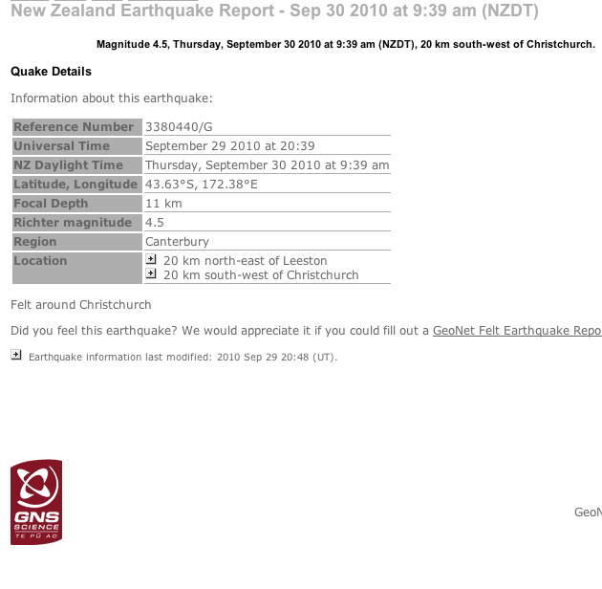
Rapid Earthquake Detection

Slide 18
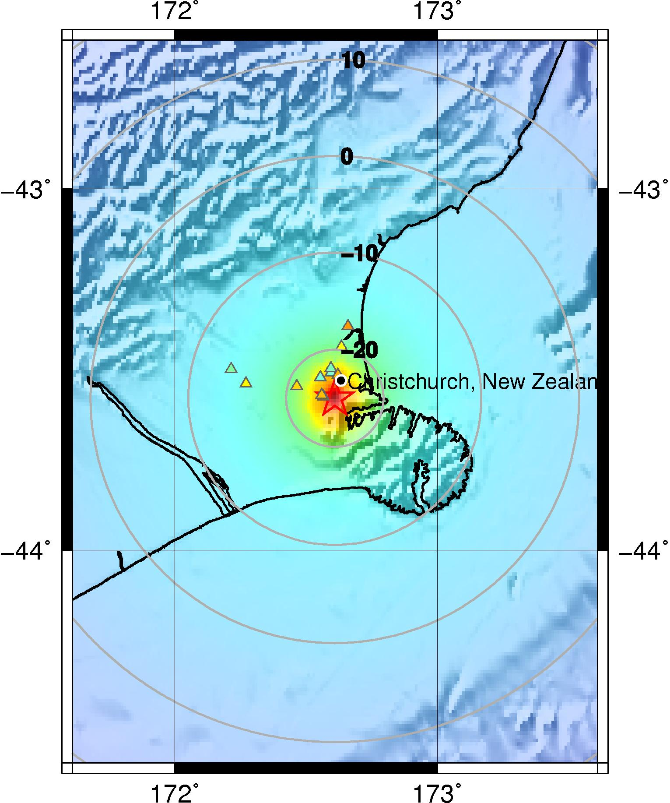
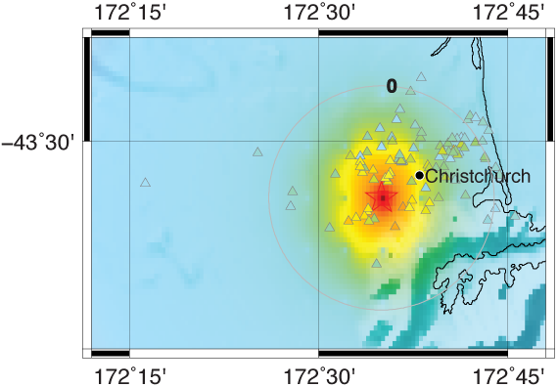
Alert Maps: Expected Shaking Maps
Extrapolate current shaking to all other locations
Site effects seen from individual maximum amplitudes
Circles represent isocrons (equal-times) since/until the wave passes each location.
First maps in 7 seconds, later maps update features.
M6.0: February 22nd, 2011
14 sensors
Detected in 7 seconds
Updated until 25 seconds

Slide 19
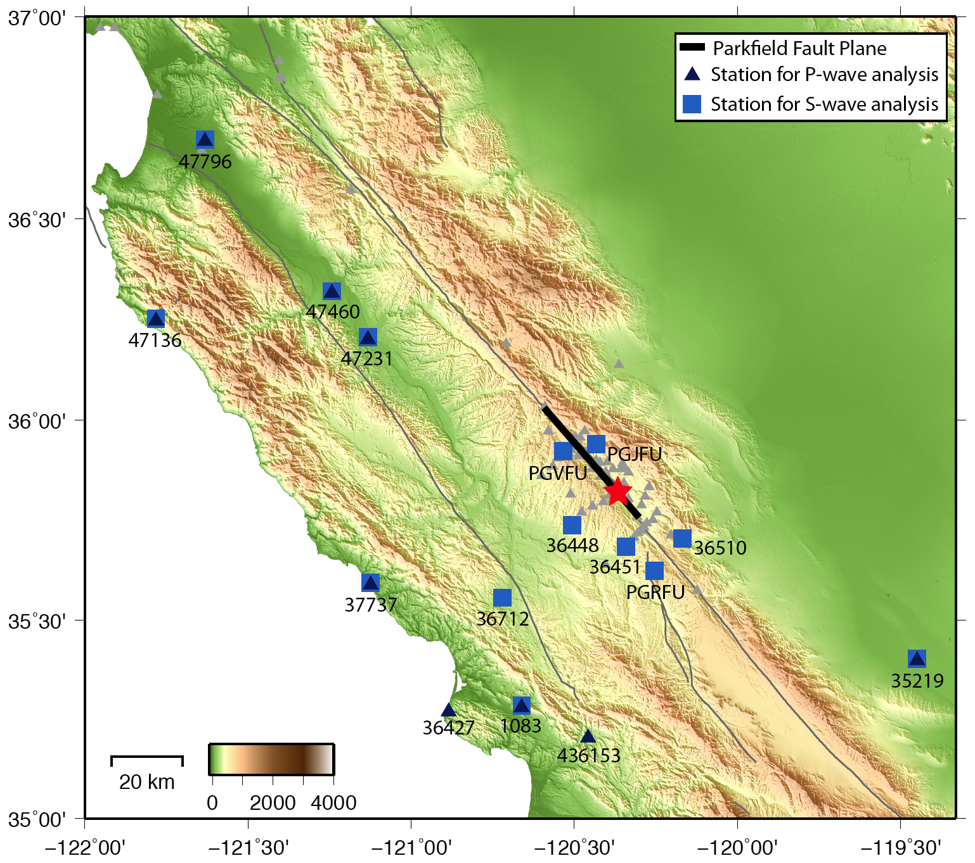
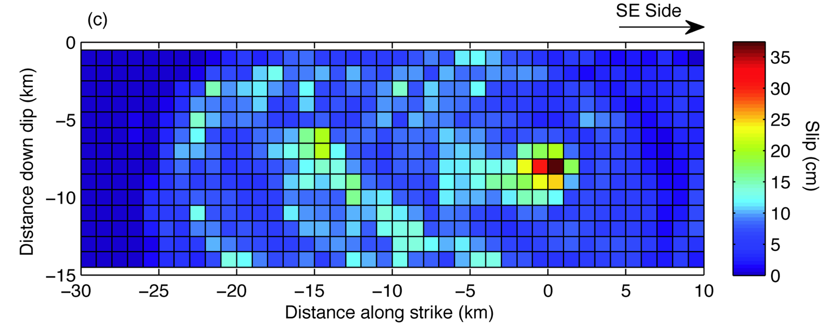
Scientific Objectives
Rapid earthquake detection:
  Rapid magnitude estimation
  Advanced Alert
Earthquake rupture
Ground motion amplification
Building monitoring

Slide 20
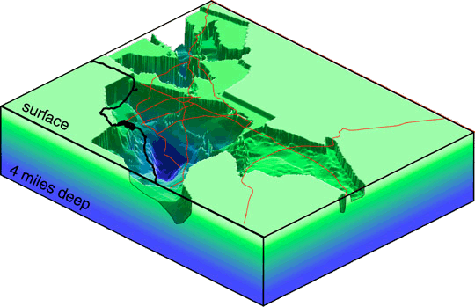
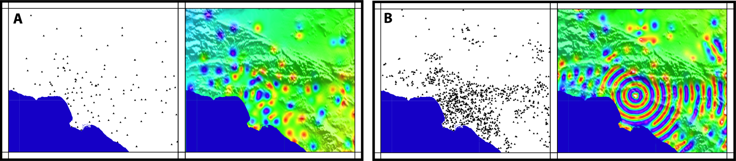
Scientific Objectives
Rapid earthquake detection:
  Rapid magnitude estimation
  Advanced Alert
Earthquake rupture
Ground motion amplification
Building monitoring
www.scec.org

Slide 21
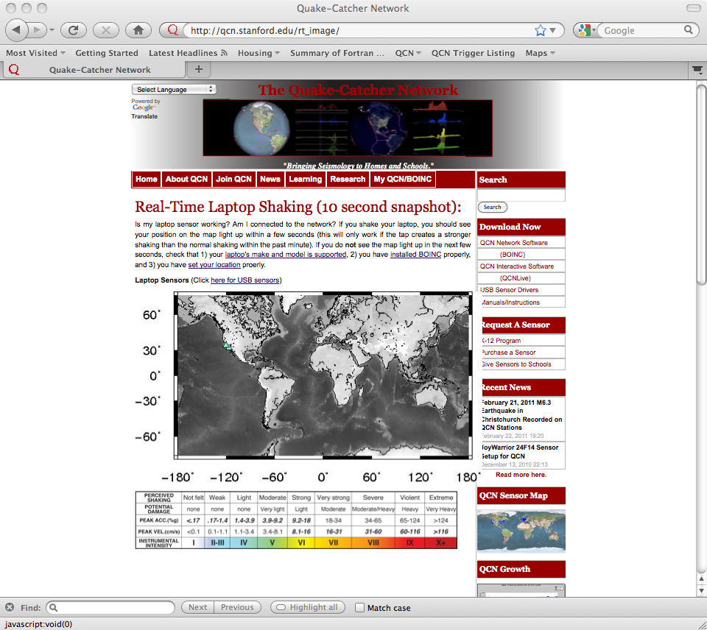
Real Time Shaking:
http://qcn.stanford.edu/rt_image
Condense shaking to viewable format for 1000s of sensors.
Several seconds of latency.

Slide 22




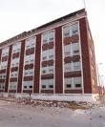

Scientific Objectives
Rapid earthquake detection:
  Rapid magnitude estimation
  Advanced Alert
Earthquake rupture
Ground motion amplification
Building monitoring
G. Prieto et al. 2009

Slide 23
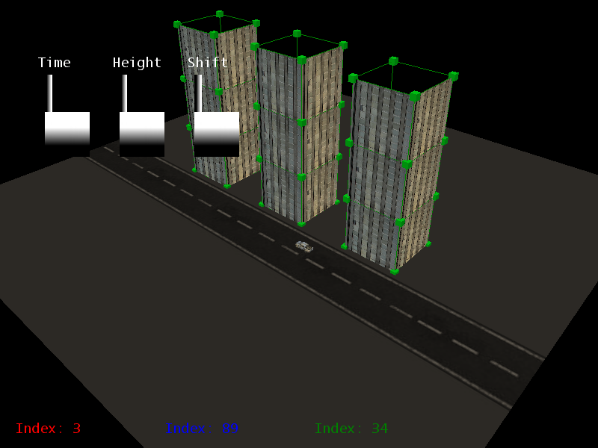
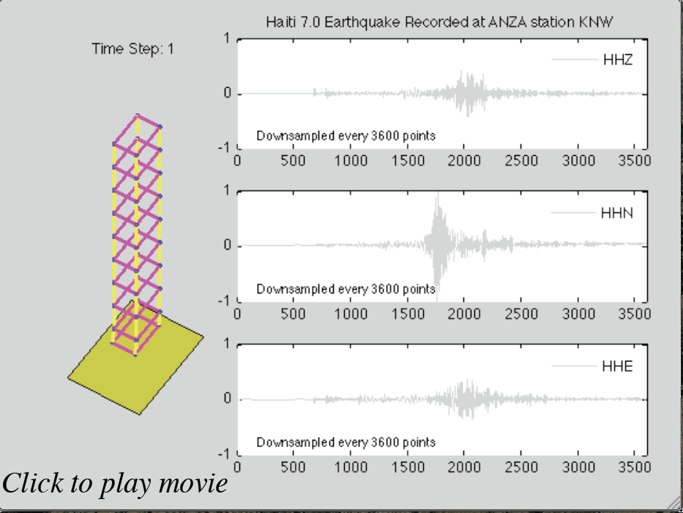
Scientific Objectives: Building Visualization
Courtesy of Debi Kilb
And Daniel Rohrlick

Slide 24




Acknowledgements
Thanks to all of the QCN participants, especially K-12 teachers and classrooms
This project is supported in part by:
  National Science Foundation (NSF)
  Southern California Earthquake Center (SCEC)
  Incorporated Research Institutions for Seismology (IRIS)
  United Parcel Service (UPS)
More Information: http://qcn.stanford.edu

Slide 25
For More Information:
Web Site: http://qcn.stanford.edu
Contact: Jesse F. Lawrence
Email: jflawrence@stanford.edu

