Slide 1
Class tutorial
Measuring Earthquake and volcano activity from space
Shimon Wdowinski
University of Miami

Slide 2
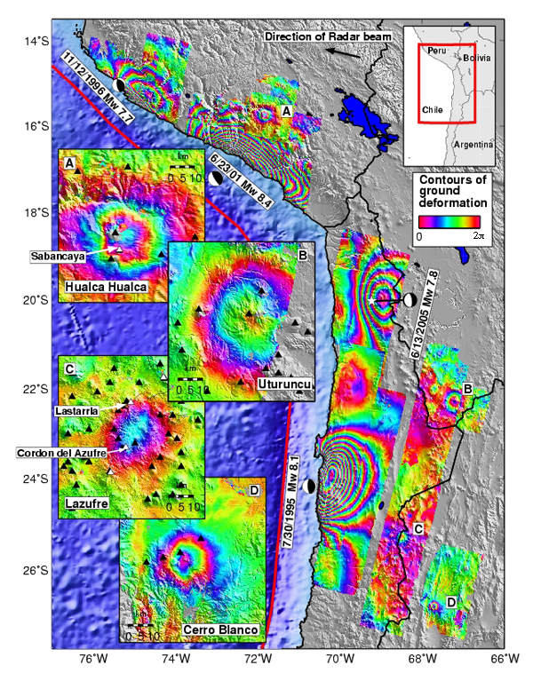
Interferogram of the Central Andes
[Source: Matt Prichard]

Slide 3
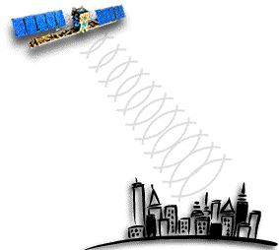
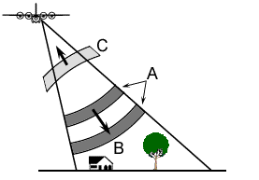
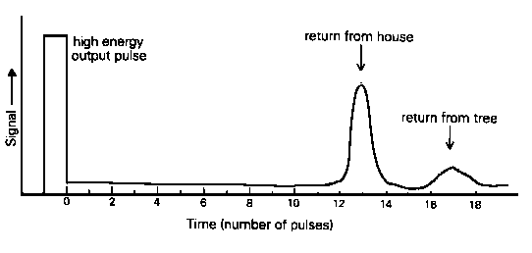
Synthetic Aperture Radar (SAR)
RADAR remote sensing is an `active`
imaging technique that utilises the
microwave region (~1-100 cm) of the
EM spectrum
Notes:
Imaging radar is active system, that is,
satellite transmit microwave and receive the return signal.
It cannot be affected by cloud cover because microwave in the range from 1 cm and 1 m penetrates the cloud.

Slide 4
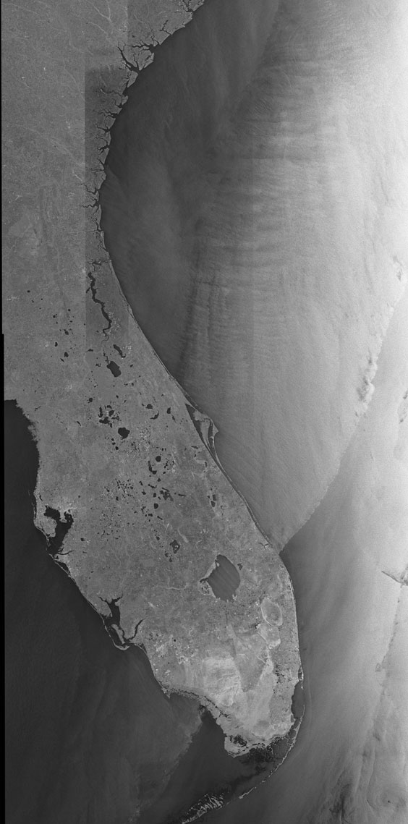
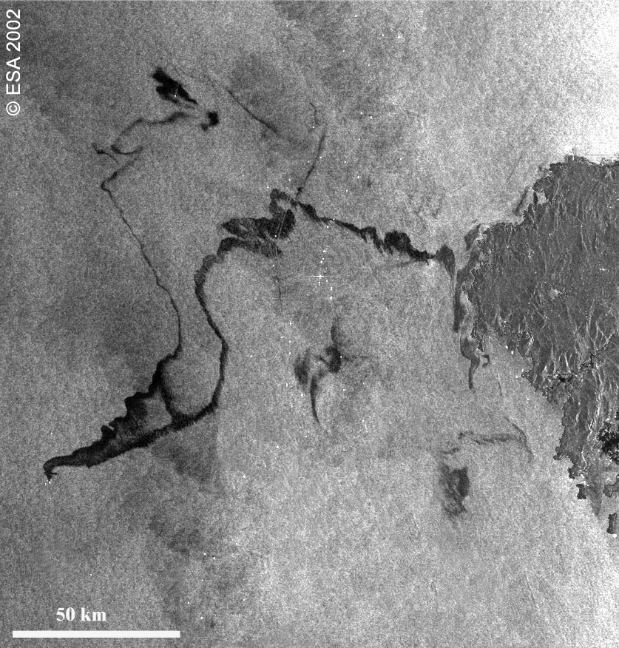
Synthetic Aperture Radar (SAR)
2001 oil spill off northern Spanish Coast
(Imaged by ENVISAT ASAR)
RADARSAT-1

Slide 5
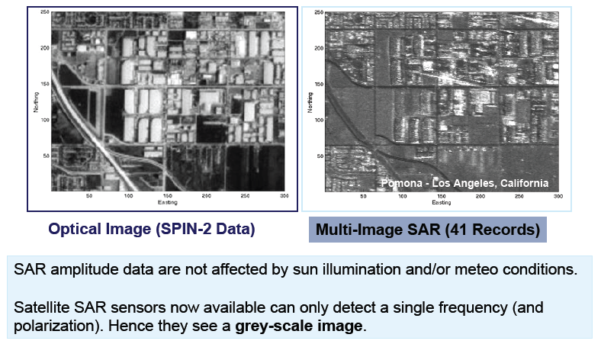
SAR amplitude data vs optical images

Slide 6
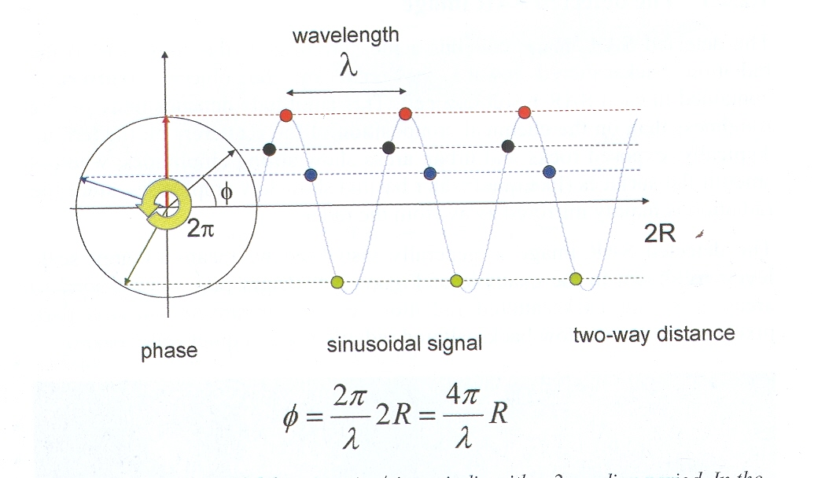
Second observable - phase
The phase is proportional to the two-way travel distance divided by the transmitted wavelength.

Slide 7
SAR – phase observable
Radar
transmited/
Received signal
R
=
x
Time delay
Light Vel.
= Wavelength x (Wave number + phase)
SAR is most sensitive to phase measurements
R
ground surface
Notes:
ꎠ Synthetic Aperture Radar instruments transmit microwave
and then record the time delay as well as strength of the returning signal,
so it can measure distances between satellite and ground targets using this simple equation.
ꎠ If we get two SAR image with proper spatial separation, that is, baseline, we can make a phase difference image by subtracting the phase value.
The phase difference image, called interferogram, enables the generation of topography using SAR interferometry.
Add to this, when we remove topographic phase from the phase difference image,
surface deformations can be measured with high accuracy.
This technique is called as SAR interferometry.

Slide 8
SAR - Phase information
Amplitude Phase

Slide 9

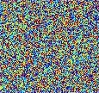
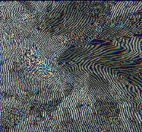
InSAR processing:
phase interferogram
Calculate phase interferogram, i.e. subtract the phase of of the “slave” from that of the “master”.
phase “master”
phase “slave”
phase interferogram
-
=
Note that while both the master and slave appear random, the interferogram does not.

Slide 10
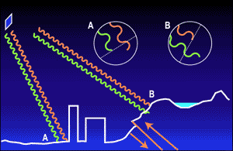
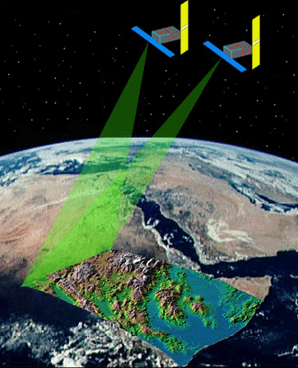
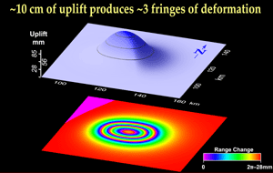
Interferometric SAR - InSAR
Changes in surface location result in detectable phase changes
Two or more data acquisition of the same area from nearby location (< 1000 m)
Fringes – 1 cycle (2π) = ½ λ

Slide 11
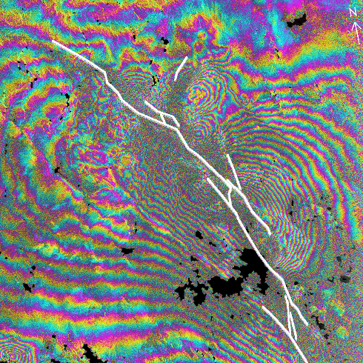
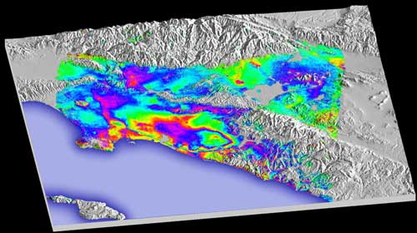
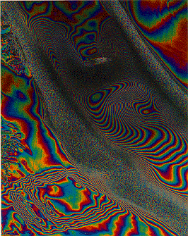
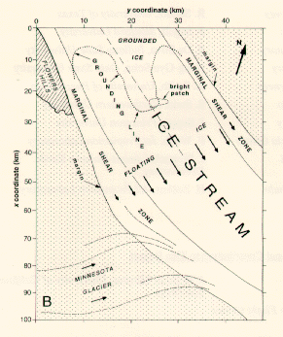
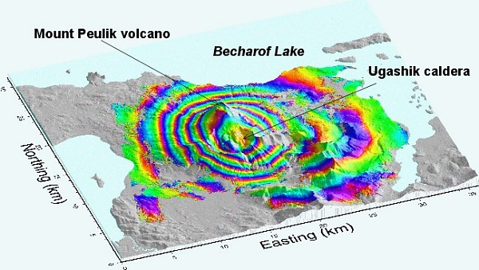
InSAR Applications
Land subsidence
Earthquake deformation
Volcano inflation
Glacial movement

Slide 12
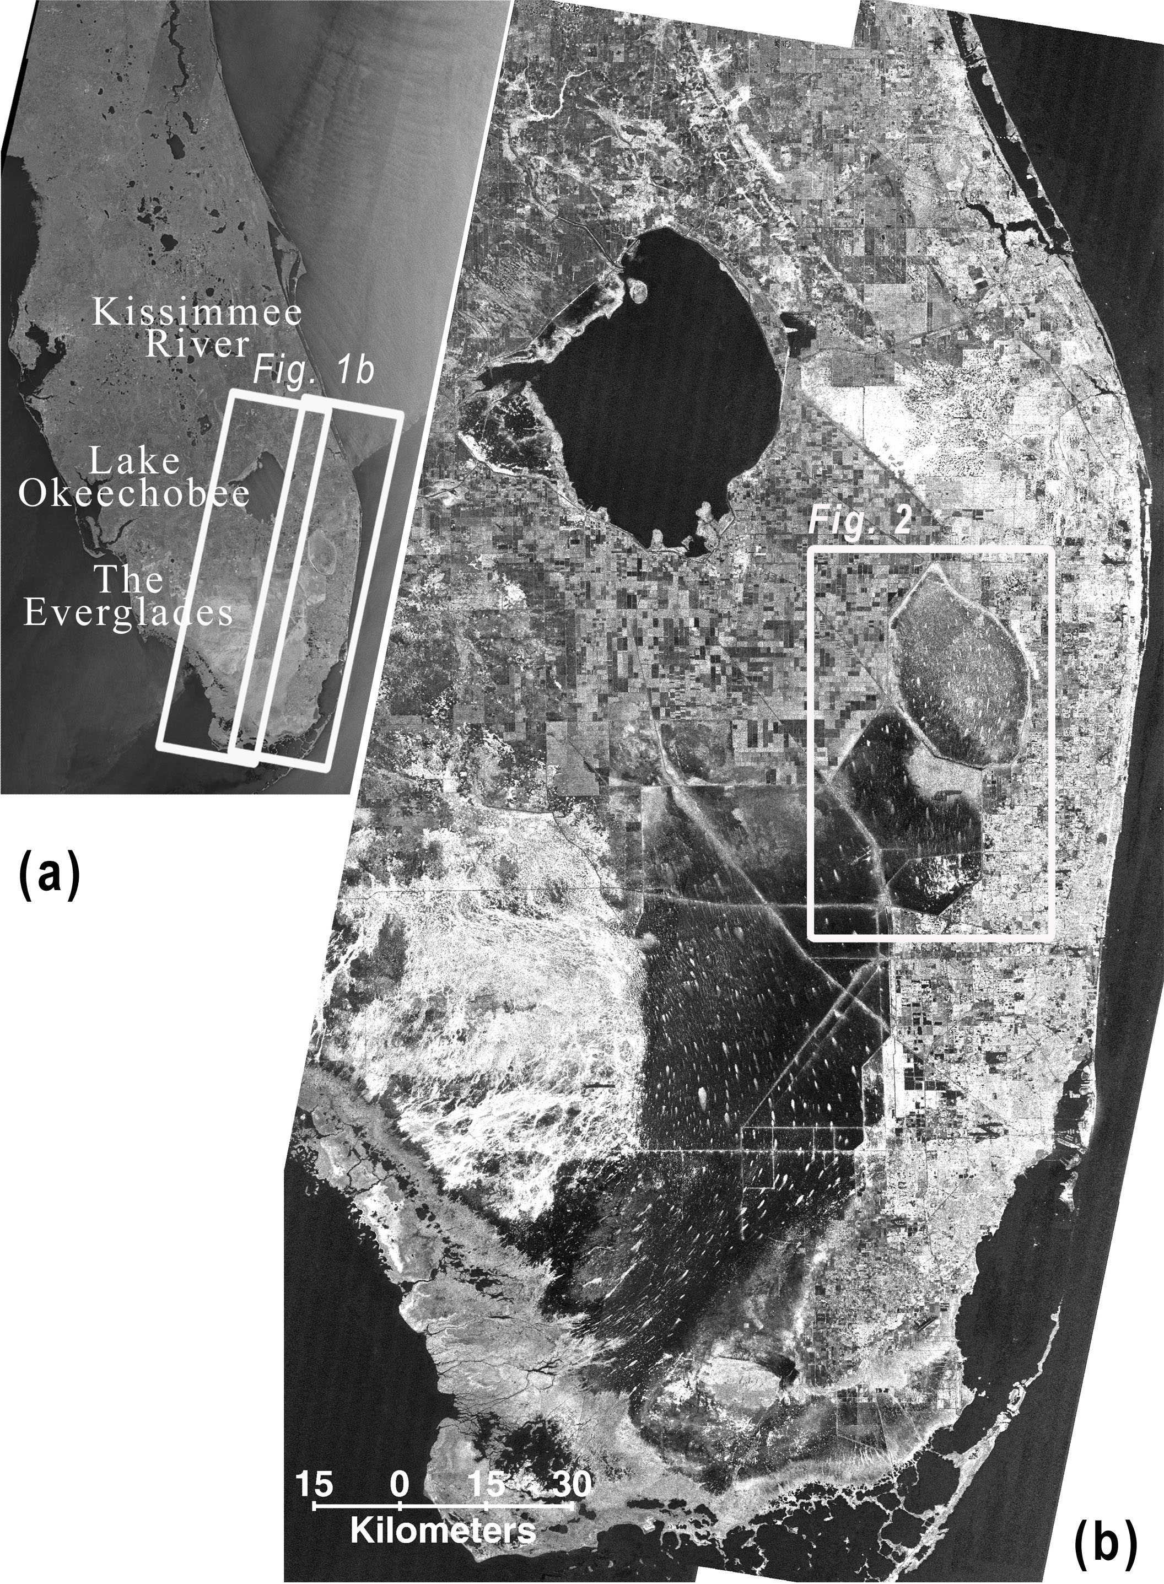
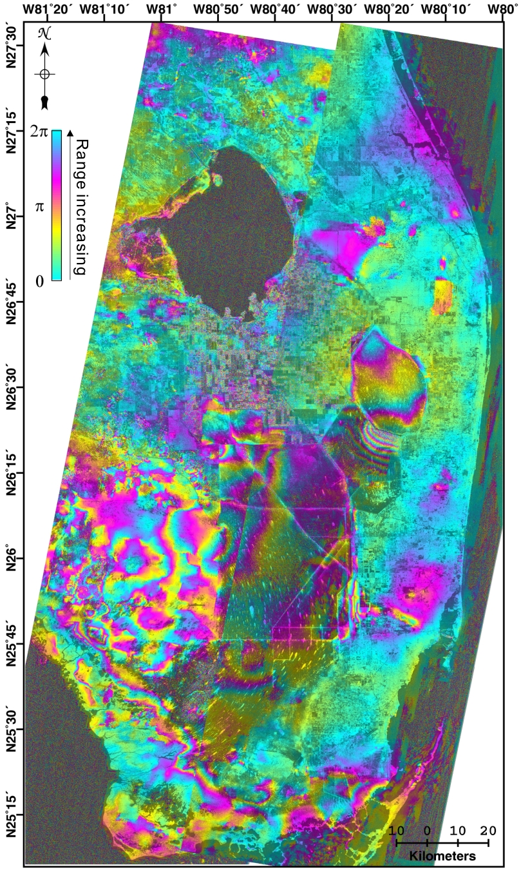
L-band
Data: JERS-1 L-band
(λ = 24 cm)
Area: 225 km x 75 km
Acquisitions: 12 swaths
During 1993-1996

Slide 13
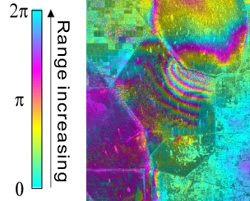
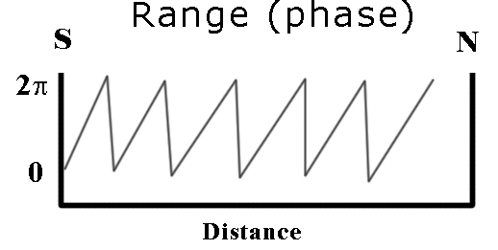
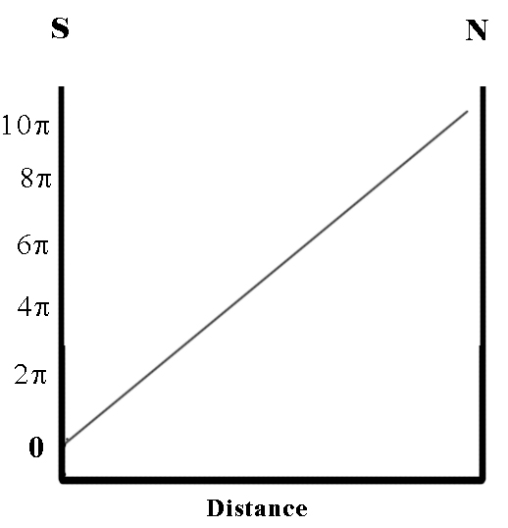
L-band interferogram
Wrapped phase
N
Unwrapped phase
S
InSAR measures phase change along the line-of-sight (LOS) between the satellite and the surface.

Slide 14
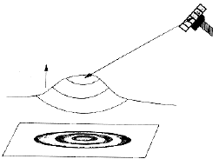
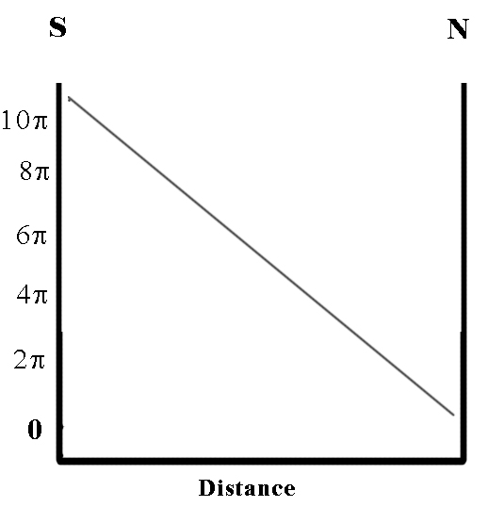
Surface change
Range (phase)
N
S
Surface change

Slide 15
Displacement
Surface change
100 cm
N
50 cm
S
0
Vertical Displacement = (λ/2) / [cos(view angle)].
JERS-1:
λ = 24 cm
θ = 37.5º
Each cycle (2π) represents 15.1 cm of vertical displacement
For C-band (5.6 cm), each cycle of vertical displacement ~4 cm, depending on the view angle.

Slide 16
Interferogram of the Central Andes
[Source: Matt Prichard]

Slide 17
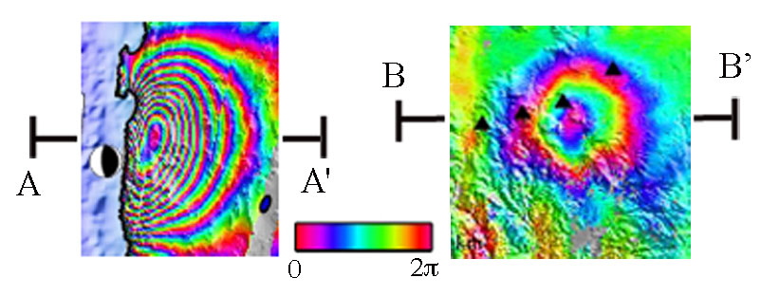
The tutorial
[Source: Matt Prichard]

