Slide 1
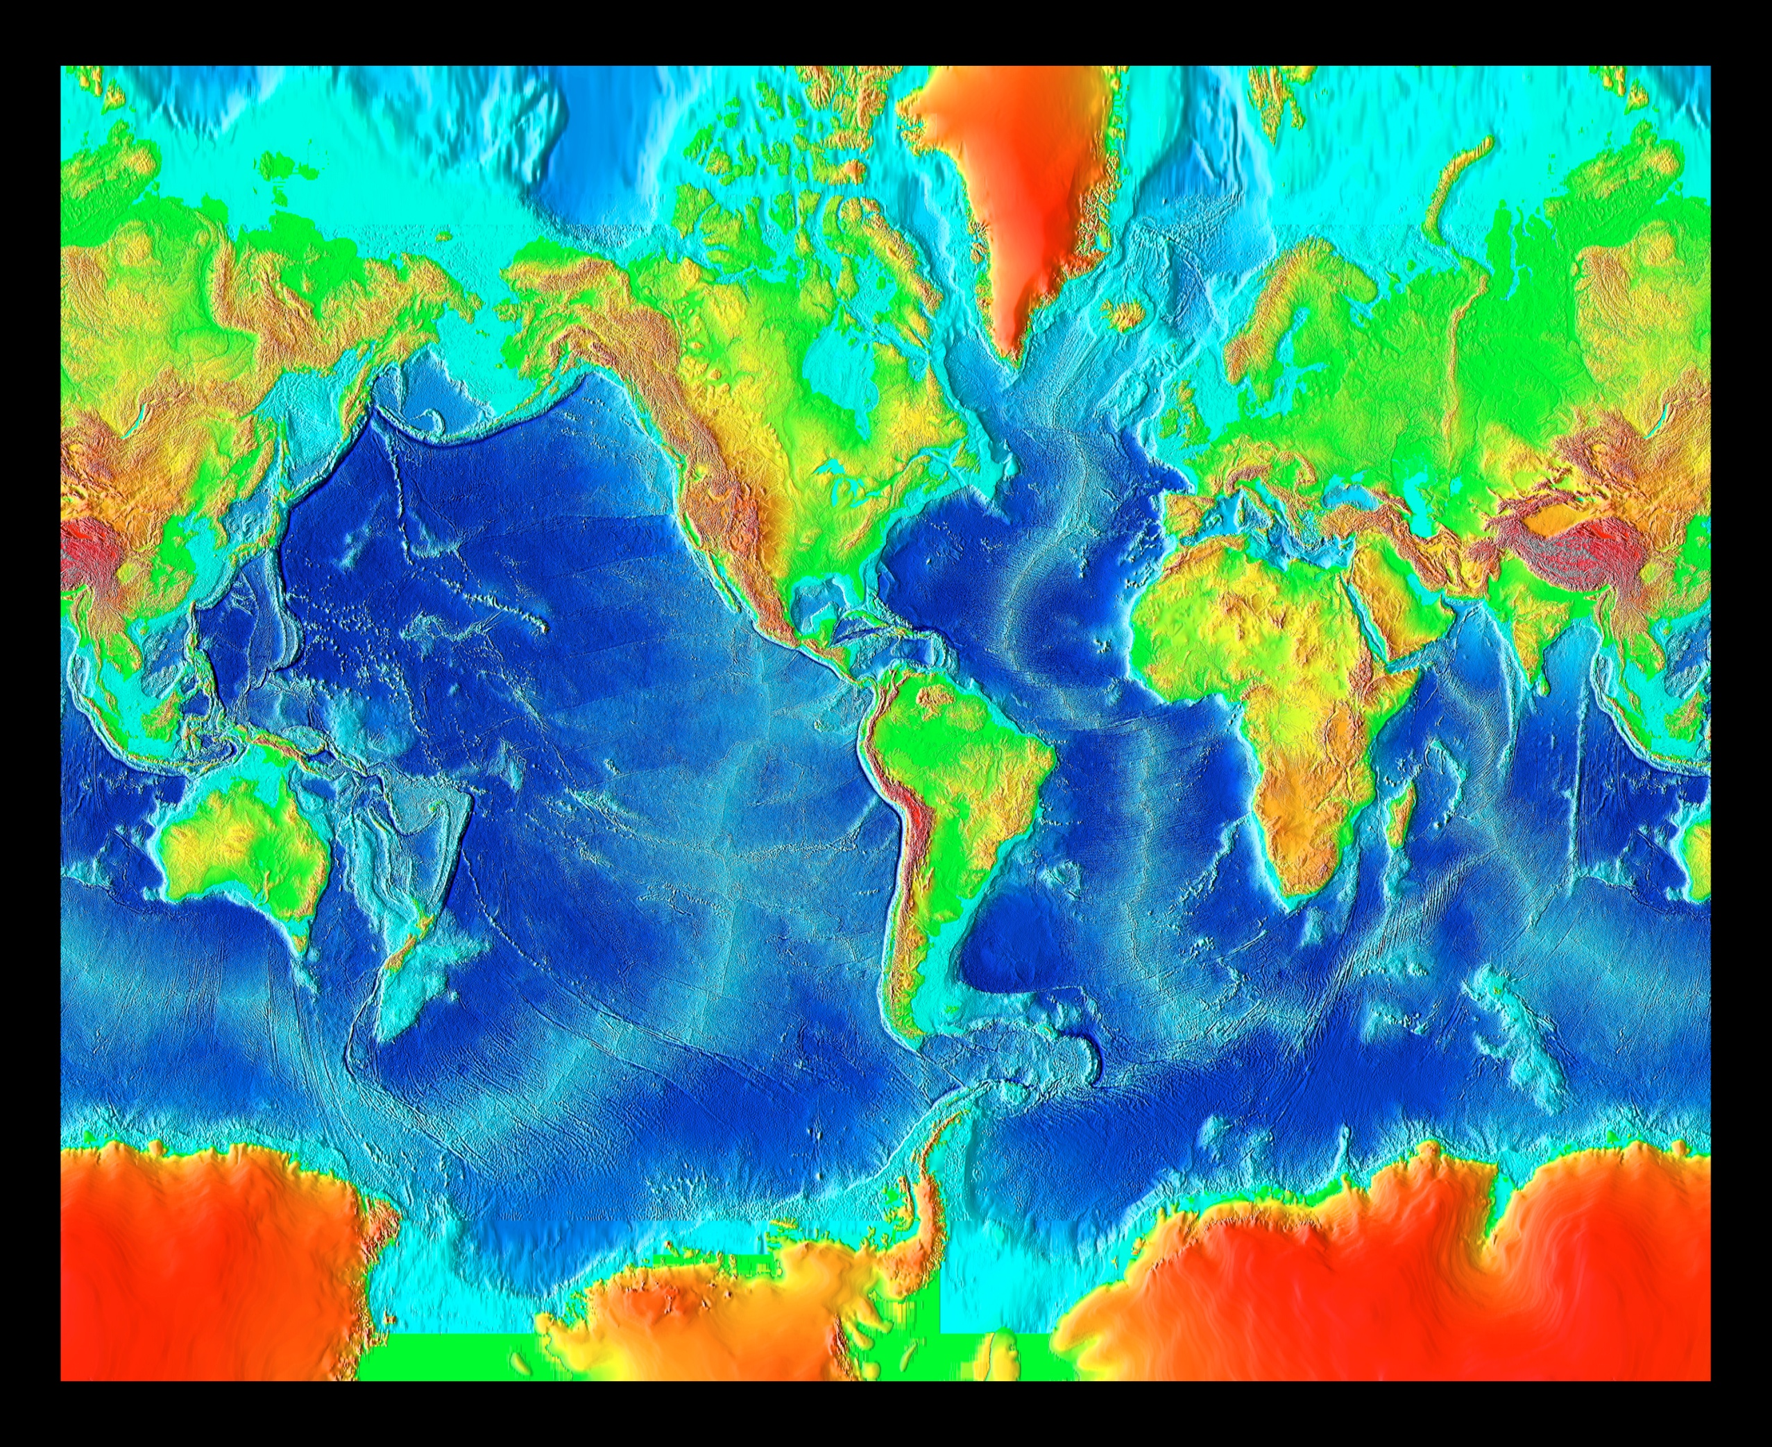
PART 1: Plate motion/boundaries along the eastern margin of the Pacific Plate
(NOAA).

Slide 2
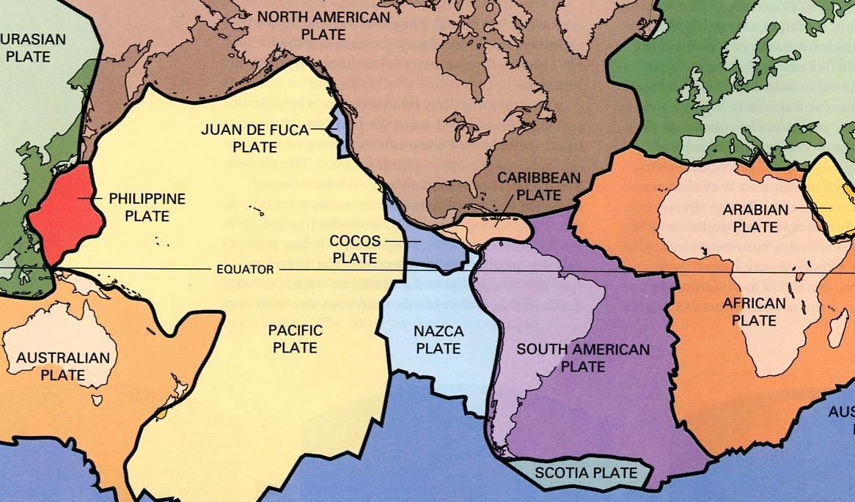
PART 1: Plate boundaries of 12 major plates
Kious and Tilling, USGS

Slide 3
PART 1: Topographic/Bathymetric trends (eastern margin of the Pacific plate)
(modified from NOAA).

Slide 4
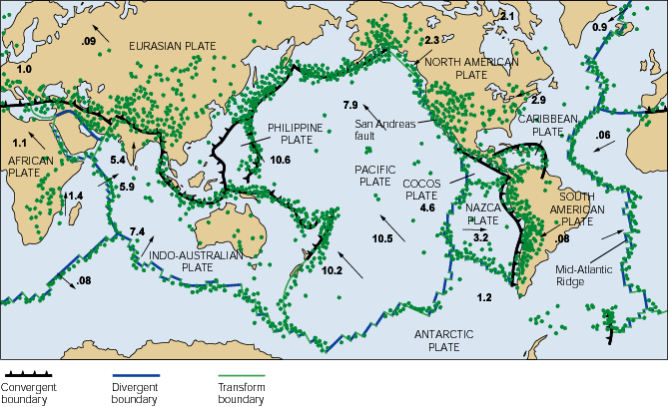
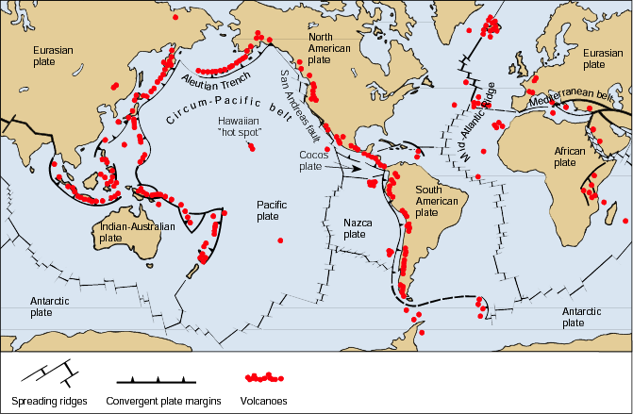
PART 1: Trends in earthquake and volcano distribution; hot spot trends
1B: Earthquakes along the eastern Pacific plate boundary (modified from Monroe and Wicander)
1C: Bathymetry and age of Hawaiian hot spot
60 Myr
43 Myr
Midway
(25 Myr)
1B: Volcanoes along the eastern Pacific plate boundary (modified from USGS)
Oahu
(2-3 Myr)
Hawaii
(Active)

Slide 5
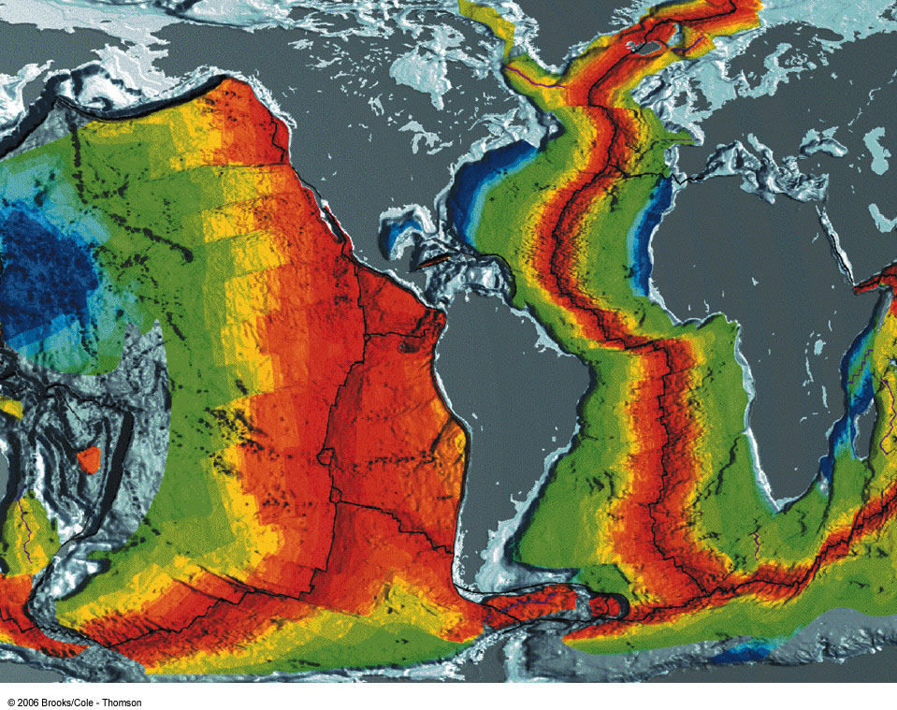
PART 1: Trends age of oceanic crust (Pacific and Atlantic ocean floors)
less than 1 my 48 m.y. 68 m.y 155 m.y.
(NOAA-NGDC).

Slide 6
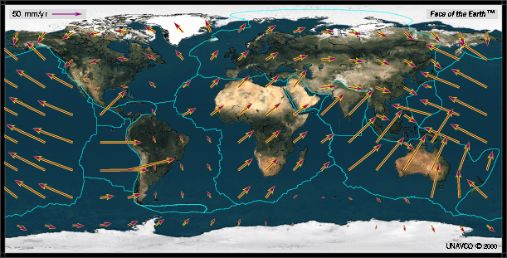
PART 1: GPS vectors/velocities for 12 major plates

Slide 8
PART 2: Future plate configuration at the African-Arabian plate boundary system
(NOAA).

Slide 9
PART 2: Plate boundaries of 12 major plates
Kious and Tilling, USGS

Slide 10
PART 2: Topographic/Bathymetric trends (African-Arabian plate boundary)
(modified from NOAA).

Slide 11
PART 2: Trends in earthquake and volcano distribution; hot spot trends
1B: Earthquakes along the eastern Pacific plate boundary
1B: Volcanoes along the eastern Pacific plate boundary
(modified from Monroe and Wicander)
(modified from USGS)

Slide 12
PART 1: Trends age of oceanic crust (Pacific and Atlantic ocean floors)
less than 1 my 48 m.y. 68 m.y 155 m.y.
(NOAA-NGDC).

Slide 13
PART 2: GPS vectors/velocities for 12 major plates

Slide 15
PART 3: Identification of ancient plate boundaries
(NOAA).

Slide 16
PART 3: Plate boundaries of 12 major plates
Kious and Tilling, USGS

Slide 17
PART 3: Identification of ancient plate boundaries
(modified from NOAA).

