Slide 1
Geophotography as Pedagogy: Students Creating and Using Geologic Images
David Mogk, Montana State University
On the Cutting Edge Geophotography Webinar
April 2, 2013

Slide 2
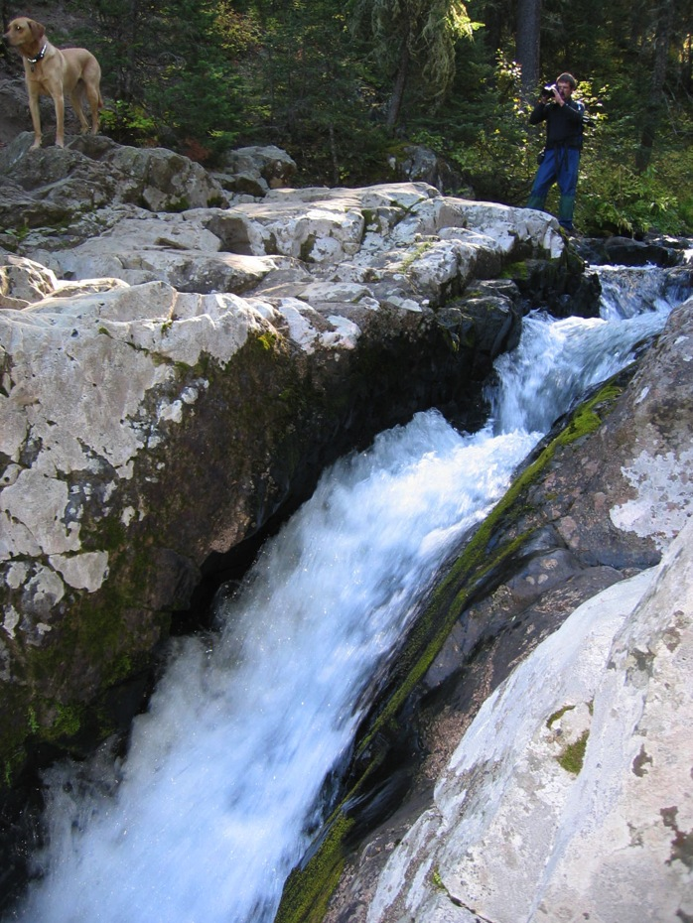
Part I:
Using Photos in Your Classroom Instruction
  What we’ve learned from the cognitive sciences
Part II:
Class Activities Where Students are the Photographers
Photo Credit: Travis Corthouts, Dept. Earth Sciences, Montana State Univ.

Slide 3
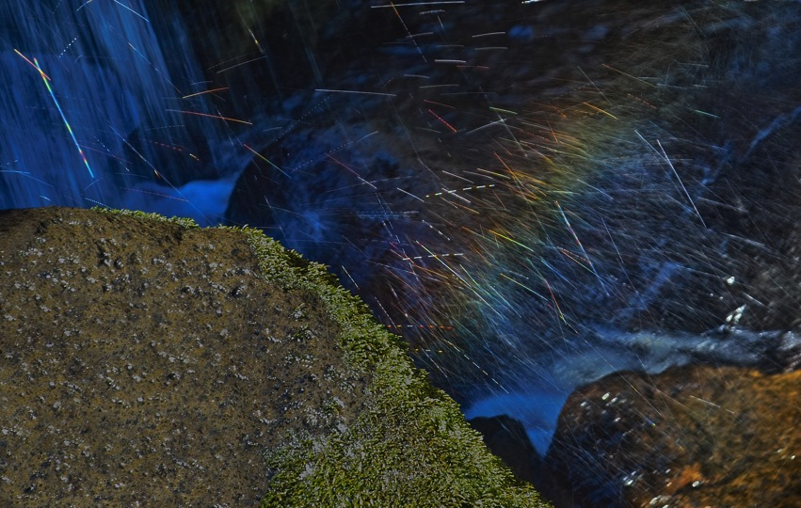
Photography is Transformative
I. Nature into Culture—Inscriptions (Latour, 1987)
  Permanent, portable, and public records
  Landscapes, outcrops, close-ups
  Aesthetic intent
  Awe and Wonder
  Documentary
    categorizing
    explaining
  Capture Earth’s dynamics
Photo Credit: Travis Corthouts, Dept. Earth Sciences, Montana State University
http://serc.carleton.edu/earthandmind/posts/Through_a_lens

Slide 4
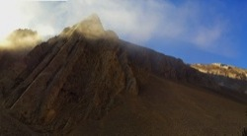
Photography is Transformative
II. Students Into Scientists
Students had to make fundamental decisions
  Scale, proportion
  Knowing what to include or exclude
  Knowing what to emphasize (with lighting, post-production…)
  Externalizing stored knowledge
  Conveying meaning purposefully
  Gaining technical expertise (geologic, photographic)
  Joy of discovery, self-directed inquiry, decision-making
Photo Credit: Travis Corthouts, Dept. Earth Sciences, Montana State University

Slide 5
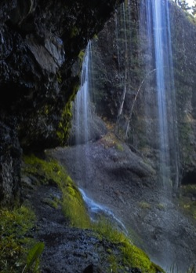
Photography is Transformative
III. The Viewing Public, the “Spectator”—connecting to the place or event (Barthes, 1981)
Changing the viewer through the relationship with the photograph
The “Studium”—the general interest of the photo
The “Punctum”—the piercing point; revealed through memory, reflection, deeper thought
Photo Credit: Travis Corthouts, Dept. Earth Sciences, Montana State University

Slide 6
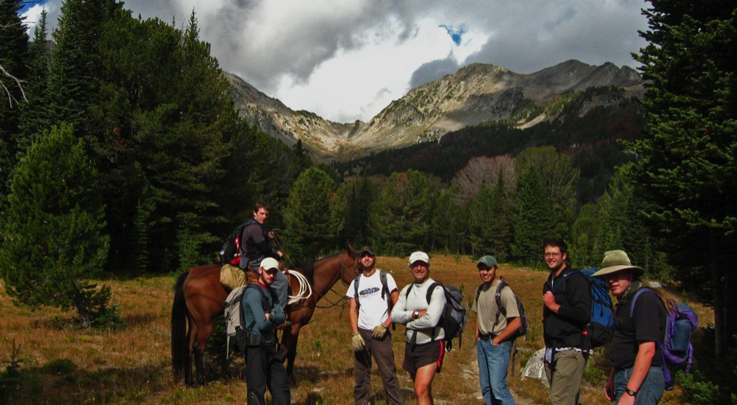
What do we know from cognitive psychology?
Teaching Geoscience With Visualizations http://serc.carleton.edu/NAGTWorkshops/visualization/index.html
Every picture tells a story (Rod Stewart, 1971)… but how can we be sure the right message is being received?

Slide 7
Cognitive Load Theory
Informs How we can Best use Photos in Education
From Maxwell et al., 2013
Long-term memory
  Sub-conscious and permanent storage of information; essentially infinite capacity
Working Memory
  Information from the environment, or long-term memory becomes focus of active attention and processing
  Can only hold a finite number of items for limited time; new information is integrated with existing knowledge; defines limits to learning
Cognitive Load
  Intrinsic cognitive load—mental effort related to the difficulty of content to be learned; complexity increases C.L.
  Extraneous cognitive load: effort required to understand material not directly related to learning process; detracts from learning
  Germane Cognitive load: effort devoted to construction of new knowledge, meaningful engagement, new understanding

Slide 8
What Makes an Effective Photo for Instruction?
Selecting the right photo
  What are you trying to demonstrate?
  What do the students already know?
  Feedback: does the photo convey the intended information, enable the desired learning?
Students don’t necessarily see what the instructor sees
  Students’ learning follows what they already know
  What do students focus on in the image?
  Does the photo generate new questions?
  Can the students understand and interpret processes represented? (What assessment will you use?)

Slide 9
What Makes an Effective Photo for Instruction?
Simple is usually better
  Focus on the essentials
Context is important
  Allows students to draw from earlier learning experiences
Guidance helps
  Visual or textual clues, focus on what is important, what can be ignored (“disembedding”)

Slide 10
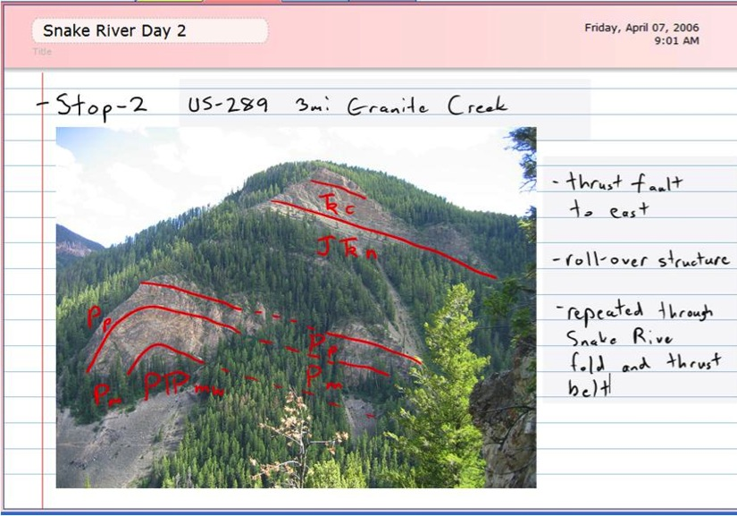
Annotations
Distilled from Barbara Tversky
Textual, provide context
  Stratigraphic units, ….
Lines
  Discriminate A from B
  Connecting A and B
  Pathways from A to B
Arrows
  Directionality
  Pointing, labeling
  Temporal sequence
Outlines
  Enclosure, area of interest

Slide 11
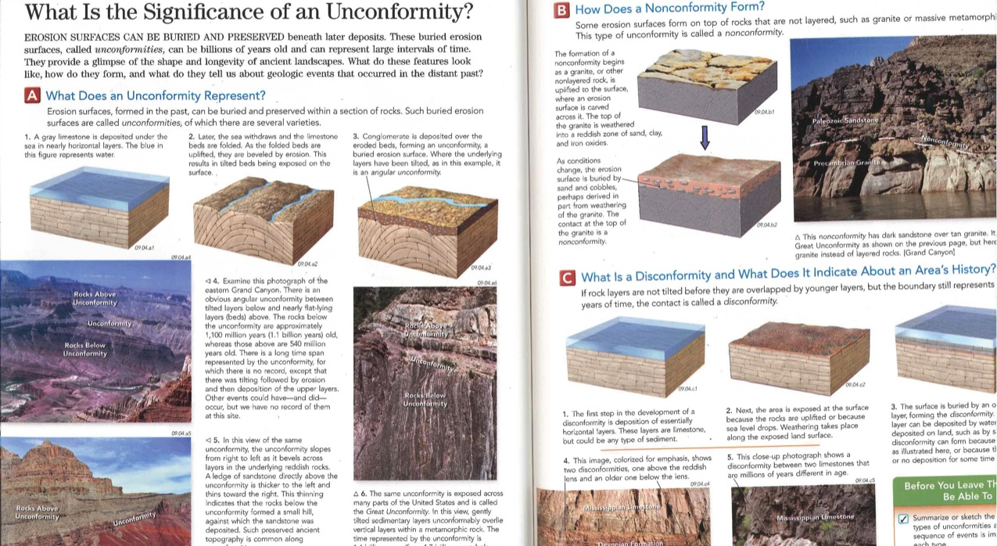
Reynolds et al.: Tell the story in pictures and graphics

Slide 12
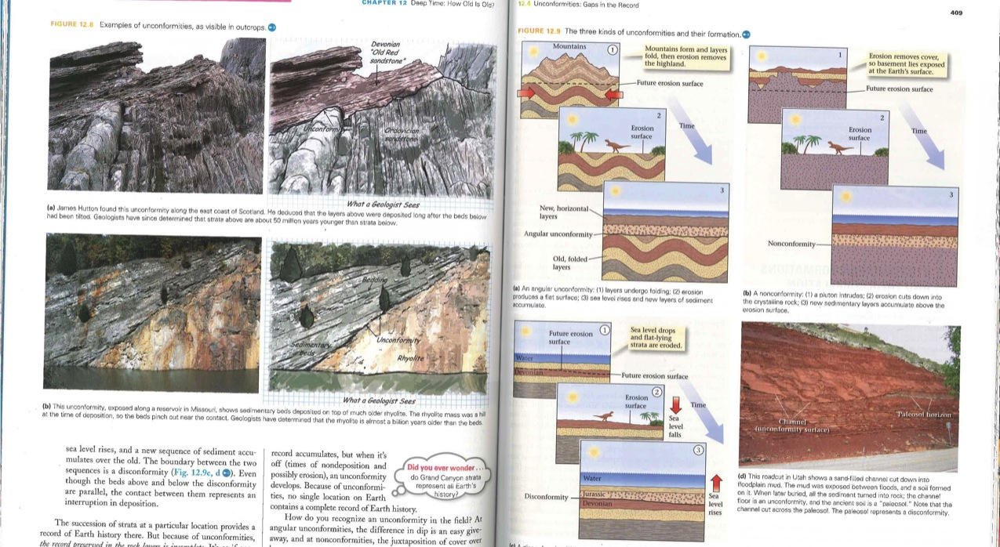
Reynolds et al. II

Slide 13
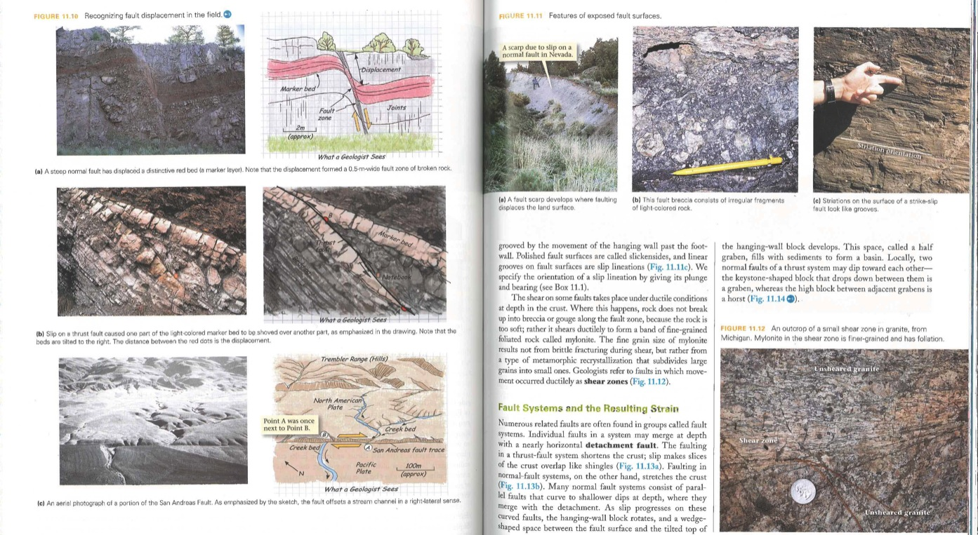
Marshak: Through the Eyes of a Geologist

Slide 14
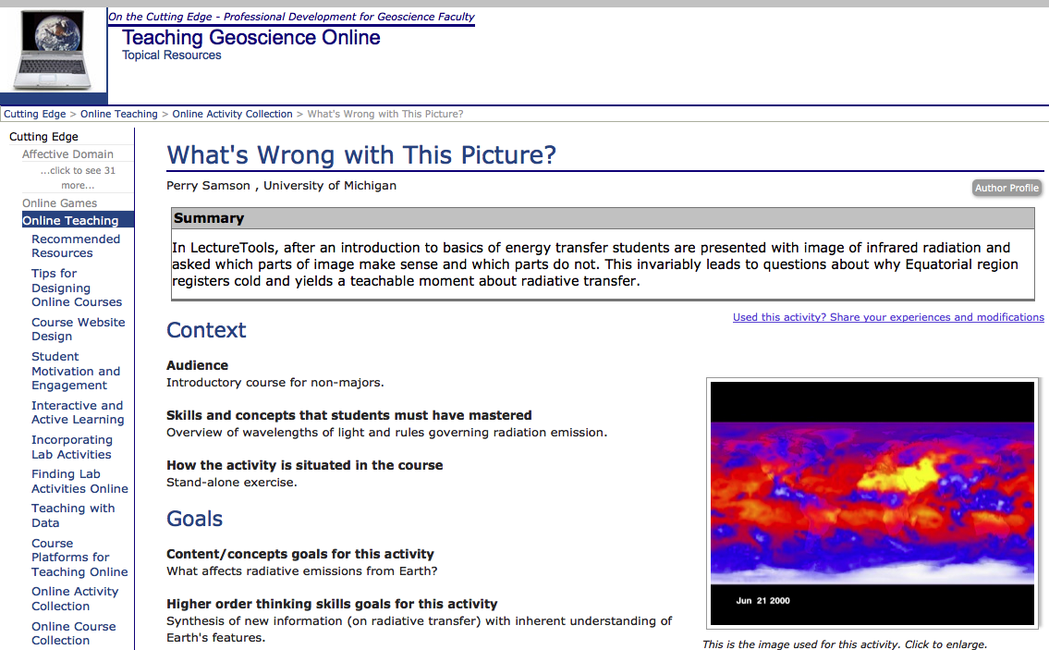
Perry Samson: What’s Wrong With This Picture?
Teaching Strategies:
Interactive Lectures
Peer Instruction
Guided Discovery
http://serc.carleton.edu/NAGTWorkshops/online/activities/46664.html

Slide 15
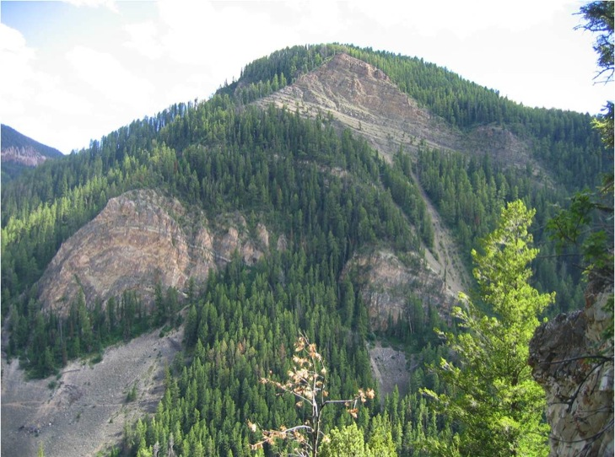
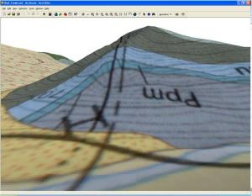
Teaching With Geopads
Field photos downloaded into field-based computers in real time. Ability to superpose layers (maps, etc.)
http://serc.carleton.edu/research_education/geopad/mapping_projects.html

Slide 16
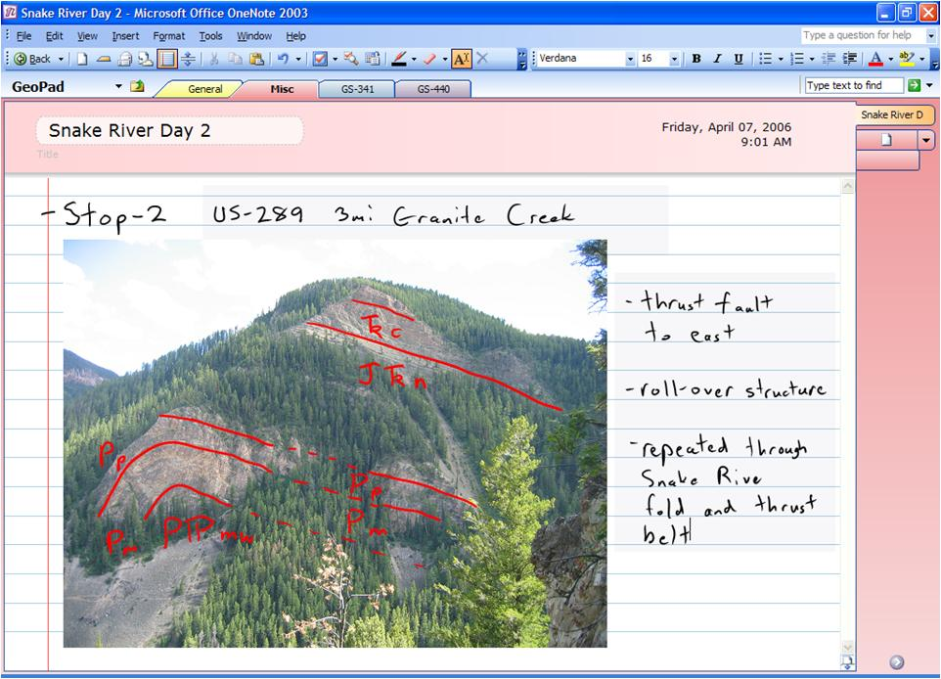
Image Mark-Ups
Using One-Note Software:
annotated field photographs and other imported images;
Looking at the landscape may be confusing to students.
Use “White board” sketches directly on photo.
Or, have students take photo, annotate, to demonstrate understanding.

Slide 17
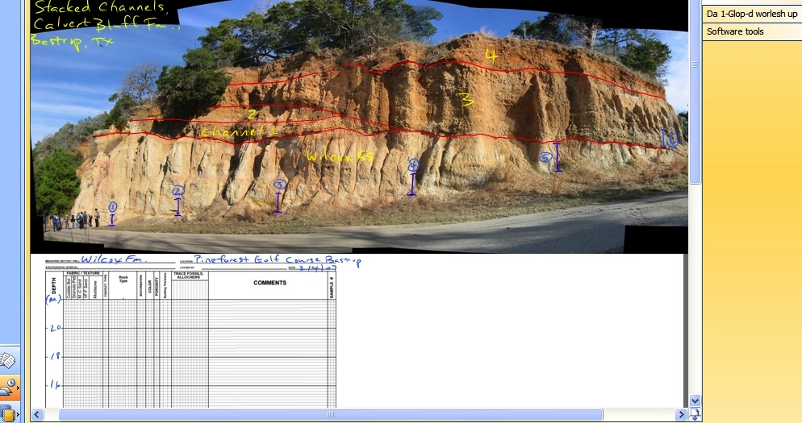
Image Mark-Up II
Students can mark-up other image materials such as maps, overview sketches, or competing interpretations. They can further examine their annotated images by using on-off toggle functionality that will separates their interpretative notes from the image.

Slide 18
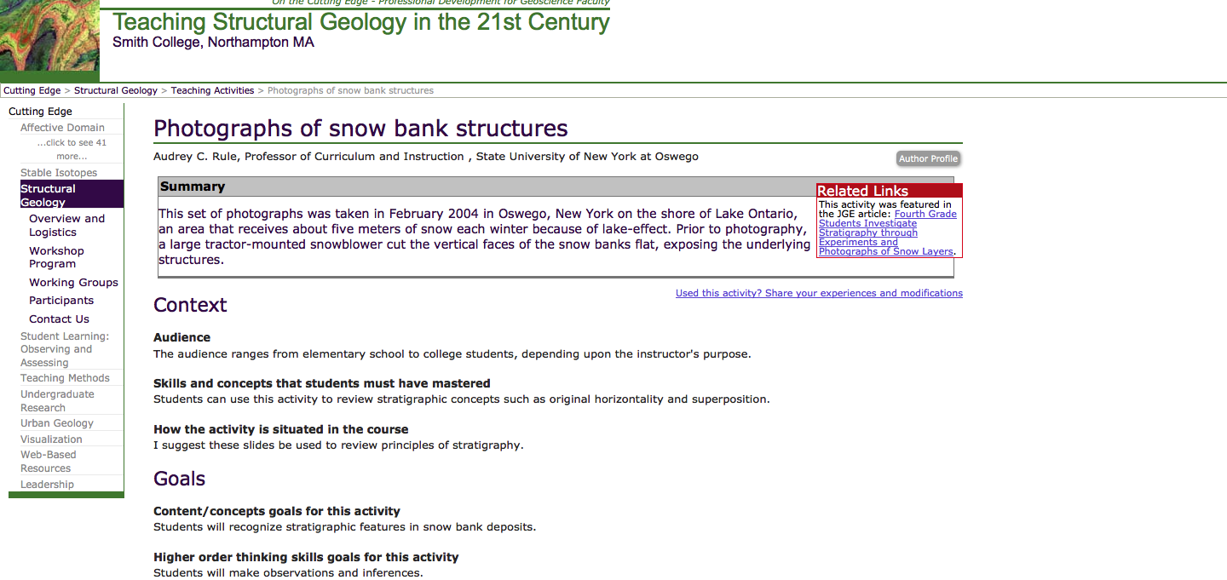
Audrey Rule: Photographs of Snow Bank Structures
Students can review stratigraphic concepts such as original horizontality and superposition.
http://serc.carleton.edu/NAGTWorkshops/structure/activities/10594.html

Slide 19
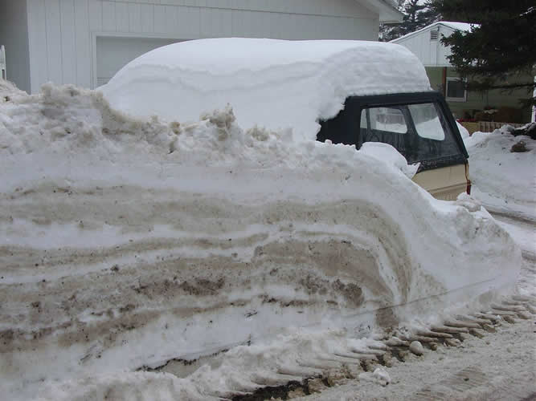
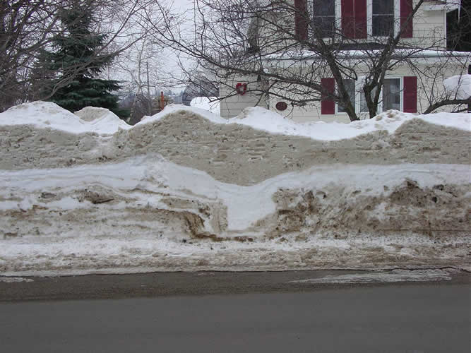
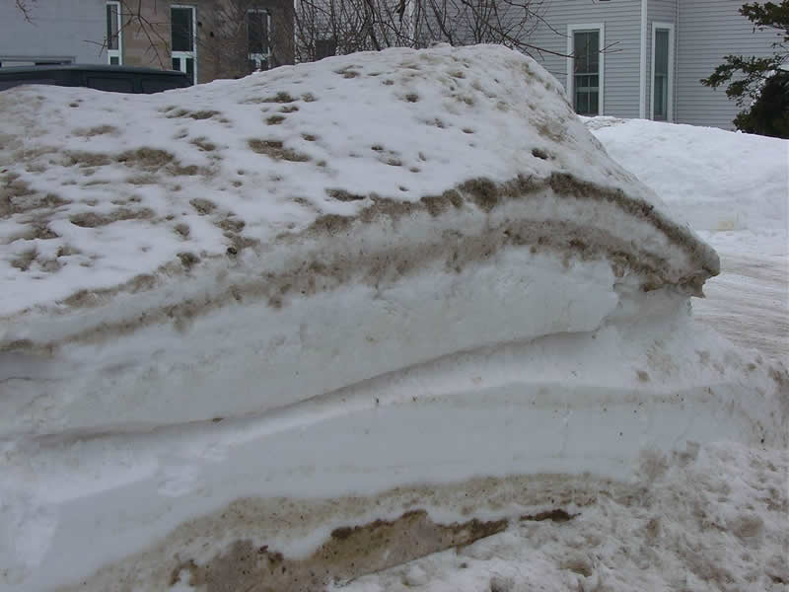
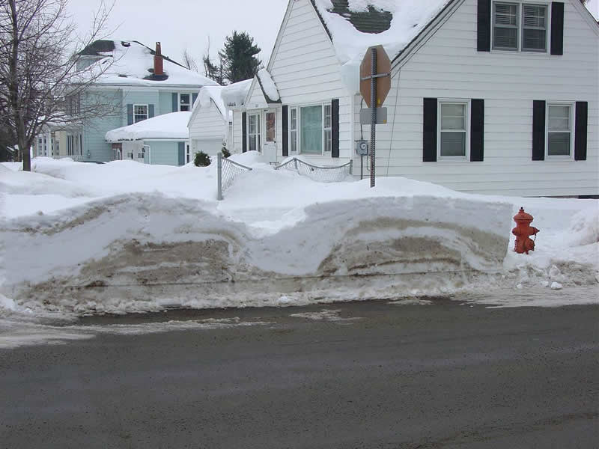
Photo Credits: Audrey Rule

Slide 20
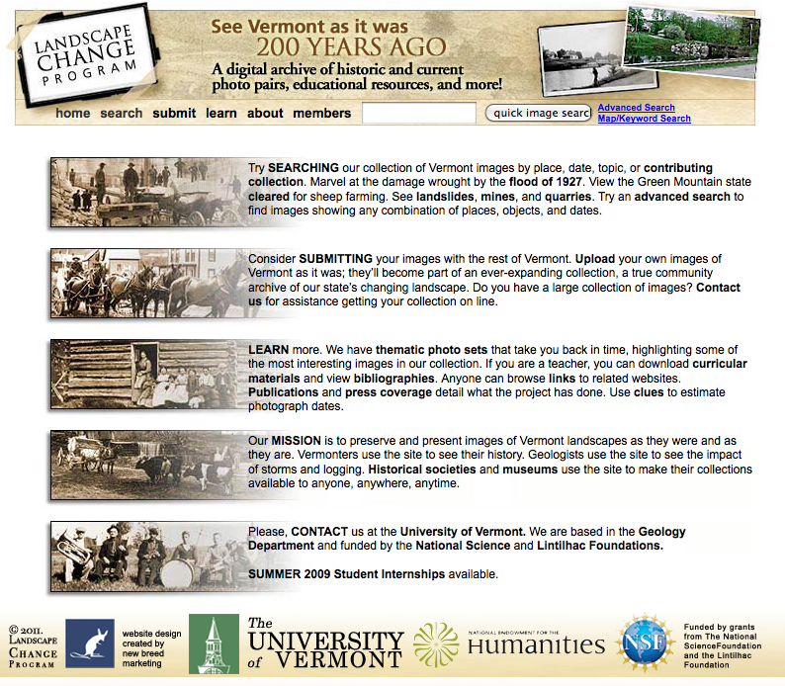
Paul Bierman: Landscape Change Program
http://www.uvm.edu/landscape/menu.php

Slide 21
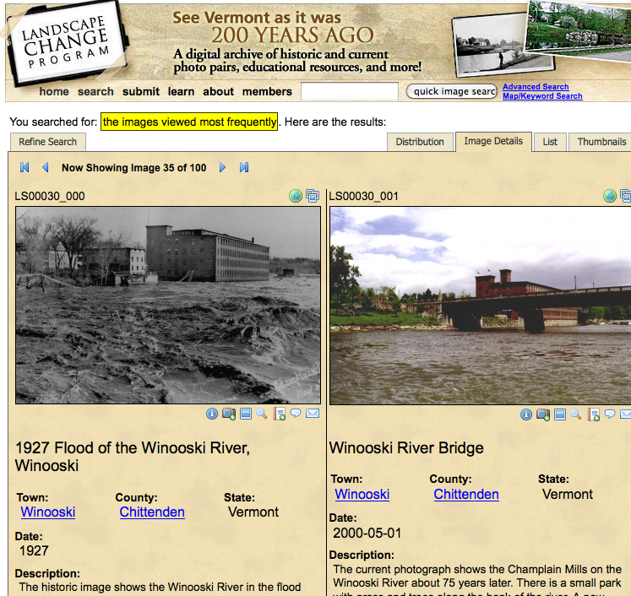

Slide 22
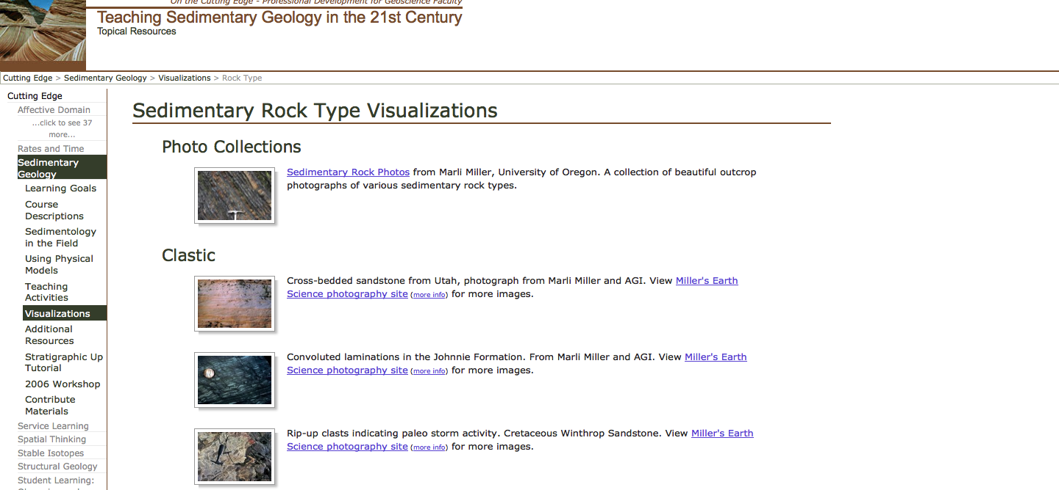
Use of Photo Atlases in Class Activities
http://serc.carleton.edu/NAGTWorkshops/sedimentary/visualizations/rocktype.html

Slide 23
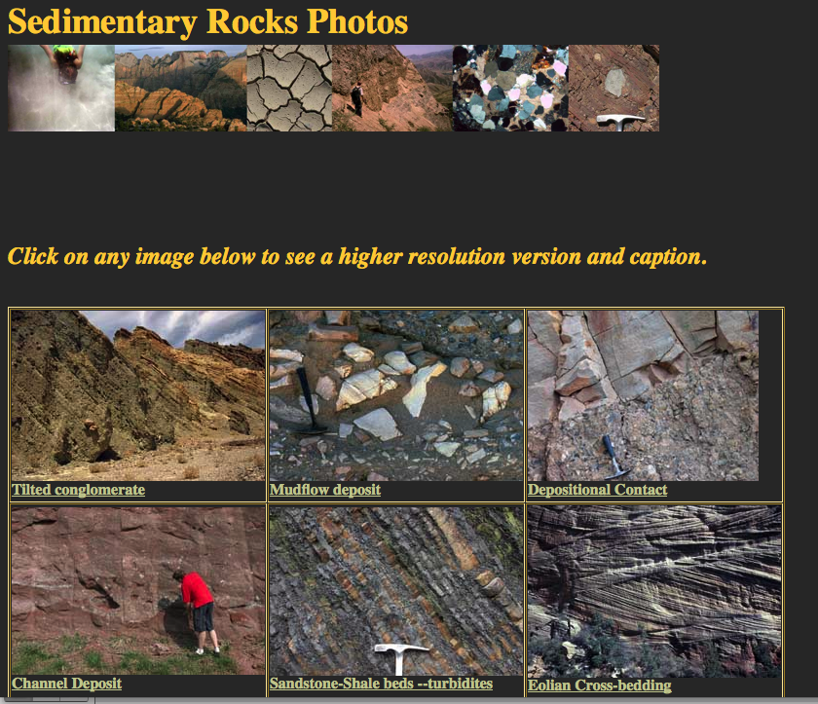
Given access to these comprehensive image archives, how would you effectively use these in class or in an assignment?
http://www.marlimillerphoto.com/Sed.html

Slide 24
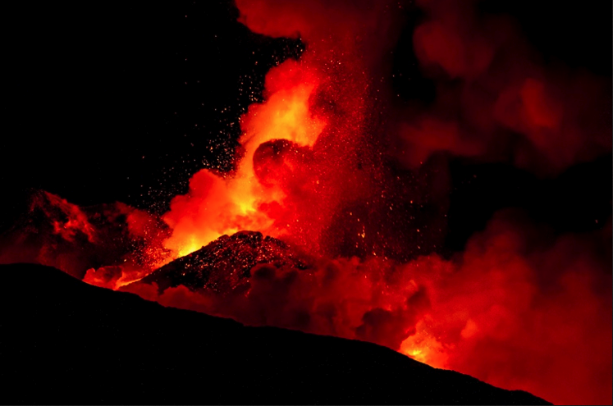
Photo Image Archives
AGI’s Earth Science World Image Bank http://www.earthscienceworld.org/images/
NASA/USRA’s Earth Science Picture of the Day http://epod.usra.edu/
GEODIL http://www.geodil.com
On the Cutting Edge http://serc.carleton.edu/NAGTWorkshops/visualization/collections.html
February 19, 2013 Eruption of Mount Etna
Photo Credit: Marco Restivo; EPOD

Slide 25
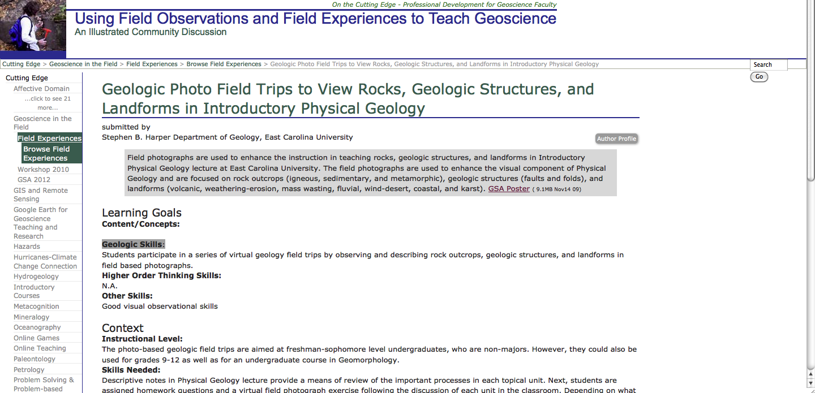
Steve Harper: Geologic Photo Field Trips to View Rocks, Geologic Structures, and Landforms in Introductory Physical Geology
http://serc.carleton.edu/NAGTWorkshops/field_experiences/posters/37444.html

Slide 26
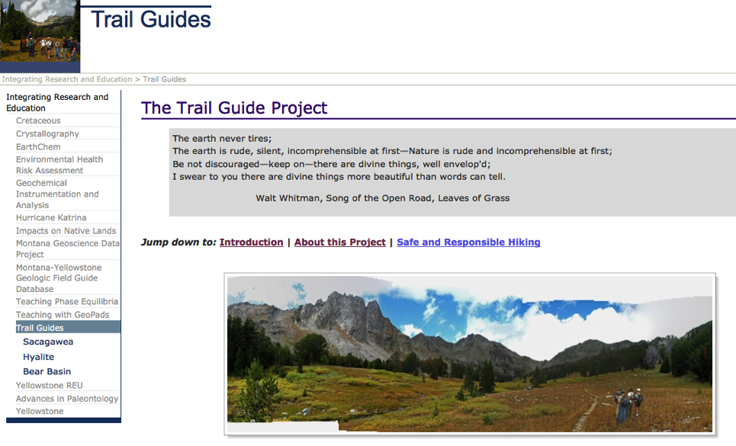
Trail Guide Project
David Mogk, Montana State University
Encourage citizens to get out into the field
  Capture the aesthetics
Details of access, trail conditions
Step by step guide to key features
  Hikes will be more enjoyable if you know what to look for
Interpretations based on geoscience
A service-learning project by students
http://serc.carleton.edu/37967

Slide 27
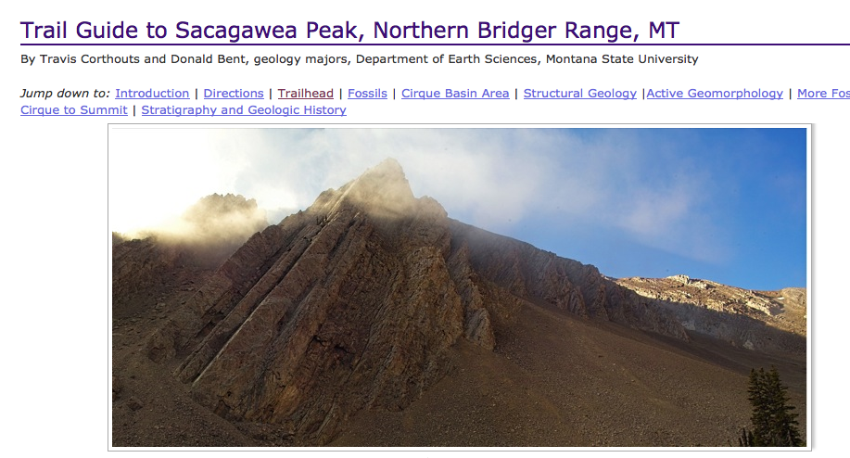
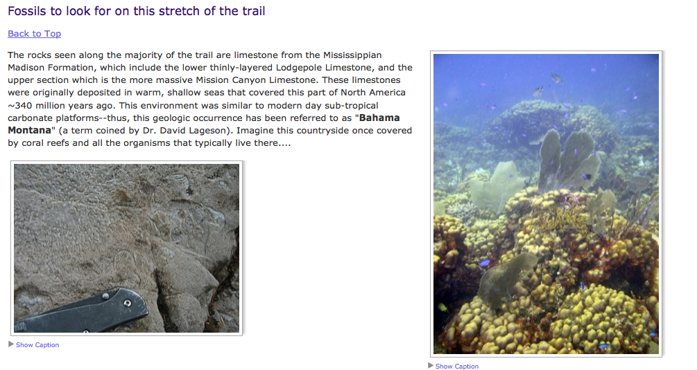
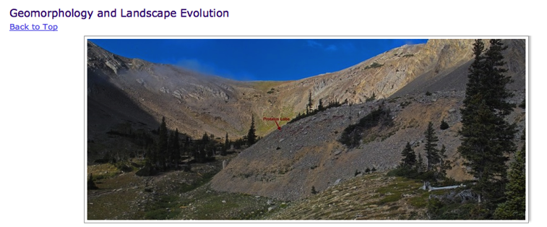
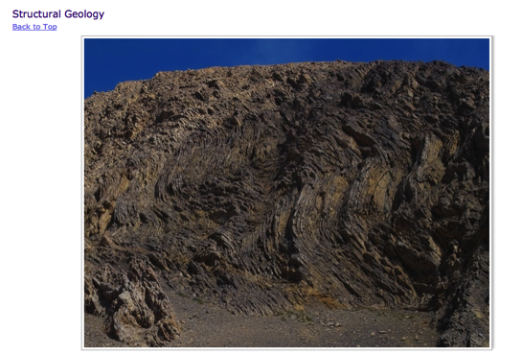
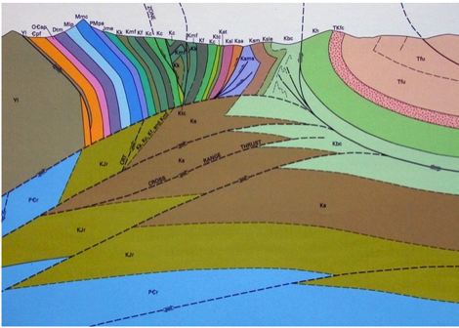

Slide 28
A Geophotography Class: A View on Earth David Mogk, Dept. Earth Sciences, Montana State Univ.
Multi-disciplinary course co-taught with photography professor (co-listed Science and Art)
Introduction
  Earth Science processes for Art students
  Technical photography skills, composition for E. Sci. students
Two weeks of field trips to explore landscapes
  Agriculture, mining, forestry, recreation…
Students developed an art portfolio to represent dynamic processes or human impacts;
  Art show in Student Union

Slide 29
New Activities
Charlie Lindgren Science of Sand: http://www.scienceofsand.info/sand/geophoto.htm
  http://serc.carleton.edu/NAGTWorkshops/geophoto/workshop2013/workspace_2013/lindgren.html
Bob Filson http://serc.carleton.edu/dev/NAGTWorkshops/geophoto/activities/71114.html
Mike Rygel Atlas of Sedimentary Structures
  http://serc.carleton.edu/NAGTWorkshops/geophoto/workshop2013/workspace_2013/rygel.html
Martin Schmidt http://serc.carleton.edu/NAGTWorkshops/geophoto/workshop2013/workspace_2013/schmidt.html

Slide 30
Discussion?
New ideas about how to use photos in class activities?
New ideas about how to engage students in photography as a class activity?

