Slide 1
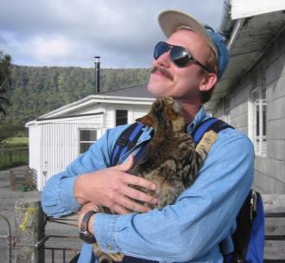
How to get the most out of your (geo)photography
February 26, 2013 Webinar
Jerry F. Magloughlin
Colorado State University
Rationale
My approach: pragmatism & geoscientists; overview & fundamentals
Geophotography in general
The four components (PEST)
Equipment
Planning
Shooting tips

Slide 2
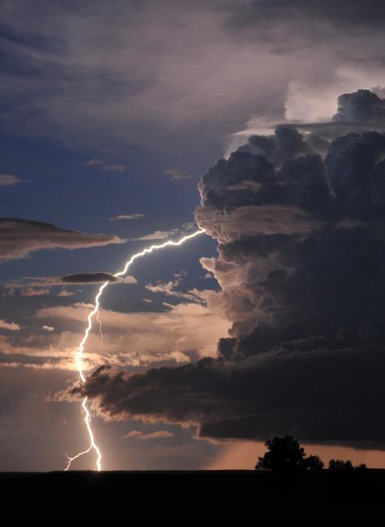
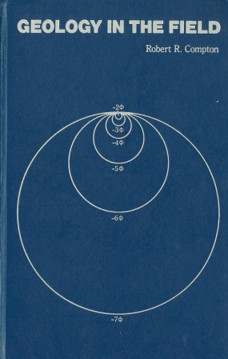
1. Rationale
Photography is pervasive in geology (teaching, research, outreach; indoor, outdoor, photomicroscopy, other imaging).
“Photographs…show features exactly as they are, thus being the most convincing kind of graphic evidence.” –R.R. Compton
Geoscientists visit amazing places, but often return with mediocre photographs.
An explosion of equipment & techniques… harder now?
Rarely is any training afforded!
Issues unique to, or special considerations in, GEOphotography.
Photographic skills may be worsening!

Slide 3
Survey question:
I received “significant” instruction on what to do, photographically, in the field while doing geology/geoscience/field work:
Click yes (agree) or no (disagree)

Slide 4
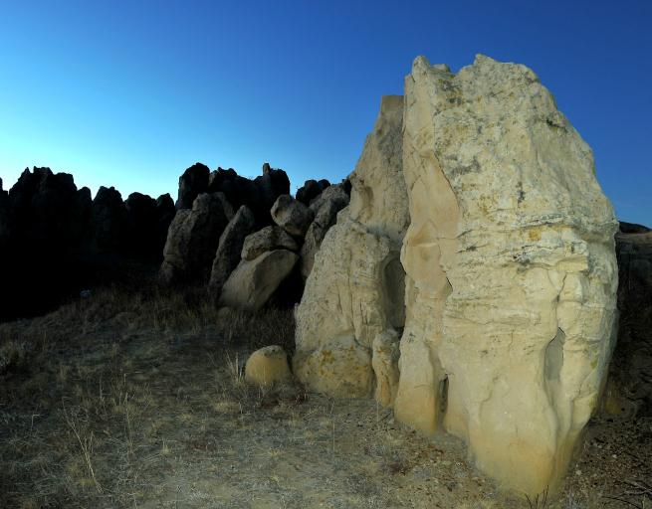
2. My approach: pragmatism & geoscientists
We’re geoscientists first, photographers second
Not unlimited money or time
We’re usually on a schedule
We still want high quality images
My approach:
  careful choice of equipment,
  planning,
  care while photographing,
  modest investments in workflow…
  we can do a lot better!

Slide 5
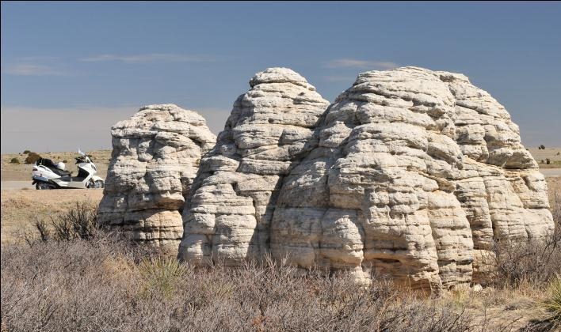
In this webinar: cameras, planning, key points when shooting.
Goal: maximum benefit for the minimum time invested, and that includes helping to ensure you get a good photograph.
Ellen Bishop: From Shooting to Post-processing: Making the Most of your Camera's Capabilities.
Steve Weaver: Beyond the snapshot: making the excellent geo- photograph in the field.
Marli Miller: Public Outreach
David Mogk: Geophotography as
Pedagogy: Students Creating and
Using Geologic Images.

Slide 6
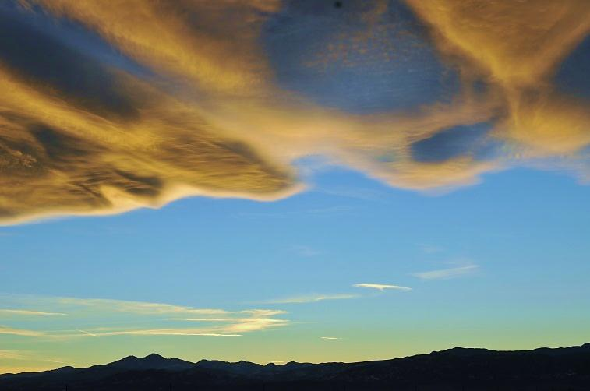
3. What IS geophotography?
Geophotography involves the use of light (visible, UV, IR) and realistic recording and processing of images of geologic features and processes (or experimental equivalents), motivated by a scientific understanding or question, in order to accomplish a specific, useful goal.
Notes:
Note: doesn’t exclude video
Field, lab, microscope
Scientific understanding separates what we’re doing from

Slide 7
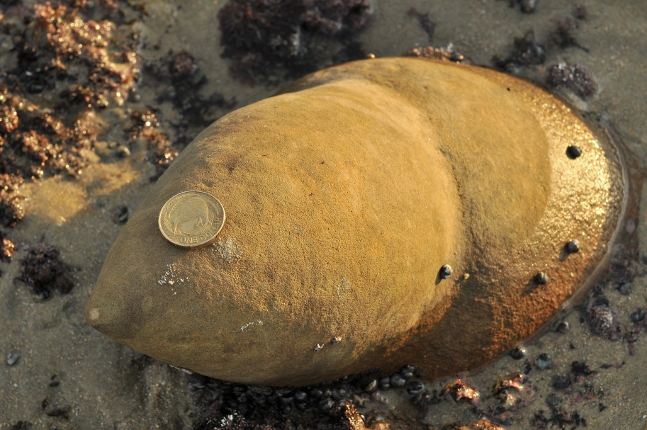
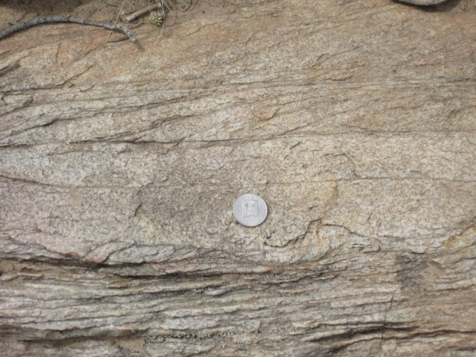
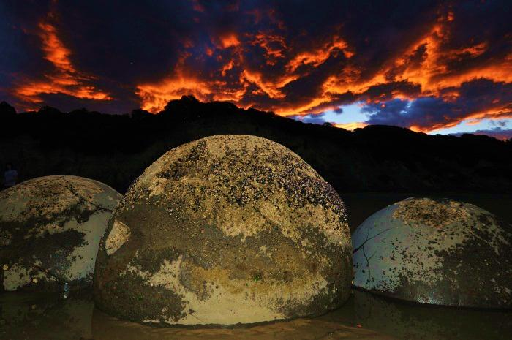
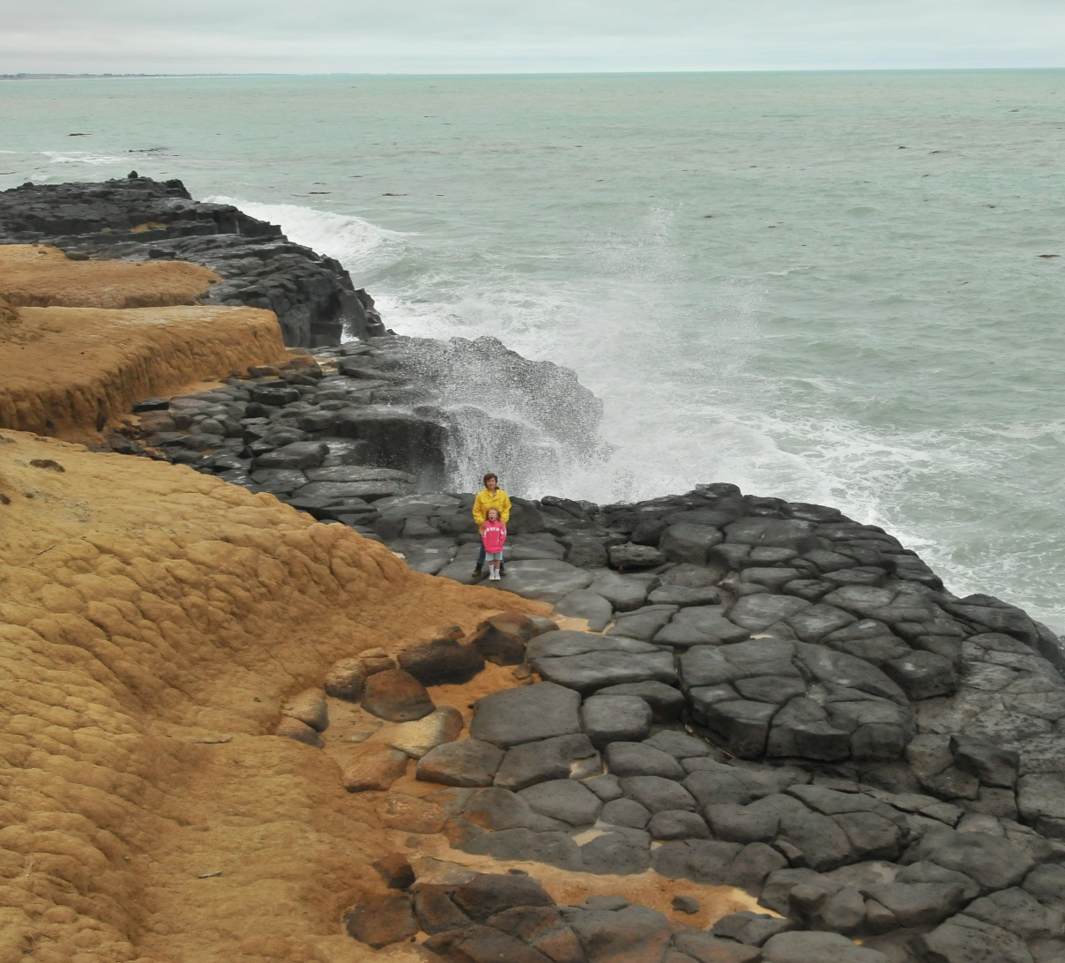
There is a continuum:
Emotion, drama, wonder, reaction triggering, ambiguity, imagination, depth, uneven framing, curiosity, ambiguous scale/size, possibly low DR, incompleteness
“The Geo-Mugshot”
Artistic & landscape photography
Good geophotography
Balanced framing, subject centered, minimize ‘depth’, realistic (mid-day) color, scale included, standard point of view, sharp, stop action, completeness, horizontal
Notes:
Fundamental point: steal from the artistic approach and incorporate as much of it as possible into your photograph, while giving up little or none of what’s necessary to accomplish the purpose.
‘completeness’: example of a bird’s head or fossil [at green river fossils] (geophotography) versus its entire body (mug shot)

Slide 8
There is a continuum:
Emotion, drama, wonder, reaction triggering, ambiguity, imagination, depth, uneven framing, curiosity, ambiguous scale/size, possibly low DR, incompleteness
“The Geo-Mugshot”
Artistic & landscape photography
Good geophotography
Balanced framing, subject centered, minimize ‘depth’, realistic (mid-day) color, scale included, standard point of view, sharp, stop action, completeness, horizontal
Notes:
Fundamental point: steal from the artistic approach and incorporate as much of it as possible into your photograph, while giving up little or none of what’s necessary to accomplish the purpose.
‘completeness’: example of a bird’s head or fossil [at green river fossils] (geophotography) versus its entire body (mug shot)

Slide 9
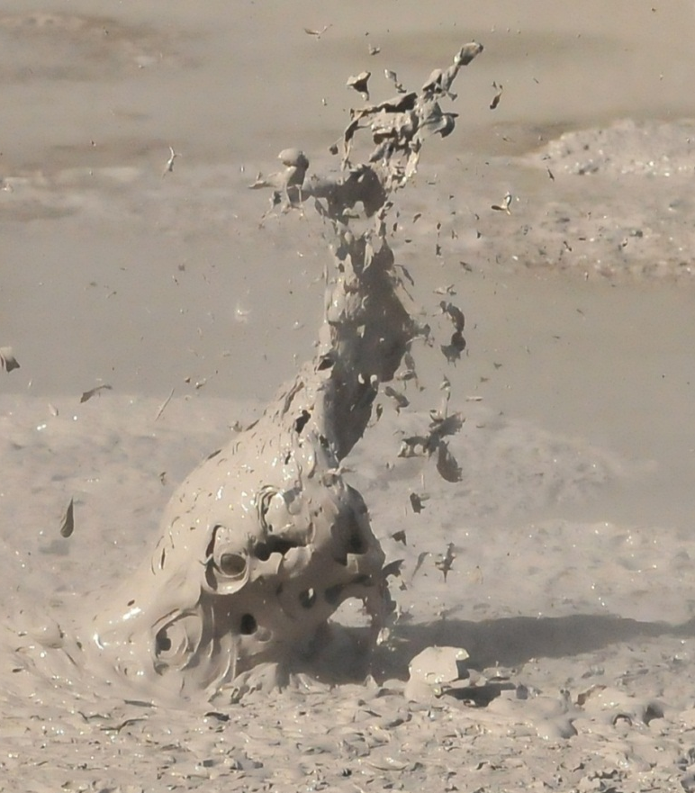
4. The four components
Planning (light, conditions)
Equipment (good camera with a variety of manual controls, good lens, tripod)
Shooting/execution (all efforts on-site)
The post-processing
No matter what your equipment, you can get better results.
Notes:
This is not generally different from good photography, only there may be additional variables.

Slide 10
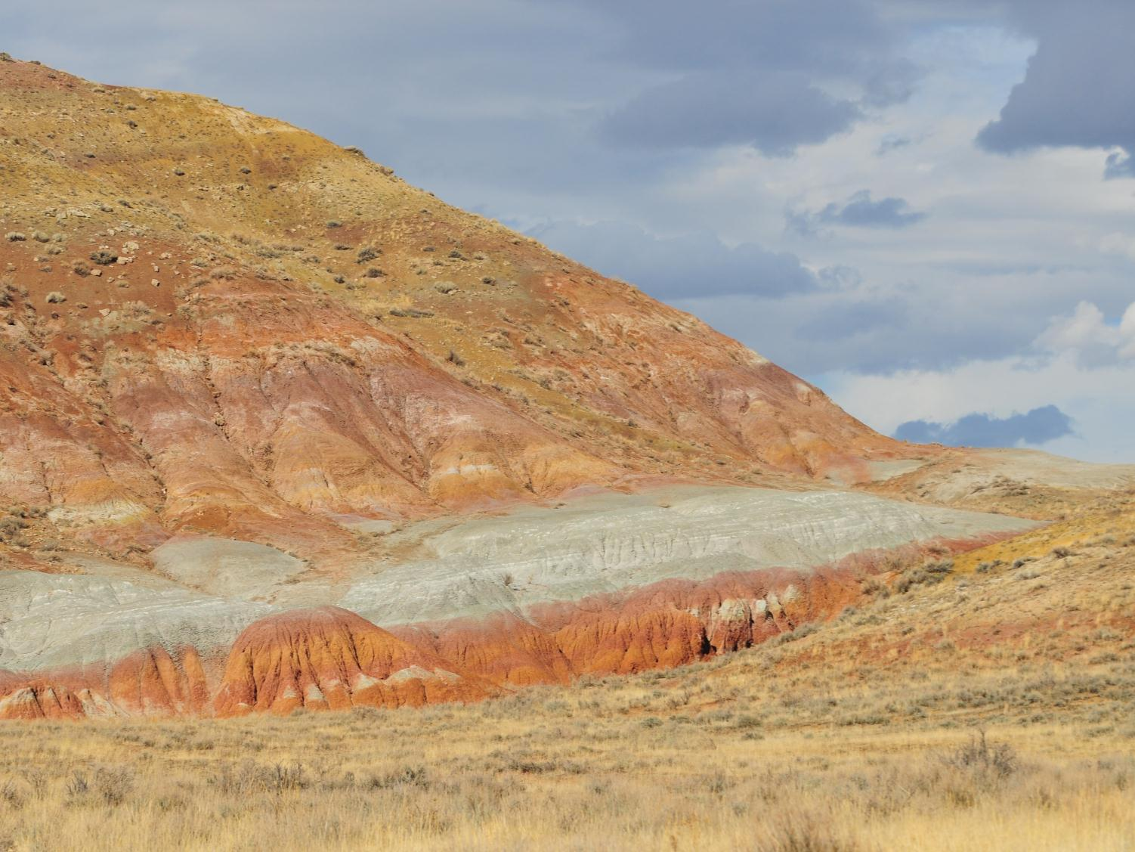
5. Equipment:
Cameras

Slide 11
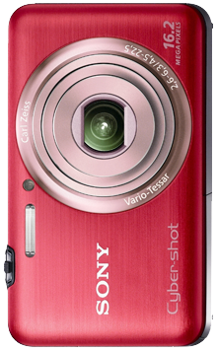
Point & shoot
Pros:
Small & light (field consideration)
Cheap
Easy to use; not as much room to grow as a photographer
Easy access/backup camera
Some are “waterproof”
Cons:
Not great in low light
Not great sensors
Minimal manual control
Fixed lens
View finders marginal or must use LCD (soft, bright sunshine)
Difficult to shoot in sophisticated set-ups

Slide 12
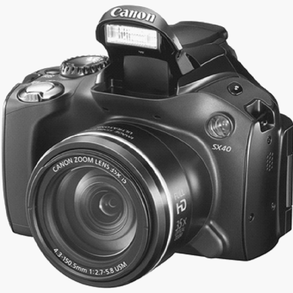
Bridge/EVF (electronic viewfinder)
Pros:
Lightweight
Reasonably small & cheap
May take filters
Good image quality
Better telephoto capability
May have much better lenses
More manual control
Cons:
Sensors still small
Viewfinder & LCD issues
Can’t change lenses
Usually not great for macro
http://www.adorama.com/alc/0012789/article/Buying-Guide-The-Best-EVF-Cameras-Right-Now

Slide 13
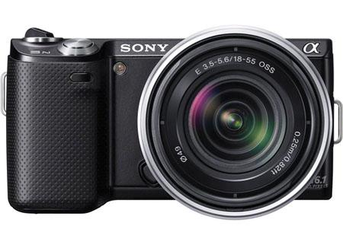
MILC/Hybrid
Pros:
Some have excellent sensors & image quality
Not fixed lens
‘Pancake’ lenses and/or adapters for DSLR lenses
Better in low light
Panorama mode (Sony)
More sophisticated
Filters
Range of accessories including GPS-tagging, flashes, and microphones
Cons:
Moderately expensive
Heavier
May have/need an array of lenses
No through-the-lens viewfinder
Uses batteries faster
Crop factors from 1.5x to 5.5x
http://www.adorama.com/alc/0013367/article/The-Best-MILCs-Right-Now

Slide 14
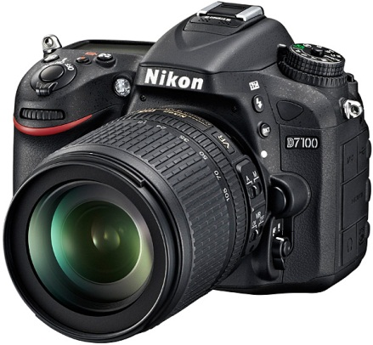
DSLR
Pros:
The best sensors
The best low-light sensitivity
Wide array of lenses
Sophisticated in-camera software
Filters
All accessories
Highest pixel counts
Some have ‘full-frame’ sensors
May have multiple memory cards
Cons:
Most expensive
All accessories
Heaviest
May have/need an array of lenses
Some don’t have built-in flash
Most difficult to learn to use

Slide 15
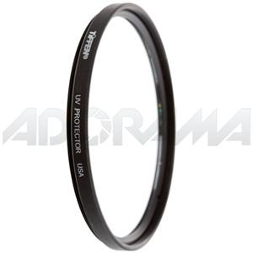
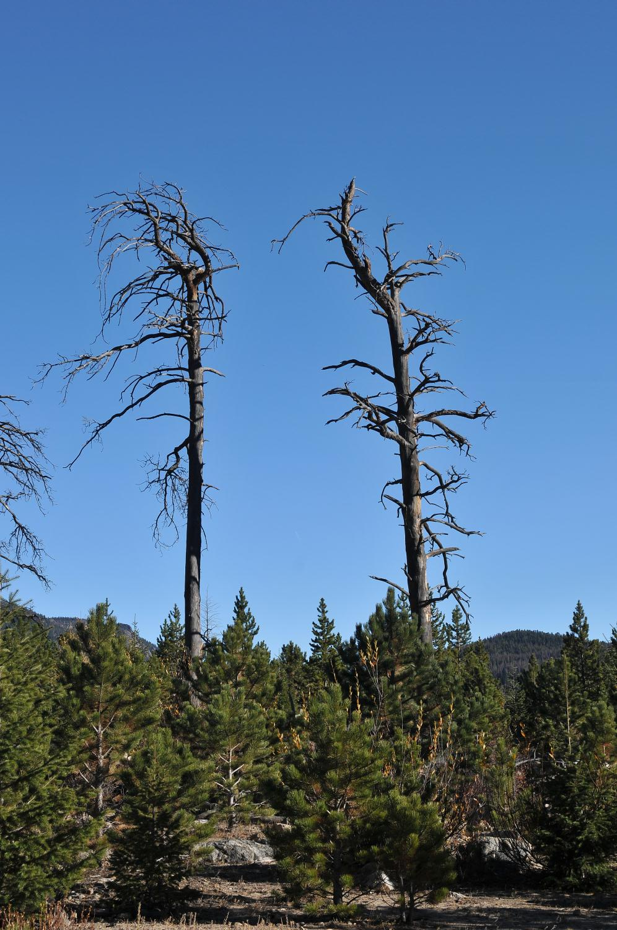
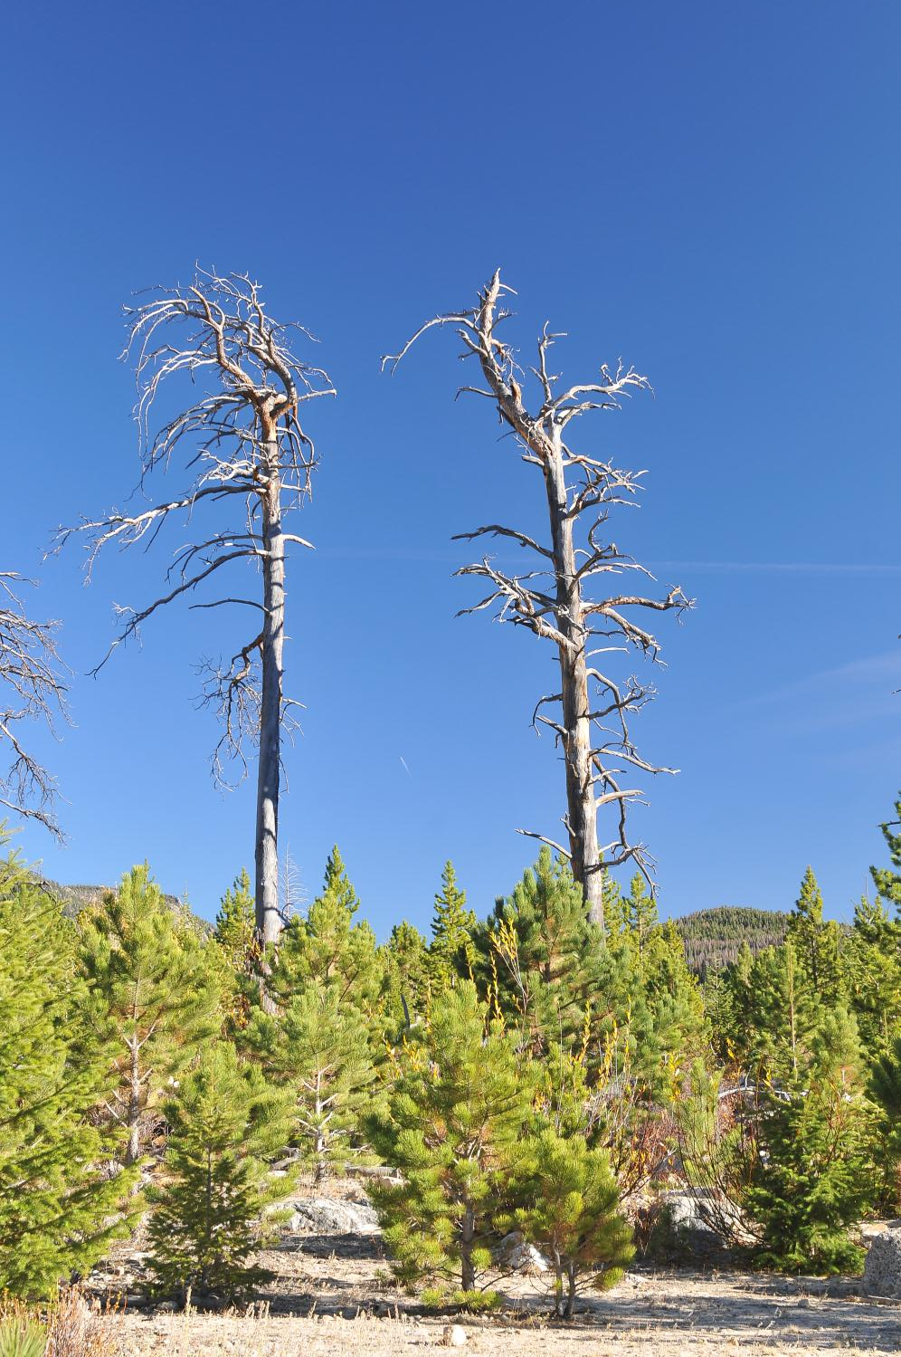
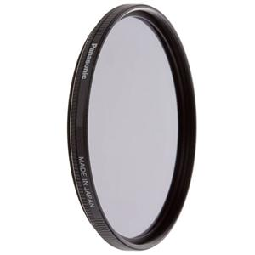
Equipment: filters
UV & polarizing
Minimal effect with digital sensors (far less sensitive to UV) but protects lenses from accidents and cleaning. Get multi-coated filters (ghosting, cleaning). Keep clean!
Richer colors, darkens skies, reduces reflections.

Slide 16
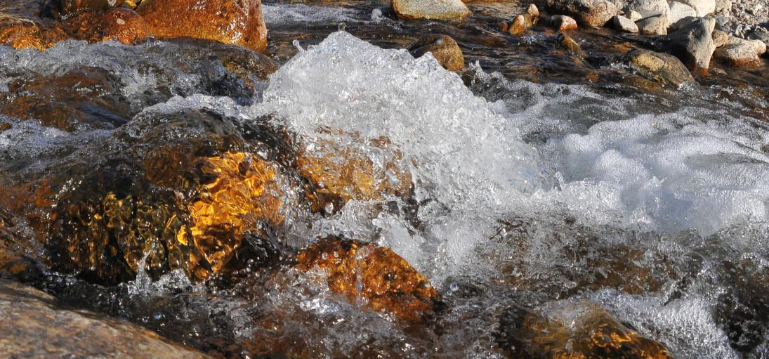
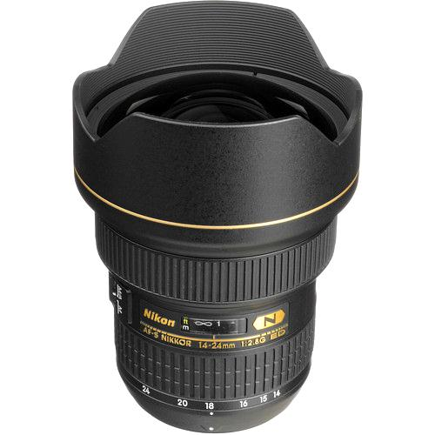
Equipment: wide angle lenses
We shoot many large things.
WA lenses allow great depth of field—a good antidote to the geologic mugshot.
If zoom, will handle a lot of your average uses.

Slide 17
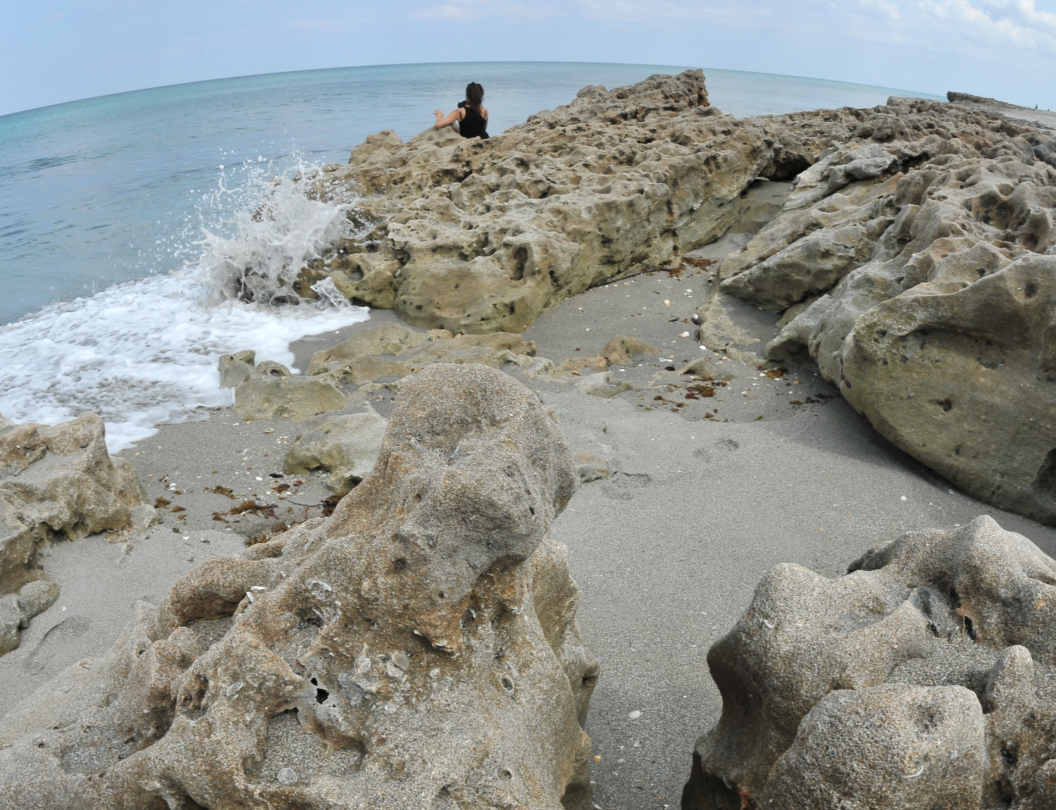

Slide 18
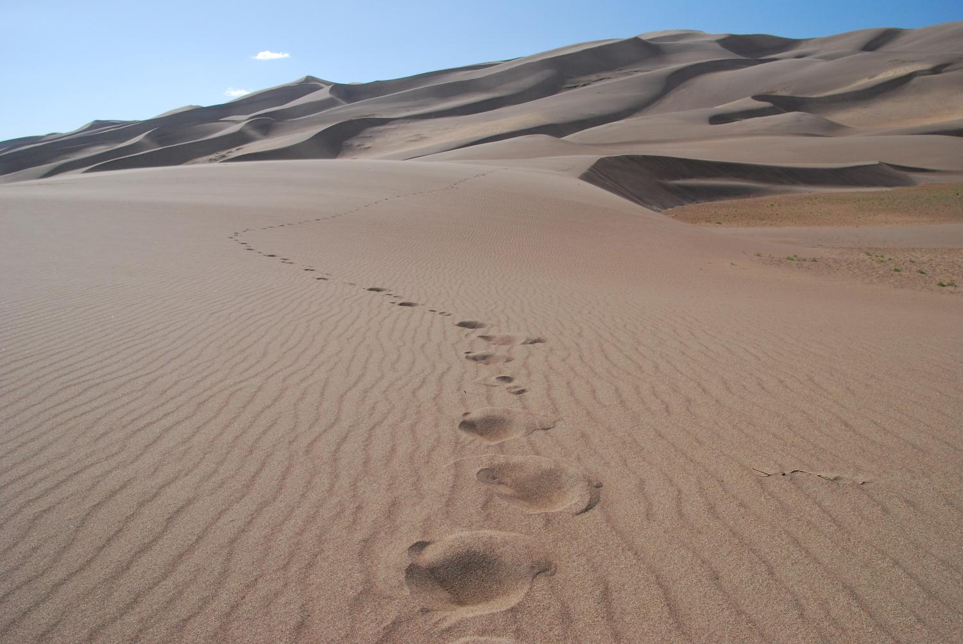

Slide 19
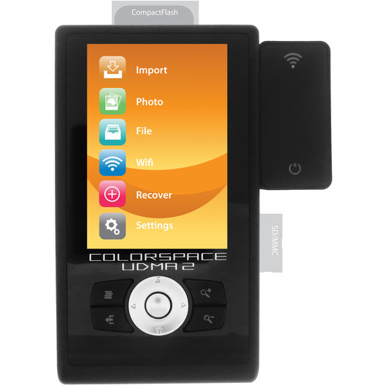
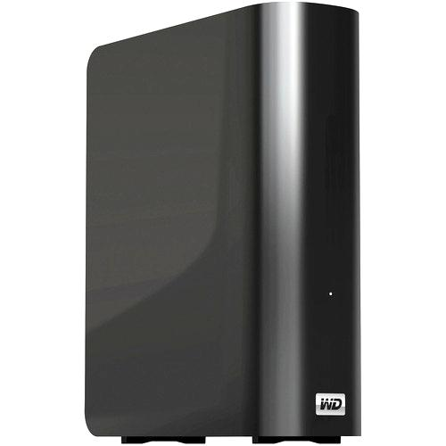
Equipment: Redundant storage!
Notes:
always store in separate places

Slide 20
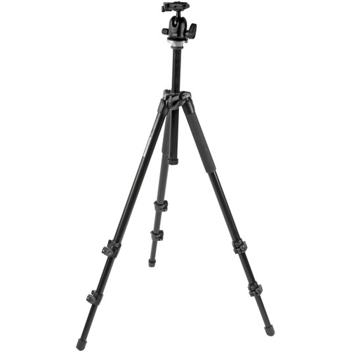
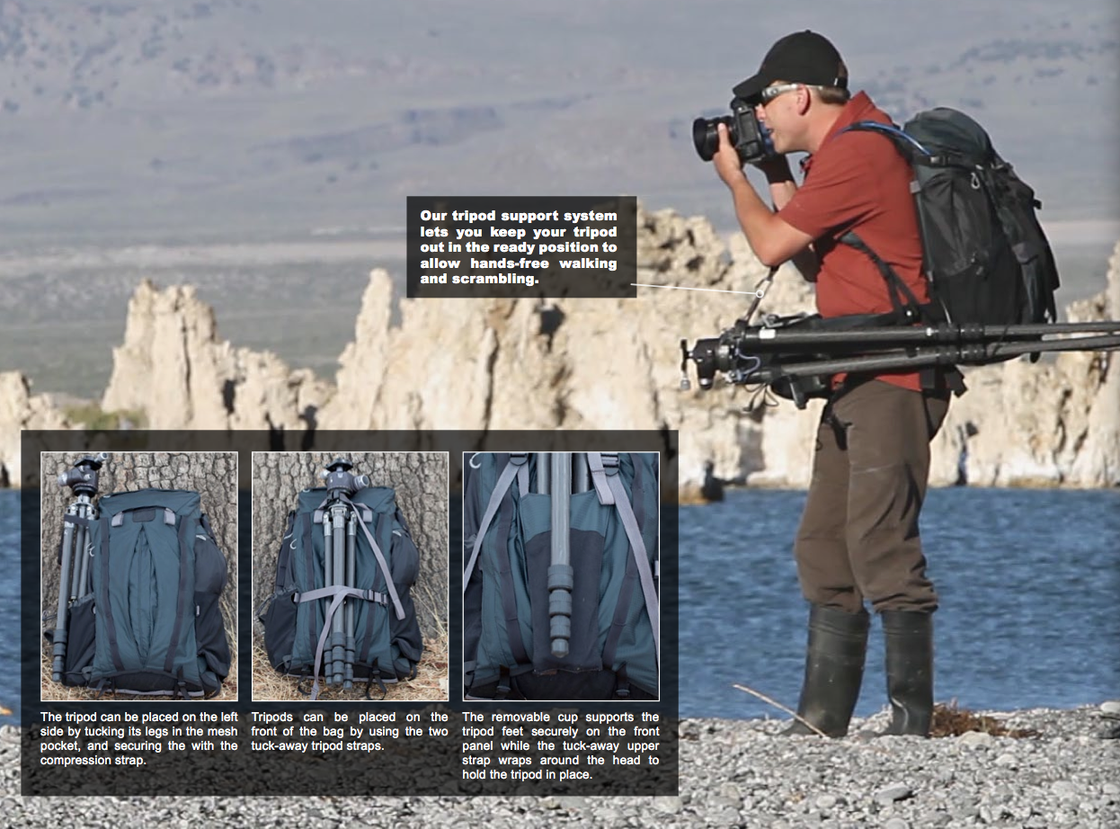
Equipment: tripod
Quality = weight
Quality = $$$
recent Kickstarter project
Notes:
http://www.kickstarter.com/projects/134466492/rotation180-photo-backpack

Slide 21
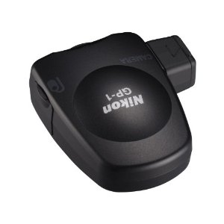
GPS tagging

Slide 22
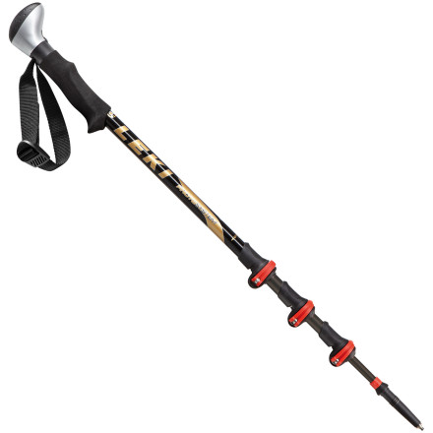
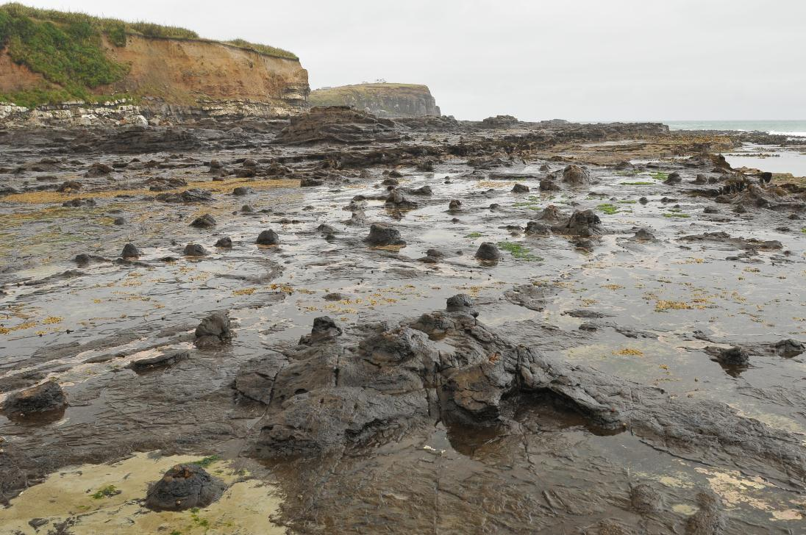
6. Planning
LEKI Photosystem Carbon Speedlock Trekking Pole
Weather:
  cold (batteries)
  wet (protection)
  gray (flash)
Physical conditions:
  dusty (less valuable equipment? avoid changing lenses?)
  precarious (less valuable equipment, and less of it?)
Where:
  total weight, tripod, monopod (some double as hiking sticks; Gitzo, Novoflex)
  good quality pack is valuable!
Light:
  reflector?
  flash?
When (are you going to be there):
  topography (Google Earth)
  http://photoephemeris.com/
Bottom line: equipment, weight, batteries, lighting
Notes:
Leki: $144 @ backcountry.com

Slide 23
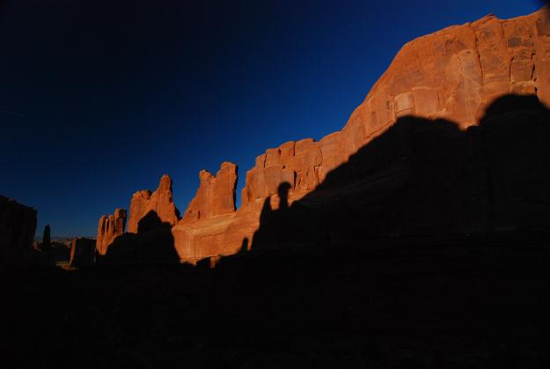
6. Planning
LEKI Photosystem Carbon Speedlock Trekking Pole
Weather:
  cold (batteries)
  wet (protection)
  gray (flash)
Physical conditions:
  dusty (less valuable equipment? avoid changing lenses?)
  precarious (less valuable equipment, and less of it?)
Where:
  total weight, tripod, monopod (some double as hiking sticks; Gitzo, Novoflex)
  good quality pack is valuable!
Light:
  reflector?
  flash?
When (are you going to be there):
  topography (Google Earth)
  http://photoephemeris.com/
So: equipment, weight, batteries, lighting
Notes:
Leki: $144 @ backcountry.com

Slide 24
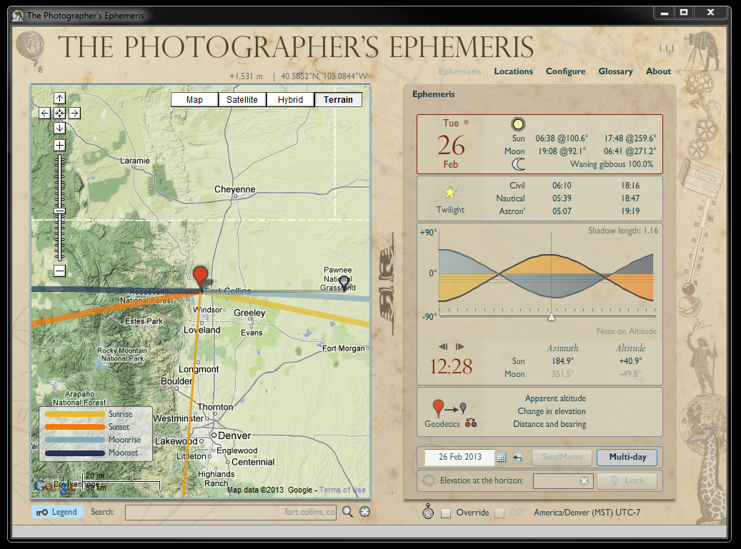
sunset
sunrise
current sun direction

Slide 25
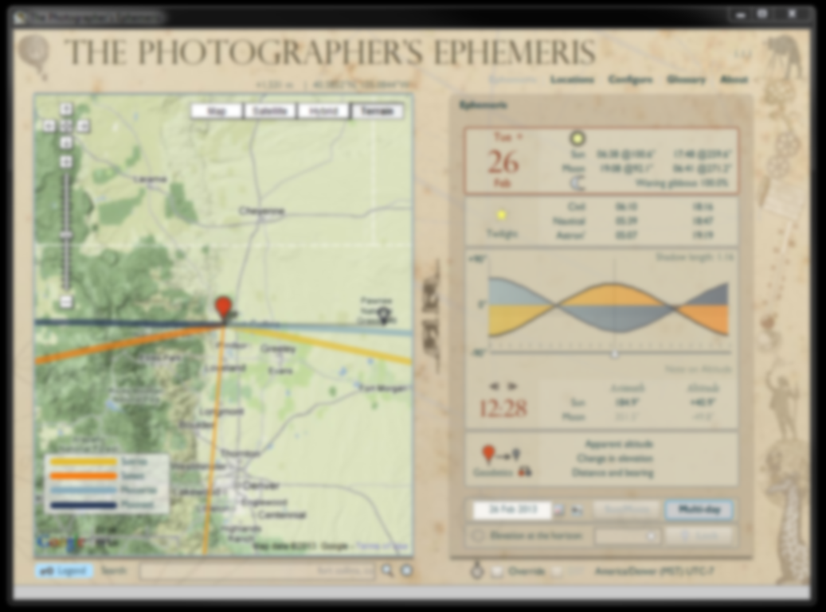
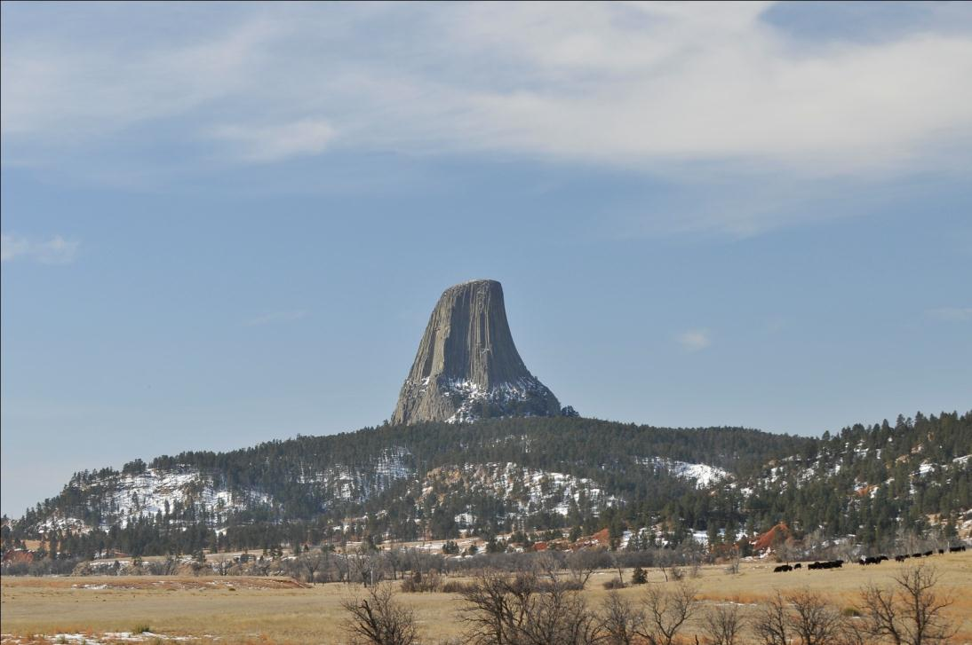
sunset
sunrise
current sun direction

Slide 26
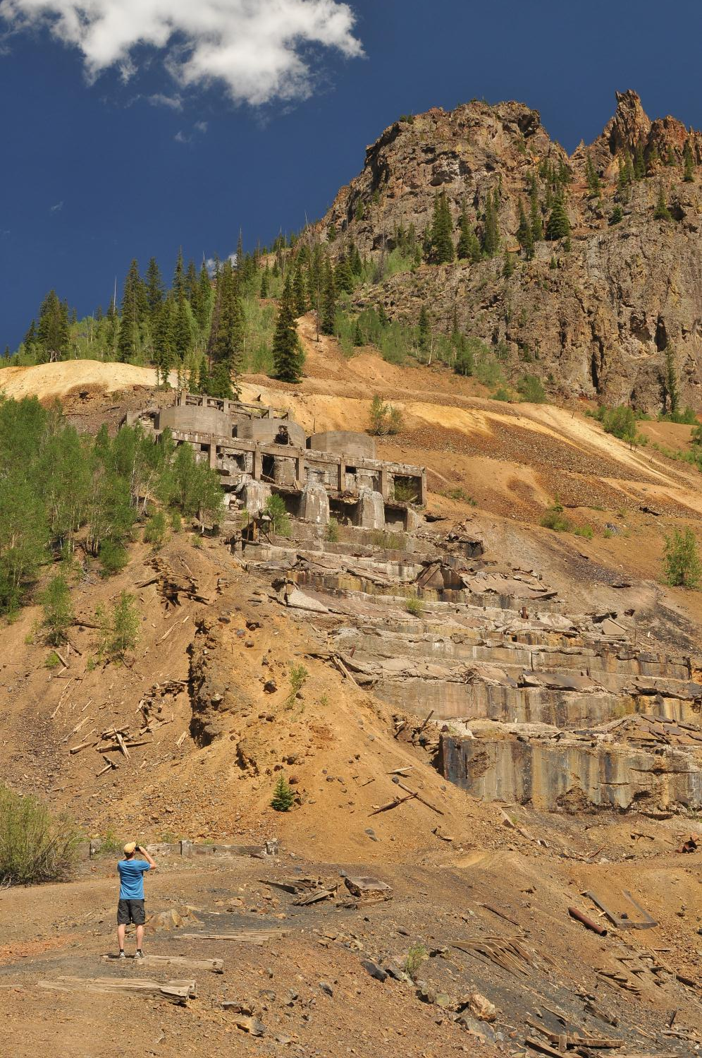
7. Shooting tips
(biggest impact with least effort & expense)
Focus & sharpness
White balance
Exposure
Depth of field
Life, action, humor

Slide 27
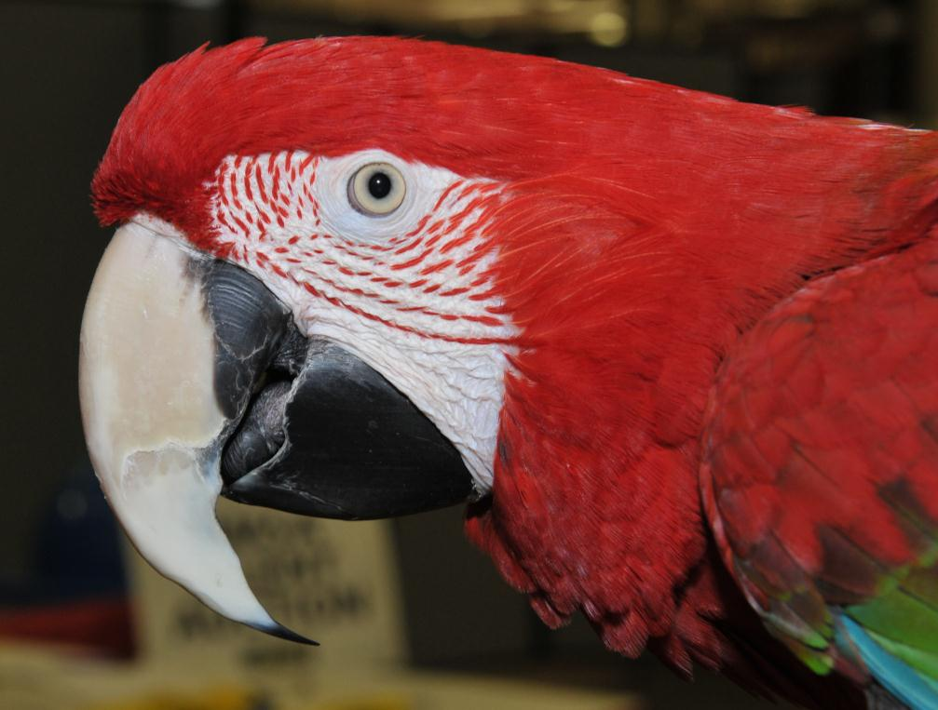
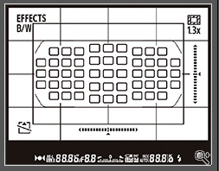
Focus & sharpness
Control where your camera focuses…

Slide 28
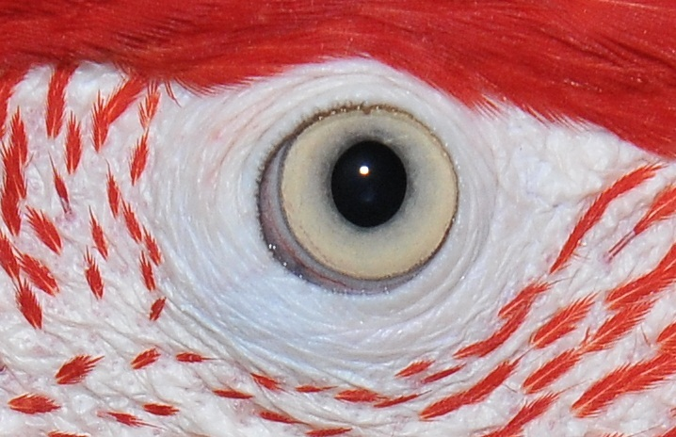
Focus & sharpness
Control where your camera focuses…

Slide 29
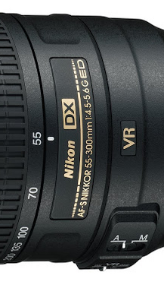
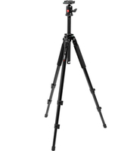
Focus & sharpness
Control where your camera focuses…
“Good glass” makes a difference
Clean optics & filters
Tripod
Vibration reduction (OIS) helps
Lenses have ‘sweet spots’
With more pixels, more care is needed
Take lots of shots
Make sure shots are sharp on-site

Slide 30
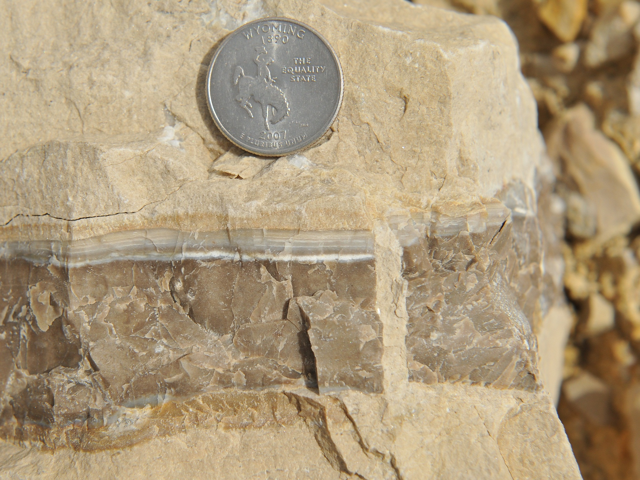

Slide 31
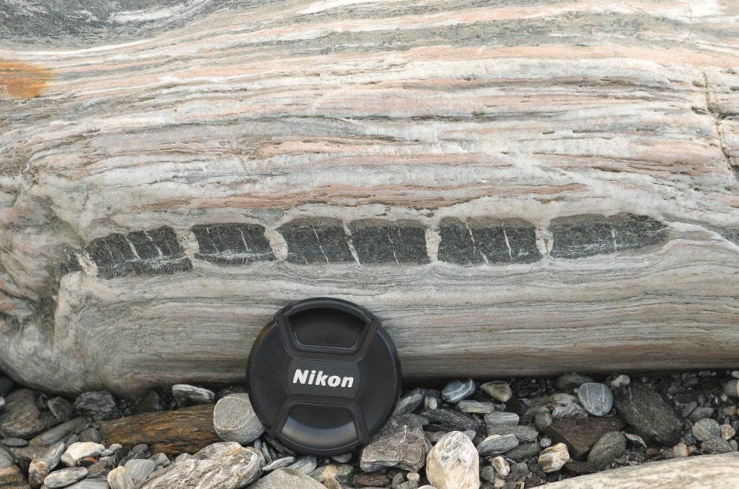
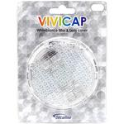
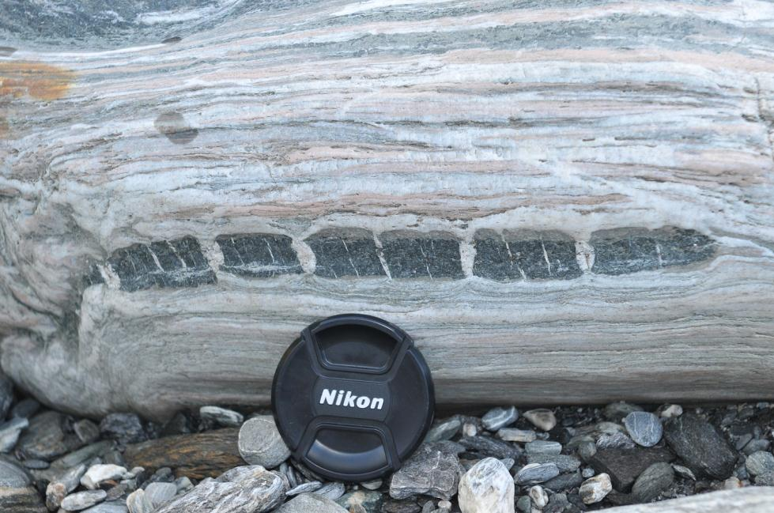
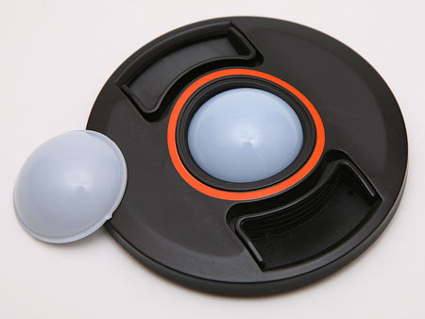
White balance
Manual
Auto

Slide 32
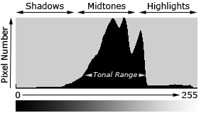
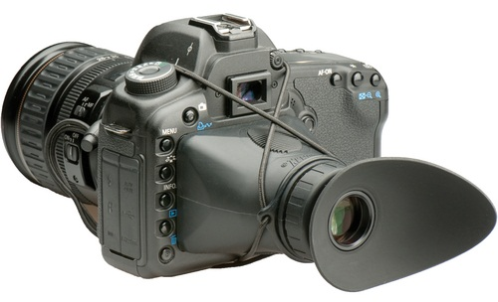
Exposure
Know your histograms
Make sure your images are
correctly exposed on-site
Hoodman LCD viewer (bright sunlight)

Slide 33
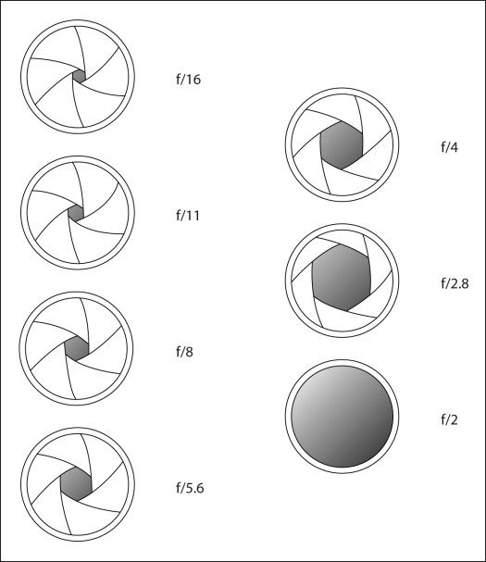
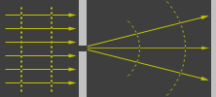

Depth of field—changing f/stop
A smaller aperture is not always better, and can be substantially worse.
http://www.cambridgeincolour.com/
Notes:
F/2 for 50 mm lens: 50 mm focal length/25 mm diameter = 2 = f/2
F/2.8 is next, and allows half the light through—F/1.4 doubles the light (area) of f/2

Slide 34

Gain of depth of field with decreasing aperture…
F/2.8
Notes:
6266

Slide 35

F/7.1

Slide 36

F/14
Notes:
6270

Slide 37

F/22
Notes:
6274

Slide 38




f/10 f/14 f/18 f/22
Notes:
f/14, 18, 22

Slide 39


Slide 40

Add life, action, humor

Slide 41

Notes:
Illustrates cropping.

Slide 42


Slide 43

Resources
Practice!
Your local photographic club or society!
References and Resources
Adorama Learning Center: http://www.adorama.com/alc/
B&H Photo “InDepth”: http://www.bhphotovideo.com/indepth/
Cambridge in Colour: http://www.cambridgeincolour.com/
Nikon tutorials: http://www.nikonusa.com/en/Learn-And-Explore/index.page
OneSlide Photography: http://oneslidephotography.com/
Poster on Geophotography, GSA Denver:
http://warnercnr.colostate.edu/~jerrym/zGSAGeophotographyPosterDenver2010Magloughlin.pptx
PowerPoint on Geophotography, GSA Minneapolis:
http://warnercnr.colostate.edu/~jerrym/zGeophotographyTalkMagloughlinGSAMnpls2011.pptx
PDF on Geophotography, GSA Minneapolis:
http://warnercnr.colostate.edu/~jerrym/zGeophotographyTalkMagloughlinGSAMnpls2011.pdf
Manuscript on Geophotography, submitted to Journal of Geoscience Education:
http://warnercnr.colostate.edu/~jerrym/zGeophotographyJGEManuscript2012.pdf

