Slide 1
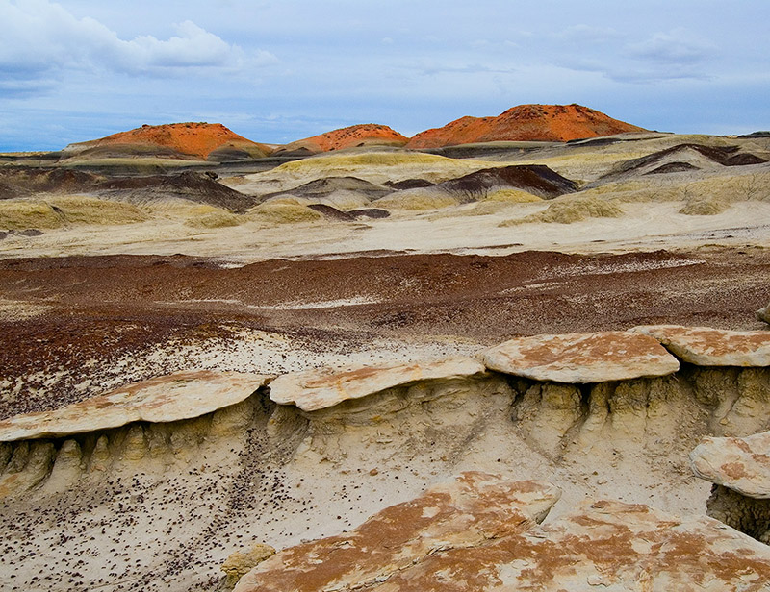
Beyond the Snapshot:
Making the Excellent
Geo-photograph in the Field
Stephen G. Weaver
Colorado College

Slide 2
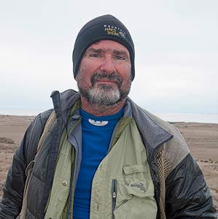

Slide 3
The goal of my photography is to communicate my vision of the natural world
by extracting images that evoke a sense of place and transport the viewer into the environment I am photographing on both grand and intimate scales

Slide 4
What makes a photograph “Excellent” or successful
???

Slide 5
I believe the image must “Speak” to the viewer and communicate a sense of place, subject, and sometimes even evoke emotion

Slide 6
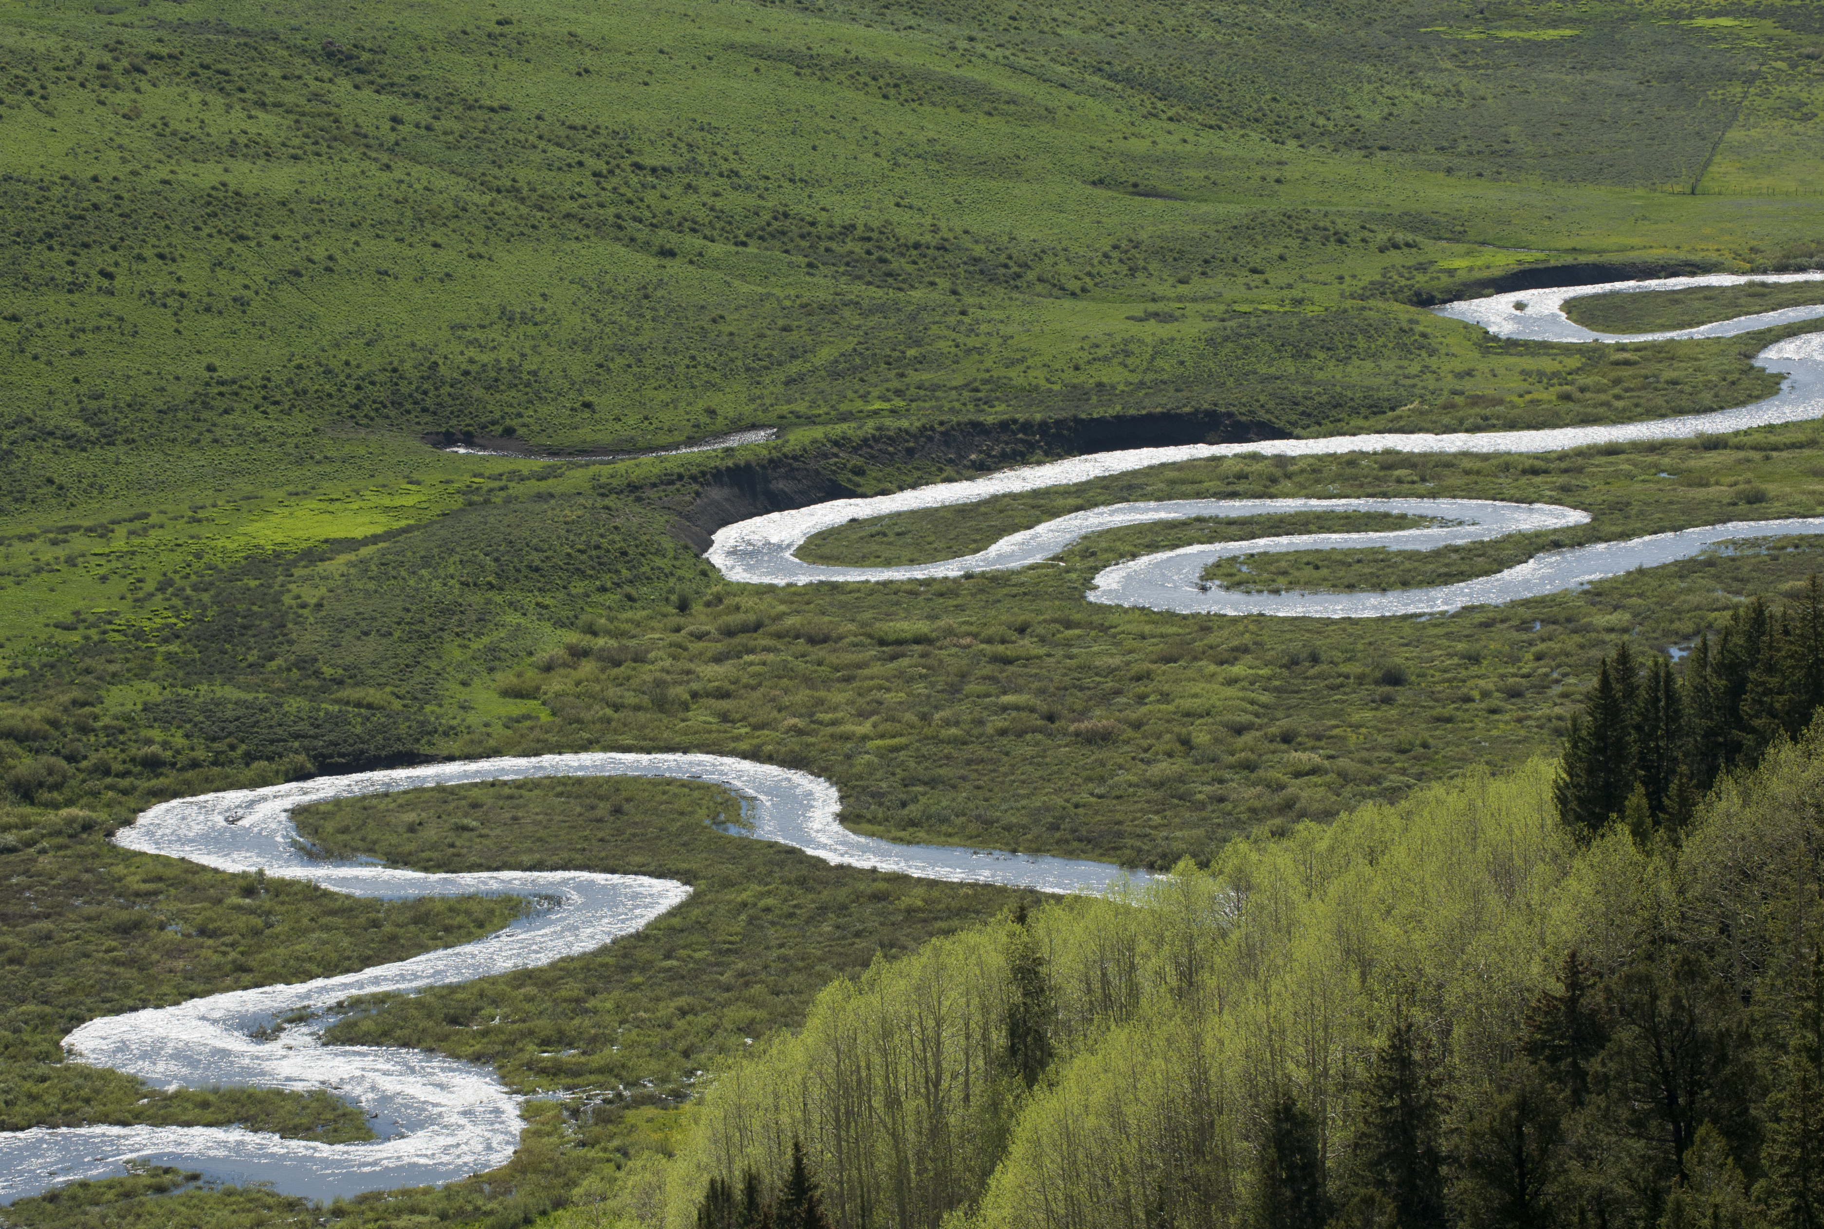
The well made Geo-photograph must clearly communicate the intended subject to the viewer

Slide 7
So What are the requirements for making an excellent
geo-photograph?

Slide 8
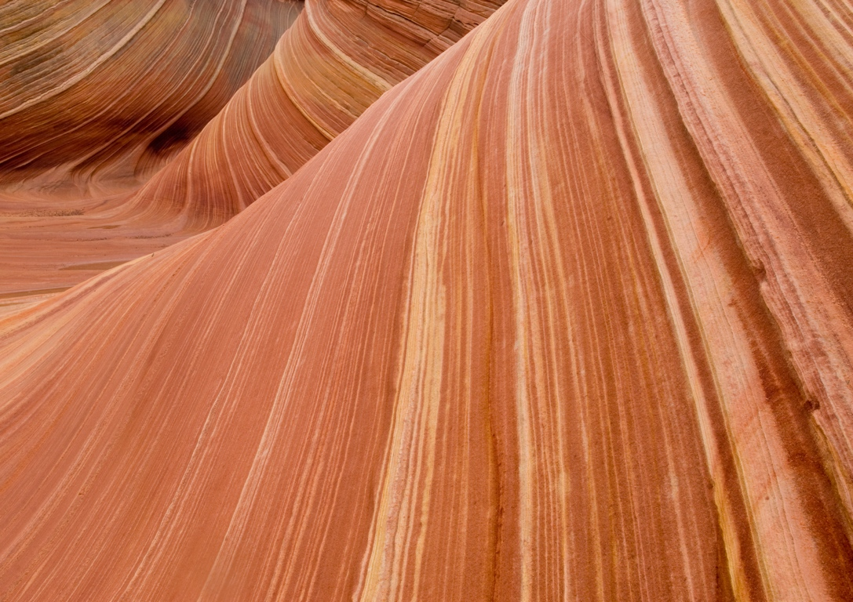
Good Subject
Good Technique
Good Conditions

Slide 9
So let us explore the elements of making an excellent
Geo-Photograph

Slide 10
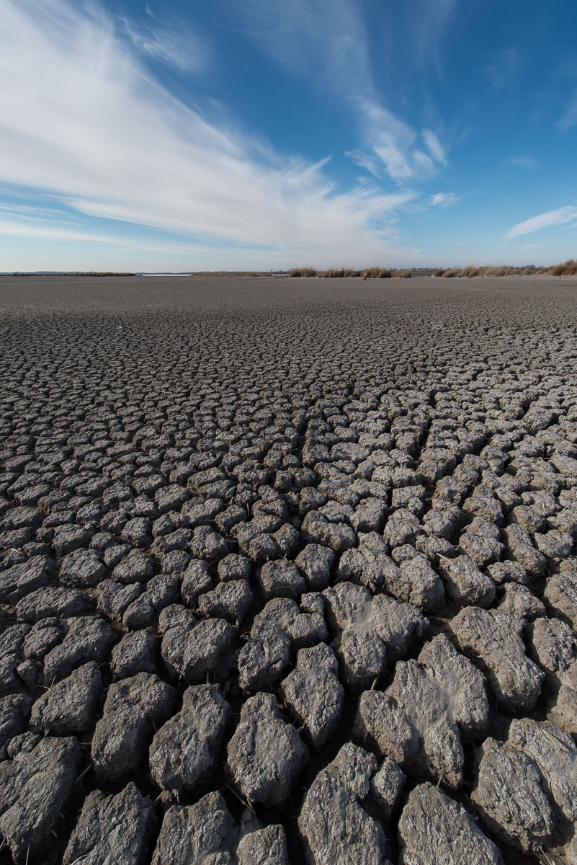
“Left Brain”
Technical Aspects :
Equipment and how to use it

Slide 11
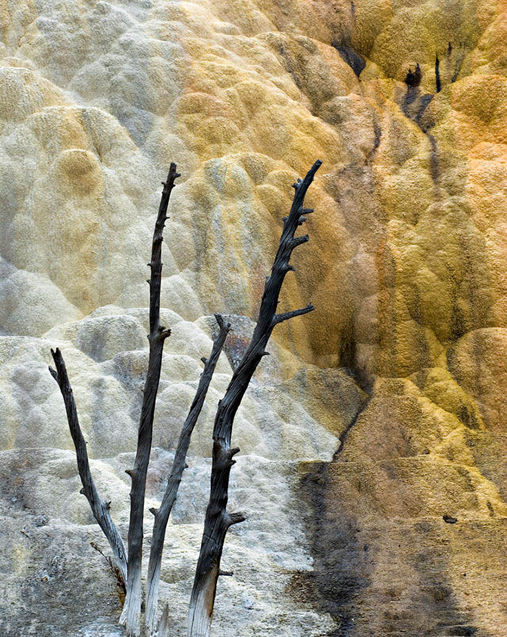
“Right Brain”
***Creative Aspects***
Learning to See:
Composition
Using Light!

Slide 12
Modern Cameras
Digital Point and Shoots
digital mirror-less with interchangeable lenses: Nikon V1, Sony NEX series
***Digital SLR! ***

Slide 13
Lenses
“Normal” lens: field of view is about what the human eye sees
Focal Length in full-frame 35mm
=50mm
“Wide angle” < 50mm
“Telephoto”> 50mm
Modern Zoom lenses give great flexibility in framing your scene/subject

Slide 14
Ansel Adams said:
“Owning a Nikon doesn’t make you a great photographer, it makes you a nikon owner”

Slide 15
So the Important Point is :
The camera and lens do not make the picture, the photographer does and having the best equipment money can buy does not translate to making great photographs!!
your camera, lenses and tripod are just the tools to make the image!!

Slide 16
Technique
1. Need to know how to get proper exposure
2. Need to know how to control focus

Slide 17
The technical goal is to become proficient enough that you really do not have to stop and think about what you need to do with the camera to get the proper exposure and focus.
Practice, Practice, Practice

Slide 18
The Creative Aspects:
Designing the photograph
Composition
Using Light

Slide 19
Composition
The art of imposing order and structure on the random natural world

Slide 20
Simplify!!!!
Avoid visual clutter

Slide 21
When designing a photograph, always ask why you are taking the photograph and what do you want to show the viewer.

Slide 22
Think graphically !!
Extract an image from a scene by using the elements of graphic design:
color, line, pattern, texture, form

Slide 23
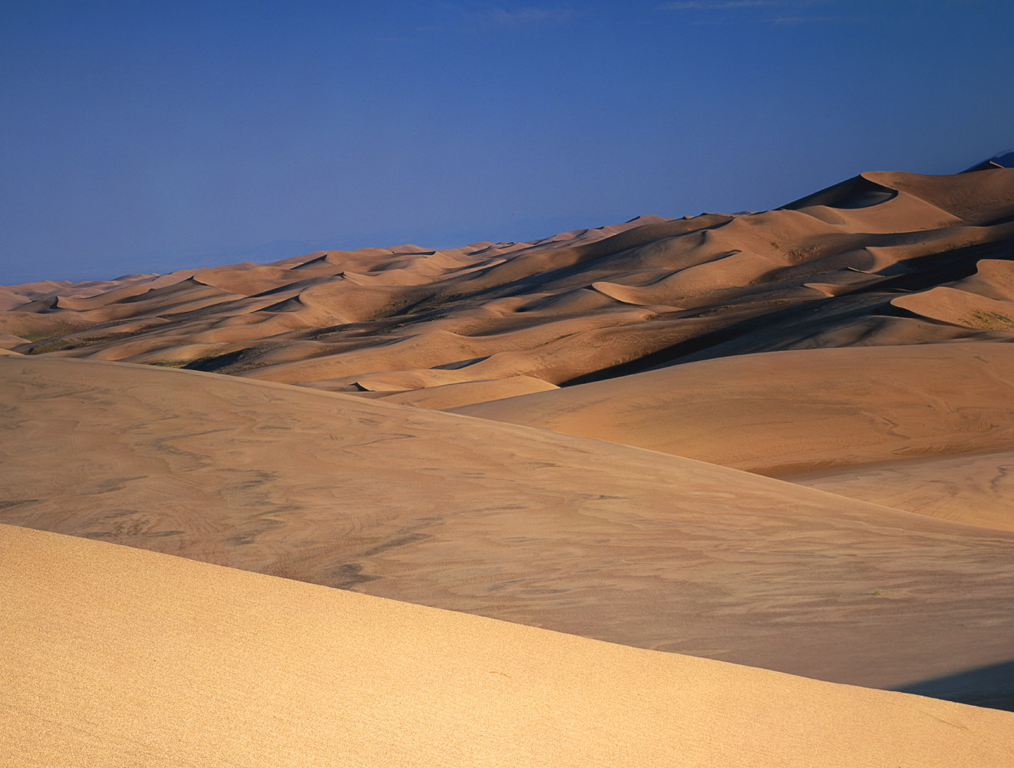

Slide 24
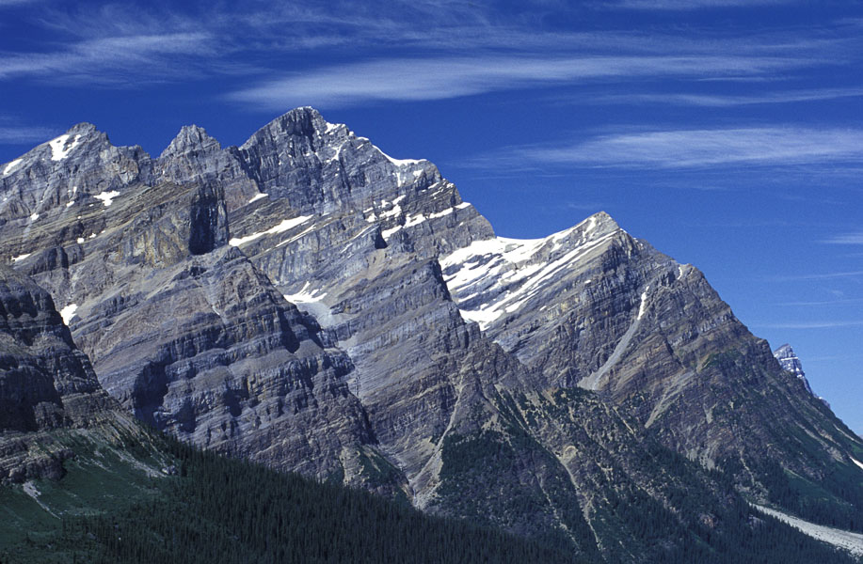

Slide 25
The Rule of Thirds

Slide 26
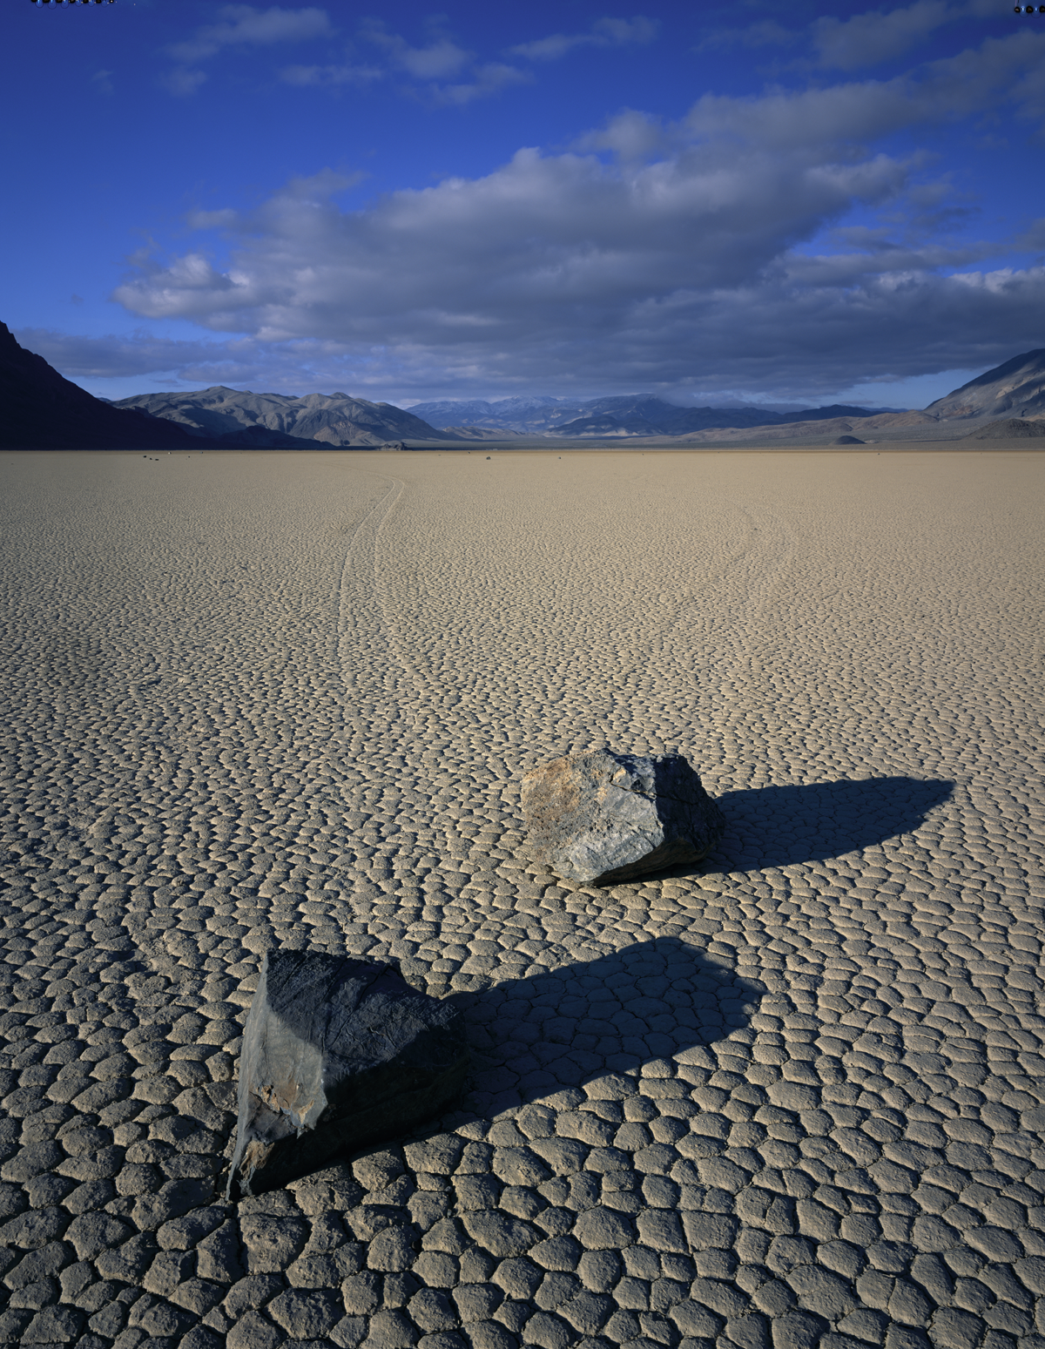

Slide 27
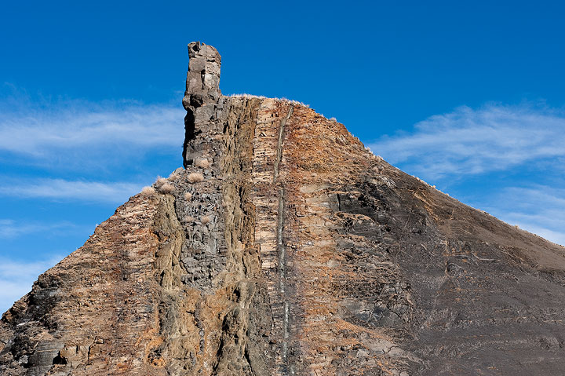

Slide 28
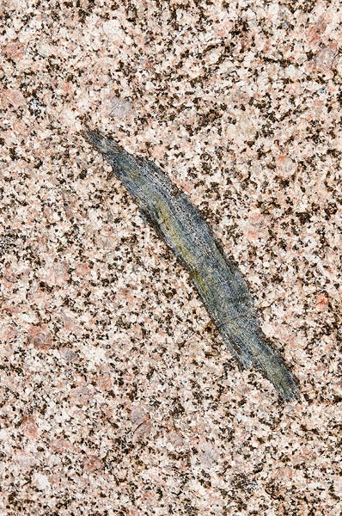

Slide 29
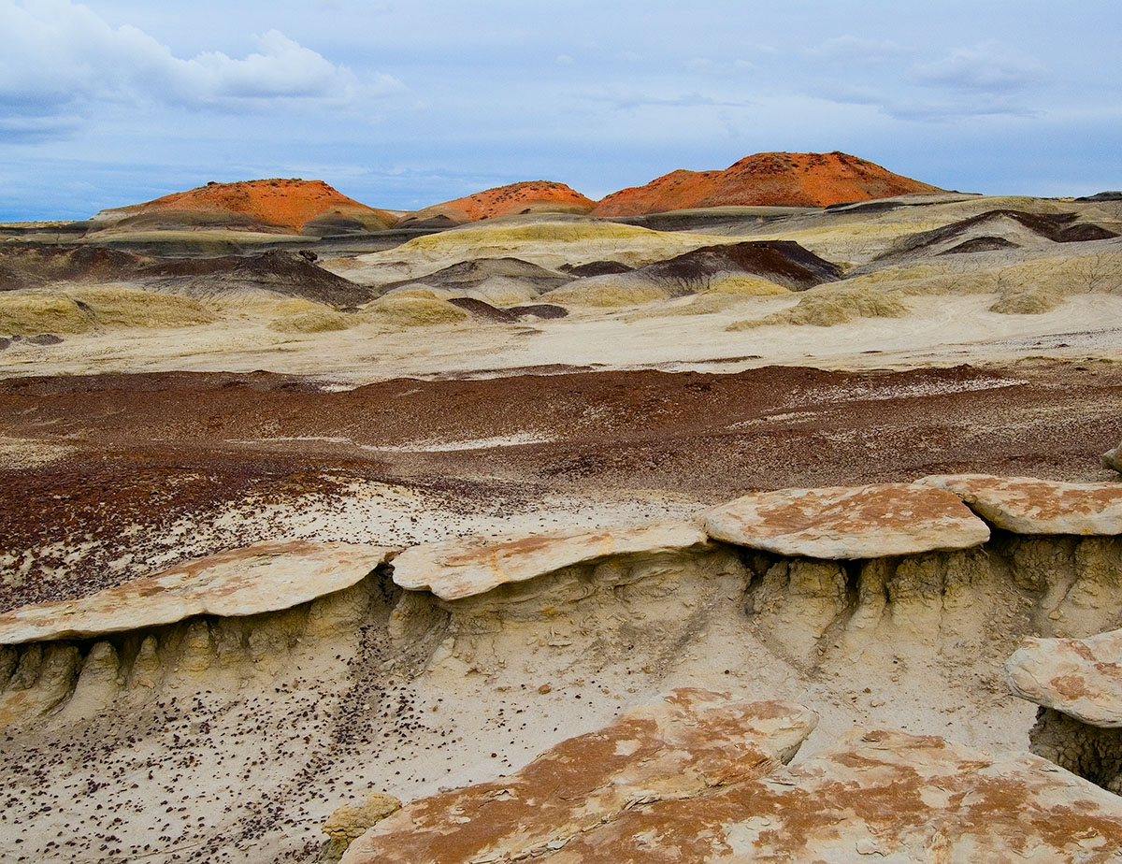

Slide 30
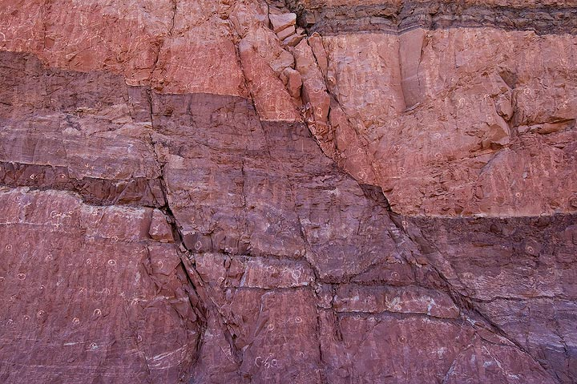

Slide 31
To improve the fine tuning of your compositions:
Use a Tripod!!!!

Slide 32
It is all about :
The Light!

Slide 33
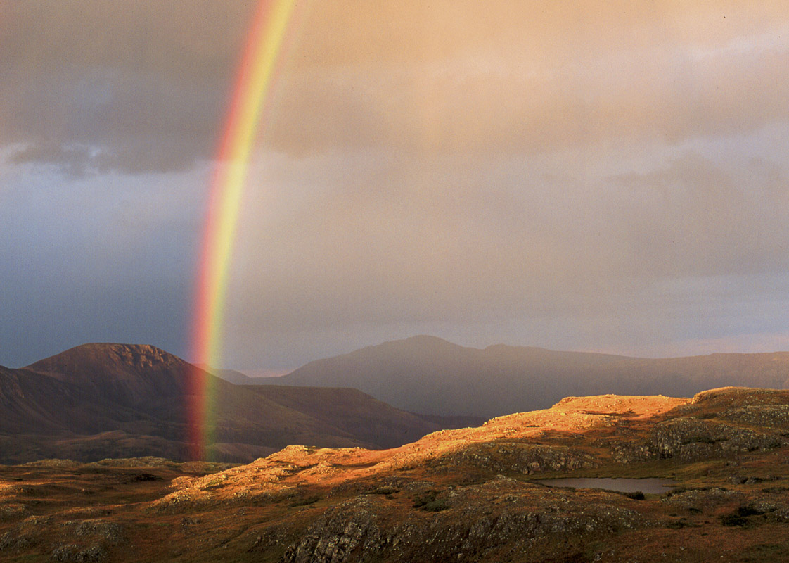

Slide 34
Awareness of Light is our most essential tool in terms of our aesthetic control when making a photograph!
Without “good light” a photograph will fail!

Slide 35
Seeing the Light
Being aware of the light and how its quality affects the perception of any subject is critical to improving your photography
Slow down and watch how the light changes

Slide 36
Directions of Light
Front Light
Side light
Backlight

Slide 37
Light Source
Direct point source: high contrast
Soft Diffuse: low contrast
Reflected Light

Slide 38
Light “color”
Warm
Cool

Slide 39
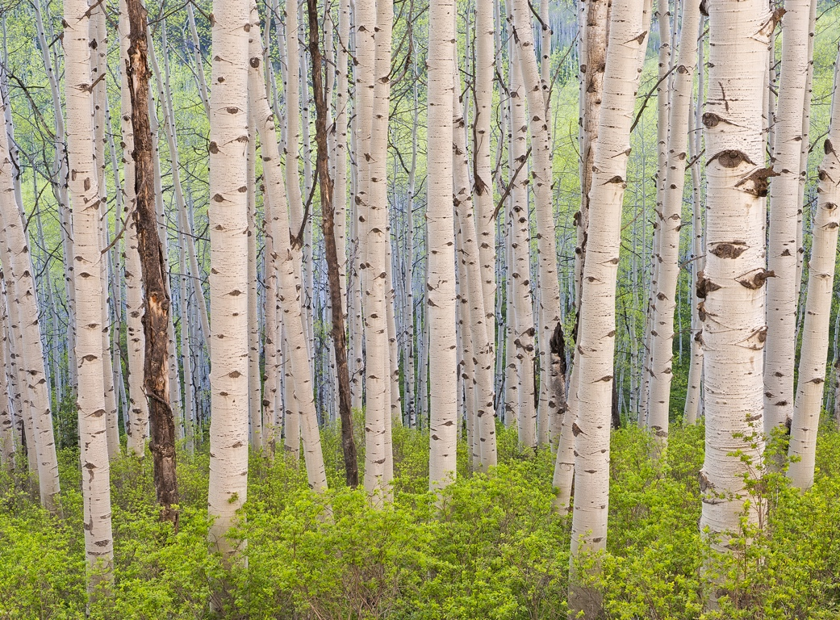
Warm Light

Slide 40
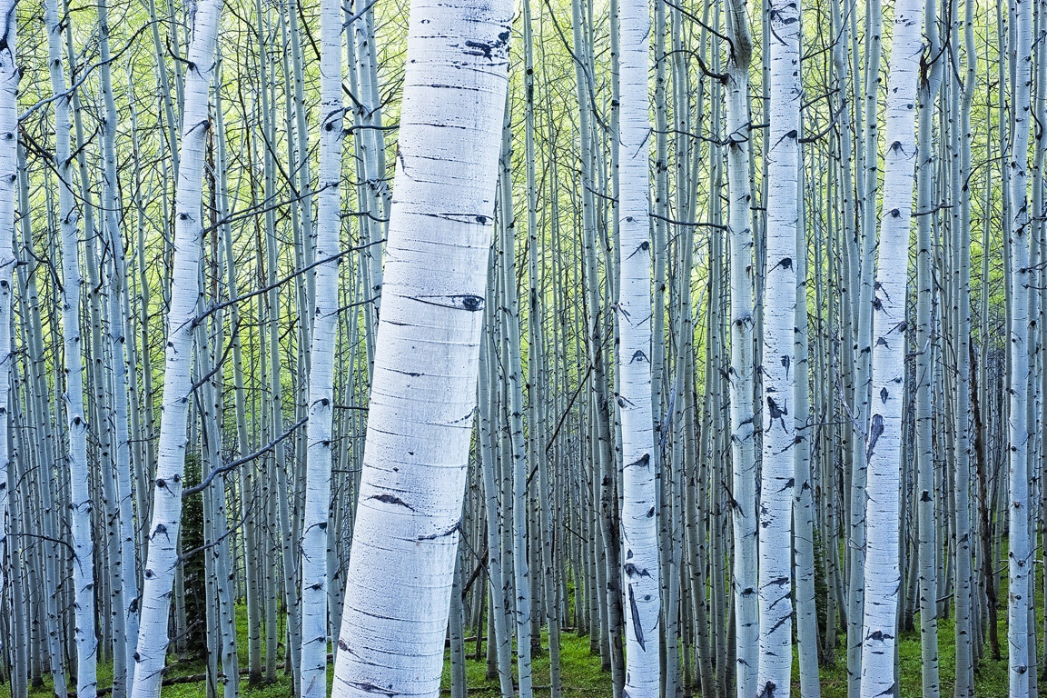
Cool Light

Slide 41
White Balance
changing the white balance will change the “color” of light!
shoot RAW to be able to do this

Slide 42
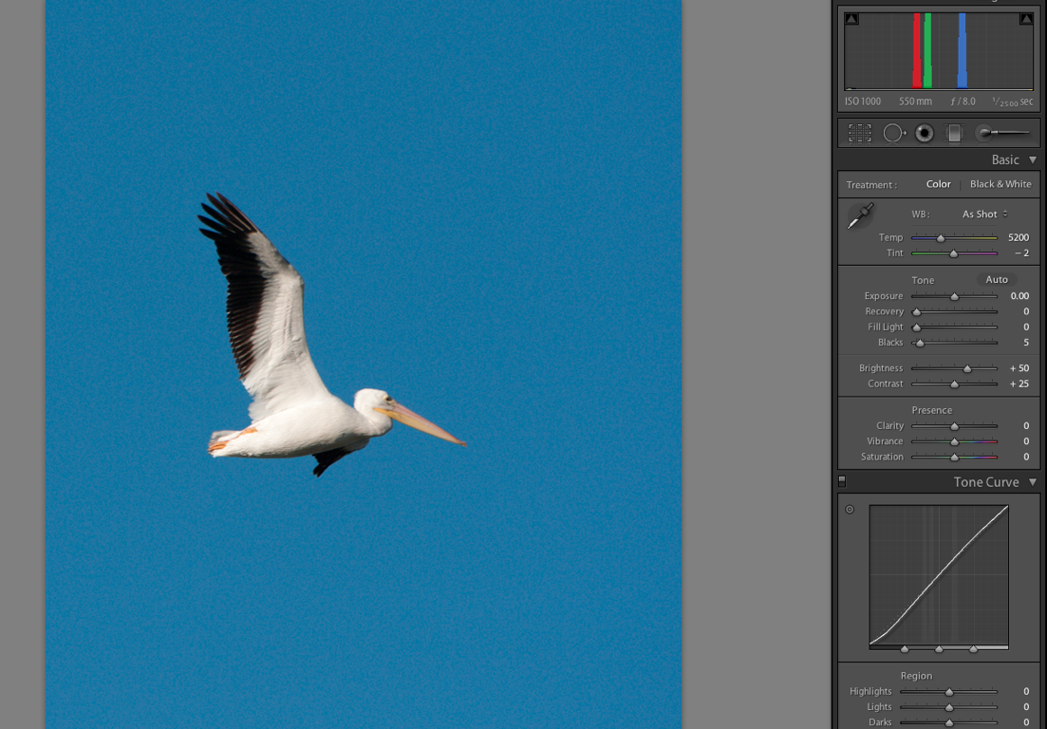

Slide 43
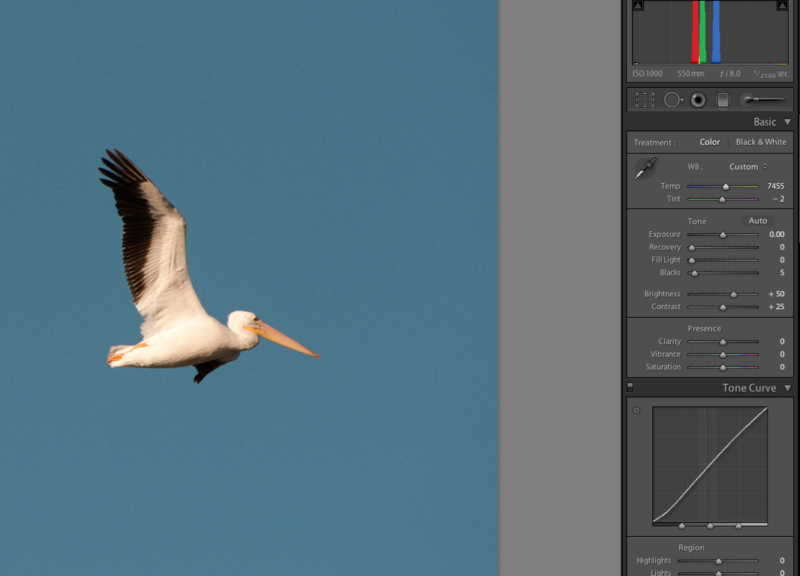

Slide 44
So what is “good” light ???

Slide 45
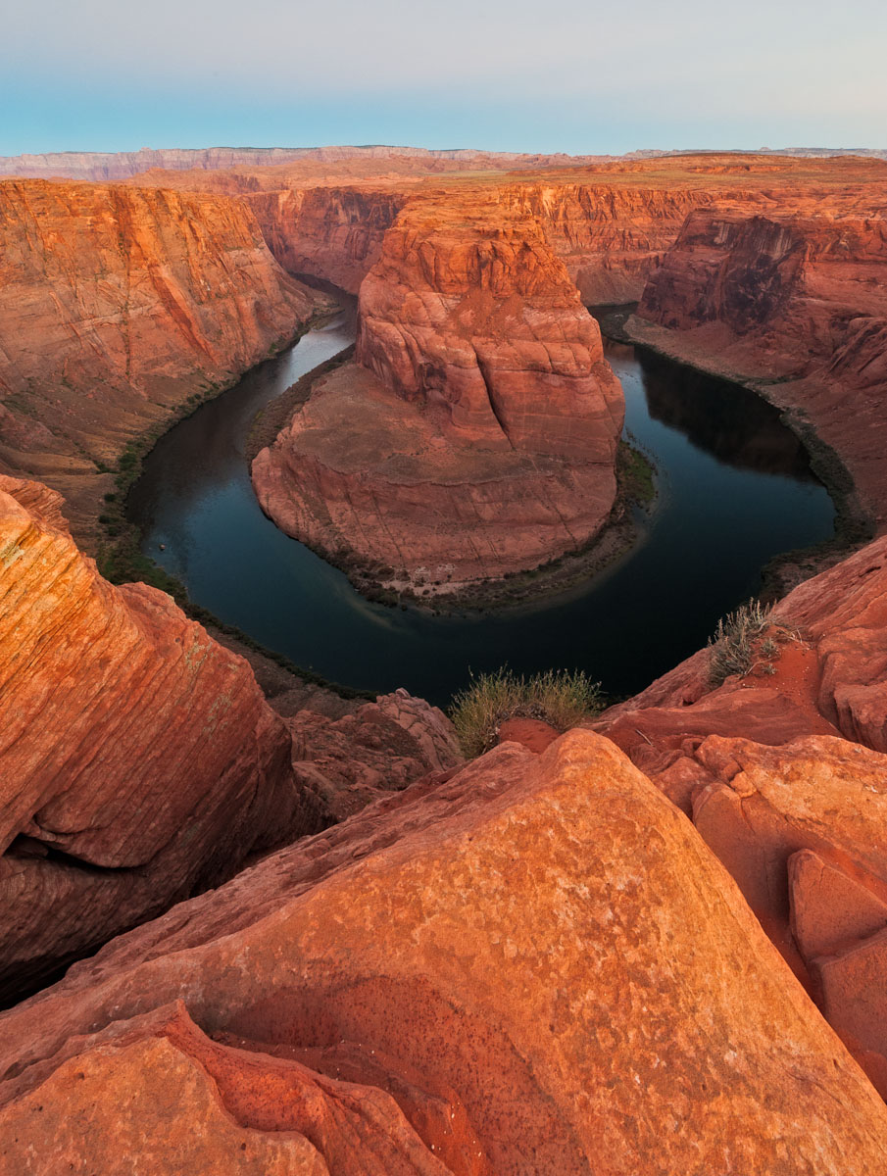

Slide 46
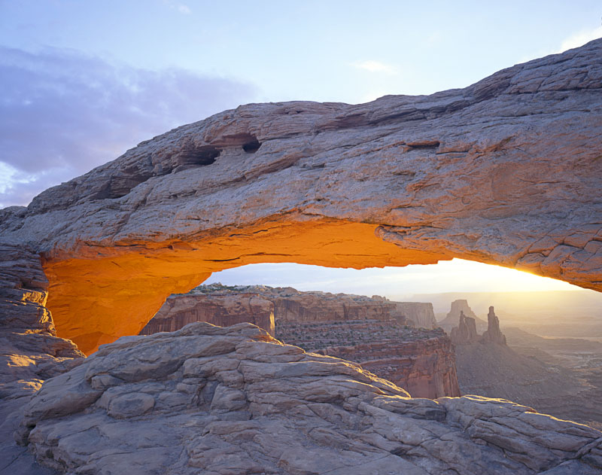

Slide 47
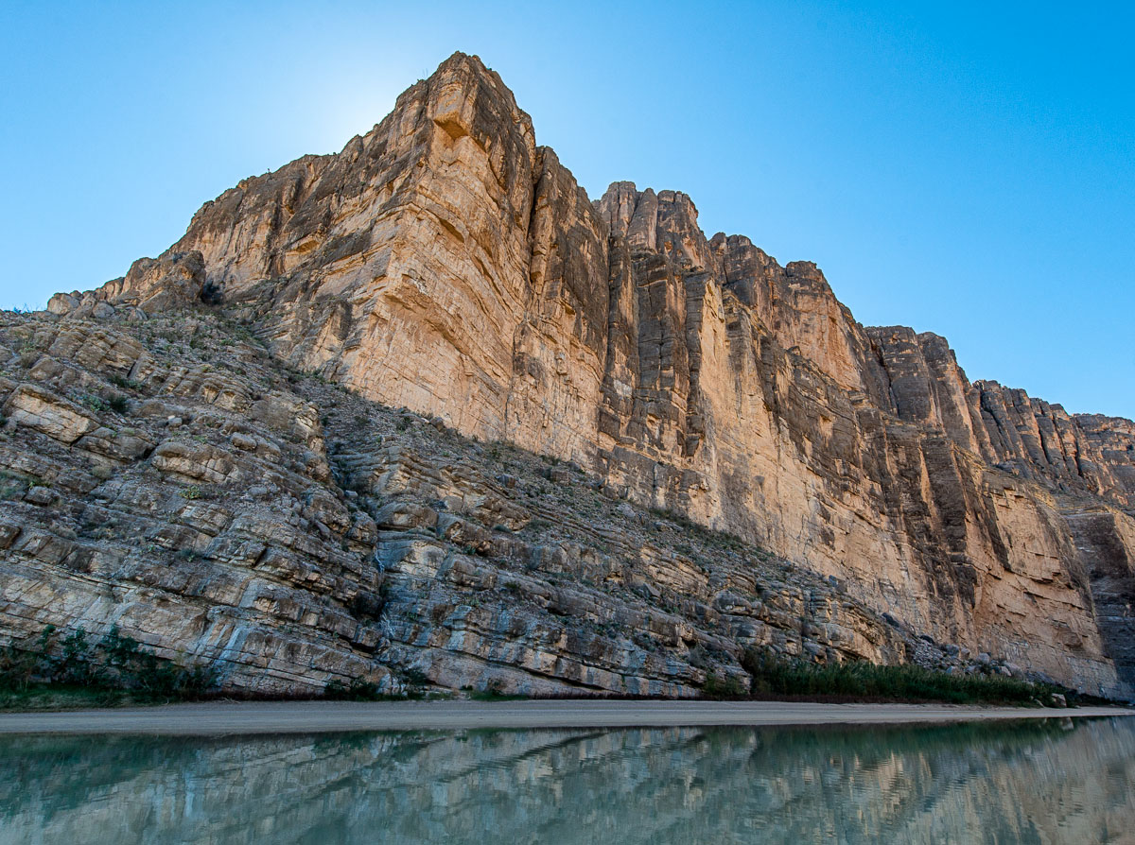

Slide 48
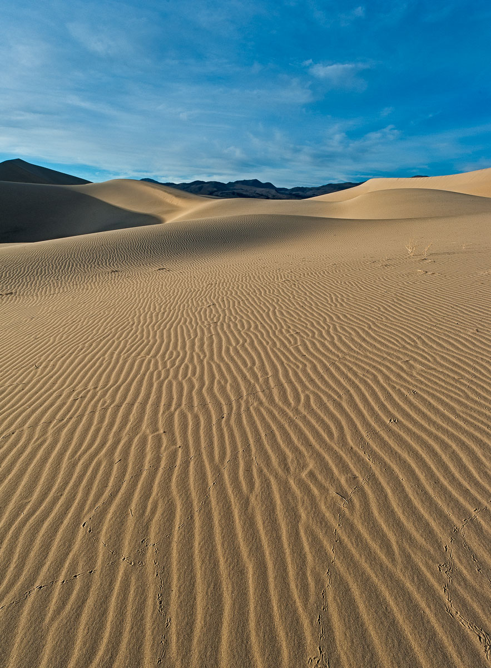

Slide 49
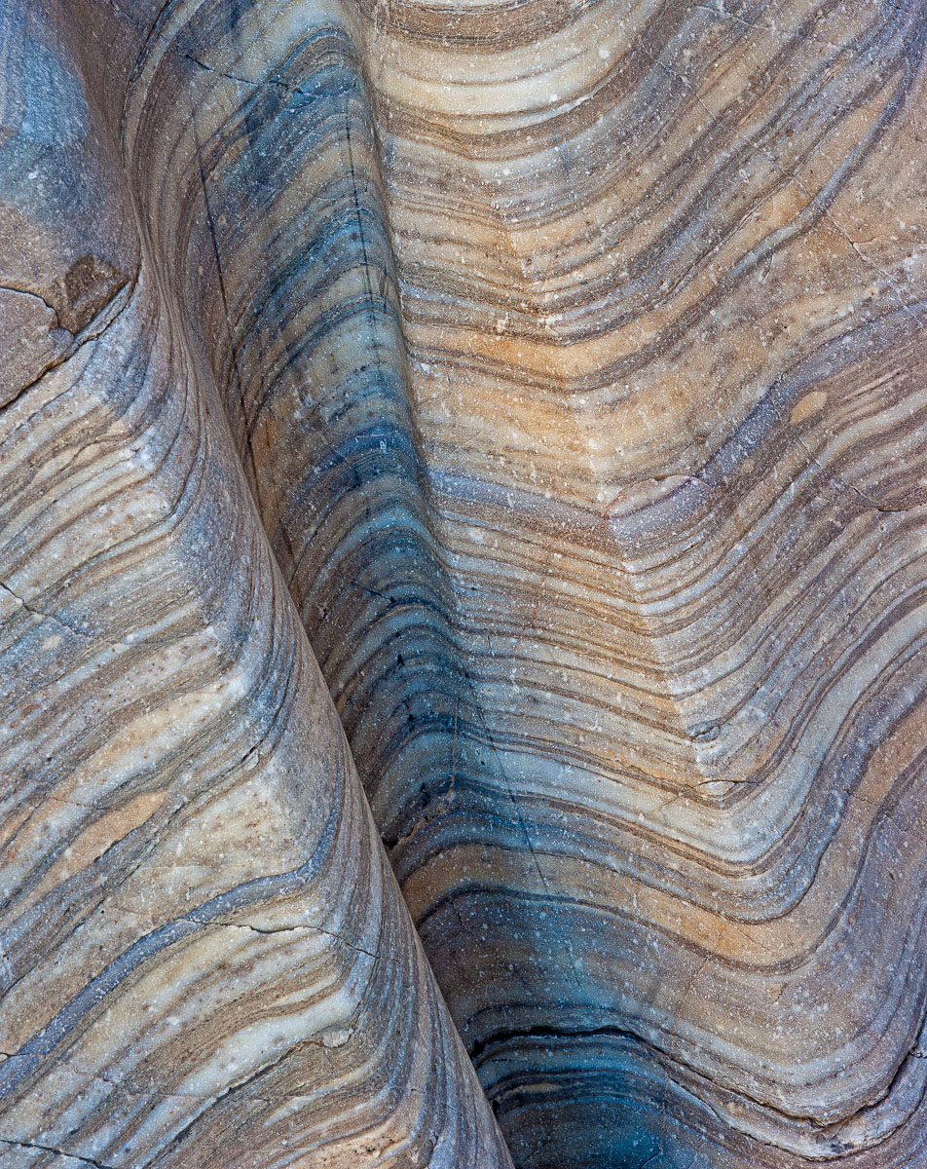
Best Light for photographing outcrops and close up details:
Soft diffuse light and shade:
Colors and details “pop”

Slide 50
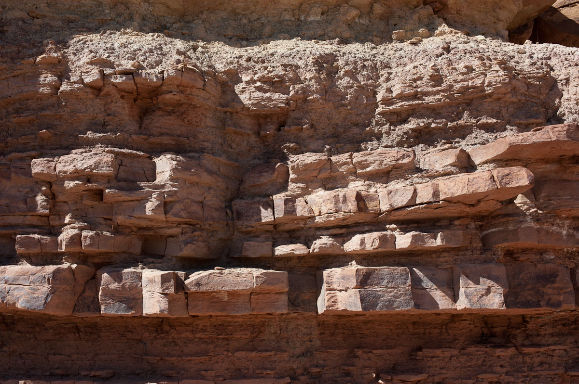

Slide 51
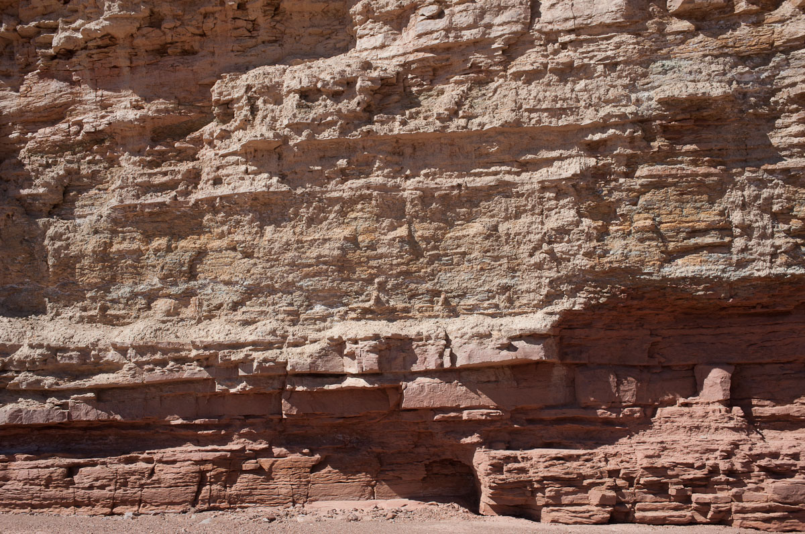

Slide 52
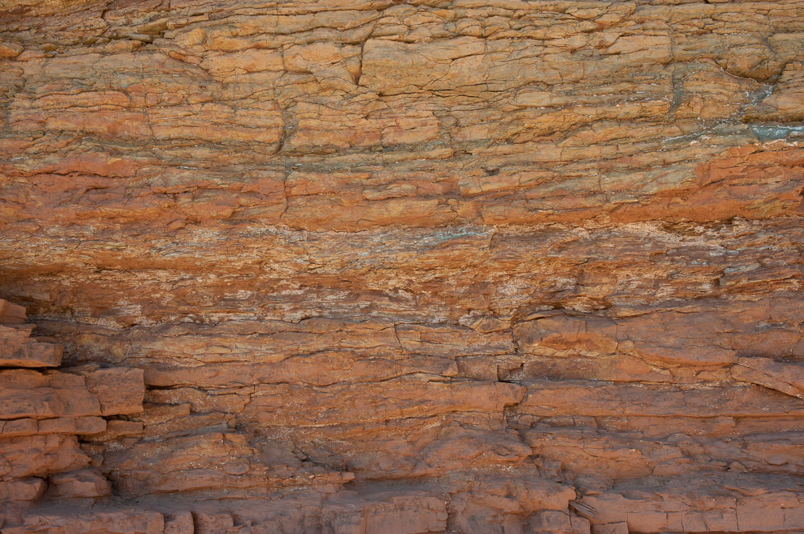

Slide 53
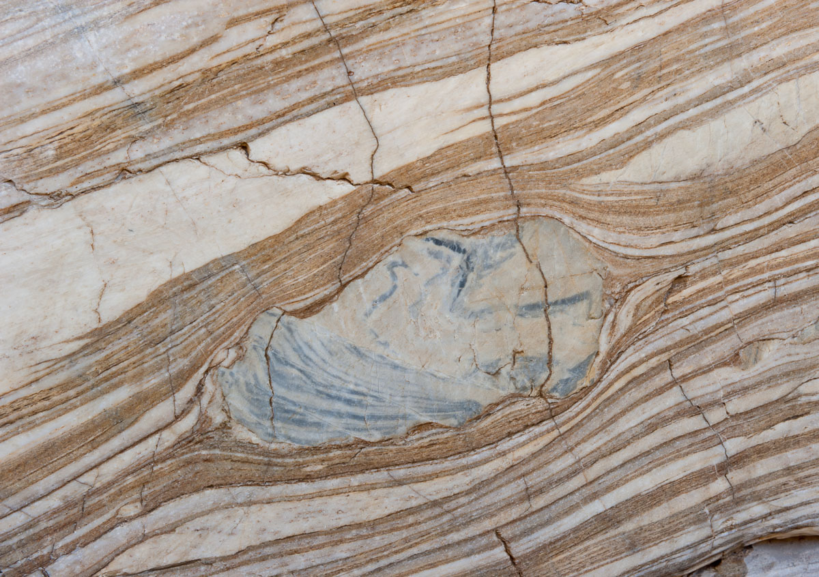

Slide 54
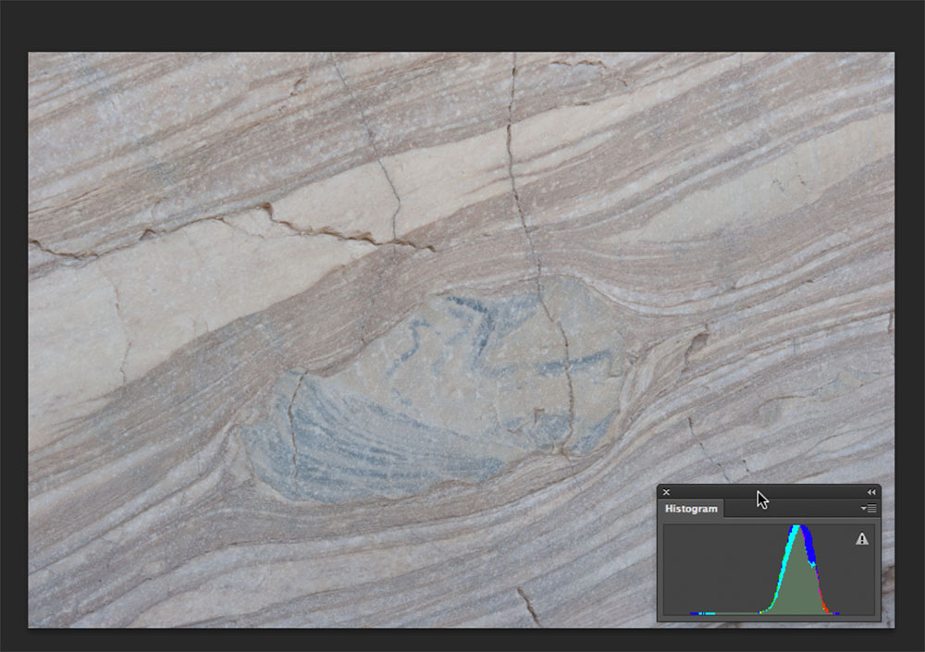

Slide 55
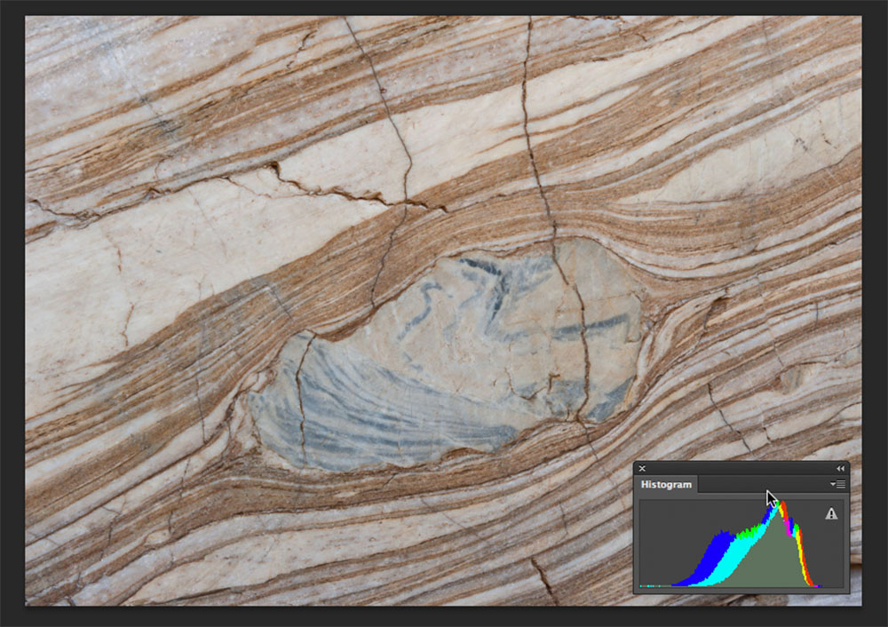

Slide 56
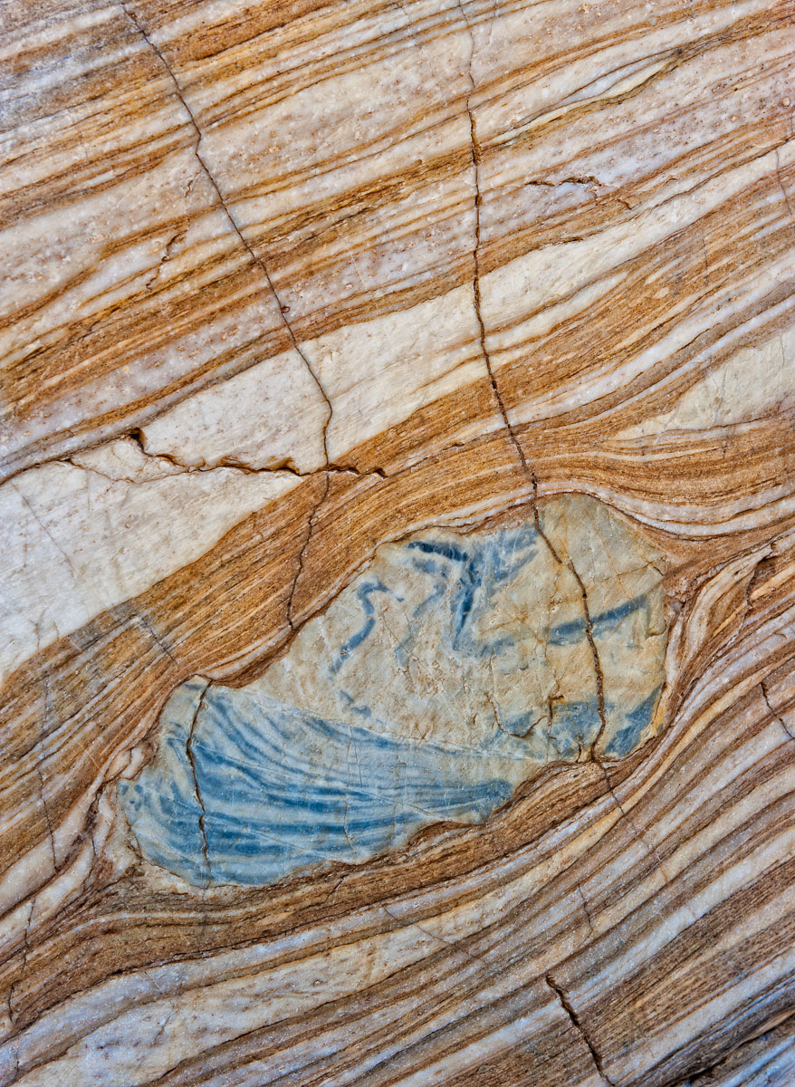

Slide 57
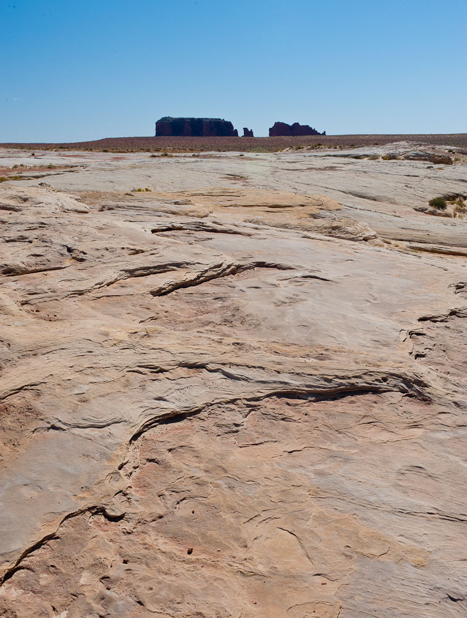
High Noon
Harsh Light !!!

Slide 58
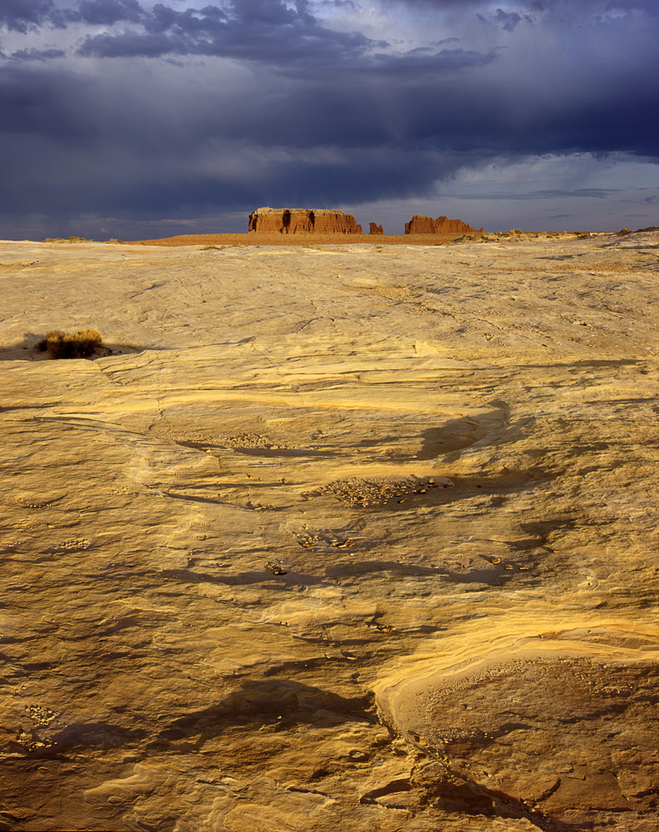
Just before sunset:
Low angle warm
Good Light!!

Slide 59
Lets Return to the Essential Technical Aspects
Exposure and Focus

Slide 60
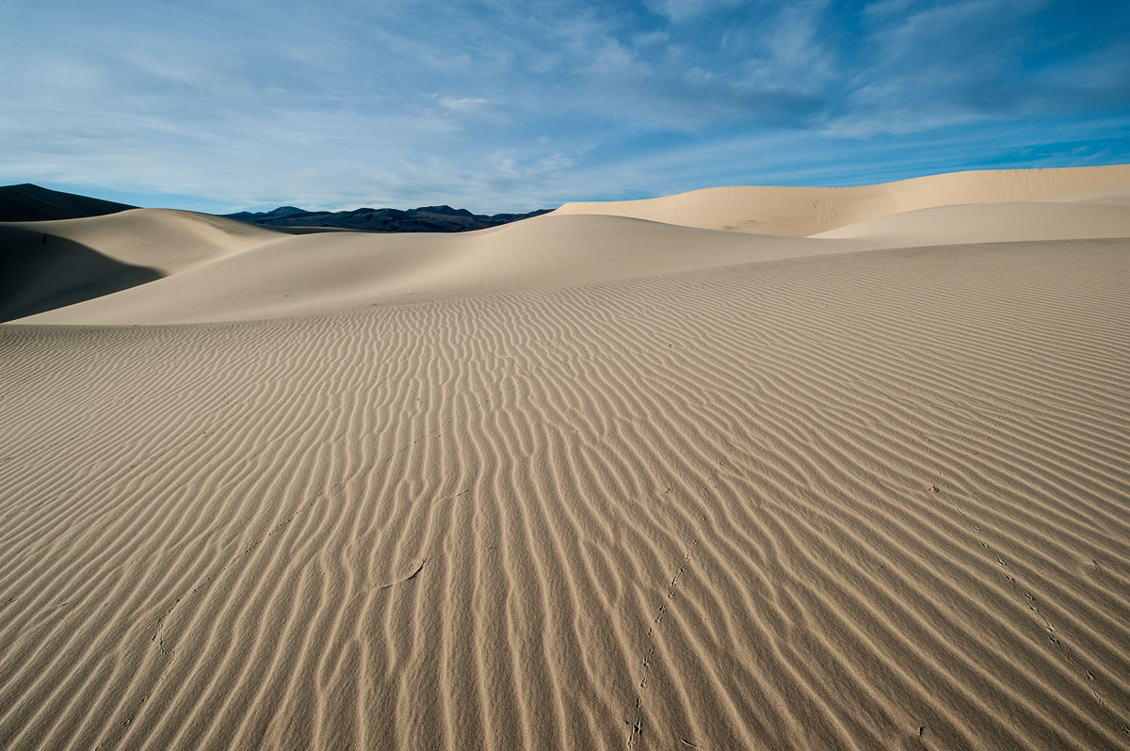
Understanding Exposure
“Correct Exposure”:
getting your images exposed the way YOU want them exposed!!!

Slide 61
Controlling exposure is all about controlling the amount of light which is exposing the film or being collected by the digital sensor
The basic unit of light used in photography is the stop
In the simplest terms, a stop is always relative, and defined as a doubling or halving of any value. When you increase one stop you have twice as much light and when you decrease 1 stop you have 1/2 the light

Slide 62
The exposure you make of an image can be controlled by three parameters in your camera:
1. Shutter speed
2. Aperture
3. Film speed or sensor sensitivity

Slide 63
Measuring the light to determine the
“proper” exposure settings
Light meters!
in camera TTL meters are reflected light meters calibrated to read a
medium tone reflectance
What does this mean and why is it important ???

Slide 64
Reflectance
The brightness of an illuminated object depends on how much light falls on the object and how much is reflected back
Black tree bark reflects about 5% of the light and absorbs 95%
White snow in the same light will reflect about 90% and absorbs 10%
In photography this range of reflectance of white and black objects in the same light corresponds to about 5 stops of light

Slide 65
It turns out that an object that reflects 18% of the same light illuminating the white and black objects is a neutral mid-tone gray, which corresponds to about 2 1/2 stops lighter than black and 2/12 stops darker than white!
Why is this important?:
Because Light meters are calibrated to an 18% neutral mid-tone reflectance!!!!

Slide 66
Exposure Meters Tell You How to Make the Thing They are Metering
NEUTRAL
NOT HOW TO PROPERLY EXPOSE IT!!

Slide 67
So if you meter a scene that has bright white snow in and expose using the meter reading will the snow be properly exposed and white in the picture?????

Slide 68
NO!
It will look dull gray
This is why you need to learn about metering a scene and adjusting your exposure settings
(shutter speed and aperture settings)
to give proper exposure for the reflectance of the important objects in the scene

Slide 69

Exposing for Tonality
+2 1/2 texture-less white
+1 light
Mid Tone ( what your meter reads! )
-1 dark
-2 1/2 detail-less black

Slide 70
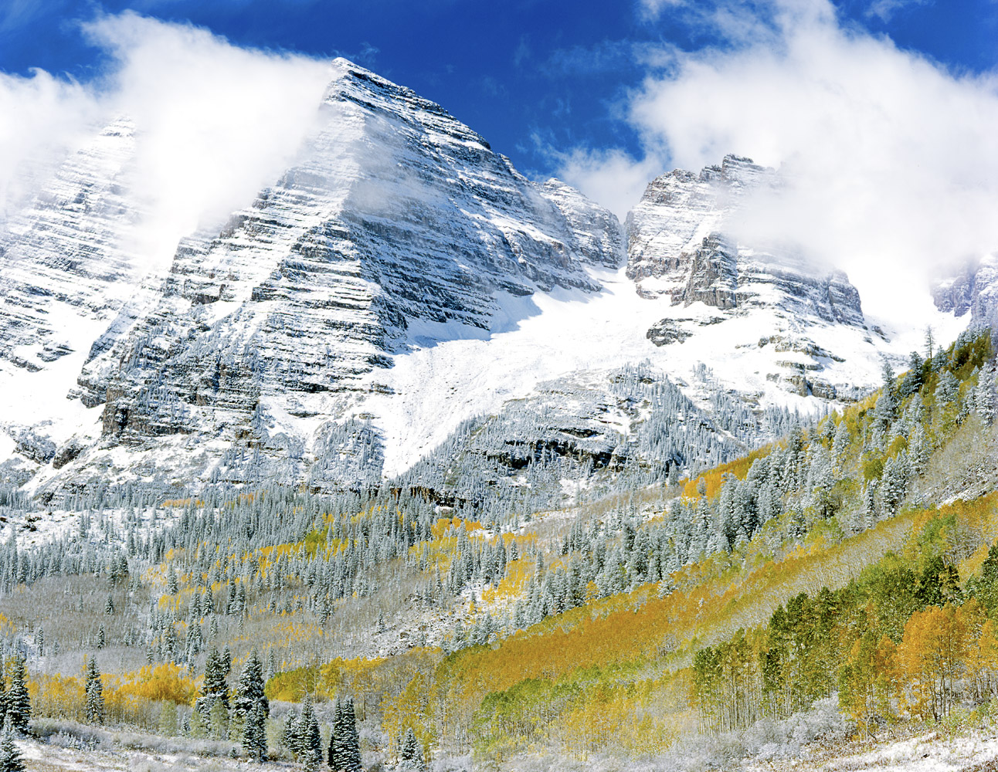

Slide 71
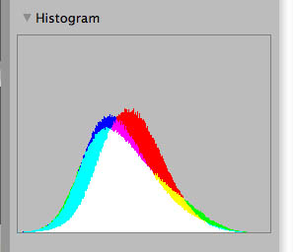
Using the Histogram!
Powerful digital tool for evaluating good exposure

Slide 72
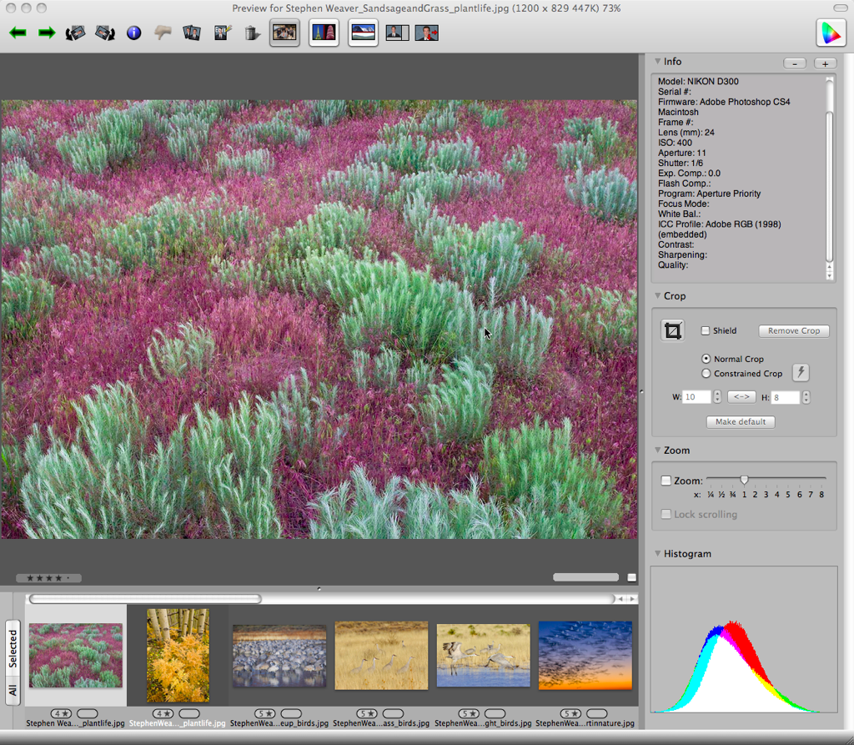

Slide 73
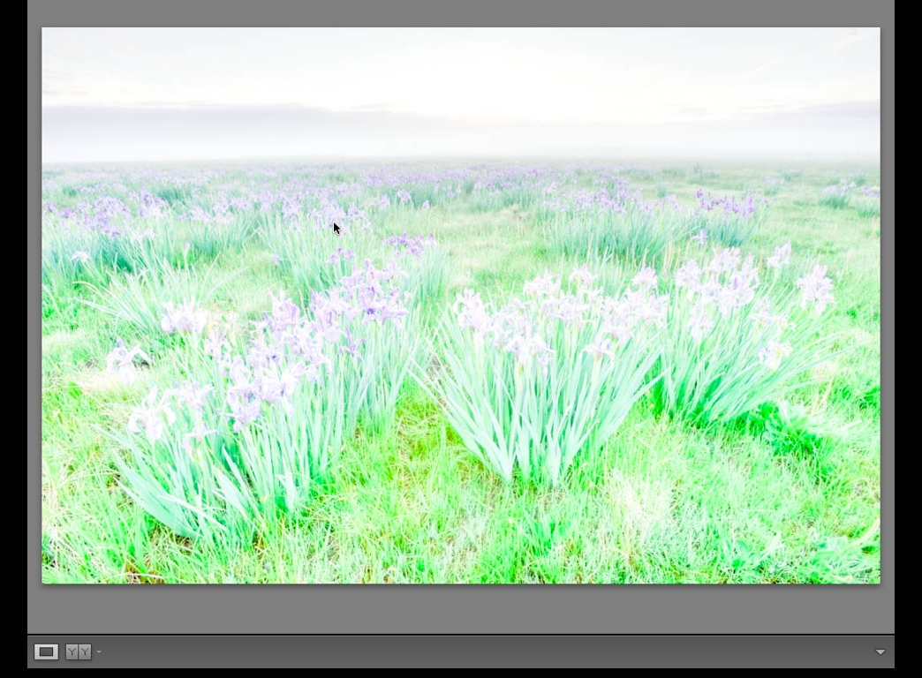
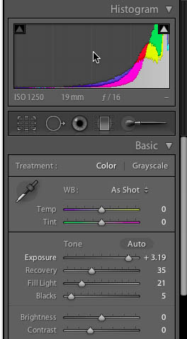
Over exposed

Slide 74
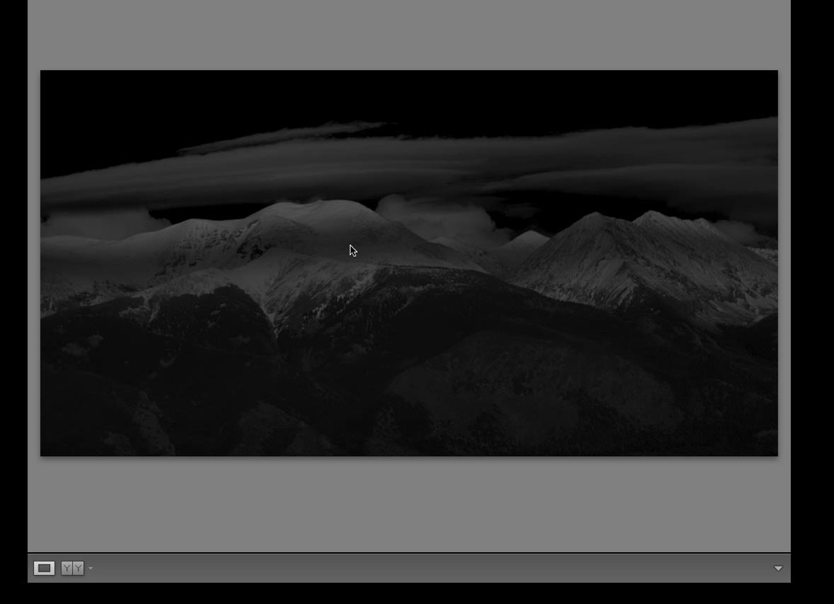
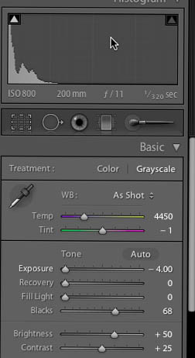
Underexposed

Slide 75
How do you deal with scenes that have greater than 5 stops of exposure values???
1. Graduated Neutral Density Filters
2. Software
3. Some higher end Modern DSLR’s have higher dynamic range sensors

Slide 76
Focusing and Depth of Field
Utilizing different lens aperture settings gives you a powerful way to control what is in focus in the image
A low f/stop(large aperture opening) will give you a limited depth of field, while a high f/stop (small aperture opening) will give a large depth of field

Slide 77
Focus stacking
Take several images at different focus points
Use software to combine the images to give extreme depth of field
Particularly useful for macro and photo-microscopy
*Helicon Focus software

Slide 78
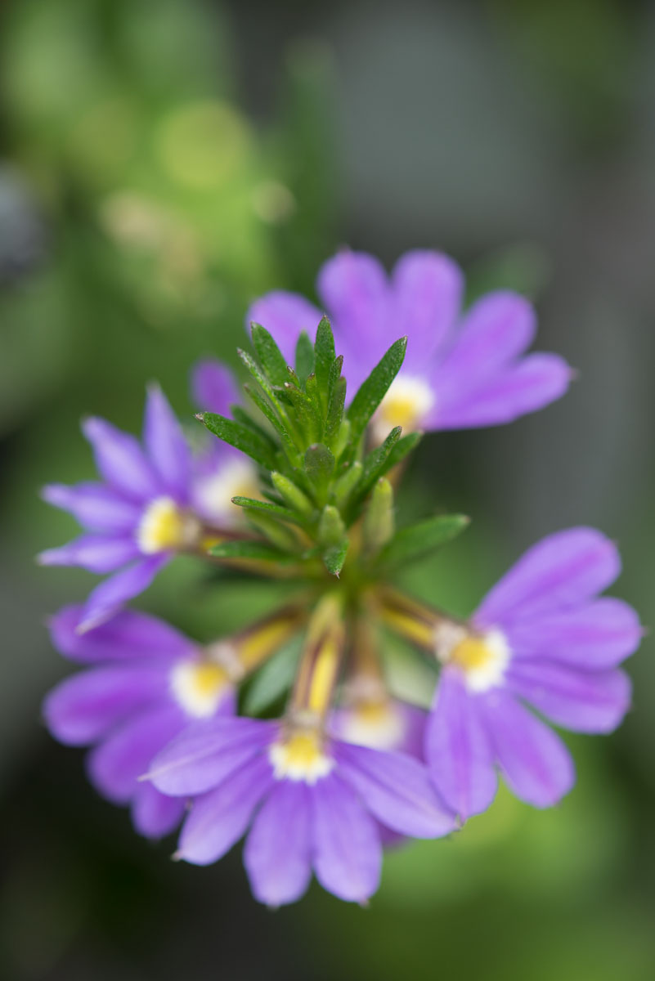


Slide 79
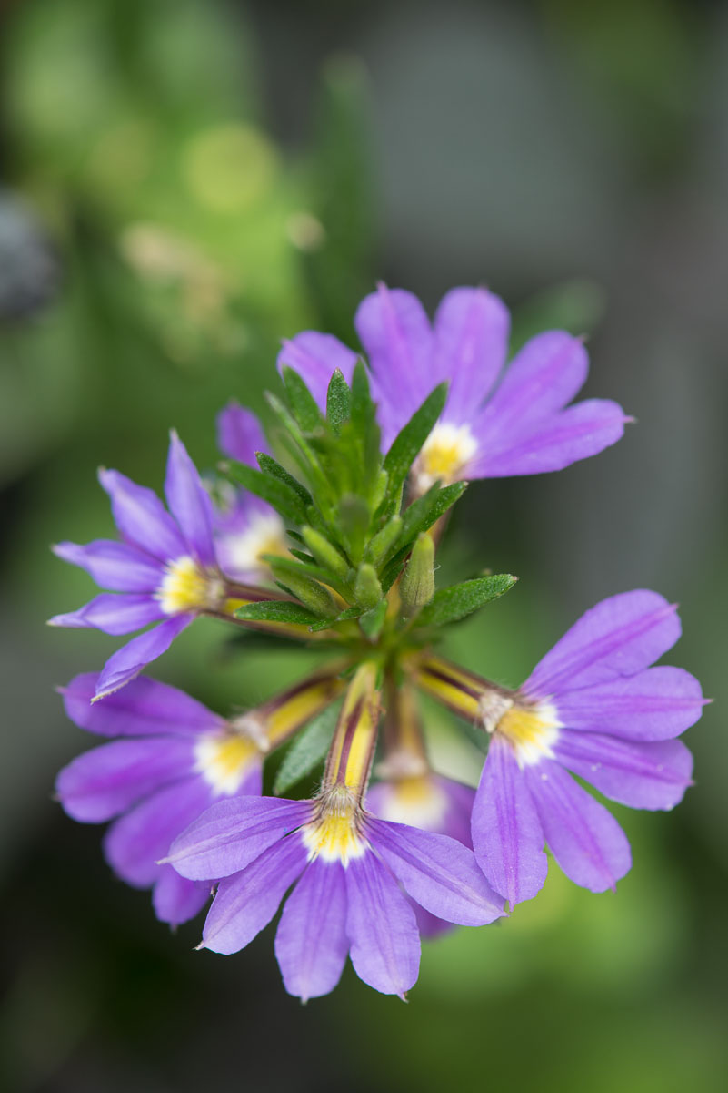
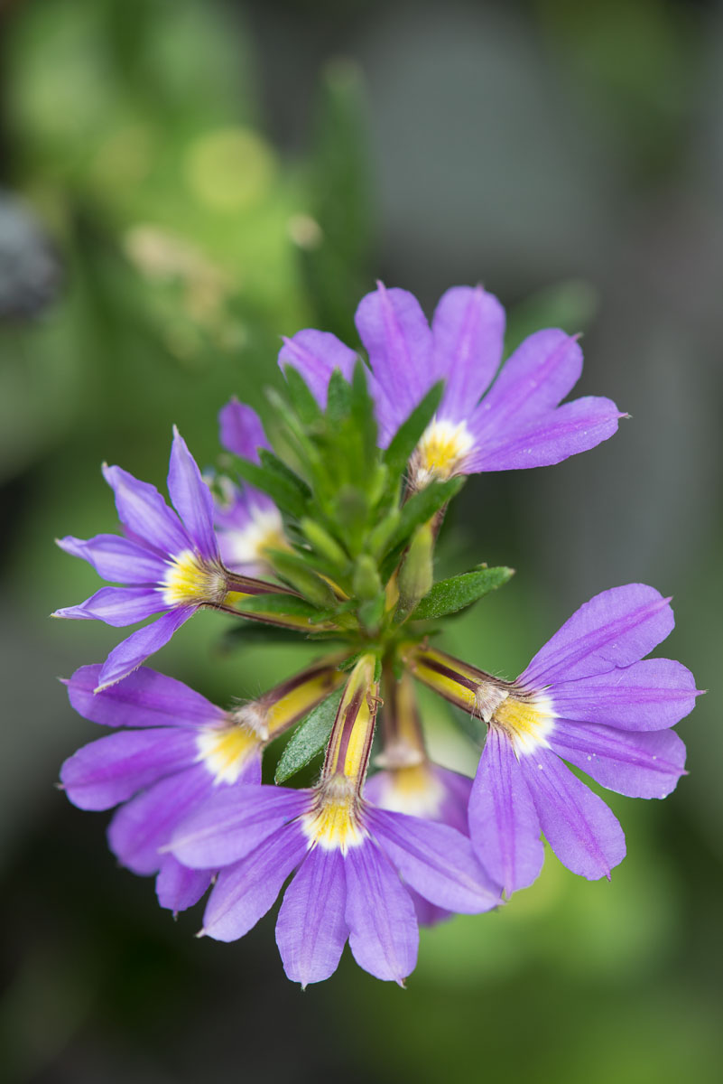

Slide 80
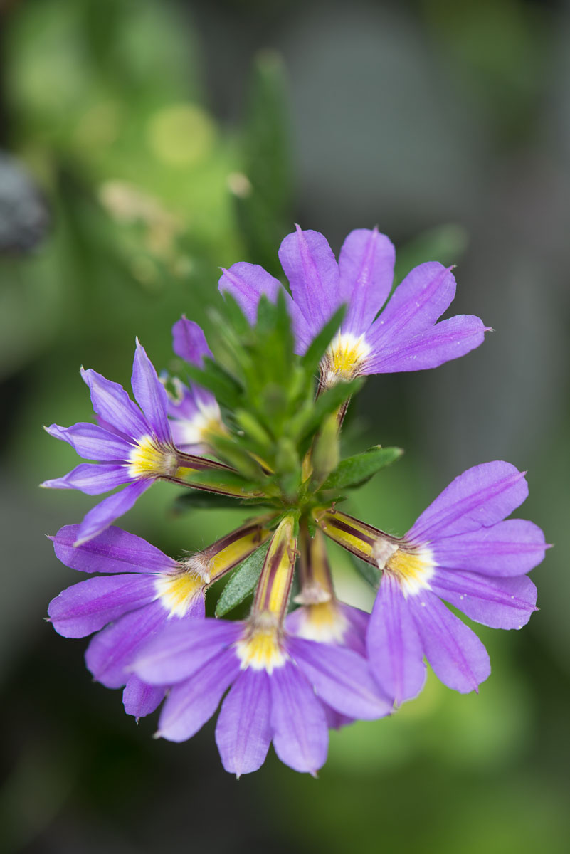


Slide 81
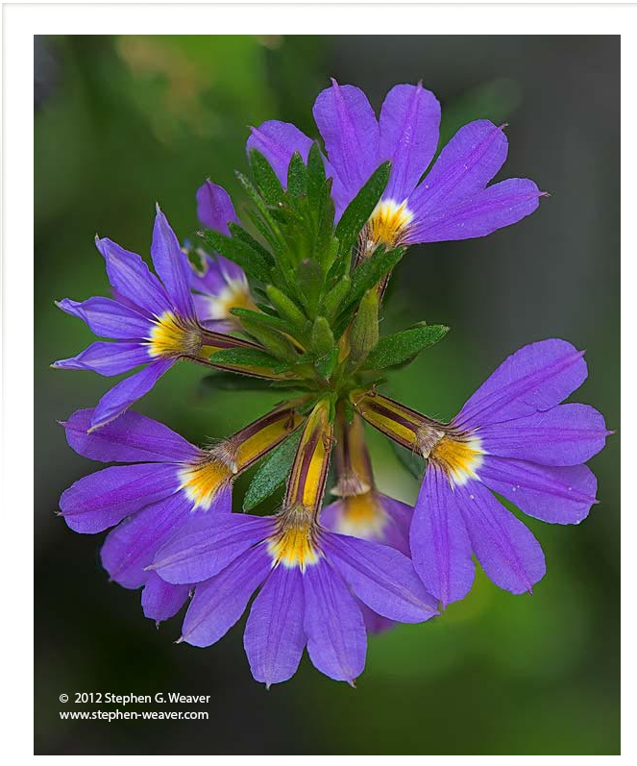

Slide 82
Here is the secret to making great Geo-photographs :
Good Technique +
Good Subject +
Good Conditions =
Excellent Geo-Photograph!

Slide 83
Recommended Website references
Helicon focus: http://www.heliconsoft.com/
Guy Tal Photography E-books http://guytalbooks.com/
Adobe Photoshop Lightroom: www.adobe.com/Lightroom

Slide 84
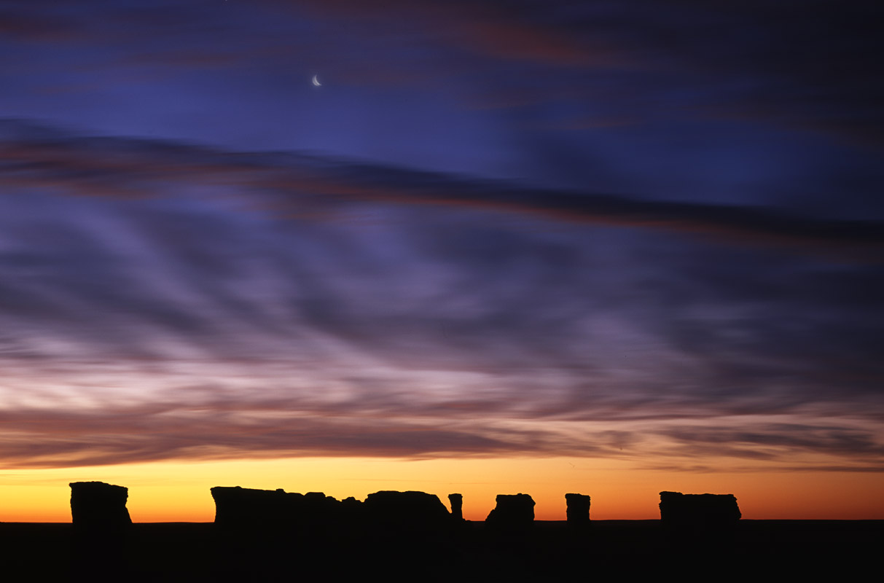

Slide 85
THANKS
QUESTIONS???

