Slide 1
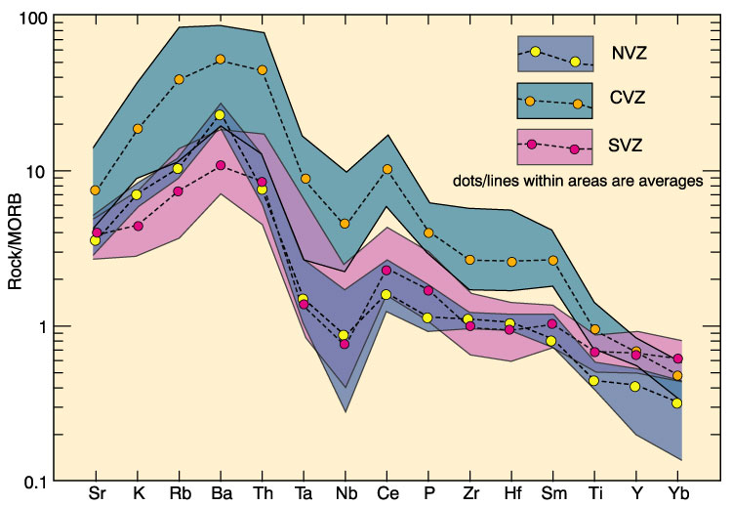
Understanding this diagram means you graduate from geochemistry!
Notes:
Problems – textbooks do not show error bars. Many AGU presentations of data don’t show data bars. Students cannot yet understand Methods sections of published peer-reviewed papers. How do they know if these are good or bad data.
Figure for Andes from Winter, 2001 after Pearce, 1983

Slide 2
Using a Portable X-Ray Fluorescence spectroscope in Geochemistry
Do graduates know how to evaluate and determine good data or bad data?

Slide 3
Motivations
Time invested in senior theses
Not every student participates in theses
Graduates bound for industry jobs and/or internships prior to graduate school
Pedagogical advantages of mini-research projects during regular course-work

Slide 4
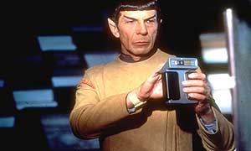
Notes:
A possible solution? Warning- your students will no longer “get” the tricorder reference!

Slide 5
Advantages of hand-held PXRF
Analysis time is seconds to minutes
Minimal sample prep
Detection limits, reproducibility, accuracy, analytical blanks
Anecdotal reports of increased use by industry – anyone can operate but emphasize need to develop and follow QC protocols

Slide 6
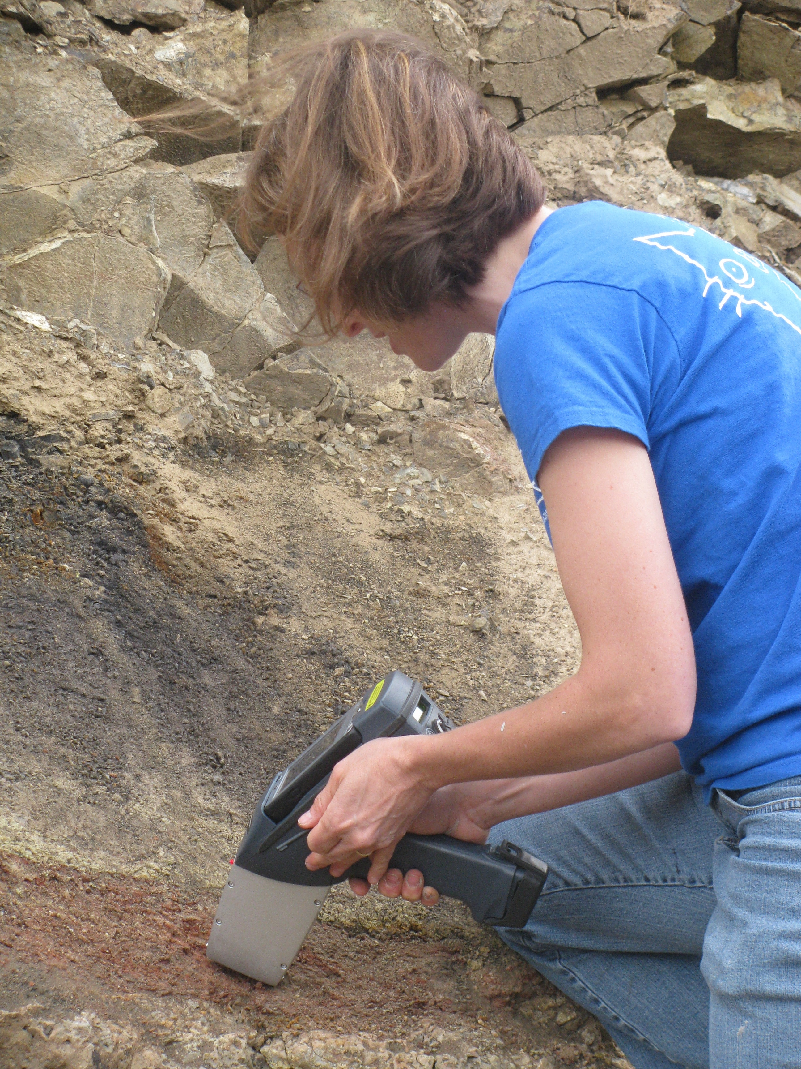
My tricorder
Data down-loads to Excel directly
Notes:
Processes 2500 counts per second

Slide 7
Notes:
Zr, Nb, Mo strongly fluoresce – graph from Innov-X literature

Slide 8
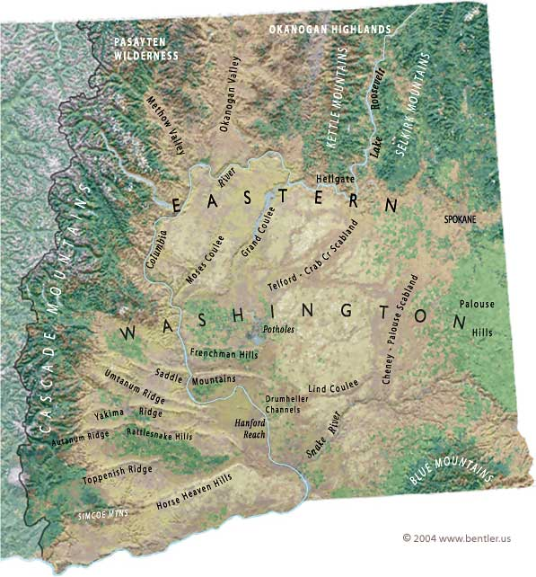
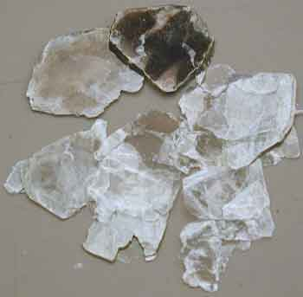
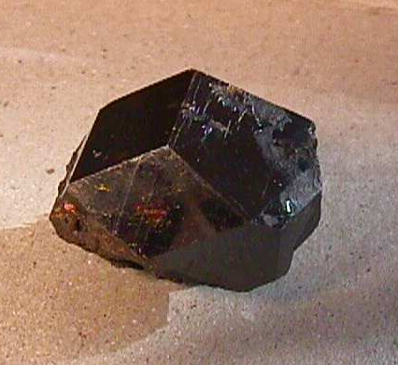
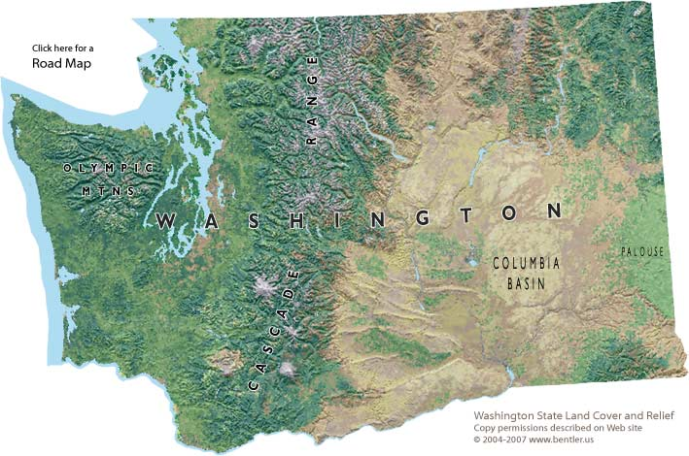
A case study
B.C. Rockies
65-75 mya
Idaho Batholith
53.5 to 55.5 mya
Cascades
55 mya to Recent
www.cropsoil.uga.edu
www.rockhounds.com
Possible to trace minerals to their source
  Elemental composition, age, temperature of formation
Assume that sediment and floodwaters originated in the same region as the minerals

Slide 9
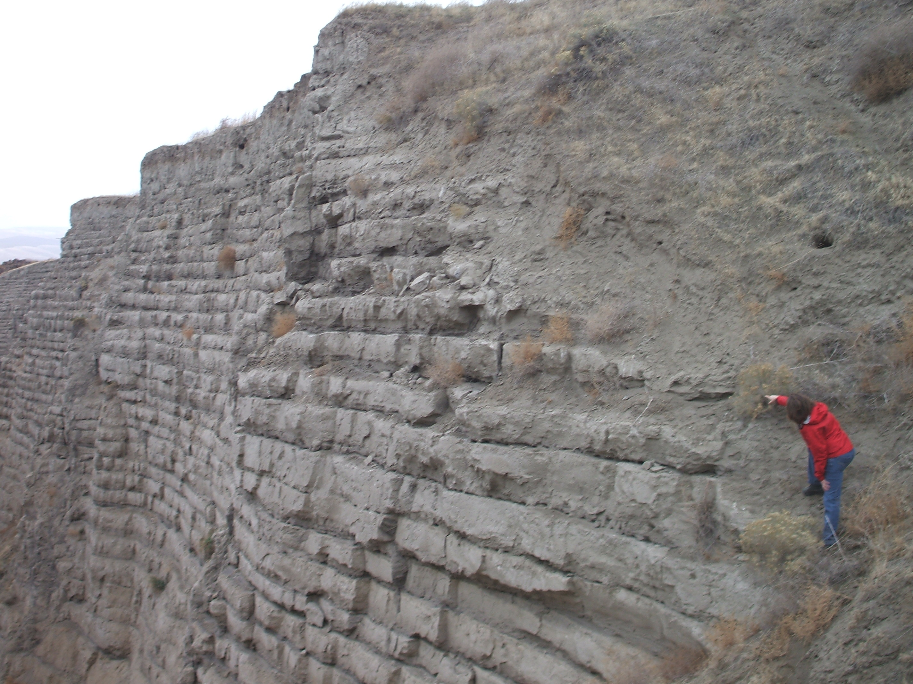
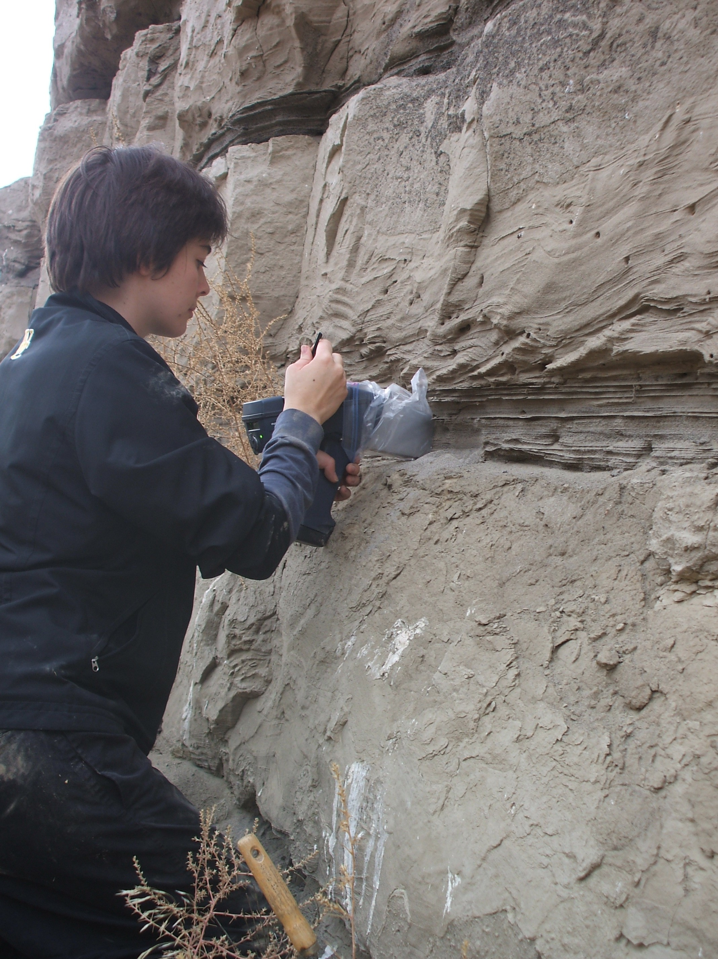
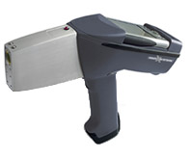
Tamara Carley – senior thesis
3 PXRF readings at the coarse basal unit of each sample location
Collect sediment for lab analysis
http://www.innov-x-sys.com/products
Notes:
Manufacturer will give quoted precision.
Student tested field vs lab precision as part of senior thesis
Tamara now at Vanderbuilt working on PhD – has NSF graduate fellowship!

Slide 10
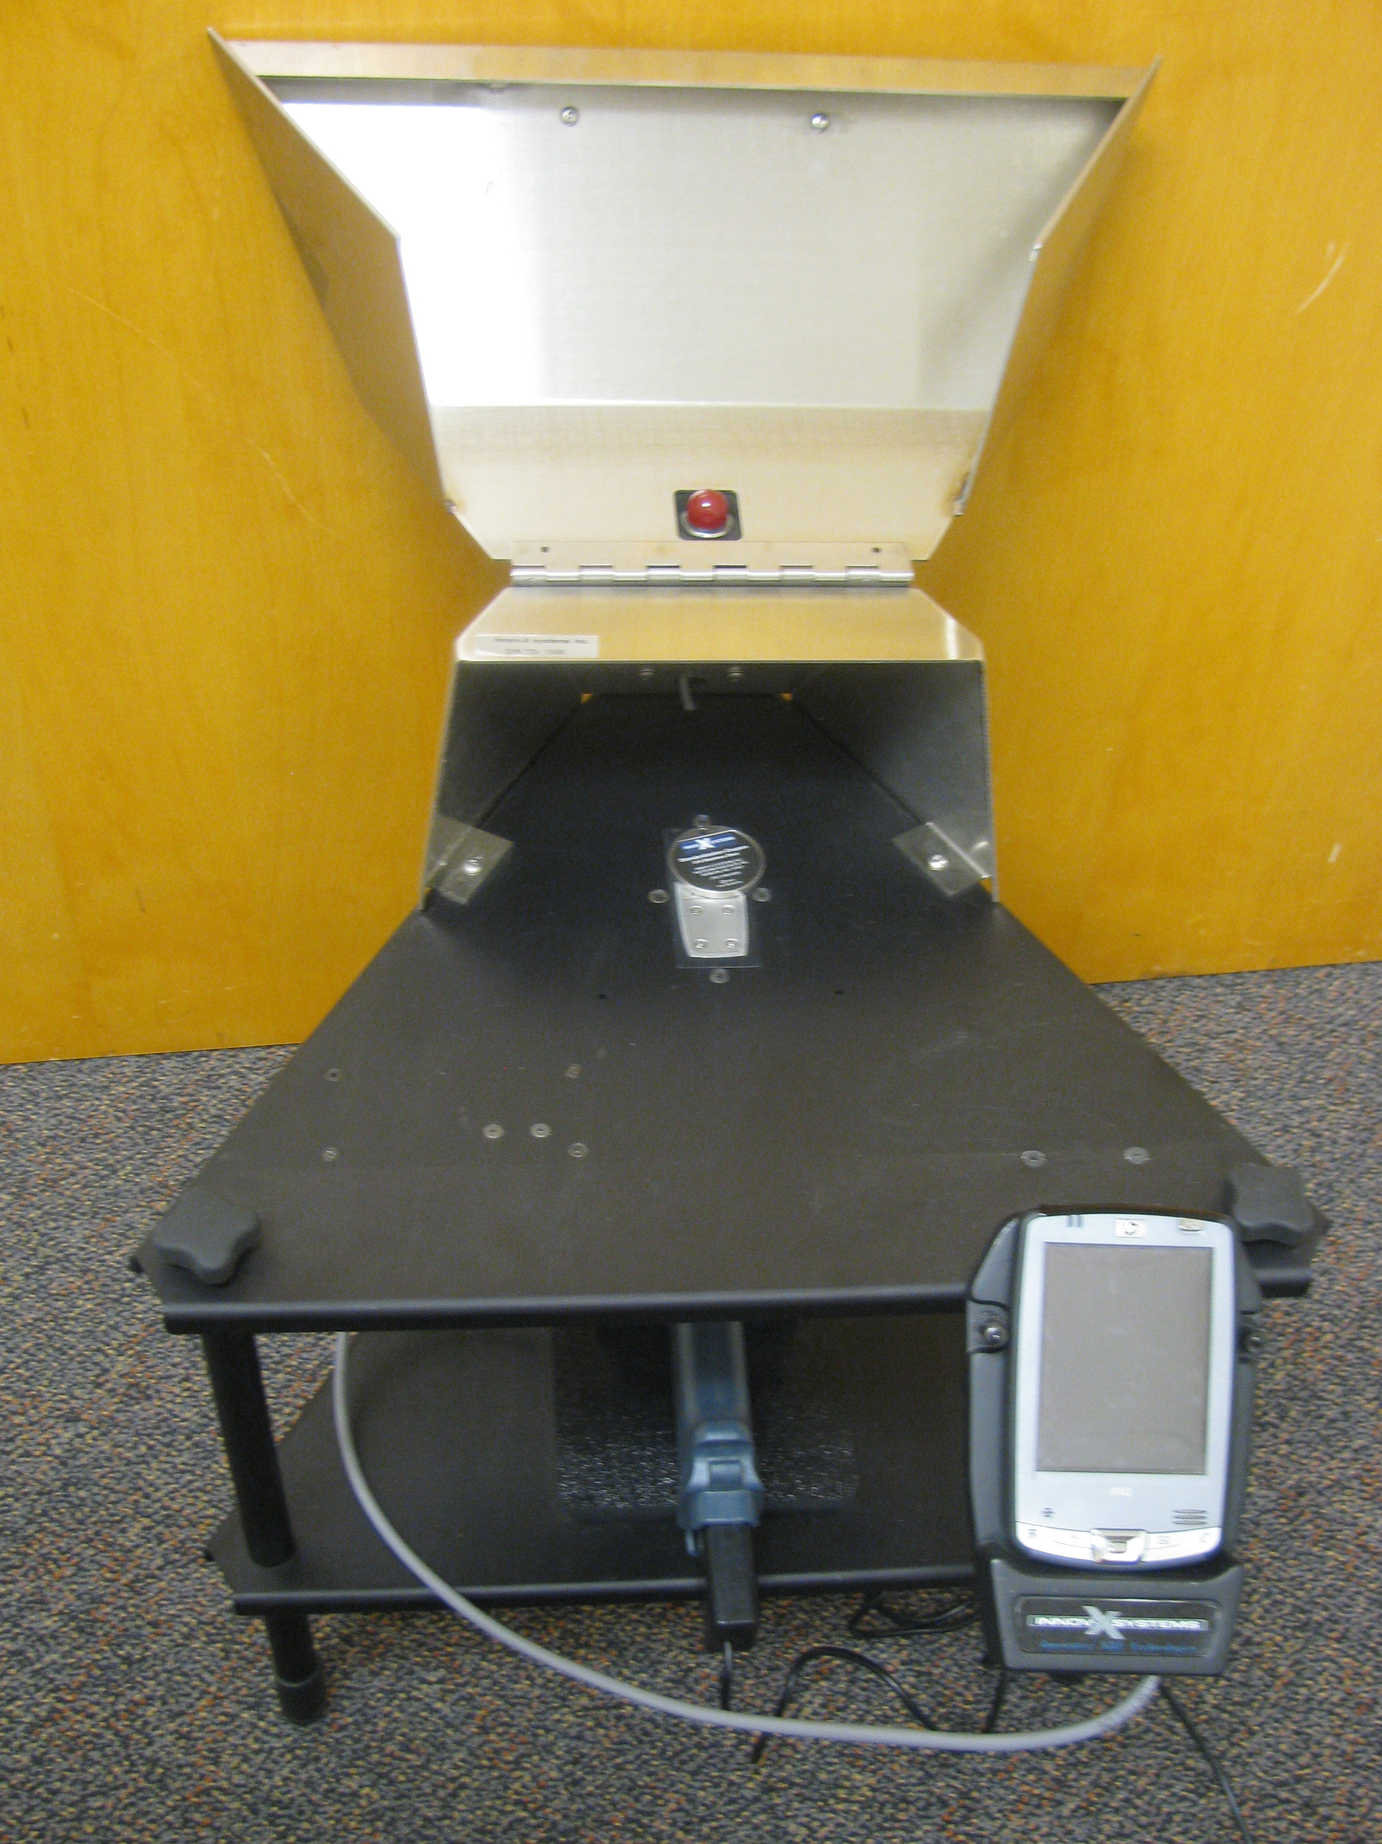
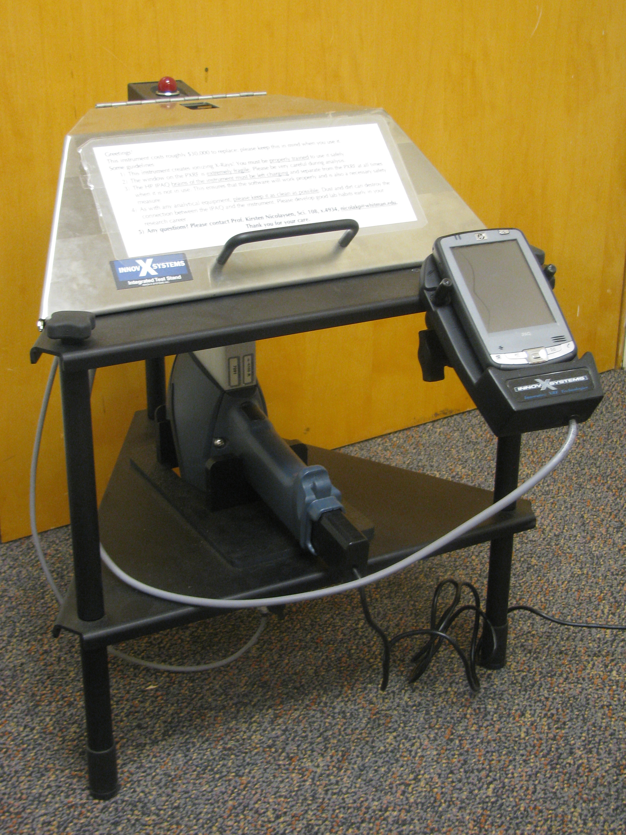
Lab test stand

Slide 11
PXRF Development Findings

Slide 12
Comparing elemental abundance (ppm) with stratigraphic position
Conclusion – we can use pXRF to target sampling campaign
Notes:
Dark Green diamonds – pre-Late Wisconsinin rhythmites
Blue diamonds – Wisconsinin rhythmites (Pleistocene Missoula floods)
Precision – 2 std deviation
Range of CRB compositions given by bar at base
Red lines – samples targeted for mineral separation

Slide 13
SAFETY
Whitman College – Geology Department
Safety summary and training acknowledgement – PXRF
This safety training was completed _________________(day/month/year) by student ___________________________________ under the guidance of faculty member _______________________________________.
I understand that this instrument creates ionizing radiation in the form of X-rays that can damage human tissue. ___________ (initials)
I understand that the pXRF produces X-ray whose energies are 10-60 keV meaning that bone will absorb X-rays 3 to 5 times more effectively than soft tissue. ________
I understand that the highest output of radiation is approximately 27,000 mrem/hour or 10,500 counts per second at the analysis window. ______________
Notes:
This is an example of a training document that every student user signs to indicate they’ve completed training.

Slide 14
SAFETY II
I understand that increasing the distance between the window and the any living tissue decreases the radiation dose and that I should never point the pXRF at myself or another person or allow someone to stand directly within two feet of the analysis window during operation.
At the above radiation dose, I understand that it would take continuous direct exposure for two hours, or a cumulative direct exposure for two hours to exceed the maximum radiation dose allowed per year by OSHA. ______________
I understand that at the trigger, when using the instrument properly in the field, my hand and body receive less than 0.05 mrem/hr of radiation.
___________________________ ______________________________
(signature of student researcher) (signature of faculty trainer)
____________________ _________________
(date signed) (date signed)

Slide 15
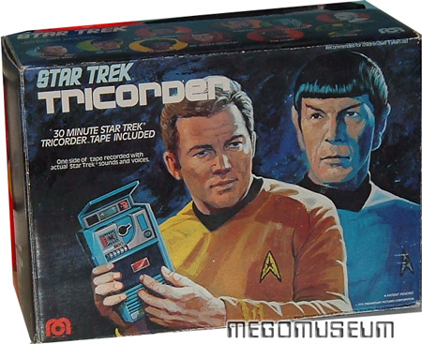
Instrument cost is significant. Solution? NAGT website
Notes:
John McNett invented tricorder for TV. Sold out on ebay for ~$99. Real thing is ~$30k.

Slide 16
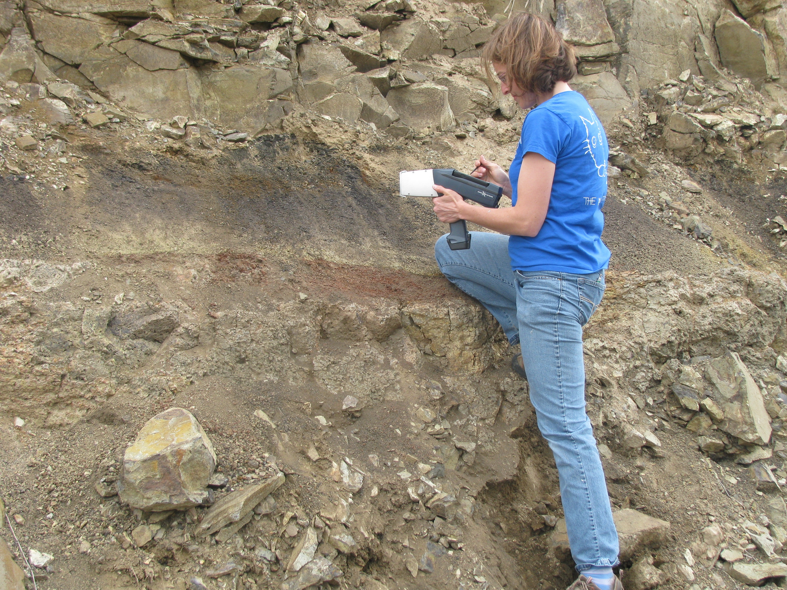
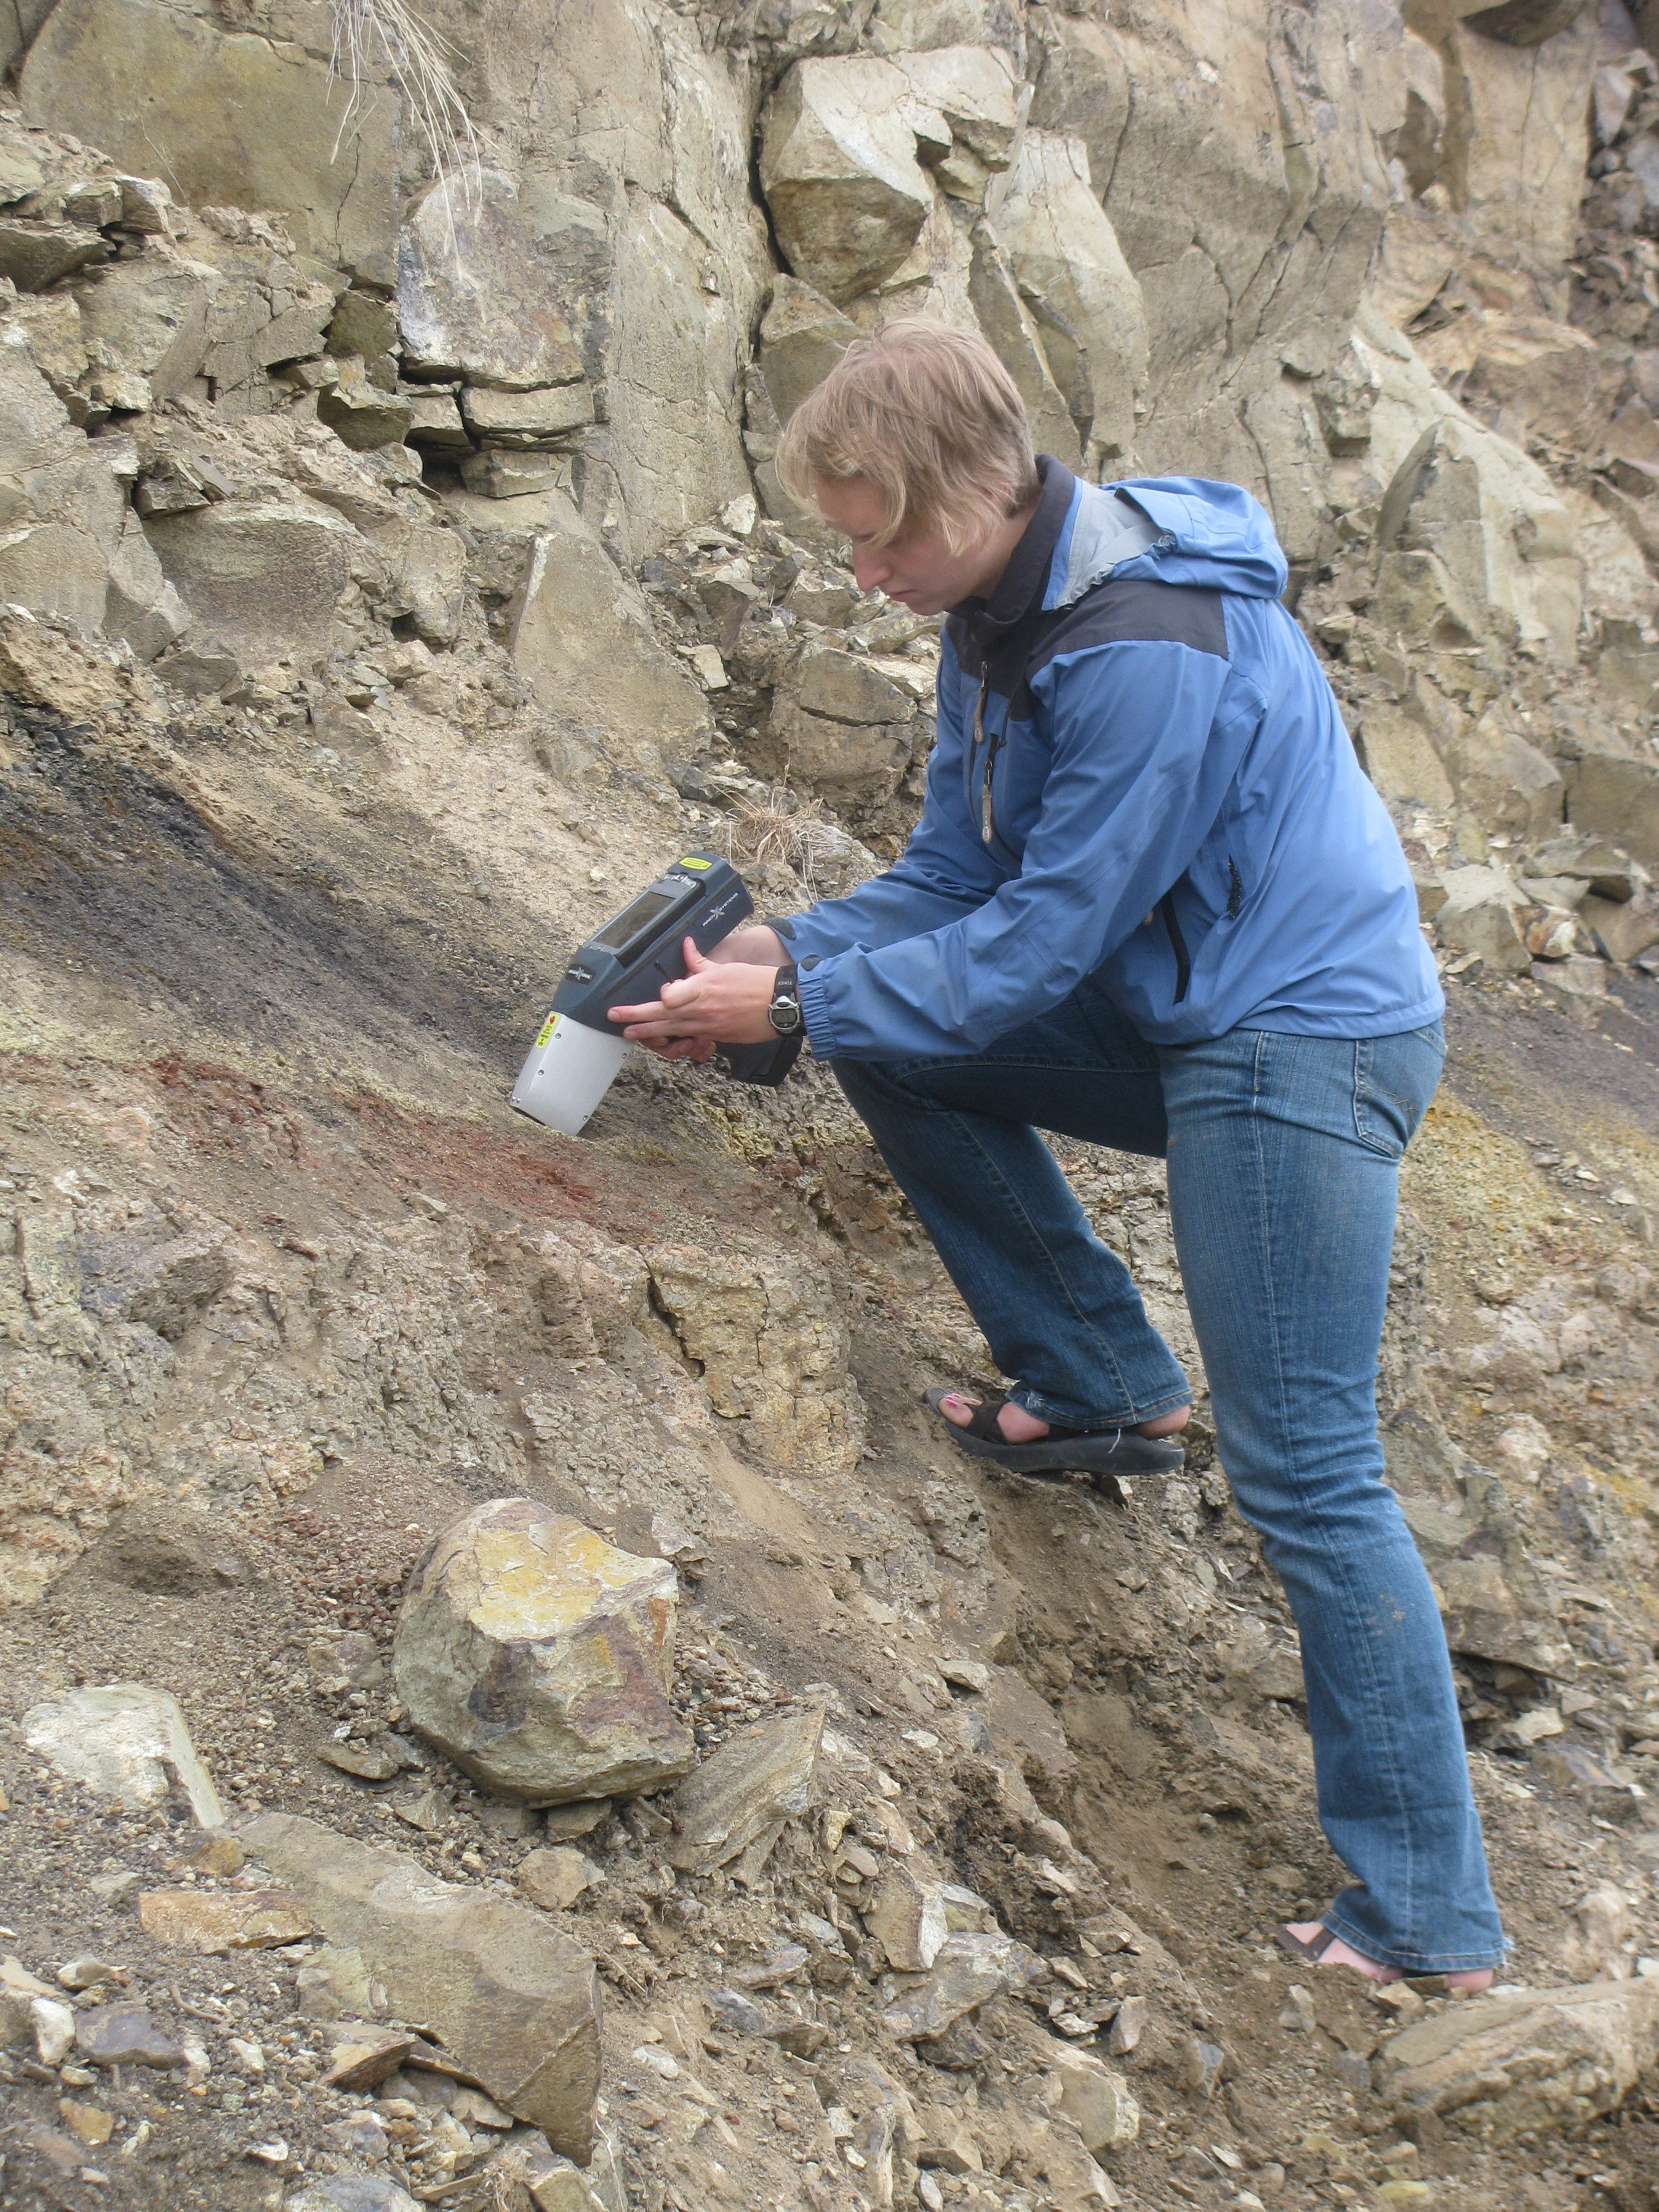
Case study – basalt weathering and paleosol development in the Columbia River Basalts

Slide 17
For discussion
Does your class already provide opportunities to measure and evaluate data?
How much time devoted to topic?
Mini-project or lecture?
What works best for you?

