Slide 1


Gas hydrate P-T conditions:
Predicting the location of resources and hazards
Megan Elwood Madden, melwood@ou.edu
Assistant Professor of Geochemistry, School of Geology and Geophysics,
University of Oklahoma
Concepts:
  Thermal conductivity and heat flow
  Lithostatic/hydrostatic load at depth
  Gas hydrates and their potential safety, energy, and environmental impacts
  Relevance of phase diagrams to geochemical, environmental, and energy-related problems in geology
Skills:
  Develop P-T models of the near surface using heat flow, thermal conductivity, and density data
  Use spreadsheets and graphs to answer geochemical problems
  Combine and analyze different types of data sets
  Use spatial analysis skills to calculate a volume of hydrate and convert to mass, moles of methane, and finally energy and greenhouse gas equivalents.
NYDailyNews.com

Slide 2
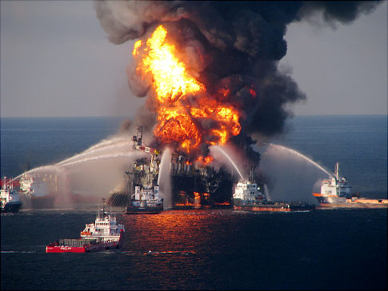
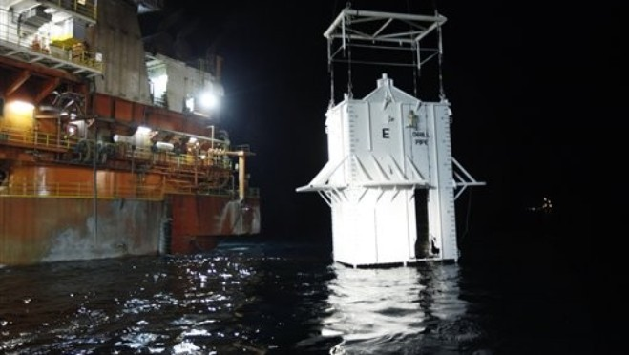
Gas Hydrates in the News
Gulf Spill: Did Pesky Hydrates Trigger the Blowout? by Richard A. Kerr on May 10, 2010, Science
Hydrates stymie oil spill containment box
by Erwin Seba on May 9, 2010 Reuters

Slide 3

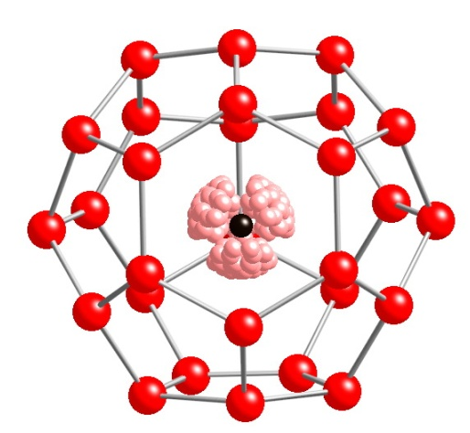
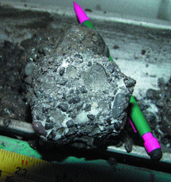
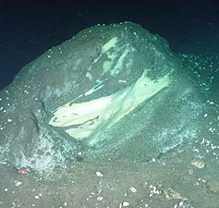
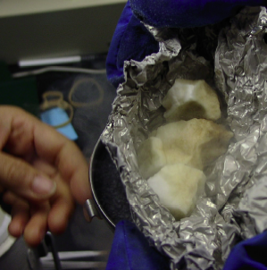
What are gas hydrates?
Stern et al. 1996
Methane Hydrate:
CH4 * 5.75 H2O
NOAA

Slide 4
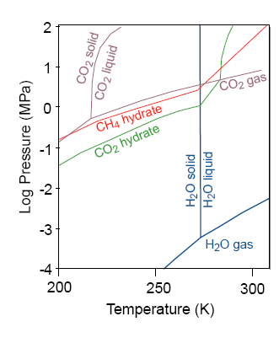
Controls on Hydrate Stability
↑Pressure ↑ Stability
↓Temperature ↑ Stability
↑ Guest gas concentration ↑ Stability
↑ Activity of water, ↓Salt ↑ Stability

Slide 5
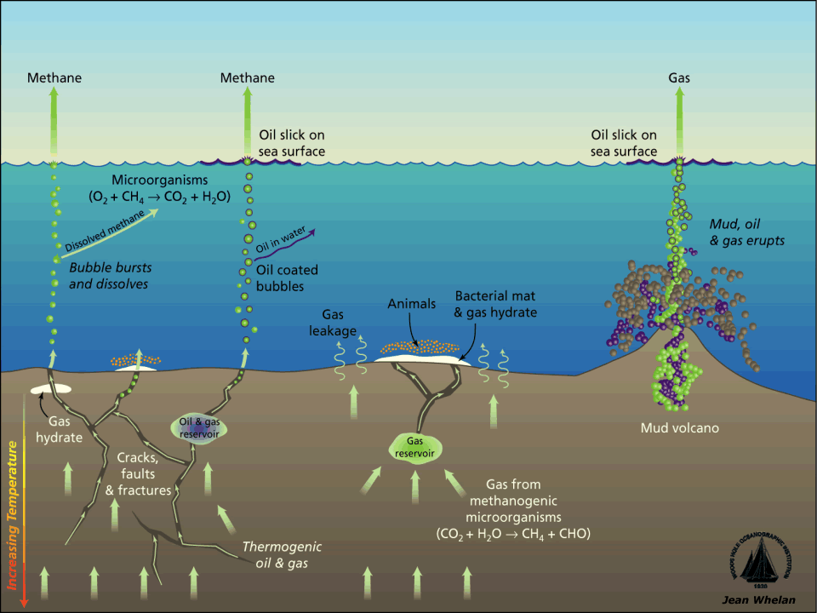
Seafloor Sediments

Slide 6
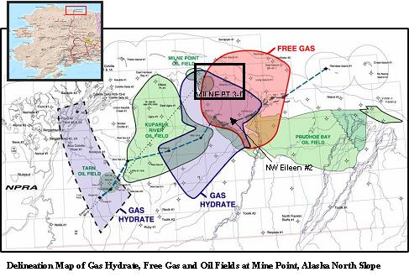
Permafrost Deposits

Slide 7
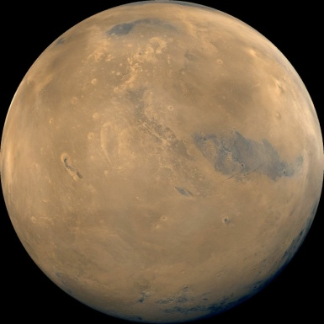
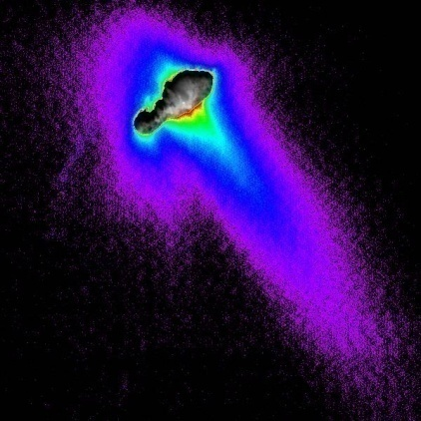
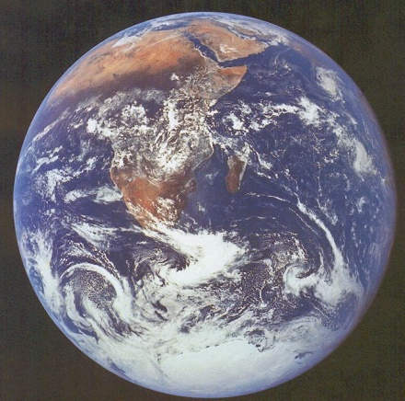
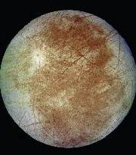
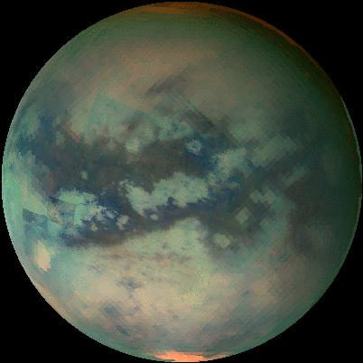
Gas Hydrates as Planetary Materials
Earth
Europa
Titan
Mars
Comets
Significant reservoirs for water in the outer Solar System
Planetary-scale reservoirs for greenhouse gases
Impact on surface features and atmospheres

Slide 8
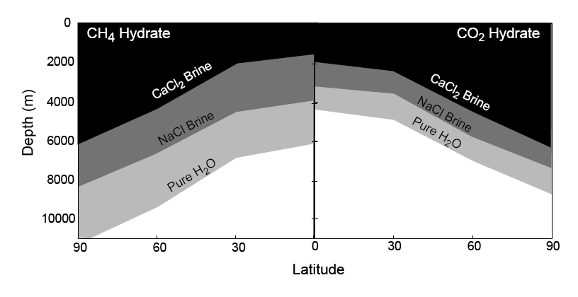
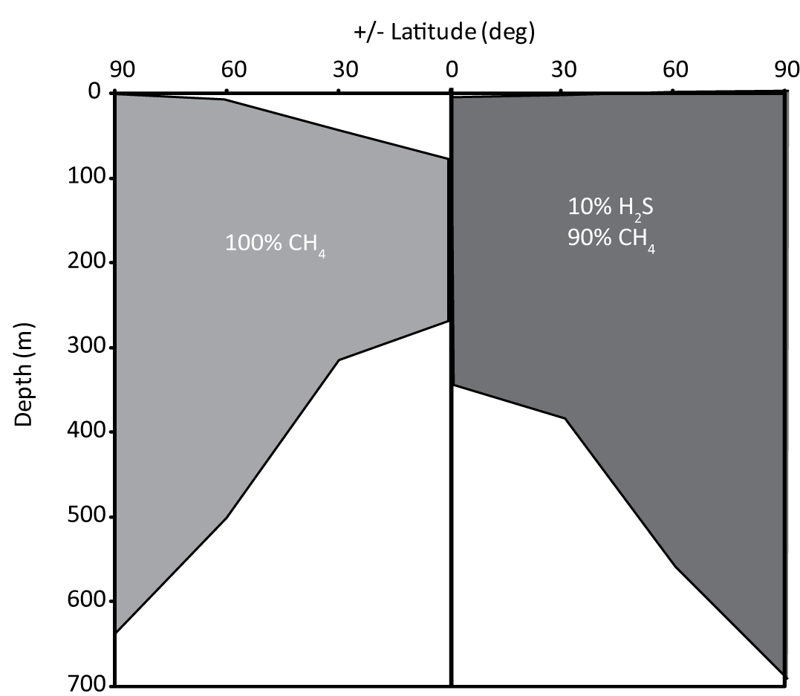
Elwood Madden et al. (2007-GRL)
Mars Hydrate
Stability Zones
Elwood Madden et al. (2010-PSS)

Slide 9


Context:
  Principles of Geochemistry, required upper division course
  Mainly inorganic geochemistry
  Stresses thermodynamics and kinetics
  2nd or 3rd homework assignment
  Section on geothermal, lithostatic, and hydrostatic gradients
  Most students go to graduate school or energy industry

Slide 10

The Questions:
1. Use heat flow, thermal conductivity, density and average surface temperature to create a diagram showing pressure and temperature conditions at depth in
a) seawater in the Gulf of Mexico
b) Gulf of Mexico sediments beneath 1500 m of seawater and
c) permafrost on the North Slope of Alaska.
Location | Density (g/cm³) | Thermal Conductivity (W/mK) | Heat Flux (mW/m²) | Average Surface Temperature (K)
GOM seawater | 1.3 | 0.56 | -8 | 298.7
GOM sediment | 2.1 | 0.99 | 31 | 277.5
Alaska Permafrost | 1.5 | 2.25 | 68 | 269.0

Slide 11
P-T conditions at depth

Slide 12
2. Using the P-T conditions for the methane hydrate stability field in pure water and seawater found in Table 2 (Sloan, 1998; Dickens and Quinby-Hunt, 1994), create a diagram comparing the P-T curves for each of the three environments with depth and the methane hydrate stability field in pure water and seawater.
Hydrate stability data
 | Pure water | Seawater
P (MPa) | T (K) | T(K)
2.9 | 274 | 272.5
4.2 | 278 | 276.5
6.2 | 282 | 280.5
9.4 | 286 | 284.5
14.6 | 290 | 288.5
23.6 | 294 | 292.5

Slide 13
3. Use the diagrams you created to answer the following questions:
A. Over what range of water depths would you expect methane hydrate to form in the water column in the Gulf of Mexico?
B. You are working with an energy company to drill a deepwater oil well in 1500 m of water. Would you expect methane hydrate to form in sediments around the well? If yes, over what range in depths? If no, why not?
C. Over what range in depths would you expect to find methane hydrate in permafrost on Alaska’s North Slope?
850 m
600 m
660 m
240 m

Slide 14
4. If the average surface temperature on the North Slope increases by 3 degrees over the next century, how will this affect the methane hydrate stability zone?

Slide 15
If the porosity of the permafrost sediments is 10% and half of the pore space is filled by methane hydrate, calculate the greenhouse gas equivalent as barrels of oil which would be released from a 100 km² area given the data below.
Alternatively, this calculation could also be used to determine the energy that could be produced from the region if the methane trapped in the hydrates could be produced as a resource. How many cars could you fuel for 1 year if you produced all the methane hydrate present?
Molecular Formula: (CH₄)₈(H₂O)₄₆ Molecular Weight: 957.04 g/mol Density: 0.95 g/cm³
Greenhouse gas/energy : 1kg CH₄ =0.05 barrels of oil consumed = 0.004 passenger cars/yr
Thickness of hydrate stability field lost: 420m
Volume of Hydrate released: 420m* 10¹⁰m²*0.05 = 2.1x10⁹m^{3\}
Mass of hydrate released: 2.1x10⁹m³*950 kg/m³ *1000g/kg = 2.0x10¹⁵g
Moles of methane released:
2.0x10¹⁵g Hydrate / 957.04 g/mol *(8/46 mol CH₄/mol H₂O) = 3.6x10¹¹ moles
Mass of methane Released: 3.6x10¹¹ / 16 = 2.3x 10¹⁰ g
Greenhouse gas equivalent = 2.3 x 10¹⁰ g /1000 *0.05 = 1.1x 10⁶ barrels of oil
Energy Equivalent: 2.3 x 10¹⁰ g /1000 *0.004 = 90,000 cars

Slide 16
Evaluation:
  Graded as a homework set, with partial to full credit assigned for each question and/or step in the calculations.
  Accurate calculation of P-T conditions at depth
  Formulating graphs and text that communicate their results.
  How the graphs and spreadsheets were used
  Successfully complete a series of conversions

Slide 17
Gas Hydrates in the News
Gulf Spill: Did Pesky Hydrates Trigger the Blowout? by Richard A. Kerr on May 10, 2010, Science
Possibly, based on stability field….
Hydrates stymie oil spill containment box
by Erwin Seba on May 9, 2010 Reuters
Of course they did!

