Slide 1
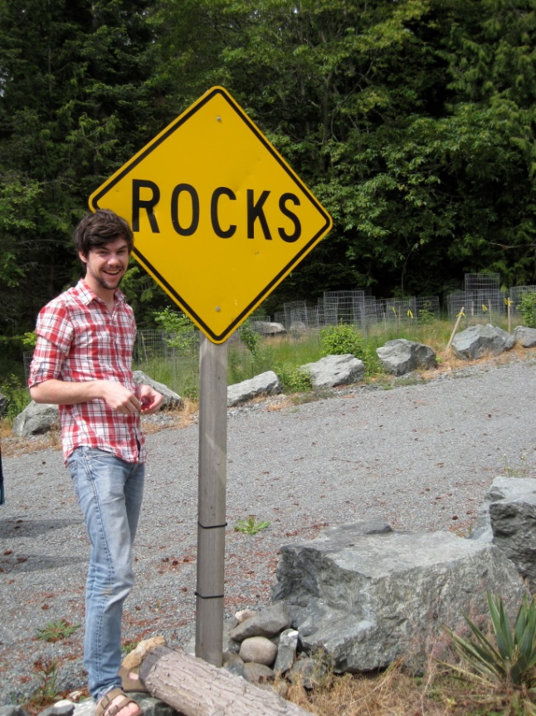
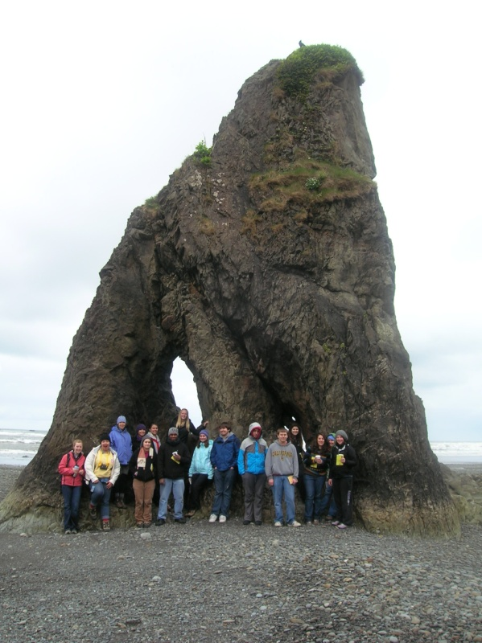
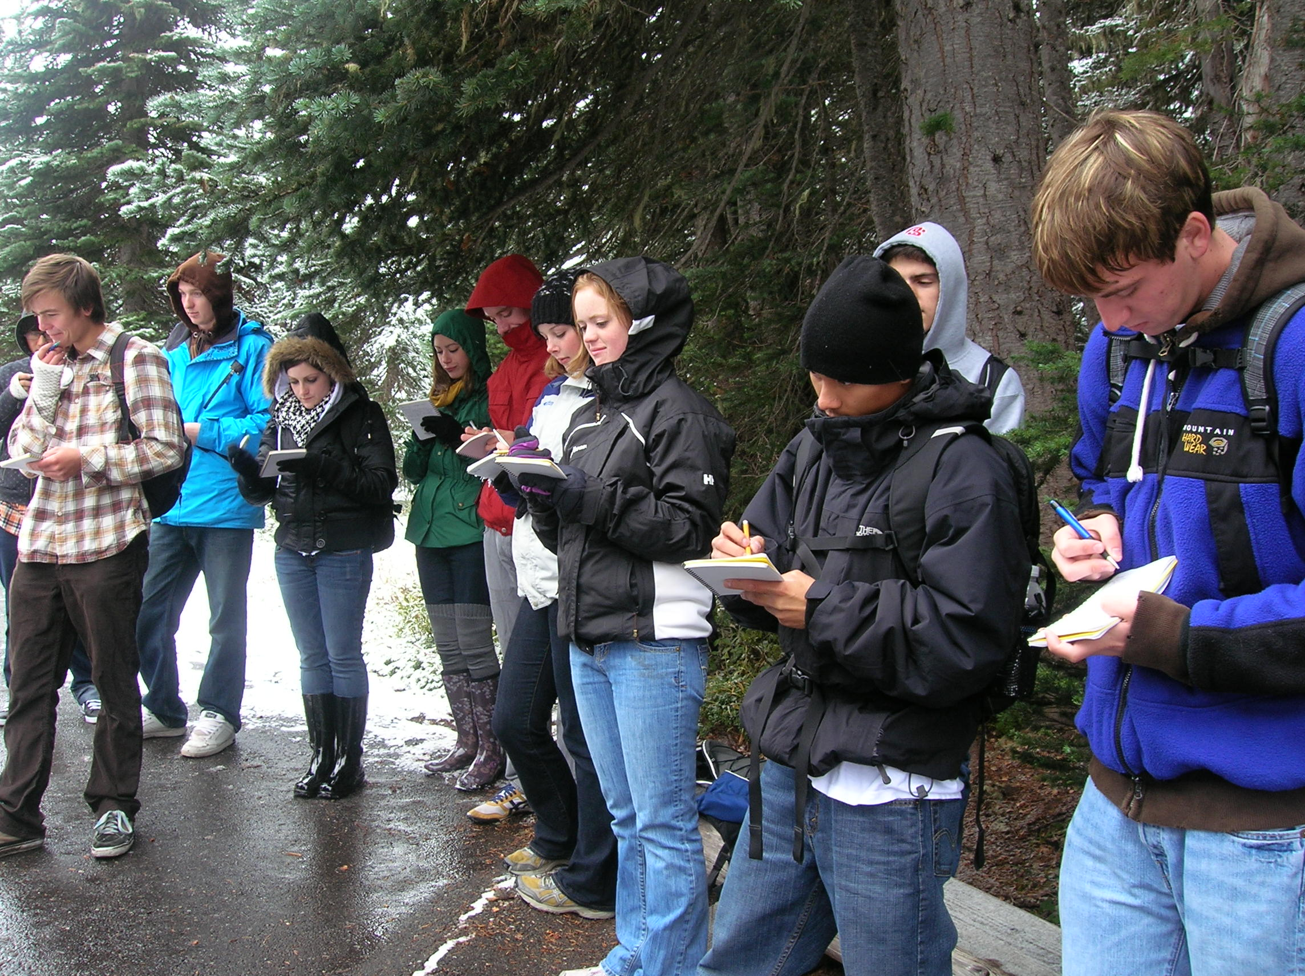
Keep it simple and fun:
Field geology for non-majors
Lyn Gualtieri
Seattle University
gualtieri@seattleu.edu

Slide 2
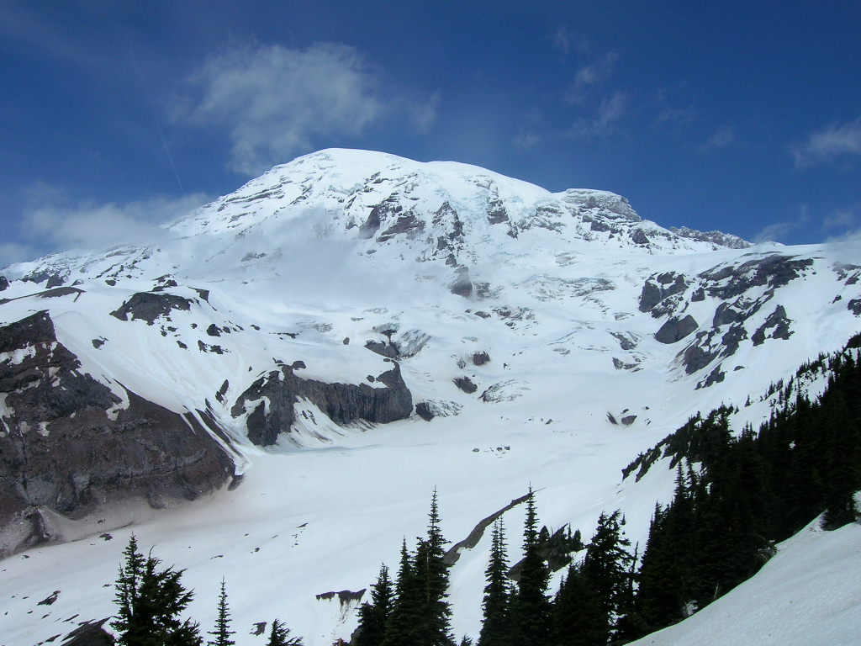
Outcomes
• Students get excited about the natural world
• Appreciation for and understanding of scientific method
• Students link visuals to textbooks
• Appreciation of spatial and temporal scales (maybe)
• Creative thinking
• In the moment learning
• Builds camaraderie

Slide 3
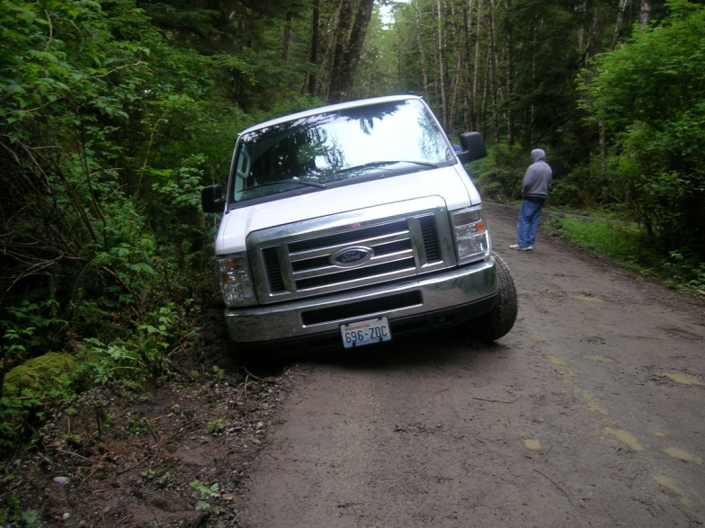
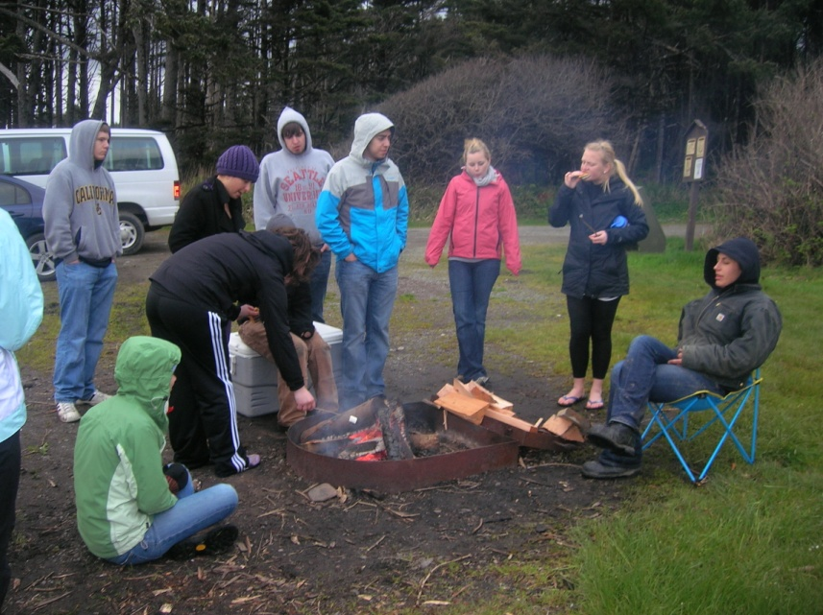
Logistical challenges
• Concentrating outside the classroom
• Connecting pre-trip readings to
field observations
• Site-to-site connections
• Detailed note-taking in field books
• Sketching
• Long van rides
• Camping

Slide 4
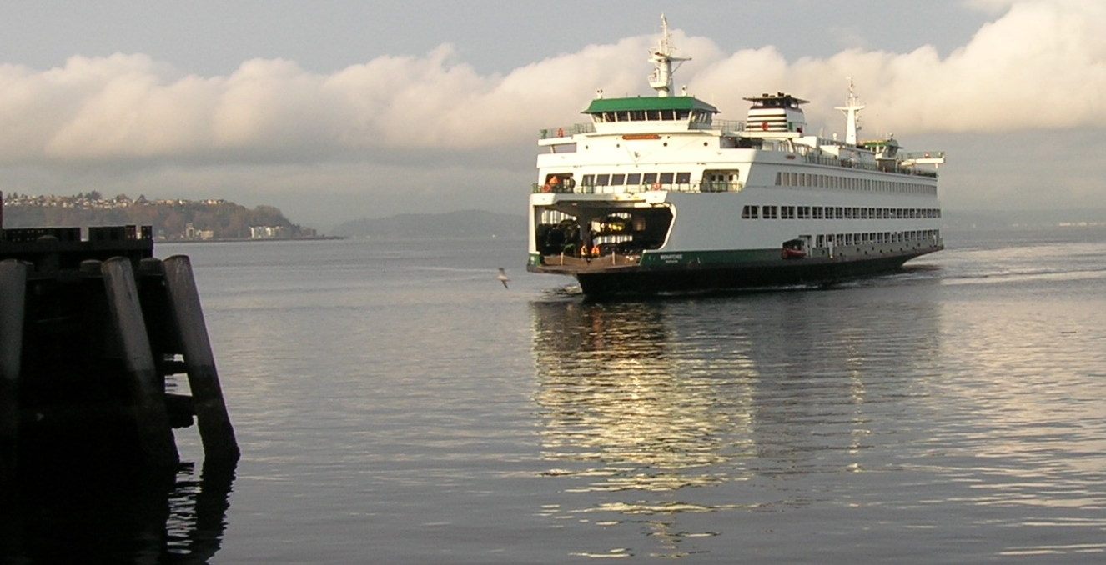
Example assignment: fieldtrip on your own
(idea from Maria Kelly, Edmonds CC)
Choose fieldtrip location and outcrop
Observations
Site description
Two sketches (with scale)
Photographs (with scale)
How does the site fit into the regional geologic history?
Discussion with geologic map
Pre-recorded 3 min. presentation
Field report

Slide 5
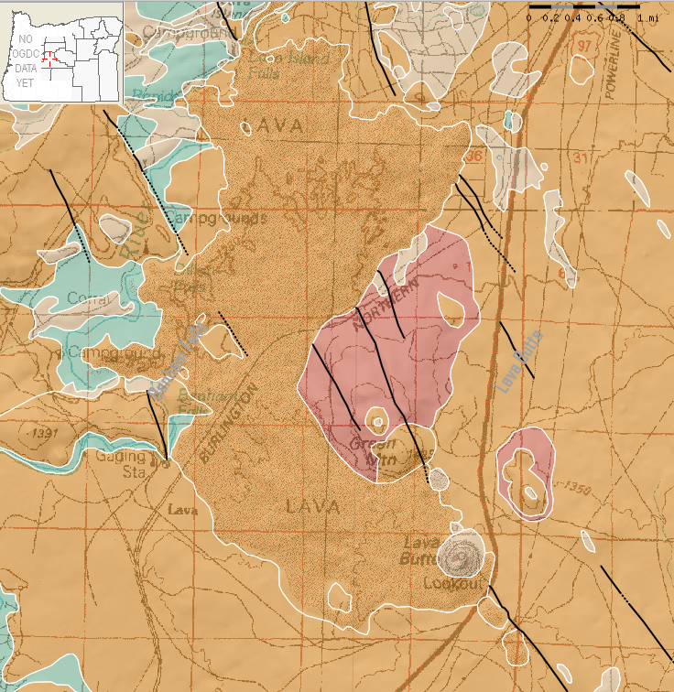
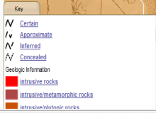
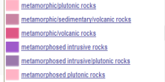
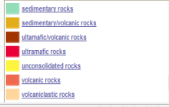
Difficulties
• Site selection
• Geologic maps
• Geologic time
• Easier to copy from textbook or website
verbatim
• No practice in public speaking skills in
pre-recorded presentations

Slide 6
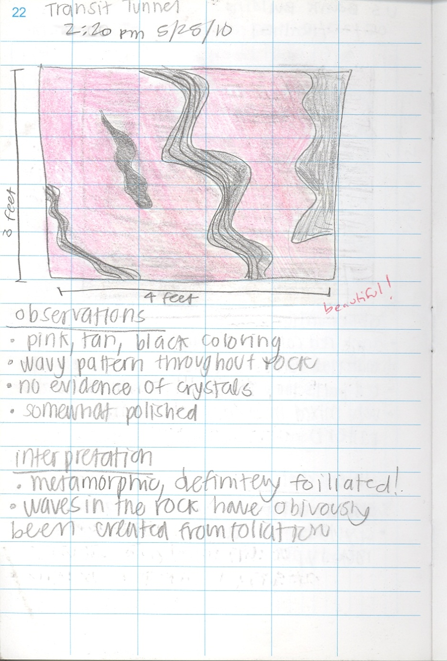
Example of student work
Seattle, Caitlin + Laura

Slide 7
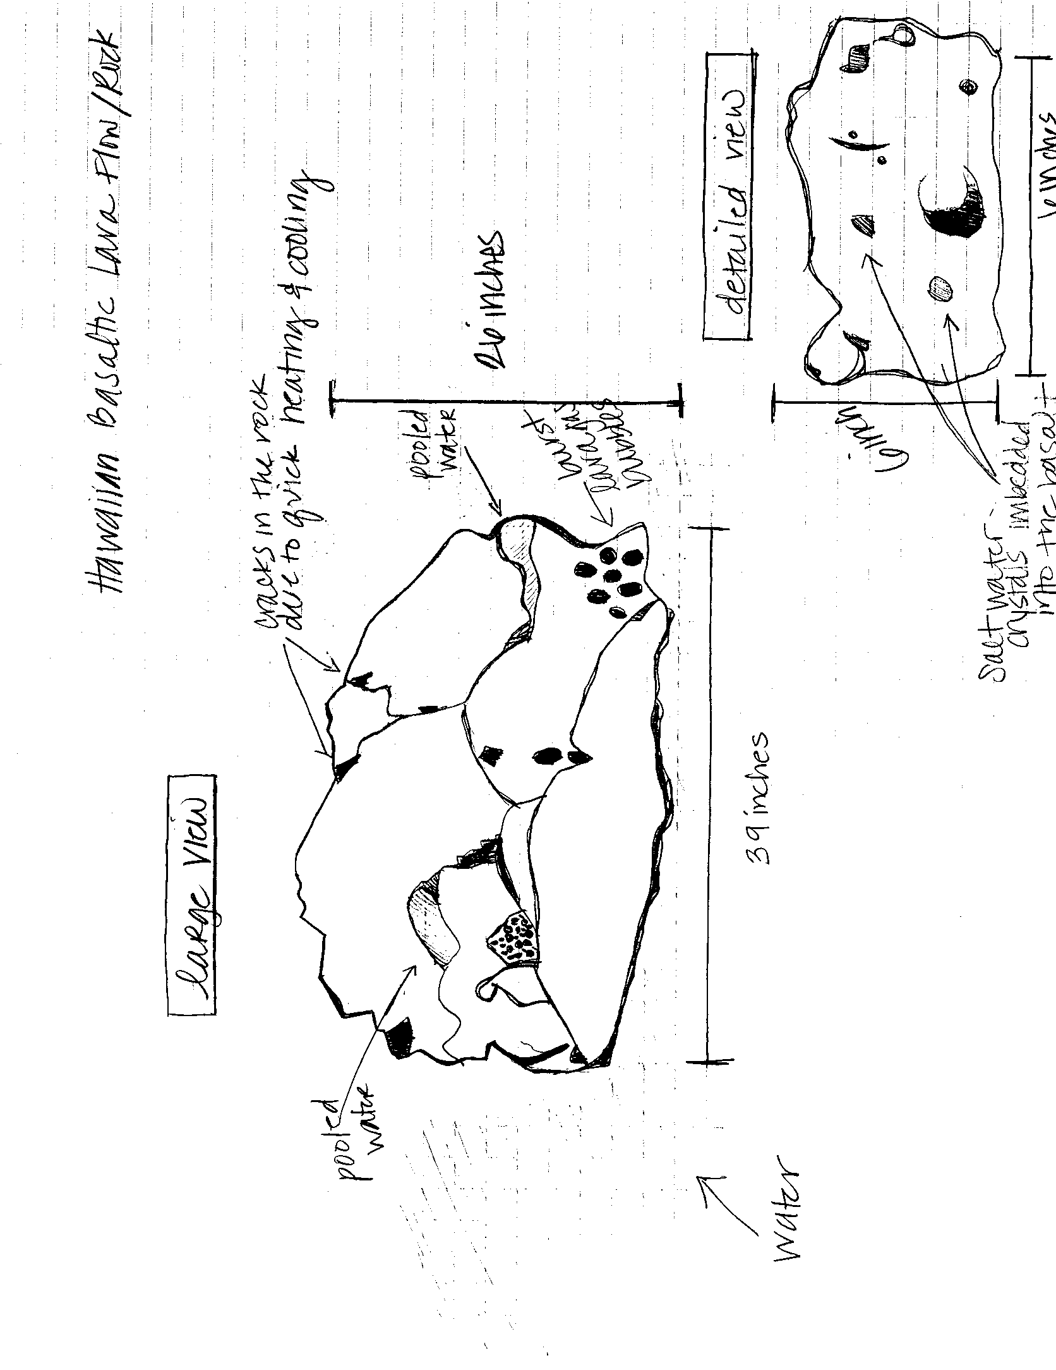

Example of student work
Lanikai Beach, Griffan

Slide 8
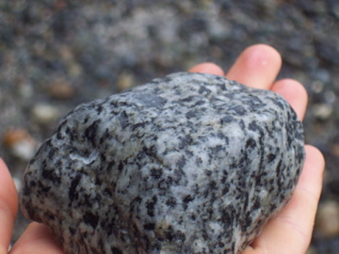
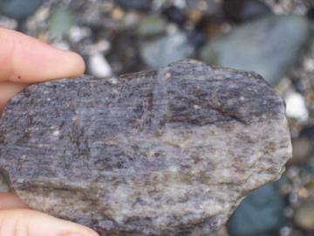
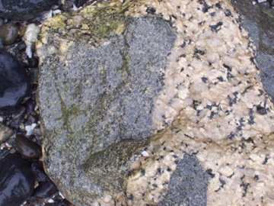

Example of student work
Bainbridge Island,
Hailey and Colleen

Slide 9
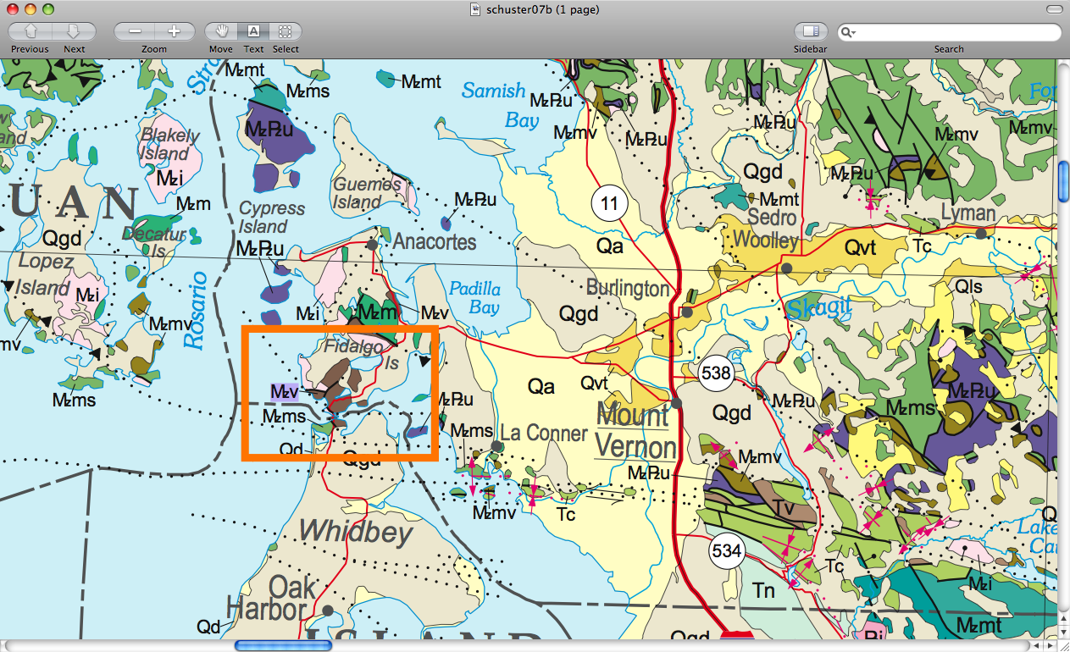

Example of student work
Deception Pass, Alex

Slide 10
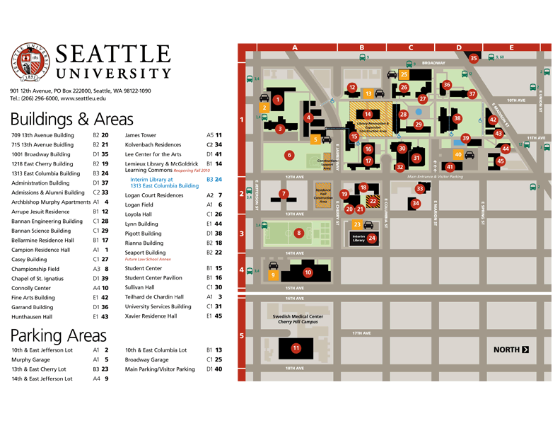
Example assignment: A field guide to the rocks
and building stones of Seattle University
Groups assigned building stones and rocks on campus
Observations
Site description with GPS
Two sketches with scale
Photographs with scale
Generic origin of rocks
Pre-recorded 3 min. presentation (video or powerpoint)
One group synthesizes for final presentation

Slide 11
Example of student work: imovie
Alex, Michael, Eden, Erynn
Few weeks to construct
Some details incorrect…
Research on history of Seattle University

Slide 12
Example assignment: Geology of I-90
Fall 2010
Transect from Seattle to eastern WA
Freshman seminar on 4 Saturdays
Fieldbooks/observations/sketches/pre-trip readings
Group experts and presentations

Slide 13
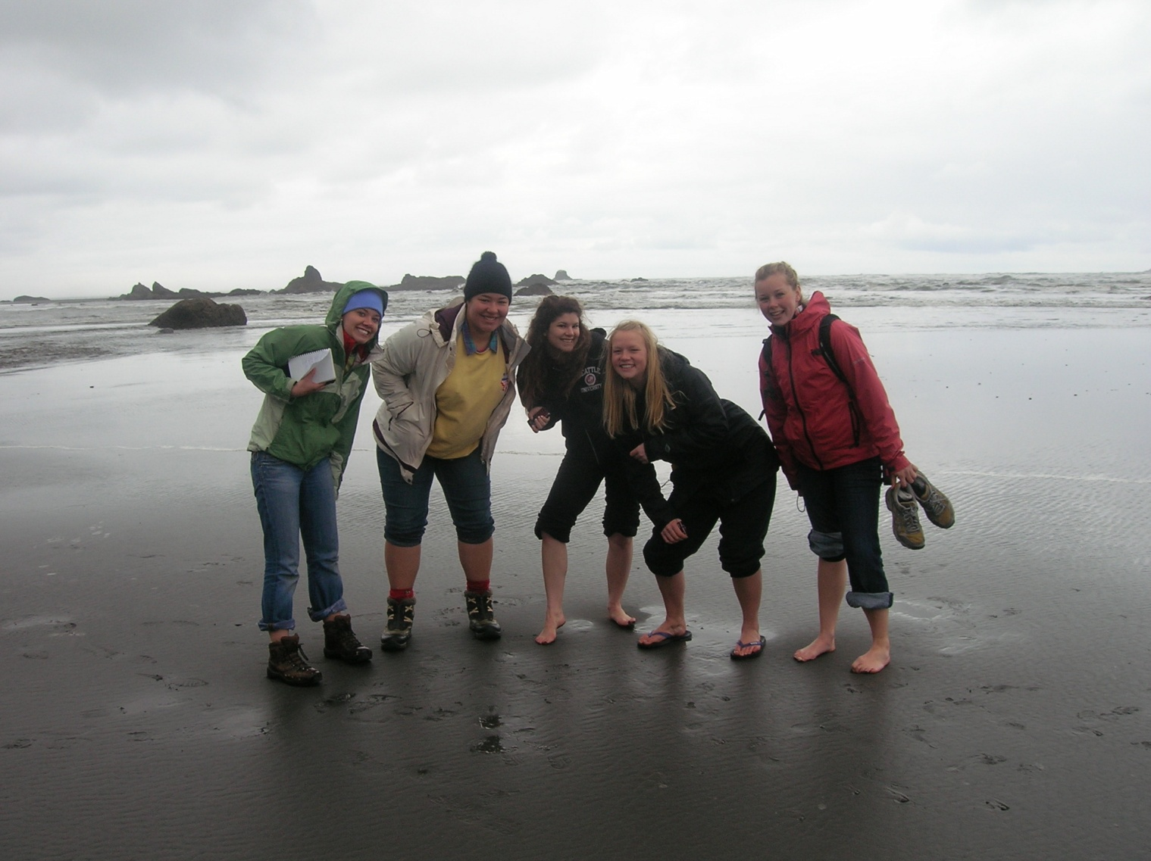
Keep it fun!

