Slide 1
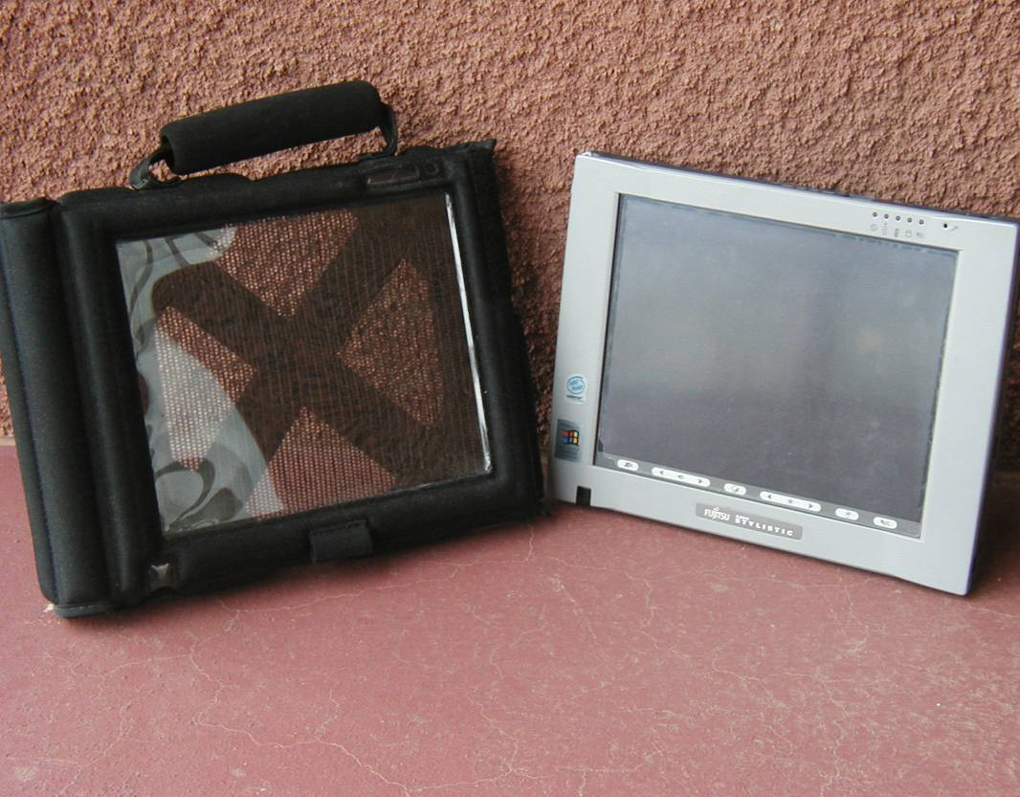
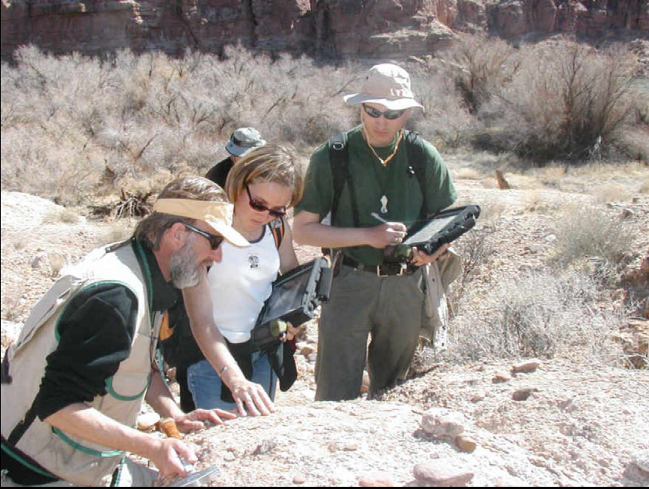
An Incremental Approach For
Teaching Field Mapping
Using Rugged Tablet Computers & GIS
Paul Umhoefer (Instructor) Professor of Geology
Mark Manone (Technical leader) Geospatial Research & Information Lab
Geology Program,
School of Earth Sciences & Environmental Sustainability
Northern Arizona University

Slide 2
GLG 440 - Advanced Field Geology – 6 credits
{Introductory Field Methods – 2 credits}
• Capstone Geology course: Class of 12-20 students (all NAU); 1 prof in each of 4 projects; 1 TA in each project
• Spring semester class:
*** 2 projects in semester (long weekends)
*** 2 projects in classic summer style in May
• review basic field methods (despite Intro Field Methods class)
• mix of traditional advanced mapping and field methods
• always include one hydro – geomorphology project
• included tablet computer component for the last 8 years

Slide 3
Incremental approach to GIS - digital mapping…
{obvious now, but took us 4-5 years to figure out}
typically 3 exercises
Exercise 1 – ONLY in lab
• Previewing the field area with air photos & images;
• getting to know your map area & data
• preliminary map…
Exercise 2 – ONLY in lab; Preview map again in lab;
• Georeference a traditional field map;
• edit and digitize geologic features in GIS
• produce a final digital map
Exercise 3 – in lab and field; Preview map again in lab;
• Complete digital map in a GIS with Rugged tablet computers & GPS
Exercise 4 – return to traditional mapping…. OR
• Optional mapping with tablets

Slide 4
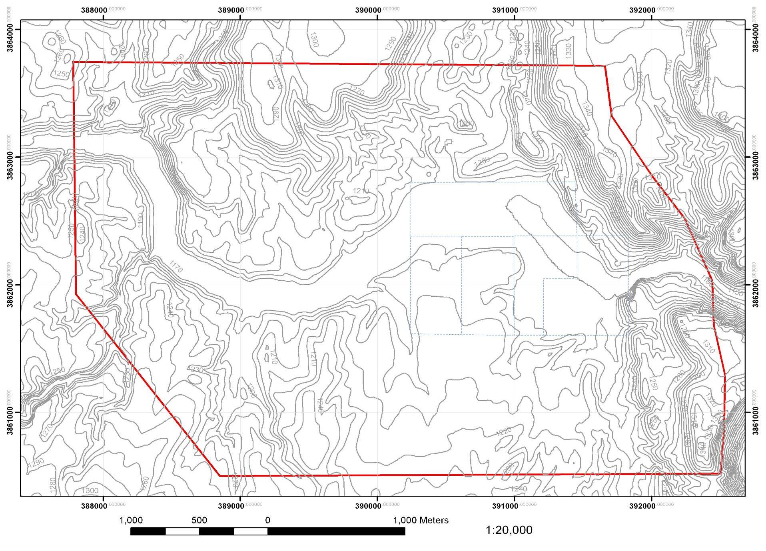
Project 1 - preview in lab only

Slide 5
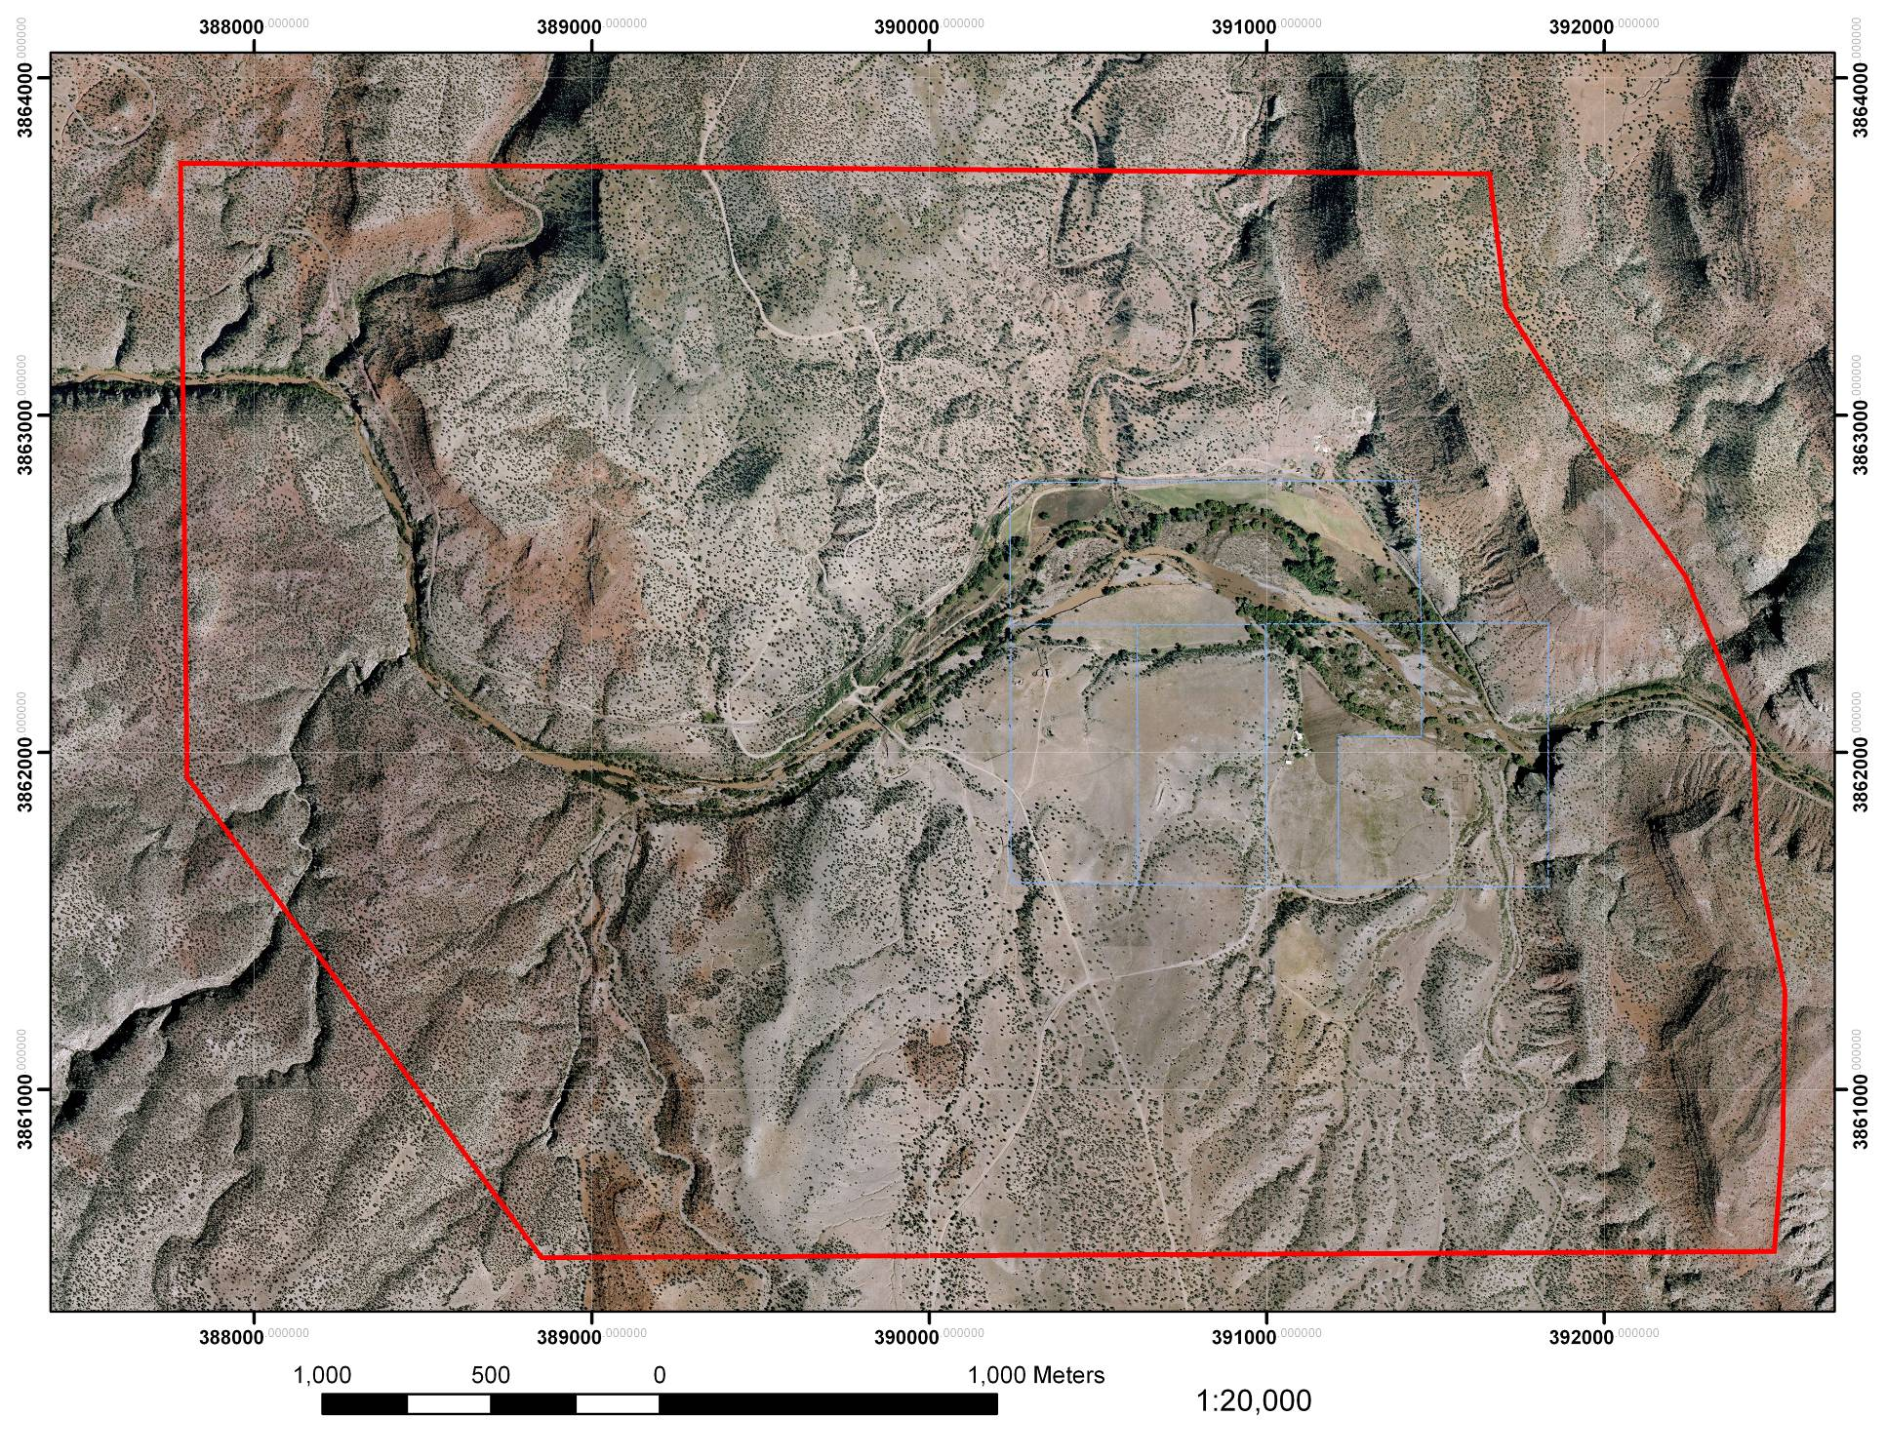
Project 1

Slide 6
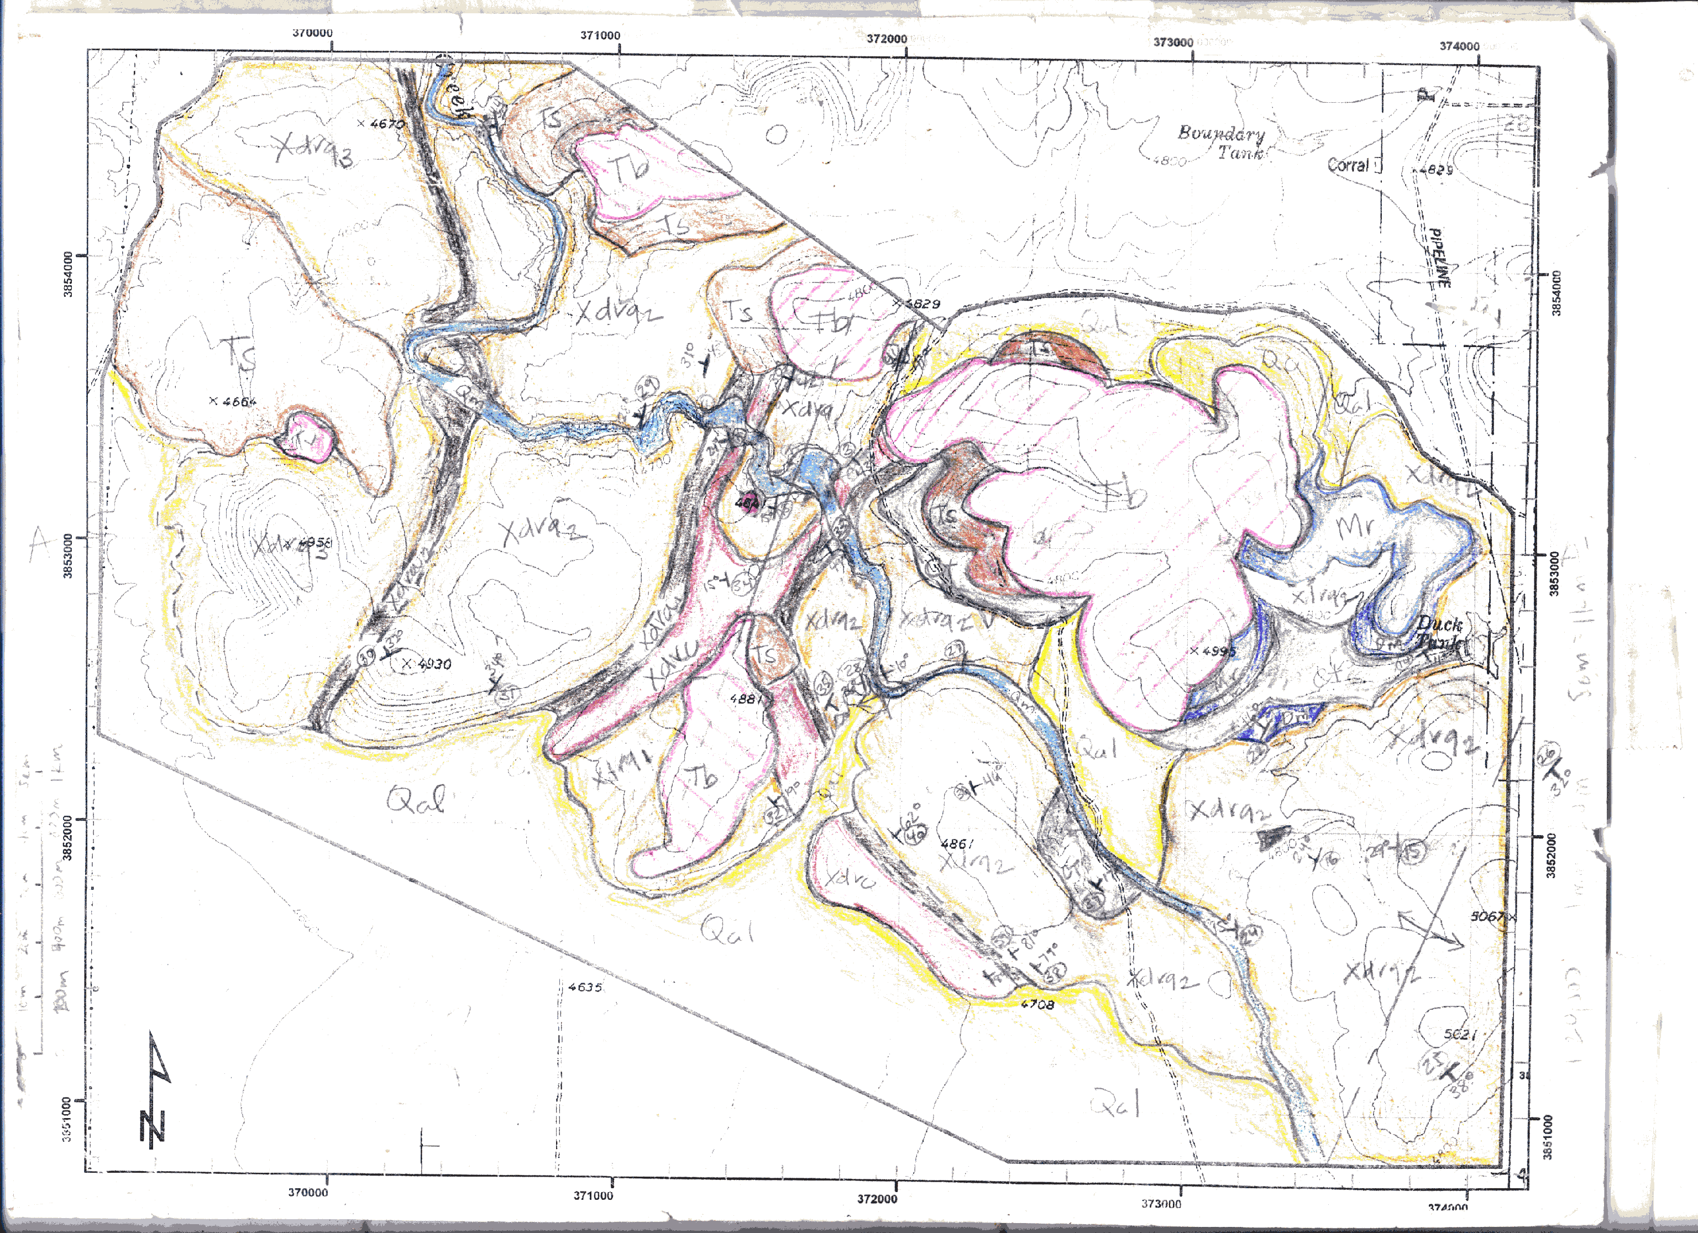
Project 2 - traditional mapping in field

Slide 7
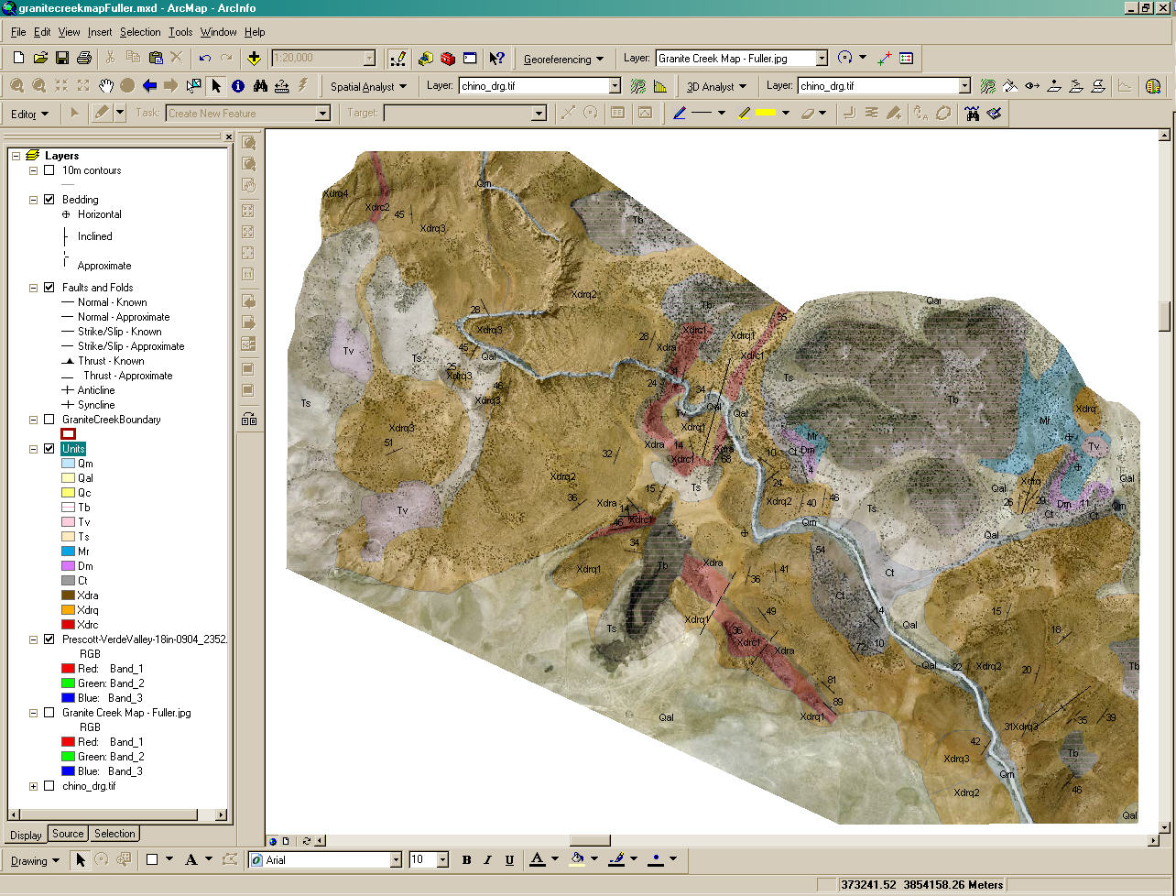
Project 2
GIS map on
air photo base

Slide 8
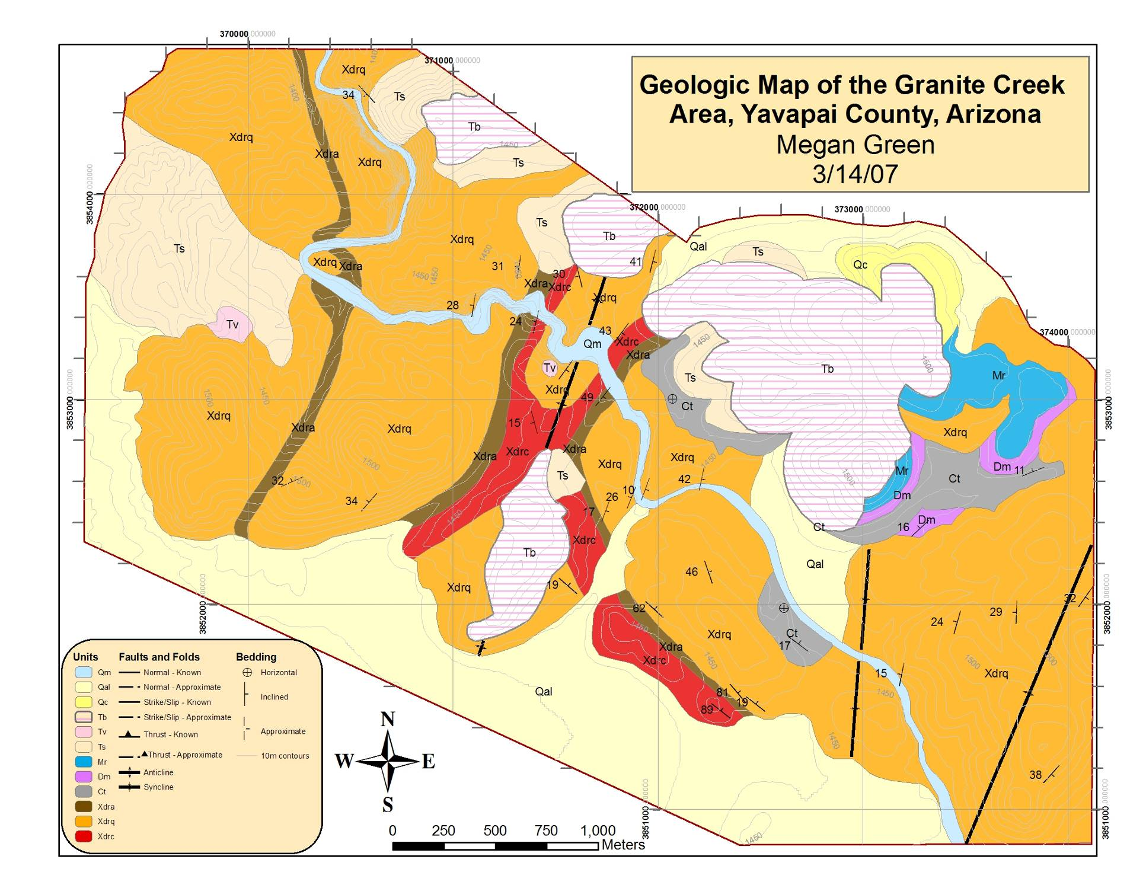
Project 2

Slide 9
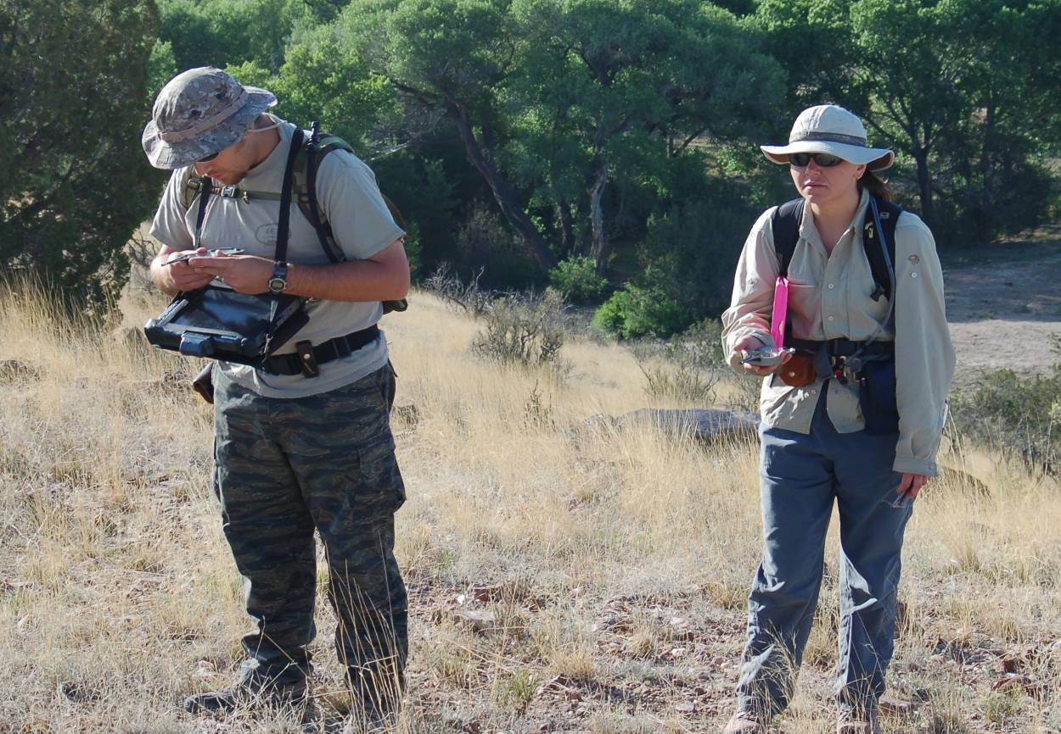
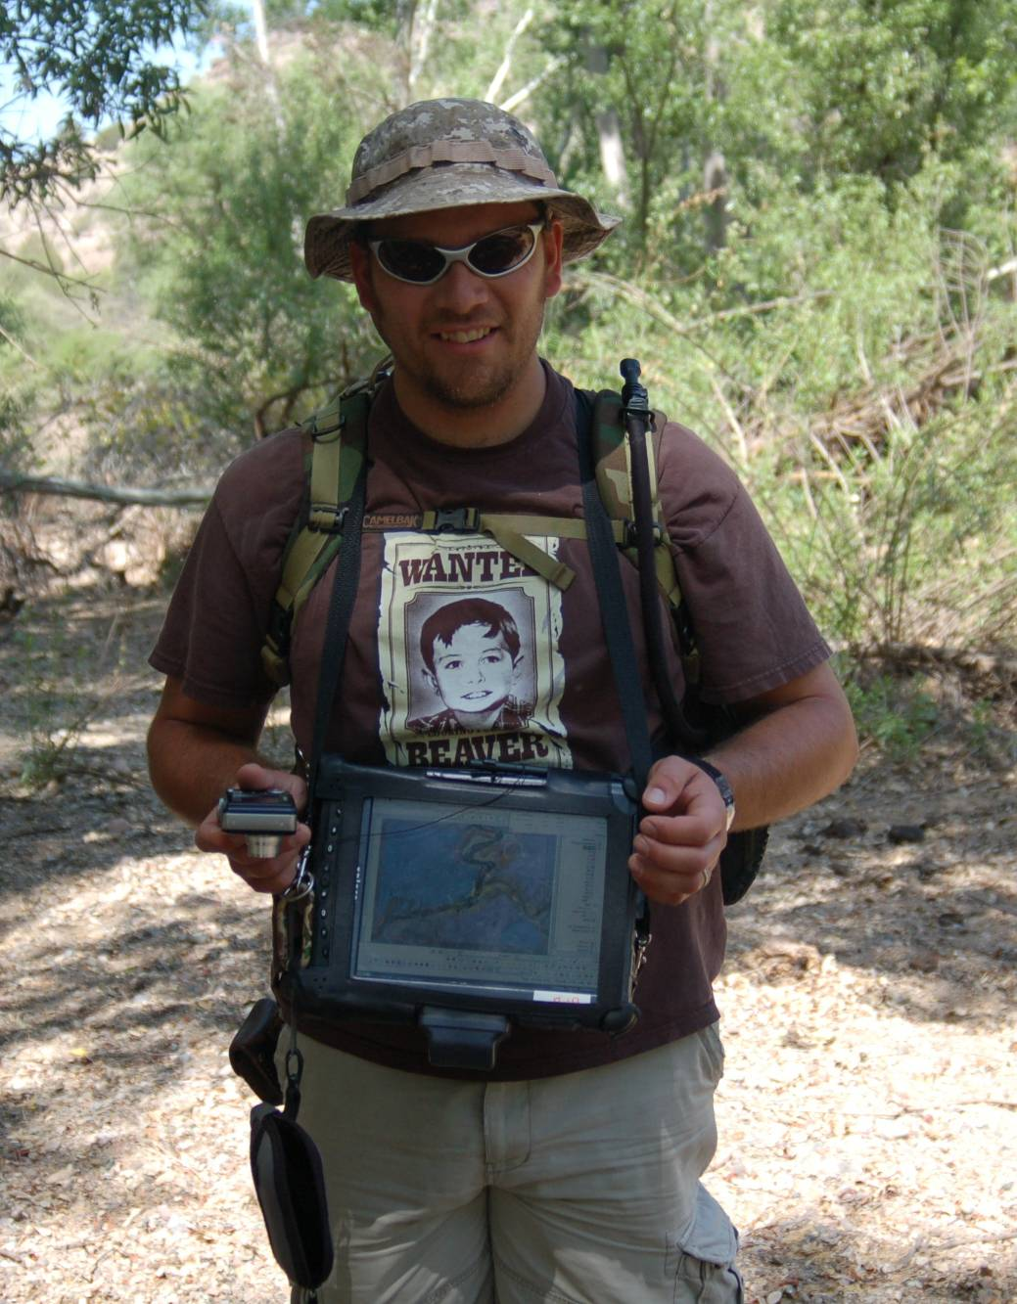
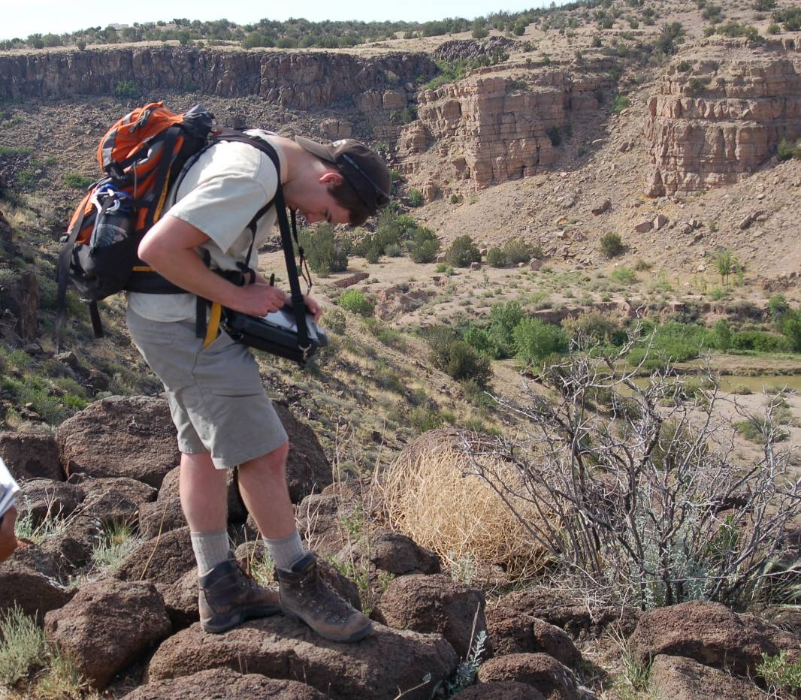
Project 3 - dive into
Tablets in field…

Slide 10
Project 3
BUT are students ready to dive in to full blown
Tablet computer mapping??
some are not…
• We added a short (one afternoon) on-campus mapping project
with tablet computers,
so basic use of tablets
Is familiar in field

Slide 11
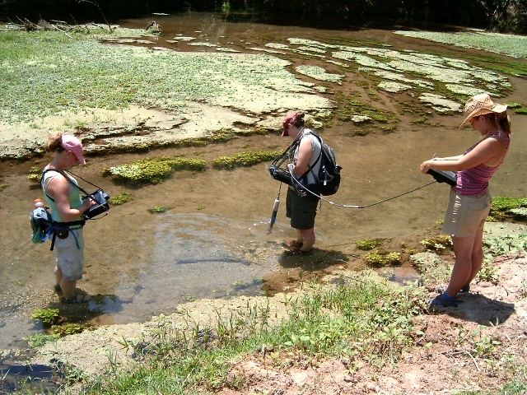
Project 3
Collecting hydrogeologic data…

Slide 12
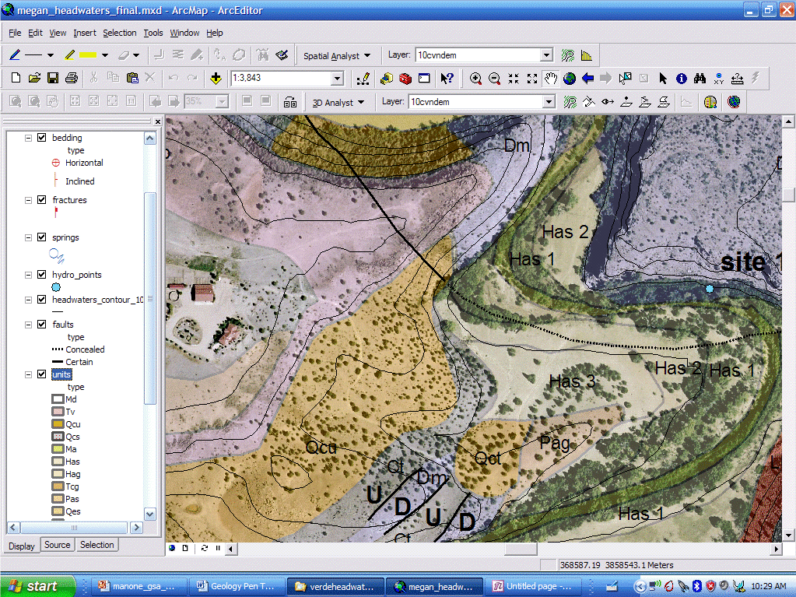
Project 3
Use fairly simple area &
non-mapping data collecting with tablets
Paleozoic
Tertiary
Quaternary

Slide 13
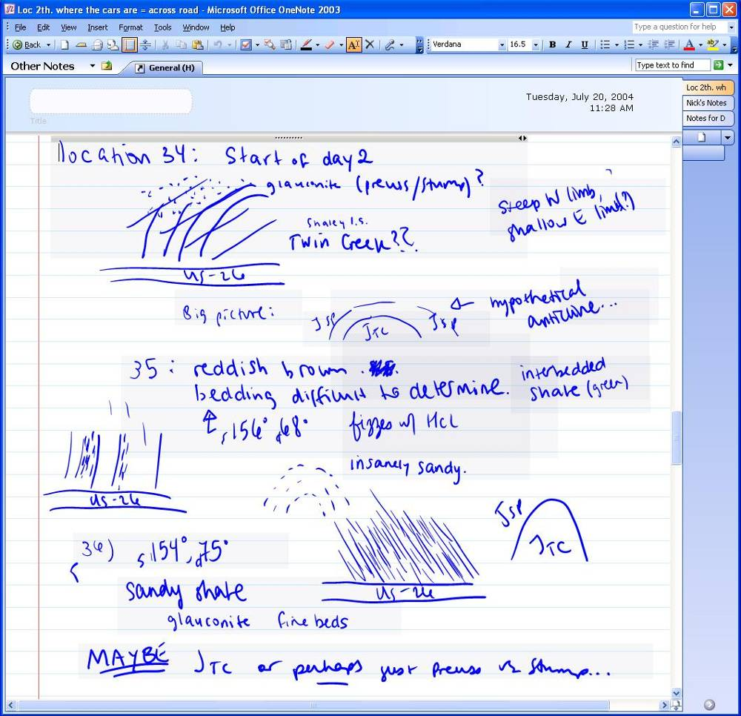
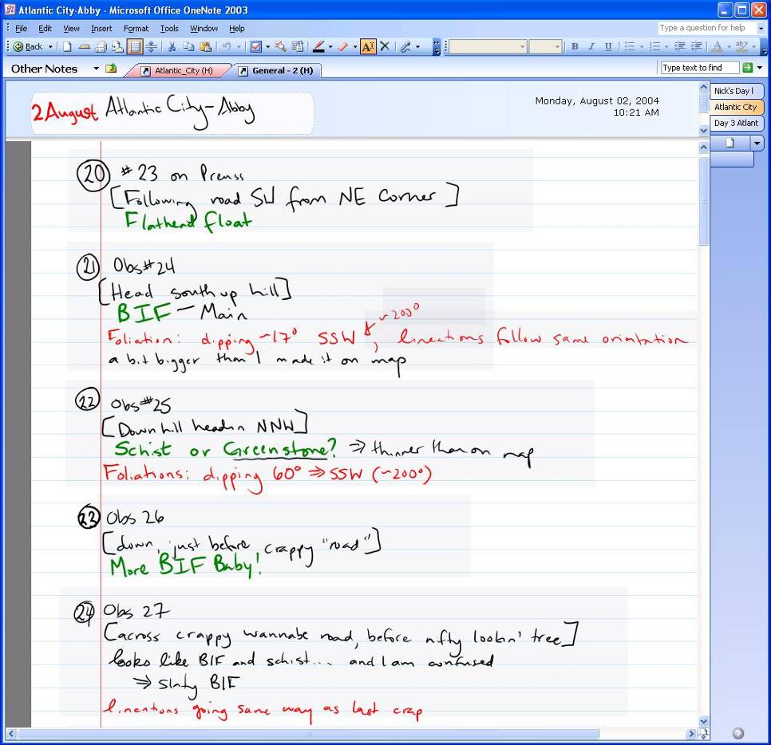
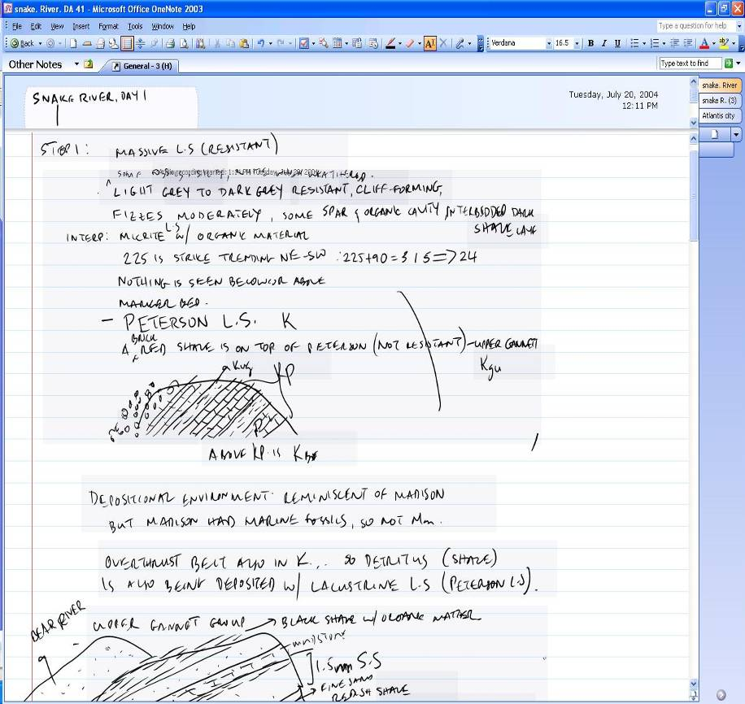
Project 3
Use tablets for
Note taking

Slide 14
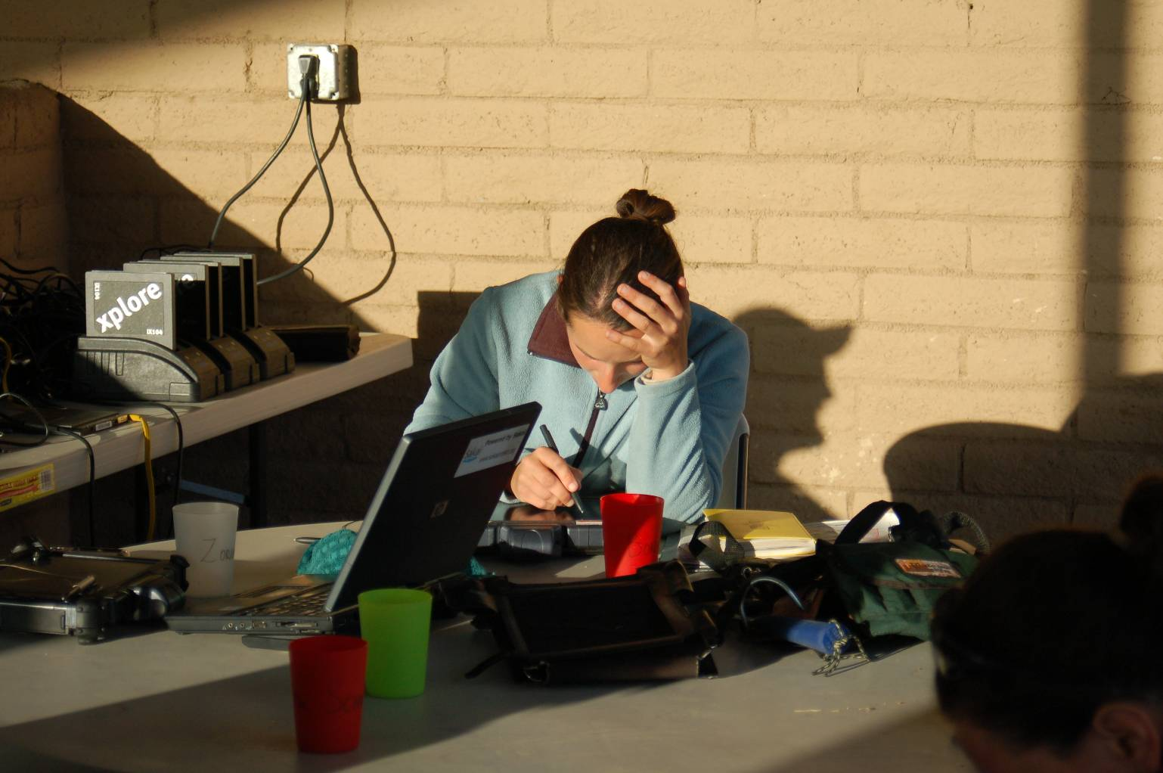
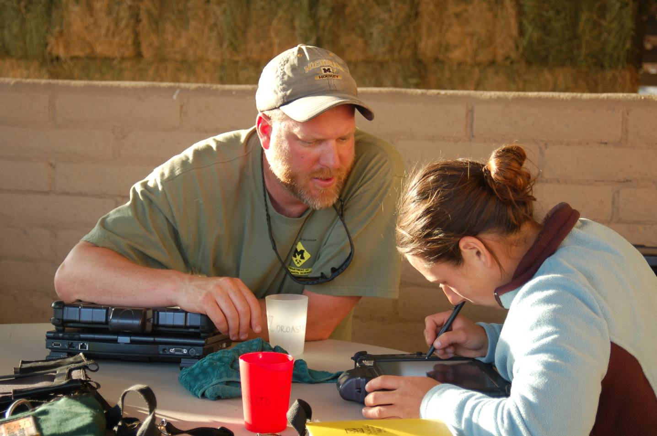
Project 3
Pick
logistically
Simple
location
Stay at Rural
Bed & Breakfast
Within field area
• electricity for charging
• good evening work
conditions

Slide 15
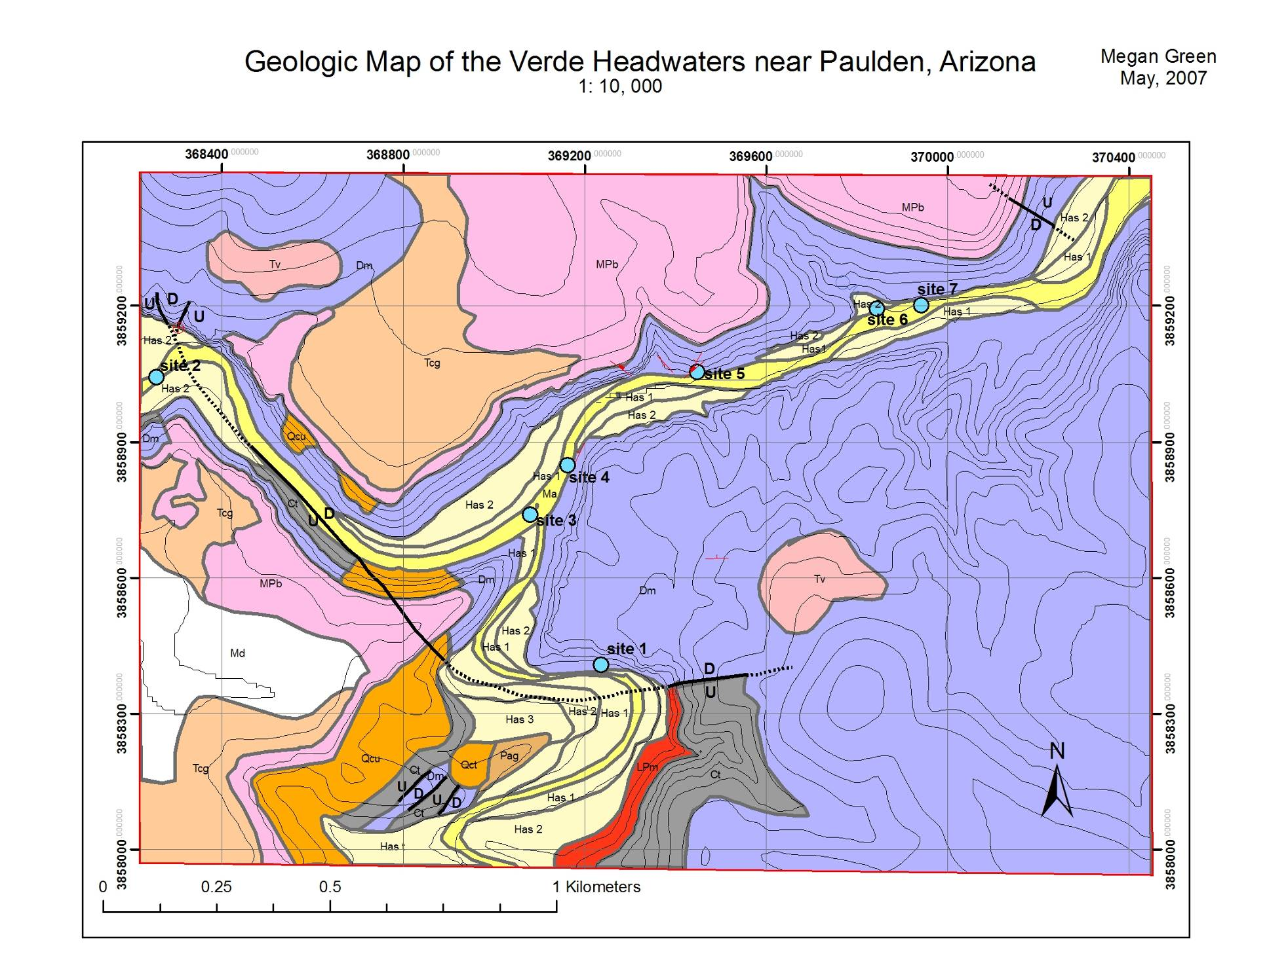
Project 3
B & B

Slide 16
Assessment – Professional Assessors at NAU
• Students split on if using field based GIS is positive
5 yes, 3 neutral, 5 no
• Students positive on using GIS to make final map versus hand drawn map
8 yes, 3 neutral, 2 no
• Students very positive about using GIS to preview and recon field areas
13 yes
• Some students complained about Logistics & computer problems with field-based GIS

Slide 17
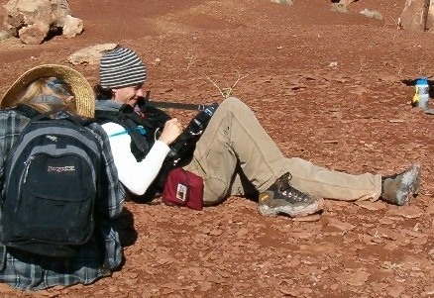
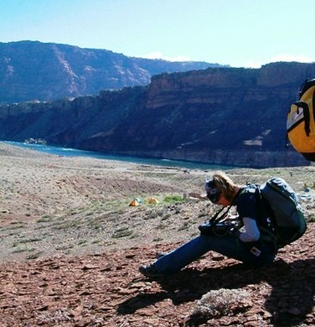
Conclusions: Tablet computers work well…
But (for us) only after incremental approach was used;
Keep it simple; provide easy logistics; extra instructors
••• Former students have used GIS & tablets in many jobs.

