Slide 1
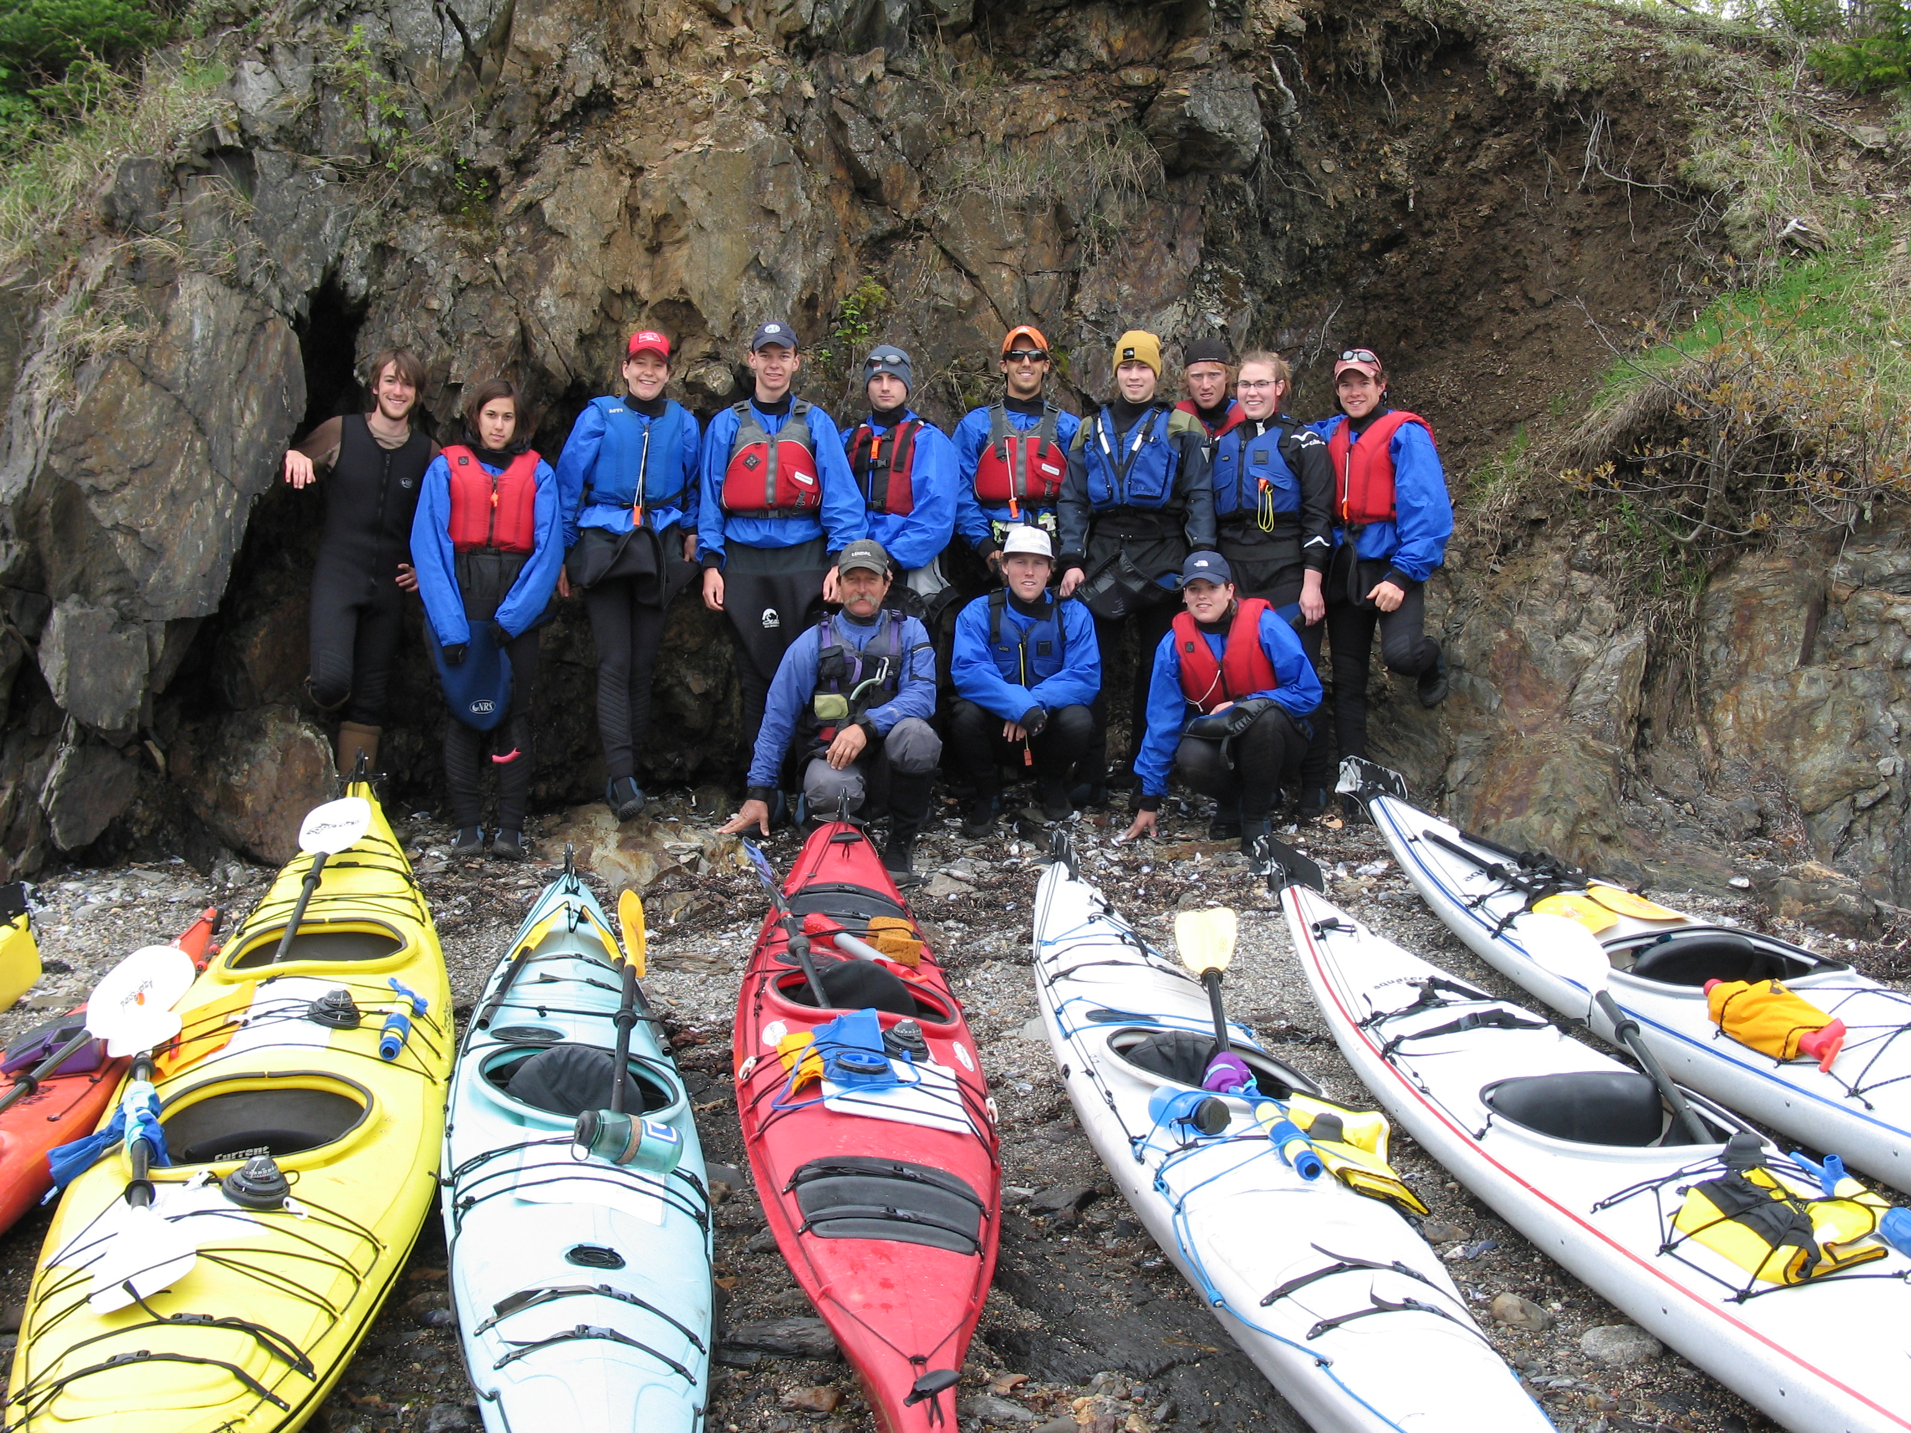
    S39: Geology of the Maine Coast by Sea Kayak 2009
Sabrina
Judson
Miles
Adam
Greg
Carter
Dava
“Dots”
Dan
“Kratz”
Tom
Greg
Molly
Important things and dates:
This is an extra cost short term, approx $ 1,500 per student.
Submit the application form to me before the end of the first week of winter semester if you want to enroll in this short term.
Deadline for financial aid application is January 19, 2009.
Financial aid award decisions are made on February 2, 2009.
Registration for extra cost short terms, February 7-13, 2009.

Slide 2
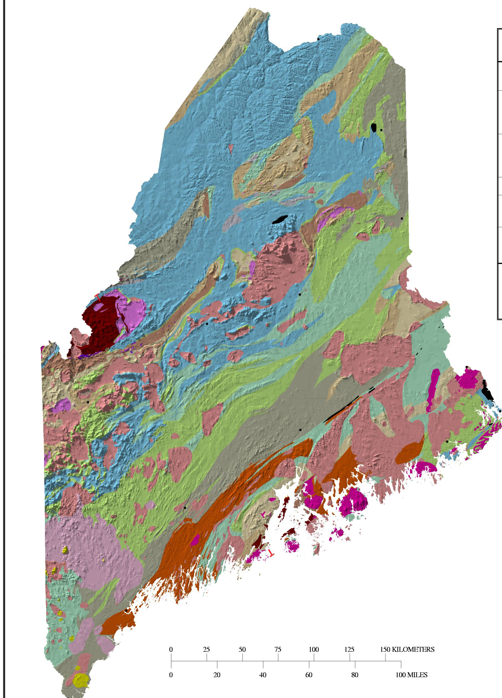
Isle Au Haut – Commingled intrusive igneous rocks, “think like a fluid”
Isle Au Haut

Slide 3
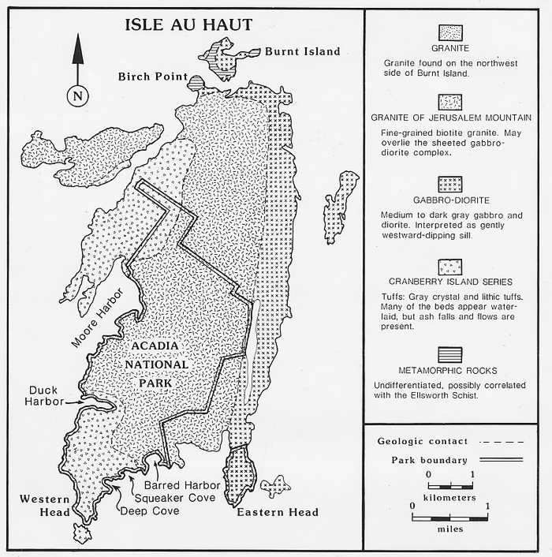
Bedrock Geology of
Isle Au Haut
Penobscot Bay

Slide 4
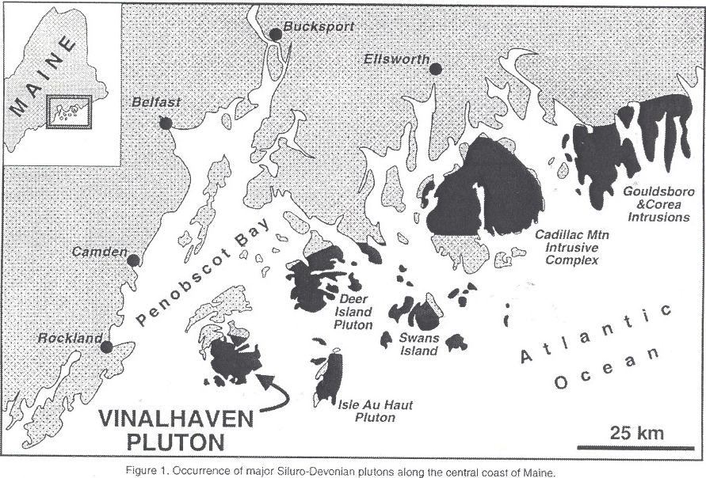
Formed as part of the Coastal Maine Magmatic Province
Formed during the Silurian period as large intrusions beneath Gander

Slide 5
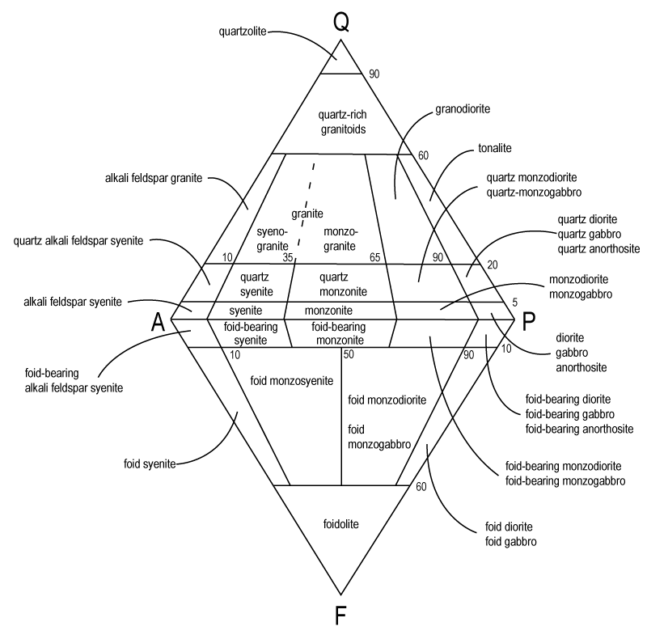
Commingling of two magmatic fluids; one granitic the other gabbroic

Slide 7
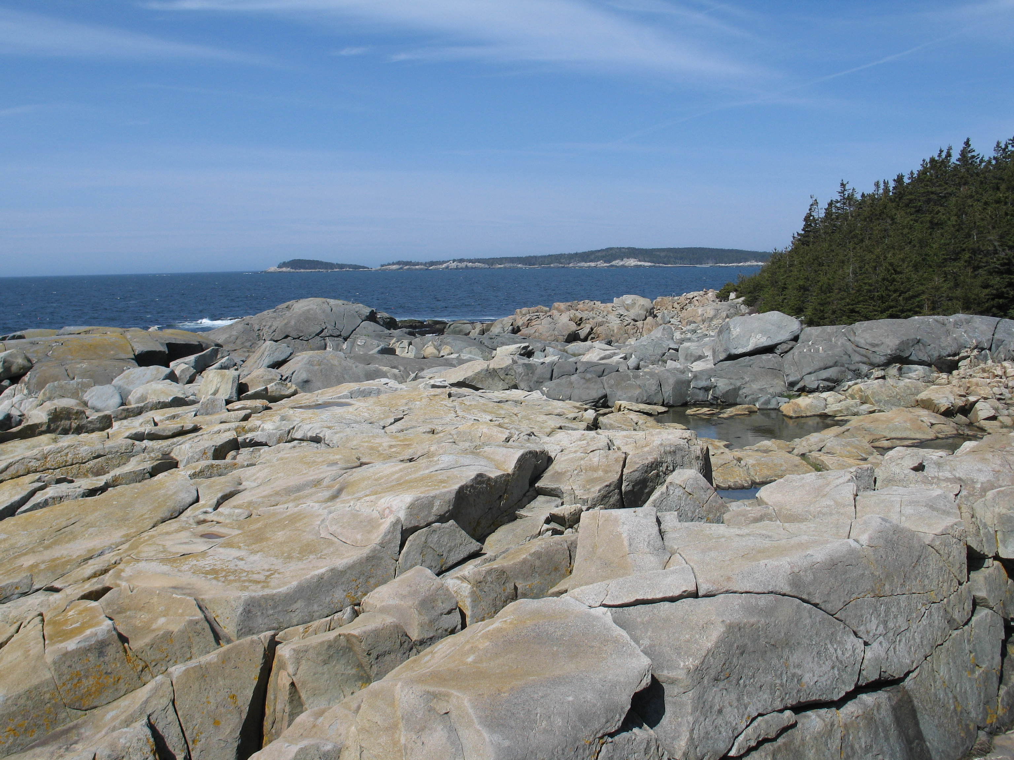
Gabbro
Granite

Slide 8
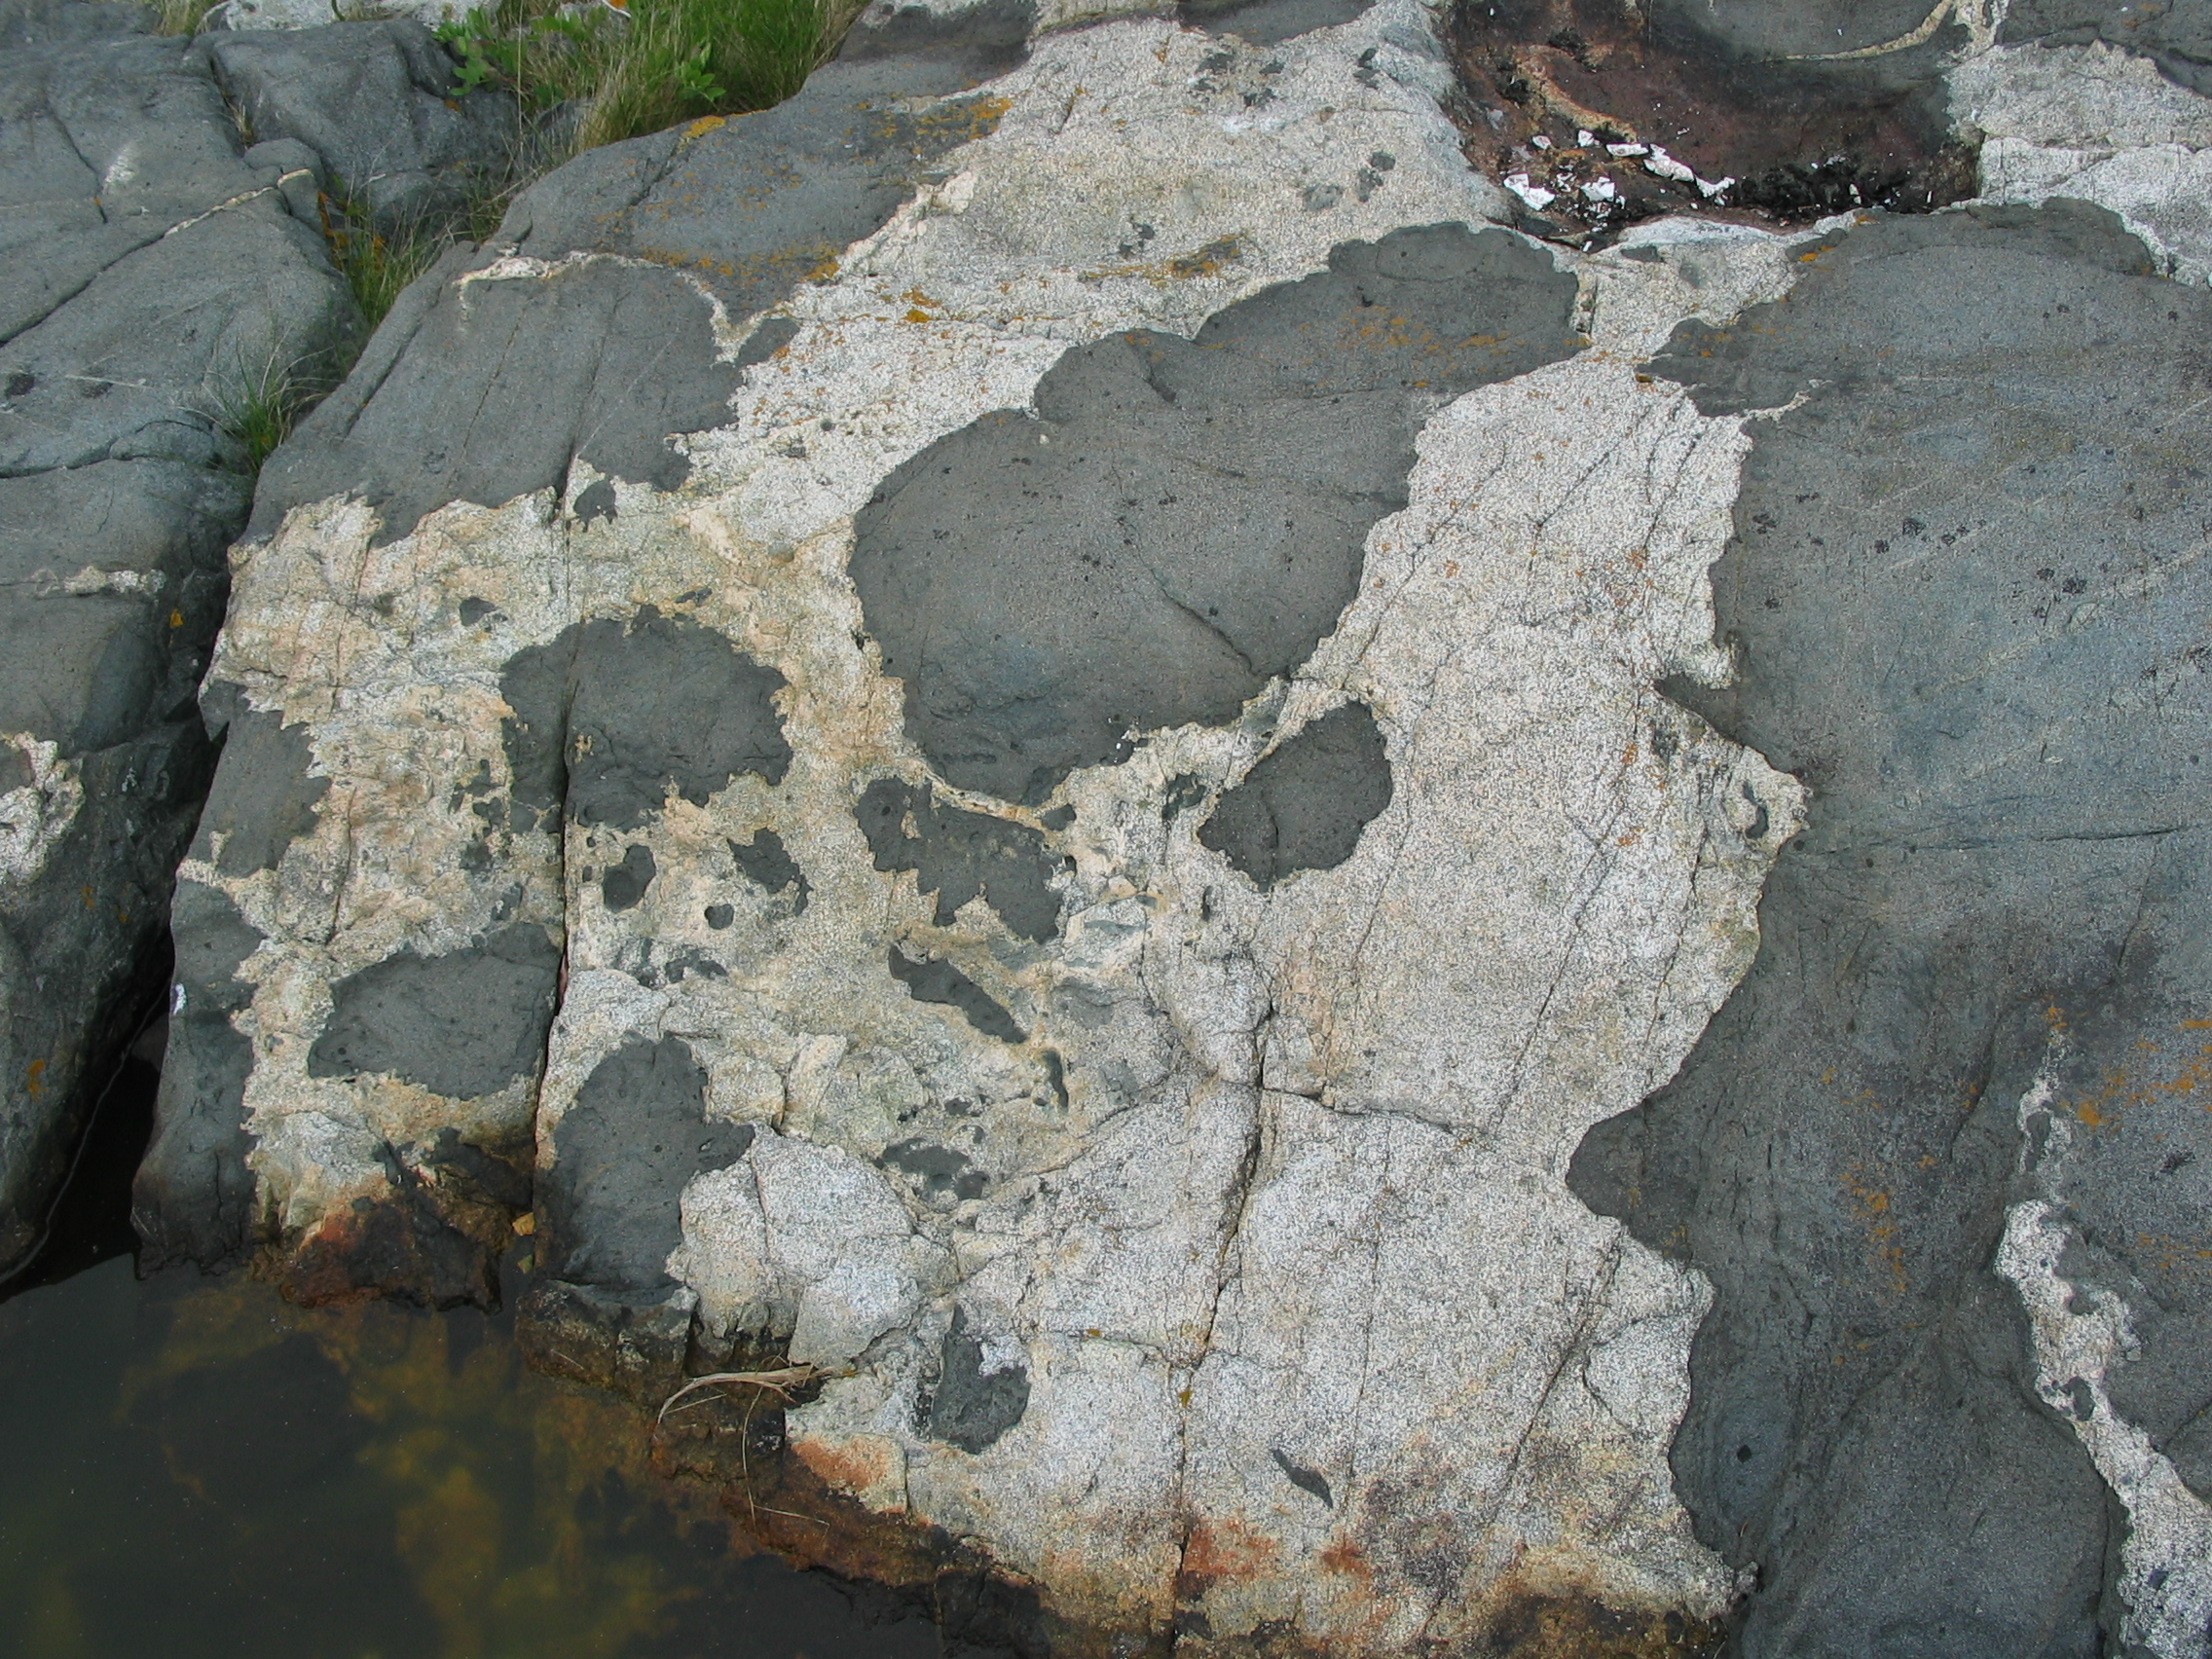

Slide 9
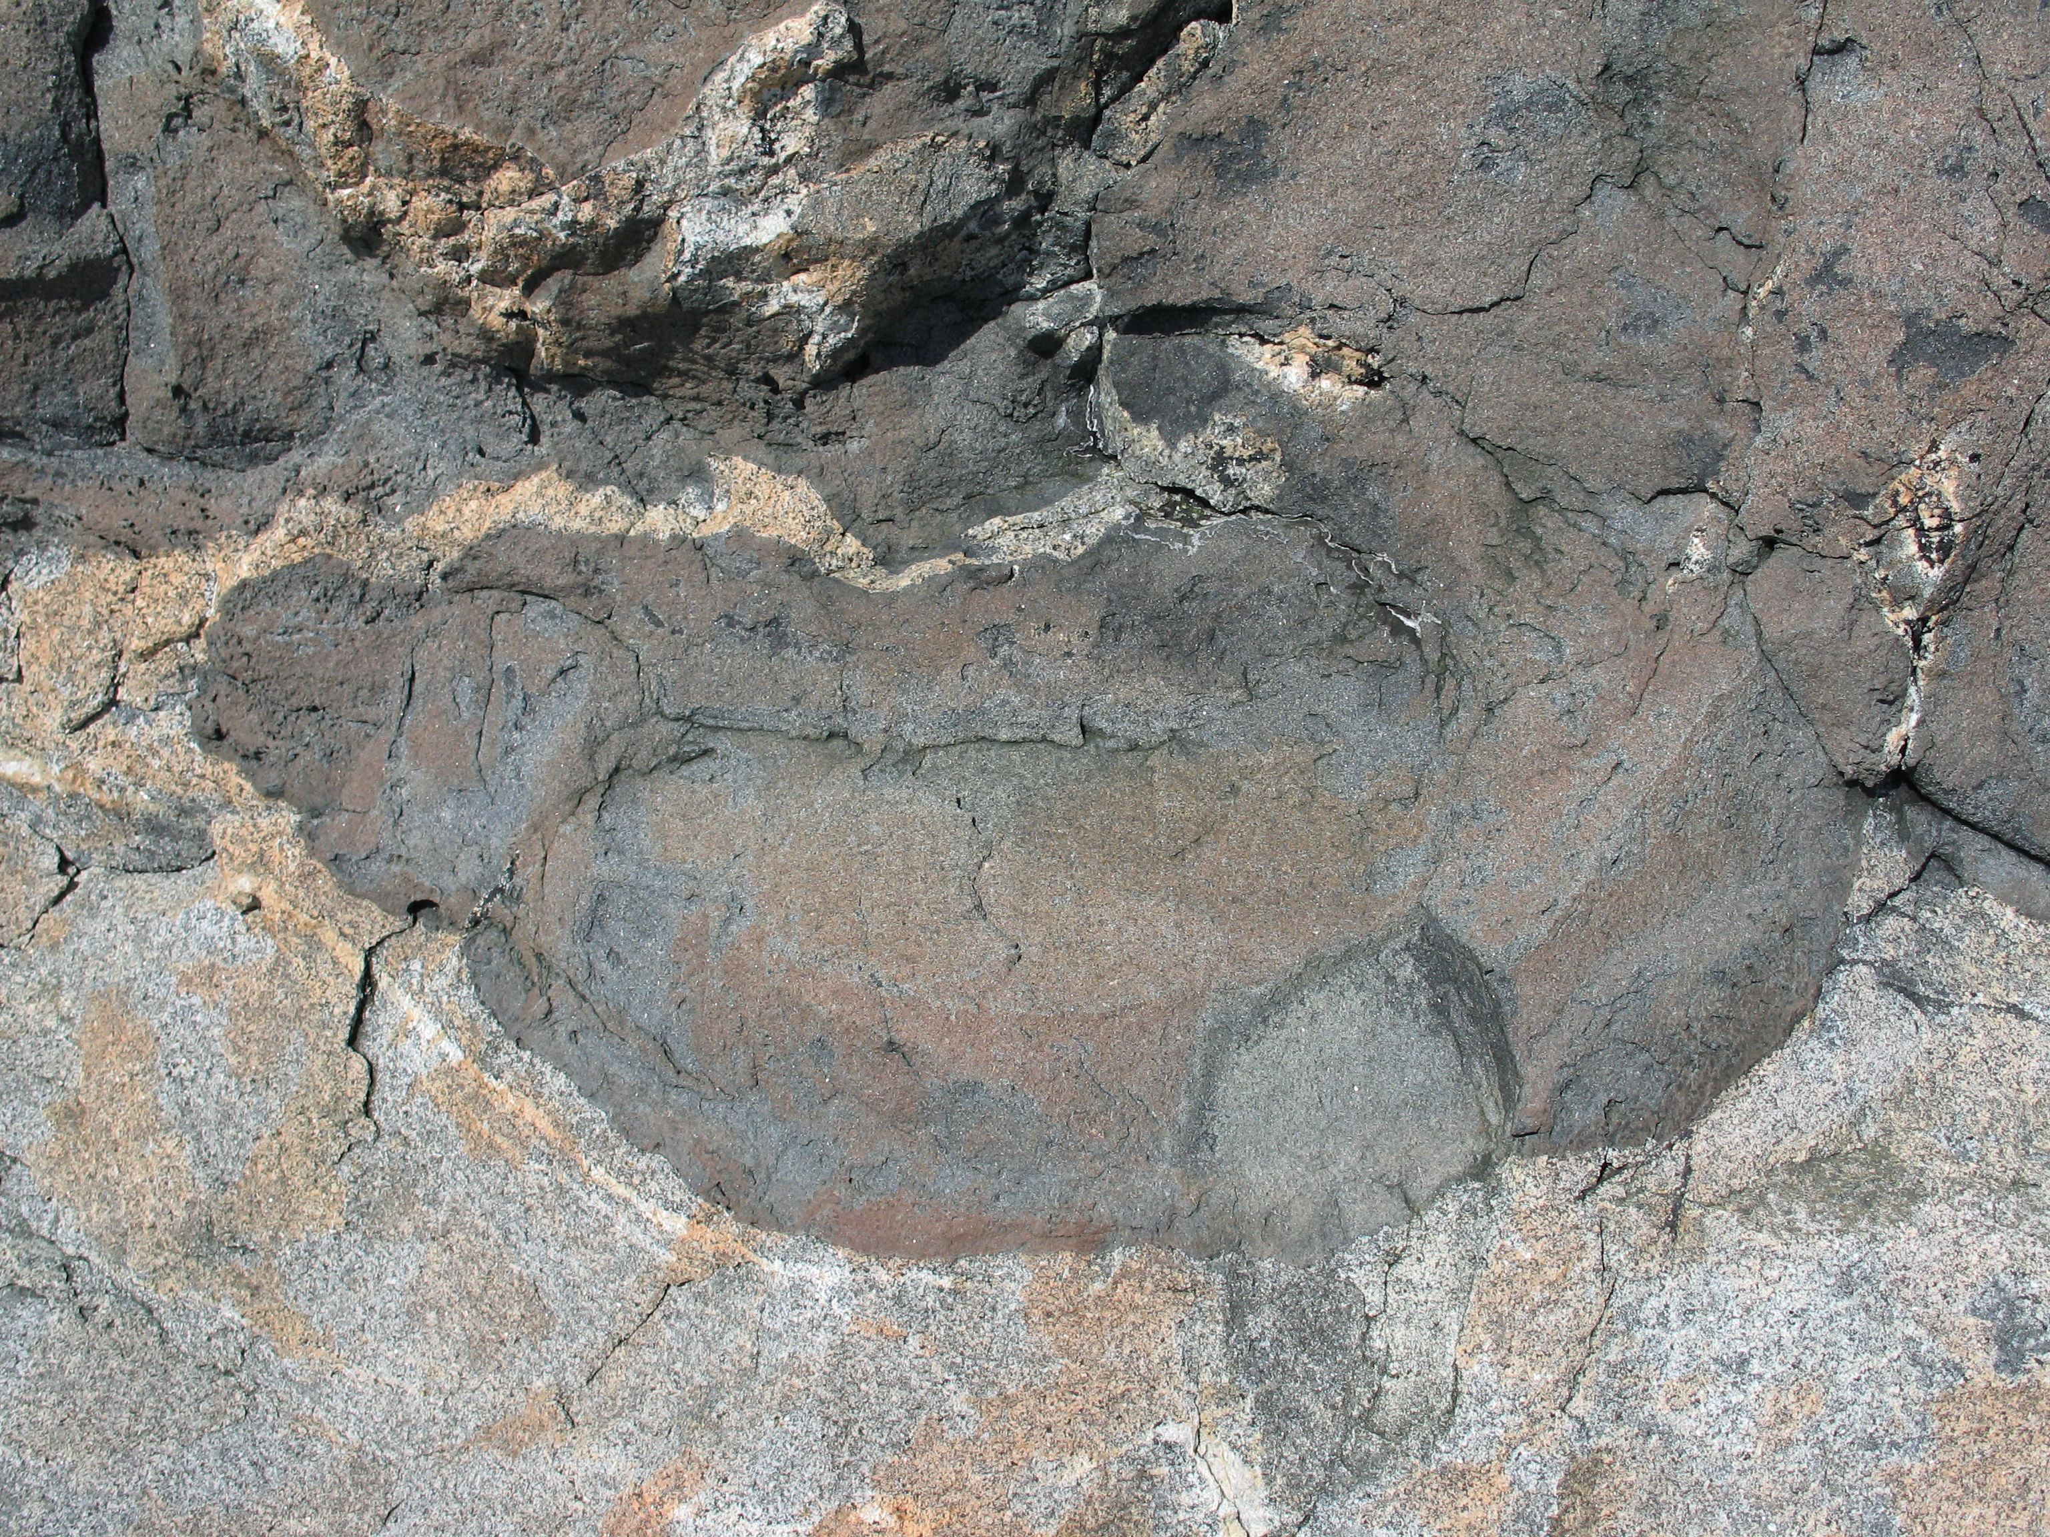

Slide 10
