Slide 1
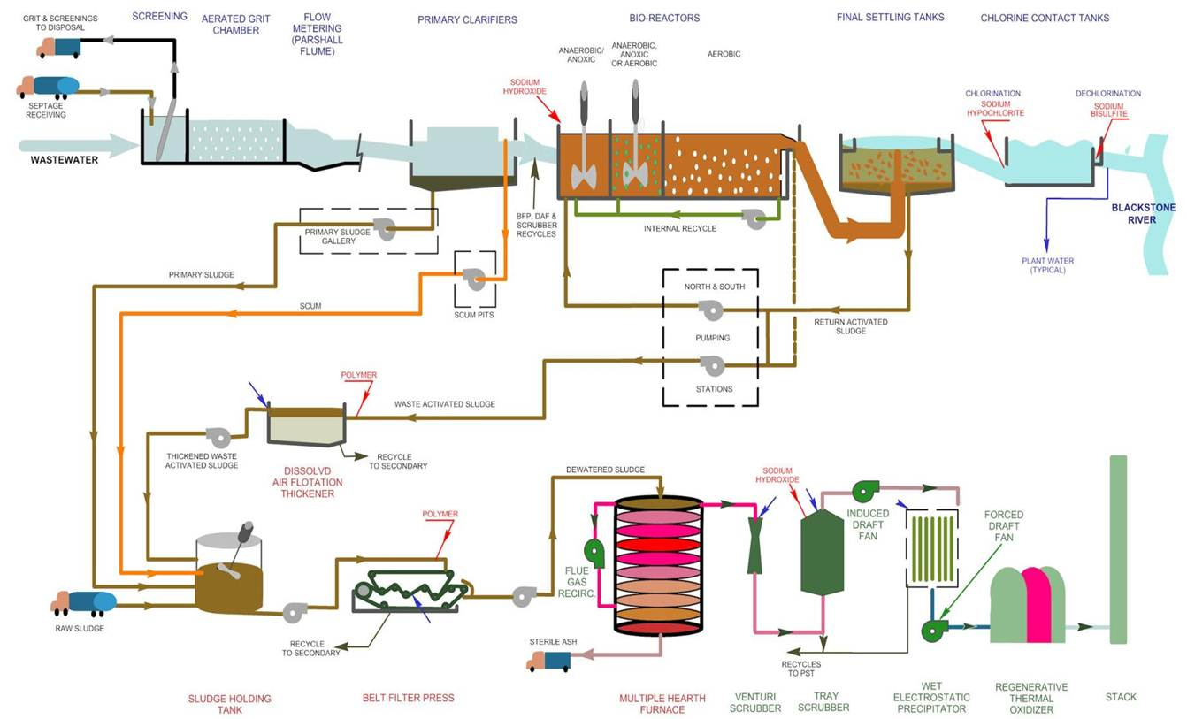
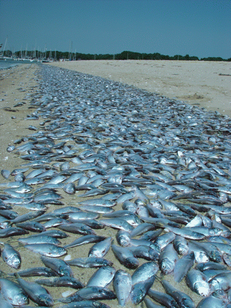

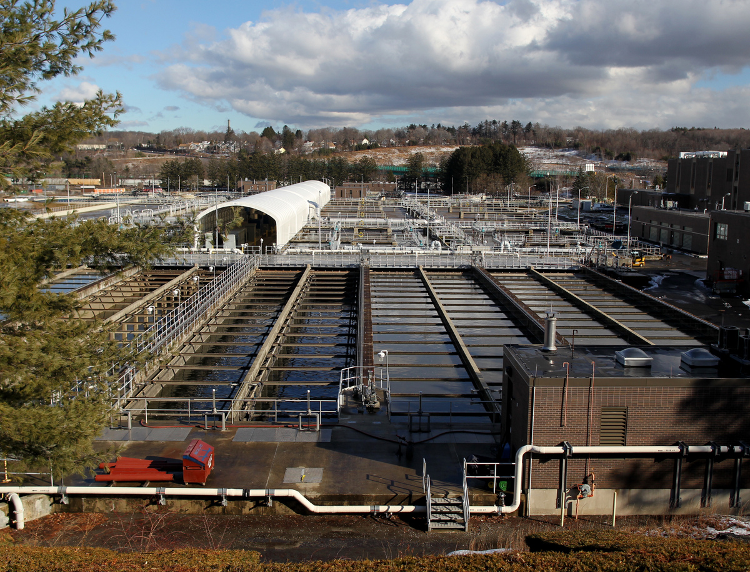
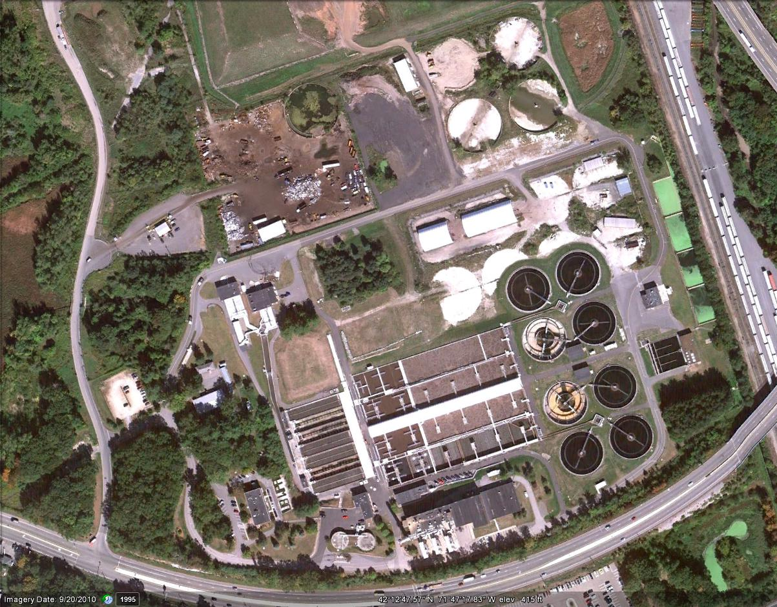
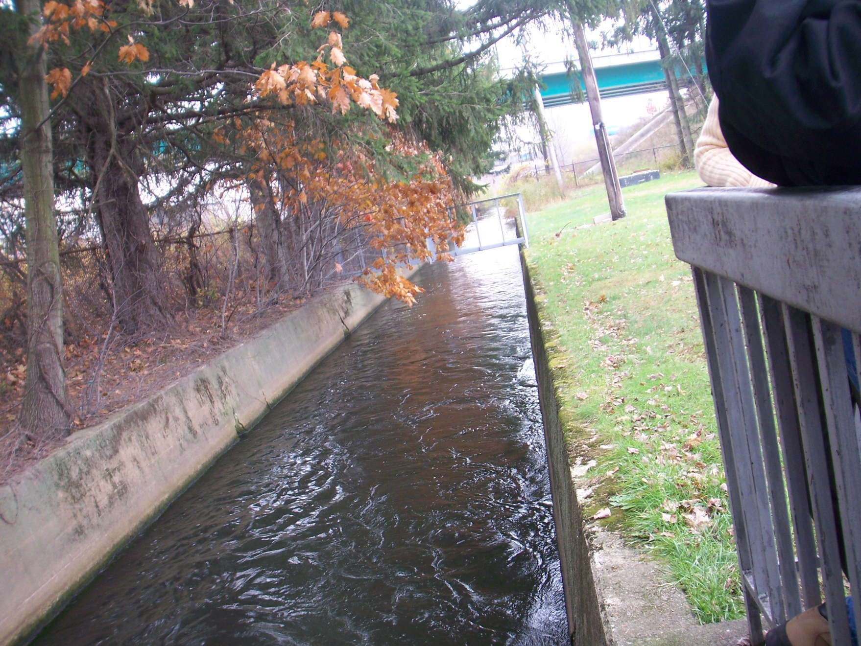
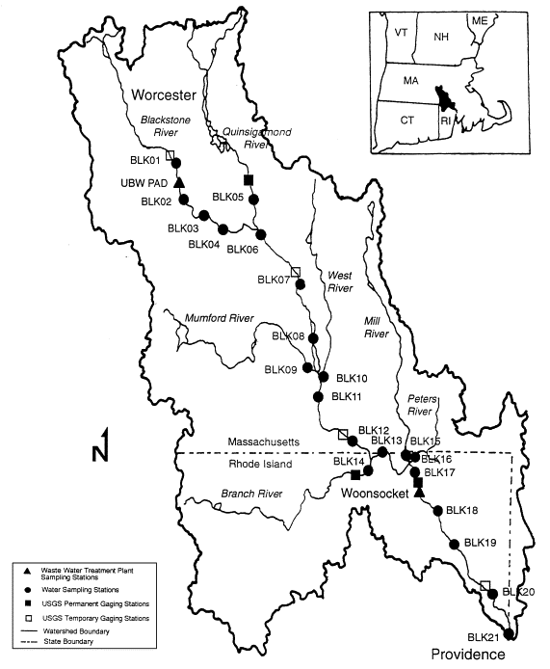
Wastewater Treatment Plant field trip
Sara Mitchell
College of the Holy Cross, Worcester MA
Cleanup of the Blackstone stalls in a legal quagmire
By David Abel
January 22, 2012
Worcester area officials say pollution controls already in place at the… (Jonathan Wiggs/Globe Staff)
Federal environmental officials have called it the nation’s most polluted river, after decades as a receptacle of raw sewage and other waste.
In recent years, the Environmental Protection Agency has pressed local officials to clean up the Blackstone River, which runs from Worcester to Narragansett Bay. The agency says insufficient wastewater treatment has elevated nitrogen and phosphorous levels, squeezing out the oxygen and killing fish, spawning algae blooms, and making much of the river and bay off-limits for swimming and fishing.
The effort to purge the river has sparked lawsuits and pitted the federal government against Worcester, environmental groups against the EPA, and now Massachusetts against Rhode Island, where state officials are blaming their northern neighbor for the ‘‘slow biochemical strangulation’’ of their state’s ‘‘greatest natural asset.’’
On Thursday, Rhode Island Attorney General Peter Kilmartin wrote to his state’s congressional delegation, asking it to urge local EPA officials to ignore advice from the Massachusetts Department of Environmental Protection, which previously called on the federal environmental officials to delay imposing strict pollution controls on the Worcester-area wastewater treatment plant until further studies are complete.
‘‘I write to strenuously oppose and resist MassDEP’s attempt to lend its name to an antienvironmental position,’’ Kilmartin wrote. ‘‘In the face of this challenge, Rhode Islanders cannot unilaterally disarm and complacently allow extrajudicial influence at the expense of our beautiful bay.’’
Since 2008, Worcester-area officials have resisted complying with the federal government’s cleanup plan, which they say would require onerous increases in water and sewer fees. At the same time, environmental advocates argue that the EPA’s proposed pollution limits are inadequate.
The long-running battle was supposed to come to a head this month when lawyers representing the EPA, the Worcester area’s Upper Blackstone Water Pollution Abatement District, and environmental groups appeared before a three-judge panel at the US First Circuit Court of Appeals in Boston. But the lawyers never got to make their arguments.
The panel, which includes retired US Supreme Court Justice David Souter, said new computer models from the abatement district about the scale of the pollution and new data about the effect of upgrades to its treatment plant made the planned arguments moot. They urged the parties to spend the next month trying to settle the case.
Madeline Fleisher, a Justice Department attorney representing the EPA, told the judges she had ‘‘serious doubts’’ about the value of the new computer models and worried that negotiations would only further delay efforts to clean the river.
‘‘This could end up taking years,’’ Fleisher said.
But district officials applauded the judges’ orders and said the new data show why spending an estimated $200 million on additional pollution controls, which they said would be the cost of complying with the EPA’s requirements, would produce little benefit to the river and bay.
They said the amount of nitrogen and phosphorous in the river has been reduced by nearly two thirds since the district completed $180 million in upgrades to the sewage treatment plant in Millbury.
Environmental advocates, who dispute the district’s cost estimates, questioned the benefits from the district’s upgraded plant. ‘‘The district is still discharging very large quantities of nitrogen and phosphorous from its wastewater plant,’’ said Christopher Kilian, a senior attorney at the Boston-based Conservation Law Foundation, which challenged the EPA’s proposed pollution limits in court as too weak.
The lawsuits stem from a 2008 permit issued by the EPA that required the district to reduce pollution to comply with state and federal water quality standards. Those requirements have yet to take effect because of the litigation.
In a brief to the court, EPA lawyers wrote that the permit was based on ‘‘a plentiful array of data, scientific studies, and technical guidance.’’
The EPA described the Blackstone River as having severe growth of plant life as the result of elevated levels of phosphorous, chlorine, nitrogen, and other nutrients.
The agency cited state studies that described the river as impaired, with algae covering virtually the entire river bottom. The agency also noted similar damage evident in Upper Narragansett Bay, where the amount of eelgrass, a vital habitat for many fish and invertebrate species, has shrunk from as much as 16,000 acres to less than 100.
In his letter, Kilmartin said the treatment plants in his state have already been upgraded or are undergoing upgrades to reduce pollution into the bay.
‘‘While the Massachusetts situation threatens to fester indefinitely, the Rhode Island permitees are making rapid progress towards meeting those standards,’’ he wrote.
District and Worcester officials, however, have questioned the basis of the EPA’s permit. They note water rates have already nearly tripled over the last eight years and say they will double if further pollution controls are required.
The local officials argued that their newcomputer models show that additional pollution controls would have a marginal benefit. They blamed much of the remaining pollution on the large number of dams in the river, which they said is beyond their control.
Their arguments were supported last year by Ken Kimmell, commissioner of the Massachusetts Department of Environmental Protection, who in a letter to local EPA officials over the summer urged the agency to modify its permit to allow the district to use new tools to evaluate the pollution limits. He also requested the EPA work with other agencies to determine the appropriate limits.
In a telephone interview, Kimmell described his letter to the EPA as ‘‘not antienvironmental’’ but ‘‘proscience.’’
‘‘We weren’t necessarily asking the EPA to lower their standards, rather we were asking them to look at the matter with the fresh data that had been generated,’’ he said. ‘‘There are fundamental scientific questions that have to be answered. There needs to be a better understanding of the relationship of the discharges from the different sources and the actual impact on the health of the bay.’’
But last fall, more than a dozen environmental groups sent a letter urging local EPA officials to impose the limits immediately, noting that 56 million gallons of treated wastewater a day are being discharged into the Blackstone.
‘‘If the Blackstone and Narragansett Bay are to become and remain usable by wildlife, fish, anglers, swimmers, and shell fishermen, the [treatment plant] must immediately and significantly reduce its output of nitrogen and phosphorus pollution,’’ they wrote.
Description
The Upper Blackstone Water Pollution Abatement District (UBWPAD) wastewater treatment plant serves the city of Worcester and several surrounding communities, including the College of the Holy Cross. It is less than 15 minutes away. Tours led by the treatment plant staff are free for the public and are scheduled ahead of time. The staff member walks us through the entire plant, starting at the 8-foot pipe where the sewer comes in and ending at the outflow canal to the Blackstone River.
I schedule the wastewater treatment plant field trip during the surface and groundwater unit of Introduction to Geology. Prior to the tour, I discuss some of the controversy surrounding this treatment plant (see Boston Globe article at right). It is currently involved in litigation with the EPA regarding nitrogen and phosphorus limits, and is blamed for eutrophication of Narragansett Bay downstream in Rhode Island.
Assignment
After the tour, students write a short compare-contrast essay relating the treatment process at the UBWPAD to what happens to wastewater from their home. For students with homes on a city sewer system, I ask them to compare their treatment plant to the UBWPAD. For those who are on individual septic systems, I ask them to compare and contrast the two methods of treating water. (Handouts available). Many students say later that they never knew what happened to wastewater from their home.
Goals
Engage students with how wastewater from our campus, the surrounding community, and their own home is treated
Give students a not-quite hands-on introduction to the scientific basis behind wastewater treatment (hydrology, physics, biology, math, chemistry)
See how wastewater treatment fits into a broader environmental context (regulations, economics, downstream ecological health)
Get outside on one more “field” lab before winter begins
The process
Cover photo from journal Elements, April 2008
Caption: Eutrophication of Greenwich Bay, Rhode Island, killed these juvenile menhaden in August 2003. Excess nutrients, including phosphate and nitrogen, promote blooms of algae and blue-green bacteria, depleting oxygen to the point where fish and other marine animals suffocate. Eutrophication is becoming more widespread due to increased use of phosphate fertilizers and to inadequate wastewater treatment practices. It is estimated that about half of the lakes in Asia, Europe and North America are eutrophic (ILIC 2008). PHOTO BY THOMAS ARDITO, NARRAGANSETT BAY ESTUARY PROGRAM, WWW.NBEP.ORG
UBWPAD website: http://www.ubwpad.org/
Examples of students’ questions
Does anyone ever call you guys when they lose something down the drain?
What’s the weirdest thing that’s come through here?
Why don’t you have a tertiary treatment system?
Why doesn’t this plant compost the solid waste?
Does it matter that there are ducks sitting in that pool?
Why do you treat the effluent with bleach during the summer but not the winter?
Is this water safe to drink? [spoken about water at the end of the process]
Are metals or other non-biologic pollutants removed?
How do you handle working around this smell all the time?
Why do I continue doing this lab even though it’s stinky and (after doing the tour 8 times and counting) boring?
Students routinely describe it as one of the more memorable Intro Geo field trips
It gets students thinking about how society deals with wastewater
It highlights a connection between campus and the local municipal infrastructure, one students often overlook
It can spark a discussion about environmental regulations, consumer costs, and other “real life” issues
The tour guides at the UBWPAD also work in the lab or in “compliance,” always been happy to discuss their educational background (often Environmental or other science) and how they ended up with this job
It can spark a discussion about downstream effects of wastewater discharge into a river
Students who have taken other Environmental Studies courses (Environmental Law, Environmental History, Environmental Policy) often make connections to material learned in those other courses
It is incredibly easy
Other ideas for environmentally themed, “local water,” field trips
Take a trip to an urban river, arrange for someone from the city sewer department to meet and talk about stormwater management, regulations, urban water quality with class
Arrange for a tour of snowmaking operations at a local ski mountain
Have someone from campus Physical Plant meet class and discuss flooding, runoff, snow removal, athletic field maintenance issues
Visit water supply facility (post-9/11, ours will not run tours for colleges anymore)
Acknowledgements
Terry Swanson in the Department of Earth and Space Sciences at the U of Washington has been doing this field trip with his Environmental Geology class for years. As his TA for that class, I brought students to the West Point treatment plant in Seattle, WA.
Holy Cross Intro Geo students from 2006-2011
The Upper Blackstone Water Pollution Abatement District
Photo of discharge canal to Blackstone from Worcester Academy blog: http://waenvironment.wordpress.com/ Taken in 2009
Post-tour feedback from students
“Prior to the lab, I didn't even know who was responsible for handling the wastewater in my area. Through the assignment, I learned a lot about the MWRA, and was especially impressed by the expansive area they provide coverage for. This interest led me to work with MWRA GIS data in one of my GIS projects this semester. So, the interest and knowledge I gained from that lab has definitely extended beyond Intro Geology.” Anthony Pepe (Bio and ENVS, ‘14)
“Overall, the combination of the tour and background research of waste water treatment at home was a valuable experience in combining education from class, hands on visual learning, and background research. For me at least, all of these contributed to enhancing my education in the topic.” (Craig Connolly, Bio and ENVS, ‘13)
Blackstone River Watershed and UBWPAD

